Slide 1
Lesson 139 Part 1
Gathering the House of Israel
Jeremiah 30-33
We are to understand that the scattered remnants are exhorted to return to the Lord from whence they have fallen; which if they do, the promise of the Lord is that he will speak to them, or give them revelation…
D&C 113:10

Slide 2
The Gathering In The Last Days
3 Phases
The gathering of Israel to the land of Zion, The American hemisphere
The return of the Ten Tribes from the countries of the north
The reestablishment of the Jews in Palestine as God’s chosen people

Slide 3
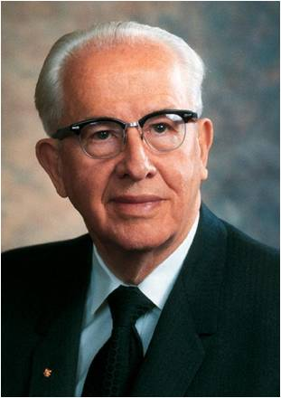
“This miracle of the return of the Jews was to be one of the events to precede Christ’s second coming, and the scriptures are very clear with reference to this fact. Isaiah said that they shall gather ‘the dispersed of Judah from the four corners of the earth’ and ‘set them in their own land,’ that they will ‘build the old waste,’ and ‘repair the waste cities.’
“Jeremiah, who predicted so clearly their dispersion, also states that the Lord will ‘cause them to return to the land that I gave to their fathers, and they shall possess it,’ and ‘build them, as at the first.’” (1)
Jeremiah 30:3; 33:7 Isa. 11:11–12

Slide 4
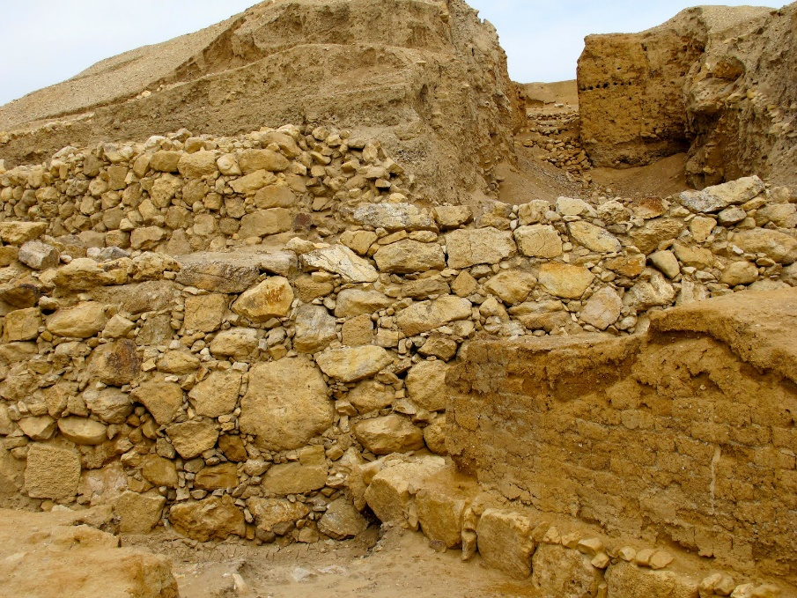
Return
For, lo, the days come, saith the Lord, that I will bring again the captivity of my people Israel and Judah, saith the Lord: and I will cause them to return to the land that I gave to their fathers, and they shall possess it.
The Jews, after 70 years of captivity in Babylon will return to Jerusalem.
refers to the return of the Jews after seventy years of captivity in Babylon.
Double Meaning:
It also refers to the restoration of the Jews to their homeland in the last days after they have been scattered for the second time. And it refers to the return of the lost tribes from the lands of the north.
Jeremiah 30:3
(2)

Slide 5
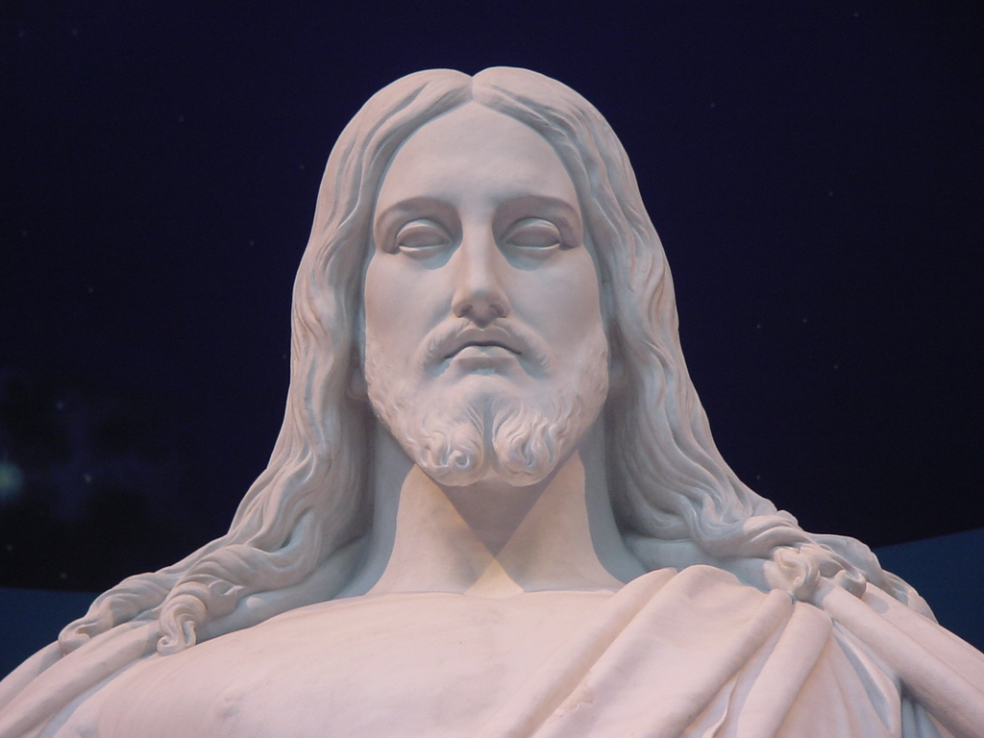
Latter-day King David
Once again there is a mention of the latter-day David who will be King in Israel. Sometimes He is called “the Branch” because Jesus, who is the King David of the latter days, is a branch of the ancient line of King David.
And I will make them one nation in the land upon the mountains of Israel; and one king shall be king to them all: and they shall be no more two nations, neither shall they be divided into two kingdoms any more at all:
Ezekiel 37:22
Jeremiah 23:5; 30:9; 33:15 Matthew 1:1; 12:23; 22:42 Isaiah 11:1

Slide 6
Israel’s Condition During Jeremiah’s Time
For thus saith the Lord, Thy bruise is incurable, and thy wound is grievous.
While Israel’s condition of spiritual decay and physical bondage is grievous and difficult, it is not incurable or hopeless.
Jeremiah 30:12
Statue of Elijah slaying a Baal priest at Muhraka Mount Carmel

Slide 7
Hope For Israel
Jeremiah 30:3
Jeremiah 30:7
Jeremiah 30:8
Jeremiah 30:10
Jeremiah 30:17
Jeremiah 31:3
Jeremiah 31:8
Jeremiah 31:9
Jeremiah 31:13
I will gather them from the north
You will have peace and rest
I will turn sadness into happiness
You will be saved
The Lord Loves Us
I will bring them out of Captivity
I will lead them
You will be healed and healthy
I will ease your burdens

Slide 8
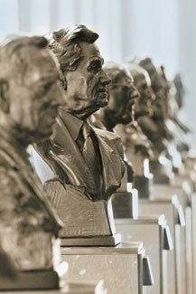
The Watchmen
Hall of the Prophets LDS Conf. Center Salt Lake City
For there shall be a day, that the watchmen upon the mount Ephraim shall cry, Arise ye, and let us go up to Zion unto the Lord our God.
The Watchmen are the righteous prophets of the latter days’
In the last dispensation they will cry to all people to join together in proper worship of the Lord.
Hearken, O ye people of my church, saith the voice of him who dwells on high, and whose eyes are upon all men; yea, verily I say: Hearken ye people from afar; and ye that are upon the islands of the sea, listen together. D&C 1:1
Jeremiah 31:6; Ezekiel 3:16-21

Slide 9
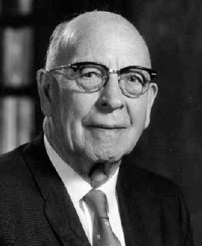
“‘I will bring them … : a great company shall return thither.’
This was something the Lord was going to do. Note that Jeremiah does not say that they will return hither, or to the place where this prediction was made, but thither, or to a distant place.
He understood that Joseph was to be given a new land in the ‘utmost bound of the everlasting hills.’
Jeremiah 31:6-9; Genesis 49:22-26; Deuteronomy 33:13-17

Slide 10
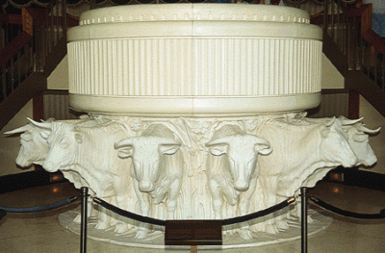
Ephraim
Birthright placed upon the head of Joseph by divine revelation
“Joseph was the eldest son of Rachel and … the most worthy son of Jacob. …
“For reasons which we do not understand for the history of those events is very brief, this authority came down through the lineage of Joseph’s second son, Ephraim.
It was Ephraim who was called to occupy the position held by his father, and he is spoken of in the scriptures as the firstborn in Israel” (5)
“Ephraim was given the birthright in Israel, and in the last days it has been the tribe of Ephraim’s privilege first to bear the message of the Restoration of the gospel to the world and to gather scattered Israel (6)
The Tribe of Ephraim is represented by the ox Deut. 33:17
Jeremiah 31:9; 1 Chr. 5:1-2; Deut. 33:13-17; D&C 64:36; 133:26-34

Slide 11
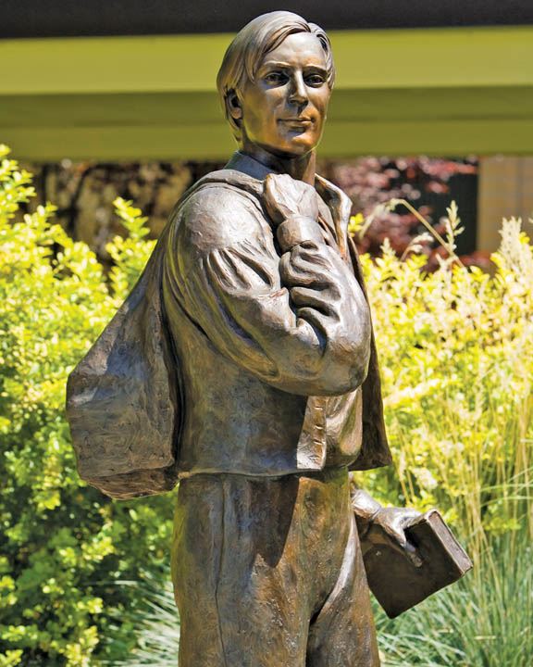
Joy and Happiness—A State of Well-Being
The promises of great abundance and rejoicing and the end of sorrow are exactly opposite to the promises given in other chapters of tragedy, desolation, and lamentation for Judah.
Webster defines joy as “1. The emotion excited by the acquisition or expectation of good; … gladness; delight. 2. State of happiness; … bliss. … 3. That which causes … happiness.” He says that happiness is “a state of well-being.”
The Prophet Joseph Smith defined happiness as “the object and design of our existence; and [it] will be the end thereof,” he continued, “if we pursue the path that leads to it; and this path is virtue, uprightness, faithfulness, holiness, and keeping all the commandments of God.” (4)
Jeremiah 31:10-16

Slide 12
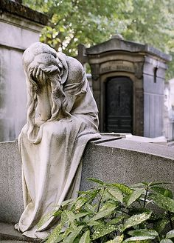
Rachel Weeping For Her Children
Rachel, the beloved spouse of Jacob, earnestly desired children. She is here depicted as bitterly weeping for her children and refusing to be comforted because she had none, for they had been taken captive.
Montparnasse Cemetery, Paris
In Rama was there a voice heard, lamentation, and weeping, and great mourning, Rachel weeping for her children, and would not be comforted, because they are not.
Matthew 2:18
Jeremiah 31:15-17
(2)

Slide 13
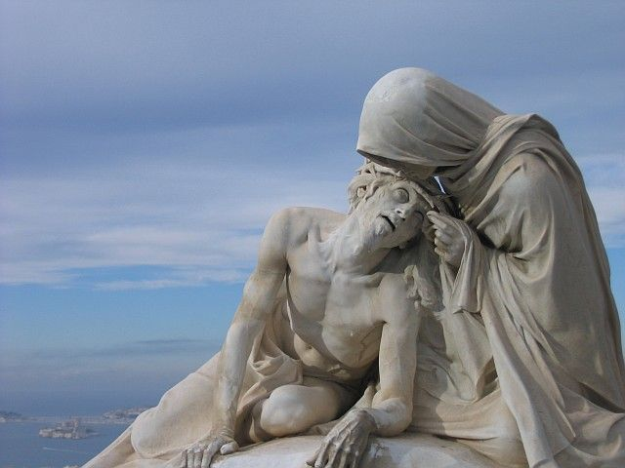
Woman Shall Compass A Man
Many times in Hebrew writing Israel is described as a woman and sometimes as a bride.
The marriage relationship between the woman (Israel) and her husband (the Lord Jesus Christ) is used to depict a very tender, intimate association.
The Lord used this relationship numerous times in the scriptures as an example of His commitment to care for, protect, and bless His covenant people.
Jeremiah 31:22
(2)

Slide 14
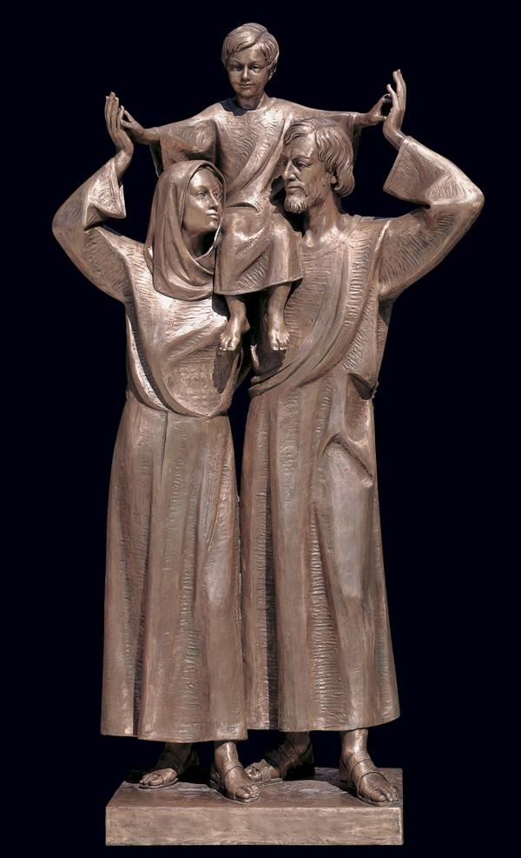
Sour Grapes and Children’s Teeth
Children are affected by what their parents are and do. Apparently the Jews had erroneously set a stigma on the children of known sinners
Children will not be punished for their parents’ sins….
However:
Children may suffer the consequences of parental sins
(2)
Jeremiah 31:29-30

Slide 15
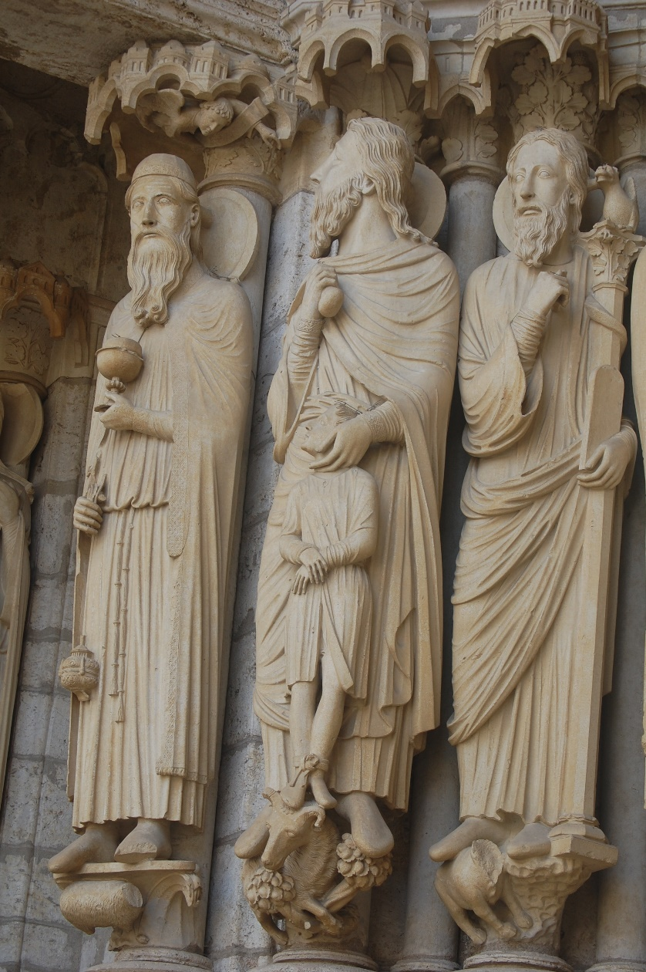
The Restoration of the Gospel
“The time has at last arrived when the God of Abraham, of Isaac, and of Jacob, has set His hand again the second time to recover the remnants of his people, … and establish that covenant with them, which was promised when their sins should be taken away.” (4)
This covenant has never been established with the house of Israel, nor with the house of Judah, for it requires two parties to make a covenant, and those two parties must be agreed, or no covenant can be made. (2)
Jeremiah 31:31-34; Isaiah 11; Romans 11:25–27

Slide 16
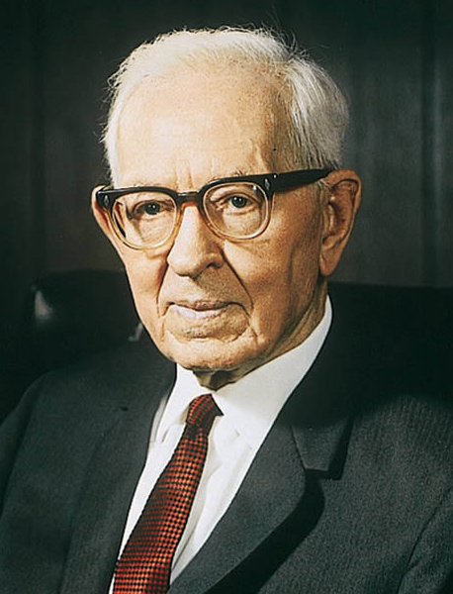
“The Lord has promised that the time shall come when every man shall be his own teacher, that is, he will know because of righteous living what to do.
He will be so filled with the Spirit of the Lord that he will be guided and directed in doing right without the necessity of someone coming into his home to set it in order.
Now is a good time for us to begin.”
Jeremiah 31:34
(5)

Slide 17
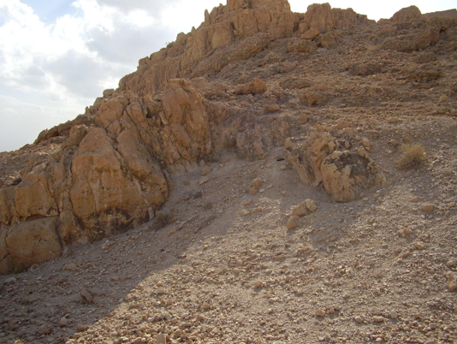
Jeremiah is Imprisoned
In the 10th year of Zedekiah king of Judah, which was the 18th year of Nebuchadnezzar
Jeremiah was shut up in the courts which was the house of Zedekiah
Jeremiah bought the field of Hanameel, his cousin, and gave him 17 shekels of silver
While Jeremiah was in prison, his cousin came to him and asked him to buy property in their family’s ancestral homeland, which was near Jerusalem. The Lord revealed to Jeremiah that purchasing this land was a symbolic witness that the Jews would someday return from captivity and possess the promised land once again.
Jeremiah 32

Slide 18
What Will the Lord Do For Scattered Israel?
“Cleanse them from all their iniquity”
“Cause them to dwell safely”
“Cure them”
Jeremiah 32:37 | Jeremiah 32:37 | Jeremiah 32:42 | Jeremiah 33:6 | Jeremiah 33:7 | Jeremiah 33:8 | Jeremiah 33:8
“Gather them”
“Bring upon them all the good that (He has) promised them”
“Build them”
“Pardon all their iniquities”

Slide 19
Regardless of what we have done or how lost we may feel, Jesus Christ can heal us
Regardless of what we have done, Jesus Christ can cleanse us

Slide 20
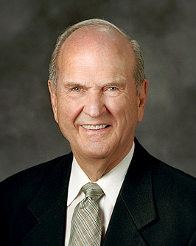
“When we realize that we are children of the covenant, we know who we are and what God expects of us. His law is written in our hearts. He is our God and we are His people. Committed children of the covenant remain steadfast, even in the midst of adversity. …
“The greatest compliment that can be earned here in this life is to be known as a covenant keeper. The rewards for a covenant keeper will be realized both here and hereafter.”
Jeremiah 31:33
(7)

Slide 21
Sources:
Suggested Hymn: #106 God Speed The Right
Video: Meet Troy (2:30)
Ezra Taft Benson (In Conference Report, Apr. 1950, p. 75.)
Old Testament Institute Manual Prophecies of a Latter-day Gathering Chapter 25
Elder LeGrand Richards (Israel! Do You Know? pp. 177–78.)
Teachings of the Prophet Joseph Smith, pp. 255–56 and History of the Church, 1:313–14
Joseph Fielding Smith (Doctrines of Salvation, 1:319. And comp. Bruce R. McConkie, 3 vols. [1954–56], 3:162).
Bible Dictionary “Ephraim”
Elder Russell M. Nelson (“Covenants,” Ensign or Liahona, Nov. 2011, 88
Presentation by ©http://fashionsbylynda.com/blog/

Slide 22
The Branch (David) Jeremiah 30:9
“Since it takes a first and a second coming to fulfill many Messianic prophecies, we of necessity must consider them here, and in the case of the Davidic-Messianic utterances show also how they apply to our Lord’s Second Coming. Christ is the Son of David, the Seed of David, the inheritor, through Mary his mother, of the blood of the great king. He is also called the Stem of Jesse and the Branch, meaning Branch of David. Messianic prophecies under these headings deal with the power and dominion he shall wield as he sits on David’s throne, and have reference almost exclusively to his second sojourn on planet earth.
“That the Branch of David is Christ is perfectly clear. We shall now see that he is also called David, that he is a new David, an Eternal David, who shall reign forever on the throne of his ancient ancestor. ‘It shall come to pass in that day, saith the Lord of hosts, ‘that is, in the great millennial day of gathering, that ‘they shall serve the Lord their God, and David their king, whom I will raise up unto them.’ (Jer. 30:8–9.)
“How glorious shall be the coming day when the second David, who is Christ, reigns on the throne of the first David; when all men shall dwell safely; when the earth shall be dotted with temples; and when the gospel covenant shall have full force and validity in all the earth!” Bruce R. McConkie (The Promised Messiah, pp. 192–95).
Woman Shall Compass A Man Jeremiah 31:22:
… [the Hebrew word translated as ‘compass’] signifies to encompass with love and care, to surround lovingly and carefully,— the natural and fitting dealing on the part of the stronger to the weak and those who need assistance. And the new thing that God creates consists in this, that the woman, the weaker nature that needs help, will lovingly and solicitously surround the man, the stronger. Herein is expressed a new relation of Israel to the Lord, a reference to a new covenant which the Lord, ver. 31ff., will conclude with His people, and in which He deals so condescendingly towards them that they can lovingly embrace Him. This is the substance of the Messianic meaning in the words.” (Keil and Delitzsch, Commentary,8:2:30.)
Sour Grapes Jeremiah 31:29-30
“There is the man who resisted release from positions in the Church. He knew positions were temporary trusts, but he criticized the presiding leader who had released him, complaining that proper recognition had not be given; the time had not been propitious; it had been a reflection upon his effectiveness. He bitterly built up a case for himself, absented himself from his meetings, and justified himself in his resultant estrangement. His children partook of his frustrations, and his children’s children. In later life he ‘came to himself,’ and on the brink of the grave made an about-face. His family would not effect the transformation which now he would give his life to have them make. How selfish! Haughty pride induces eating sour grapes, and innocent ones have their teeth set on edge. ‘It is hard for thee to kick against the pricks.’
“When I was a child, we used the expression, ‘He cut off his nose to spite his face.’ To us, that meant that one was fighting against fate, rebelling against the inevitable, damaging himself to spite others, breaking his toe to give vent to his senseless anger.
“Eight lovely children had blessed the temple marriage of a man and woman who in later years were denied a temple recommend. They would not be so dealt with by this young bishop. Why should they be deprived and humiliated? Were they less worthy than others? They argued that this boy-bishop was too strict, too orthodox. Never would they be active, nor enter the door of that Church as long as that bishop presided. They would show him. The history of this family is tragic. The four younger ones were never baptized; the four older ones never were ordained, endowed, nor sealed. No missions were filled by this family. Today the parents are ill at ease, still defiant. They had covered themselves with a cloud, and righteous prayers could not pass through. (see Lam. 3:44.)
President Spencer W. Kimball “Sour grapes! Such unhappy food!” (Spencer W. Kimball, in Conference Report, Apr. 1955, p. 95.)
Rachel Weeping For Her Children Jeremiah 31:15-17:
“The lamentation of Rachel is heard at Ramah, as the most loftily situated border-town of the two kingdoms, whence the wailing that had arisen sounded far and near, and could be heard in Judah. … The destruction of the people of Israel by the Assyrians and Chaldeans is a type of the massacre of the infants at Bethlehem [as cited by Matthew in his gospel (Matthew 2:18)], in so far as the sin which brought the children of Israel into exile laid a foundation for the fact that Herod the Idumean became king over the Jews, and wished to destroy the true King and Saviour of Israel that he might strengthen his own dominion.” (C. F. Keil and F. Delitzsch, Commentary on the Old Testament, 8:2:25–26.)
Ephraim and the Ox Jeremiah 31:9 and Deut. 33:17
Jewish tradition says the “four standards” under which Israel encamped in the wilderness, to the east, Judah, to the north, Dan, to the west, Ephraim, to the south, Reuben, were respectively a lion, an eagle, an ox, and a man, while in the midst was the tabernacle containing the Shekinah symbol of the Divine Presence

Slide 23
The Covenant Jeremiah 31:30-34
“Christ, in the days of His flesh, proposed to make a covenant with them, but they rejected Him and His proposals, and in consequence thereof, they were broken off, and no covenant was made with them at that time. But their unbelief has not rendered the promise of God of none effect: no, for there was another day limited in David, which was the day of His power; and then His people, Israel, should be a willing people;—and He would write His law in their hearts, and print it in their thoughts; their sins and their iniquities He would remember no more.
“Thus after this chosen family had rejected Christ and His proposals, the heralds of salvation said to them, ‘Lo, we turn unto the Gentiles;’ and the Gentiles received the covenant, and were grafted in from whence the chosen family were broken off; but the Gentiles have not continued in the goodness of God, but have departed from the faith that was once delivered to the Saints, and have broken the covenant in which their fathers were established [see Isaiah 24:5]. …
“And now what remains to be done, under circumstances like these? I will proceed to tell you what the Lord requires of all people, high and low, rich and poor, male and female, ministers and people, professors of religion and non-professors, in order that they may enjoy the Holy Spirit of God to a fulness and escape the judgments of God, which are almost ready to burst upon the nations of the earth. Repent of all your sins, and be baptized in water for the remission of them, in the name of the Father, and of the Son, and of the Holy Ghost, and receive the ordinance of the laying on of the hands of him who is ordained and sealed unto this power, that ye may receive the Holy Spirit of God; and this is according to the Holy Scriptures, and the Book of Mormon; and the only way that man can enter into the celestial kingdom. These are the requirements of the new covenant.” Prophet Joseph Smith (History of the Church, 1:313–14.)
A New Covenant Jeremiah 31:31-34
“This covenant has never been established with the house of Israel, nor with the house of Judah, for it requires two parties to make a covenant, and those two parties must be agreed, or no covenant can be made.
“Christ, in the days of His flesh, proposed to make a covenant with them, but they rejected Him and His proposals, and in consequence thereof, they were broken off, and no covenant was made with them at that time. But their unbelief has not rendered the promise of God of none effect: no, for there was another day limited in David, which was the day of His power; and then His people, Israel, should be a willing people;—and He would write His law in their hearts, and print it in their thoughts; their sins and their iniquities He would remember no more.
“Thus after this chosen family had rejected Christ and His proposals, the heralds of salvation said to them, ‘Lo, we turn unto the Gentiles;’ and the Gentiles received the covenant, and were grafted in from whence the chosen family were broken off: but the Gentiles have not continued in the goodness of God, but have departed from the faith that was once delivered to the Saints, and have broken the covenant in which their fathers were established [see Isaiah 24:5]; and have become high-minded, and have not feared; therefore, but few of them will be gathered with the chosen family. …
“And now what remains to be done, under circumstances like these? I will proceed to tell you what the Lord requires of all people … in order that they may enjoy the Holy Spirit of God to a fulness and escape the judgments of God … Repent of all your sins, and be baptized in water for the remission of them, in the name of the Father, and of the Son, and of the Holy Ghost, and receive the ordinance of the laying on of the hands of him who is ordained and sealed unto this power, that ye may receive the Holy Spirit of God; and this is according to the Holy Scriptures, and the Book of Mormon; and the only way that man can enter into the celestial kingdom. These are the requirements of the new covenant” (in History of the Church, 1:313–15; see also Old Testament Student Manual: 1 Kings–Malachi, 3rd ed. [Church Educational System manual, 2003], 256).
Scattering of Israel: Jeremiah 30:7-12
“Why was Israel scattered? … They were scattered because they turned from the Lord, worshipped false gods, and walked in all the ways of the heathen nations. They were scattered because they forsook the Abrahamic covenant, trampled under their feet the holy ordinances, and rejected the Lord Jehovah, who is the Lord Jesus, of whom all their prophets testified. Israel was scattered for apostasy. …
“What, then, is involved in the gathering of Israel? The gathering of Israel consists in believing and accepting and living in harmony with all that the Lord once offered his ancient chosen people. It consists of having faith in the Lord Jesus Christ, of repenting, of being baptized and receiving the gift of the Holy Ghost, and of keeping the commandments of God. It consists of believing the gospel, joining the Church, and coming into the kingdom. It consists of receiving the holy priesthood, being endowed in holy places with power from on high, and receiving all the blessings of Abraham, Isaac, and Jacob, through the ordinance of celestial marriage. And it may also consist of assembling to an appointed place or land of worship” elder Bruce R. McConkie (A New Witness for the Articles of Faith [1985], 515; see also Book of Mormon Student Manual [2009], 70–71).

Slide 24
Buying the Field Jeremiah 25:11
The Lord’s purpose in having Jeremiah buy the field was to demonstrate to the Israelites that the Babylonian captivity was not permanent. Having the purchase documents preserved would allow Jeremiah’s heirs to establish their claim to the land once the captivity was over. Jeremiah had earlier prophesied that the captivity would last for 70 years (Jer. 25:11) and the purchase provided “real world” confirmation that after the 70 years were over, the Jews would come back and reestablish the nation. Otherwise recording the purchase and preserving the documents would have made no sense. Gracethrufaith
see also: http://copper-scroll-project.com/the-copper-scroll-project-and-jeremiahs-deed/ for an interesting article of Jeremiah’s Cave. The Copper Scroll and Jeremiah’s Deed

Slide 25
Jeremiah At A Glance – Bible Dictionary
Jeremiah 1-6 | Prophecies of reign of Josiah | Jeremiah 1:4-5 Jeremiah 3:12-19 | Premortal Condition and Jeremiah’s Calling Prophecy of the return of Israel from the scattered condition, gathering one of a city and two of a family to Zion, a pleasant land where Israel and Judah can dwell in safety and peace
Jeremiah 7-20 | Prophecies under Jehoiakim
Jeremiah 21-38 | Prophecies under Zedekiah | Jeremiah 21-23 | On pastors or rulers of people, with promise of king Messiah
 |  | Jeremiah 24 | Exiles carried away with Jehoiachin
 |  | Jeremiah 26-29 | False prophets and containing the prophet’s letter to the exiles in Babylon, warning against the prophets there
 |  | Jeremiah 30-33 | Prophecies of the latter-day restoration of Israel and the gospel covenant, containing the story of the prophet’s buying a field, showing the firmness of his faith in the people’s restitution
 |  | Jeremiah 34-38 | Narratives of the treatment of the prophet and other events during the last times of the siege
Jeremiah 39-44 | The prophet’s history and other events after the fall of the city
Jeremiah 46-51 | Prophecies against foreign nations | Jeremiah 50-51 | In their present form are later than Jeremiah
Jeremiah 52 | Historical conclusion

