Slide 1
Lesson 14
Acquiring Spiritual Knowledge Part 3

Slide 2
Review –
The Pattern
Having an honest desire to know the truth
Seeking truth through prayer
Being willing to live according to the truth God has revealed
Diligently studying the word of God

Slide 3
Review –
Eternal Perspective
Act in Faith
Seek further understanding through divinely appointed sources
Examine concepts and questions with an eternal perspective

Slide 4
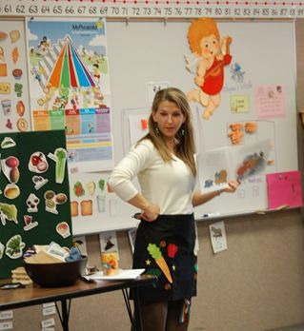
Scenario
During a health class at school, Samuel’s teacher is discussing some of the latest research on nutrition.
As part of her presentation, she shows the class some recent studies that show the health benefits of coffee.
The research seems legitimate, and Samuel begins wondering about the Word of Wisdom.

Slide 5
“Why would the Lord prohibit something that has these health benefits?” he asks himself as he leaves the class.
Throughout the rest of the day, this question about coffee continues to bother Samuel, and he wonders how inspired the Word of Wisdom is.
What do you think Samuel could do to act in faith in this situation?

Slide 6
What Do You Know?
What do you know about Heavenly Father and His plan of salvation that can help when secular knowledge contradicts God’s revealed word through His prophets?
Even if there are health benefits to drinking coffee, how could having an eternal perspective help us to see that we should continue to obey the Word of Wisdom?

Slide 7
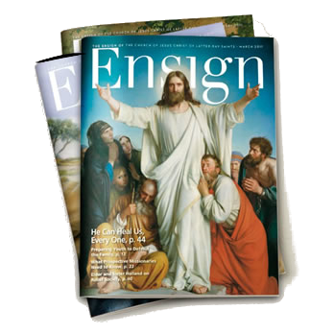
Seeking Further Understanding
How should we think and feel about God’s revealed word to His prophets and apostles compared to other sources of knowledge?
READ
Isaiah 5:20 and Proverbs 3:5–6
What divinely appointed sources would you use to better understand the issue Samuel faced?
Holy Bible
lds.org
The
Book
of
Mormon
Doctrine
And
Covenants
ANOTHER TESTAMENT
OF JESUS CHRIST

