Slide 1
Lesson 140 Part 1
Jeremiah Foretells Destruction of Many Nations
Jeremiah 42-52
And the land of Judah shall be a terror unto Egypt, every one that maketh mention thereof shall be afraid in himself, because of the counsel of the Lord of hosts, which he hath determined against it.
Isaiah 19:17

Slide 2
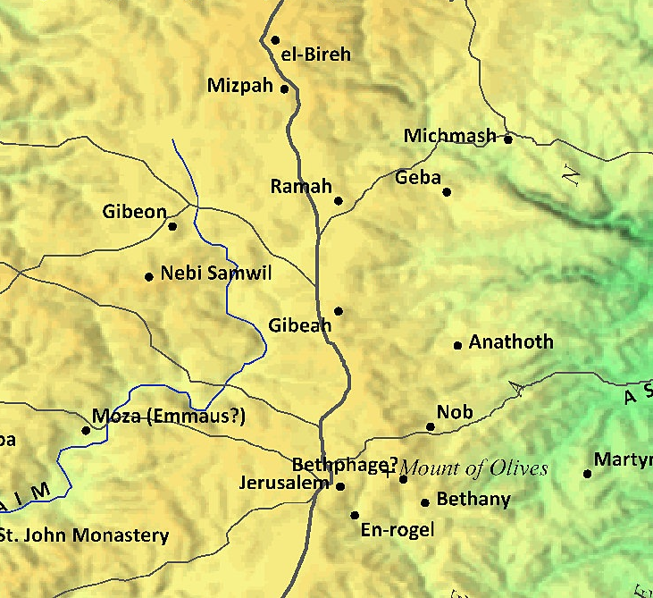
Previously…
A man named Ishmael killed Gedaliah.
Ishmael and his men also killed all who were living with Gedaliah, whether they were Jews or Babylonians.
Johanan organized an army and attacked Ishmael’s men, killing many, taking others as prisoners, and freeing prisoners taken in the attack on Gedaliah.
Worried about the Babylonians’ reaction to the Jews because of what happened, all the Jews moved from Mizpah to an area close to Bethlehem called Chimham. From there they intended to go to Egypt for safety.
Jeremiah was among the group that moved to Chimham.

Slide 3
Those Left Behind—the Remnant
After the Babylonian army came a second time against Jerusalem, they carried most of the Jews away with them to Babylon.
The small group of Jews who remained in Jerusalem were called a “remnant,” meaning those left behind.
Several of the remnant believed that if they went to Egypt they would be spared from further abuse from the Babylonian army.

Slide 4
I Will Pray For You
Jeremiah was approached by the people of Judah, who asked and asked for advice.
Then Jeremiah the prophet said unto them, I have heard you; behold, I will pray unto the Lord your God according to your words; and it shall come to pass, that whatsoever thing the Lord shall answer you, I will declare it unto you; I will keep nothing back from you.
The Lord told them that if they stay where they are they would be safe and have peace.
If they went to Egypt they would suffer death, famine and pestilence.
Jeremiah 42:1-12

Slide 5
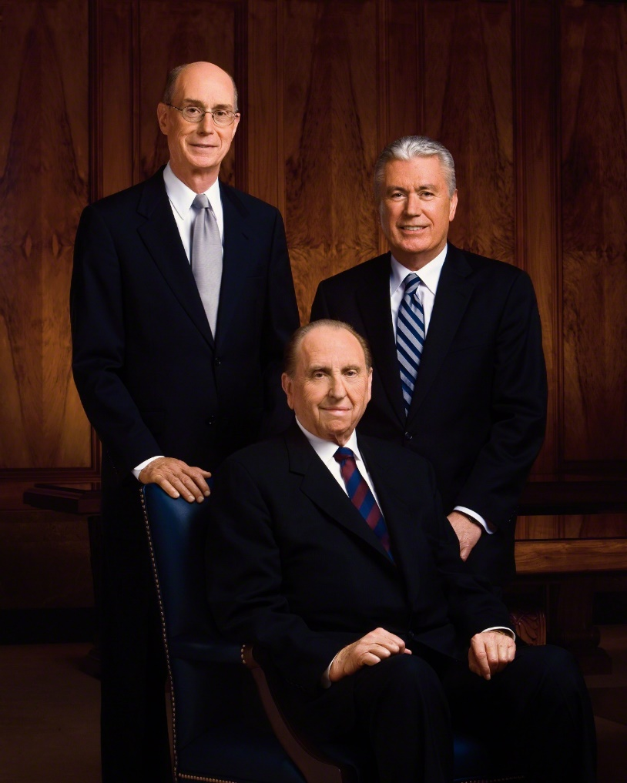
The Lord’s Promises of Safety and Peace
“We promise that as you keep the covenants you have made and these standards, you will be blessed with the companionship of the Holy Ghost, your faith and testimony will grow stronger, and you will enjoy increasing happiness.” (2)
When we disregard the Lord’s counsel given through His prophets, we bring negative consequences upon ourselves
Jeremiah 42:1-12

Slide 6
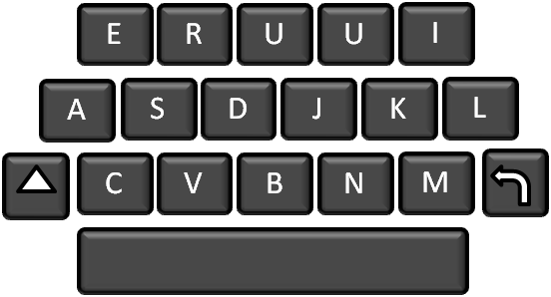
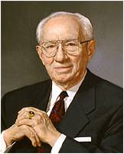
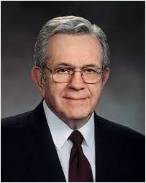
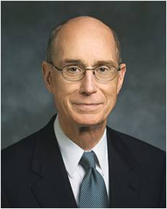
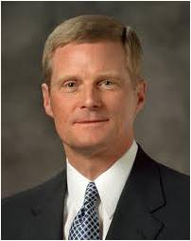
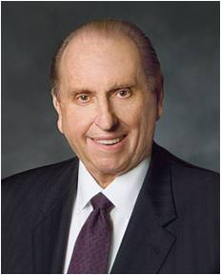
Prophets Today Encourage Us:
Dress modestly
Talk reverently
Listen to uplifting music.
Avoid all immorality and personally degrading practices. Take hold of your life and order yourself to be valiant.
Know the gifts we have been given, to know how to develop them, and to recognize the opportunities to serve others that God provides us.
I promise and testify we will be blessed with increased faith in the Savior and greater spiritual assurance as we seek to always retain a remission of our sins.
Be grateful
Be smart
Be clean
Be true
Be humble
Be prayerful
May we ever choose the harder right instead of the easier wrong.
(3)
(4)
(5)
(6)
(7)

Slide 7
“ye dissembled in your hearts”
The people lied when they told Jeremiah they would obey the Lord’s words.
Why do you think people sometimes choose to disregard the counsel of the Lord given through His prophets even though they have been warned of the consequences?
The choices we make determine our destiny. (7)
Jeremiah 42:20

Slide 8
People Disbelieve Jeremiah As Speaking For God
Jeremiah tells that Johanan and the other proud leaders of this group of Jews did not believe Jeremiah’s counsel.
What excuses do the proud give for disobeying the prophets’ words in our day?
“The central feature of pride is enmity—enmity toward God and enmity toward our fellowmen. Enmity means “hatred toward, hostility to, or a state of opposition.” It is the power by which Satan wishes to reign over us.”
“Pride is essentially competitive in nature. We pit our will against God’s. When we direct our pride toward God, it is in the spirit of “my will and not thine be done.”
“The proud cannot accept the authority of God giving direction to their lives.”
Jeremiah 43:2-3

Slide 9
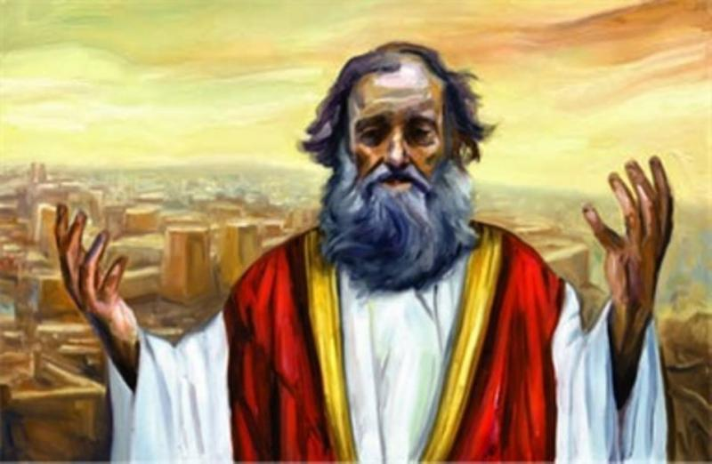
Egypt
The remnant of the Jews not only disobeyed the Lord and went to Egypt, but they also took Jeremiah with them.
After they arrived in Egypt, Jeremiah prophesied that when the Babylonian army destroyed Egypt, the king of Babylon (Nebuchadnezzar) would make his throne there.
Jeremiah 44

Slide 10
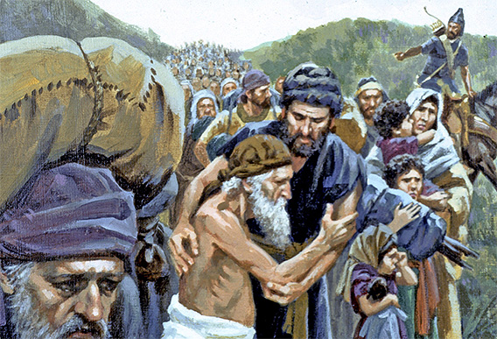
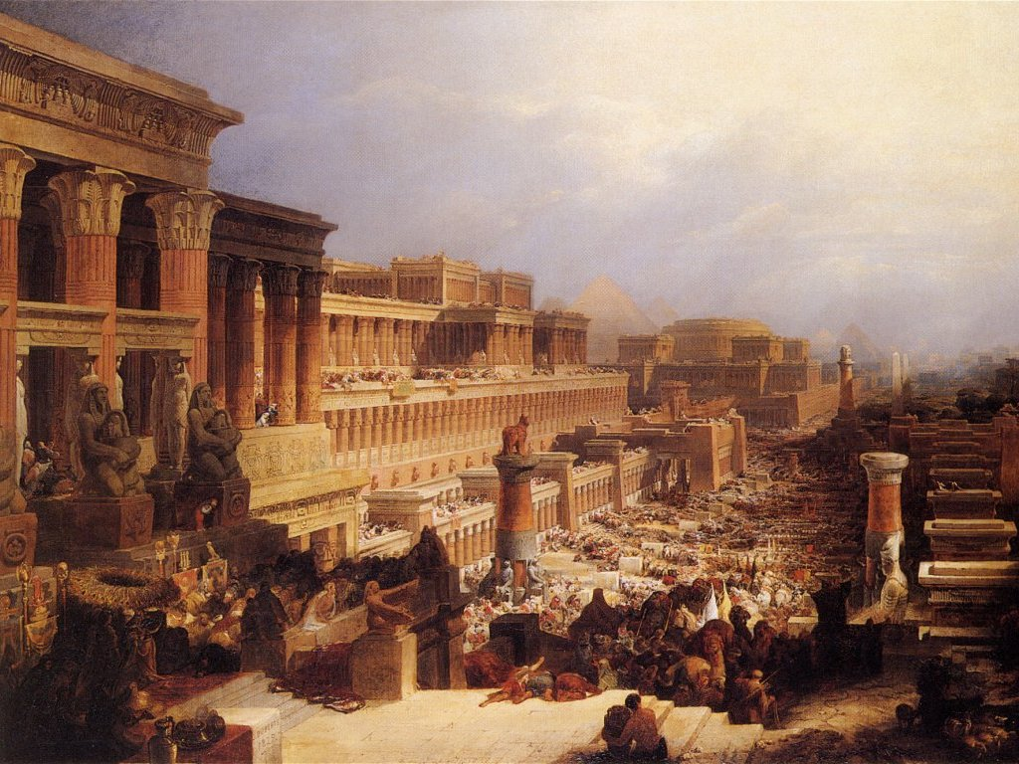
Those Living in Egypt
Jeremiah told the Jews that they would be destroyed in Egypt because they continued to practice forms of idol worship and because they would not obey the Lord; only a few would survive and return to Judah as a witness that the Lord’s word was fulfilled.
This prophecy was fulfilled among yet another group of Jews who could have received blessings at the Lord’s hand if they would have obeyed His prophet. But instead, they trusted in their own judgment.
Jeremiah 44
(10)

Slide 11
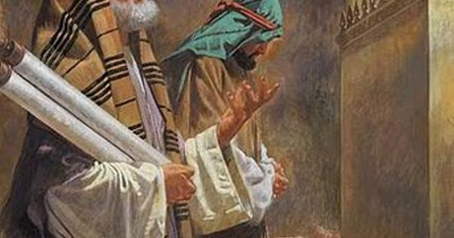
Baruch the Scribe
He wrote down his oracles for the first and second scrolls in 605/4 B.C. He certainly continued to record the prophet’s sayings thereafter and went with him to Egypt, where he probably continued his work as a scribe. (9)
Baruch, the scribe who wrote Jeremiah’s revelations and read them on the steps of the temple in the days of King Jehoiakim.
Apparently, Baruch had hoped the Lord would take away his trials and troubles because he did the Lord’s work. The Lord, however, promised him no deliverance from trials, only that he would not die in the near future.
We too should remember that we cannot expect that just because we are living right the Lord will take away trials, persecution, and other difficult experiences. Like those who have been true and faithful to the Lord since the beginning of time, we must be faithful in good times and in bad.
Jeremiah 45 see also Jeremiah 36
(10)

Slide 12
Those That Would Be Destroyed
Egypt Jeremiah 46
Philistia Jeremiah 47
Moab Jeremiah 48
Ammon Jeremiah 49:1-6
Edom Jeremiah 49:7-22
Damascus Jeremiah 49:23-27
Kedar Jeremiah 49:28-29
Hazor Jeremiah 49:30-37
Elam Jeremiah 49:34-39
Babylon Jeremiah 50-51
Jeremiah 46-51
(10)

Slide 13
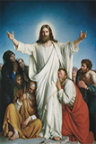
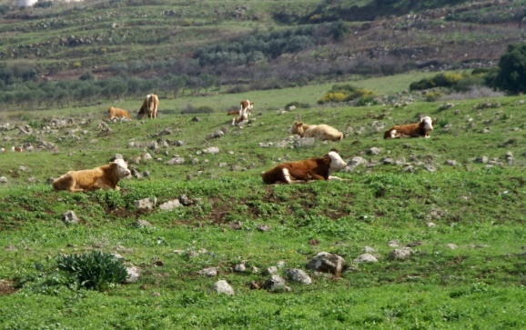
Messages of Hope
Jeremiah 46:27-28
Jeremiah 50:17-20
Jeremiah 50:33-34
I will save thee from afar off, and thy seed from the land of their captivity; and Jacob shall return, and be in rest and at ease, and none shall make him afraid.
I am with thee; for I will make a full end of all the nations whither I have driven thee: but I will not make a full end of thee, but correct thee in measure; yet will I not leave thee wholly unpunished.
I will punish the king of Babylon and his land, as I have punished the king of Assyria.
He shall feed on Carmel and Bashan, (rich in pastures, cattle, oaks of forests and beautiful plains)
I will pardon them whom I reserve.
Their Redeemer is strong; the Lord of hosts is his name: he shall throughly plead their cause, that he may give rest to the land, and disquiet the inhabitants of Babylon..
Isaiah 2:13 ; Ezekiel 27:6 ; Zechariah 11:2
Amos 4:1 ; Jeremiah 50:19
by Carl Heinrich Bloch

Slide 14
A Message For Our Days
Through the strength of our Redeemer, we can be delivered from physical and spiritual bondage
The good news for Israel is that although the Lord will destroy all these other nations, He promised to preserve His people and not completely destroy them
The messages of destruction are also symbolic of the destruction of the wicked in the last days.
Jeremiah 46-51
(10)

Slide 15
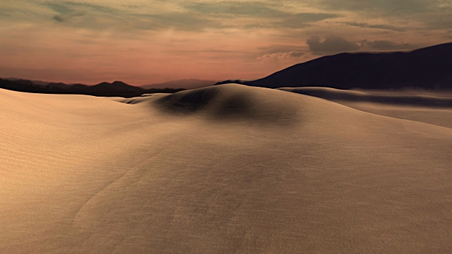
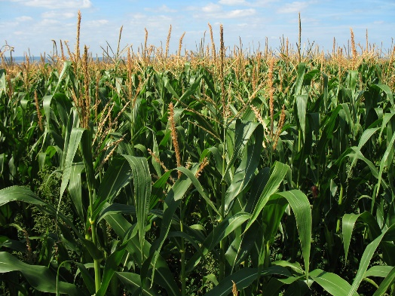
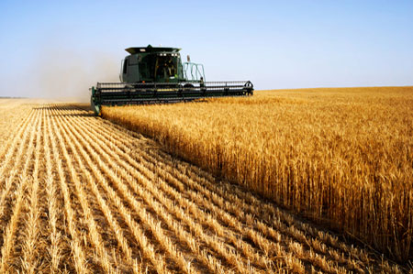
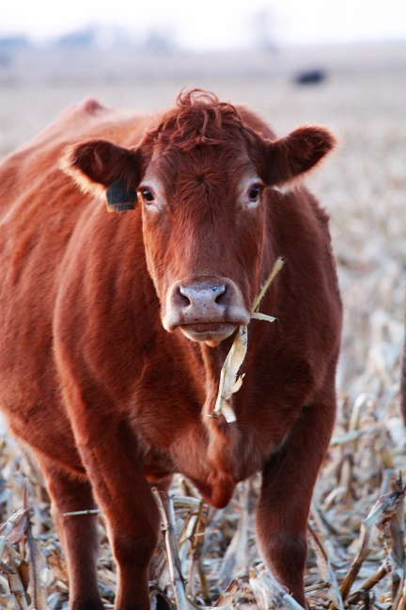
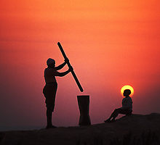
The Destroying Wind—The Lord Destroys Babylon
The east wind is hot and dry from the desert and carries with it particles of sand that do much damage.
When the corn is trodden out by cattle
Crushed out with a heavy wheel of iron
A Shovel thrown up against the wind
A chaff broken straw separated from it
Jeremiah 51
(1)

Slide 16
The Destroying Wind—The Lord Destroys Babylon
Jeremiah predicted the downfall not only of Nebuchadnezzar’s Babylon but of spiritual Babylon as well. His vision swept across the centuries from 600 B.C. to beyond A.D. 2000. And the downfall anciently of Nebuchadnezzar’s Babylon was a prototype of the future downfall of “Babylon the Great”
The east wind is hot and dry from the desert and carries with it particles of sand that do much damage.
Behold, it came to pass that Mosiah discovered that the people of Zarahemla came out from Jerusalem at the time that Zedekiah, king of Judah, was carried away captive into Babylon. Omni 1:15
The Babylonians took King Zedekiah captive and killed all of his sons except Mulek, who escaped to the Americas.
Many of the Jews in Jerusalem were either killed or taken captive and carried to Babylon.
Now the land south was called Lehi, and the land north was called Mulek, which was after the son of Zedekiah; for the Lord did bring Mulek into the land north, and Lehi into the land south.
Helaman 6:10
When the corn is trodden out by cattle
Crushed out with a heavy wheel of iron
A Shovel thrown up against the wind
A chaff broken straw separated from it
And now will you dispute that Jerusalem was destroyed? Will ye say that the sons of Zedekiah were not slain, all except it were Mulek? Yea, and do ye not behold that the seed of Zedekiah are with us, and they were driven out of the land of Jerusalem? But behold, this is not all—
Helaman 8:21
Jeremiah 51
(1)

Slide 17
Sources:
Suggested Hymn: #319 Ye Elders of Israel
1. Old Testament Institute Manual The Babylonian Captivity Chapter 24
For the Strength of Youth[booklet, 2011], ii.
Gordon B. Hinckley A Prophet’s Counsel and Prayer for Youth Text of a talk given to youth and young single adults on 12 November 2000 at the Conference Center in Salt Lake City and broadcast by satellite throughout the Church.
Elder Boyd K. Packer Counsel to Youth Oct. 2011 Gen. Conf.
President Henry B. Eyring Help Them Aim High Oct. 2012 Gen. Conf.
Elder David A. Bednar Always Retain a Remission of Your Sins April 2016 Gen. Conf.
President Thomas S. Monson Choices April 2016 Gen. Conf.
Ezra Taft Benson Beware of Pride April 1989 Gen. Conf.
J. A. Thompson, The Book of Jeremiah, The New International Commentary on the Old Testament, p. 683.)
Old Testament Seminary Handbook
See also: https://www.lds.org/general-conference/1989/04/beware-of-pride?lang=eng
Presentation by ©http://fashionsbylynda.com/blog/

Slide 18
Chimham: Jeremiah 41:7
If the reading geruth is correct, a "lodging-place" or "khan" on the highway to Egypt, may be meant (Jeremiah 41:17). It may have been built by Chimham son of Barzillai; or it may have been named from him as owner of the land on which it stood. But probably with Josephus we should read gidhroth, "hurdles" or "sheep pens" (Ant., X, ix, 5). Biblehub
Pride: Jeremiah 43: 2-3
When pride has a hold on our hearts, we lose our independence of the world and deliver our freedoms to the bondage of men’s judgment. The world shouts louder than the whisperings of the Holy Ghost. The reasoning of men overrides the revelations of God, and the proud let go of the iron rod. (See 1 Ne. 8:19–28; 1 Ne. 11:25; 1 Ne. 15:23–24.)
Pride is a sin that can readily be seen in others but is rarely admitted in ourselves. Most of us consider pride to be a sin of those on the top, such as the rich and the learned, looking down at the rest of us. (See 2 Ne. 9:42.) There is, however, a far more common ailment among us—and that is pride from the bottom looking up. It is manifest in so many ways, such as faultfinding, gossiping, backbiting, murmuring, living beyond our means, envying, coveting, withholding gratitude and praise that might lift another, and being unforgiving and jealous.
Disobedience is essentially a prideful power struggle against someone in authority over us. It can be a parent, a priesthood leader, a teacher, or ultimately God. A proud person hates the fact that someone is above him. He thinks this lowers his position.
Selfishness is one of the more common faces of pride. “How everything affects me” is the center of all that matters—self-conceit, self-pity, worldly self-fulfillment, self-gratification, and self-seeking. Source: (8)
Jeremiah Approaches People of Judah (The Remnant) Jeremiah 42:
“After this incident, Jeremiah was approached by the people of Judah, who asked him to pray to God in their behalf and ask His advice and counsel. The prophet did pray, and the Lord advised the people to stay in Judah and be blessed. They were told not to be afraid of the king of Babylon; the Lord would save them and deliver them from his hand and have compassion upon them. On the other hand, if they went to Egypt to escape war and hunger, they should be severely disappointed. They were told that famine, pestilence, and the sword would be their terrible lot. (42:1–22) But the stubborn Jews refused to heed the Lord’s words through Jeremiah and proceeded into Egypt, taking the hapless prophet and his scribe Baruch with them. (43:1–7) “At Tahpanhes, the word of the Lord came to Jeremiah predicting the destruction of Egypt at the hands of the same Nebuchadnezzar who had destroyed Jerusalem: [Jeremiah 43:8–13].
“Thus the disobedient Jews who had escaped from troubles in Judah would meet them head-on in Egypt. (See also 44:12–14.) Jeremiah continued to castigate them for their idolatrous worship of the ‘queen of heaven,’ but they refused to heed his words. (44:15–30).” (Sperry, Voice of Israel’s Prophets, pp. 184–85.)
OT Institute Manual Chapter 24
Destruction of Egypt Jeremiah 46:
The “brigandines” in verse 4 were a coat of mail or armor, usually made of overlapping metal scales like the scales of a fish. The “day of the Lord” (v. 10) refers to the Second Coming (see Joel 1:15; Amos 5:18).
It will be a “day of vengeance, that he may avenge him of his adversaries” (v. 10). Verses 14 and 25 mention Egyptian cities. No is a name for Jupiter’s city, or Thebes. Egypt is described as a fair heifer, but destruction would come to her from the north (Babylon) (see v. 20). Amidst all this turmoil, however, Israel was promised that the Lord would save her and her seed and that she would return, for the Lord Himself would be with her. The last two verses are the only ones in chapter 46 that were not fulfilled in Jeremiah’s time or shortly thereafter.
Destruction of Philistines: Jeremiah 47:
The “waters” that “rise up out of the north” (v. 2) refers to a multitude of people coming from Chaldea. The stamping of hoofs, the rushing of chariots, and the rumbling of wheels describe a war. The destruction is attributed to the Lord, who allows wicked nations to do such things against those who have become ripe in iniquity.
Ignoring the Commandments Jeremiah 42:2:
“Why do prophets proclaim unpopular commandments and call society to repentance for rejecting, modifying, and even ignoring the commandments? The reason is very simple. Upon receiving revelation, prophets have no choice but to proclaim and reaffirm that which God has given them to tell the world. Prophets do this knowing full well the price they may have to pay. Some who choose not to live the commandments make every effort to defame the character of the prophets and demean their personal integrity and reputation. In response, the prophets remain silent and merely turn the other cheek. The world may see this as weakness, but it is one of the greatest strengths a [person] can have—to be faithful, unyielding, and unwavering to that which he [or she] knows to be true, accepting whatever consequences may follow.” Elder Robert D. Hales(“If Thou Wilt Enter into Life, Keep the Commandments,” Ensign, May 1996, 37).

Slide 19
Destruction of Egypt Jeremiah 46:
The “brigandines” in verse 4 were a coat of mail or armor, usually made of overlapping metal scales like the scales of a fish. The “day of the Lord” (v. 10) refers to the Second Coming (see Joel 1:15; Amos 5:18).
It will be a “day of vengeance, that he may avenge him of his adversaries” (v. 10). Verses 14 and 25 mention Egyptian cities. No is a name for Jupiter’s city, or Thebes. Egypt is described as a fair heifer, but destruction would come to her from the north (Babylon) (see v. 20). Amidst all this turmoil, however, Israel was promised that the Lord would save her and her seed and that she would return, for the Lord Himself would be with her. The last two verses are the only ones in chapter 46 that were not fulfilled in Jeremiah’s time or shortly thereafter.
Destruction of Philistines: Jeremiah 47:
The “waters” that “rise up out of the north” (v. 2) refers to a multitude of people coming from Chaldea. The stamping of hoofs, the rushing of chariots, and the rumbling of wheels describe a war. The destruction is attributed to the Lord, who allows wicked nations to do such things against those who have become ripe in iniquity.
Destruction of Moab: Jeremiah 48:
Moab was doomed to destruction, and the Lord pronounced a curse upon her enemies if they did not proceed to destroy her. God is the author of life and has the right to give and take it. These people had forfeited their lives by their idolatry and other crimes. The wrath of God is seen in verse 35 where He pronounces doom on those who deceive the people in attempting to practice their idolatry in the holy places. Verse 42 predicts that Moab will be destroyed as a people. The implication is not that all the Moabites would be destroyed, but that their identity as a people would cease. This prophecy was fulfilled literally, even though people continued to live in the land of Moab. They were taken captive by the Chaldeans and never afterward resumed their status as a nation. Verse 47 promises that the Lord will “bring again the captivity of Moab in the latter days.” This passage could mean the conversion of the remnants of these people to the gospel in the last days.
Destruction to the Ammonites, Edom, Kadar, Hazor, and Elam: Jeremiah 49:
It is believed that this prophecy was given after the capture of Jerusalem. The Ammonites had taken advantage of the depressed condition of Israel and invaded their territories, hoping to make them their own. Jeremiah intimated that God would preserve the descendants of Israel and bring them home again one day to their inheritances (see v. 2). The promise to the Ammonites (v. 6) was fulfilled when they returned with the Moabites and Israelites with permission given the edict of Cyrus.
The Lord said He had made Edom bare (see vv. 7–22), meaning He had uncovered all her hiding places and made them known to her enemies. The widows and orphans of Esau would be cared for by the Lord, who is the best of husbands to the one and the most loving father to the other.
Verse 39 speaks of the Lord’s bringing again the captivity of Elam in the latter days. Again, it is supposed that this passage means their conversion, as with the Moabites.
Destruction of Babylon forever: Jeremiah 50:
Scattered Israel will be brought again into the lands of their inheritance. They shall seek the Lord and join with Him in a perpetual covenant which cannot be broken. The “assembly of great nations from the north country” (v. 9) is discussed by Clarke: “The army of Cyrus was composed of Medes, Persians, Armenians, Caducians, Sacae, &c. Though all these did not come from the north; yet they were arranged under the Medes, who did come from the north, in reference to Babylon.” (Commentary, 4:383.)
By these captors Israel would be “scattered as sheep” (v. 17), and the king of Babylon, Nebuchadnezzar, would be punished. In the future, however, Israel will be brought again to their lands of inheritance (see v. 19) and will be forgiven (see v. 20). They will be led by the Lord Jesus Christ (see v. 34). He is the advocate with the Father (see D&C 29:5) and pleads our cause before Him.
Verses 41–46 describe the destruction of Babylon, which was a wonder to all the surrounding nations, because they thought Babylon was impregnable. Here Babylon is seen not only as a national power but as the symbol of worldliness and spiritual wickedness. (Compare D&C 133:14.)

Slide 20
Jeremiah At A Glance – Bible Dictionary
Jeremiah 1-6 | Prophecies of reign of Josiah | Jeremiah 1:4-5 Jeremiah 3:12-19 | Premortal Condition and Jeremiah’s Calling Prophecy of the return of Israel from the scattered condition, gathering one of a city and two of a family to Zion, a pleasant land where Israel and Judah can dwell in safety and peace
Jeremiah 7-20 | Prophecies under Jehoiakim
Jeremiah 21-38 | Prophecies under Zedekiah | Jeremiah 21-23 | On pastors or rulers of people, with promise of king Messiah
 |  | Jeremiah 24 | Exiles carried away with Jehoiachin
 |  | Jeremiah 26-29 | False prophets and containing the prophet’s letter to the exiles in Babylon, warning against the prophets there
 |  | Jeremiah 30-33 | Prophecies of the latter-day restoration of Israel and the gospel covenant, containing the story of the prophet’s buying a field, showing the firmness of his faith in the people’s restitution
 |  | Jeremiah 34-38 | Narratives of the treatment of the prophet and other events during the last times of the siege
Jeremiah 39-44 | The prophet’s history and other events after the fall of the city
Jeremiah 46-51 | Prophecies against foreign nations | Jeremiah 50-51 | In their present form are later than Jeremiah
Jeremiah 52 | Historical conclusion

Slide 21
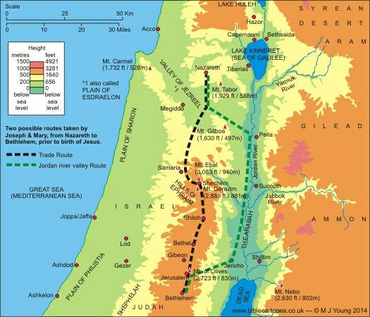
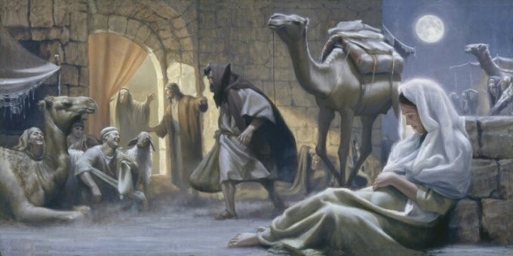
Chimham's Inn: Luke 2:1-7
“And it came to pass in those days that a decree went out from Caesar Augustus that all the world should be registered. This census first took place while Quirinius was governing Syria. So all went to be registered, everyone to his own city. Joseph also went up from Galilee, out of the city of Nazareth, into Judea, to the city of David, which is called Bethlehem, because he was of the house and lineage of David, to be registered with Mary, his betrothed wife, who was with child. So it was, that while they were there, the days were completed for her to be delivered. And she brought forth her firstborn Son, and wrapped Him in swaddling cloths, and laid Him in a manger, because there was no room for them IN THE INN.”
There were two possible routes they could have taken. {See map} One was more direct; the other turned East, ran along the Jordan River toward Jericho and then turned West, back again toward Jerusalem. Both were approximately 70-75 miles in distance, give or take, and would have taken four or five days if one were to walk about 20 miles a day. Where it says that the days were accomplished that she should be delivered, you can tell she must have been VERY pregnant and not too far from her due date.
The Jordan route would have been the most likely for two reasons. First, it would have been flatter terrain and thus easier traveling. Being the lower in elevation, it would also have been more moderate in temperature. The other reason was that most Jewish people did not like to go through Samaria. They did all they could to skirt around that region lest they be soiled by contact with those ignorant Gentiles.
Either way, in those days, it was a long and difficult journey from Nazareth and Mary, being great with child, would have found it particularly difficult.
Under normal circumstances, she would never have accompanied Joseph on this journey because, back then, only men were taxed. But because she was so far along in her pregnancy, which no one could adequately explain, she would have been in grave danger had she remained in Nazareth. She wasn't legally married to Joseph yet, simply betrothed, so they assumed she had broken the Law of Moses. They might have stoned her to death.
Now what about this Inn, and who in the world is Chimham (pronounced "Kím-ham)?"
There is a very long history and an interesting story to tell. Located in greater Bethlehem, it was a well-known place for travelers to stop along their journey. Like all lodging places throughout the Middle East and all along the Silk Road, such places, called "caravanserai," offered travel-weary folk lodging for the night as well as food and water for their transportation, kinda like our Modern-day hotels. The oldest of these caravanserai is in present-day Turkey. Still standing, it is 600 years old!
Something of Interest—Not Doctrine
Chimham’s Inn
Chimham's Inn
Herod was king back then though he was not the true King. He wasn't even Jewish. He was an Edomite; a usurper and a very evil King at that, though he was a great builder.
If there were a rightful king of Israel by birth and lineage, it sure wasn't him. Both Joseph and Mary were direct descendants of King David. They were the rightful heirs of the throne, a bonafide royal couple. Thus, Jesus had a double claim to the throne of his father, David.
Matthew chapter 1 records Joseph's lineage to David, who's ancestor was Solomon. Mary's lineage is recorded in Luke chapter 3. Her ancestor was Nathan, another of David's sons, for he had many.
The lineage in Matthew only goes as far back as David, the son Abraham, because Matthew is all about Jesus as the King of Israel. Luke, however, portrays the perfect Man which is why the genealogy there traces all the way back to Adam, proving Jesus was fully man. He did not take over some human body, like invasion of the body snatchers.
1

Slide 22
Mary and Joseph's distant relative, David, was a Bethlehem boy from way back. He lived there until he became king and moved into the palace, which was located in Hebron at that time. His home in Bethlehem where he grew up was passed down to him by his father, Jesse who got it from his father, Obed whose Mom and Dad were Boaz and Ruth, the Moabitess.
Boaz, you recall, was the wealthiest and most eligible bachelor in all of Bethlehem who had fallen madly in love with Ruth, the widow of Naomi's son, so you can imagine it was not too shabby, more like an estate. His parents were Salmon and Rahab. You remember her, the reformed prostitute from Jericho who helped the two Hebrew spies. Salmon's father was Nahshon, captain of the tribe of Judah, who lead the Israelites through the Red Sea.
Back when David was King, his son, Absolom, who was extremely handsome and charismatic, wanted the throne for himself. He stole the hearts of the people away from his father. But instead of fighting his son, David chose to walk away. He didn't want to kill him.
As he was wandering here and there with his mighty men, several people helped him. Let's follow the story in lI Samuel 17:27-29.
“Now it happened, when David had come to Mahanaim, that Shobi the son of Nahash from Rabbah of the people of Ammon, Machir the son of Ammiel from Lo Debar, and Barzillai the Gileadite from Rogelim, brought beds and basins, earthen vessels and wheat, barley and flour, parched grain and beans, lentils and parched seeds, honey and curds, sheep and cheese of the herd, for David and the people who were with him to eat. For they said, “The people are hungry and weary and thirsty in the wilderness.””
This man, Barzillai, was very old, about 80 years of age. Two chapters later when Absolom was killed, David prepared to cross back over the Jordan and return home. Gilead, where he had sought refuge, is in present day Jordan. He wanted to reward Barzillai for his many kindnesses but he declined as we'll read below:
“Please let your servant turn back again, that I may die in my own city, near the grave of my father and mother. But here is your servant Chimham; let him cross over with my lord the king, and do for him what seems good to you.” And the king answered, “Chimham shall cross over with me, and I will do for him what seems good to you. Now whatever you request of me, I will do for you.” Then all the people went over the Jordan. And when the king had crossed over, the king kissed Barzillai and blessed him, and he returned to his own place. Now the king went on to Gilgal, and Chimham went on with him. And all the people of Judah escorted the king, and also half the people of Israel.”
2 Samuel 19:37-40
Later on, David, on his deathbed, didn't have much of anything good to say about anyone: Kill this person and that guy," except for the "sons of Barzillai.
““But show kindness to the sons of Barzillai the Gileadite, and let them be among thosewho eat at your table, for so they came to me when I fled from Absalom your brother.”
I Kings 2:7 NKJV
We don't even know Barzillai's real name, only that he was the son, "bar," of "Zillai;" but his sons were accorded forever the privilege of eating at David's table in his own house, you know, the beautiful home of Boaz in greater Bethlehem. Later on, this house came to belong to Chimham and his descendants as you see in the scripture below.
“Then Johanan the son of Kareah, and all the captains of the forces that were with him, took from Mizpah all the rest of the people whom he had recovered from Ishmael the son of Nethaniah after he had murdered Gedaliah the son of Ahikam—the mighty men of war and the women and the children and the eunuchs, whom he had brought back from Gibeon. And they departed and dwelt in the habitation of Chimham, which is near Bethlehem, as they went on their way to Egypt,”
Jeremiah 41:16-17
2

Slide 23
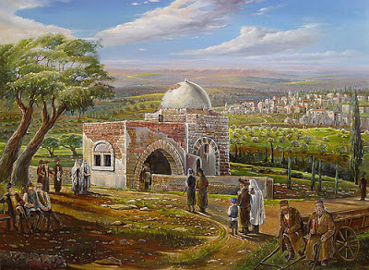
Baby Jesus was placed in a very particular manger, most likely the one at the foot of the Tower of Eder, Eder Migdol, or the Tower of the Flock. It was here that they kept sheep used for temple sacrifices.
They were all good quality sheep fit for use a sacrifices because, as soon as they were born, they were "wrapped in swaddling" clothes to lie in mangers so that, while they were very young and rambunctious, they wouldn't jump around and injure themselves. That would render them unfit to be used. So, when the Angel told the shepherds that they would find the babe wrapped in "swaddling clothes, lying in a manger," there was no doubt in their minds what manger it was!
You remember that this house once belonged to Boaz, whose great, great grandfather was Nahshon, the captain of Judah. But there was someone long before Nahshon who built that house years before and who lived there first: Jacob.
His favorite wife, Rachel, had died, so he buried her just outside Bethlehem and erected a monument there when exists to this day.
“So Rachel died and was buried on the way to Ephrath (that is, Bethlehem). And Jacob set a pillar on her grave, which is the pillar of Rachel’s grave to this day. Then Israelj ourneyed and pitched his tent beyond the tower of Eder.” Genesis 35:19-21
Rachel's tomb is still there.
Notice the name change from Jacob to Israel? That means there is a spiritual truth hidden here. Jacob was his given name but the name, Israel, was given to him by the Lord. He "pitched his tent just beyond the Tower of Eder," where the flocks of the temple sacrifices were kept. Being his most beloved wife, he wanted to be close to her so he built his house nearby the monument he erected.
Years later when the young shepherd boy, David, came along, he most likely was a shepherd to those very sheep who would be used in temple sacrifices. He would even fight against wild beasts for these sheep who were basically born to die.
How ironic that when the original family owners, the ROYAL COUPLE, the parents of David's great, great, great, great......grandson, the King of ALL KINGS, came looking for lodging and safe haven so that His mother, Mary, could have her baby, there was no room in His own house. They were relegated to a cold stable for animals where there was only a stone manger filled with hay for her to place Him, wrapped in swaddling clothes.
And that, Church, is the amazing history of the Inn where no room was found for the King of all Kings and Lord of all Lords known as Chimham's Inn.
http://emmausrevelations.blogspot.com/2015/12/chimham-inn.html
3

