Slide 1
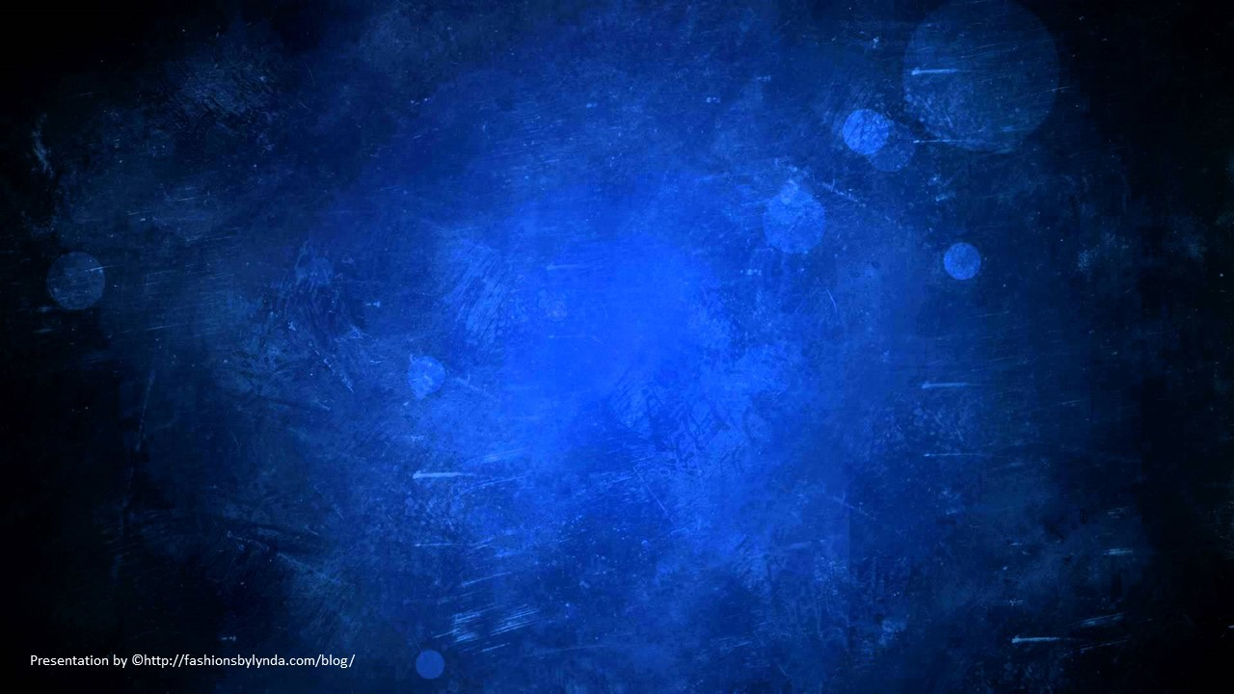
Lesson 142 Part 1
Vision of Glory
Ezekiel 1-3
That he may receive also the counsel from those whom I have set to be as plants of renown, and as watchmen upon her walls.
D&C 124:61

Slide 2
Ezekiel
He was of the lineage of Zadok; the son of Buzi, in the land of the Chaldeans by the river Chebar (Tel Abib)
His name means God will strengthen.
He was carried away into Babylon by Nebuchadnezzar along with Jehoiachin (King of Judah) and prophesied during the period of 592-570 B.C.
Ezekiel’s family must have been considered prominent and influential, for, according to the account in 2 Kings 24:14–16, mostly the ‘chief men of the land’ were taken captive
He was granted extraordinary vision and provided consequences of apostasy, idolatry, repentance covenants and the blessing of being heirs with the Good Shepherd
He saw beyond the tragedies of his era to a future time of renewal when the Lord would gather His people, give them “a new heart” and “a new spirit,” and help them live His laws
He prophesied of the miraculous events of the coming of the Book of Mormon
(2, 3)

Slide 3
The Book of Ezekiel
Ezekiel 1-24 | Ezekiel 25-32 | Ezekiel 33-39 | Ezekiel 40-48
Prophecies of Judgment against Jerusalem and the nation | Prophecies against Israel’s enemies | Prophecies of restoration | Visions of reconstruction of the temple and its worship—a unique prophecy
The prophet Ezekiel is the author of the book of Ezekiel.
Ezekiel prophesied and delivered the Lord’s words to the Jewish exiles in Babylon at about the same time that Jeremiah was prophesying in Judah and Daniel was prophesying in the Babylonian court.

Slide 4
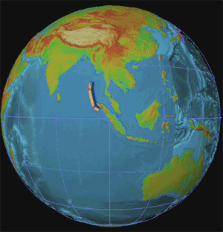
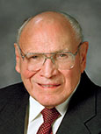
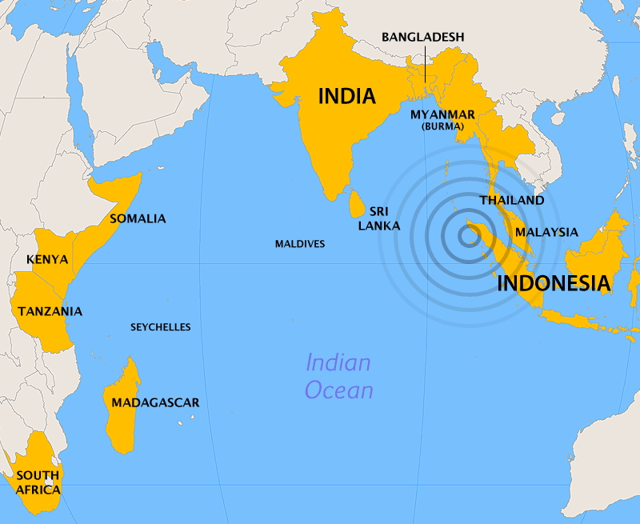
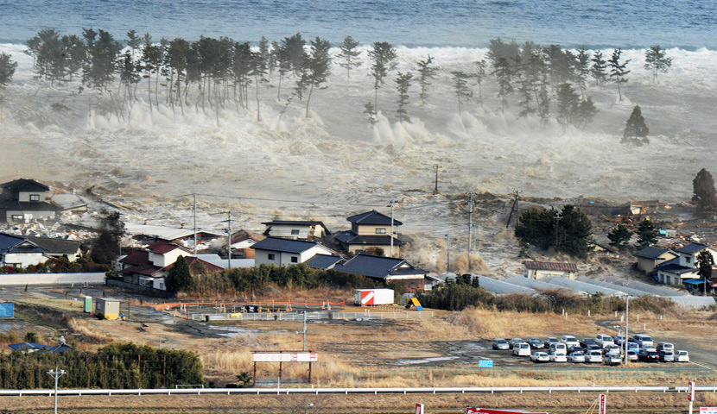
A Terrible Day
“On December 26, 2004, a powerful earthquake struck off the coast of Indonesia, creating a deadly tsunami that killed more than 200,000 people. It was a terrible tragedy. In one day, millions of lives were forever changed.
“But there was one group of people who, although their village was destroyed, did not suffer a single casualty.
“The reason?
“They knew a tsunami was coming.
(4)

Slide 5
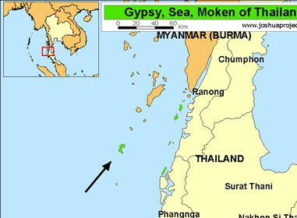
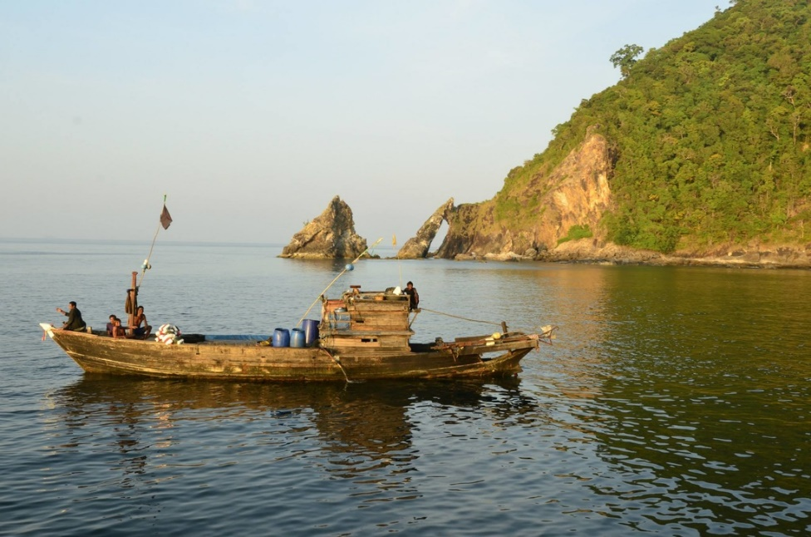
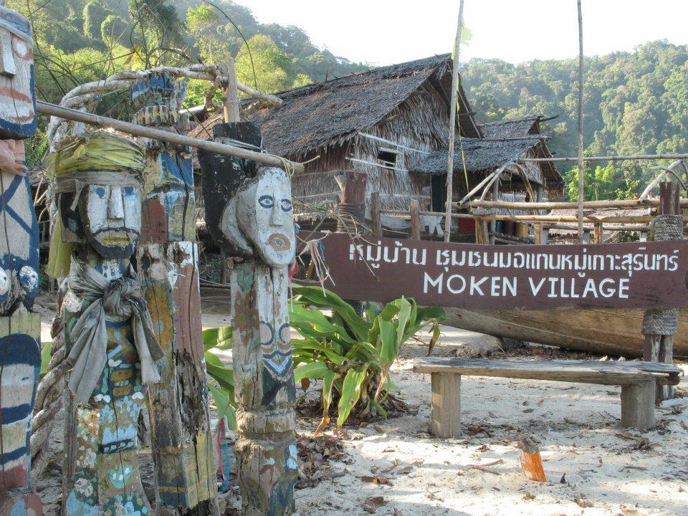
The Moken People
“The Moken people live in villages on islands off the coast of Thailand and Burma (Myanmar). A society of fishermen, their lives depend on the sea. For hundreds and perhaps thousands of years, their ancestors have studied the ocean, and they have passed their knowledge down from father to son.
“One thing in particular they were careful to teach was what to do when the ocean receded. According to their traditions, when that happened, the ‘Laboon’—a wave that eats people—would arrive soon after.
“When the elders of the village saw the dreaded signs, they shouted to everyone to run to high ground.
(4)

Slide 6
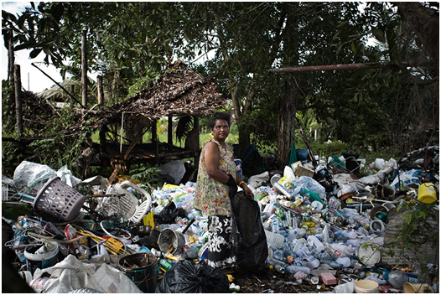
“Not Everyone Listened”
“One elderly fisherman said, ‘None of the kids believed me.’ In fact, his own daughter called him a liar.
But the old fisherman would not relent until all had left the village and climbed to higher ground.”
(4)

Slide 7
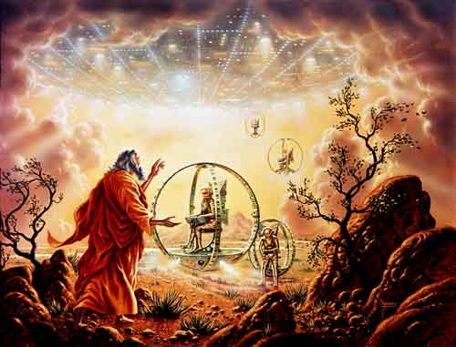
Ezekiel’s Vision
It is very difficult, if not impossible, for a mortal to convey in writing the message and spirit of a vision or other revelation from God so that the reader will have a complete understanding of what took place and what was communicated.
Such was the challenge of Ezekiel in describing his transcendent visions of heaven.
Ezekiel 1:1

Slide 8
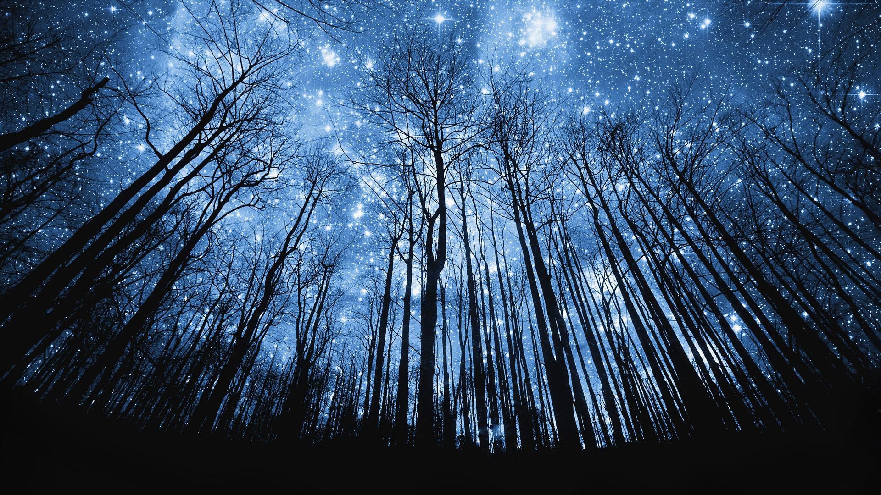
Experiencing A Revelation
“…could you gaze into heaven five minutes, you would know more than you would by reading all that ever was written on the subject. ” (5)
One must experience revelation to understand it fully.
Ezekiel 1:1

Slide 9
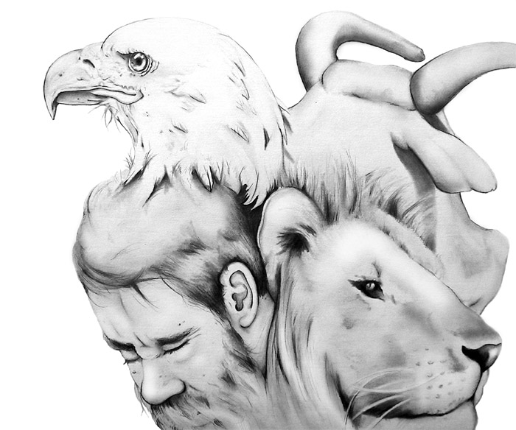
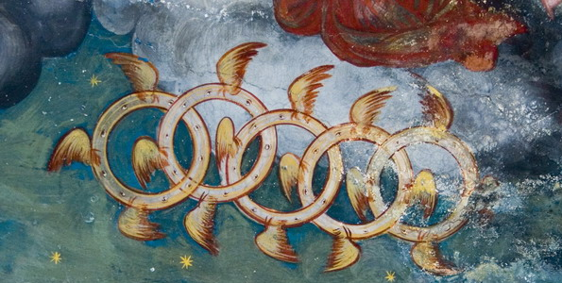
Ezekiel’s Eternal World
Ezekiel often used symbolism, metaphor, simile, comparisons, and other kinds of figurative language to try to convey the experience they had and the message they received.
Likeness and appearance
Everything Ezekiel said need not be taken literally, for he used many figurative expressions to try to tell that which was far beyond mortal experience.
Ezekiel 1:1
(1)

Slide 10
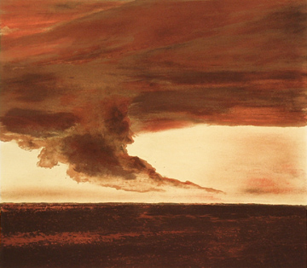
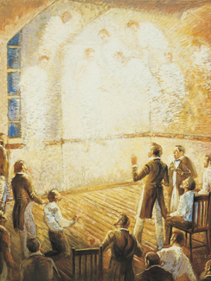
Whirlwind
Wind, Tempests, or Storm = The Power of God
The power of God’s presence
Then the Lord answered Job out of the whirlwind, and said, Job 38:1
Bob Booth
When the Lord poured out His Spirit with great power at the dedication of the Kirtland Temple in this dispensation, “a noise was heard like the sound of a rushing mighty wind, which filled the Temple” (6)
Ezekiel 1:4
(1)

Slide 11
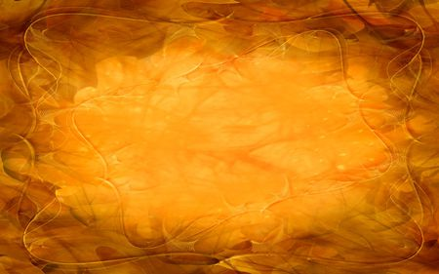
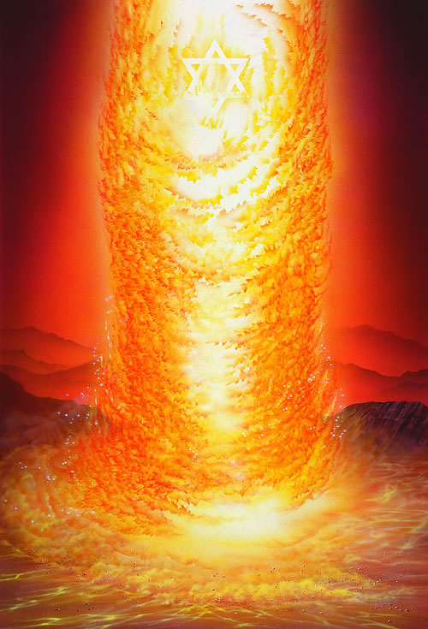
Association of Glory and Power
Of God’s presence or that of His messengers.
Cloud, Fire, Brightness, Color of Amber, Lamps, Lightning
And it came to pass as he prayed unto the Lord, there came a pillar of fire and dwelt upon a rock before him; and he saw and heard much; and because of the things which he saw and heard he did quake and tremble exceedingly.
1 Nephi 1:6
While he yet spake, behold, a bright cloud overshadowed them: and behold a voice out of the cloud, which said, This is my beloved Son, in whom I am well pleased; hear ye him. Matthew 17:5
For behold, verily, verily, I say unto you, the time is soon at hand that I shall come in a cloud with power and great glory. D&C 34:7
Ezekiel 1:13
(1)

Slide 12
Four Heavenly Creatures
Face of a man, … a lion, … an ox … [and] the face of an eagle
Ezekiel described four heavenly creatures and their manner of movement.
Lion = King = predator = wild
Calf = domesticated = burden = service
Man = human = intelligent = reasoning
Eagle = angel-like = not earthly = Majestic (7)
And the first beast was like a lion, and the second beast like a calf, and the third beast had a face as a man, and the fourth beast was like a flying eagle..
Revelation 4:7
They are limited to four individual beasts, which were shown to John, to represent the glory of the classes of beings in their destined order or sphere of creation, in the enjoyment of their eternal felicity. D&C 77:3
Ezekiel 1:10
(1)

Slide 13
Dominion Over All Creatures
Ezekiel saw that the throne of God was above the creatures.
That placement represents His having dominion over all living things, though He provides the means for all His creations, both human and animal, to enter into eternal glory, each in their appropriate order.
…to represent the glory of the classes of beings in their destined order or sphere of creation, in the enjoyment of their eternal felicity. D&C 77:3
Ezekiel 1:10, 26-28; D&C 77:2-3
(1)

Slide 14
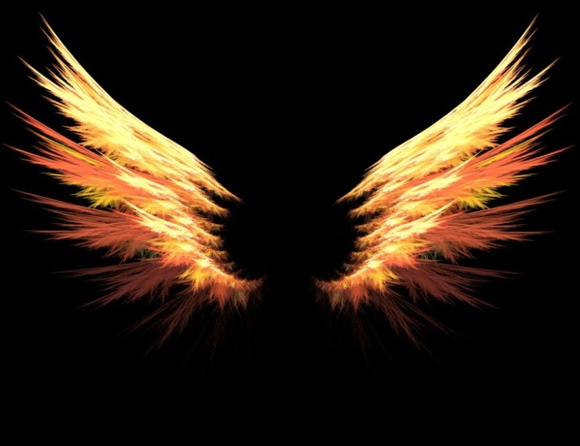
Wings
The Power to Move = Act
“More often than not, ancient and modern iconography depicts heavenly beings as possessing wings. This image is purely symbolic, however, for “an angel of God never has wings.”
(5)
And the four beasts had each of them six wings about him; and they were full of eyes within: and they rest not day and night, saying, Holy, holy, holy, Lord God Almighty, which was, and is, and is to come. Revelation 4:8
Ezekiel 1:6
(1)

Slide 15
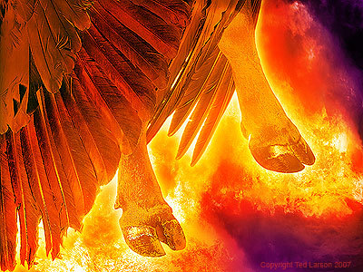
Feet like Burnished Brass
The word straight = “standing upright, not bent, as when sitting or kneeling” (8)
The creatures did not travel as a person travels when walking.
Sole of the feet of a calf = smooth and shiny
Highly polished or burnished brass = amber is beautiful
Daniel Sees the Lord as:
His body also was like the beryl, and his face as the appearance of lightning, and his eyes as lamps of fire, and his arms and his feet like in colour to polished brass, and the voice of his words like the voice of a multitude. Daniel 10:6
Ezekiel 1:7
(1)

Slide 16
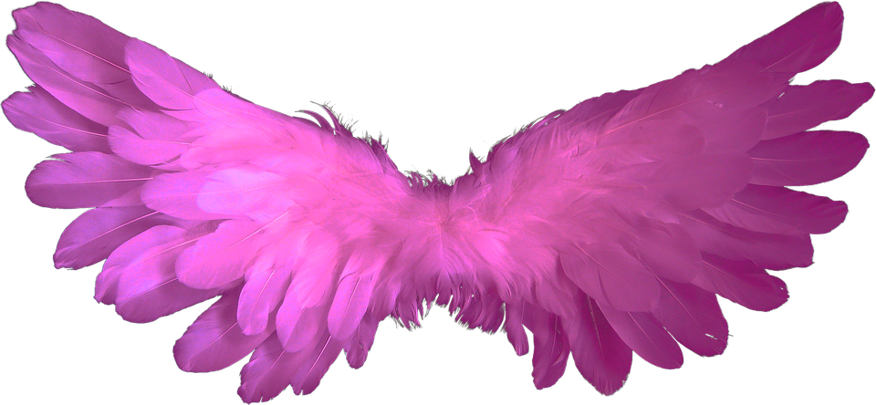
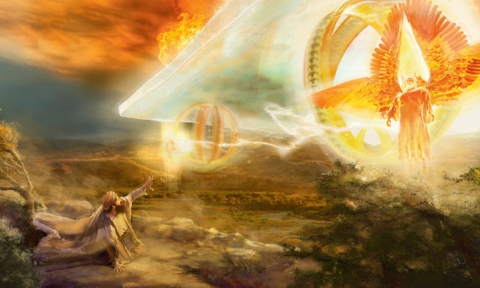
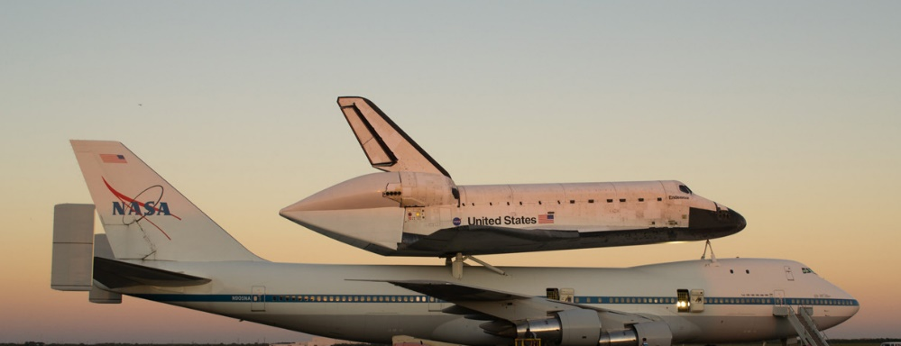
Wings Were Joined Together
The creatures of Ezekiel’s vision were in complete harmony and unity. They moved as one, symbolizing the total unity that exists among all living things who submit to God’s will.
Ezekiel 1:9, 11
(1)

Slide 17
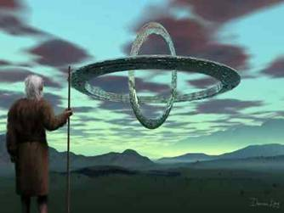
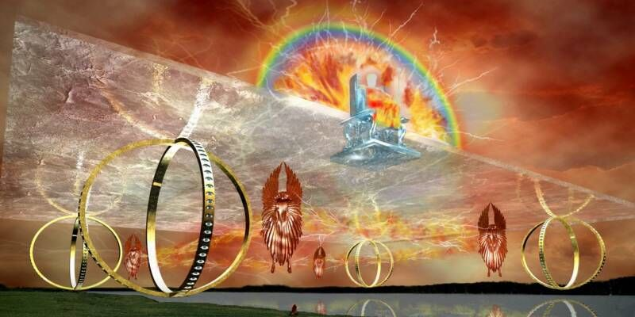
Four Wheels
These are artist’s depiction of Ezekiel’s visions
He also saw four wheels that moved with the creatures. While some have attempted to explain what these figures and objects represent, the full meaning of Ezekiel’s vision has not yet been revealed to us by the Lord.
At present the interpretation of Ezekiel’s vision has not been given to the Church, so the Lord does not hold His Saints accountable for understanding what is represented by the wheels
Ezekiel 1:15-21
(1)

Slide 18
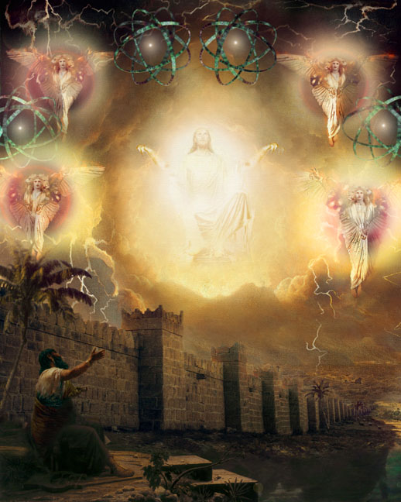
God on the Throne
Ezekiel saw a firmament, or expanse, above or over the creatures. Above the firmament Ezekiel saw God sitting on His throne in His glory.
Ezekiel used several terms to describe the brilliance, beauty, and glory of God. Then, as a humble witness to such glory, beauty, and majesty, he fell upon his face in awe and reverent submission.
Ezekiel 1:26-28
(1)

Slide 19
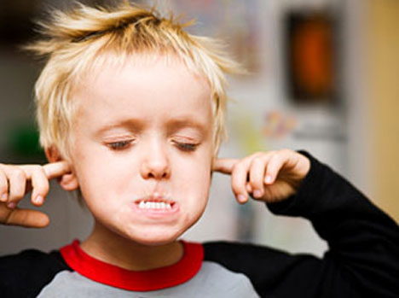
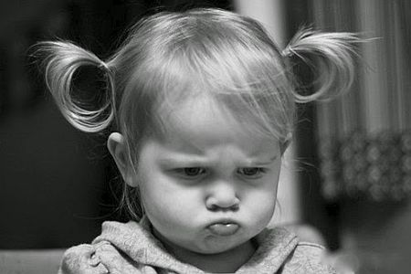
Impudent Children
stubbornness and an unwillingness to change.
Briers, thorns, and scorpions = the difficulties Ezekiel would face as he taught the people.
Ezekiel 2:4-7

Slide 20
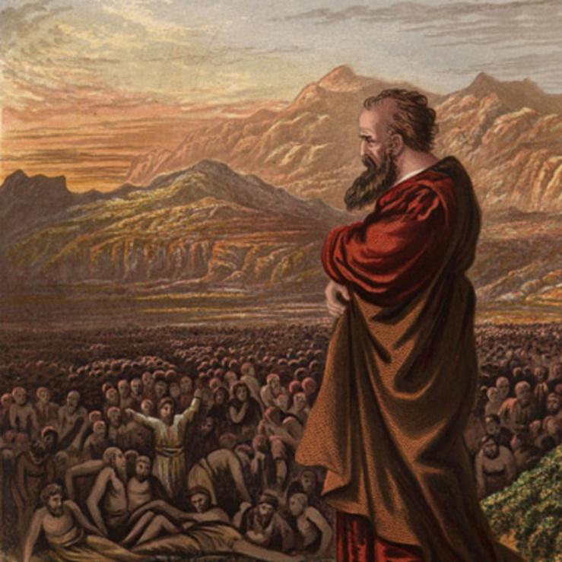
Ezekiel Receives His Call
His call was not only to the Exiles, but to all the 12 Tribes… wherever they may be
Facing Opposition:
The Lord had strengthened Ezekiel’s resolve to teach the rebellious children of Israel.
harder than flint
Behold, I have made thy face strong against their faces, and thy forehead strong against their foreheads.
I heard also the noise of the wings of the living creatures that touched one another, and the noise of the wheels over against them, and a noise of a great rushing.
So the spirit lifted me up, and took me away, and I went in bitterness, in the heat of my spirit; but the hand of the Lord was strong upon me.
Ezekiel 2:4-14

Slide 21
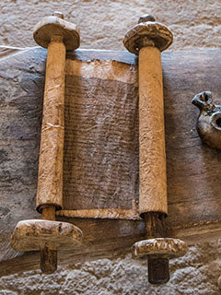
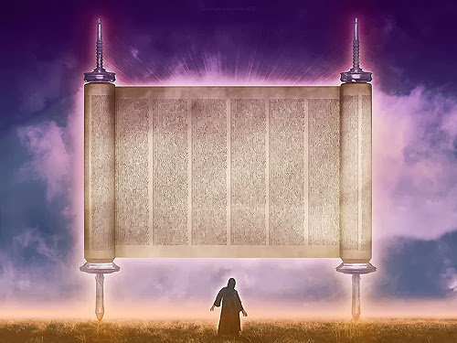
Roll of the Book
John saw a Little Book:
And I saw another mighty angel come down from heaven, clothed with a cloud: and a rainbow was upon his head, and his face was as it were the sun, and his feet as pillars of fire:
And he had in his hand a little book open: and he set his right foot upon the sea, and his left foot on the earth,
Ezekiel was commanded to eat a roll (a book), which was in his mouth ‘as honey for sweetness,’ but in the writing itself there was ‘lamentations, and mourning, and woe.’ (9)
some writings were recorded on paper, parchment, or other materials and rolled up like this scroll.
We are to understand that it was a mission, and an ordinance, for him to gather the tribes of Israel; behold, this is Elias, who, as it is written, must come and restore all things. D&C 77:14
Ezekiel 2:9-10

Slide 22
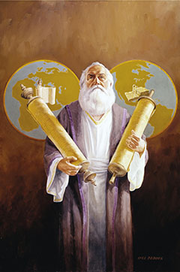
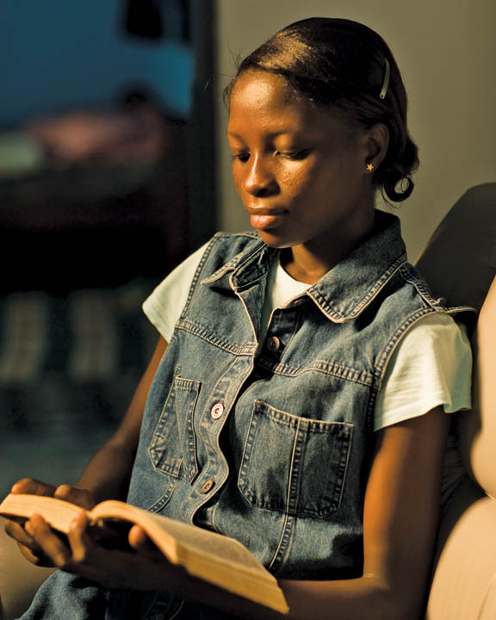
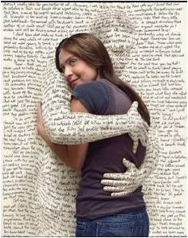
How Can We Make Jesus Part Of Our Lives?
Ezekiel internalizing the word of God and making it a part of his life
Ezekiel 2:9-10

Slide 23
Made a Face
Hebrew idiom = “face up to it”
The Lord promised Ezekiel power, courage, and firmness, since his mission was to a very rebellious and stubborn people.
The Lord gives His humble servants sufficient strength to withstand the world’s opposition as they seek to do His will.
Ezekiel 3:8; Jeremiah 1:17-19

Slide 24
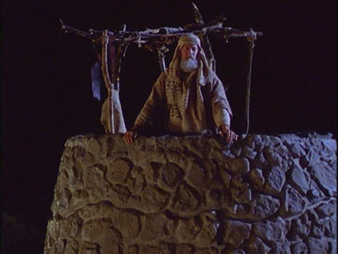
The Watchman
A watchman on a wall or tower had the responsibility to warn the people of impending danger from enemy attacks
Ezekiel’s prophecies did not fall on friendly ears. But, as a watchman, he had to raise the warning voice. (1)
Ezekiel 3:17

Slide 25
Doctrinal Mastery
And it came to pass at the end of seven days, that the word of the Lord came unto me, saying,
Son of man, I have made thee a watchman unto the house of Israel: therefore hear the word at my mouth, and give them warning from me.
Ezekiel 3:16-17

Slide 26
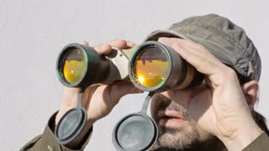
Raising a Warning
The analogy of the watchman referred to the military watchman who had to stay awake and who faced execution if he failed to warn the city when the enemy appeared.
Such a watchman was in jeopardy always: the enemy sought to destroy him to keep him from raising the warning and, if he did not raise the warning when it was needed, his life was in jeopardy at the hands of those he was responsible to warn. (1)
If we heed the warnings of prophets, we can be prepared to face challenges and dangers that threaten us
Ezekiel 3:17

Slide 27
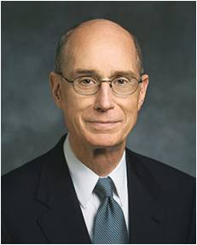
“Because the Lord is kind, He calls servants to warn people of danger. That call to warn is made harder and more important by the fact that the warnings of most worth are about dangers that people don’t yet think are real.”
(10)

Slide 28
Sources:
Suggested Hymn: #285 God Moves in a Mysterious Way
Videos:
Journey to Higher Ground (1:36)
Watchman on the Tower (4:17)
Old Testament Institute Manual Ezekiel: Watchman of Israel Chapter 26
Who’s Who in the Old Testament by Ed J. Pinegar and Richard J. Allen pp. 56-57
Bible Dictionary
Elder L. Tom Perry (“Journey to Higher Ground,” Ensign orLiahona, Nov. 2005, 16)
Joseph Smith (History of the Church, 6:50; 1:253).
History of the Church, 2:428.
Poway Institute Handout Becky Davies and Lesley Meacham
(C. F. Keil and F. Delitzsch, Commentary on the Old Testament, 9:1:23
Elder Bruce R. McConkie (Doctrinal New Testament Commentary,3:507
President Henry B. Eyring (“A Voice of Warning,” Ensign, Nov. 1998, 32).
Presentation by ©http://fashionsbylynda.com/blog/

Slide 29
Ezekiel 1-3 | Ezekiel 4-24 | Ezekiel 25-32 | Ezekiel 33-48
Ezekiel sees the Lord and His glory. He is called as a watchman to the house of Israel to warn, reprove, and call them to repentance. | The Lord instructs Ezekiel to use symbols to represent the wickedness of Israel and the destruction of Jerusalem. Ezekiel prophesies of the Lord’s judgments on Jerusalem and explains why famine, desolation, war, and pestilence will sweep the land of Israel. | The Lord commands Ezekiel to declare the wickedness of the nations surrounding Israel and prophesy of their destruction. | The Lord reproves the leaders of Israel for being poor shepherds over their people. The Lord will be a true shepherd to Israel. Ezekiel records his vision of Israel’s restoration after the exile and in the latter days. The Lord promises to gather the Israelites from captivity, return them to their promised lands, renew His covenant with them, and reunite the kingdoms of Israel and Judah.

Slide 30
The Four Beasts: Ezekiel 1:10
The Prophet Joseph explained that the four beasts in John’s vision were representative of classes of beings (see D&C 77:3). The faces of the creatures in Ezekiel’s vision seem to represent the same thing. The following interpretation, from an ancient Jewish commentary, is in harmony with that view: “Man is exalted among creatures; the eagle is exalted among birds; the ox is exalted among domestic animals; the lion is exalted among wild beasts; and all of them have received dominion, and greatness has been given them, yet they are stationed below the chariot of the Holy One” (Midrash Shemoth Rabbah 23; in D. Guthrie and J. A. Motyer, eds., The New Bible Commentary: Revised, p. 667).
The Roll: Ezekiel 2:6-10
Elder Bruce R. McConkie wrote that “John’s act of eating a book containing the word of God to him was in keeping with the custom and tradition of ancient Israel. The act signified that he was eating the bread of life, that he was partaking of the good word of God, that he was feasting upon the word of Christ—which was in his ‘mouth sweet as honey.’ But it made his ‘belly bitter’; that is, the judgments and plagues promised those to whom the Lord’s word was sent caused him to despair and have sorrow of soul. ‘How sweet are thy words unto my taste! yea, sweeter than honey to my mouth!’ (Psalm 119:103.) Such is the exulting cry of the Psalmist. And, conversely, how bitter is the penalty for rebellion and disobedience. Ezekiel had a similar experience. He was commanded to eat a roll (a book), which was in his mouth ‘as honey for sweetness,’ but in the writing itself there was ‘lamentations, and mourning, and woe.’ (Ezek. 2:6–10; 3:1–3.)” (Doctrinal New Testament Commentary,3:507.)
Visions Exekiel 1:5-14
“In his vision, Ezekiel saw four creatures, each of which had four faces. ‘They four had the face of a man, … a lion, … an ox … [and] the face of an eagle’ (Ezekiel 1:10). The Apostle John had a similar vision. In his vision, the creatures were described as being ‘like a lion, … like a calf, … [having] a face as a man, and … like a flying eagle’ (Revelation 4:7). The Prophet Joseph explained that the four beasts in John’s vision were representative of classes of beings (see D&C 77:3). The faces of the creatures in Ezekiel’s vision seem to represent the same thing. The following interpretation, from an ancient Jewish commentary, is in harmony with that view: ‘Man is exalted among creatures; the eagle is exalted among birds; the ox is exalted among domestic animals; the lion is exalted among wild beasts; and all of them have received dominion, and greatness has been given them, yet they are stationed below the chariot of the Holy One’ (Midrash Shemoth Rabbah 23; in D. Guthrie and J. A. Motyer, eds.,The New Bible Commentary: Revised, p. 667).
“Ezekiel saw that the throne of God was above the creatures (Ezekiel 1:26–28). That placement represents His having dominion over all living things, though He provides the means for all His creations, both human and animal, to enter into eternal glory, each in their appropriate order (see D&C 77:2–3)” (Old Testament Student Manual: 1 Kings–Malachi, 3rd ed. [Church Educational System manual, 2003], 266).
Watchmen Ezekiel 3:17:
“As watchmen on the tower of Zion, it is our obligation and right as leaders to speak out against current evils—evils that strike at the very foundation of all we hold dear as the true church of Christ. …
“As one of these watchmen, with a love for humanity, I accept humbly this obligation and challenge and gratefully strive to do my duty without fear. In times as serious as these, we must not permit fear of criticism to keep us from doing our duty, even at the risk of our counsel being tabbed as political, as government becomes more and more entwined in our daily lives.
“In the crisis through which we are now passing, we have been fully warned. This has brought forth some criticism. There are some of us who do not want to hear the message. It embarrasses us. The things which are threatening our lives, our welfare, our freedoms are the very things some of us have been condoning. Many do not want to be disturbed as they continue to enjoy their comfortable complacency.
“The Church is founded on eternal truth. We do not compromise principle. We do not surrender our standards regardless of current trends or pressures. Our allegiance to truth as a church is unwavering. Speaking out against immoral or unjust actions has been the burden of prophets and disciples of God from time immemorial. It was for this very reason that many of them were persecuted. Nevertheless, it was their God-given task, as watchmen on the tower, to warn the people.” President Ezra Taft Benson (In Conference Report, Apr. 1973, pp. 49–50; or Ensign, July 1973, p. 38.)
Wheels Ezekiel 1:15-21 The wheels that Ezekiel saw in his vision are an example of images that are open for interpretation. About such images, the Prophet Joseph Smith taught: “I make this broad declaration, that whenever God gives a vision of an image, or beast, or figure of any kind, He always holds Himself responsible to give a revelation or interpretation of the meaning thereof, otherwise we are not responsible or accountable for our belief in it. Don’t be afraid of being damned for not knowing the meaning of a vision or figure, if God has not given a revelation or interpretation of the subject” (in History of the Church, 5:343).
Words of the Prophets Ezekiel 2:7; 3:4
“It should be remembered that not every statement made by a Church leader, past or present, necessarily constitutes doctrine. It is commonly understood in the Church that a statement made by one leader on a single occasion often represents a personal, though well-considered, opinion, not meant to be official or binding for the whole Church. The Prophet Joseph Smith taught that ‘a prophet [is] a prophet only when he [is] acting as such’ Elder D. Todd Christofferson [in History of the Church, 5:265]” (“The Doctrine of Christ,” Ensign or Liahona, May 2012, 88).

Slide 31
Comparing God’s Countenance
Isaiah 6:1-5 | Revelation 1:10-16 | D&C 76:19-23 | D&C 110:1-4
1. In the year that king Uzziah died I saw also the Lord sitting upon a throne, high and lifted up, and his train filled the temple. 2 Above it stood the seraphims: each one had six wings; with twain he covered his face, and with twain he covered his feet, and with twain he did fly. 3 And one cried unto another, and said, Holy, holy, holy ,is the Lord of hosts: the whole earth is full of his glory. 4 And the posts of the door moved at the voice of him that cried, and the house was filled with smoke. 5 ¶Then said I, Woe is me! for I am undone; because I am a man of unclean lips, and I dwell in the midst of a people of unclean lips: for mine eyes have seen the King, the Lord of hosts. | 10 I was in the Spirit on the Lord’s day, and heard behind me a great voice, as of a trumpet, 11 Saying, I am Alpha and Omega, the first and the last: and, What thou seest, write in a book, and send it unto the seven churches which are in Asia; unto Ephesus, and unto Smyrna, and unto Pergamos, and unto Thyatira, and unto Sardis, and unto Philadelphia, and unto Laodicea. 12 And I turned to see the voice that spake with me. And being turned, I saw seven golden candlesticks; 13 And in the midst of the seven candlesticks one like unto the Son of man, clothed with a garment down to the foot, and girt about the paps with a golden girdle. 14 His head and his hairs were white like wool, as white as snow; and his eyes were as a flame of fire; 15 And his feet like unto fine brass, as if they burned in a furnace; and his voice as the sound of many waters. 16 And he had in his right hand seven stars: and out of his mouth went a sharp two edged sword: and his countenance was as the sun shineth in his strength. | 19 And while we meditated upon these things, the Lord touched the eyes of our understandings and they were opened, and the glory of the Lord shone round about. 20 And we beheld the glory of the Son, on the right hand of the Father, and received of his fulness; 21 And saw the holy angels, and them who are sanctified before his throne, worshiping God, and the Lamb, who worship him forever and ever. 22 And now, after the many testimonies which have been given of him, this is the testimony, last of all, which we give of him: That he lives! 23 For we saw him, even on the right hand of God; and we heard the voice bearing record that he is the Only Begotten of the Father— | 1. The veil was taken from our minds, and the eyes of our understanding were opened. 2 We saw the Lord standing upon the breastwork of the pulpit, before us; and under his feet was a paved work of pure gold, in color like amber. 3 His eyes were as a flame of fire; the hair of his head was white like the pure snow; his countenance shone above the brightness of the sun; and his voice was as the sound of the rushing of great waters, even the voice of Jehovah, saying: 4 I am the first and the last; I am he who liveth, I am he who was slain; I am your advocate with the Father.

Slide 32
Comparing John’s Vision to Ezekiel’s
Revelation 4:2 | Ezekiel 1:26-28
1. And immediately I was in the spirit: and, behold, a throne was set in heaven, and one sat on the throne. 3 And he that sat was to look upon like a jasper and a sardine stone: and there was a rainbow round about the throne, in sight like unto an emerald. 4 And round about the throne were four and twenty seats: and upon the seats I saw four and twenty elders sitting, clothed in white raiment; and they had on their heads crowns of gold. 5 And out of the throne proceeded lightnings and thunderings and voices: and there were seven lamps of fire burning before the throne, which are the seven Spirits of God. 6 And before the throne there was a sea of glass like unto crystal: and in the midst of the throne, and round about the throne, were four beasts full of eyes before and behind. 7 And the first beast was like a lion, and the second beast like a calf, and the third beast had a face as a man, and the fourth beast was like a flying eagle. 8 And the four beasts had each of them six wings about him; and they were full of eyes within: and they rest not day and night, saying, Holy, holy, holy, Lord God Almighty, which was, and is, and is to come. 9 And when those beasts give glory and honour and thanks to him that sat on the throne, who liveth for ever and ever, 10 The four and twenty elders fall down before him that sat on the throne, and worship him that liveth for ever and ever, and cast their crowns before the throne, saying, 11 Thou art worthy, O Lord, to receive glory and honour and power: for thou hast created all things, and for thy pleasure they are and were created. | 26 ¶And above the firmament that was over their heads was the likeness of a throne, as the appearance of a sapphire stone: and upon the likeness of the throne was the likeness as the appearance of a man above upon it. 27 And I saw as the colour of amber, as the appearance of fire round about within it, from the appearance of his loins even upward, and from the appearance of his loins even downward, I saw as it were the appearance of fire, and it had brightness round about. 28 As the appearance of the bow that is in the cloud in the day of rain, so was the appearance of the brightness round about. This was the appearance of the likeness of the glory of the Lord. And when I saw it, I fell upon my face, and I heard a voice of one that spake.

