Slide 1
Lesson 142 Part 2
Parables, Allegories, and Prophecies
Ezekiel 4-32
Presentation by ©http://fashionsbylynda.com/blog/

Slide 2
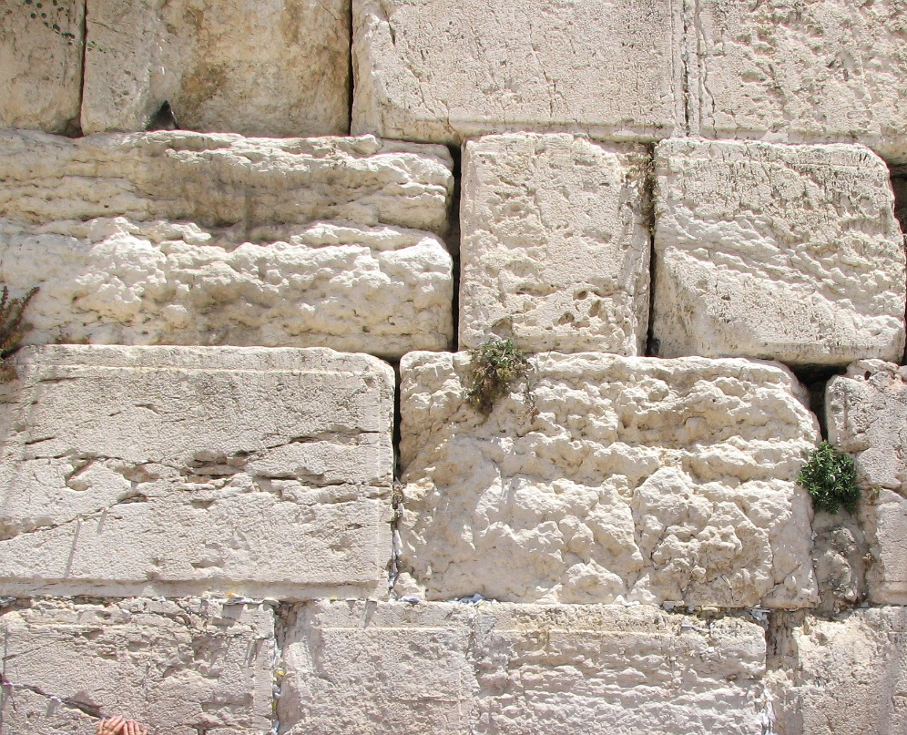
Ezekiel And the Clay tablet
To portray to the people the events that would befall the city.
The Lord wanted to make very clear to the people through many means the message He had for them.
Ezekiel was instructed to present other visual representations before the people to teach His messages more effectively.
The “iron pan” = the wall that the Chaldeans erected around Jerusalem during their siege. It prevented escape and allowed no entry of supplies.
Twice Nebuchadnezzar had gone to war against Judah and taken captives both times.
Both times, however, he retreated, thinking he had taught Judah a lesson. So Jerusalem was still intact until the third siege, which brought the destruction of Judah.
Ezekiel 4:1-3
(1)

Slide 3
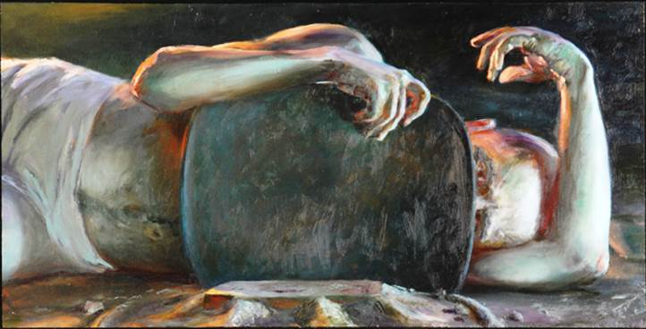
Lie On Your Side
For 430 Days
Ezekiel was to be fettered to the bed and bound down to show that the two kingdoms were bound down, or brought into bondage, because of their iniquity. But whether Ezekiel actually performed this act is not known.
It seems strange that the Lord would ask a prophet to lie immobile for fifteen months. Perhaps Ezekiel performed the act in some kind of symbolic way. (see notes*)
After forming the image of Jerusalem under siege, Ezekiel was told to lie on his side for 390 days and to bear the iniquity of Israel (in this case it appears the Northern Kingdom is meant).
Then he was to change sides and lie for another 40 days to bear the iniquity of Judah.
Without a revealed key for interpreting these numbers, one cannot definitely interpret this passage.
Ezekiel 4:4-8
(1)

Slide 4
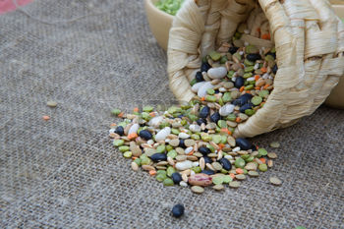
Eating Specific Foods
“In times of scarcity, it is customary in all countries to mix several kinds of coarser grain with the finer, to make it last the longer.
This mashlin, which the prophet is commanded to take, of wheat, barley, beans, lentiles, millet, and fitches, was intended to show how scarce the necessaries of life should be during the siege.
Each man’s allowance being scarcely a pint and a half, and ten ounces, a little more than half a pound of bread, for each day’s support.”
I will break the staff of bread” = the time would come when the inhabitants of Jerusalem would be without bread
Ezekiel 4:9-11, 16-17; 2 Kings 25;3
(2)

Slide 5
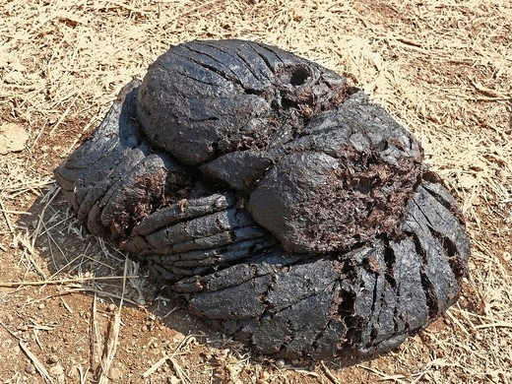
Cook With Dung
Dried ox and cow dung is a common fuel in the east
The prophet is to prepare his bread with dry human excrement. …
They were not allowed to leave the city to collect cow dung.
They were to use human ordure for fuel.
Eating Defiled Bread:
Because foreign lands were considered unclean, living and eating in other lands was considered unclean.
However, we find that the prophet was relieved from using this kind of fuel, for cows’ dung was substituted at his request.
Ezekiel 4:12-15; Hosea 9:3-4; Amos 7:17
(2)

Slide 6
Cutting and Dividing Ezekiel’s Hair
“To make the head bald, or to shave or pluck the beard, was a sign of mourning among the Hebrews and many other nations” (3)
Ezekiel represented the Jewish nation and particularly the city of Jerusalem. That which he was to do to his hair would also be done to Judah
The razor = the Babylonians who would cut Judah asunder with the sword and would be the means of bringing judgments upon them.
Ezekiel 5:1-4; 12; Isaiah 22:12; Job 1:20
(1)

Slide 7
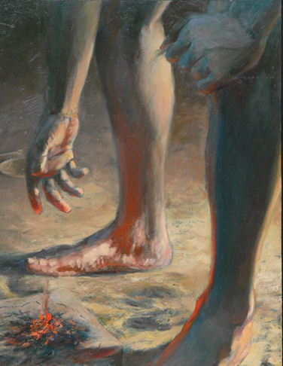
The Third
Ezekiel was to burn one-third of the hair in the city, so also would one-third of Judah’s inhabitants perish in Jerusalem during its siege.
The third of the hair Ezekiel cut with a knife represented the people who would be destroyed by the sword in the environs of Jerusalem.
The third that was scattered in the wind = those who would be taken captive and scattered far from their homeland.
Sword drawn after them who would be scattered = those hairs Ezekiel bound to his skirts and later cast into the fire.
However: Some of Judah would escape because of the Lord’s promise.
Ezekiel 5:1-4; 12
(1)

Slide 8
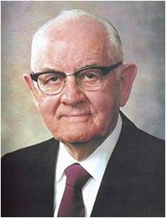
“Whorish Heart”
The idolatry practiced by Israel
Judah worshiped strange gods because they put their trust in the power of men and earthly governments instead of in Jehovah and righteousness as the solution to human happiness and welfare.
Modern idolatry is essentially the same as ancient idolatry, though the outward form has changed.
“There are unfortunately millions today who prostrate themselves before images of gold and silver and wood and stone and clay. But the idolatry we are most concerned with here is the conscious worshipping of still other gods. Some are of metal and plush and chrome, of wood and stone and fabrics.
They are not in the image of God or of man, but are developed to give man comfort and enjoyment, to satisfy his wants, ambitions, passions and desires. Some are in no physical form at all, but are intangible.” (4)
Ezekiel 6:9
(1)

Slide 9
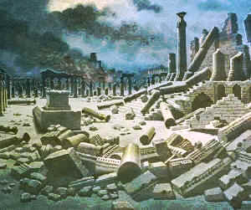
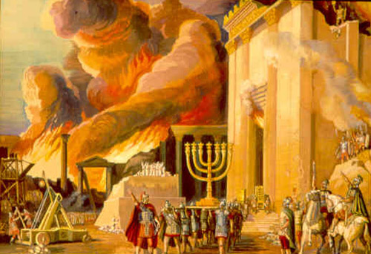
“Not the Sounding Again of the Mountains”
The impending destruction of Jerusalem.
“The hostile troops are advancing! Ye hear a sound, a tumultuous noise; do not suppose that this proceeds from festivals upon the mountains; from the joy of harvestmen, or the treaders of the wine-press.
[Great rejoicing was common at harvest time.]
It is the noise of those by whom ye and your country are to fall; … and not the reverberation of sound, or reflected sound, or reechoing from the mountains. ‘Now will I shortly pour out,’ Here they come!”
Ornament = The temple, the most beautiful ornament of Jerusalem. The temple will be despoiled and desecrated by conquerors because the people had despoiled and spiritually desecrated it with their idols.
Ezekiel 7:7-8, 20
(2)

Slide 10
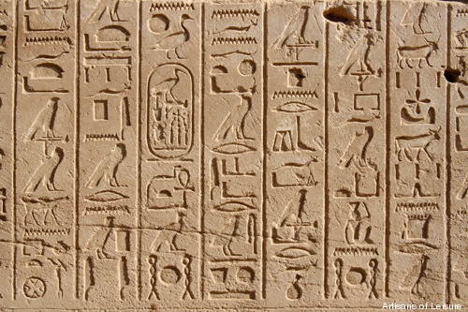
Ezekiel’s Vision of the Temple
Ox
Ape
Dog
Crocodile
Ibis
Scaraboeus (beetle)
“It is very likely that these images portrayed on the wall were the objects of Egyptian adoration:
It appears that these were privately worshipped by the Sanhedrin or great Jewish council, consisting of seventy or seventy-two persons, six chosen out of every tribe, as representatives of the people.
The images were portrayed upon the wall, as we find those ancient idols are on the walls of the tombs of the kings and nobles of Egypt.”
Ezekiel 8:7-12
(2)

Slide 11
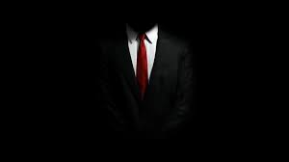
In The Dark
Worship took place in the dark.
This fact, in addition to the necessity Ezekiel was under to dig through the wall to see in, indicates that ancient Israelites knew of the Lord but sought to hide their abominable practices from Him.
They said, “The Lord seeth us not”.
Such is often the case among those who perform unrighteous acts.
It is foolish it is for anyone to assume that they can hide their acts from God’s all-seeing eye!
“There are no corners so dark, no deserts so uninhabited, no canyons so remote, no automobiles so hidden, no homes so tight and shut in but that the all-seeing One can penetrate and observe” (4)
Ezekiel 8:12
(1)

Slide 12
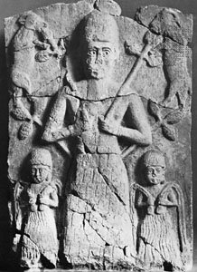
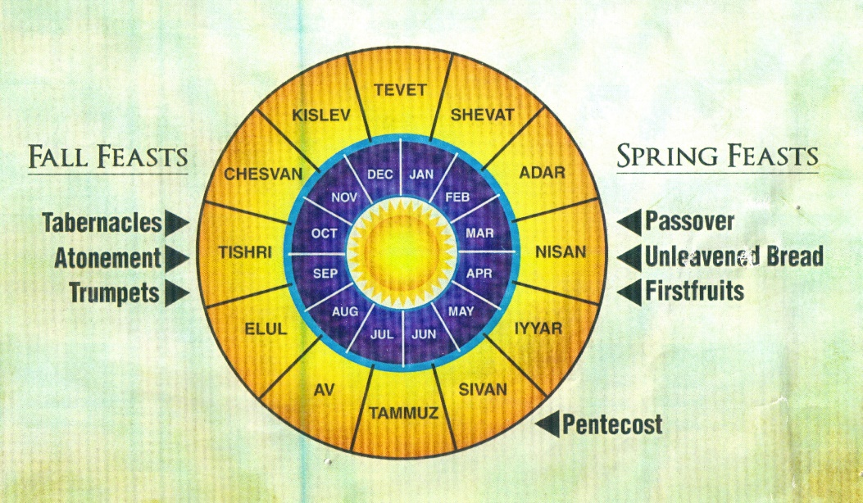
Tammuz
“A deity worshipped both in Babylonia and in Phoenicia—the same as the Greek Adonis.
He appears to have been a god of the spring, and the myth regarding him told of his early death and of the descent of Istar his bride into the underworld in search of him..”
The death of Tammuz symbolized the destruction of the spring vegetation by the heat of summer, and it was celebrated annually by seven days of women’s mourning in the 4th month (June–July), which was called Tammuz.
This superstition had been introduced into Jerusalem.”
Ezekiel 8:12
(6)

Slide 13
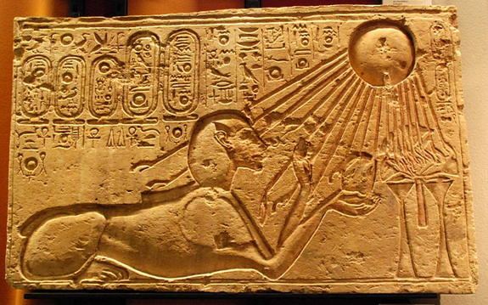
Worship of the Sun
With backs toward the temple
“Sun worship was practiced by the Canaanites, but lately had been reintroduced from Assyria.
Between the porch and the altar was the place where the priests offered prayer, with their faces, of course, towards the Temple.
In this spot, with their backs to the temple, the adoration of the sun took place, as complete a renunciation of Yahweh [Jehovah] as possible.”
For our fathers have trespassed, and done that which was evil in the eyes of the Lord our God, and have forsaken him, and have turned away their faces from the habitation of the Lord, and turned their backs.
2 Chronicles 29:6
Ezekiel 8:16; 2 Kings 23:5, 11; Jeremiah 8:2; Joel 2:17
(1)

Slide 14
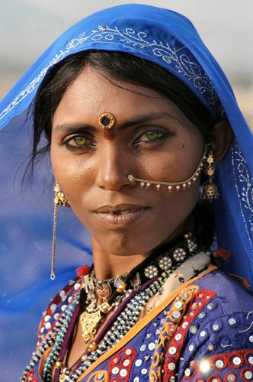
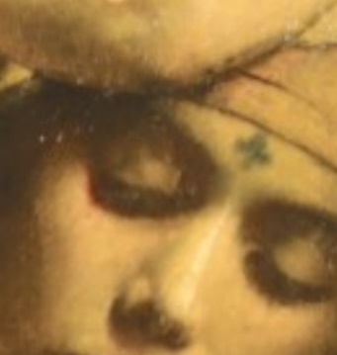
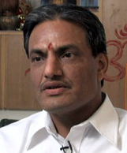
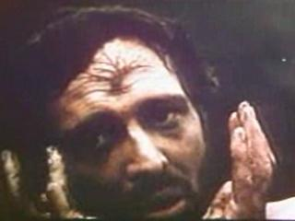
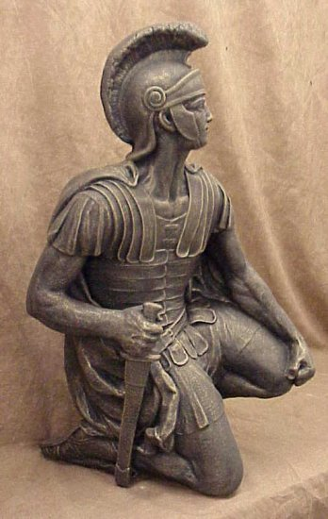
Mark On Their Forehead
Faithful ones for protection = showing that they belonged to God
Ancient Customs:
In Egypt a runaway slave was freed from his master if he went to the temple and gave himself up to the god, receiving certain marks upon his person to denote his consecration to the deity there worshiped.
Cain had a mark put on him for his protection, as an evidence of God’s promise to spare his life notwithstanding his wickedness.
To this day all Hindoos have some sort of mark upon their forehead signifying their consecration to their gods.
Several passages in the book of Revelation represent the saints as having a mark on their foreheads.
The followers of the ‘beast’ are also said to be marked in the forehead or in the hands.
The Romans marked their soldiers in the hand and their slaves in the forehead.
The woman in scarlet, whom John saw, had a name written on her forehead. [Revelation 17:5.]”
Hollywood depiction
Ezekiel 9:4; Genesis 4:15
(7)

Slide 15
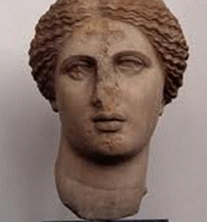
Slaying Those With No Mark
The mark represented the allegiance of the faithful to God. As those who belonged to God, they would be preserved.
And it was the more righteous part of the people who were saved, and it was they who received the prophets and stoned them not; and it was they who had not shed the blood of the saints, who were spared—3 Nephi 10:12
This passage shows that even in war, plagues, and starvation, the Lord can preserve whom He will and leave the rest to die.
In the great destructions in the Americas before Christ’s visit, though thousands were killed, the more righteous were spared.
Even though there will be martyrs and other exceptions, the Saints of this day have a promise that generally the righteous will be preserved in the tribulations to come.
It is not just association with God’s kingdom that preserves individuals; it is individual righteousness. In fact, the Lord has reserved His most severe judgments for those who profess His name but do not obey Him. Orson Pratt said: “Where shall these great and severe judgments begin? Upon what people does the Lord intend to commence this great work of vengeance? Upon the people who profess to know his name and still blaspheme it in the midst of his house. They are the ones designated for some of the most terrible judgments of the latter days.”
Ezekiel 9:5-8; 3 Nephi 10:12
(7)

Slide 16
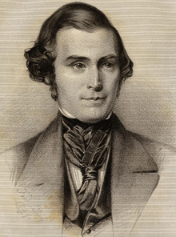
To Severe?
It is not just association with God’s kingdom that preserves individuals; it is individual righteousness.
In fact, the Lord has reserved His most severe judgments for those who profess His name but do not obey Him. (8)
Orson Pratt said: “Where shall these great and severe judgments begin?
Upon what people does the Lord intend to commence this great work of vengeance?
Upon the people who profess to know his name and still blaspheme it in the midst of his house.
They are the ones designated for some of the most terrible judgments of the latter days.” (12)
Ezekiel 9:5-8; D&C 112:24-26

Slide 17
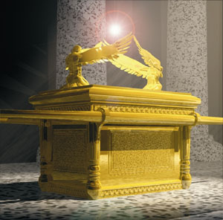
Cherubim
“Apparently a cherub is an angel of some particular order or rank to whom specific duties and work are assigned. That portion of the Lord’s word which is now available among men does not set forth clearly either the identity or work of these heavenly beings. …
“In English, the plural of cherub is cherubs; in Hebrew, the plural is cherubim, except that the King James Version of the Bible erroneously translates the plural as cherubims.
The Book of Mormon (Alma 12:21; 42:2–3), the Pearl of Great Price (Moses 4:31), and the [Joseph Smith Translation] of the Bible (Ex. 25:20–22), give the plural as cherubim.”
Ezekiel 10
(9)

Slide 18
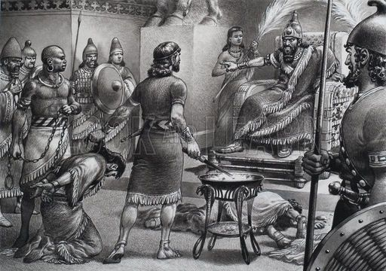
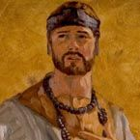
Zedekiah’s Blinding
Zedekiah did not believe Jeremiah or Ezekiel’s prophecy. But Ezekiel said that Zedekiah would not see Babylon…literally
Hoping to escape the last siege on Jerusalem Zedekiah and his troops fled down toward Jericho, but never reached it.
The armies of the Chaldeans overtook Zedekiah and his army was scattered.
He was taken to up to Riplah near Hamath where Nebuchadnezzar had his headquarters.
Zedekiah’s sons (princes) were among the prisoners and they were brought before the king and were killed before Zedekiah’s eyes then they blinded his eyes, put in chains, and hauled off to Babylon.
He died in Babylon, however one of his son’s, Mulek, was not with his brothers, who was one of the bands which escaped from Jerusalem then to the western hemisphere.
Ezekiel 12:1-4; Jeremiah 39:7; 52:9; Omni 15-18; Helaman 8:21
(9)

Slide 19
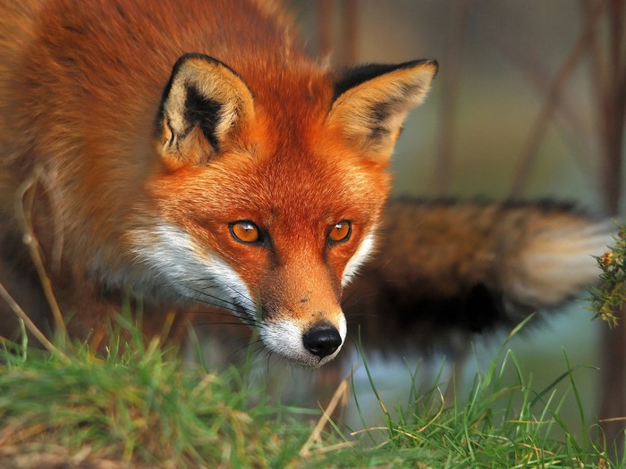
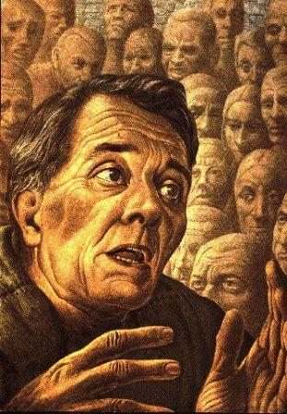
Cunning Foxes In the Desert
False prophets pacify and lull people into carnal security, they obtain their prey by subtlety.
False prophets have not provided for the people a secure defense against spiritual destruction.
Ezekiel compared the work of the false prophets to daubing a wall “with untempered morter”.
And others will he pacify, and lull them away into carnal security, that they will say: All is well in Zion; yea, Zion prospereth, all is well—and thus the devil cheateth their souls, and leadeth them away carefully down to hell.
2 Nephi 28:21
Ezekiel 13:4-5, 10
(1)

Slide 20
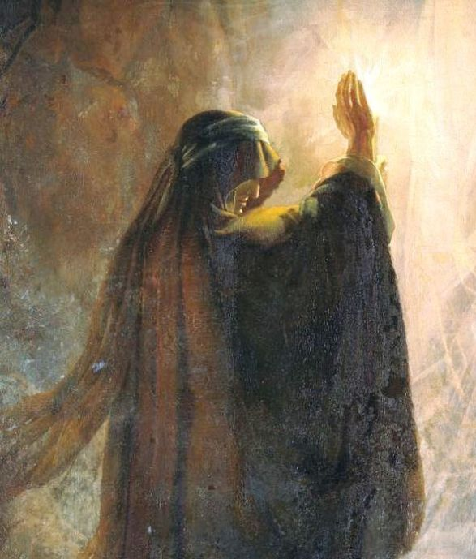
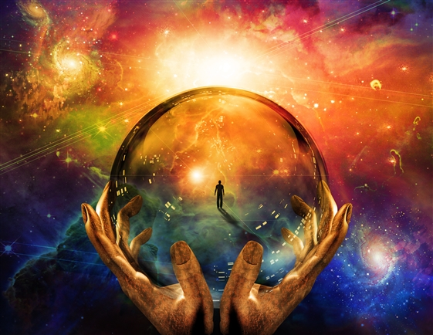
Denunciation of Sorcerers
Pillows = would better be translated bands or coverings. The kerchief was a kind of veil used as part of the trappings in the magical arts (10)
Ezekiel prophesied against women who, by divination led people away from God and gave them a false sense of security.
They brought destruction upon those who might otherwise live (spiritually) and held up and sustained those who ought to have been condemned. They promised prosperity and freedom which they could not deliver.
And behold, others he flattereth away, and telleth them there is no hell; and he saith unto them: I am no devil, for there is none—and thus he whispereth in their ears, until he grasps them with his awful chains, from whence there is no deliverance. 2 Nephi 28:22
Ezekiel 13:13-23
(1)

Slide 21
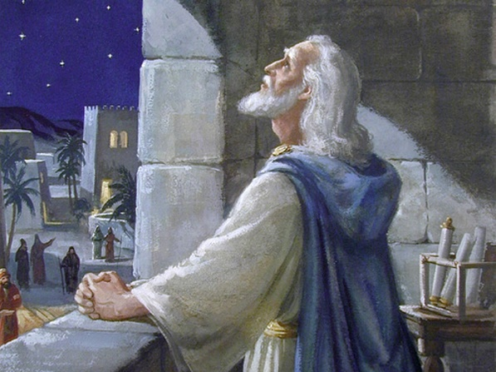
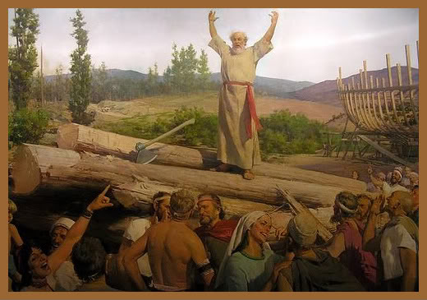
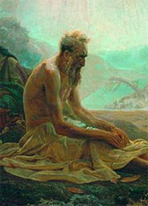
Even the Most Righteous Could Not Save
And if the prophet be deceived when he hath spoken a thing, I the Lord have deceived that prophet, and I will stretch out my hand upon him, and will destroy him from the midst of my people Israel.
“And if the prophet be deceived when he hath spoken a thing, I the Lord have not deceived that prophet.” JST 14:9
Daniel
Noah
The Lord told them He would not counsel them until they stopped seeking answers from idols as well. He emphasized that each individual must be righteous in order to endure the coming judgments and that they could not rely on their leaders’ righteousness
Job
All people stand or fall in accordance with their own actions and cannot rely on the righteousness of others
See Luke 16:19-31*
Ezekiel 14:14
(1)

Slide 22
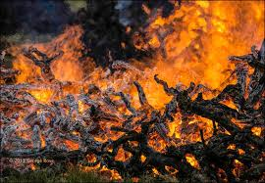
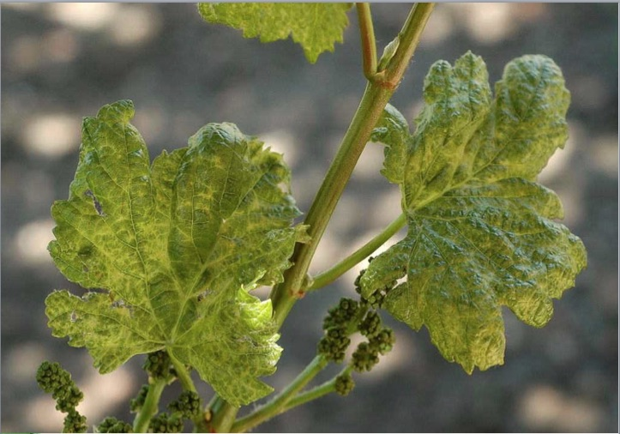
Good For Nothing Vines
Vines, or vineyard = Children of Israel
Compare Isaiah 5:1-25
Though they had been set up as the Lord’s vineyard to produce fruit, they did not produce and were of little value.
“The worthlessness of a vine save only for its fruit was set forth by the Lord through His prophet; and truly it is so, that the wood of the grape plant is fit for nothing but burning; the whole vine as wood is inferior to a branch from a forest tree.
And Israel is represented as such a vine, precious if but fruitful, otherwise nothing but fuel and that of poor quality.”
Ezekiel 15
(11)

Slide 23
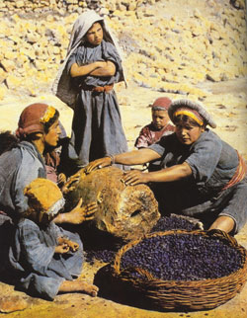
Relationships—Judah’s Iniquities
“Thy navel [umbilical cord] was not cut” = they were still being nourished in their wickedness by the degrading practices of their heathen neighbors who had given them birth in iniquity.
Neither were they “washed … salted … nor swaddled” = They had not been cleansed from the corruptions they had obtained from their parents.
Mother and father = the Hittites and Amorites who were leaders in Canaanite idolatry.
Daughter = Jerusalem, a representative of Judah or Israel.
Husband = Lord. (The antecedents of both that and her are “daughter,” not “mother.”)
Children = were offered in sacrifice to Molech as part of heathen worship.
Sisters = Samaria and Sodom. They and Jerusalem were all motivated by the same spirit of idolatry.
Worse than a Harlot:
A harlot takes presents from her lovers, and that is her motivation; in Judah’s case, not only did she not receive such presents from her lovers (the false gods gave no benefits to Israel) but instead she gave the presents to her lovers.
Ezekiel 16
(1)

Slide 24
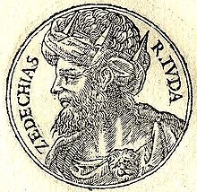
Do Not Seek Deliverance From Egypt
High Ceders = Jews
Highest Branch = Zedekiah
Tender one = one of his sons, Mulek = whom the Lord brought out and planted him and his company upon the choice land of America, which He had given unto a remnant of the tribe of Joseph for an inheritance, in fulfillment of the blessing of Jacob and Moses upon the head of that tribe. (12)
Ezekiel 17
(1)

Slide 25
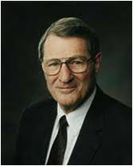
Men Will Be Punished For Their Own Sins
“All are free to choose, of course, and we would not have it otherwise. Unfortunately, however, when some choose slackness, they are choosing not only for themselves, but for the next generation and the next.
Small equivocations in parents can produce large deviations in their children! Earlier generations in a family may have reflected dedication, while some in the current generation evidence equivocation. Sadly, in the next, some may choose dissension, as erosion takes its toll”
God will hold us accountable for our own choices
Ezekiel 18
(13)

Slide 26
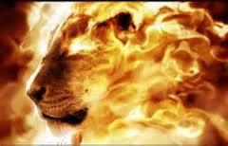
The Lost Blessings
Because of their foolishness.
The Allegory:
“The lioness, if not the doomed country [Judah], is Hamutal, the mother of Zedekiah.
The first of her whelps would then be Jehoahaz, who after reigning for a short time was taken prisoner to Egypt by Pharaoh-nechoh.
Jehoahaz was in turn succeeded by Jehoiakim, a son of Josiah by a wife other than Hamutal. Jehoiakim was succeeded by his son Jehoiachin.
When the last-named was taken captive by the Babylonians, Hamutal’s second son, Zedekiah, was appointed king in his stead. He must, therefore, be the other ‘whelp’ of the allegory. When taken captive by Nebuchadrezzar and carried to Babylon, Zedekiah fulfilled the requirements of the last two verses.”
Ezekiel 19:1-9; 2 Kings 24:18; 2 Kings 23:31-33
(14)

Slide 27
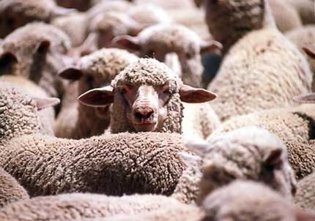
Remember the Covenant
Some leaders of the Jews in Babylon (where Ezekiel lived in captivity) wanted to receive instruction from the Lord through Ezekiel.
The Lord called them to repentance for seeking the Lord while also seeking revelation from others gods.
Passing under the rod = “alludes to the custom of tithing the sheep . … The sheep were all penned; and … only one sheep could come out at once. … [The shepherd] counted … and as the tenth came out, he marked it with the rod [dipped in vermilion], and said, ‘This is … set apart for the Lord.’”
Thus, the converted Israelites will be the Lord’s, just as tithing is.
Ezekiel 20
(1, 2)

Slide 28
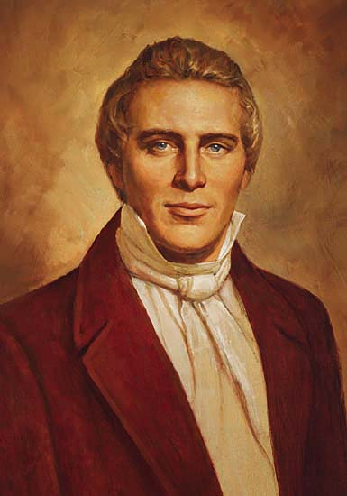
Righteous Sometimes Suffer With the Wicked
When righteous people live among the wicked, they sometimes experience tribulations resulting from the unrighteousness of their neighbors. Sometimes the “innocent are compelled to suffer for the iniquities of the guilty”
Ezekiel 21
(15)

Slide 29
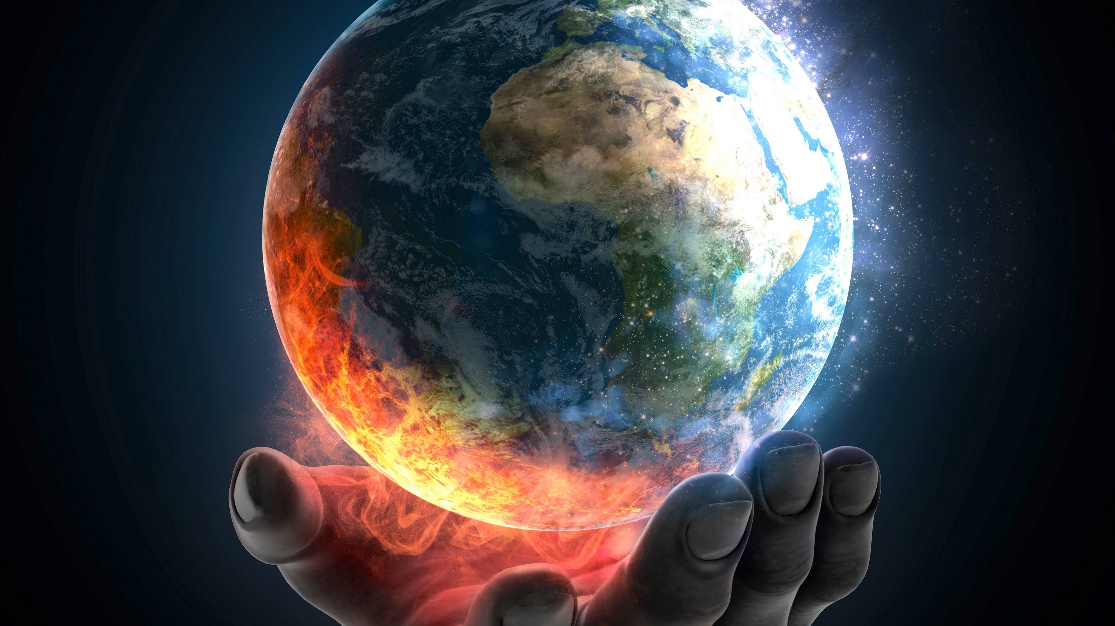
Judgments of the Last Days
“It is a false idea that the Saints will escape all the judgments, whilst the wicked suffer; for all flesh is subject to suffer, and ‘the righteous shall hardly escape;’ still many of the Saints will escape, for the just shall live by faith; yet many of the righteous shall fall a prey to disease, to pestilence, etc., by reason of the weakness of the flesh, and yet be saved in the Kingdom of God.
So that it is an unhallowed principle to say that such and such have transgressed because they have been preyed upon by disease or death, for all flesh is subject to death; and the Savior has said, ‘Judge not, lest ye be judged.’”
Ezekiel 21
(15)

Slide 30
Sources:
Suggested Hymn: #239 Choose the Right
Video:
Sharing Your Light (2:56)
Old Testament Institute Manual Ezekiel: Watchman of Israel Chapter 26
Clarke, Commentary, 4:434-435; 439-440; 443, 477 (found in OT Institute Manual)
James M. Freeman, Manners and Customs of the Bible, p. 256 (found in OT Institute Manual)
President Spencer W. Kimball The Miracle of Forgiveness (1969), 40
“Message of Inspiration,” Church News, 30 May 1970, p. 2
J. R. Dummelow A Commentary on the Holy Bible, pp. 497–98. (found in OT Institute Manual)
Guthrie and Motyer, New Bible Commentary, p. 670; see also 2 Chronicles 29:6
Freeman, Manners and Customs of the Bible, pp. 301–2
N. B. Lundwall, comp., Inspired Prophetic Warnings to All Inhabitants of the Earth, p. 139.
Bruce R. McConkie (Mormon Doctrine, pp. 124–25.)
10. The Interpreter’s Bible, 6:132–33.
11. James E. Talmage, Jesus the Christ, p. 542.
12. Orson Pratt’s Works on the Doctrines of the Gospel, pp. 280–81.
13. Elder Neal A. Maxwell “Settle This in Your Hearts,” Ensign, Nov. 1992, 65–66.
14. Sperry, Voice of Israel’s Prophets, p. 211.
15. Joseph Smith Teachings p. 34
(History of the Church, 4:11.)
Presentation by ©http://fashionsbylynda.com/blog/

Slide 31
Ezekiel 1-3 | Ezekiel 4-24 | Ezekiel 25-32 | Ezekiel 33-48
Ezekiel sees the Lord and His glory. He is called as a watchman to the house of Israel to warn, reprove, and call them to repentance. | The Lord instructs Ezekiel to use symbols to represent the wickedness of Israel and the destruction of Jerusalem. Ezekiel prophesies of the Lord’s judgments on Jerusalem and explains why famine, desolation, war, and pestilence will sweep the land of Israel. | The Lord commands Ezekiel to declare the wickedness of the nations surrounding Israel and prophesy of their destruction. | The Lord reproves the leaders of Israel for being poor shepherds over their people. The Lord will be a true shepherd to Israel. Ezekiel records his vision of Israel’s restoration after the exile and in the latter days. The Lord promises to gather the Israelites from captivity, return them to their promised lands, renew His covenant with them, and reunite the kingdoms of Israel and Judah.

Slide 32
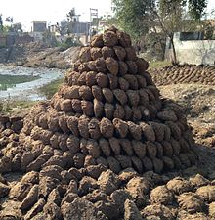
Sour Grapes and Children’s Teeth on Edge: Ezekiel 18:2
While we are all free to exercise our agency and choose for ourselves, the role of parents in raising their children in righteousness is extremely important in helping children learn how to exercise their agency righteously. Elder Neal A. Maxwell of the Quorum of the Twelve Apostles taught about the importance of parents raising their children in righteousness:
“All are free to choose, of course, and we would not have it otherwise. Unfortunately, however, when some choose slackness, they are choosing not only for themselves, but for the next generation and the next. Small equivocations in parents can produce large deviations in their children! Earlier generations in a family may have reflected dedication, while some in the current generation evidence equivocation. Sadly, in the next, some may choose dissension, as erosion takes its toll” (“Settle This in Your Hearts,” Ensign, Nov. 1992, 65–66).
Dung cakes, made from the by-products of animal husbandry, are traditionally used as fuel in India for making food in a domestic hearth called a Chulha. They are made by hand by village women and are traditionally made from cow or buffalo dung. One dung cake of an average size gives 2100 kJ worth of energy. Dung cakes are also known as uple, kande, gosse or thepdi.
These are the cakes of cow dung molded by bare hands with a curvature to be able to keep stuck to the walls. Once dried they are put in a pile and covered with thatch called bitauda. These bitaudas are visible all over India albeit with different names. The sizes and shapes of the cakes might vary by region. Its also not uncommon to see these cakes directly used in earthen ovens.
This bio-fuel has been used for a long time primarily of two reasons 1. for easy disposal of cow dung 2. easily available and cheap fuel. After burning the residue ash is used to wash hands since it becomes germs free as bi-product of burning and sprinkled also on crops to get rid of certain pests. Wikipedia
*Lie on His Side Ezekiel 4:8
Why the numbers 390 and 40 were used is not clear. Though Ezekiel was told that each day represented a year (v. 6), the years do not fit any known history.
Keil and Delitzsch, using the total of 430 days or years (390+40), suggested that this is the number of years Israel was in bondage in Egypt (see Exodus 12:40–41). They explain the split of 390 days and 40 days as referring to the forty years after Moses killed the Egyptian and fled into the wilderness of Midian (see Exodus 2:11–15; Acts 7:23, 30). This time, just before Moses returned to deliver them, was probably the most intense period of suffering for Israel. (see Commentary,9:1:74–76.) Others, however, believe that the 430 years included the time from Abraham to the Exodus. (see Old Testament Student Manual: Genesis–2 Samuel, pp. 119–20.)
Without a revealed key for interpreting these numbers, one cannot definitely interpret this passage.
A pile of dung cakes in the village Nihal Singh Wala of District Moga in Punjab
Ezekiel 13:5 Gaps: Breaks in the Wall:
“Kitto is of the opinion that reference is here made to ‘cob-walls;’ that is, walls which are made of beaten earth rammed into molds or boxes, to give shape and consistence, and then emptied from the molds, layer by layer, on the wall, where it dries as the work goes on. Such walls cannot stand the effects of the weather, and houses built on this principle soon crumble and decay. … To protect them from the weather a very fine mortar is sometimes made, which is laid thickly on the outside of the walls. When this mortar is properly mixed with lime, it answers the purpose designed; but where the lime is left out, as is often the case, the ‘untempered mortar’ is no protection. …
“Some commentators, however, translate taphel, which in our version is rendered ‘untempered mortar,’ by the word ‘whitewash.’ They represent the idea of the text to be the figure of a wall of unendurable material, and coated, not with cement which might protect it, but with a mere thin covering of lime, which gives the wall a finished durable appearance, which its real character does not warrant.” Freeman (Manners and Customs of the Bible, p. 302.)
Scarcity of Food: Ezekiel 4:9-17: “… The whole of the above grain, being ground, was to be formed into one mass, out of which he was to make three hundred and ninety loaves; one loaf for each day; and this loaf was to be of twenty shekels in weight. Now a shekel, being in weight about half an ounce, this would be ten ounces of bread for each day; and with this water to the amount of one sixth part of a hin, which is about a pint and a half of our measure. All this shows that so reduced should provisions be during the siege, that they should be obliged to eat the meanest sort of aliment, and that by weight, and their water by measure; each man’s allowance being scarcely a pint and a half, and ten ounces, a little more than half a pound of bread, for each day’s support.” (Clarke, Commentary, 4:434.)

Slide 33
Salted and Swaddled Ezekiel 16:4:
The reference to not being salted comes from an ancient practice wherein “new-born babes were rubbed with salt in order to harden their skin, as this operation was supposed to make it dry, tight, and firm. … The salt may also have been applied as an emblem of purity and incorruption.” (Freeman, Manners and Customs of the Bible, p. 304.) Swaddling means being wrapped in a cloth or bandage, which would have been somewhat of a protection to a tender infant. The message being conveyed by Ezekiel is that the Jews had never really been cleansed from the corruptions of the world and born as God’s children. Without God’s care they had no one as their protector.
Sour Grapes Ezekiel 19:
While we are all free to exercise our agency and choose for ourselves, the role of parents in raising their children in righteousness is extremely important in helping children learn how to exercise their agency righteously.
Elder Neal A. Maxwell of the Quorum of the Twelve Apostles taught about the importance of parents raising their children in righteousness:
“All are free to choose, of course, and we would not have it otherwise. Unfortunately, however, when some choose slackness, they are choosing not only for themselves, but for the next generation and the next. Small equivocations in parents can produce large deviations in their children! Earlier generations in a family may have reflected dedication, while some in the current generation evidence equivocation. Sadly, in the next, some may choose dissension, as erosion takes its toll” (“Settle This in Your Hearts,” Ensign, Nov. 1992, 65–66).
Elder and Younger Ezekiel 16:46.
The words elder and younger could more clearly be rendered greater and lesser. Perhaps they are a reference to the degree of iniquity, that is, Samaria’s was greater, Sodom’s lesser. Left hand equals the direction north; right hand means south. The word daughters is used here and throughout the rest of the chapter with a different meaning than the word daughter in verse 45; daughters are cities under the domination of Samaria and Sodom, lesser cities in the surrounding areas. (See Keil and Delitzsch, Commentary,9:1:221–23; Interpreter’s Bible, 6:148–49.)
Ezekiel 20:45-48 “The forest of the field in the south is a figure denoting the kingdom of Judah [the southern part of the land of Israel]. … The forest is a figure signifying the population, or the mass of people. Individual men are trees. The green tree is a figurative representation of the righteous man, and the dry tree of the ungodly (v. 3, compare Luke xxiii. 31). The fire which Jehovah kindles is the fire of war. … From the terrible fierceness of the fire, which cannot be extinguished, every one will know that God has kindled it, that it has been sent in judgment.” (Keil and Delitzsch, Commentary, 9:1:288–89.) The Lord further described in the next chapter the terribleness of the wrath of war that would come upon Judah (see Ezekiel 21:1–17).
Agency to choose right from wrong Ezekiel 19
“Heavenly Father has given you agency, the ability to choose right from wrong and to act for yourself. Next to the bestowal of life itself, the right to direct your life is one of God’s greatest gifts to you. While here on earth, you are being proven to see if you will use your agency to show your love for God by keeping His commandments. …
“You are responsible for the choices you make. God is mindful of you and will help you make good choices, even if your family and friends use their agency in ways that are not right. Have the moral courage to stand firm in obeying God’s will, even if you have to stand alone. As you do this, you set an example for others to follow” ([booklet, 2011], 2).

Slide 34
Ezekiel 17 Commentary in the Riddle
Ezekiel 17:3 | A Great Eagle | Nebuchadnezzar (Jeremiah 48:40 Jeremiah 49:22
 | Great Wings | Extensive empire
 | Long-winged | Swift in his conquests
 | Full of feathers | Having multitudes of subjects
 | Divers colors | People from various nations
 | Came to Lebanon | Came against Judea
 | The highest branch | Zedekiah or King Jehoiachin
 | Cedar | The Jewish state and king
Ezekiel 17:4 | The top of his young twigs | Princes of Judah
 | A land of traffic | Chaldea
 | A city of merchants | Babylon; for which this city was the most celebrated of all the cities of the east. Its situation procured it innumerable advantages; its two rivers, the Tigris and Euphrates, and the Persian Gulf, gave it communication with the richest and the most distant nations.
Ezekiel 17:5 | The seed of the land | Zedekiah, brother of Jehoiachin
 | Planted it in a fruitful field | Made him king of Judea in place of his brother
 | Placed it by great waters | Put him under the protection of Babylon, situated on the confluence of the Tigris and Euphrates.
 | Set it as a willow tree | Made him dependent on this city of great waters, as the willow is on humidity.
Clarke, Adam. "Commentary on Ezekiel 17". "The Adam Clarke Commentary". www.studylight.org/commentaries/acc/ezekiel-17.html. 1832.
1

Slide 35
Ezekiel 17:6 | A spreading vine of low stature | The Jewish state having then no height of dominion, it must abide under the wings or branches of the Chaldean king.
 | Those branches turned toward him, and the roots - under him | Zedekiah was wholly dependent on Nebuchadnezzar, both for his elevation to the throne, and his support on it.
Ezekiel 17:7 | Another great eagle | Pharaoh-hophra, or Apries, king of Egypt.
 | Did bend her roots | Looked to him for support in her intended rebellion against Nebuchadnezzar
Ezekiel 17:8 | Planted in a good soil | Though he depended on Babylon, he lived and reigned as Nebuchadnezzar's vicegerent in the land of Judea.
Ezekiel 17:9 | Shall it prosper? | Shall Zedekiah succeed in casting off the yoke of the king of Babylon
 | Shall he not pull up the roots? | Nebuchadnezzar will come and dethrone him.
 | Cut off the fruit and leaves | The children of Zedekiah. His sons will be murdered before him and Zedekiah himself
Ezekiel 17:10 | Shall - utterly whither | The regal government shall be no more restored. Zedekiah shall be the last king, and the monarchy shall finally terminate with him.
Ezekiel 17:15 | Sending his ambassadors into Egypt | Zedekiah must have sent his ambassadors into Egypt, between the sixth month of his sixth year, and the fifth month of his seventh year. (Ezekiel 8:1)
Ezekiel 17:16 | In the midst of Babylon he shall die | His eyes were put out; he was carried to Babylon, and never returned.
Clarke, Adam. "Commentary on Ezekiel 17". "The Adam Clarke Commentary". www.studylight.org/commentaries/acc/ezekiel-17.html. 1832.
2

Slide 36
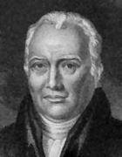
Ezekiel 17:18 | Despised the oath | The Lord had bound himself by oath, in the presence of Jehovah, to be faithful to the covenant that he made with Nebuchadnezzar, and he took the first opportunity to break it; therefore he shall not escape.
Ezekiel 17:20 | Spread my net upon him | To be caught (Ezekiel 12:3)
Ezekiel 17:21 | All his fugitives | All who attempted to escape with him, and all that ran to Egypt, etc., shall fall by the sword.
Ezekiel 17:22 | I will also take of the highest branch of the high cedar | I will raise up another monarchy, which shall come in the line of David, namely, the Messiah; who shall appear as a tender plant, as to his incarnation; but he shall be high and eminent; his Church, the royal city, the highest and purest ever seen on the face of the earth.
Ezekiel 17:23 | In the mountain of the height of Israel | He shall make his appearance at the temple, and found his Church at Jerusalem.
Ezekiel 17:24 | All the trees of the field shall know | All the people of Israel and of Chaldea.
 | I the Lord have brought down the high tree | Have dethroned Jehoiachin.
 | Have exalted the low tree | Put Zedekiah, brother of Jehoiachin, in his place.
 | Have dried up the green tree | Zedekiah, who had numerous children, but who were all slain before his eyes at Riblah.
 | And have made the dry tree to flourish | Have raised up a rod out of the stem of Jesse, the family of David being then apparently dried up and extinct. This was the promised Messiah, of the increase and government of whose kingdom and peace there shall be no end; upon the throne of David, and upon his kingdom, to order and establish it with judgment and with justice, from henceforth, even for ever. The high and green tree, says Bishop William Newcome, refers to Nebuchadnezzar; the low and the dry tree, to the Jews. Bible Studies of Bishop William Newcome (1729-1800)
Clarke, Adam. "Commentary on Ezekiel 17". "The Adam Clarke Commentary". www.studylight.org/commentaries/acc/ezekiel-17.html. 1832.
Adam Clarke 1762-1832

Slide 37
Tammuz Ezekiel 8:14 :
God of fertility with embodying the powers for new life in nature in the spring. The name Tammuz seems to have been derived from the Akkadian form Tammuzi, based on early Sumerian Damu-zid, The Flawless Young, which in later standard Sumerian became Dumu-zid, or Dumuzi. The earliest known mention of Tammuz is in texts dating to the early part of the Early Dynastic III period (c. 2600–c. 2334 bce), but his cult probably was much older. Although the cult is attested for most of the major cities of Sumer in the 3rd and 2nd millennia bce, it centred in the cities around the central steppe area (the edin)—for example, at Bad-tibira (modern Madīnah), where Tammuz was the city god.
As shown by his most common epithet, Sipad (Shepherd), Tammuz was essentially a pastoral deity. His father, Enki, is rarely mentioned, and his mother, the goddess Duttur, was a personification of the ewe. His own name, Dumu-zid, and two variant designations for him, Ama-ga (Mother Milk) and U-lu-lu (Multiplier of Pasture), suggest that he actually was the power for everything that a shepherd might wish for: grass to come up in the desert, healthy lambs to be born, and milk to be plentiful in the mother animals.
When the cult of Tammuz spread to Assyria in the 2nd and 1st millennia bce, the character of the god seems to have changed from that of a pastoral to that of an agricultural deity. The texts suggest that in Assyria (and later among the Sabaeans), Tammuz was basically viewed as the power in the grain, dying when the grain was milled.
The cult of Tammuz centred around two yearly festivals—one celebrating his marriage to the goddess Inanna, the other lamenting his death at the hands of demons from the netherworld. During the 3rd Dynasty of Ur (c. 2112–c. 2004 bce) in the city of Umma (modern Tell Jokha), the marriage of the god was dramatically celebrated in February–March, Umma’s Month of the Festival of Tammuz. During the Isin-Larsa period (c. 2004–c. 1792 bce), the texts relate that in the marriage rite the king actually took on the identity of the god and thus, by consummating the marriage with a priestess incarnating the goddess, magically fertilized and fecundated all of nature for the year.
The celebrations in March–April that marked the death of the god also seem to have been dramatically performed. Many of the laments for the occasion have as a setting a procession out into the desert to the fold of the slain god. In Assyria, however, in the 7th century bce, the ritual took place in June–July. In the major cities of the realm, a couch was set up for the god upon which he lay in state. His body appears to have been symbolized by an assemblage of vegetable matter, honey, and a variety of other foods.
Among the texts dealing with the god is “Dumuzi’s Dream,” a myth telling how Tammuz had a dream presaging his death and how the dream came true in spite of all his efforts to escape. A closely similar tale forms the second half of the Sumerian myth “The Descent of Inanna,” in which Inanna (Akkadian: Ishtar) sends Tammuz as her substitute to the netherworld. His sister, Geshtinanna, eventually finds him, and the myth ends with Inanna decreeing that Tammuz and his sister may alternate in the netherworld, each spending half of the year among the living.
Tammuz’s courtship and wedding were a popular theme for love songs and anecdotal verse compositions that seem to have been used primarily for entertainment. A number of true cult texts, however, follow the rite step by step as if told by a close observer, and many laments were probably performed in the actual rites.
Eventually a variety of originally independent fertility gods seem to have become identified with Tammuz. Tammuz of the cattle herders, whose main distinction from Tammuz the Shepherd was that his mother was the goddess Ninsun, Lady Wild Cow, and that he himself was imagined as a cattle herder, may have been an original aspect of the god. The agricultural form of Tammuz in the north, where he was identified with the grain, may also have been an originally independent development of the god from his role as the power in the vegetation of spring. A clear fusion, though very early, was the merger of Tammuz in Uruk with Amaushumgalana, the One Great Source of the Date Clusters—i.e., the power of fertility in the date palm (see Dumuzi-Amaushumgalana).
A later important fusion was the merger of Tammuz and Damu, a fertility god who probably represented the power in the sap of rising in trees and plants in spring. The relation of still other figures to Tammuz, such as Dumuzi-Apzu—a goddess who appears to have been the power in the waters underground (the Apzu) to bring new life to vegetation—is not entirely clear.
Written by: The Editors of Encyclopædia Britannica
http://www.britannica.com/topic/Tammuz-Mesopotamian-god

Slide 38
Ezekiel 9:4 And the Lord said unto him, Go through the midst of the city, through the midst of Jerusalem, and set a mark upon the foreheads of the men that sigh and that cry for all the abominations that be done in the midst thereof.
Revelation | Mark on the forehead or hands
7:3 | Saying, Hurt not the earth, neither the sea, nor the trees, till we have sealed the servants of our God in their foreheads.
9:4 | And it was commanded them that they should not hurt the grass of the earth, neither any green thing, neither any tree; but only those men which have not the seal of God in their foreheads.
14:1 | And I looked, and, lo, a Lamb stood on the mount Sion, and with him an hundred forty and four thousand, having his Father’s name written in their foreheads
22:4 | And they shall see his face; and his name shall be in their foreheads.
13:16-17 | And he causeth all, both small and great, rich and poor, free and bond, to receive a mark in their right hand, or in their foreheads: And that no man might buy or sell, save he that had the mark, or the name of the beast, or the number of his name.
14:9 | And the third angel followed them, saying with a loud voice, If any man worship the beast and his image, and receive his mark in his forehead, or in his hand,
17:5 | And upon her forehead was a name written, MYSTERY,BABYLON THE GREAT, THE MOTHER OF HARLOTS AND ABOMINATIONS OF THE EARTH.
20:4 | And I saw thrones, and they sat upon them, and judgment was given unto them: and I saw the souls of them that were beheaded for the witness of Jesus, and for the word of God, and which had not worshipped the beast, neither his image, neither had received his mark upon their foreheads, or in their hands; and they lived andreigned with Christ a thousand years.

Slide 39
Ezekiel 18
Student Handbook
Teeth are set on edge (v. 2) | Pucker
Eaten upon the mountains (vv. 6, 11, 15) | Participated in idol worship
Defiled (vv. 6, 11, 15) | Been immoral with
Come near to (v. 6) | Have sexual relations with
Oppressed (vv. 7, 12, 16, 18) | Been unfair to, placed burdens upon
Pledge (vv. 7, 12, 16) | Money someone owes
Given forth upon usury (vv. 8, 13) | Charged interest when giving loans
Increase (v. 8) | An unfair amount of money to charge
Executed (vv. 8, 17) | Performed
Bear (vv. 19–20) | Carry, be accountable for
Equal (vv. 25, 29) | Fair, just

Slide 40
Ezekiel 21 Commentary OT Institute Manual
Ezekiel 21:6-7 | Breaking of Thy Loins | To depict the terror and pain of the judgments that would come upon Judah, Ezekiel was told to sigh and mourn like a woman in the pains of travail, or childbirth.
Ezekiel 21:10, 13 | The sword contemn even the rod | The sword of Nebuchadnezzar, meaning his destructive force, had contempt for any strength or power promised to Judah (compare Genesis 49:9–10). His sword destroyed the regal government of Judah just as it had brought down other nations over which it had been wielded in power.
Ezekiel 21:12,14, 17 Jeremiah 31:9 Ezekiel 22:13 | Smite … upon Thy Thigh” and “Smite Thine Hands Together | Signs of great emotion—in this case great alarm and horror at the impending calamity. Smiting the hands also showed contempt, anger, or triumph, or indicated a pledge.
Ezekiel 21:21 | He Made His Arrows Bright, He Consulted with Images, He Looked in the Live | Three methods of divination used by idolaters were shaking arrows and drawing one out or watching them fall, consulting with idols, and examining the entrails of animal sacrifices—customs no more ridiculous than consulting cards and tea leaves or reading palms. Nebuchadnezzar conquered Jerusalem because Jehovah allowed it, not because an arrow, an image, or a liver bespoke good omens. (Freeman, Manners and Customs of the Bible, pp. 305–7.)
Ezekiel 17:26-27 D&C 133:25 Micah 4:7 Revelation 11:15 | Remove the Diadem … until He Come Whose Right It Is” | Judah would be overturned and her king deposed until He comes who has the right to reign over Israel and all flesh: Jesus Christ the King

Slide 41
Ezekiel 21-23 Highlights—Bible Headings
Ezekiel 23 | Allegory of Two Sisters | Samaria and Jerusalem worshipping idols are both now destroyed in their wickedness
Ezekiel 24:1-14 | Parable of the Boiling Pot | Judgment of Jerusalem. Boiling the contents of the pot on the fires represents the siege of Jerusalem by the Babylonians. The scum in the pot indicates impurity and bloodshed in Jerusalem, the inhabitants of which are in a very sinful state. The heating of the empty pot represents the burning of the city of Jerusalem after the siege.
Ezekiel 24:15-17 | Do Not Morn Death of Wife | The Lord told Ezekiel not to mourn for her as a sign to the Jews that they should not mourn the destruction of Jerusalem and the kingdom of Judah because the great wickedness of Judah made her punishments deserved and fair. As his dearest one, his wife, had been taken from him, so should its dearest object, the holy temple, be taken from the nation by destruction, and their children by the sword.
Ezekiel 25 | Vengence fall on the Ammonites, Moabite, and Edomites, and Philistines | The surrounding nations will fall
Ezekiel 26-28 | Tyre and Sidon will fall and be destroyed | Ezekiel laments fall of Tyre. The Lord will gather the people of Israel to their own land and they will dwell safely
Ezekiel 30-32 | Egypt will be overthrown by Babylon | Pharaoh's glory and fall are compared to that of the assyrians When it rises again, it will be the basest of kingdoms

Slide 42
Parable of the Rich Man and Lazarus
Luke 16

Slide 43
Folktale brought out by Jesus to teach a lesson

Slide 44
Before Jesus there was an Egyptian folktale circulating depicting a rich man dressed in fine linen and a poor man on a straw mat, whose roles were reversed after death…

Slide 45
Brought to Israel by Alexandrian Jews, the folktale was altered to a rich tax collector
by the name of
Bar Ma’jan and a poor teacher of the law…
Tax collector

Slide 46
…after death, the teacher of the law strolled along the broad streams of Paradise while the tax collector standing next to the water was unable to reach it to quench his thirst

Slide 47
A Certain rich man, clothed in purple and fine linen, did very well for himself
Jesus gives this parable
Luke 16:19

Slide 48
A poor man, Lazarus, begs for crumbs from the table
Luke 16:21

Slide 49
They both die and Lazarus was taken by angels into Abraham’s bosom, and the rich man was buried
R.I.P.
Lazarus

Slide 50
“Abraham’s Bosom”
This is the only phrase used in the entire Bible. It meant Paradise to the rabbis
To sit on someone’s right side during dinner was to recline in their “bosom”, which is also a position of close friendship.
Lazarus was now at Abraham’s bosom, a place where every Jew wanted to be.

Slide 51
Bruce R. McConkie
“Paradise, the temporary abode of righteous Abraham as he awaited the day of his resurrection”
New Testament Commentary 1:521

Slide 52
The tables had been turned. Lazarus was with Abraham in Paradise and the rich man in torment
Luke 16:22-23

Slide 53
Lazarus had received evil things in life, while the rich man had received good things.
Now Lazarus is comforted, while the man is tormented
“And beside all this, between us and you there is a great gulf fixed…”
Luke 16:25-26

Slide 54
Lazarus could not bring the man water because of the “great gulf” between them
One can not move from one kingdom to another until after the resurrection.

Slide 55
I desire these things be known to my 5 brothers.
They have the prophets to hear the Word of God.
But if they see me, they will believe. (A SIGN)
If they haven’t already listened to the Word of God, they will not now.
Luke 16:27-31

