Slide 1
Lesson 144
Resurrection of Dry Bones
Ezekiel 37
The spirit and the body shall be reunited again in its perfect form; both limb and joint shall be restored to its proper frame, even as we now are at this time; and we shall be brought to stand before God, knowing even as we know now, and have a bright recollection of all our guilt.
Alma 11:43
Judah
Joseph

Slide 2
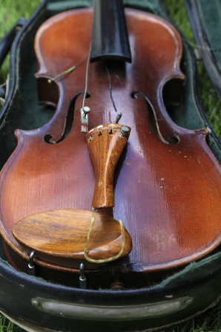
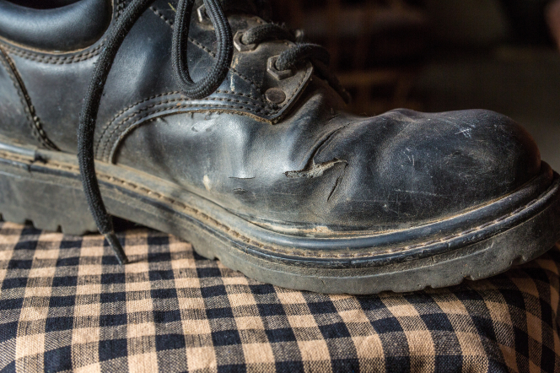
Physical or Spiritual Condition
How has the condition of each object changed over time?
How might these objects represent what can happen to us physically or spiritually over time?
Ezekiel 37

Slide 3
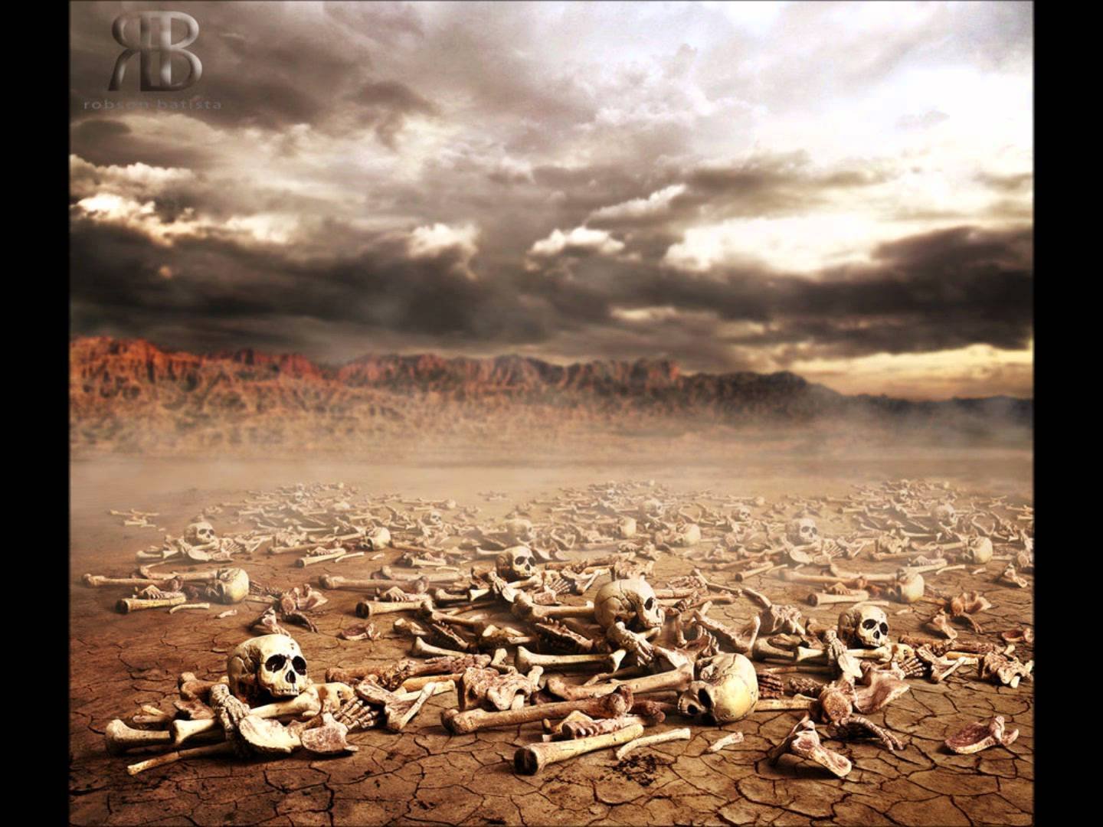
Vision of the Desert
Dry Bones = Lost Hope
Very dry = the bodies in the valley had been there for a significant period of time.
Can these bones live?
Ezekiel 37:1-3

Slide 4
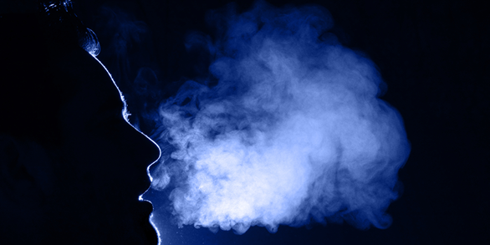
Breath of Life
Our spirits, which God placed in our physical bodies.
Ezekiel was referring to the reuniting of our bodies and spirits.
Ezekiel 37:5

Slide 5
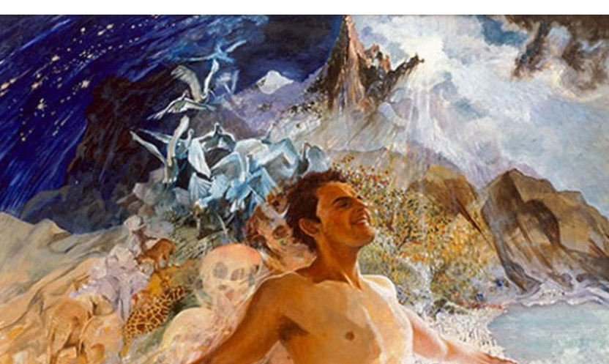
More Than One Truth
To those who are spiritually alert
“It will be seen from this passage that the doctrine of the resurrection from the dead … is invoked to symbolize the restoration of Israel’s exiles to their own land.
Ezekiel saw in vision the resurrection of many people. Resurrection is the reuniting of the spirit with the body in a perfect, immortal state.
A resurrected body is no longer subject to death, so the body and the spirit will never again be separated.
Ezekiel 37:7-10; Alma 11:43-45

Slide 6
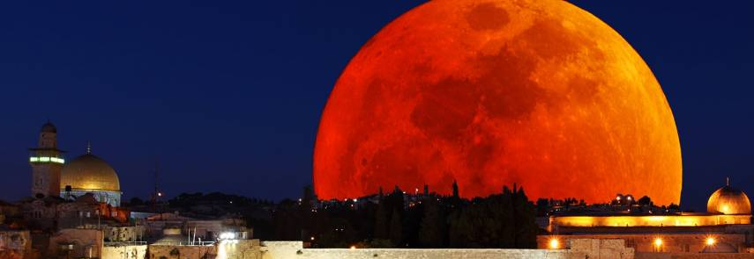
Restoring
To those who are spiritually alert
“It will be seen from this passage that the doctrine of the resurrection from the dead … is invoked to symbolize the restoration of Israel’s exiles to their own land.
I will not leave you comfortless: I will come to you.
Yet a little while, and the world seeth me no more; but ye see me: because I live, ye shall live also.
John 14:18-19
Jesus Christ has the power to resurrect us and when we are resurrected, our bodies will be made whole again
Ezekiel 37:11-14

Slide 7
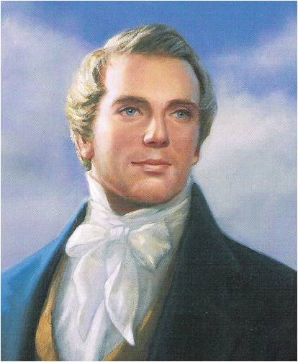
“So plain was the vision, that I actually saw men, before they had ascended from the tomb, as though they were getting up slowly. They took each other by the hand and said to each other, "My father, my son, my mother, my daughter, my brother, my sister."
And when the voice calls for the dead to arise, suppose I am laid by the side of my father, what would be the first joy of my heart? To meet my father, my mother, my brother, my sister; and when they are by my side, I embrace them and they me...
All your losses will be made up to you in the resurrection, provided you continue faithful. By the vision of the Almighty I have seen it.
The expectation of seeing my friends in the morning of the resurrection cheers my soul and makes me bear up against the evils of life. It is like their taking a long journey, and on their return we meet them with increased joy.
(3)

Slide 8
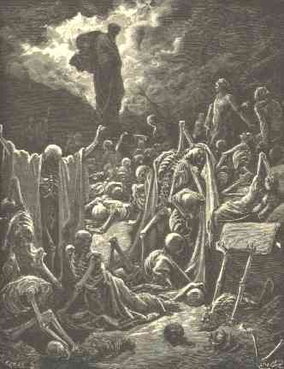
The Whole House of Israel
A destroyed nation
"As is common in Ezekiel's revelations, the symbolic activity or vision is followed by a clear interpretation. 'These bones are the whole house of Israel,' the Lord said. The metaphor of scattered bones well describes Israel's pitiful condition: they had been destroyed as a nation, their temple and holy city lay in ruins, thousands of their number had been killed in the Babylonian invasion (and earlier invasions as well), and their Davidic monarch and thousands of their countrymen had been taken into exile. They lamented, 'our bones are dried, and our hope is lost: we are cut off for our parts'
"Ezekiel's vision of the dry bones announced to ancient and modern Israel that their scattering would not be forever. The Lord would bring them out of their graves, assemble their scattered parts, give them life, and reestablish them in their own land. The image of resurrection in this passage shows that though the house of Israel were dead, it would be restored again-to life and to a renewed covenant with God." (4)
Ezekiel 37:11-14

Slide 9
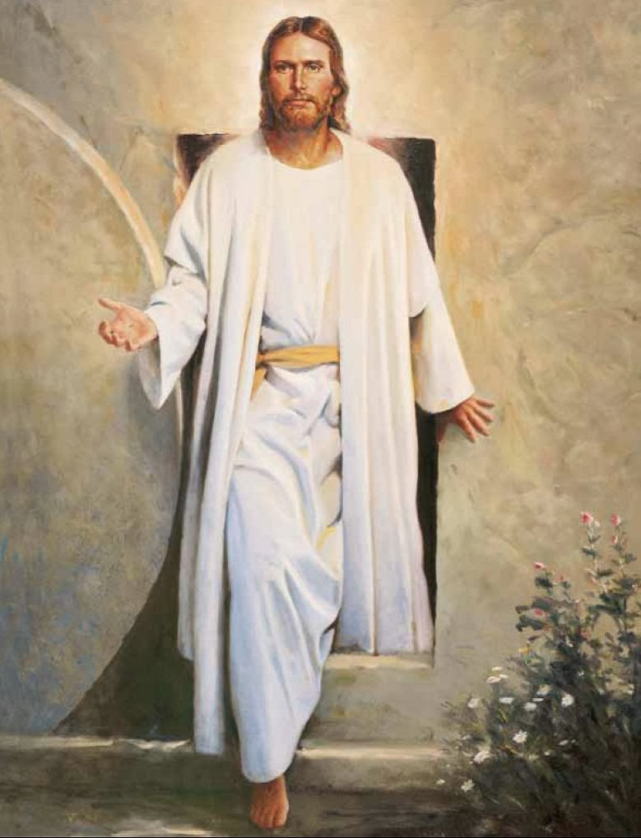
God has revealed His Son from the heavens and the doctrine of the resurrection also; and we have a knowledge that those we bury here God will bring up again, clothed upon and quickened by the Spirit of the great God; and what mattereth it whether we lay them down, or we lay down with them when we can keep them no longer?
Let these truths sink down in our hearts, that we may even here begin to enjoy that which shall be in full hereafter. (3)

Slide 10
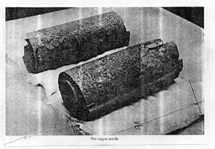
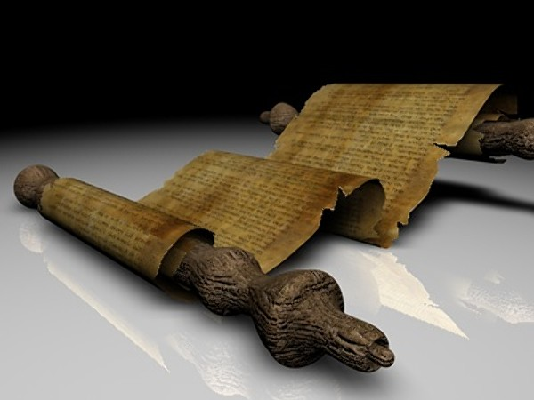
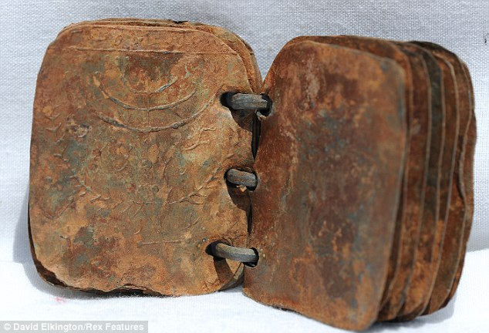
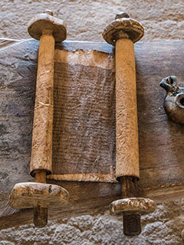
The Sticks
Wooden tablets or to scrolls, which anciently were rolled around sticks
Copper Scrolls-found in Jewish and Christian apocryphal writings.
Found Near Jordon
The revelations of Jesus Christ... are recorded not only in the Bible, or on the stick of Judah, but also in the Book of Mormon, or stick of Joseph in the hands of Ephraim, as well as in the New Testament, and those revelations of modern date as those of ancient time, have been sealed with the blood of him who brought them forth, and this testimony therefore is in force to all the world. The Lord is not trifling with this generation, neither is he trifling with the Saints or with the world of mankind. During the last 48 years the Gospel has been preached to this generation, and this work will continue preaching to the Gentiles, until the Lord directs otherwise. (5)
Ezekiel 37:15-16

Slide 11
Doctrinal Mastery
The word of the Lord came again unto me, saying,
Moreover, thou son of man, take thee one stick, and write upon it, For Judah, and for the children of Israel his companions: then take another stick, and write upon it, For Joseph, the stick of Ephraim, and for all the house of Israel his companions:
And join them one to another into one stick; and they shall become one in thine hand.
Ezekiel 37:15-17

Slide 12
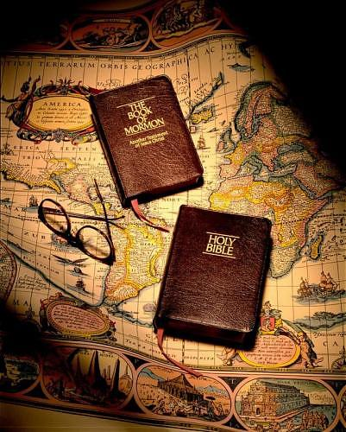
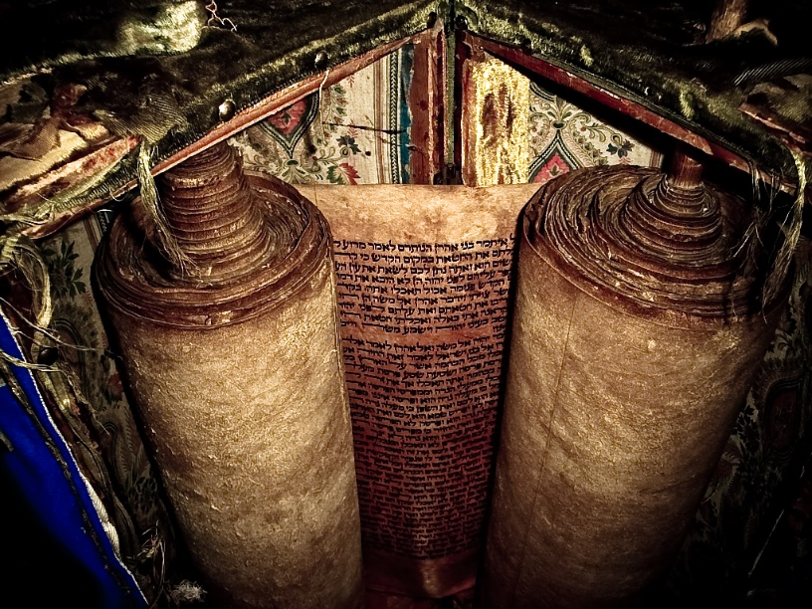
The Stick of Joseph
The Stick of Judah
The Bible and the Book of Mormon come together as witnesses that Jesus Christ is our Savior
The records of Lehi and his descendants from the tribe of Joseph were preserved and obtained in the latter-days—The Book of Mormon
Bible was preserved primarily through the Jews, many of whom were of the tribe of Judah
Ezekiel 37:19

Slide 13
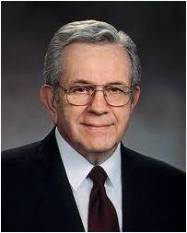
“The stick or record of Judah … and the stick or record of Ephraim … are now woven together in such a way that as you pore over one you are drawn to the other; as you learn from one you are enlightened by the other. They are indeed one in our hands. Ezekiel’s prophecy now stands fulfilled.
“With the passing of years, these scriptures will produce successive generations of faithful Christians who know the Lord Jesus Christ and are disposed to obey His will. …
“… The revelations will be opened to them as to no other in the history of the world. Into their hands now are placed the sticks of Joseph and of Judah.
They will develop a gospel scholarship beyond that which their forebears could achieve. They will have the testimony that Jesus is the Christ and be competent to proclaim Him and to defend Him.” (6)

Slide 14
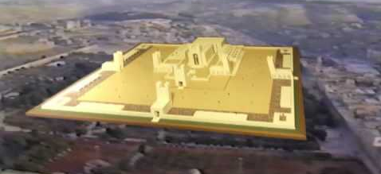
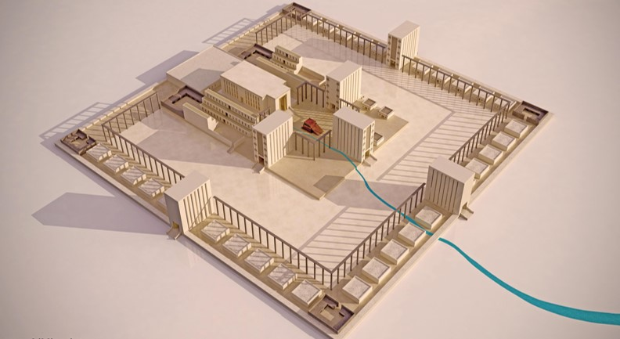
The Sanctuary
The holy sanctuary or temple that would be part of the great reunification of Israel. Soon after this vision, Ezekiel received a detailed vision of what the new temple in Jerusalem would be like (see Ezekiel 40–48). (1)
“Ezekiel predicted the building of a temple in Jerusalem which will be used for ordinance work after the gathering of Israel from their long dispersion and when they are cleansed from their transgressions.” (7)
Ezekiel 37:26

Slide 15
Union of the Sticks
Reuniting of the kingdoms of Judah and Israel.
The reunited house of Israel will be led by their Shepherd and King, Jehovah. The Lord promised He would renew His covenant with the house of Israel and sanctify them.
Ezekiel 37:21-28

Slide 16
Sources:
Suggested Hymn: #82 For All the Saints
Video:
God’s Words Never Cease (2:55)
Old Testament Institute Manual Prophecies of the Restoration Chapter 27
Sidney B. Sperry (The Voice of Israel’s Prophets, pp. 225–26.)
Joseph Smith (Teachings of the Prophet Joseph Smith, selected and arranged by Joseph Fielding Smith [Salt Lake City: Deseret Book Co., 1976], 295-296)
Kent P. Jackson, ed., Studies in Scripture, Vol. 4: 1 Kings to Malachi [Salt Lake City: Deseret Book Co., 1993], 301
Wilford Woodruff (Journal of Discourses, 19:296)
Elder Boyd K. Packer (“Scriptures,” Ensign, Nov. 1982, 53).
President Joseph Fielding Smith (Doctrines of Salvation, 2:244).
Presentation by ©http://fashionsbylynda.com/blog/

Slide 17
Ezekiel 1-3 | Ezekiel 4-24 | Ezekiel 25-32 | Ezekiel 33-48
Ezekiel sees the Lord and His glory. He is called as a watchman to the house of Israel to warn, reprove, and call them to repentance. | The Lord instructs Ezekiel to use symbols to represent the wickedness of Israel and the destruction of Jerusalem. Ezekiel prophesies of the Lord’s judgments on Jerusalem and explains why famine, desolation, war, and pestilence will sweep the land of Israel. | The Lord commands Ezekiel to declare the wickedness of the nations surrounding Israel and prophesy of their destruction. | The Lord reproves the leaders of Israel for being poor shepherds over their people. The Lord will be a true shepherd to Israel. Ezekiel records his vision of Israel’s restoration after the exile and in the latter days. The Lord promises to gather the Israelites from captivity, return them to their promised lands, renew His covenant with them, and reunite the kingdoms of Israel and Judah.

Slide 18
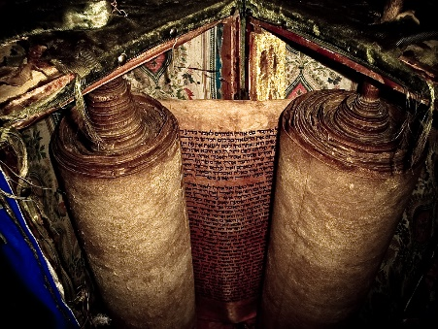
Ezekiel 37:7:
"To those of us who already believe and have a testimony that there will be a resurrection of the physical bodies of all mankind, these Old Testament scriptures seem clear enough. But that is because we have been tutored and taught by the clarity of latter-day revelation and by the Holy Ghost. Therefore, when we read these Old Testament scriptures we understand their doctrinal meaning. But many of our Christian and Jewish friends, who do not have the benefit of latter-day revelation and who do not enjoy the gift of the Holy Ghost, interpret these Old Testament verses differently. They see them as figurative, or allegorical, expressions or as some-thing-anything-other than literal, plain-spoken declarations about a physical resurrection of the corporeal bodies of mankind. Many present-day Christians are not even sure that Jesus himself was resurrected with his physical body, and most of those who may believe Jesus had a physical resurrected body do not believe he still has that body today.
"As Latter-day Saints we are a highly favored people in that we have not only all that the Bible has to say about the resurrection but also the additional, more detailed, and more specific testimonies from the Book of Mormon, the Doctrine and Covenants, the Pearl of Great Price, the Joseph Smith Translation, and the teachings of the latter-day prophets, particularly those of the Prophet Joseph Smith." (Robert J. Matthews, A Bible! A Bible! [Salt Lake City: Bookcraft, 1990], 197 - 198.)
"Abuhav Synagogue's ancient Torah scroll dates back to 14th century, still fit for reading, unlike many ancient scrolls exhibited in museums. Meir Karsenti, 80, a manager (gabbai) at the Abuhav Synagogue in Safed, was particularly excited last week as he geared up to take out what is thought to be the oldest Torah scroll in the world which can still actually be used. 'From research we conducted it appears the scroll was written in the 14th century by Isaac Aboab of Castile,' Karsenti said. 'A scribe examined the scroll two years ago and confirmed it was fit for reading. There are many ancient Torah scrolls in museums but they are banned for reading during prayers because of erased letters or words. This scroll can be read in a synagogue,' he said.“
http://www.israelmuse.com/2010/09/blog-sefads-500-year-old-torah-scroll.html#.VxJb2jArKUk
Ezekiel 37:1-14
“There is nothing more real, more literal, more personal than the resurrection, as Ezekiel then beheld in vision. He saw the dead live again, live literally and personally, each one becoming in physical makeup as he had been in mortality. It was with each of them as it would be with their Lord, when he, having also come forth from his valley of dry bones, stood in the upper room with his disciples, ate before them, and permitted them to handle his physical body. To his people the Lord’s voice came: ‘I will open your graves, and cause you to come up out of your graves, and bring you into the land of Israel.’ (Ezek. 37:1–14.) He who shall do all this, as we are now acutely aware, is the Lord Jesus Christ who is the God of Israel.” Elder Bruce R. McConkie (The Promised Messiah, pp. 270–71.)
The Stick Ezekiel 37:15-17
In addition, while serving as an associate professor of ancient scripture at Brigham Young University, Keith Meservy commented on the discovery of some ancient wooden tablets:
“The discovery in 1953 of these writing boards from biblical Calah in Mesopotamia altered the thinking of scholars about how Middle Eastern cultures made records. Wooden tablets filled with wax represent the ‘earliest known form of ancient book’ and help us understand an important prophecy of Ezekiel foretelling the uniting of the Bible and Book of Mormon” (“Ezekiel’s Sticks and the Gathering of Israel,” Ensign, Feb. 1987, 4).
Ezekiel’s prophecy that the two sticks would be joined “one to another into one stick” (Ezekiel 37:17) is clarified by the phrase “shall grow together,” which is found in 2 Nephi 3:12. This phrase helps us understand that the joining together of the two sticks is a process that will occur over time.
The Stick Ezekiel 37:15-17
Ellis T. Rasmussen, author of A Latter-day Saint Commentary on the Old Testament, commented on the term etz:
“Commonly translated stick, the Hebrew word used is etz, a generic word meaning ‘wood’ (there are other words meaning ‘stick,’ ‘staff,’ ‘branch,’ or ‘scepter’). This was wood upon which it was possible to write. Babylonian writing tablets of wood have been found hinged together and faced with wax, with writing engraved on them. Two wooden tablets represent the scriptures from Judah (the Bible) and Joseph (the Book of Mormon) to ‘be one in mine hand’ (Ezek. 37:15–19 and fn.)” (A Latter-day Saint Commentary on the Old Testament [1993], 608).

Slide 20
Dem Bones — also called Dry Bones and Dem Dry Bones — is a well-known spiritual song. The melody was composed by African-American author and songwriter James Weldon Johnson (1871–1938). Some sources also credit his brother, J Rosomond Johnson. First recorded by Bascomb Lunsford in February 1928, Brunswick 231. Both a long and a shortened version of the song are widely known. The lyrics are inspired by Ezekiel 37:1-14, where the Prophet visits the "Valley of Dry Bones" and prophesies that they will one day be resurrected at God's command, picturing the national resurrection of Israel.
Intro:
Ezekiel connected dem dry bones,
Ezekiel connected dem dry bones,
Ezekiel in the Valley of Dry Bones,
Now hear the word of the Lord.
Verse 1:
Toe bone connected to the foot bone
Foot bone connected to the heel bone
Heel bone connected to the ankle bone
Ankle bone connected to the shin bone
Shin bone connected to the knee bone
Knee bone connected to the thigh bone
Thigh bone connected to the hip bone
Hip bone connected to the back bone
Back bone connected to the shoulder bone
Shoulder bone connected to the neck bone
Neck bone connected to the head bone
Now hear the word of the Lord.
Chorus:
Dem bones, dem bones gonna walk around.
Dem bones, dem bones gonna walk around.
Dem bones, dem bones gonna walk around.
Now hear the word of the Lord.
Something for Fun
Intro 2:
Ezekiel connected dem dry bones,
Ezekiel connected dem dry bones,
Ezekiel in the Valley of Dry Bones,
Now hear the word of the Lord.
Verse 2:
Head bone (dis)connected from the neck bone
Neck bone connected from the shoulder bone
Shoulder bone connected from the back bone
Back bone connected from the hip bone
Hip bone connected from the thigh bone
Thigh bone connected from the knee bone
Knee bone connected from the shin bone
Shin bone connected from the ankle bone
Ankle bone connected from the heel bone
Heel bone connected from the foot bone
Foot bone connected from the toe bone
Now hear the word of the Lord.
Chorus:
Dem bones, dem bones gonna rise again.
Dem bones, dem bones gonna rise again.
Dem bones, dem bones gonna rise again.
Now hear the word of the Lord.
Finale:
Dem bones, dem bones, dem dry bones.
Dem bones, dem bones, dem dry bones.
Dem bones, dem bones, dem dry bones.
Now hear the word of the Lord.
Dry Bones—Ezekiel 37
https://www.youtube.com/watch?v=8lKpzzOEhyY
Delta Rhythm Boys ---Dry Bones
https://www.youtube.com/watch?v=hYeQUXXYvK0
Gospel singers: Come Alive: Youtube Lauren Daigle
https://www.youtube.com/watch?v=VuCLqoxigNA
JOHN BIDDEN - DRY BONES: Youtube
https://www.youtube.com/watch?v=I77MVmSlYk8

