Slide 1
Lesson 147
God is Near You
Daniel 3-5
But it is good for me to draw near to God: I have put my trust in the Lord GOD, that I may declare all thy works. Psalms 73:28
v

Slide 2
Choices
Not adopting a popular fashion trend that goes against the Lord’s standards.
Not joining with your peers when they invite you to cheat on a school assignment.
What are the positive consequences of these choices?
What are the negative consequences of these choices?
Walking out of a movie with inappropriate content

Slide 3
The Golden Image
King Nebuchadnezzar had a large golden image or statue made that was approximately 90 feet (27.4 meters) high and 9 feet (2.74 meters) wide.
The king then gathered leaders from his kingdom for “the dedication of the image”.
At the dedication, an official messenger announced that when music sounded, everyone was to “fall down and worship the golden image”.
Daniel 3:1-5

Slide 4
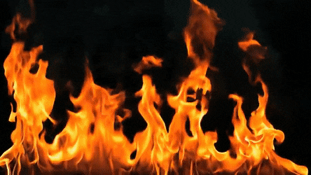
For Those Who Did Not Worship
And whoso falleth not down and worshippeth shall the same hour be cast into the midst of a burning fiery furnace.
Thou shalt not make unto thee any graven image…Thou shalt not bow down thyself to them, nor serve them
Exodus 20:4-5
Daniel 3:6-7

Slide 5
Shadrach, Meshach, and Abed-nego
When the prearranged sounds of the comet, flute, harp, and other instruments reverberated through the area and the masses of men and women everywhere fill their homes and the street with kneeling worshippers of the huge golden image, three men refused to insult their true God.
v
They prayed to God, and when confronted by the raging and furious emperor king, they courageously answered in the face of what could be certain death. (1)
Daniel 3:14-18

Slide 6
Certain Jewish Leaders reported to King Nebuchadnezzar that three young men did not bow down to worship the idol and they were brought before the king
Is it true you do not worship the god I have built?
v
We are not worried. Our God will deliver us from the fiery furnace. We will not serve any image you have set up
The king commanded his army men to bind the boys up and put them in the furnace.
They were bound with what they had on. Hosen = coat or garment
Daniel 2:19-21

Slide 7
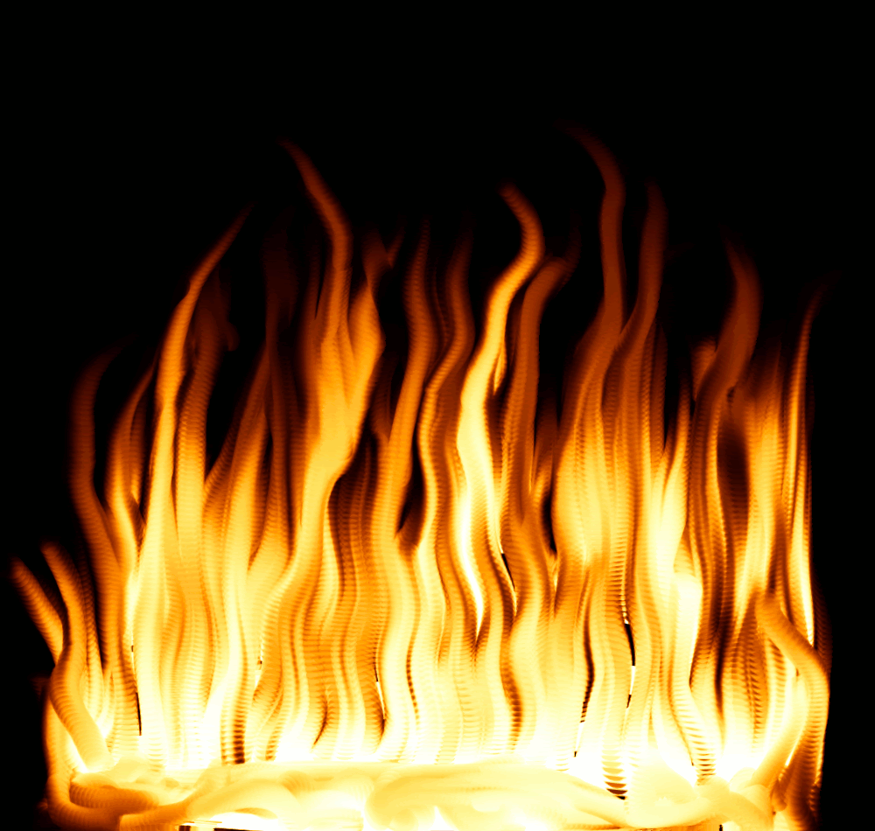
Cast Into The Fiery Furnace
When the Jewish, “mighty men”, tossed the boys into the furnace they were instantly burned because of the intense heat.(4)
When heated to an ordinary degree, this could be done without danger to the men who performed this service; but in the present case the heat of the fire was so great, that the servants themselves perished by it.” (2
v
The king apparently viewed the events in the furnace through an opening at the bottom. (3)
Daniel 3:22

Slide 8
The Fourth Man
Lo, I see four men loose, walking in the midst of the fire, and they have no hurt; and the form of the fourth is like the Son of God.
Who is the angel who delivered these servants? It is the same individual who was in the fiery furnace with a form "like the Son of God." We might not always think of using the term "angel" to describe the Lord Himself, but occasionally the scriptures use "angel" in this manner. Bible Dictionary
The king and his men noticed that they had not been burned.
The king had a “change of heart” and released the boys and promoted them.
If we choose to obey the Lord, He will be with us
Daniel 3:25-30

Slide 9
“As we go about living from day to day, it is almost inevitable that our faith will be challenged.
We may at times find ourselves surrounded by others and yet standing in the minority or even standing alone concerning what is acceptable and what is not.
Do we have the moral courage to stand firm for our beliefs, even if by so doing we must stand alone? …
“… May we ever be courageous and prepared to stand for what we believe, and if we must stand alone in the process, may we do so courageously, strengthened by the knowledge that in reality we are never alone when we stand with our Father in Heaven.”
Daniel 4:19
(7)

Slide 10
Another Dream
Nebuchadnezzar recognized Daniel’s ability to receive revelation from God is clear from the events associated with Daniel’s interpretation of Nebuchadnezzar’s previous dream.
Daniel’s spiritual powers, however, did not necessarily convert Nebuchadnezzar from his polytheistic beliefs or his belief in the supreme Babylonian god Bel. By acknowledging Daniel’s spiritual abilities, Nebuchadnezzar was not acknowledging Jehovah as the only or even the supreme god. (1)
Daniel 4:19

Slide 11
Bewildered
Daniel was troubled because he knew that the message of Nebuchadnezzar’s dream was not good. He knew he must announce to Nebuchadnezzar the judgments of God to come upon him. Nebuchadnezzar noticed Daniel’s concern and realized that Daniel had the interpretation. “He asks him, with friendly address, to tell him it without reserve. (1)
The dream was a prophecy of the king’s removal from the throne and his madness for 7 years.
A year later, while boasting of his accomplishments in his kingdom, the events in his dream began to be fulfilled. (1)
It was not until 7 years that the king regained his reason. (4)
Daniel 4:8-9

Slide 12
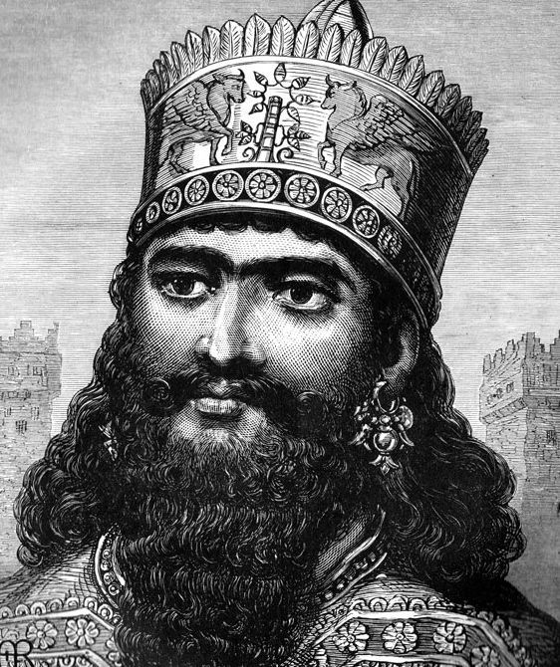
Reform Your Life
A Lengthening of Thy Tranquility
Daniel counseled the king to reform his life, to repent of his sins, and to show greater mercy to the poor.
The implication of Daniel’s statement is that if Nebuchadnezzar would do as he was counseled, he might receive divine favor and avert the threatened punishment, thus maintaining his prosperity of life.
Mercy to the poor was mentioned as a prerequisite to obtaining forgiveness of sin. It is one of the most sincere evidences of repentance and submission to the Lord’s will.
Pure religion and undefiled before God and the Father is this, To visit the fatherless and widows in their affliction, and to keep himself unspotted from the world. James 1:27
Daniel 4:27

Slide 13
Praise To The Lord
Nebuchadnezzar praised and glorified God after his reason was restored to him indicates that he recognized his experience as a just punishment for his pride.
It does not necessarily follow, however, that this experience caused his sincere repentance or conversion to the God of Daniel. Nevertheless, it is remarkable that Daniel had even that much influence on a man steeped in idolatry and heathen superstitions. (1)
Daniel 4:27

Slide 14
Belshazzar the King?
He is identified in the Book of Daniel as the King of Babylon and son and successor to Nebuchadnezzar.
From recent archaeological discoveries it appears that Belshazzar in actuality had been the son of Nabonidus (the last king of Babylon) and therefore the grandson of Nebuchadnezzar—making him prince-regent of the empire, rather than king.
Since, however, he was the man upon the throne with whom Israel had to do, he is designated king in the book of Daniel.
Daniel 5
5,6

Slide 15
Hosting a Feast
Belshazzar had the vessels that had been taken from the temple in Jerusalem brought to the feast.
The king and the people mocked the Lord by drinking wine from these vessels while they praised their false gods.
During the feast, a hand appeared and wrote on a wall in the king’s palace. Belshazzar was greatly concerned, and when others were unable to interpret the writing, he summoned Daniel.
Before interpreting the writing, Daniel spoke to Belshazzar about what his predecessor Nebuchadnezzar had experienced when his mind was “hardened in pride”.
Daniel 5

Slide 16
Handwriting on the Wall
The handwriting on the wall indicated not only that the Babylonian kingdom would be overthrown but also the means by which it would be overthrown:
When Daniel read the writing he read and Parsin, but in giving the interpretation he employed the form Peres . …
We have thus a play upon words in which the basic idea of division is linked with the name of the conqueror.” (5)
Daniel 5:25-29

Slide 17
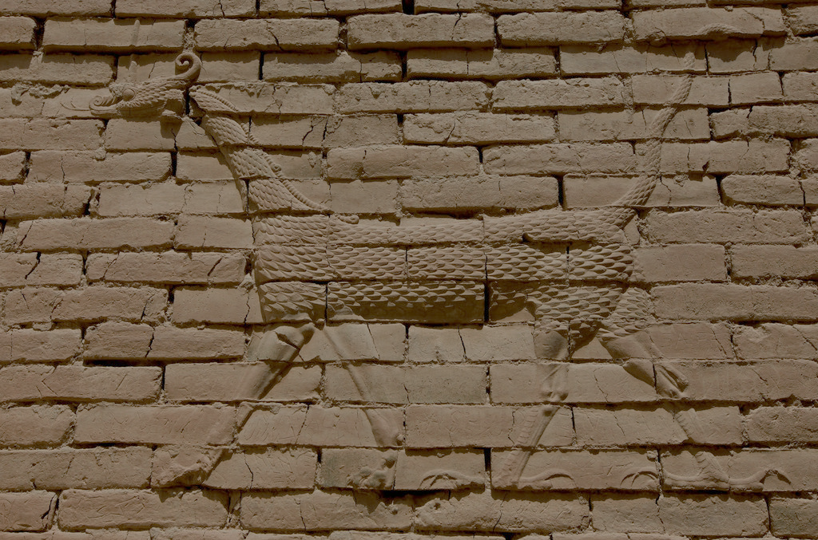
Fall of Babylon
Babylon was surrounded by a massive wall over one hundred feet thick and three hundred feet high.
To breach such a wall, even with constant sieging, would take months, and yet there is no hint in Daniel’s record that the city was under siege at this time.
Could a city of Babylon’s size and fortifications be taken in one night? *see notes
And Darius the Median took the kingdom, being about threescore and two years old. (62 years old)
Daniel 5:30-31

Slide 18
Sources:
Suggested Hymn: # 96 Dearest Children, God Is Near You (verse 2)
Video: Healing the Sick (1:25)
Old Testament Institute Manual Daniel: Prophet of God, Companion of Kings Chapter 28
2. C. F. Keil and F. Delitzsch, Commentary on the Old Testament, 9:3:130.
3. D. Guthrie and J. A. Motyer, eds., The New Bible Commentary: Revised,p. 692
4. W. Cleon Skousen The Fourth Thousand Years p. 752
5. Guthrie and Motyer, New Bible Commentary, p. 694.)
6. Who’s Who in the Old Testament by Ed J. Pinegar and Richard J. Allen p. 27
7. President Thomas S. Monson (“Dare to Stand Alone,” Ensign or Liahona, Nov. 2011, 60, 67).

Slide 20
Shadrach, Meshach, and Abednego: We remind ourselves of the integrity of the three Hebrews, Shadrach, Meshach, and Abednego, who like Daniel defied men and rulers, to be true to themselves and to keep faith with their faith. They were required by decree of the emperor to kneel down and worship a monumental image of gold which the king had set up. In the face of losing caste, of losing position, of angering the king, they faced the fiery furnace rather than to fail and deny their God. The cunningly devised scheme worked as the vicious planners expected. The dedication must have been exciting with the people from far and near attending. Had there ever been such an image? such a spectacle? Ninety feet of gold in the form of a man-what could be more scintillating, more sparkling? There must have been almost countless people milling in the streets and in the area where the gigantic image stood when the herald announced the procedure and the decree that all must kneel at the sound of the music and all must worship the image. Neither the cunning of the deceivers, the conspiring, cunning tricksters, nor the fear of the king and what he could do to them, dissuaded the three courageous young men from their true path of rightness. When the pre-arranged sounds of the cornet, flute, harp and other instruments reverberated through the area and the masses of men and women everywhere filled their homes and the streets with kneeling worshippers of the huge golden image, three men refused to insult their true God. They prayed to God, and when confronted by the raging and furious emperor king, they courageously answered in the face of what could be certain death. Though they did not know the will of God, though they did not know for sure if the Lord would save them, it mattered not. Right was right and their faith sustained them. Their answer was not contingent upon the Lord performing a miracle. They were content to do right and let the consequence follow, be it rescue or death. Spencer W. Kimball (February 25, 1964, BYU Speeches of the Year, 1964 19.)
The Fourth Person: When Nebuchadnezzar saw four men loose, walking in the midst of the fire, unhurt; and the fourth like unto the Son of God-how changed was the scene! Nebuchadnezzar was converted by the power that he saw manifested, and he issued a decree saying, "That every people, nation, and language which spake anything amiss against the God of Shadrach, Meshach, and Abednego, shall be cut in pieces, and their houses shall be made a dunghill." In this way was the Lord able to touch the heart of a heathen king, and to turn the heart of a nation. And I will say to the Latter-day Saints-you may call it prophecy if you choose-that if this people will be united and will keep the commandments of God, God will turn the popular sentiment of this nation in our favor; the nation will feel disposed to bestow upon us favor instead of persecution and destruction. But it is our business to step forward as did Esther, and be willing to risk all for the salvation of the people. In undertaking her task, Esther said, "If I perish, I perish." Here is a lesson for our sisters. But the people of God will not perish. There will always be a ram caught in the thicket for their deliverance. Lorenzo Snow (Journal of Discourses, 26 vols. [London: Latter-day Saints' Book Depot, 1854-1886], 23: 293)
Nebuchadnezzar: He was best remembered in history as the flamboyant and fabulous builder of Babylon. He was also a shrewd strategist in the field of battle. He pushed the boundaries of his empire westward including the conquest of Egypt. His life came to a close in 562 B.C. and he was replaced by his son, Amil-Marduk [EvilMerodach of the Bible]. (Jeremiah 52:31 After the reign of only two years. Evil-Merodach was killed in 560 B.C. by his brother-in-law, Neriglissor who was a former officer in Nebuchadnezzar’s army and had married the king’s daughter sometime earlier and now he murdered his son. Neriglissor ruled until 556 B.C. when he died and was replaced by his young son, Labashi-Marduk. This boy only lasted 9 months when he was assassinated and one of the conspirators took over the throne. His name was Nabonidus and he ruled Babylon until its fall in 539 B.C. All of these political upheavals were probably witnessed by Daniel. (4)
The Fiery Furnace: Shadrach, Meshach, and Abednego did not know if God would spare them from the fiery furnace. They simply said: "If it be so, our God whom we serve is able to deliver us from the burning fiery furnace, and he will deliver us out of thine hand, O king. But if not, be it known unto thee, O king, that we will not serve thy gods, nor worship the golden image which thou hast set up." (Daniel 3:17-18.)
Note the words "but if not." These are words of unconditional commitment. The possibility of "if" was with these three until the very moment of their rescue, but they had determined their course regardless. Sometimes we must "take the heat," even if we are not certain the thermostat of trial will soon be turned down.
When we have that kind of courage, neither will we walk alone in our own "fiery furnace," for, as is recorded in Daniel, there was a fourth Form in that fiery furnace with the valiant threesome, and the Form was "like the Son of God"! (Daniel 3:25.) (All These Things Shall Give Thee Experience [Salt Lake City: Deseret Book Co., 1979], 48)

Slide 21
Vessels of the Temple: Daniel 5 When the Babylonians overthrew Jerusalem, they “carried out thence all the treasures of the house of the Lord” (2 Kings 24:13). As Keil and Delitzsch noted, during the feast the Babylonians “drank out of the holy vessels of the temple of the God of Israel to glorify … their heathen gods in songs of praise. In doing this they did not only place ‘Jehovah on a perfect level with their gods’ (Havernick), but raised them above the Lord of heaven, as Daniel (ver. 23) charged the king. The carrying away of the temple vessels to Babylon and placing them in the temple of Bel was a sign of the defeat of the God to whom these vessels were consecrated; … the use of these vessels in the drinking of wine at a festival, amid the singing of songs in praise of the gods, was accordingly a celebrating of these gods as victorious over the God of Israel.” (Commentary,9:3:180.) Vessels of the temple included altar of incense, golden candlestick, table of shewbread, and ark of the covenant
*Was Babylon Really Overthrown in One Night? Daniel 5:30-31 Historical sources other than the Bible indicate that that is exactly what happened, supporting Daniel’s record exactly. The ancient Greek historian, Herodotus, recorded that “Cyrus had previously caused the Pallacopas, a canal which ran west of the city, and carried off the superfluous water of the Euphrates into the lake of Nitocris, to be cleared out, in order to turn the river into it; which, by this means, was rendered so shallow that his soldiers were able to penetrate along its bed into the city.” (In Samuel Fallows, ed., The Popular and Critical Bible Encyclopedia and Scriptural Dictionary ,s.v. “Babylon,” p. 207.)
Cyrus diverted the water and marched his soldiers under the wall of Babylon. Thus the Persians marched under the massive walls. Harry Thomas Frank discussed the reasons why the city, even then, surrendered so easily: “Cyrus’ orders preceded him to the city. No revenge was to be taken. The city was to have its normal life restored as quickly as possible. The gods which Nabonidus had taken from the equally well-treated provincial cities were to be restored at once. There was, above all, to be no terrorizing of the population. Indeed, Cyrus intended to change some of the policies of Nabonidus which had made him objectionable to his subjects. One can imagine the reception Cyrus received when he made his appearance in the capital a few weeks after its capture. He was not a conqueror. He was a liberator! And far from installing a foreign rule over the people, Cyrus personally took the role of Marduk, the chief god of Babylon, in the New Year Festival, thereby claiming for himself and his heirs the right to rule the Babylonian Empire by divine designation.” (Discovering the Biblical World, p. 140.)

