Slide 1
Lesson 148
Commandments Part 4

Slide 2
The Sabbath Day
What are some ways you could respond to Jennifer to help her act in faith?
How could you help Jennifer view her concern about keeping the Sabbath day holy with an eternal perspective?
What are some gospel truths and principles that might help Jennifer want to keep the Sabbath day holy?
You and Jennifer are discussing your weekend plans. Jennifer says, “The way we’re supposed to spend Sunday seems like a waste of time. I could do so much more on the weekend if I didn’t have to worry about keeping the Sabbath day holy.”

Slide 3
If thou turn away thy foot from the sabbath, from doing thy pleasure on my holy day; and call the sabbath a delight, the holy of the Lord, honourable; and shalt honour him, not doing thine own ways, nor finding thine own pleasure, nor speaking thine own words:
Then shalt thou delight thyself in the Lord; and I will cause thee to ride upon the high places of the earth, and feed thee with the heritage of Jacob thy father: for the mouth of the Lord hath spoken it.
Isaiah 58:13-14

Slide 4
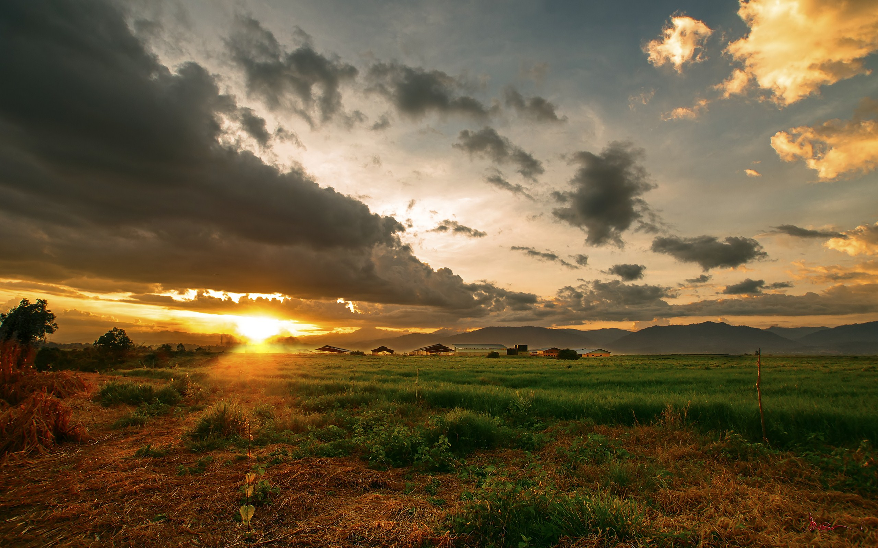
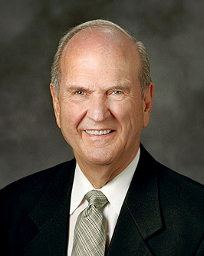
Exodus 20:8
Remember the sabbath day, to keep it holy.
“I learned from the scriptures that my conduct and my attitude on the Sabbath constituted a sign between me and my Heavenly Father.
With that understanding, I no longer needed lists of dos and don’ts.
When I had to make a decision whether or not an activity was appropriate for the Sabbath, I simply asked myself, ‘What sign do I want to give to God?’
That question made my choices about the Sabbath day crystal clear.” (1)
Mathew 12:12
Wherefore it is lawful to do well on the sabbath days.
Exodus 31:13
Speak thou also unto the children of Israel, saying, Verily my sabbaths ye shall keep: for it is a sign between me and you throughout your generations; that ye may know that I am the Lord that doth sanctify you.
Ezekiel 20:20
And hallow my sabbaths; and they shall be a sign between me and you, that ye may know that I am the Lord your God.

Slide 5
Tithing Scenario
Marlo and Paul are young men who live in the same ward. Paul’s family is struggling financially, and Paul helps support them with the money he makes from his part-time job. After church one day, Marlo notices that Paul seems unhappy.
“What’s the matter?”
“The talk in sacrament meeting about tithing troubled me. How can I afford to pay tithing when my family can barely pay for our daily living expenses?”
“I can imagine that your situation must be really tough. It isn’t always easy to make ends meet. Can I think about your question for a little while and get back to you?”
“Sure,” Paul says.

Slide 6
8 Will a man rob God? Yet ye have robbed me. But ye say, Wherein have we robbed thee? In tithes and offerings.
9 Ye are cursed with a curse: for ye have robbed me, even this whole nation.
10 Bring ye all the tithes into the storehouse, that there may be meat in mine house, and prove me now herewith, saith the Lord of hosts, if I will not open you the windows of heaven, and pour you out a blessing, that there shall not be room enough to receive it.
Marlo remembers what Malachi said…
He thinks this will be a good passage to share with Paul. Marlo also decides to study some talks about tithing from general conference.
He finds the talk “Tithing: A Test of Faith with Eternal Blessings,” given by Elder Robert D. Hales (1932–2017) of the Quorum of the Twelve Apostles at the October 2002 general conference.
As Marlo studies the talk, he reads the following account:

Slide 7
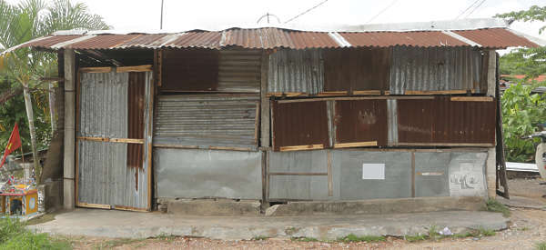
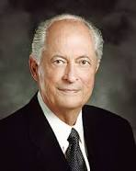
“I know of two missionaries who visited a very poor family.
The family’s home was made of pressboard and sticks, with a dirt floor and no electricity or beds.
Each evening the father, a farm laborer, spent his entire day’s wages on groceries for dinner.
Departing from their humble home, the senior companion thought to himself, ‘The law of tithing will surely be a stumbling block to this family.
Perhaps we shouldn’t bring it up for a while.’ A few moments later, the junior companion, who had grown up in similar circumstances in his own country, voiced his own thoughts aloud:
‘I know the principle of tithing isn’t taught for four more discussions, but can we please teach it the next time we visit?
They need to know about tithing now because they need the help and the blessing of the Lord so much’” (2)

Slide 8
The next day, Marlo decides to share with Paul some of the things he has found and has been thinking about.
Marlo also bears his testimony about the importance of paying tithing and about the blessings he has received as he has paid a full tithe.
After Marlo shares Malachi 3:8–10 and the excerpt from Elder Hales’s talk, Paul feels better about his concern and thanks Marlo for discussing the blessings of paying tithing with him.

Slide 9
Why do you think Marlo decided to share Malachi 3:8–10 with Paul? How could this passage help Paul act in faith and view his question about paying tithing with an eternal perspective?
How do you think the account Elder Hales shared could inspire Paul to act in faith?
What else do you think Marlo could do to help Paul view the law of tithing with an eternal perspective?
How did Marlo use divinely appointed sources to help Paul?
Can you think of anything else Marlo could do to help Paul?

Slide 10
Sources:
Suggested Hymn: #148 Sabbath Day
Suggested Video:
Sabbath Day is a Delight (2:52)
Just for Fun: Why Do Mormons Pay Tithing (4:34)
President Russell M. Nelson “The Sabbath Is a Delight,” April 2015 general conference
Elder Robert D. Hales “Tithing: A Test of Faith with Eternal Blessings” Ensign or Liahona, Nov. 2002, 29).
Presentation by ©http://fashionsbylynda.com/blog/

