Slide 1
Lesson 17
The Godhead
The Father has a body of flesh and bones as tangible as man’s; the Son also; but the Holy Ghost has not a body of flesh and bones, but is a personage of Spirit.
D&C 130:22

Slide 2
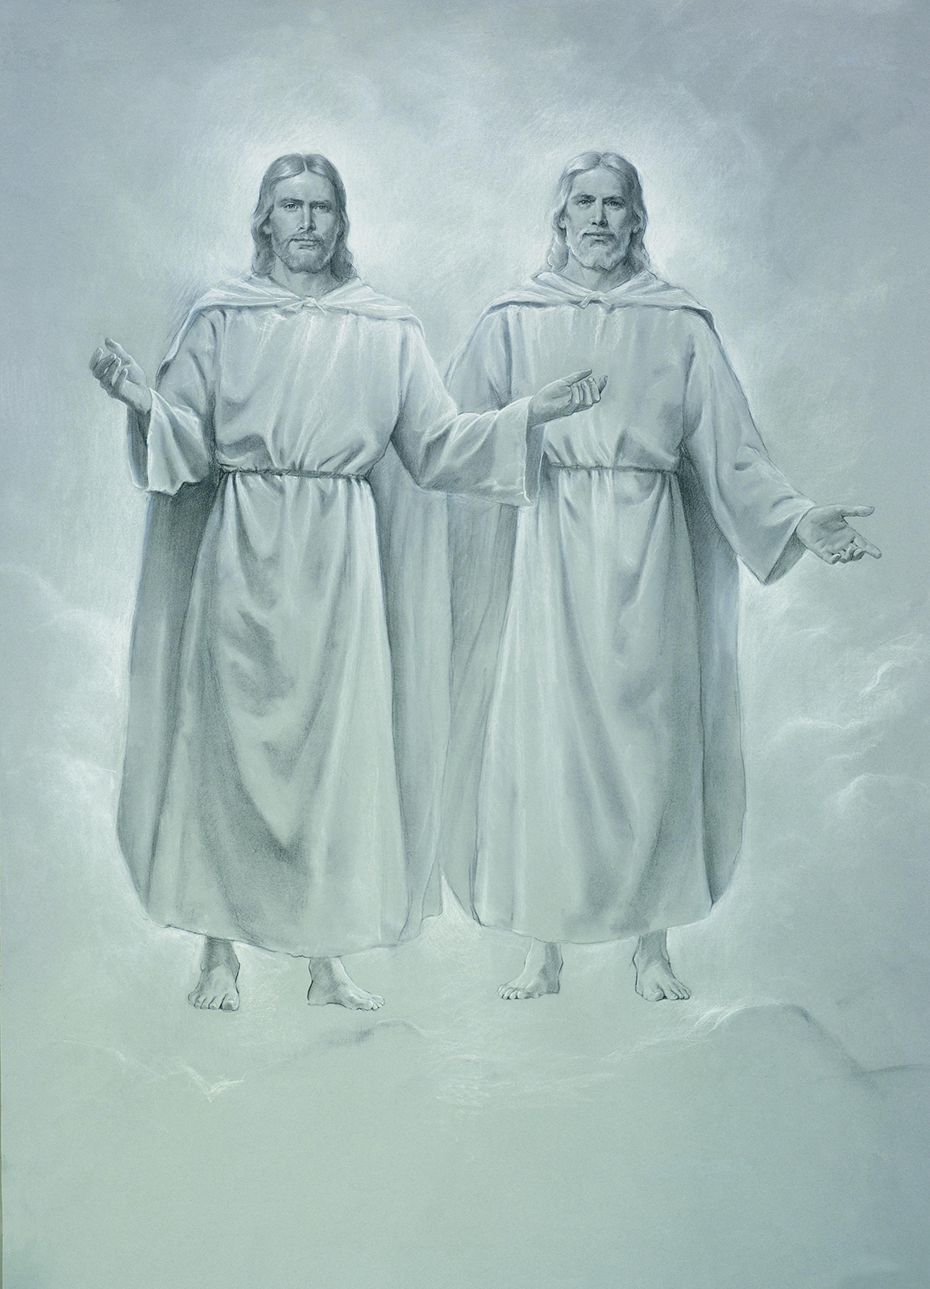
There are three separate personages in the Godhead: God, the Eternal Father; His Son, Jesus Christ; and the Holy Ghost.
The Father and the Son have tangible, glorified bodies of flesh and bone, and the Holy Ghost is a personage of spirit.
They are one in purpose and are perfectly united in bringing to pass Heavenly Father’s plan of salvation.

Slide 3
God, The Father
Furthermore we have had fathers of our flesh which corrected us, and we gave them reverence: shall we not much rather be in subjection unto the Father of spirits, and live?
Hebrews 12:9
God the Father is the Supreme Being whom we worship. He is the Father of our spirits.
He is perfect, has all power, and knows all things.
He is also just, merciful, and kind. God loves each of His children perfectly, and all are alike unto Him.
His work and glory is to bring about the immortality and eternal life of man.
For none of these iniquities come of the Lord; for he doeth that which is good among the children of men; and he doeth nothing save it be plain unto the children of men; and he inviteth them all to come unto him and partake of his goodness; and he denieth none that come unto him, black and white, bond and free, male and female; and he remembereth the heathen; and all are alike unto God, both Jew and Gentile.
2 Nephi 26:33
See also: John 17:3; Mosiah 4:9; Moses 1:39

Slide 4
How does knowing that God is the Father of your spirit influence the way you see yourself?
When have you felt God’s love in your life? How did that strengthen your love for Him?

Slide 5
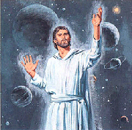
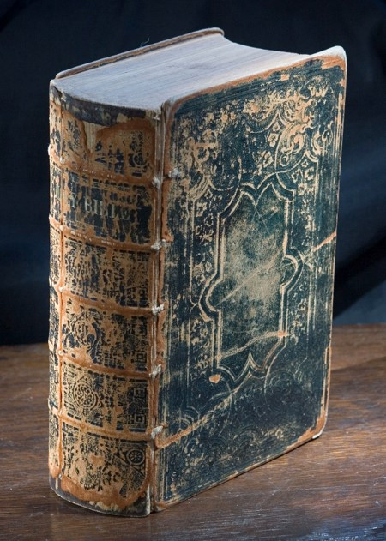
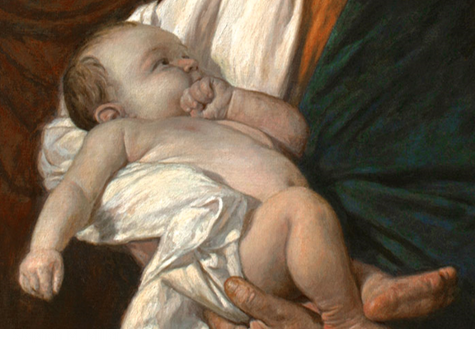
Jesus Christ
He is Jehovah of the Old Testament and the Messiah of the New Testament.
Jesus Christ is the Firstborn of the Father in the spirit and is the Only Begotten of the Father in the flesh.
Under the Father’s direction, Jesus Christ created the heavens and the earth.

Slide 6
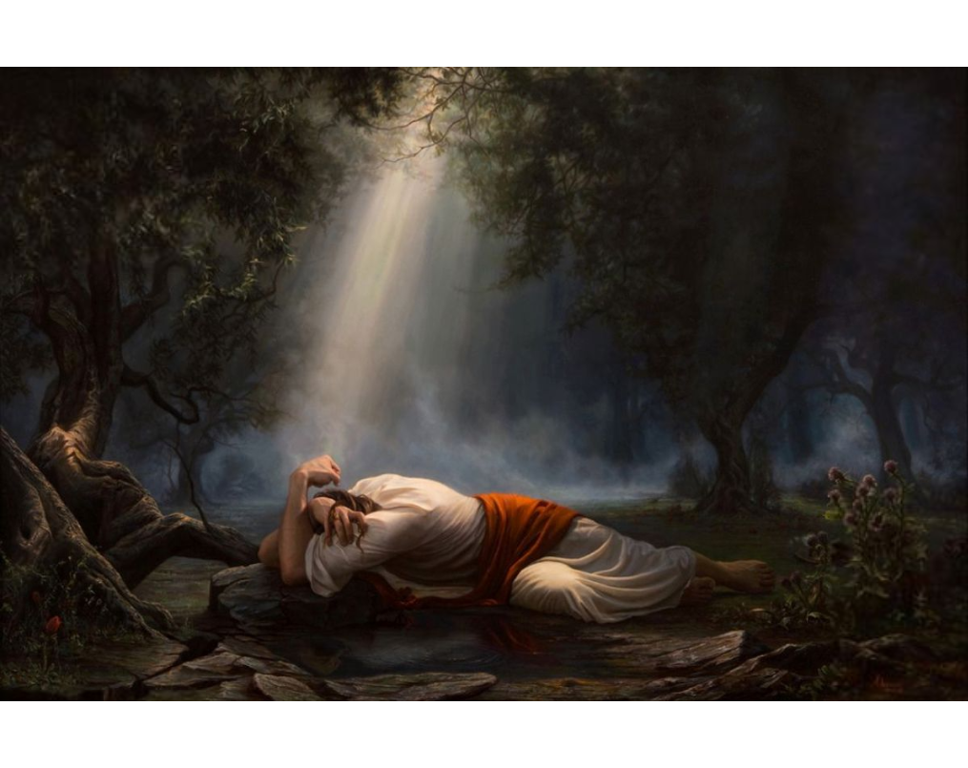
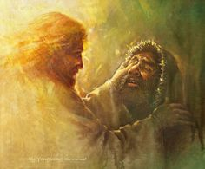
Behold, I am Jesus Christ, whom the prophets testified shall come into the world.
And behold, I am the light and the life of the world; and I have drunk out of that bitter cup which the Father hath given me, and have glorified the Father in taking upon me the sins of the world, in the which I have suffered the will of the Father in all things from the beginning.
3 Nephi 11:10-11
Jesus Christ does the will of the Father in all things.
He lived a sinless life and atoned for the sins of all mankind.
His life is the perfect example of how we are to live.
For the hour is nigh, and that which was spoken by mine apostles must be fulfilled; for as they spoke so shall it come to pass;
For I will reveal myself from heaven with power and great glory, with all the hosts thereof, and dwell in righteousness with men on earth a thousand years, and the wicked shall not stand.
D&C 29:10-11

Slide 7
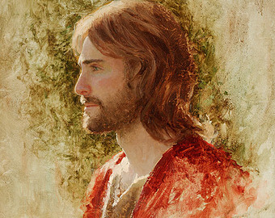
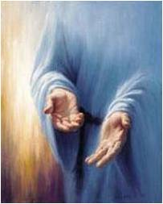
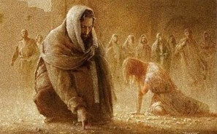
In our day, as in ancient times, He stands at the head of His Church. He will come again in power and glory and will reign on the earth during the Millennium.
He was the first of Heavenly Father’s children to be resurrected.
He will judge all mankind.
Jared Barns
Therefore I would that ye should be perfect even as I, or your Father who is in heaven is perfect.
3 Nephi 12:48

Slide 8
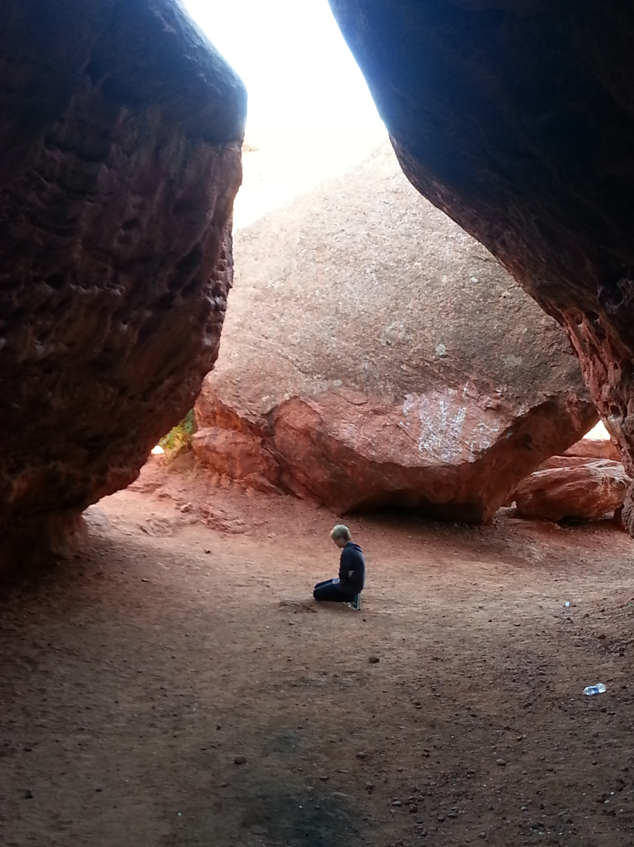
In His Name
Because Jesus Christ is our Savior and our Mediator with the Father, all prayers, blessings, and priesthood ordinances should be done in His name.
And whatsoever ye shall ask the Father in my name, which is right, believing that ye shall receive, behold it shall be given unto you.
Pray in your families unto the Father, always in my name, that your wives and your children may be blessed.
3 Nephi 18:20-21

Slide 9
What name is often used in the Old Testament for Jesus Christ?
How does knowing that Jesus Christ created the heavens and the earth influence how you feel about Him and His creations?
What about the Savior’s life and example impresses you the most?
How does it make you feel to know that Jesus Christ will return to the earth in power and glory and reign on earth during the Millennium?
What specific teaching of the Savior brings you hope or comfort or courage?

Slide 10
The Holy Ghost
The Holy Ghost is the third member of the Godhead. He is a personage of spirit and does not have a body of flesh and bone. He is often referred to as the Spirit, the Holy Spirit, the Spirit of God, the Spirit of the Lord, and the Comforter.
And Jesus, when he was baptized, went up straightway out of the water: and, lo, the heavens were opened unto him, and he saw the Spirit of God descending like a dove, and lighting upon him:
Matthew 3:16
The Holy Ghost bears witness of the Father and the Son, reveals the truth of all things, and sanctifies those who repent and are baptized.
Through the power of the Holy Ghost, we can receive spiritual gifts, which are blessings or abilities given by the Lord for our own benefit and to help us serve and bless others.

Slide 11
How is the Holy Ghost different from the other members of the Godhead?
What are some of the various names for the Holy Ghost?
What does the Holy Ghost do for us?
When is a time that you have felt the Holy Ghost in your life?

Slide 12
Sources:
Suggested Hymn: #143 Let The Holy Spirit Guide
Video:
The Doctrine of the Godhead (1:42)
Old Testament Teacher Manual
https://www.lds.org/manual/old-testament-seminary-teacher-material-2018/genesis/lesson-17?lang=eng
Presentation by ©http://fashionsbylynda.com/blog/

Slide 13
Discussion Questions Set of 2
How does knowing that God is the Father of your spirit influence the way you see yourself?
When have you felt God’s love in your life? How did that strengthen your love for Him?
How does knowing that God is the Father of your spirit influence the way you see yourself?
When have you felt God’s love in your life? How did that strengthen your love for Him?
What name is often used in the Old Testament for Jesus Christ?
How does knowing that Jesus Christ created the heavens and the earth influence how you feel about Him and His creations?
What about the Savior’s life and example impresses you the most?
How does it make you feel to know that Jesus Christ will return to the earth in power and glory and reign on earth during the Millennium?
What specific teaching of the Savior brings you hope or comfort or courage?
What name is often used in the Old Testament for Jesus Christ?
How does knowing that Jesus Christ created the heavens and the earth influence how you feel about Him and His creations?
What about the Savior’s life and example impresses you the most?
How does it make you feel to know that Jesus Christ will return to the earth in power and glory and reign on earth during the Millennium?
What specific teaching of the Savior brings you hope or comfort or courage?
How is the Holy Ghost different from the other members of the Godhead?
What are some of the various names for the Holy Ghost?
What does the Holy Ghost do for us?
When is a time that you have felt the Holy Ghost in your life?
How is the Holy Ghost different from the other members of the Godhead?
What are some of the various names for the Holy Ghost?
What does the Holy Ghost do for us?
When is a time that you have felt the Holy Ghost in your life?

