Slide 1
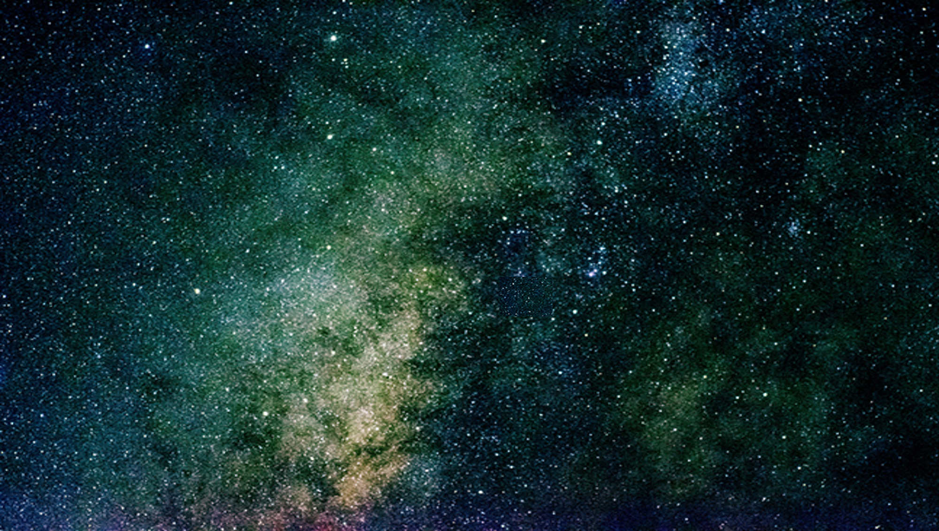
Lesson 21
Lesson 21
The Plan of Salvation
Part 1

Slide 2







Slide 3
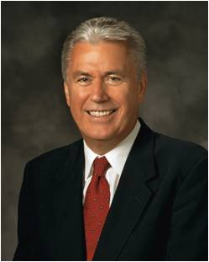

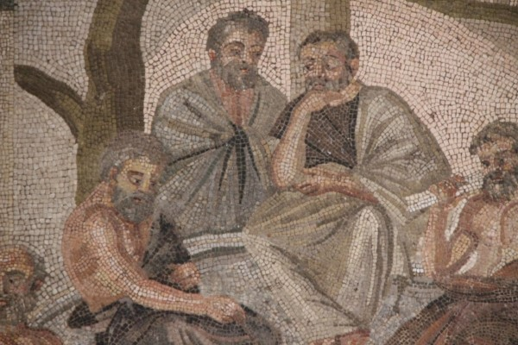
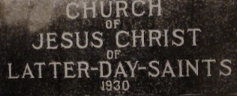
Lesson 21
“I believe every human being carries in his or her heart some form of fundamental questions regarding life itself. Where did I come from? Why am I here? What will happen after I die?
“These kinds of questions have been asked by mortals since the dawn of time. Philosophers, scholars, and pundits have spent their lives and fortunes seeking for answers.
“I am grateful that the restored gospel of Jesus Christ has answers to the most complex questions in life. These answers are taught in The Church of Jesus Christ of Latter-day Saints. They are true, plain, straightforward, and easy to understand. They are inspired.”
Dieter F. Uchtdorf

Slide 4

Lesson 21
Premortal Existence
In the premortal existence Heavenly Father introduced a plan to enable us to become like Him and obtain immortality and eternal life.
For behold, this is my work and my glory—to bring to pass the immortality and eternal life of man.
Moses 1:39
To fulfill this plan and become like our Father in Heaven, we must come to know Him and His Son, Jesus Christ, and have a correct understanding of Their character and attributes. (see John 17:3).
And this is life eternal, that they might know thee the only true God, and Jesus Christ, whom thou hast sent.
John 17:3

Slide 5
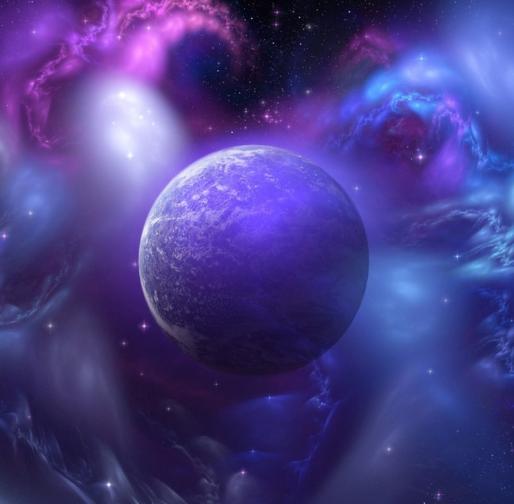
Lesson 21
The Great Plan of Happiness
The scriptures refer to Heavenly Father’s plan as the plan of salvation, the great plan of happiness, the plan of redemption, and the plan of mercy.
This plan includes the Creation, the Fall, the Atonement of Jesus Christ, and all of the laws, ordinances, and doctrine of the gospel.
Moral agency—the ability to choose and act for ourselves—is also essential to Heavenly Father’s plan. Our eternal progression depends on how we use this gift.
…And they are free to choose liberty and eternal life…
2 Nephi 2:27

Slide 6
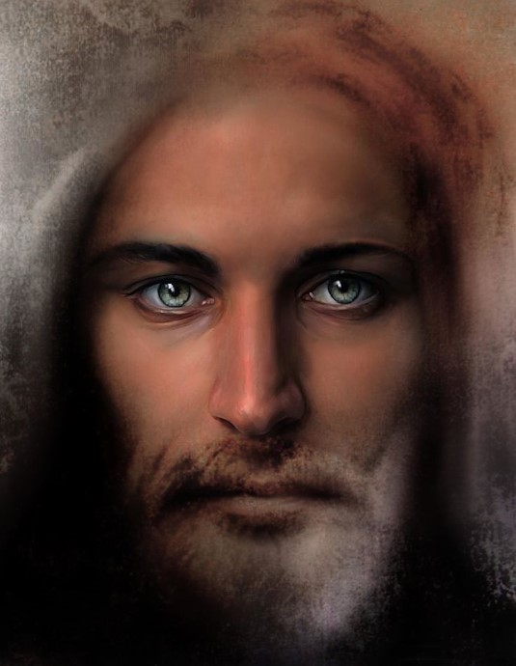
Lesson 21
The Central Figure
Jesus Christ is the central figure in Heavenly Father’s plan. The plan of salvation enables us to become perfected, receive a fulness of joy, enjoy our family relationships throughout the eternities, and live forever in the presence of God.

Slide 7
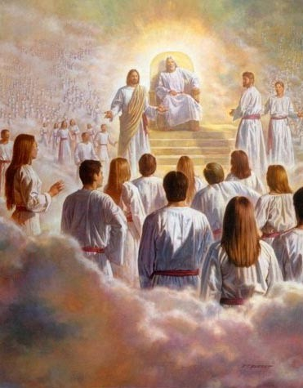
Lesson 21
Premortal Life
Before we were born on the earth, we lived in the presence of our Heavenly Father as His spirit children.
Abraham, the intelligences that were organized before the world was; and among all these there were many of the noble and great ones;
And God saw these souls that they were good, and he stood in the midst of them, and he said: These I will make my rulers; for he stood among those that were spirits, and he saw that they were good; and he said unto me: Abraham, thou art one of them; thou wast chosen before thou wast born.
Abraham 3:22-23
In this premortal existence we participated in a council with Heavenly Father’s other spirit children.
During that council Heavenly Father presented His plan and the premortal Jesus Christ covenanted to be the Savior.

Slide 8
Lesson 21
Agency
We used our agency to follow Heavenly Father’s plan.
Those who followed Heavenly Father and Jesus Christ were permitted to come to the earth to experience mortality and progress toward eternal life.
Lucifer, another spirit son of God, rebelled against the plan.
He became Satan, and he and his followers were cast out of heaven and denied the privileges of receiving a physical body and experiencing mortality.
Jeremiah 1:4–5; Hebrews 12:9; 2 Nephi 2:27; 3 Nephi 11:10–11

Slide 9
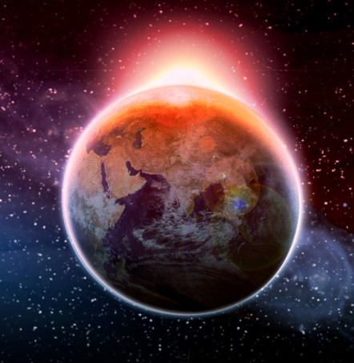
Creation
Adam was the first man created on the earth. God created Adam and Eve in His own image.
All human beings—male and female—are created in the image of God.
Jesus Christ created the heavens and the earth under the direction of the Father.
That by him, and through him, and of him, the worlds are and were created, and the inhabitants thereof are begotten sons and daughters unto God.
D&C 76:24
So God created man in his own image, in the image of God created he him; male and female created he them. Genesis 1:27
The Creation of the earth was essential to God’s plan. It provided a place where we could gain a physical body, be tested and tried, and develop divine attributes.
Gender is an essential characteristic of each person’s premortal, mortal, and eternal identity and purpose.

Slide 10

The Fall
In the Garden of Eden, God joined Adam and Eve in marriage. While Adam and Eve were in the garden, they were still in God’s presence and could have lived forever. They lived in innocence, and God provided for their needs.
God gave Adam and Eve their agency while they were in the Garden of Eden. He commanded them not to eat the forbidden fruit—the fruit of the tree of knowledge of good and evil. Obeying this commandment meant that they could remain in the garden.

Slide 11
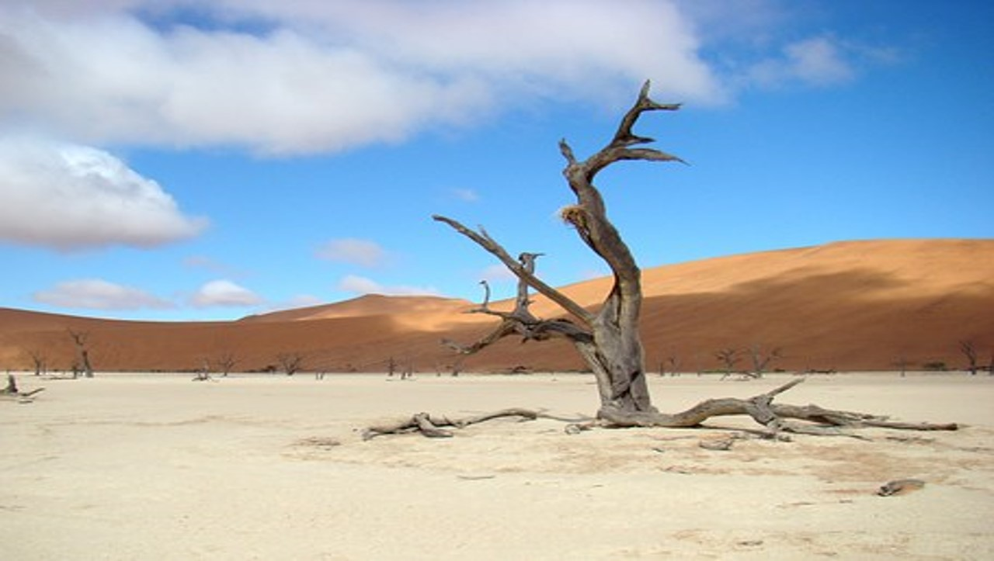
However, Adam and Eve did not yet understand that if they remained in the garden they could not progress by experiencing opposition in mortality.
They could not know joy because they could not experience sorrow and pain. Furthermore, they could not have children.
Satan tempted Adam and Eve to eat the forbidden fruit, and they chose to do so. Because of this choice, they were cast out from God’s presence and became fallen and mortal. Adam and Eve’s transgression and the changes they experienced as a result, including spiritual and physical death, are called the Fall.

Slide 12
Spiritual death is separation from God.
Physical death is the separation of the spirit from the mortal body.

Slide 13
The Fall is an essential part of Heavenly Father’s plan of salvation.
As a result of the Fall, Adam and Eve could have children. They and their posterity could experience joy and sorrow, know good from evil, and progress.
And now, behold, if Adam had not transgressed he would not have fallen, but he would have remained in the garden of Eden. And all things which were created must have remained in the same state in which they were after they were created; and they must have remained forever, and had no end.
And they would have had no children; wherefore they would have remained in a state of innocence, having no joy, for they knew no misery; doing no good, for they knew no sin.
But behold, all things have been done in the wisdom of him who knoweth all things.
Adam fell that men might be; and men are, that they might have joy.
2 Nephi 2:22-25

Slide 14
Lesson 21
Our Inheritance
As descendants of Adam and Eve, we inherit a fallen condition during mortality.
We are separated from God’s presence and are subject to physical death.
We are also tested by the difficulties of mortal life and the temptations of the adversary.
While we are not accountable for Adam and Eve’s transgression, we are responsible for our own sins. Through the Atonement of Jesus Christ, we can overcome the negative effects of the Fall, receive forgiveness for our sins, and eventually experience a fulness of joy.
Genesis 1:28; Mosiah 3:19; Alma 34:9–10

Slide 15

Mortal Life
Mortal life is a time of learning, during which we prove that we will use our agency to do all that the Lord has commanded and prepare for eternal life by developing divine attributes.
We do this as we exercise faith in Jesus Christ and His Atonement, repent, receive saving ordinances and covenants such as baptism and confirmation, and faithfully endure to the end of our mortal lives in following the example of Jesus Christ.
In mortality our spirits are united with our physical bodies, giving us opportunities to grow and develop in ways that were not possible in the premortal life. Because our Father in Heaven has a tangible body of flesh and bone, our bodies are necessary for us to progress and become like Him. Our bodies are sacred and should be respected as a gift from our Heavenly Father.
… know ye not that your body is the temple of the Holy Ghost which is in you, which ye have of God,…
1 Corinthians 6:19

Slide 16
Life After Death
When we die, our spirits enter the spirit world and await the Resurrection.
The spirits of the righteous are received into a state of happiness, which is called paradise. Those who die without knowledge of the truth and those who are disobedient in mortality enter a temporary place in the postmortal world called spirit prison.
Every person eventually will have the opportunity to learn the principles of the gospel and receive its ordinances and covenants. Many of the faithful will preach the gospel to those in spirit prison. Those who choose to receive the gospel, repent, and accept the ordinances of salvation that are performed for them in temples will dwell in paradise until the Resurrection (see 1 Peter 4:6).
For for this cause was the gospel preached also to them that are dead, that they might be judged according to men in the flesh, but live according to God in the spirit.1 Peter 4:6

Slide 17
Lesson 21
Resurrection
Resurrection is the reuniting of our spirit bodies with our perfected physical bodies of flesh and bone. After resurrection we will be immortal—our spirit and body will never again be separated.
Every person born on earth will be resurrected because Jesus Christ overcame physical death.
The righteous will be resurrected before the wicked and will come forth in the First Resurrection.
1 Corinthians 15:20-22

Slide 18
Lesson 21
Final Judgment
The Final Judgment will occur after the Resurrection.
Jesus Christ will judge each person to determine the eternal glory that he or she will receive.
This judgment will be based on each person’s desires and obedience to God’s commands
And I saw the dead, small and great, stand before God; and the books were opened: and another book was opened, which is the book of life: and the dead were judged out of those things which were written in the books, according to their works.

Slide 19
Lesson 21
Kingdoms of Glory
There are three kingdoms of glory: the celestial kingdom, the terrestrial kingdom, and the telestial kingdom.
Those who are valiant in the testimony of Jesus and obedient to the principles of the gospel will dwell in the celestial kingdom in the presence of God the Father and His Son, Jesus Christ, and with their righteous family members.
There are also celestial bodies, and bodies terrestrial: but the glory of the celestial is one, and the glory of the terrestrial is another. 1 Corinthians 15:40
Luke 24:36–39; John 17:3; D&C 131:1–4

Slide 20
Sources:
Suggested Hymn: #133 Father In Heaven
Dieter F. Uchtdorf, “O How Great the Plan of Our God!” Ensign, Nov. 2016, 21
Old Testament Seminary Teacher’s Manual
Lesson 21

Slide 21
What we learn about God’s Plan
What does this matter to me?
What we learn about God’s Plan
What does this matter to me?

