Slide 1
Lesson 23
Abraham’s Seed
Abraham 2
Genesis 12
And it shall come to pass that my people, which are of the house of Israel, shall be gathered home unto the lands of their possessions; and my word also shall be gathered in one. And I will show unto them that fight against my word and against my people, who are of the house of Israel, that I am God, and that I covenanted with Abraham that I would remember his seed forever.
2 Nephi 29:14

Slide 2
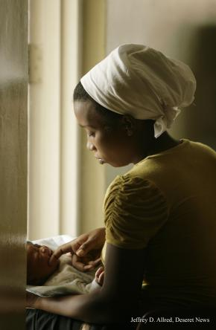
Who Are You?
“You may enjoy music, athletics, or be mechanically inclined, and someday you may work in a trade or a profession or in the arts. As important as such activities and occupations can be, they do not define who we are.
First and foremost, we are spiritual beings.
We are sons [and daughters] of
__________
and the seed of _______________________.”
God
Abraham
(1)

Slide 3
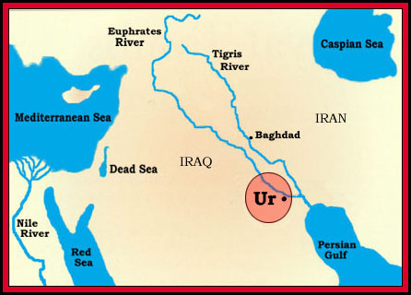
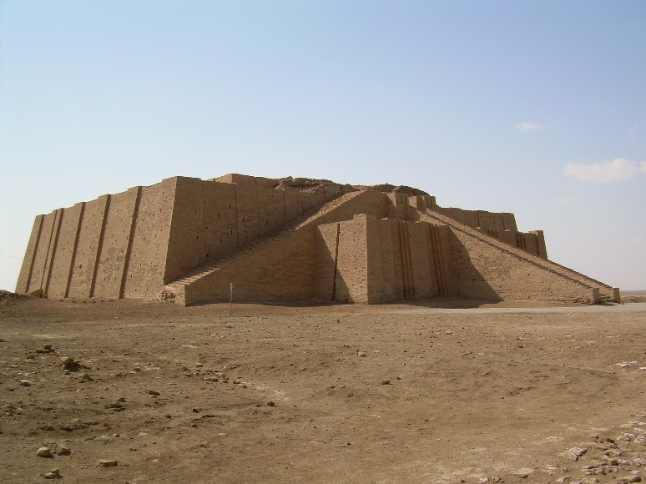
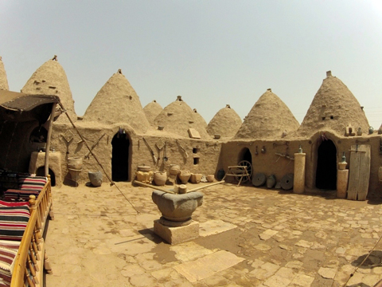
Abraham Moves
Ur First residence of Abraham, near the mouth of the Euphrates, where he was almost a victim of
human sacrifice, saw the
angel of Jehovah, and
received the Urim and
Thummim.
Haran
Canaan
Ur
Haran Abraham settled here for a time before going to Canaan. Abraham’s father and brother remained here. Rebekah (Isaac’s wife), and Rachel, Leah, Bilhah, and Zilpah (Jacob’s wives), came from this area.
Canaan Abraham, Isaac, Jacob, and their descendants were given this land for an everlasting possession.
Haran
Abraham 2:1-5
(2)

Slide 4
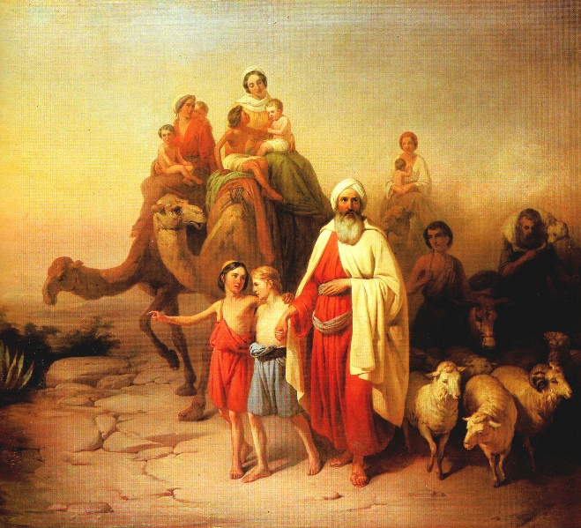
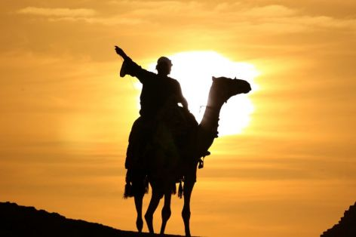
Abraham Moves
What did the Lord want Abraham to be?
What did the Lord promise to give Abraham and his seed?
What did Abraham’s posterity
need to do in order to receive
the land?
Abraham 2:6
(2)

Slide 5
The Abrahamic Covenant
Responsibilities
Blessings
Be a minister of Jesus Christ
Hearken to the Lord’s voice
Receive land for an everlasting possession.
Abraham 2:6

Slide 6
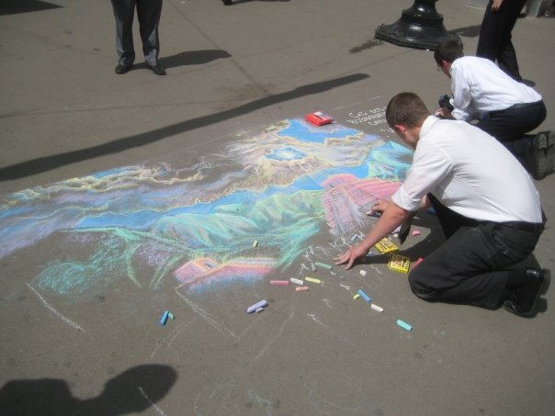
To All the Nations
The Lord promised Abraham that his descendants would take the priesthood and the blessings of the gospel of Jesus Christ to all the nations of the earth.
All those who receive the ordinances and live the gospel of Jesus Christ receive the same promises that the Lord gave to Abraham. They will be called Abraham’s seed (posterity), and will receive eternal life.
Abraham 2:9-11; Genesis 12:2-3
(3)

Slide 7
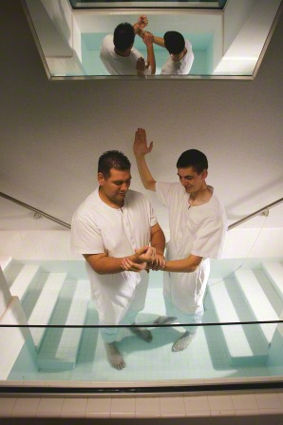
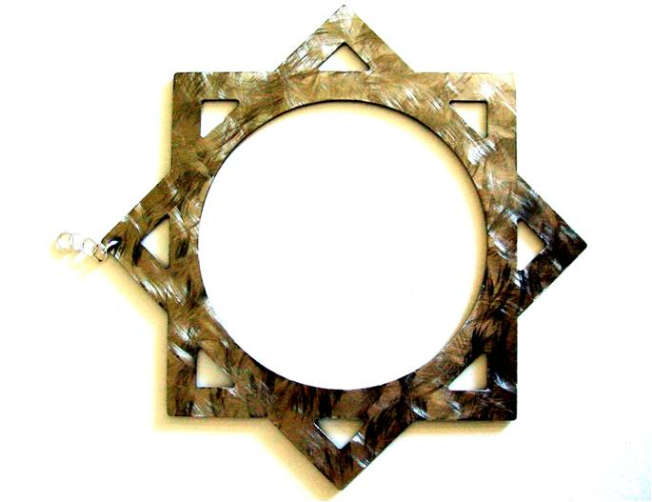
Promises
“Abraham first received the gospel by baptism (which is the covenant of salvation);
then he had conferred upon him the higher priesthood, and he entered into celestial marriage (which is the covenant of exaltation), gaining assurance thereby that he would have eternal increase;
finally he received a promise that all of these blessings would be offered to all of his mortal posterity.”
Abraham 2:9-11; Genesis 12:2-3
(4)

Slide 8
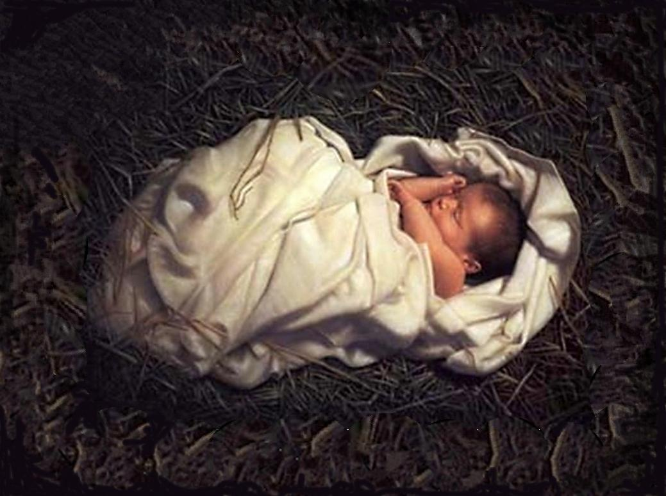
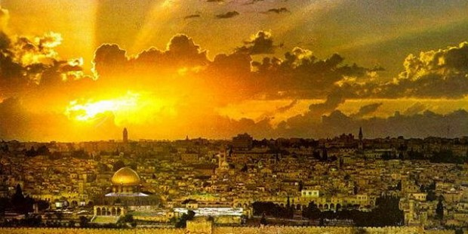
Lineage of Christ
“Included in the divine promises to Abraham was the assurance that Christ would come through his lineage, and the assurance that Abraham’s posterity would receive certain choice, promised lands as an eternal inheritance.”
Matthew 1:1; Genesis 17
(4)

Slide 9
Above Measure/Innumerable
…Abraham and his seed, out of the world they should continue; both in the world and out of the world should they continue as innumerable as the stars; or, if ye were to count the sand upon the seashore ye could not number them.
D&C 132:30
Abraham 2:9; Abraham 3:14

Slide 10
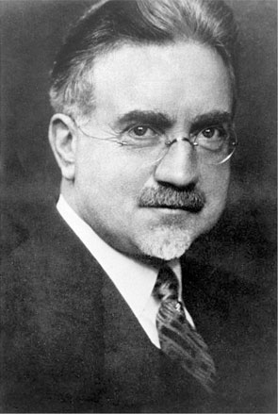
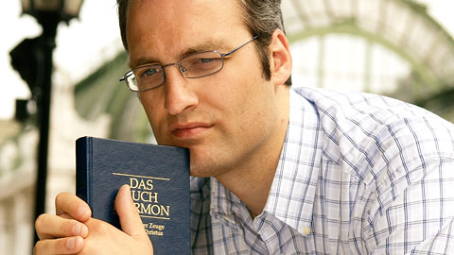
Who is Abraham’s Seed?
“…All who accept the gospel become by adoption members of the family of Abraham.”
“All who accept God’s plan for his children on earth and who live it…Those who reject the gospel forfeit the promises made to Abraham and are not children of Abraham.”
Abraham 2:10
(5)

Slide 11
Minister
As the seed of Abraham, we have a responsibility to minister to and bless all the families of the earth with the blessings of the gospel.
“His seed are the ministers of Christ; they hold the holy priesthood; they have received the divine commission to preach the gospel in all the world and to every creature And what are the blessings they offer mankind? They are salvation and eternal life.”
Abraham 2:11
(4)

Slide 12
“Truly, great responsibility rests upon the seed of Abraham in these latter days. …
“… We are here upon the earth at this time to magnify the priesthood and to preach the gospel. That is who we are, and that is why we are here.”
Abraham 2:11
(1)

Slide 13
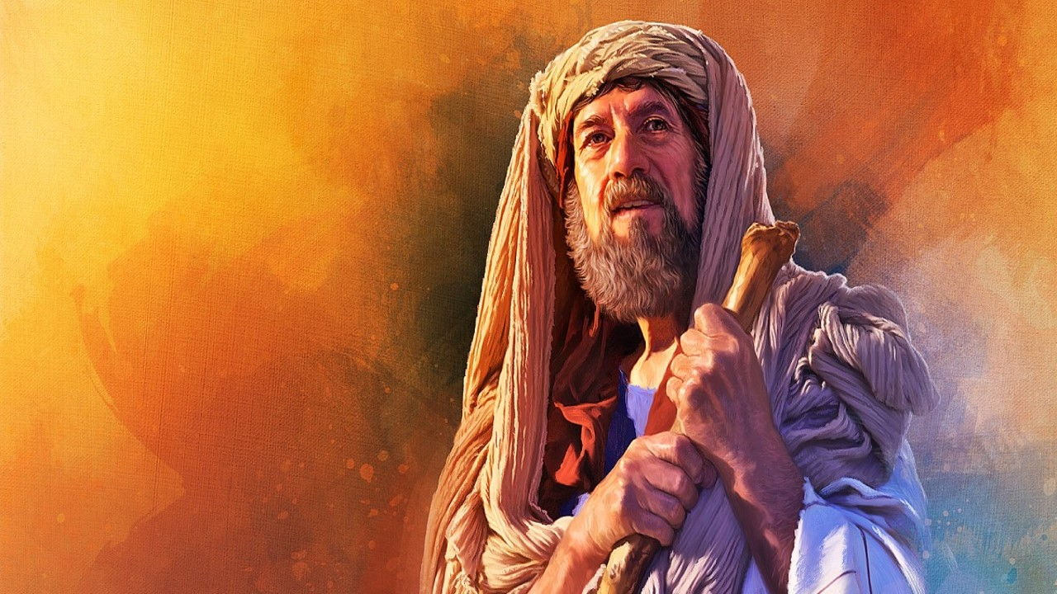
Now, after the Lord had withdrawn from speaking to me, and withdrawn his face from me, I said in my heart: Thy servant has sought thee earnestly; now I have found thee;
If we seek the Lord earnestly, we will find Him
Abraham 2:12

Slide 14
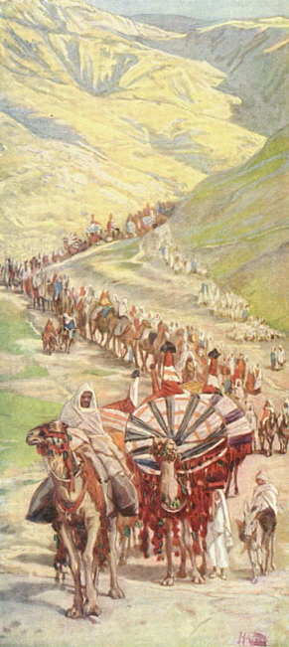
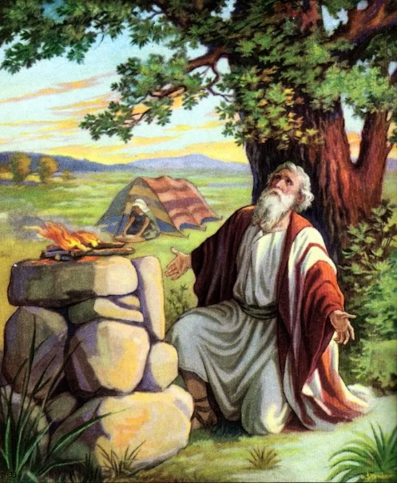
Canaan
Abraham was 62 years old when he left Haran, whereas Genesis 12:4 says he was 75 years old.
He took his wife, and nephew Lot, and those followers. The scriptures say he obtained many servants.
At one time he had 318 trained servants armed and fighting men.(Gen. 14:14)
He also had many flocks in Haran. (Abr. 2:5)
Canaan was given as the promised land to Abraham and his seed as part of the Abrahamic Covenant
Abraham 2:14-20

Slide 15
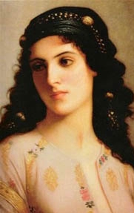
Famine in Canaan
Before Abraham entered Egypt, the Lord warned him that the Egyptians would see how beautiful Sarai was and would kill Abraham so they could take her.
Therefore, the Lord instructed Sarai to say that she was Abraham’s sister to save Abraham’s life and to protect herself.
Both Sarai and Abraham acted in faith, believing that God would deliver them.
Canaan
Egypt
Abraham 2:22–25; Genesis 12:14–20

Slide 16
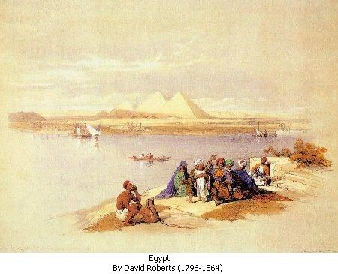
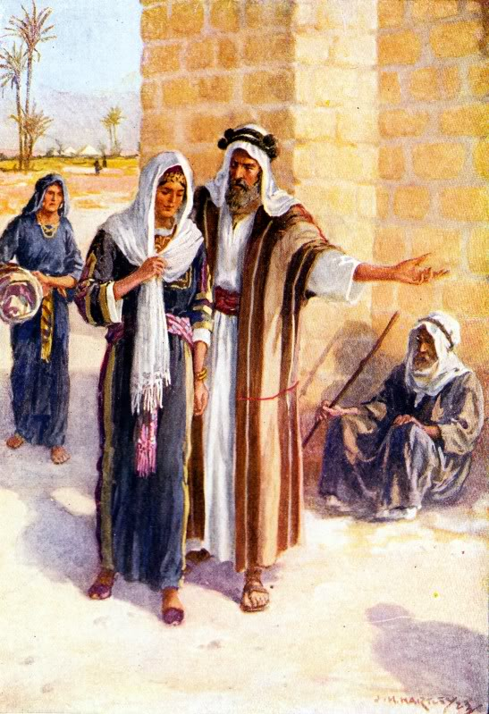
Sarai and Abraham in Egypt
Both Sarai and Abraham acted in faith, believing that God would deliver them. Sarai was taken into Pharaoh’s house, and Abraham was given riches..
The Lord sent a plague to Pharaoh and his house, and Pharaoh realized that Sarai was being protected by God and that she was married to Abraham. Pharaoh then sent Abraham and Sarai away.
Abraham 2:22–25; Genesis 12:14–20

Slide 17
Sources:
Suggested Song: #6 Redeemer of Israel
Videos:
The Abrahamic Covenant (7:16)
Your Day For a Mission (3:31)
Elder David A. Bednar (“Becoming a Missionary,” Ensign or Liahona, Nov. 2005, 47).
(“Becoming a Missionary,” 47).
2. Bible Maps (map 9)
3. The Pearl of Great Price: Teacher Manual, (2000), 40–42
4. Bruce R. McConkie Mormon Doctrine, p. 13
Millennial Messiah pp. 263-64 and Improvement Era, June 1959
5. John A. Widtsoe Evidences and Reconciliations, 3:28. See also Brigham Young, Journal of Discourses, 7:290-91
Presentation by ©http://fashionsbylynda.com/blog/

Slide 18
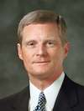
“You may enjoy music, athletics, or be mechanically inclined, and someday you may work in a trade or a profession or in the arts. As important as such activities and occupations can be, they do not define who we are. First and foremost, we are spiritual beings. We are sons [and daughters] _____________________of and the seed of _________________________________”
(David A. Bednar, “Becoming a Missionary,” Ensign or Liahona, Nov. 2005, 47).
“You may enjoy music, athletics, or be mechanically inclined, and someday you may work in a trade or a profession or in the arts. As important as such activities and occupations can be, they do not define who we are. First and foremost, we are spiritual beings. We are sons [and daughters] _____________________of and the seed of _________________________________”
(David A. Bednar, “Becoming a Missionary,” Ensign or Liahona, Nov. 2005, 47).
“You may enjoy music, athletics, or be mechanically inclined, and someday you may work in a trade or a profession or in the arts. As important as such activities and occupations can be, they do not define who we are. First and foremost, we are spiritual beings. We are sons [and daughters] _____________________of and the seed of _________________________________”
(David A. Bednar, “Becoming a Missionary,” Ensign or Liahona, Nov. 2005, 47).
“You may enjoy music, athletics, or be mechanically inclined, and someday you may work in a trade or a profession or in the arts. As important as such activities and occupations can be, they do not define who we are. First and foremost, we are spiritual beings. We are sons [and daughters] _____________________of and the seed of _________________________________”
(David A. Bednar, “Becoming a Missionary,” Ensign or Liahona, Nov. 2005, 47).
“You may enjoy music, athletics, or be mechanically inclined, and someday you may work in a trade or a profession or in the arts. As important as such activities and occupations can be, they do not define who we are. First and foremost, we are spiritual beings. We are sons [and daughters] _____________________of and the seed of _________________________________”
(David A. Bednar, “Becoming a Missionary,” Ensign or Liahona, Nov. 2005, 47).
“You may enjoy music, athletics, or be mechanically inclined, and someday you may work in a trade or a profession or in the arts. As important as such activities and occupations can be, they do not define who we are. First and foremost, we are spiritual beings. We are sons [and daughters] _____________________of and the seed of _________________________________”
(David A. Bednar, “Becoming a Missionary,” Ensign or Liahona, Nov. 2005, 47).
“You may enjoy music, athletics, or be mechanically inclined, and someday you may work in a trade or a profession or in the arts. As important as such activities and occupations can be, they do not define who we are. First and foremost, we are spiritual beings. We are sons [and daughters] _____________________of and the seed of _________________________________”
(David A. Bednar, “Becoming a Missionary,” Ensign or Liahona, Nov. 2005, 47).
“You may enjoy music, athletics, or be mechanically inclined, and someday you may work in a trade or a profession or in the arts. As important as such activities and occupations can be, they do not define who we are. First and foremost, we are spiritual beings. We are sons [and daughters] _____________________of and the seed of _________________________________”
(David A. Bednar, “Becoming a Missionary,” Ensign or Liahona, Nov. 2005, 47).

Slide 19
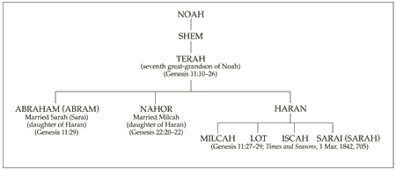
For Further Reading:
The Abrahamic Covenant
By S. Michael Wilcox
January 1998 Ensign
Abraham called his wife sister:
The idea that Abraham, the great man of righteousness, deceived Pharaoh in order to protect his own life has troubled many students of the Old Testament. That his life was in danger because of Sarah’s beauty seems quite clear. It seems peculiar, but whereas the Egyptian pharaohs had a strong aversion to committing adultery with another man’s wife, they had no qualms about murdering the man to free his spouse for remarriage.
“To kill the husband in order to possess himself of his wife seems to have been a common royal custom in those days. A papyrus tells of a Pharaoh who, acting on the advice of one of his princes, sent armed men to fetch a beautiful woman and make away with her husband. Another Pharaoh is promised by his priest on his tombstone, that even after death he will kill Palestinian sheiks and include their wives in his harem.” (Kasher, Encyclopedia of Biblical Interpretation, 2:128.)
Abraham could validly state that Sarah was his sister. In the Bible the Hebrew words brother and sister are often used for other blood relatives. (See Genesis 14:14, in which Lot, Abraham’s nephew, is called “his brother.”) Because Abraham and Haran, Sarah’s father, were brothers, Sarah was Abraham’s niece and thus could be called sister. The accompanying pedigree chart shows this relationship.
Another ancient custom that might shed light on the relationship permitted a woman to be adopted as a man’s sister upon their marriage to give her greater legal and social status (see Encyclopaedia Judaica,s.v. “Sarah,” 14:866).
Even though Abraham was correct in calling her his sister, he did deceive the Egyptians. How can this action be justified? The answer is very simple. His action was justified because God told him to do it (see Abraham 2:22–25). Old Testament Institute manual
Abrahamic Covenant:
“The covenant was renewed with Isaac (Genesis 24:60) and again with Jacob. (Gen. 28; 35:9-13.) Those portions of it which pertain to personal exaltation and eternal increase are renewed with each member of the House of Israel who enters the order of celestial marriage; through that order the participating parties become inheritors of all the blessings of the Abraham, Isaac, and Jacob. (D&C 132; Romans 9:4; Galatians 3;4) Bruce R. McConkie Mormon Doctrine, p. 13
Lineage:
Elder David A. Bednar of the Quorum of the Twelve Apostles explained when we accepted the responsibility to be part of Abraham’s posterity:
“We were foreordained in the premortal existence to the blessings associated with birth through a particular lineage, even the chosen lineage of Abraham—not because we are better, not because we are more special, but because we have particular responsibilities that we covenanted we would fulfill. Therefore we came to the earth through a lineage with the birthright blessing of the priesthood. Every man who holds the priesthood was foreordained to that very responsibility in the premortal existence” (“Teach Them to Understand” [Brigham Young University–Idaho Education Week devotional, June 4, 1998];byui.edu).

Slide 20
Sarai as a sister:
“Sarai was instructed to tell the Egyptians that she was Abraham’s sister. It was a test of her faith, just as it was undoubtedly a difficult experience for Abraham. Whatever the Lord commands a person to do is right and must be obeyed (see Teachings of the Prophet Joseph Smith, 256). Abraham and Sarai understood this principle and passed the divine test the Lord had put before them. Elder Mark E. Petersen [of the Quorum of the Twelve Apostles] wrote: ‘To protect himself, Abraham had told Pharaoh that [Sarai] was his sister, which of course she was. Had he divulged that she was his wife, he might have been slain. But as his sister, Pharaoh was willing to buy her at a good price’ (Abraham, Friend of God [1979], 69; see also Genesis 20:12; for further discussion of this, see S. Kent Brown, “Biblical Egypt: Land of Refuge, Land of Bondage,” Ensign, Sept. 1980, pp. 45, 47)” (The Pearl of Great Price Student Manual [Church Educational System manual, 2000], 35).
Name Change:
In Genesis 12, Abraham and Sarah are still called Abram and Sarai. But later, when the Lord formalized His covenant with Abram and Sarai, they received new names.
Genesis 17:5 records that Abram’s name was changed to Abraham. Ab means “father.” Rah means “exalted.” Am means “nations.” Thus, Abraham symbolizes the covenant by which Abraham would become an exalted father of nations or a god (see D&C 132:37).
Sarai, which possibly means “contentions,” was changed to Sarah, which means “princess” (see Genesis 17:15) and also indicates Sarah’s future eternal role and exaltation (see Bible Dictionary, “Sarah or Sarai”). Accompanying Sarah’s new name was a blessing that her posterity would be great and that kings would descend from her (see Genesis 17:16).

