Slide 1

Lesson 26
The Plan of Salvation
Part 2

Slide 2






Slide 3
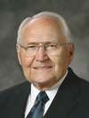
A Plan
In the premortal existence Heavenly Father introduced a plan to enable us to become like Him and obtain immortality and eternal life.
“Our Eternal Father did not send us to earth on an aimless, meaningless journey. He provided for us a plan to follow. He is the author of that plan. It is designed for man’s progress and ultimate salvation and exaltation.”
How does knowing that Heavenly Father has a plan for you affect the way you live your life?
(1)

Slide 4
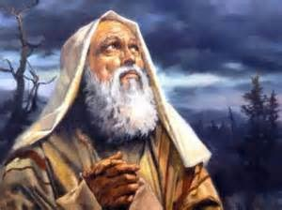
Immortality and Eternal Life
For behold, this is my work and my glory—to bring to pass the immortality and eternal life of man.
Moses 1:39
The Lord taught Moses about why He had created this world and about the work He had prepared for Moses to complete during his mortal life.

Slide 5

Immortal, Immortality
…the paradise of God must deliver up the spirits of the righteous, and the grave deliver up the body of the righteous; and the spirit and the body is restored to itself again, and all men become incorruptible, and immortal, and they are living souls, having a perfect knowledge like unto us in the flesh, save it be that our knowledge shall be perfect.
2 Nephi 9:13
Immortality is the restoring of the spirit to the body,
The condition of living forever in a resurrected state, not subject to physical death.
Spirits united with their bodies become immortal, never to die again.
(Alma 11:35)
God’s work and glory is to bring to pass the immortality and eternal life of man. (Moses 1:39)

Slide 6


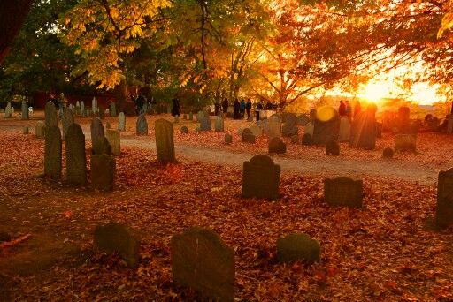
Eternal Life
To live forever as families in God’s presence.
Eternal life is God’s greatest gift to man.
D&C 132:19–20, 24, 55
To be spiritually minded is life eternal.
2 Ne. 9:39
Behold, I am the law, and the light. Look unto me, and endure to the end, and ye shall live; for unto him that endureth to the end will I give eternal life.
3 Nephi 15:9
To believe in Christ and endure to the end is life eternal.
All who die without the gospel who would have received it had they lived are heirs of the celestial kingdom.
D&C 137:7–9

Slide 7




(click enter for timer)

Slide 8
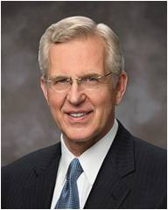
Moral Agency
“We are in a mortal experience because we cannot become as God without that experience. We must prove to Him and to ourselves that we can consistently make the right choices and then stick to those choices, come what may. …
“… God is interested in what we are becoming as a result of our choices. He is not satisfied if our exercise of moral agency is simply a robotic effort at keeping some rules. Our Savior wants us to become something, not just do some things. He is endeavoring to make us independently strong—more able to act for ourselves. …
Our eternal progression depends on how we use the gift of moral agency
“Using our agency to choose God’s will, and not slackening even when the going gets hard, will not make us God’s puppet; it will make us like Him.
God gave us agency, and Jesus showed us how to use it so that we could eventually learn what They know, do what They do, and become what They are.”
(2)

Slide 9
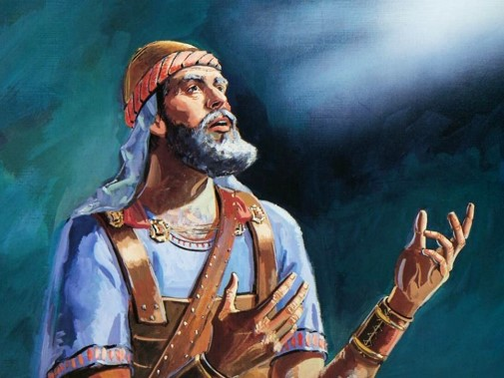
Joshua
And if it seem evil unto you to serve the Lord, choose you this day whom ye will serve; whether the gods which your fathers served that were on the other side of the flood, or the gods of the Amorites, in whose land ye dwell: but as for me and my house, we will serve the Lord.
Joshua 24:15
At the end of the prophet Joshua’s life he gathered the children of Israel together and recounted how the Lord had miraculously led them out of Egypt and blessed them to overcome their enemies in the promised land.
Joshua challenged the people to be obedient and serve the Lord and not yield to temptation.

Slide 10
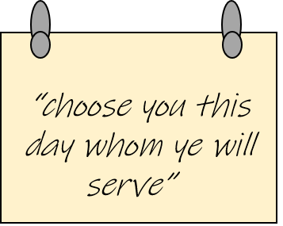
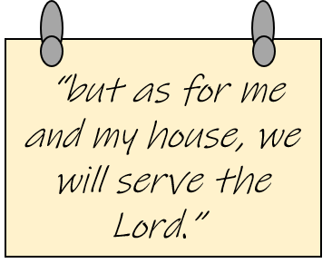
Are the choices I am currently making helping me become more like God?
In what areas of my life do I need to change or improve so I can progress spiritually?
What choices will I make today to righteously exercise my agency and serve the Lord?

Slide 11
Sources:
L. Tom Perry, “The Plan of Salvation,” Ensign or Liahona, Nov. 2006, 70.
D. Todd Christofferson “Moral Agency” Ensign, June 2009, 53.

