Slide 1
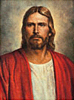
Lesson 3
The Role of the Learner
Suggested Hymn:
#304
Teach Me to Walk in the Light
Old Testament
Presentation by ©http://fashionsbylynda.com/blog/

Slide 2
What do you think is the most important position on the team?
What position is least important?
What would happen if you removed a position from your team and then tried to compete?
What would happen if the player in that position was there, but he (or she) either did not understand his role or expected others to fulfill his role?
It is important for each player to understand and fulfill his or her role in order for the team to be successful in achieving its objective

Slide 3
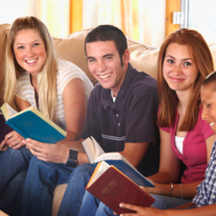
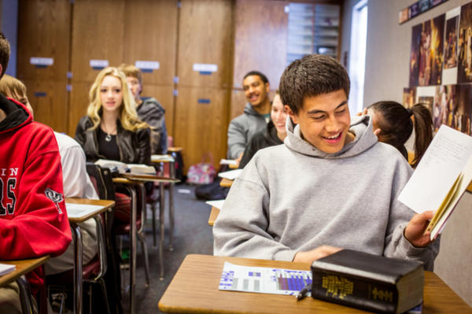
“To help youth and young adults understand and rely on the teachings and Atonement of Jesus Christ, qualify for the blessings of the temple, and prepare themselves, their families, and others for eternal life with their Father in Heaven”
As a member of our seminary class, what do you think your role is in accomplishing this purpose?
What is the purpose of Seminary?

Slide 4
Which position or role do you think is the most important?
Which do you think is the least important?
What would happen if we removed one of these roles from our seminary class?
What would happen if one of these individuals did not understand their role or expected others to fulfill their role?
Holy Ghost
Teacher
Student
Gospel Teaching and Learning

Slide 5
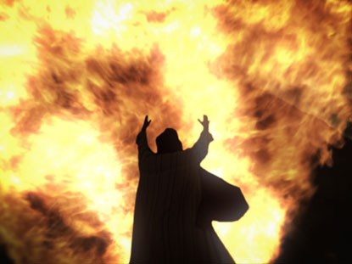
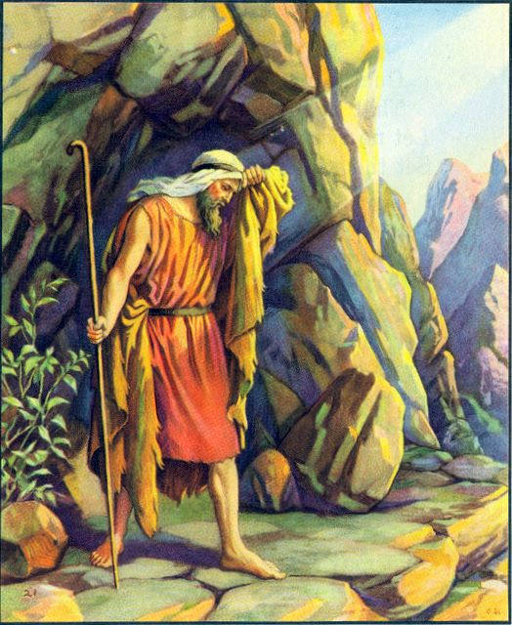
And he said, Go forth, and stand upon the mount before the Lord. And, behold, the Lord passed by, and a great and strong wind rent the mountains, and brake in pieces the rocks before the Lord; but the Lord was not in the wind: and after the wind an earthquake; but the Lord was not in the earthquake:
And after the earthquake a fire; but the Lord was not in the fire: and after the fire a still small voice.
And it was so, when Elijah heard it, that he wrapped his face in his mantle, and went out, and stood in the entering in of the cave. And, behold, there came a voice unto him, and said, What doest thou here, Elijah?
Holy Ghost
1 Kings 19:11-13

Slide 6
“Please know that your Father in Heaven loves you and so does His Only Begotten Son.
When They speak to you—and They will—it will not be in the wind, nor in the earthquake, nor in the fire, but it will be with a voice still and small, a voice tender and kind”
--Elder Jeffrey R. Holland
If the role of the Holy Ghost is to carry the truth to learners’ hearts, what do you think the teacher’s role is in seminary?

Slide 7
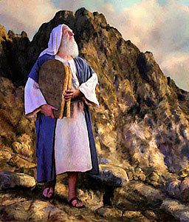
Hear, O Israel: The Lord our God is one Lord:
And thou shalt love the Lord thy God with all thine heart, and with all thy soul, and with all thy might.
And these words, which I command thee this day, shall be in thine heart:
And thou shalt teach them diligently unto thy children, and shalt talk of them when thou sittest in thine house, and when thou walkest by the way, and when thou liest down, and when thou risest up.
Teacher
The Lord commands teachers to teach the gospel by the Spirit
Deuteronomy 6:4-7

Slide 8
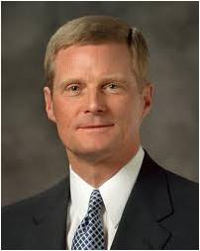
“A learner exercising agency by acting in accordance with correct principles opens his or her heart to the Holy Ghost and invites His teaching, testifying power, and confirming witness. Learning by faith requires spiritual, mental, and physical exertion and not just passive reception. …
“… A student must exercise faith and act in order to obtain the knowledge for himself or herself”
How do I obtain spiritual knowledge?
Student
Is there any way to transfer the strength that this student is building in his or her muscles to someone else?
Elder David A. Bednar

Slide 9
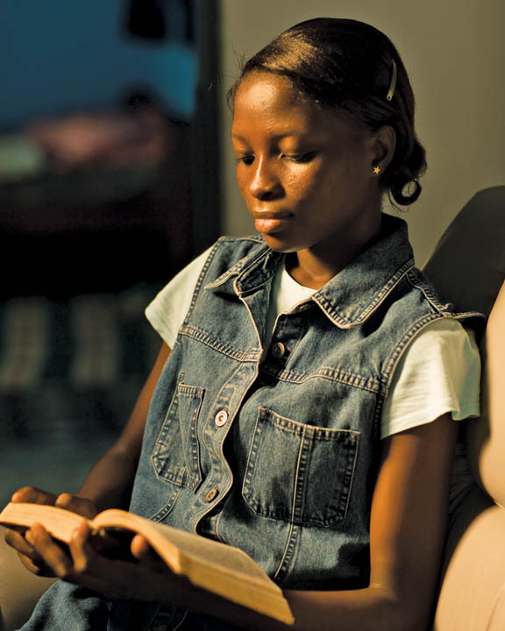
Obtaining spiritual knowledge requires effort on our part.
When we make an effort to fulfill our role as learners, we open our hearts to the Holy Ghost’s teaching power.
Elder David A. Bednar

Slide 10
Naaman was a captain in the Syrian army who suffered from a disease called leprosy.
A Jewish maid in his house suggested that the Israelite prophet Elisha in Samaria could heal him.
Naaman went with his horses and his chariot and stood at the door of Elisha’s house.
2 Kings 5

Slide 11
The prophet sent a messenger out to tell Naaman that if he washed himself in the Jordan River seven times he would be healed. This message made Naaman angry.
Naaman left. But his servants followed him and said,
“If the prophet had bid thee do some great thing, wouldest thou not have done it? how much rather then, when he saith to thee, Wash, and be clean?”
2 Kings 5

Slide 12
Naaman then went to the Jordan River and washed himself seven times as the prophet Elisha had instructed him. When he came out of the river, he was completely healed.
Naaman returned to Elisha’s house, happy and thankful. He told the prophet that he knew that he had been healed by the power of God, and he promised that from then on he would worship only God.
2 Kings 5

Slide 13
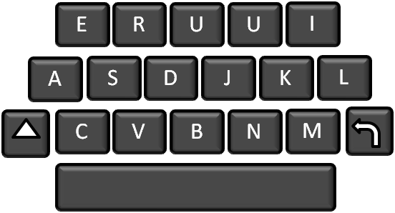
Develop a habit of daily scripture study.
Discover and express doctrines and principles that are relevant to their personal lives.
Ask questions and seek answers that help them better understand the gospel and how it applies to their lives.
Share insights, experiences, and feelings.
Explain gospel doctrines and principles to others and testify of their truthfulness.
Develop scripture study skills, such as marking, cross-referencing, and using the scripture study aids.
How can I make this Seminary year more meaningful to me?
X
zZ

Slide 14
Sources:
“The Objective of Seminaries and Institutes of Religion,” Gospel Teaching and Learning [2012].
Elder Jeffrey R. Holland (“The Tongue of Angels,” Ensign or Liahona, May 2007, 18).
Elder David A. Bednar (“Seek Learning by Faith,” Ensign, Sept. 2007, 64).
Presentation by ©http://fashionsbylynda.com/blog/

Slide 15
How the Holy Ghost’s Power relates to the roles of the teacher and the student: Elder David A. Bednar :
“Nephi teaches us, ‘When a man speaketh by the power of the Holy Ghost the power of the Holy Ghost carrieth [the message] unto the hearts of the children of men’ (2 Nephi 33:1). Please notice how the power of the Spirit carries the message unto but not necessarily into the heart. A teacher can explain, demonstrate, persuade, and testify, and do so with great spiritual power and effectiveness. Ultimately, however, the content of a message and the witness of the Holy Ghost penetrate into the heart only if a receiver allows them to enter” (“Seek Learning by Faith,” Ensign, Sept. 2007, 61).
“[A learner’s] decision to participate is an exercise in agency that permits the Holy Ghost to communicate a personalized message suited to [his or her] individual needs. Creating an atmosphere of participation enhances the probability that the Spirit will teach more important lessons than [the teacher] can communicate”
Elder Richard G. Scott (“To Learn and to Teach More Effectively” [BYU Campus Education Week devotional, Aug. 21, 2007], 4–5, speeches.byu.edu ).
This is a glorious time to be a youth in the Church. Remember that no matter how inspired parents, youth leaders, and seminary teachers may be, each student has responsibility for his or her own conversion. “You have [the] primary responsibility for your own conversion. No one can be converted for you, and no one can force you to be converted. However, others can help you in the process of conversion. Learn from the righteous examples of family members, Church leaders and teachers, and men and women in the scriptures” (True to the Faith: A Gospel Reference [2004], 43).
Conversion takes place when we are diligent about saying prayers, studying the scriptures, attending church, and being worthy to participate in church and temple ordinances. Conversion comes as we act on the righteous principles we learn in our homes and in the classroom. Conversion comes as we live pure and virtuous lives and enjoy the companionship of the Holy Ghost.
To the Teachers:
“Our students cannot know of God, and so love as they must love, unless they are taught by the Holy Spirit. Only by the Spirit can they know that God loved us enough to send His Son to be the [mediator] for our sins and that Jesus is the Son of God and that Christ paid the price of their sins. Only by the Spirit can they know that Heavenly Father and His resurrected and glorified Son appeared to Joseph Smith. Only by the Spirit can they know that the Book of Mormon is the true word of God. And only by inspiration can they feel the love of the Father and the Son for them in giving us the ordinances necessary to receive eternal life. Only by obtaining those witnesses, placed deep into their hearts by the Holy Ghost, will they be rooted on a sure foundation to stand steady through the temptations and trials of their lives” President Henry B. Eyring (“To Know and to Love God” [address to Church Educational System religious educators, Feb. 26, 2010], 2;si.lds.org).

