Slide 1
Lesson 39
Judah VS Joseph
Genesis 38-39
A man’s pride shall bring him low: but honour shall uphold the humble in spirit. Proverbs 29:23

Slide 2
Judah
Canaanite
Canaanite
Shuah
Judah, married a Canaanite woman (a daughter of Shuah).
Judah and his wife had three sons together: Er, Onan, and Shelah.
The oldest son, Er, married a woman named Tamar, but he died before they had children.
Shuah
Judah
Judah
Tamar
Er
Er
Onan
Tamar
Onan
Shelah
Shelah
According to the customary law at that time, a widow who had no children had claim on her husband’s next oldest brother or his closest living male relative.
This man, if asked by the widow, was obligated to marry her and raise up seed, or produce children, on behalf of his deceased brother.
Genesis 38:1-11

Slide 3
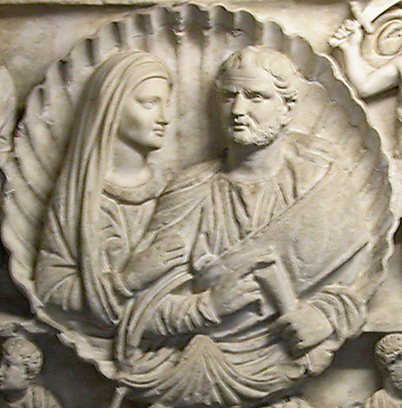
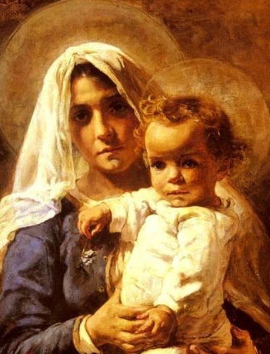
Levirate Marriage—Deut. 25:5-10
The custom of a widow marrying her deceased husband’s brother or sometimes a near heir.
5 ¶If brethren dwell together, and one of them die, and have no child, the wife of the dead shall not marry without unto a stranger: her husband’s brother shall go in unto her, and take her to him to wife, and perform the duty of an husband’s brother unto her.
6 And it shall be, that the firstborn which she beareth shall succeed in the name of his brother which is dead, that his
name be not put out of Israel.
7 And if the man like not to take his brother’s wife, then let his brother’s wife go up to the gate unto the elders, and say, My husband’s brother refuseth to raise up unto his brother a name in Israel, he will not perform the duty of my husband’s brother.
8 Then the elders of his city shall call him, and speak unto him: and if he stand to it, and say, I like not to take her;
9 Then shall his brother’s wife come unto him in the presence of the elders, and loose his shoe from off his foot, and spit in his face, and shall answer and say, So shall it be done unto that man that will not build up his brother’s house.
10 And his name shall be called in Israel, The house of him that hath his shoe loosed.
Genesis 38:8
Elizabeth Nourse

Slide 4
Deception
Canaanite
Shuah
However, when Shelah was old enough, Judah did not keep his promise to Tamar.
Tamar then resorted to deception in order to bear children by Judah, who had the responsibility to provide a husband and children for her.
Tamar
Judah
Er
Onan
Shelah
Had Judah faithfully kept his promise to Tamar, the seduction would never have taken place. Likewise, had Judah been faithful to the laws of morality, he never would have sinned with Tamar. (1)
Genesis 38:12-19

Slide 5
Secrets Exposed
Tamar’s choice to pretend to be a harlot so she could become pregnant by Judah violated the law of chastity.
Tamar knew that her actions might have serious consequences, such as being sentenced to death.
Judah sent his friend with a kid (a young goat) to pay the harlot and retrieve his signet, bracelets, and staff, but his friend could not find her.
Judah still did not realize that the woman he believed was a harlot was actually his daughter-in-law, Tamar.
By requesting Judah’s signet, bracelets, and staff, Tamar gathered evidence to show who the father of her child was.
Judah had no qualms about sending Tamar home with unfulfilled promises nor of picking up a harlot along the road.
But when he heard that Tamar was pregnant he was so incensed that he ordered her put to death.
Genesis 38:13-24

Slide 6
“The Church of Jesus Christ of Latter-day Saints has a single, undeviating standard of sexual morality: intimate relations are proper only between a man and a woman in the marriage relationship prescribed in God’s plan.
Such relations are not merely a curiosity to be explored, an appetite to be satisfied, or a type of recreation or entertainment to be pursued selfishly.
They are not a conquest to be achieved or simply an act to be performed.
Rather, they are in mortality one of the ultimate expressions of our divine nature and potential and a way of strengthening emotional and spiritual bonds between husband and wife.
We are agents blessed with moral agency and are defined by our divine heritage as children of God—and not by sexual behaviors, contemporary attitudes, or secular philosophies” (2)

Slide 7
Twins Are Born
Shuah
…that the one put out his hand: and the midwife took and bound upon his hand a scarlet thread, saying, This came out first.
Tamar
Judah
Zarah
Er
Pharez
Onan
And it came to pass, as he drew back his hand, that, behold, his brother came out: and she said, How hast thou broken forth? this breach be upon thee: therefore his name was called Pharez.
Shelah
Through the lineage of Pharez Jesus Christ was born
And afterward came out his brother, that had the scarlet thread upon his hand: and his name was called Zarah.
Genesis 38:27-30

Slide 8
Potiphar
His name means: he whom Ra (the sun-god)
He was a captain of the bodyguard of the pharaoh and benefactor of Joseph when he was sold into slavery
He was a wealthy man
He saw everything Joseph did and knew Joseph was blessed by the Lord and flourished
He made Joseph overseer of his house
His wife made multiple attempts to persuade Joseph to lie with her
Joseph resisted honorably
His wife accused Joseph falsely of licentious behavior
Potiphar became angry and put Joseph in the king’s prison
Genesis 39
(3)

Slide 9
Joseph’s Character
Joseph found grace in his (Potiphar’s) sight, and he served him: and he made him overseer over his house
Joseph was a goodly person, and well favoured
Joseph did not succumb to Potiphar’s wife’s temptations
Genesis 39:1-2

Slide 10
Doctrinal Mastery
Genesis 39:9
There is none greater in this house than I; neither hath he kept back any thing from me but thee, because thou art his wife: how then can I do this great wickedness, and sin against God?

Slide 11
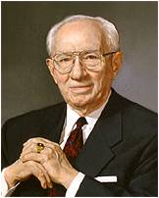
The influences today may be more apparent and more seductive, but they are no more compelling. You cannot be shielded entirely from these influences. They are all about us. Our culture is saturated with them. But the same kind of self-discipline exercised by Joseph will yield the same beneficial result.
Notwithstanding the so-called "new morality," notwithstanding the much-discussed changes in our moral standard, there is no adequate substitute for virtue. The old standard is challenged on every campus in America as it is in Europe. But God has not abrogated his commandments.
The violation of these commandments in this, as in any other age, brings only regret, sorrow, loss of self-respect, and in many cases tragedy. Rationalization and equivocation will not erase the cankering scar that blights the self-respect of a young man who takes that virtue which he can never replace. Self-justification will never mend the heart of a young woman who has drifted into moral tragedy.
(4)

Slide 12
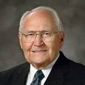
The Lord Was With Him
“We learn a great lesson from Joseph. When he was presented with a temptation, he immediately separated himself from even the appearance of evil.”
“Even making the right choices did not free Joseph from the challenges he faced in life.”
(5)

Slide 13
What Can We Learn From the Choices that Joseph made compared to Judah’s choices?
Our devotion to God gives us strength to resist temptation
If we remove ourselves from tempting situations, then we will have greater ability to resist temptation
If we do what is right, then the Lord will be with us and help us
(5)

Slide 14
Sources:
Suggested Hymn: #262 Go, Ye Messengers of Glory
Video: Joseph in Egypt (1:27) President Ezra Taft Benson
1. Old Testament Institute Manual
2. Elder David A. Bednar Ensign or Liahona, May 2013, 42).
3. Who’s Who in the Old Testament by Ed J. Pinegar and Richard J. Allen pg. 152
4. Gordon B. Hinckley (Conference Report, October 1964, pp. 116-119)
5. Elder L. Tom Perry Becoming Men in Whom the Spirit of God Is April 2002 Gen. Conf.
Presentation by ©http://fashionsbylynda.com/blog/

Slide 15
Levirate:
The word has nothing to do with the name Levi or the biblical Levites but is so called because of the Latin levir, meaning “husband’s brother,” connected with the English suffix -ate, thus constituting levirate.
Bible Dictionary
Scarlet Thread: something of interest
One reference to the scarlet thread in the Bible occurs during the birth of the twin sons of Judah and Tamar (Genesis 38:27–30). As Tamar was giving birth, the arm of one twin, Zerah, reached out of the birth canal, and immediately the midwife tied a scarlet thread to the baby’s wrist to designate Zerah as the firstborn. As it turned out, however, Zerah was not the firstborn; the arm was withdrawn into the womb, and the other twin, Perez, was born first. In the case of Perez and Zerah, the scarlet thread was to indicate who was to have the designation and privileges of the firstborn. To all appearances, Zerah seemed to be the one, but God had different plans, and Perez was the firstborn. In God’s providence, it was through Perez that the line of the Lord Jesus Christ proceeded (Matthew 1:3).
The Bible also mentions scarlet thread or scarlet yarn as part of the tabernacle’s curtains (Exodus 26:1) and the high priest’s ephod (Exodus 28:6), along with threads of gold, blue, and purple. Scripture does not comment on the significance of those colors in the curtains or ephod, but some commentators surmise that the gold, blue, and purple foreshadow Christ’s glory, heavenly origin, and kingly position, while the scarlet thread represents Christ’s atoning work on the cross through the shedding of His blood.
Theologians and Bible students sometimes refer to “the scarlet thread running through the Bible.” By this they mean that the Bible’s theme is Jesus Christ and His sacrifice for the redemption of mankind. The blood of Christ runs throughout the entire Bible, symbolically.
gotquestions.org
The purpose of such a marriage was to produce a male heir for the dead man and thus perpetuate his name and memory. It was regarded as a great calamity to die without a son, for then the man’s lineage did not continue and also the man’s property reverted to someone else’s family (through daughters, if he had any, or through other relatives). It may be that Onan, who by virtue of the death of his older brother would have been next in line for the inheritance of Judah, refused to raise up seed through Tamar because the inheritance would have stayed with the elder son’s family. He went through the outward show of taking Tamar to wife but refused to let her have children. Thus when Judah failed to keep his promise to send the youngest son to her, Tamar resorted to deception in order to bear children.
Old Testament Institute Manual
The Actions of Tamar and Judah:
Tamar’s actions show why Satan’s temptations are at times so compelling. In the ancient world, not having children would have meant embarrassment and even humiliation, perhaps resulting in a poorer quality of life for Tamar. Tamar feared the long-term consequences of remaining childless, and she viewed the risk of remaining childless as being greater than the risk of physical and spiritual death. Tamar took matters into her own hands instead of trusting in God.
We must also recognize that despite the double standard of Judah and Tamar’s situation, the Lord holds men and woman equally accountable in keeping the law of chastity. Although because of their culture Judah was not in as much physical danger as Tamar, the spiritual consequences of his violating the law of chastity were the same as they were for Tamar.
Seminary Teacher Manual

