Slide 1
Lesson 4
Studying the Scriptures
Thy word is a lamp unto my feet, and a light unto my path.
Psalms 119:105
Presentation by ©http://fashionsbylynda.com/blog/

Slide 2
What are the benefits of a good Friend?
My Friends

Slide 3
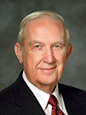
Scriptures Can Be Our Friends
“[The scriptures] can become stalwart friends that are not limited by geography or calendar. They are always available when needed. …
Learning, pondering, searching, and memorizing scriptures is like filling a filing cabinet with friends, values, and truths that can be called upon anytime, anywhere in the world. …
“… [Memorizing a scripture] is like discovering a new individual who can help in time of need, give inspiration and comfort, and be a source of motivation for needed change”
Elder Richard G. Scott

Slide 4
And it shall be with him, and he shall read therein all the days of his life: that he may learn to fear the Lord his God, to keep all the words of this law and these statutes, to do them:
Deuteronomy 17:19
This book of the law shall not depart out of thy mouth; but thou shalt meditate therein day and night, that thou mayest observe to do according to all that is written therein: for then thou shalt make thy way prosperous, and then thou shalt have good success.
Joshua 1:8
Thy word is a lamp unto my feet, and a light unto my path.
Psalms 119:105
Angels speak by the power of the Holy Ghost; wherefore, they speak the words of Christ. Wherefore, I said unto you, feast upon the words of Christ; for behold, the words of Christ will tell you all things what ye should do.
2 Nephi 32:3
And now, as the preaching of the word had a great tendency to lead the people to do that which was just—yea, it had had more powerful effect upon the minds of the people than the sword, or anything else, which had happened unto them—therefore Alma thought it was expedient that they should try the virtue of the word of God.
Alma 31:5

Slide 5
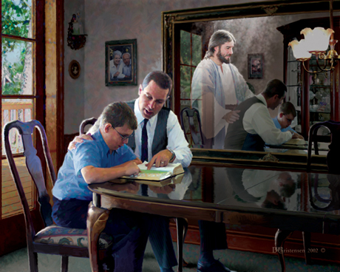
If We Study the Scriptures…
… they will help us learn to fear (respect) God and keep His commandments.
… they will tell us what to do to be prosperous and successful.
… they will light our path.
… they will lead us to do that which is just (righteous).
Doc Christensen
… they will tell us all things that we should do.
… they will heal our wounded souls.

Slide 6
Changing Your Routine
Instead of brushing for a couple of minutes every day, you’ve decided to brush for 15 minutes once a week.
You will also use seven times the usual amount of toothpaste so that your teeth will be thoroughly clean.
Why would this new plan not be a wise way to care for your teeth?
How can this example relate to our study of the scriptures?

Slide 7
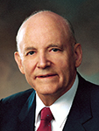
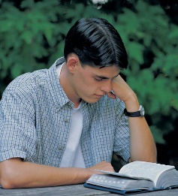
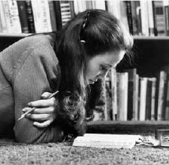
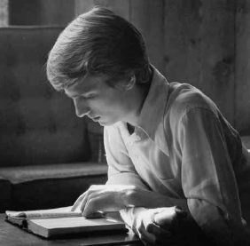
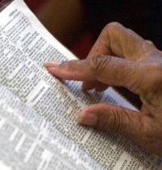
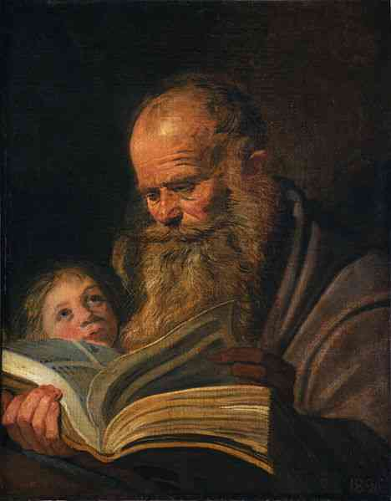
Every Day
Sunday
Monday
Tuesday
Wednesday
Thursday
Friday
Saturday
“It is certain that one who studies the scriptures every day accomplishes far more than one who devotes considerable time one day and then lets days go by before continuing.”
President Howard W. Hunter

Slide 8
Catching Something Worth While
“diamonds of truth that … must be carefully mined from the pages of the Old Testament” Elder Richard G. Scott
Doctrines
Principles
Jewelers often display diamonds on dark backgrounds.
Why do you think they do this?
Fundamental, unchanging truths of the gospel
Guide us in making decisions
A dark background helps the diamond stand out

Slide 9
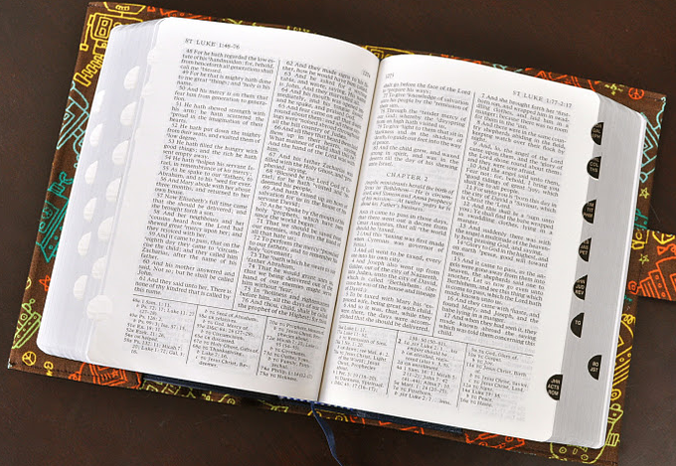
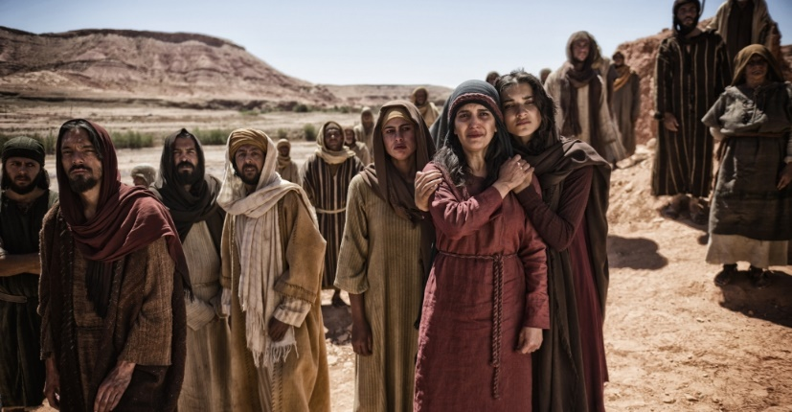
Identifying Doctrines and Principles
Understand the context and content of the scriptures.
Including historical and literary background, story line, people, events, and sermons in the scriptural text..
The context and content of the scriptures provide the background that helps doctrines and principles stand out more clearly

Slide 10
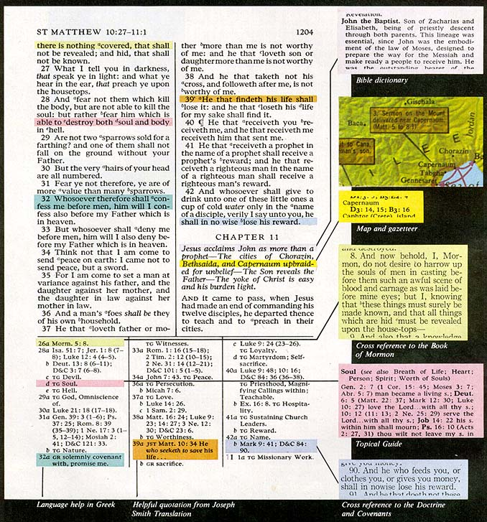
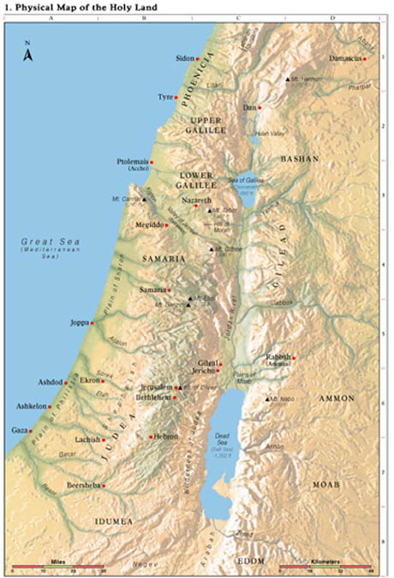
Scripture Study Aids
Chapter headings
Maps
TG-Topical Guide
Footnotes

Slide 11
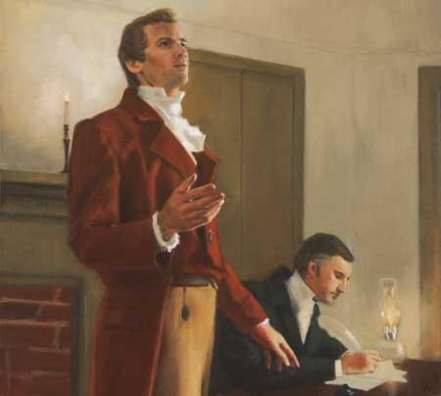
Joseph Smith’s Translation
A revision or translation of the King James Version of the Bible in English, which the Prophet Joseph Smith began in June 1830. He was commanded by God to make the translation and regarded it as part of his calling as a prophet.
Although Joseph completed most of the translation by July 1833, he continued until his death in 1844 to make modifications while preparing a manuscript for publication.
Though he published some parts of the translation during his lifetime, it is possible that he would have made additional changes had he lived to publish the entire work.
The Reorganized Church of Jesus Christ of Latter Day Saints published the first edition of Joseph Smith’s inspired translation in 1867. They have published several editions since that time.
The Guide to the Scriptures
Joseph Smith made inspired revisions to the Bible that restore lost content and clarify certain passages.
Many of these changes can be found in the footnotes or the appendix of the LDS edition of the Bible.

Slide 12
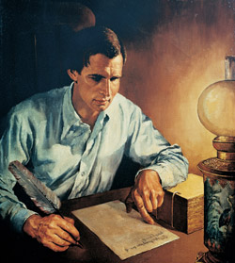
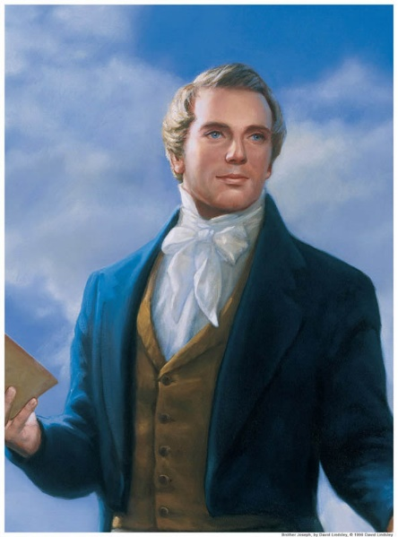
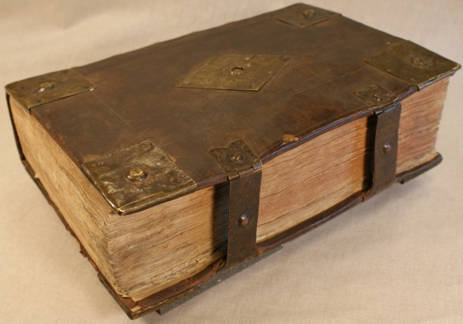
The Translation
The Prophet learned many things during the translation process. Several sections of the Doctrine and Covenants were received because of his translation work
The Book of Moses and Joseph Smith—Matthew, now included in the Pearl of Great Price, were taken directly from the Joseph Smith Translation.
The Joseph Smith Translation has restored some of the plain and precious things that have been lost from the Bible
(1 Ne. 13).
Although it is not the official Bible of the Church, this translation does offer many interesting insights and is very valuable in understanding the Bible. It is also a witness for the divine calling and ministry of the Prophet Joseph Smith.
London Library's collection of early English versions of the Bible, at the heart of which is a copy of the King James Bible of 1611.

Slide 13
Symbolism
What could fire possibly symbolize in scripture?
5.Then said I, Woe is me! for I am undone; because I am a man of unclean lips, and I dwell in the midst of a people of unclean lips: for mine eyes have seen the King, the Lord of hosts.
6.Then flew one of the seraphims unto me, having a live coal in his hand, which he had taken with the tongs from off the altar:
7. And he laid it upon my mouth, and said, Lo, this hath touched thy lips; and thine iniquity is taken away, and thy sin purged.
Isaiah 6:5-7
having a live ªcoal in his hand,
6a IE a symbol of cleansing.

Slide 14
Word Definitions
Dictionaries, footnotes, and scripture study aids can often help you to understand difficult words and phrases
Therefore thus saith the Lord of hosts, the God of Israel; Behold, I will feed them, even this people, with wormwood, and give them water of gall to drink.
Gall
Wormwood
Something bitter; hence the word is applied to bile and to the poison of serpents. More often it denotes the juice of some bitter plant
The herb Artemisia. Used metaphorically of bitter calamity or sorrow
¶They gave him vinegar to drink mingled with gall: and when he had tasted thereof, he would not drink.
Matthew 27:34

Slide 15
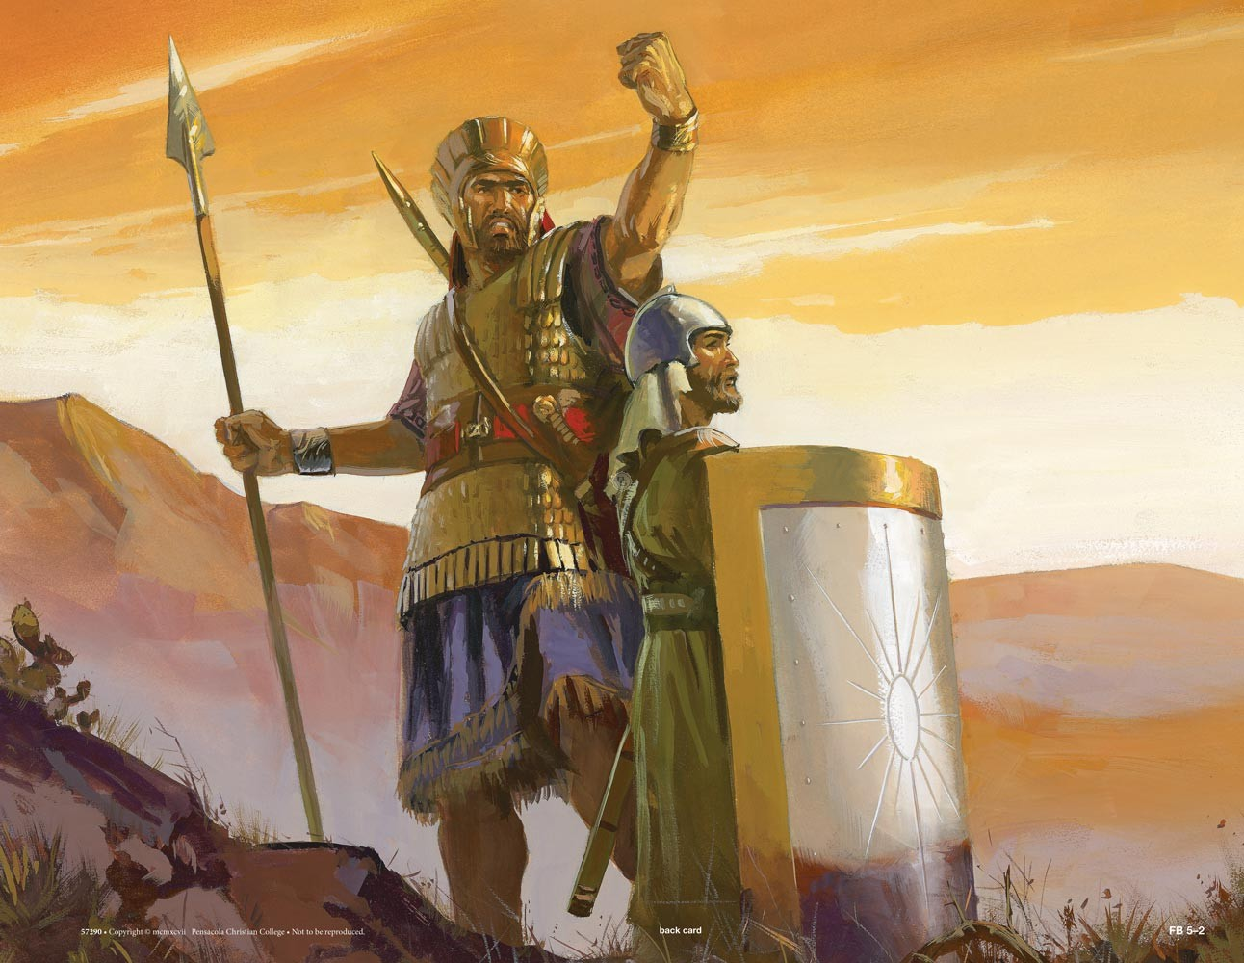
Understanding Principles
Some principles in the scriptures are clearly stated in the text and are easily identified by words and phrases such as:
Thus we see
Therefore
Wherefore
Behold
Other principles may be contained in the story line, events, parables, or people’s lives.

Slide 16
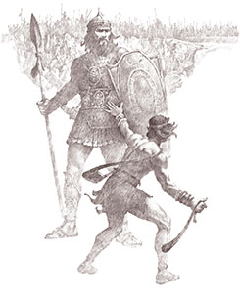
Applying the Gospel Doctrines and Principles
Read 1 Samuel 17:32-37
What is the moral or point of this story?
What can I learn from these passages?
What gospel truths are taught in this passage?
If I exercise faith in the Lord, He will help me overcome life’s challenges
What is the Principle?

Slide 17
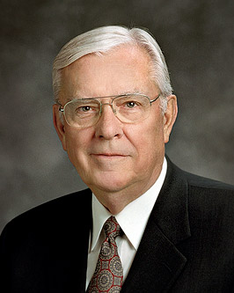
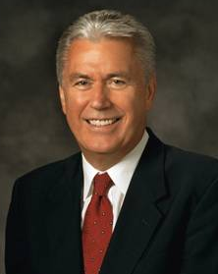
Applying Gospel Doctrine and Principles
“As you receive counsel and instruction, extract principles that will be eternally important in your lives and then make them part of your lives.”
Elder M. Russell Ballard
“The restored gospel of Jesus Christ blesses lives not just when we believe it—but much more when we live it. It is in the application of gospel principles that individuals are uplifted and families are strengthened. It is our privilege and responsibility not just to talk the talk but also to walk the walk.”
President Dieter F. Uchtdorf

Slide 18
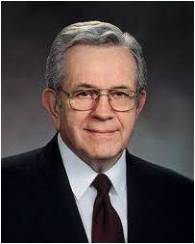
Finding Answers in the Scriptures
“If [you] are acquainted with the revelations, there is no question—personal or social or political or occupational—that need go unanswered.
Therein is contained the fulness of the everlasting gospel.
Therein we find principles of truth that will resolve every confusion and every problem and every dilemma that will face the human family or any individual in it.”
President Boyd K. Packer

Slide 19
Sources:
Suggested Hymn: #101 Guide Me to Thee
Elder Richard G. Scott (“The Power of Scripture,” Ensign or Liahona, Nov. 2011, 6).
(“Four Fundamentals for Those Who Teach and Inspire Youth” [Church Educational System symposium address, Aug. 14, 1987], 1; si.lds.org).
President Howard W. Hunter (“Reading the Scriptures,” Ensign, Nov. 1979, 64).
Elder M. Russell Ballard (“How to Solve Problems,” New Era, July 2013, 48).
President Boyd K. Packer (“Teach the Scriptures”[address to CES religious educators, Oct. 14, 1977], 3–4;si.lds.org; see also Teaching Seminary: Preservice Readings [2004], 74–75).
President Dieter F. Uchtdorf (“Four Titles,” Ensign or Liahona, May 2013, 60).
Presentation by ©http://fashionsbylynda.com/blog/

Slide 20
“[The scriptures] can become stalwart friends that are not limited by geography or calendar. They are always available when needed. … Learning, pondering, searching, and memorizing scriptures is like filling a filing cabinet with friends, values, and truths that can be called upon anytime, anywhere in the world. …
“… [Memorizing a scripture] is like discovering a new individual who can help in time of need, give inspiration and comfort, and be a source of motivation for needed change.” Elder Richard G. Scott (“The Power of Scripture,” Ensign or Liahona, Nov. 2011, 6).
“[The scriptures] can become stalwart friends that are not limited by geography or calendar. They are always available when needed. … Learning, pondering, searching, and memorizing scriptures is like filling a filing cabinet with friends, values, and truths that can be called upon anytime, anywhere in the world. …
“… [Memorizing a scripture] is like discovering a new individual who can help in time of need, give inspiration and comfort, and be a source of motivation for needed change.” Elder Richard G. Scott (“The Power of Scripture,” Ensign or Liahona, Nov. 2011, 6).
“[The scriptures] can become stalwart friends that are not limited by geography or calendar. They are always available when needed. … Learning, pondering, searching, and memorizing scriptures is like filling a filing cabinet with friends, values, and truths that can be called upon anytime, anywhere in the world. …
“… [Memorizing a scripture] is like discovering a new individual who can help in time of need, give inspiration and comfort, and be a source of motivation for needed change.” Elder Richard G. Scott (“The Power of Scripture,” Ensign or Liahona, Nov. 2011, 6).
“[The scriptures] can become stalwart friends that are not limited by geography or calendar. They are always available when needed. … Learning, pondering, searching, and memorizing scriptures is like filling a filing cabinet with friends, values, and truths that can be called upon anytime, anywhere in the world. …
“… [Memorizing a scripture] is like discovering a new individual who can help in time of need, give inspiration and comfort, and be a source of motivation for needed change.” Elder Richard G. Scott (“The Power of Scripture,” Ensign or Liahona, Nov. 2011, 6).
“[The scriptures] can become stalwart friends that are not limited by geography or calendar. They are always available when needed. … Learning, pondering, searching, and memorizing scriptures is like filling a filing cabinet with friends, values, and truths that can be called upon anytime, anywhere in the world. …
“… [Memorizing a scripture] is like discovering a new individual who can help in time of need, give inspiration and comfort, and be a source of motivation for needed change.” Elder Richard G. Scott (“The Power of Scripture,” Ensign or Liahona, Nov. 2011, 6).
“[The scriptures] can become stalwart friends that are not limited by geography or calendar. They are always available when needed. … Learning, pondering, searching, and memorizing scriptures is like filling a filing cabinet with friends, values, and truths that can be called upon anytime, anywhere in the world. …
“… [Memorizing a scripture] is like discovering a new individual who can help in time of need, give inspiration and comfort, and be a source of motivation for needed change.” Elder Richard G. Scott (“The Power of Scripture,” Ensign or Liahona, Nov. 2011, 6).
“[The scriptures] can become stalwart friends that are not limited by geography or calendar. They are always available when needed. … Learning, pondering, searching, and memorizing scriptures is like filling a filing cabinet with friends, values, and truths that can be called upon anytime, anywhere in the world. …
“… [Memorizing a scripture] is like discovering a new individual who can help in time of need, give inspiration and comfort, and be a source of motivation for needed change.” Elder Richard G. Scott (“The Power of Scripture,” Ensign or Liahona, Nov. 2011, 6).
“[The scriptures] can become stalwart friends that are not limited by geography or calendar. They are always available when needed. … Learning, pondering, searching, and memorizing scriptures is like filling a filing cabinet with friends, values, and truths that can be called upon anytime, anywhere in the world. …
“… [Memorizing a scripture] is like discovering a new individual who can help in time of need, give inspiration and comfort, and be a source of motivation for needed change.” Elder Richard G. Scott (“The Power of Scripture,” Ensign or Liahona, Nov. 2011, 6).
“[The scriptures] can become stalwart friends that are not limited by geography or calendar. They are always available when needed. … Learning, pondering, searching, and memorizing scriptures is like filling a filing cabinet with friends, values, and truths that can be called upon anytime, anywhere in the world. …
“… [Memorizing a scripture] is like discovering a new individual who can help in time of need, give inspiration and comfort, and be a source of motivation for needed change.” Elder Richard G. Scott (“The Power of Scripture,” Ensign or Liahona, Nov. 2011, 6).
“[The scriptures] can become stalwart friends that are not limited by geography or calendar. They are always available when needed. … Learning, pondering, searching, and memorizing scriptures is like filling a filing cabinet with friends, values, and truths that can be called upon anytime, anywhere in the world. …
“… [Memorizing a scripture] is like discovering a new individual who can help in time of need, give inspiration and comfort, and be a source of motivation for needed change.” Elder Richard G. Scott (“The Power of Scripture,” Ensign or Liahona, Nov. 2011, 6).

Slide 21
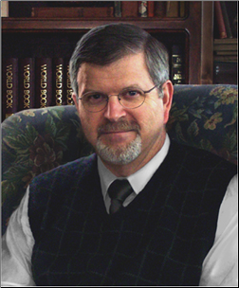
Answers from Scriptures:
Elder Dallin H. Oaks of the Quorum of the Twelve Apostles explained:
“We often hear it said that the scriptures have the answers to all of our questions. Why is this so? It is not that the scriptures contain a specific answer to every question—even to every doctrinal question. … We say that the scriptures contain the answers to every question because the scriptures can lead us to every answer. …
“… This is because scripture study will make us susceptible to the inspiration of the Holy Ghost, which, as the scriptures say, will ‘guide [us] into all truth’ (John 16:13), and by whose power we can ‘know the truth of all things’ (Moroni 10:5)” (“Studying the Scriptures” [address given at BYU–Hawaii, Mar. 14, 1986], 18, 19; see also Scripture Study—The Power of the Word Teacher Manual [Church Educational System manual, 2001], 45).
How to Read the Scriptures:
Elder Jeffrey R. Holland of the Quorum of the Twelve Apostles taught:
“Read more slowly and more carefully and with more questions in mind. … Ponder, … examine every word, every scriptural gem. … Hold it up to the light, and turn it, look and see what’s reflected and refracted there. … Such an examination may unearth a treasure hidden in a field: a pearl of great price; a pearl beyond price” (“Students Need Teachers to Guide Them” [address to CES religious educators, June 20, 1992], 4; si.lds.org).
Daily Scripture Reading:
President Harold B. Lee stated:
“If we’re not reading the scriptures daily, our testimonies are growing thinner, our spirituality isn’t increasing in depth. We, ourselves, must be studying the scriptures and have a daily habit” (Teachings of Presidents of the Church: Harold B. Lee [2000], 66).
Scriptures require effort:
Elder David A. Bednar of the Quorum of the Twelve Apostles taught:
“The combination that opens the vault door to hidden scriptural treasures includes a great deal of work—simple, old-fashioned, hard work. … We cannot expect to reap a rich scriptural harvest unless we pay the price of regular and diligent study. … The scriptural treasures we seek in our lives cannot be borrowed or loaned or obtained secondhand. We must each learn to open the vault door by applying the principle of work” (“Because We Have Them before Our Eyes,” New Era, Apr. 2006, 6).
Doc Christensen Artist
Doc’s artistic passion is figure and portrait drawing and painting. With no formal education in art and illustration, his skills have been developed around his experience, personal study and what he calls "a set of God given talents." He began his avocation as a religious illustrator and portrait artist in the late 70s when he painted the "Portrait of the Prophets"; a depiction of all the presidents of the LDS church dressed is white suits and gathered in the Celestial Room of the Salt Lake Temple. In the past decade he has begun in earnest to establish himself as a religious illustrator with the goal of causing the viewers of his paintings to ponder in depth some of the important fundamentals of the Gospel of Jesus Christ. As he continues to pursue his career as a manufacturing jeweler he is trying to free more time to dedicate to painting.
Identifying Principles
President Marion G. Romney of the First Presidency taught:
“One cannot honestly study the scriptures without learning gospel principles because the scriptures have been written to preserve principles for our benefit” (“The Message of the Old Testament” [Church Educational System Symposium on the Old Testament, Aug. 17, 1979], 3; si.lds.org).
Elder Richard G. Scott of the Quorum of the Twelve Apostles taught:
“Principles are concentrated truth, packaged for application to a wide variety of circumstances. A true principle makes decisions clear even under the most confusing and compelling circumstances” (“Acquiring Spiritual Knowledge,” Ensign, Nov. 1993, 86).

