Slide 1
Lesson 41
Return to Egypt
Genesis 44-46
And Joseph made ready his chariot, and went up to meet Israel his father, to Goshen, and presented himself unto him; and he fell on his neck, and wept on his neck a good while.
Genesis 46:29

Slide 2
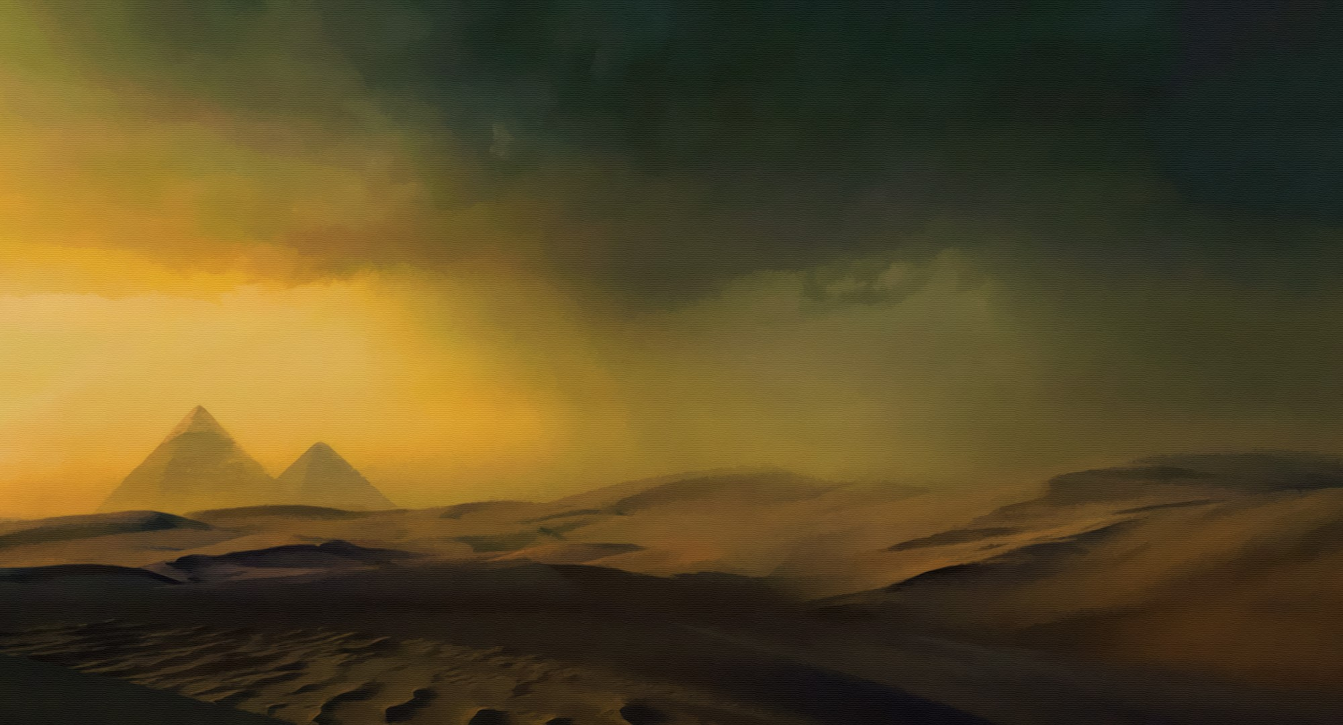
Previously…
Joseph’s older brothers came to Egypt to buy grain during a famine but did not recognize him.
Joseph recognized them, and he questioned them about their family under the pretext of accusing them of being a group of spies. By imprisoning Simeon, Joseph forced his other brothers into a situation where they would need to bring his younger brother, Benjamin, to Egypt.
When the brothers returned for more grain, they brought Benjamin with them.
Genesis 42-43

Slide 3
The Plot
Before the brothers were to return to their home Joseph had his steward fill their sacks with grain.
He secretly put the money of the brothers’ back into their bags and in Benjamin’s sack, his silver cup.
Genesis 44:1-14

Slide 4
Benjamin Accused of Theft
As the brothers were on their way back to Canaan, they were stopped by Joseph’s steward who was following them.
The steward searched every sack and found the silver cup in Benjamin’s sack.
They returned to the city.
Genesis 44:1-13

Slide 5
Judah Pleads With Joseph
Judah told Joseph how worried their father Jacob was about letting his youngest son, Benjamin, go to Egypt for fear of losing him like he had lost another son—Joseph.
What would happen to Jacob if Benjamin did not return?
What was Judah willing to do so that Benjamin could go free?
Judah’s willingness to acknowledge his iniquity and to be enslaved in place of his younger brother shows how dramatically he had changed.
Genesis 44:14-34

Slide 6
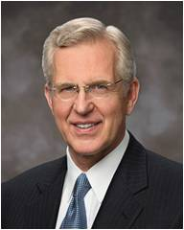
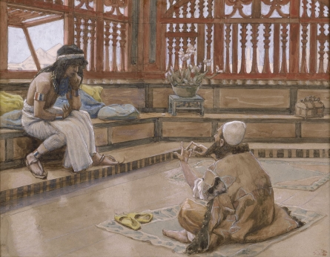
Sincere Repentance
“Repentance means striving to change. … Surely the Lord smiles upon one who desires to come to judgment worthily, who resolutely labors day by day to replace weakness with strength.
James Tissot
Sincere repentance includes acknowledging our wrongs, turning away from sinful actions, and having our heart changed through the Atonement of Jesus Christ
Real repentance, real change may require repeated attempts, but there is something refining and holy in such striving. Divine forgiveness and healing flow quite naturally to such a soul.” (1)

Slide 7
Ping Pong Ball—Represents You
How To Rise Above Your Trials and Difficulties
Trials and difficulties you face today in their homes, school, or community.
If we are faithful, God can direct our lives and help us make trials become blessings for ourselves and others

Slide 8
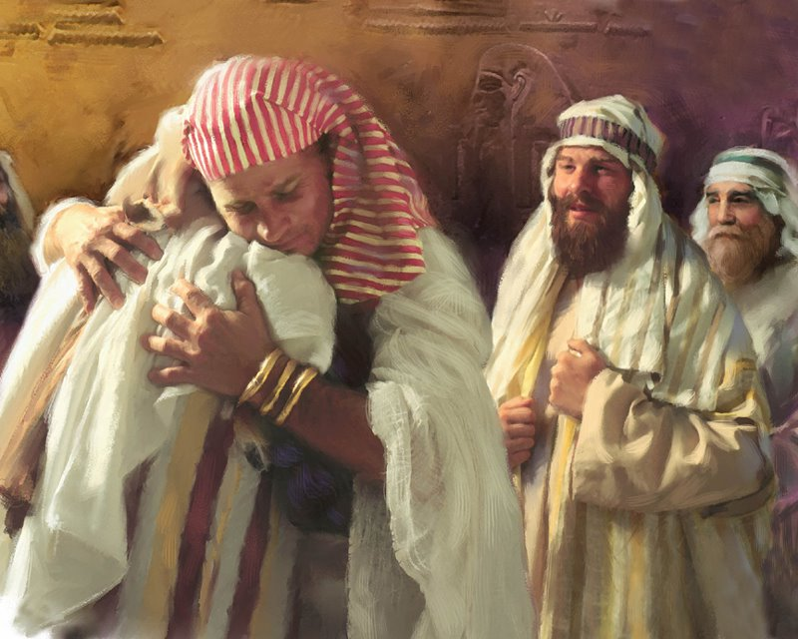
Made Himself Known
Joseph forgives what his brothers had done to him
Forgiving those who have wronged us helps us experience healing and peace
Genesis 45:14-15

Slide 9
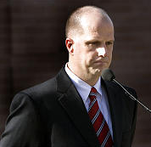
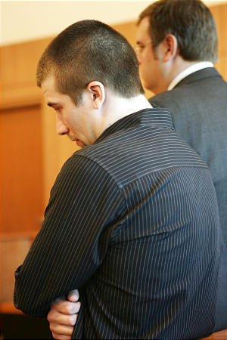
Unconditionally Forgive
On Feb. 9, 2007, the Williams family was on their way home from a night out when 17-year-old, driving from the other direction, slammed into the side of their car…
…killing his pregnant wife and two of his children:
“When a car crashed into Bishop Christopher Williams’s vehicle, he had a decision to make, and it was to ‘unconditionally forgive’ the driver who had caused the accident so that the healing process could take place unhampered” (2)

Slide 10
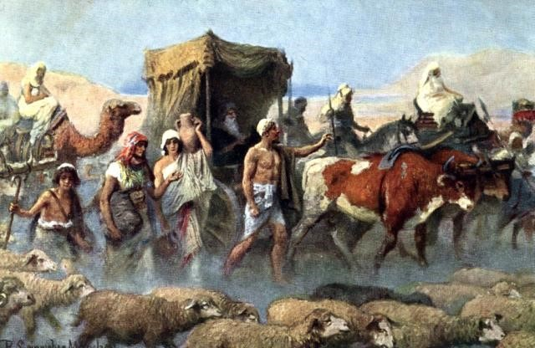
Come to Egypt
Pharaoh heard about Joseph’s family, he sent Joseph’s brothers back to Canaan with wagons loaded with food and gifts and invited Jacob’s family to come to Egypt. When the brothers arrived home in Canaan, they told Jacob that Joseph was alive and in Egypt.
At first Jacob did not believe them, but when he saw the wagons, he said, “Joseph my son is yet alive: I will go and see him before I die.”
Genesis 45:16-28

Slide 11
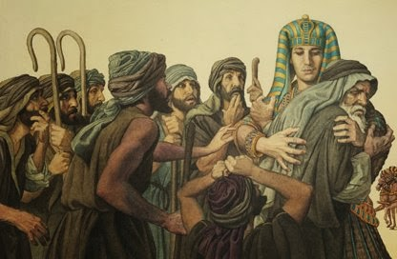
Jacob and Joseph Reunited
Jacob took all of his family and their possessions and traveled to Egypt. On the way, the Lord spoke to Jacob in a vision and told him not to fear settling his family in Egypt because He would be with him and would make of him a great nation.
Genesis 46:29-34

Slide 12
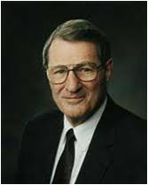
“You must trust the Lord; if you are righteous, his purposes will be served. Joseph in Egypt did just that, having many opportunities to become bitter over the way he was mistreated.
He not only rose above his difficulties, but lifted others, feeding millions of starving people.
Even though his brothers had intended to do evil to Joseph, the Lord used those evil designs to give Joseph opportunities far beyond his boyhood dreams!” (3)

Slide 13
Sources:
Suggested Hymn: #131 More Holiness Give Me
Video: Forgiveness my burden: (8:24)
https://www.lds.org/media-library/video/2010-07-14-forgiveness-my-burden-was-made-light?lang=eng
Elder D. Todd Christofferson (“The Divine Gift of Repentance,” Ensign or Liahona, Nov. 2011, 39).
President James E. Faust (“The Healing Power of Forgiveness,” Ensign or Liahona, May 2007, 69).
Neal A. Maxwell (“I Am But a Lad,” New Era, May 1981, 5).
Presentation by ©http://fashionsbylynda.com/blog/

Slide 14
Deseret News Morning News by August Miller—February 13, 2007
Christopher Williams speaks to the media Monday about the death of his pregnant wife and two children. He said he learned the power of forgiveness from his wife. "This is what she would want to do," he said of forgiving the teen driver.
As Christopher Williams was being extricated from his overturned car onto a backboard to be taken to the hospital, he looked over at his vehicle and the car that had just crashed into him, killing his pregnant wife and two of his children.
It was at that moment Williams said he had a decision to make. That decision, he said, was to "unconditionally forgive" the person who had just caused the accident. By forgiving, Williams said the healing process could continue without being "hampered by another step."
Monday, Williams showed the great composure some had already seen since Friday night's accident as he addressed the media for the first time.
Friday's accident on 2000 East near 2700 South claimed the lives of his 41-year-old wife, Michelle, who was about six months pregnant; 11-year-old son, Ben; and 9-year-old daughter, Anna. His 6-year-old son, Sam, was taken to Primary Children's Medical Center where he was listed in stable condition Monday.
Police believe the 17-year-old driver accused of smashing into the Williams family had been drinking.
Christopher Williams has shown remarkable strength, which he claims comes partly from his LDS faith and partly from his wife. It was through his wife that he learned the power of forgiveness, he said.
"This is what she would want to do," he said of forgiving the allegedly drunken teenage driver.
After 18 1/2 years of marriage, Williams called the accident and his reaction to it an "exam" from his wife "to make sure I was listening." He called his wife a humble and forgiving person whose example he tried to emulate.
As soon as Williams decided he would unconditionally forgive the other driver, he said it was at that moment he heard Sam calling to him from the back of the wrecked car.
But he admits the events of the past four days have been a bitter cup.
"I know it will all be all right one day," he said. "That bitter cup doesn't have to be drunk all at once. But we know one day it will be empty."
Williams said his memory of what happened that night is still a little "foggy," and he did not want to discuss details of the accident until he had a chance to talk with Salt Lake City police.
He said Sam is in stable condition with some broken bones and is being medicated, but Williams did not go into many other details about his son's condition. He added that Sam was not aware yet that his mother and two of his siblings were dead.
Charges against the teen could come as early as Wednesday. Salt Lake District Attorney Lohra Miller said because of the complex nature of the investigation, Wednesday would be the earliest her office could screen the case.
One of the biggest questions will be whether the teen is charged in juvenile court or as an adult. Miller said several factors need to be looked at, including the nature and severity of the case and the history of the defendant. Even how close the teen is to turning 18 will be considered, she said.
As far as the severity of the case, Miller said Friday's accident "ranks very high in my book."
Miller called the accident a "profound tragedy" for the teen's family and Williams' family. She said she has been touched by the father's kindness toward the defendant. However, that will not influence the way she screens charges.
"It's one thing to forgive someone," she said. "It's important we hold people accountable. The victim's role is to determine how they react to forgiving. My role is to determine how to keep the community safe."
Williams, despite his unconditional forgiveness, seemed to agree Monday with Miller.
"Forgiveness is a source of power. But it does not relieve us of consequences," he said.
The teen driver has been in juvenile detention since the accident. A detention hearing was held Monday in Juvenile Court, but the outcome was not known Monday evening because of laws protecting juveniles.
At Highland Park Elementary School where Ben was a sixth-grader and Anna was in fourth grade, a meeting was held between district officials, teachers and administrators before school started Monday to determine how to deal with the tragedy and simply to see how the teachers themselves were doing, Salt Lake School District spokesman Jason Olsen said.
A table was set up in the front of the school with flowers and pictures of the two classmates. Counselors were at the school all day Monday to help both teachers and students deal with the tragedy.
"It's a tragedy all the way around. It's a no-win situation," said the children's grandmother, Nadine Williams. "We're devastated. We feel great sadness for the young boy's family and the young boy."
"It's very, very painful," added the children's grandfather, Paul Williams.
To help the healing process, Chris Williams has asked members of the community to conduct their own act of kindness or forgiveness by Valentine's Day, write about it and send it to his two surviving sons.

Slide 15
Working Through Our Trials:
“Most of us need time to work through pain and loss. We can find all manner of reasons for postponing forgiveness. One of these reasons is waiting for the wrongdoers to repent before we forgive them. Yet such a delay causes us to forfeit the peace and happiness that could be ours. The folly of rehashing long-past hurts does not bring happiness.
“Some hold grudges for a lifetime, unaware that courageously forgiving those who have wronged us is wholesome and therapeutic. …
“… Only as we rid ourselves of hatred and bitterness can the Lord put comfort into our hearts. …
“Of course, society needs to be protected from hardened criminals, because mercy cannot rob justice [see Alma 42:25]. Bishop Williams addressed this concept so well when he said, ‘Forgiveness is a source of power. But it does not relieve us of consequences’ [in Deseret Morning News, Feb. 13, 2007, A8]. When tragedy strikes, we should not respond by seeking personal revenge but rather let justice take its course and then let go. It is not easy to let go and empty our hearts of festering resentment. The Savior has offered to all of us a precious peace through His Atonement, but this can come only as we are willing to cast out negative feelings of anger, spite, or revenge. For all of us who forgive ‘those who trespass against us’ [Joseph Smith Translation, Matthew 6:13] even those who have committed serious crimes, the Atonement brings a measure of peace and comfort” (“The Healing Power of Forgiveness,” President James E. Faust Ensign or Liahona, May 2007, 68–69).
Jacques Joseph Tissot (15 October 1836 – 8 August 1902), Anglicized as James Tissot, was a French painter and illustrator. He was a successful painter of Paris society before moving to London in 1871. He became famous as a genre painter of fashionably dressed women shown in various scenes of everyday life. He also painted scenes and characters from the Bible.
Jacques Tissot was born in the port town of Nantes, France and spent his early childhood there. His father, Marcel Théodore Tissot, was a successful drapery merchant. His mother, Marie Durand, assisted her husband in the family business and designed hats. A devout Catholic, Tissot's mother instilled pious devotion in the future artist from a very young age. Tissot's youth spent in Nantes likely contributed to his frequent depiction of shipping vessels and boats in his later works. The involvement of his parents in the fashion industry is believed to have been an influence on his painting style, as he depicted women's clothing in fine detail. By the time Tissot was 17, he knew he wanted to pursue painting as a career. His father opposed this, preferring his son to follow a business profession, but the young Tissot gained his mother's support for his chosen vocation. Around this time, he began using the given name of James. By 1854 he was commonly known as James Tissot; he may have adopted it because of his increasing interest in everything English.
Tissot spent the last years of his life working on paintings of subjects from the Old Testament. Although he never completed the series, he exhibited 80 of these paintings in Paris in 1901 and engravings after them were published in 1904Wikipedia

