Slide 1
Lesson 45 Part 2
Go and Get Them Out of Egypt
Exodus 3-4
…have ye not read in the book of Moses, how in the bush God spake unto him, saying, I am the God of Abraham, and the God of Isaac, and the God of Jacob?
Mark 12:26

Slide 2
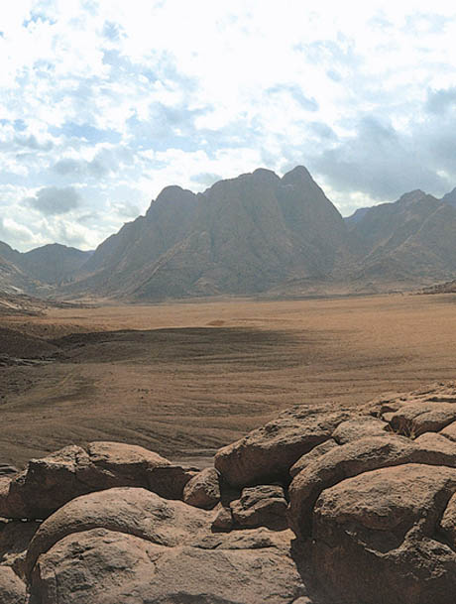
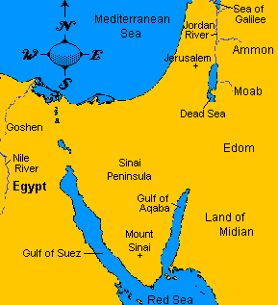
Horeb—Mountain of the Lord
Mount Sinai
Elijah Also Seeks Refuse
And he arose, and did eat and drink, and went in the strength of that meat forty days and forty nights unto Horeb the mount of God.
1 Kings 19:8
There are several possible sites for Mount Sinai. One of the traditional locations is Jebel Musa (Mountain of Moses)
Exodus 3:1

Slide 3
Burning Bush
Was it an angel?
What name should I call you before the children of Israel?
I AM
The answer is not Jehovah. The Lord is identified by another term. "Out of respect or reverence to the name of the Supreme Being, to avoid the too frequent repetition of his name," (D&C 107:4)
Jehovah declares his name as "I AM" to the children of Israel (Ex. 3:14). "I AM" is a proper name for the God of Abraham, Isaac, and Jacob. (1)
Exodus 3:2-6

Slide 4
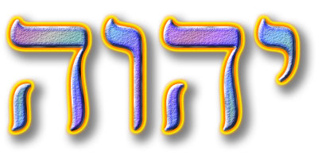
The Lord also wanted Moses to know him by the sacred name of Jehovah
Prophets like Abraham, Isaac, Jacob, Moses and many others certainly knew the Lord by the name of Jehovah.
The children of Israel were not to use this name; it was too sacred.
Jehovah
Seldom written, the name was never spoken for even the scribes who were aware of the name Jehovah would never say the word aloud (Bible Dictionary: Jehovah)
Moses could know it, but they were not to use it. To this command, they were faithful.
Under the Law of Moses, blasphemy of the name of the Lord, particularly Jehovah, was punishable by death (Lev. 24:16).
Old Testament
Accordingly, the name of Jehovah was treated with great care, appearing only 4 times in the Old Testament (Ex 6:3; Ps. 83:18; Isa 12:2; 26:4).
Exodus 3:4-6
(1)

Slide 5
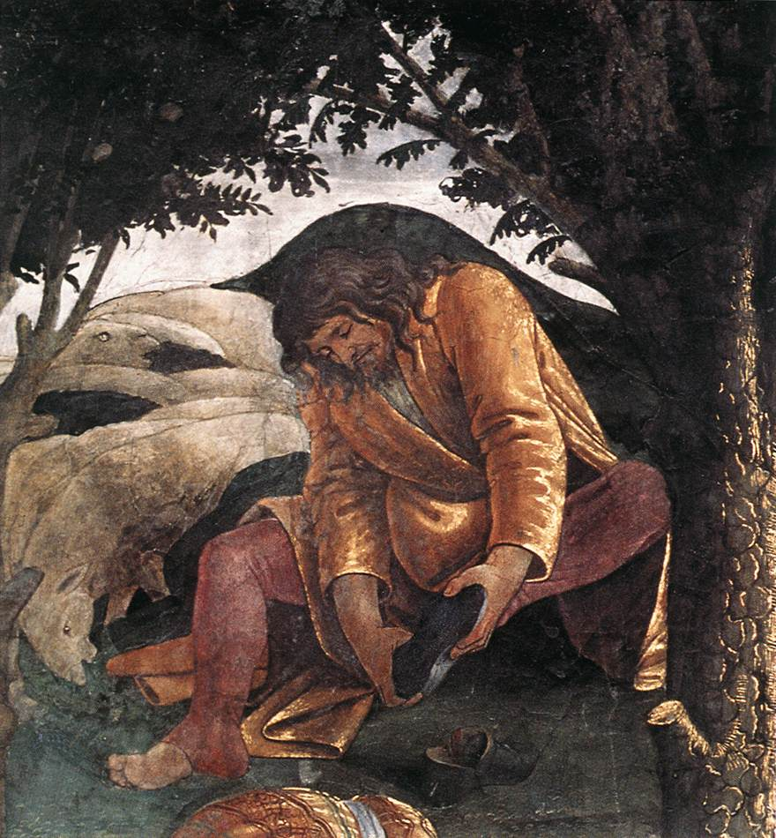
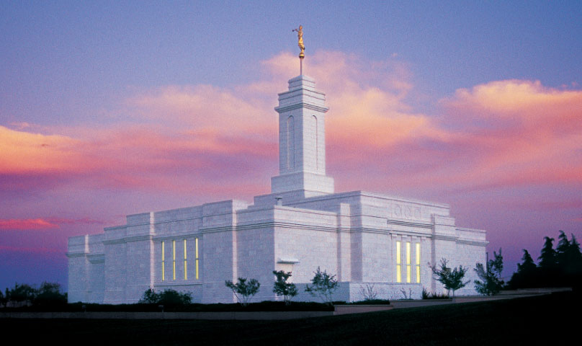
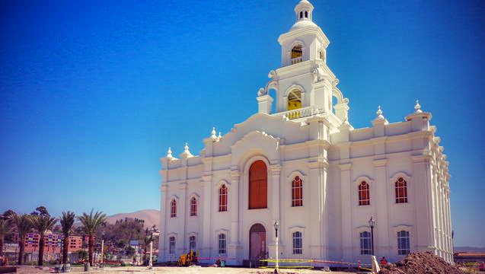
Put Off Thy Shoes
Holy Ground
We are to be reverent in sacred places; showing reverence to the Lord when we are in sacred places prepares us to draw near to Him.
Colonia Juarez Chihuahua Mexico Temple
Exodus 3:5
Tijuana Temple
To be dedicated on 13 December 2015

Slide 6
The Lord Knows
Affliction
“God sees our ______________________,
hears our ____________________,
and knows our ___________________.”
Prayers
Sorrows
Exodus 3:7

Slide 7
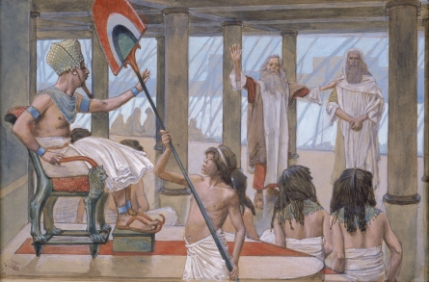
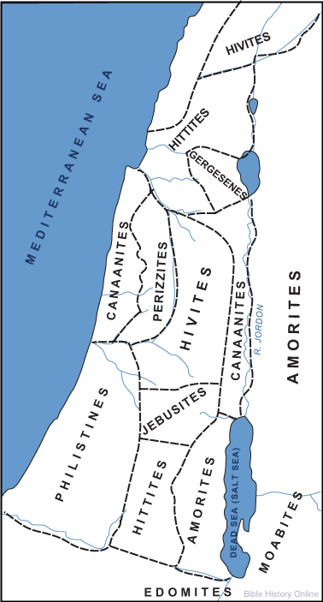
The Plan—to Deliver
Unto a land flowing with milk and honey;
unto the place of the Canaanites, and the Hittites, and the Amorites, and the Perizzites, and the Hivites, and the Jebusites.
James J. Tissot
Through Moses the children were to be rescued from the Egyptians
Moses was to go to the Pharaoh, ask for the people to be released and return to the mountain (Mt. Sinai)
The Lord often answers our prayers through other people.
Exodus 3:7-10

Slide 8
Who am I to be able to do what you have asked?
But they will not believe me or listen to me. They will say I am lying.
Perform the three sign that I will give you
Turn a rod into a snake
Display a hand bearing leprosy
Turn water into blood
I will be with you.
Who should I tell them sent me?
I have never been a good speaker. I am slow of speech.
Please, Lord, send someone else.
Tell them “I Am” sent you unto them.
I made your mouth, and I will be with you and teach you what to say.
I will make Aaron a spokesman for you and teach you what to do
Exodus 3:11-17, Exodus 4:1-17

Slide 9
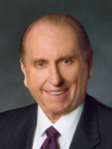
The Lord is with those He calls, and He gives them power to accomplish His work
“Now, some of you may be shy by nature or consider yourselves inadequate to respond affirmatively to a calling.
Remember that this work is not yours and mine alone. It is the Lord’s work, and when we are on the Lord’s errand, we are entitled to the Lord’s help.
Remember that whom the Lord calls, the Lord qualifies.”
(2)

Slide 10
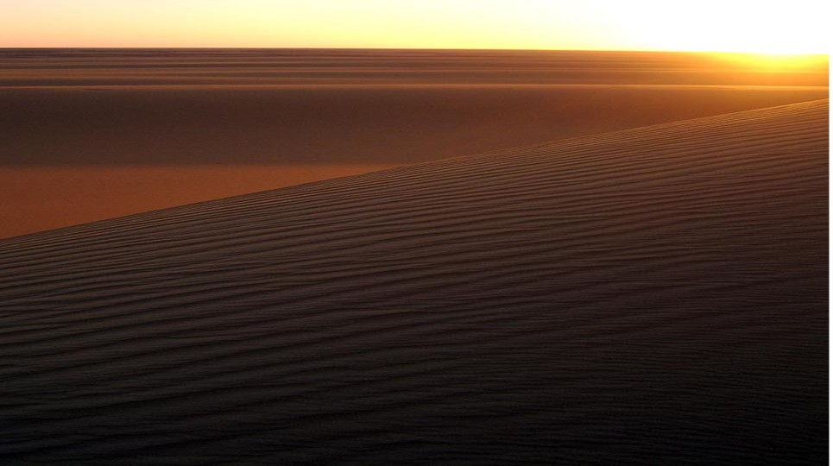
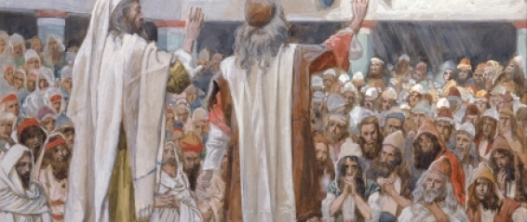
Moses left Midian, met Aaron, and traveled with him to Egypt.
Together they told the elders of Israel all that the Lord had commanded.
The children of Israel believed Moses and Aaron and worshipped the Lord.

Slide 11
Sources:
Suggested Hymn: 7 Israel, Israel, God is Calling
Gospel Doctrine.com (Exodus 1-12)
President Thomas S. Monson (“Duty Calls,” Ensign, May 1996, 44).
Presentation by ©http://fashionsbylynda.com/blog/

Slide 12
“I AM”
The theology of the Judaism and the Jehovah's Witnesses denies the idea that Jesus Christ was the pre-mortal Jehovah. John the Revelator, declared this truth in terms that any careful student of the Old Testament should understand. The scribes and Pharisees taunted Jesus as follows:
Art thou greater than our father Abraham, which is dead? And the prophets are dead: whom makest thou thyself?
...Your father Abraham rejoiced to see my day: and he saw it, and was glad.
Then said the Jews unto him, Thou art not yet fifty years old, and hast thou seen Abraham?
Jesus said unto them, Verily, verily, I say unto you, Before Abraham was, I am. (John 8:53-58)
The text should read, "Before Abraham was I AM," using the term I AM as the proper name for the God who spoke to Moses. Indeed, this was the name by which the children of Israel were supposed to know God. Gospeldoctrine.com
“I Am” is a form of “Jehovah,” one of the names of Jesus Christ recognized by the prophets Abraham, Isaac, and Jacob (see Joseph Smith Translation, Exodus 6:3 [in Exodus 6:3, footnote c ). Moses and the Israelites understood the name to mean that God is eternal and not created by man, as were other gods of the day. This name was a way for the Lord to identify Himself as the all-powerful true and living God. The Israelites came to greatly reverence this name and declared that speaking it was blasphemy. The name was so sacred that once the Tabernacle was built, only the high priest was allowed to speak the name in the Holy of Holies, once a year, on the Day of Atonement.
Whenever the name I Am or Jehovah occurs in the Old Testament’s Hebrew text, it is almost always rendered as “LORD.” In the New Testament, a group of Jews sought to kill Jesus because He said, “Before Abraham was, I am” (John 8:58). This New Testament reference confirms that Jesus Christ is Jehovah, the God of the Old Testament.
Moses’s life and mission bear many similarities to the life and mission of Jesus Christ. In fact, Moses was told, “Thou art in the similitude of mine Only Begotten” (Moses 1:6). God raised up Moses to perform a divine mission that included not only physically delivering Israel but also teaching them how to be spiritually delivered. His ministry extended beyond the limits of his own mortal lifetime. Joseph Smith taught that, in company with Elias (Elijah), Moses came to the Mount of Transfiguration and bestowed priesthood keys upon Peter, James, and John (see Matthew 17:3–4; Mark 9:4–9; Luke 9:30; D&C 63:21). Moses appeared to Joseph Smith and Oliver Cowdery on April 3, 1836, in the temple in Kirtland, Ohio, and conferred on them the keys of the gathering of Israel (see D&C 110:11). (See Guide to the Scriptures, “Moses”; scriptures.lds.org; see also Bible Dictionary,“ Moses.”)
The significance of Moses as a prophet, lawgiver, and holy messenger places him as one of the noble and great sons of God. Moses is referred to in the scriptures as being like unto Jesus Christ (see Deuteronomy 18:15–19; 3 Nephi 20:23). Just as Moses helped deliver Israel from the bondage of Egypt, Jesus Christ delivers mankind from the bondage of sin and death. As Moses worked to prepare the children of Israel to enter the promised land, Jesus Christ works to bring the children of Israel to the celestial kingdom.
For a more detailed comparison of the similarities between Moses and Jesus Christ, you may want to refer to Bruce R. McConkie, The Promised Messiah: The First Coming of Christ (1978), 442–48.
Jehovah:
"Most scholars believe that the name Jehovah (this is the Anglicized form of the name Yahweh) is derived from an old form of the Hebrew verb meaning 'to be' or 'to become.' The word stresses existence, with the meaning being that expressed in Ex. 3:14: 'I AM.' This has been understood to emphasize the unchanging nature of God, particularly his changeless commitment to the faithful." (Joseph Fielding McConkie and Donald W. Parry, A Guide to Scriptural Symbols [Salt Lake City: Bookcraft, 1990], 137)
Franklin D. Richards
At different times He told Israel that He was Jehovah until He came and dwelt in the flesh. Then He was the Son of God-the Christ. It is said concerning Him by one of the ancient prophets, that "His name shall be called Wonderful, Counselor, the Mighty God, the Everlasting Father, the Prince of Peace" (Isaiah 9:6). These were a few of the names that were given to Him besides some that John saw-such as the Word of God, King of kings and Lord of lords. (Brian H. Stuy, ed., Collected Discourses, 5 vols. [Burbank, Calif., and Woodland Hills, Ut.: B.H.S. Publishing, 1987-1992], vol. 4, Oct. 7, 1984)

Slide 13
Moses |  | Jesus
Moses was in danger of being killed in infancy and was preserved through the power of God | Exodus 1:22 | Jesus was in danger of being killed in infancy and was preserved through the power of God | Matthew 2:16 Matthew 2:20-21
The Lord promised to raise up a Prophet like Moses | Deuteronomy 18:15-18 | The multitude recognized that Jesus was “that prophet” | John 6:14
Moses overcame confrontations with Satan | Moses 1:12-22 | Jesus overcame confrontations with Satan | Matthew 4:3-11
The Lord saved the Israelites by parting the Red Sea; they walked through on dry ground. | Exodus 14 | Jesus walked across the Sea of Galilee and saved the disciples from the storm | John 6:16-21
The Lord instituted the Feast of the Passover | Exodus 12 | Jesus observes the Passover and introduces the sacrament | John 6:4 Mark 14
The Lord told the people to gather only what they needed each day so nothing was wasted and provided bread when needed and provided lifesaving water | Exodus 16:16-30 Exodus 17:5-6 | Jesus told the disciples to gather the fragments so that nothing was lost (gathering the Bread) He is the living water | John 6:5-35 John 4:10-14
God led the children of Israel through the wilderness by the Red Sea | Exodus 13:18 | A multitude followed Jesus across the Sea of Galilee | John 6:1-2
Moses controlled the winds and the sea | Exodus 14:21 | Jesus calmed the sea and walked on water | Mark 4:37-39
Moses “Came to the mountain of God” and shown the kingdoms of the world | Exodus 3:1, 12 Exodus 19:1-3 Moses 1:1, 8, 11 | Jesus went into a mountain and shown the kingdoms of the world | John 6:3, 15 (JST) Matthew 4:8
Moses was called to deliver Israel | Exodus 3:7-10 | Jesus was called to deliver Israel | 2 Nephi 6:17
Moses was a mediator between God and his people | Deuteronomy 9:16-20, 23-26 | Jesus is the mediator between us and God | 1 Timothy 2:5

