Slide 1
Lesson 47
The Atonement of Jesus Christ
Part 2

Slide 2
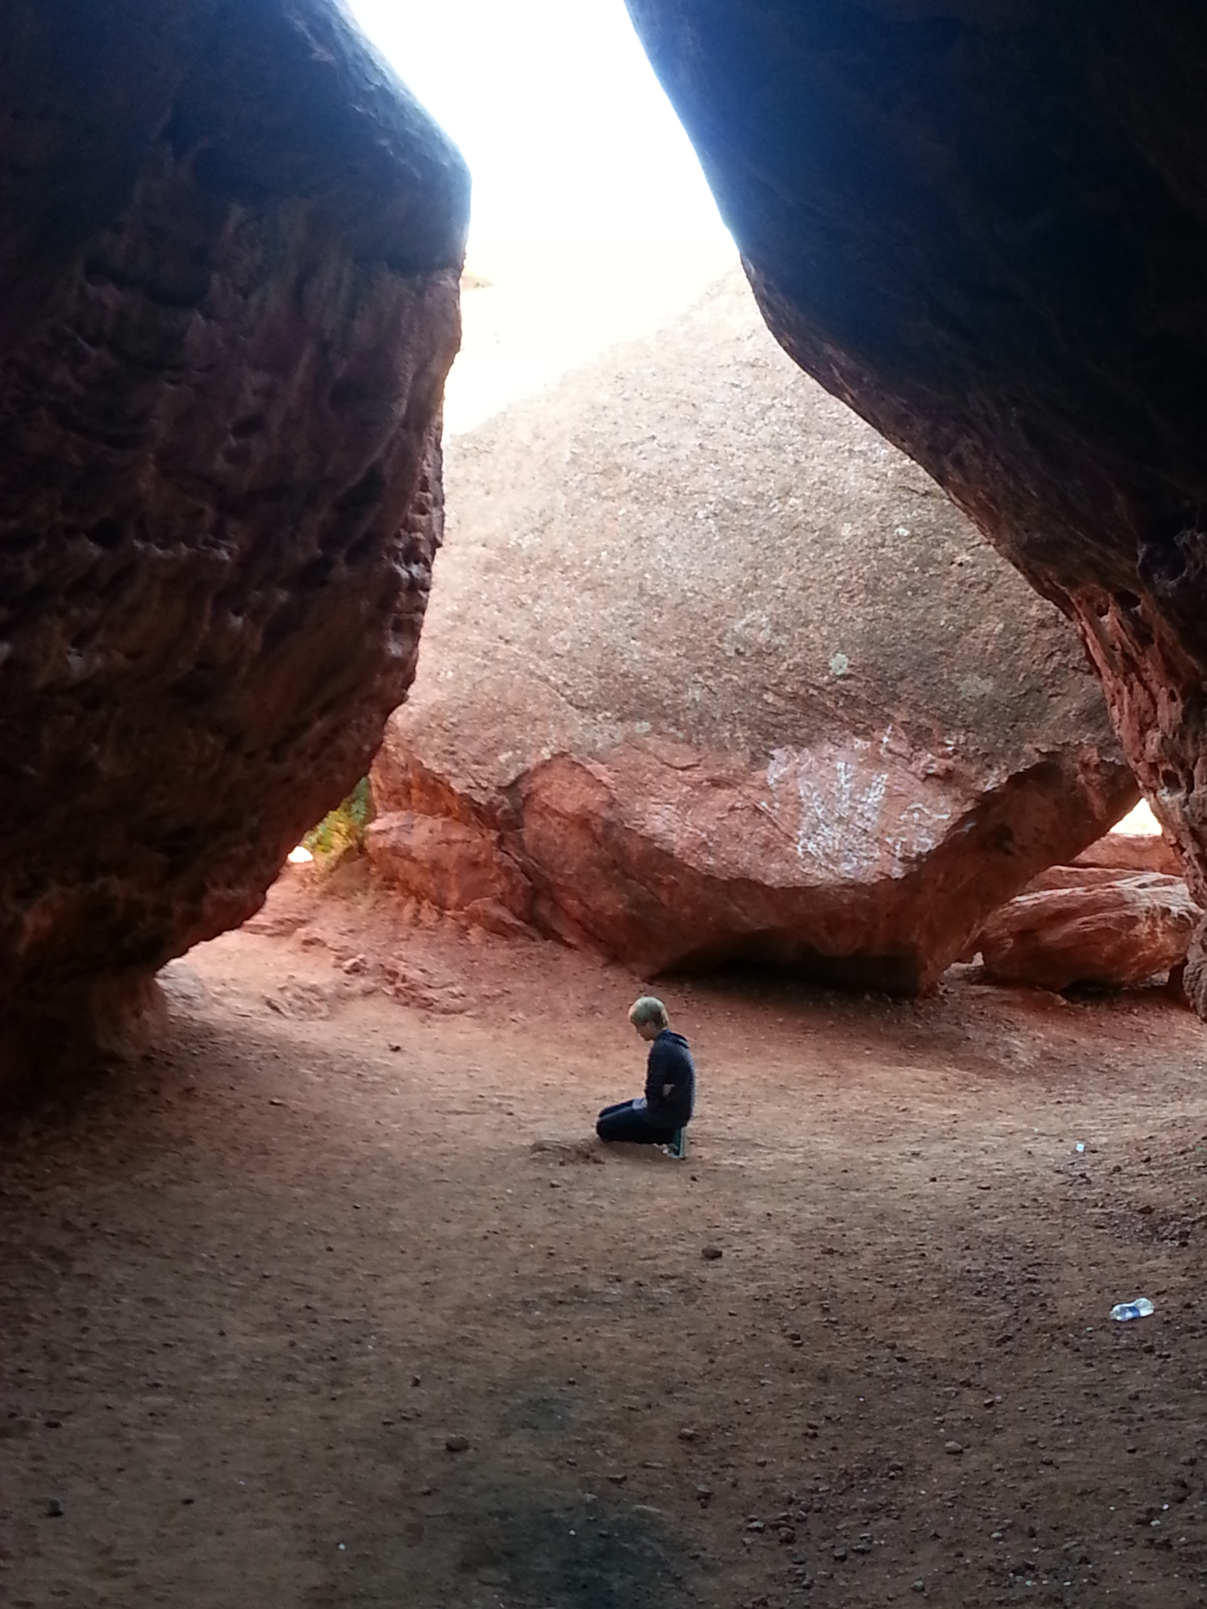
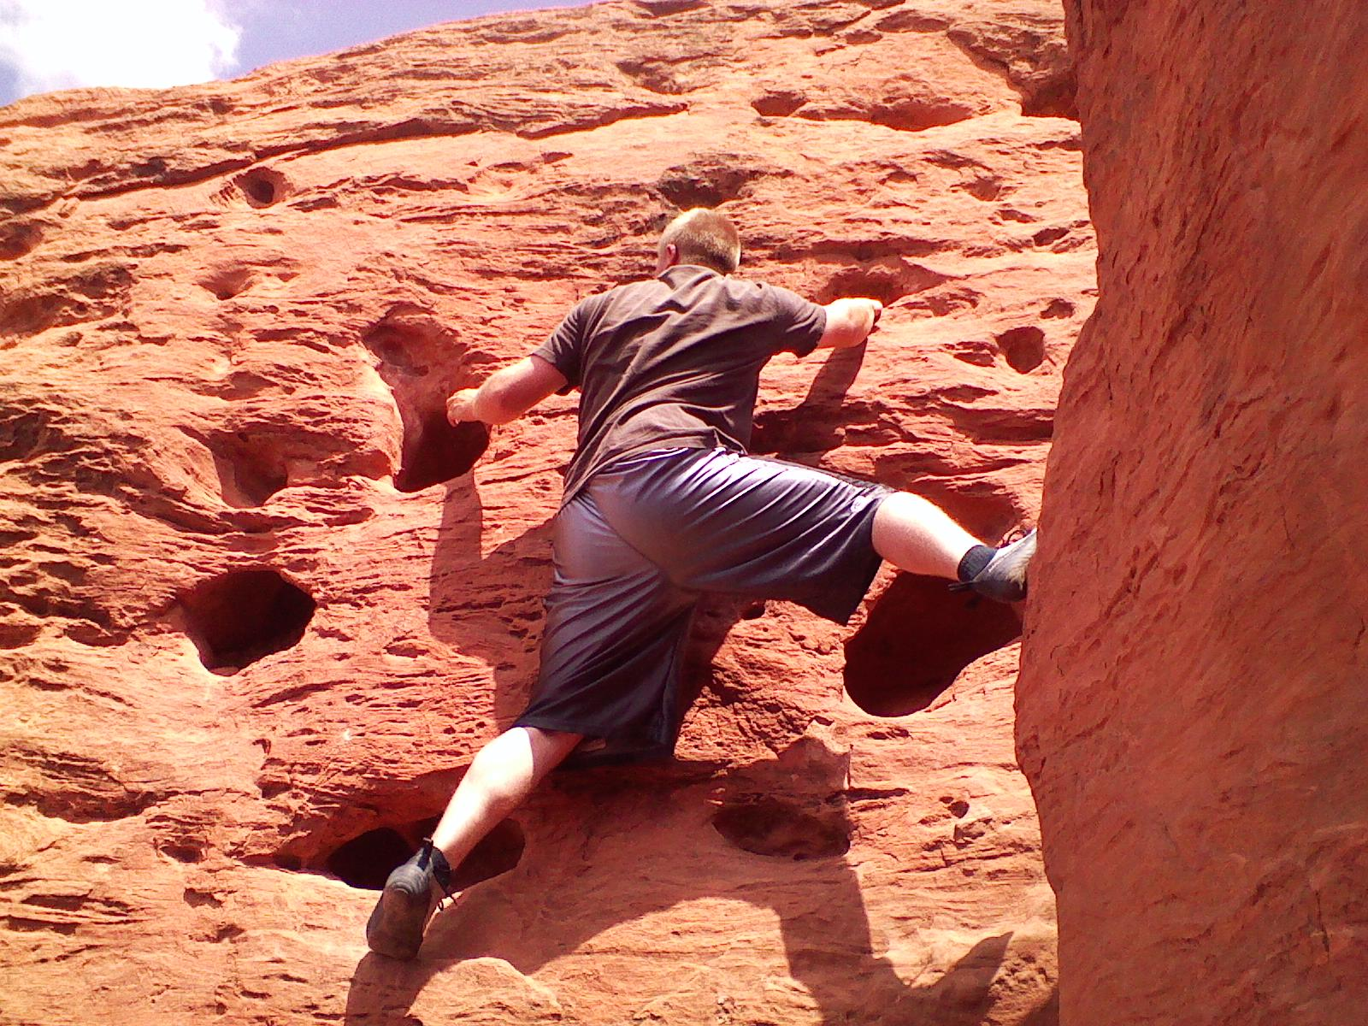
Acquiring Spiritual Knowledge---Review
Act in faith
Examine concepts and questions with an eternal perspective
Seek further understanding through divinely appointed sources

Slide 3
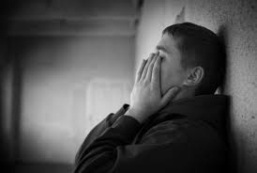
Jose
Your friend Jose has been acting noticeably discouraged lately. Every time you ask him what is wrong, he responds by saying that he doesn’t want to talk about it. A few weeks later, he finally tells you that the reason he has been so sad lately is because he has been feeling guilty for some of the sins he has committed in his life.
Jose tells you that he has tried to repent in the past but finds himself struggling with the same sins over and over. He tells you that he has given up on repenting and has begun committing even worse sins. Jose tells you, “The sins I have committed are so bad that God would never want me back. I don’t think He would ever forgive me.”
What are some ways that you could invite Jose to act in faith in order to overcome his guilt?
What do you know about Heavenly Father’s plan of salvation that you could share with Jose to help him view his situation differently?

Slide 4
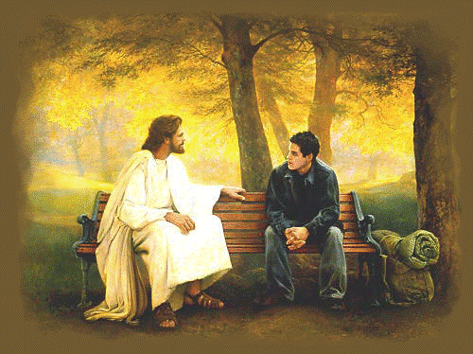
“However late you think you are, however many chances you think you have missed, however many mistakes you feel you have made or talents you think you don’t have, or however far from home and family and God you feel you have traveled, I testify that you have not traveled beyond the reach of divine love. It is not possible for you to sink lower than the infinite light of Christ’s Atonement shines.”
Jeffrey R. Holland

Slide 5
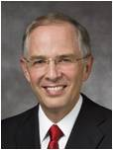
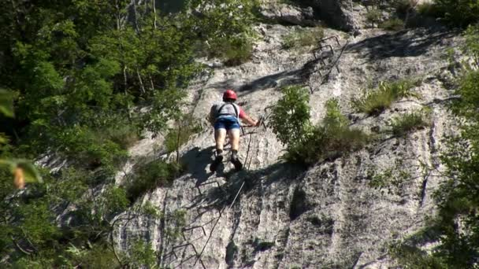
“Sometimes in our repentance, in our daily efforts to become more Christlike, we find ourselves repeatedly struggling with the same difficulties.
As if we were climbing a tree-covered mountain, at times we don’t see our progress until we get closer to the top and look back from the high ridges.
Don’t be discouraged. If you are striving and working to repent, you are in the process of repenting.”
Neil L. Andersen

Slide 6
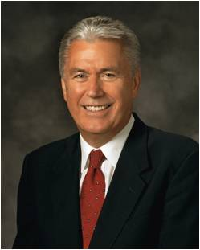
“We have all seen a toddler learn to walk. He takes a small step and totters. He falls. Do we scold such an attempt?
Of course not. What father would punish a toddler for stumbling? We encourage, we applaud, and we praise because with every small step, the child is becoming more like his parents.
“Now … compared to the perfection of God, we mortals are scarcely more than awkward, faltering toddlers.
But our loving Heavenly Father wants us to become more like Him, and … that should be our eternal goal too. God understands that we get there not in an instant but by taking one step at a time.”
Dieter F. Uchtdorf

Slide 7
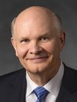
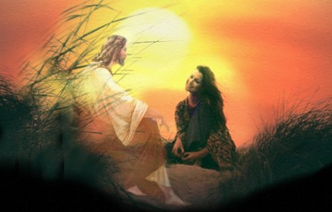
“God cares a lot more about who we are and who we are becoming than about who we once were.
He cares that we keep on trying.”
Dale G. Renlund

Slide 8
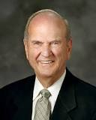
What is the purpose of an umbrella?
To provide protection or a covering from rain or sunlight
kaphar
“in Hebrew, the basic word for atonement is kaphar, a verb that means ‘to cover’ or ‘to forgive.’”
Russell M. Nelson
What can the Savior cover or shelter us from through His atoning sacrifice?
Why is Jesus Christ able to do this?

Slide 9
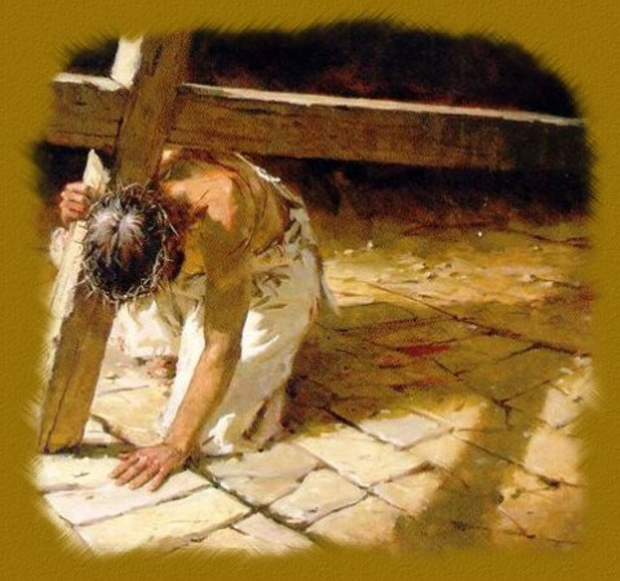
He is despised and rejected of men; a man of sorrows, and acquainted with grief: and we hid as it were our faces from him; he was despised, and we esteemed him not.
Surely he hath borne our griefs, and carried our sorrows: yet we did esteem him stricken, smitten of God, and afflicted.
But he was wounded for our transgressions, he was bruised for our iniquities: the chastisement of our peace was upon him; and with his stripes we are healed.
Isaiah 53:3-5

Slide 10
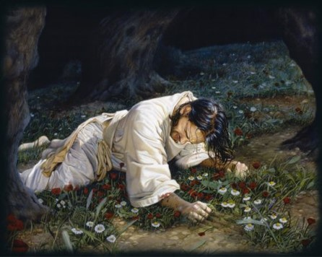
And he shall go forth, suffering pains and afflictions and temptations of every kind; and this that the word might be fulfilled which saith he will take upon him the pains and the sicknesses of his people.
And he will take upon him death, that he may loose the bands of death which bind his people; and he will take upon him their infirmities, that his bowels may be filled with mercy, according to the flesh, that he may know according to the flesh how to succor his people according to their infirmities.
Now the Spirit knoweth all things; nevertheless the Son of God suffereth according to the flesh that he might take upon him the sins of his people, that he might blot out their transgressions according to the power of his deliverance; and now behold, this is the testimony which is in me.
Alma 7:11-13
As part of His Atonement, Jesus Christ not only suffered for our sins, but He also took upon Himself the pains, temptations, sicknesses, and infirmities of all mankind.

Slide 11
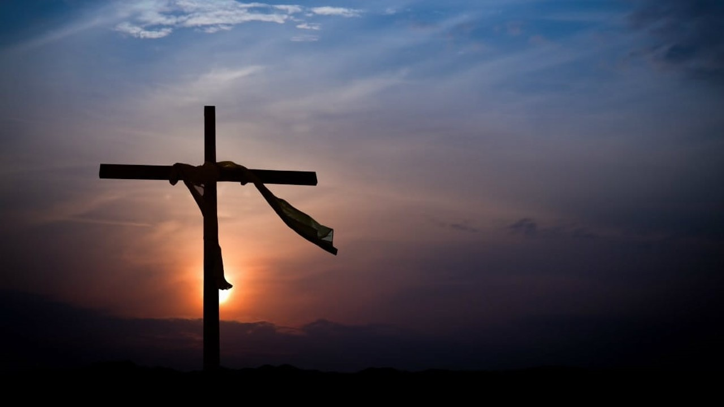
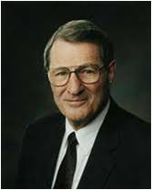
“Jesus’ perfect empathy was ensured when, along with His Atonement for our sins, He took upon Himself our sicknesses, sorrows, griefs, and infirmities and came to know these ‘according to the flesh’.
He did this in order that He might be filled with perfect, personal mercy and empathy and thereby know how to succor us in our infirmities.
He thus fully comprehends human suffering. Truly Christ ‘descended below all things, in that He comprehended all things’.”
Neal A. Maxwell
Alma 7:11–12; D&C 88:6

Slide 12
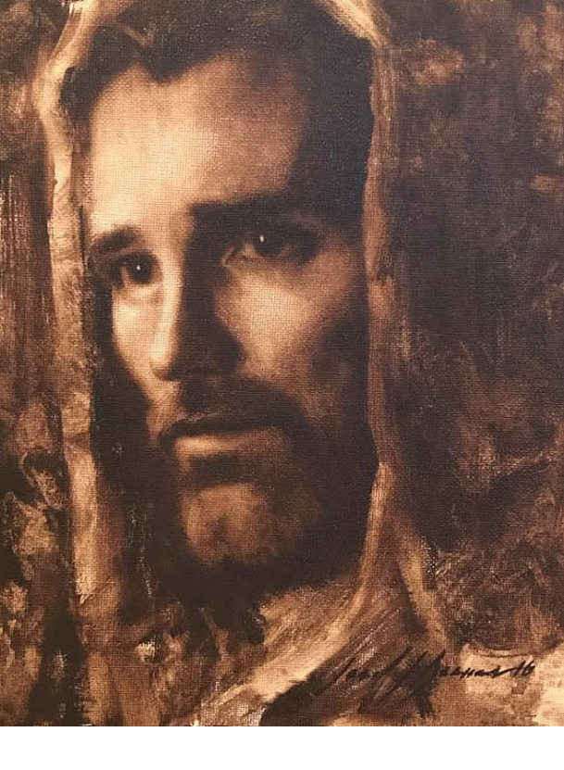
Because of the suffering He experienced through His atoning sacrifice, Jesus Christ has perfect empathy for us and can strengthen and comfort us through all of life’s difficulties.

Slide 13
Sources:
Suggested Hymn: #192 He Die! the Great Redeemer Died
Jeffrey R. Holland, “The Laborers in the Vineyard” Ensign or Liahona, May 2012, 33
Neil L. Andersen, “Repent … That I May Heal You,” Ensign or Liahona, Nov. 2009, 41
Dieter F. Uchtdorf, “Four Titles,” Ensign or Liahona, May 2013, 58
Dale G. Renlund, “Latter-day Saints Keep on Trying,” Ensign or Liahona, May 2015, 56
Russell M. Nelson, “The Atonement,” Ensign, Nov. 1996, 34
Neal A. Maxwell, “Enduring Well,” Ensign, Apr. 1997, 7
ChurchofJesusChrist.org

Slide 14
a
c
g
f
b
h
d
e
Answers: (1) a, (2) c, (3) g, (4) f, (5) b, (6) h, (7) d, (8) e

