Slide 1
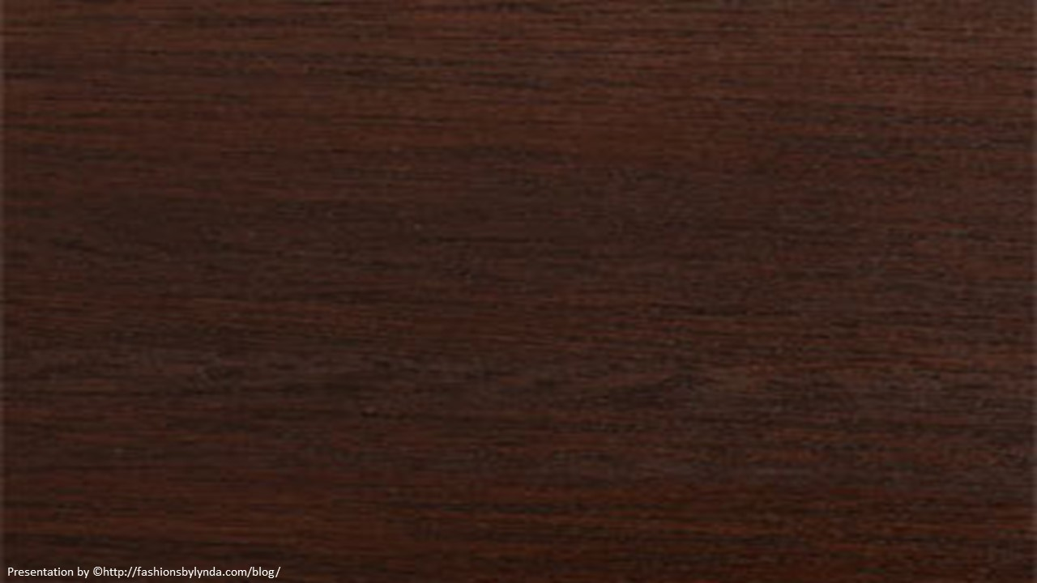
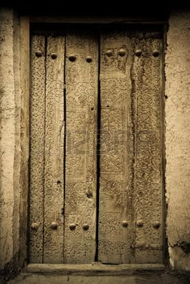
Lesson 49
The Great Cry
Passover
Exodus 12-13
And all the firstborn in the land of Egypt shall die, from the firstborn of Pharaoh that sitteth upon his throne, even unto the firstborn of the maidservant that is behind the mill; and all the firstborn of beasts.
Exodus 11:5

Slide 2
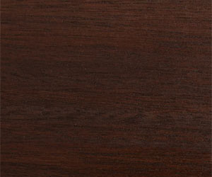
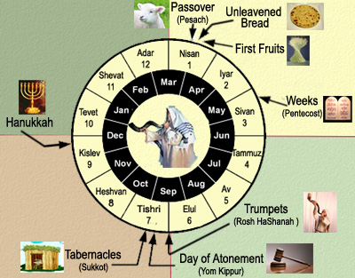
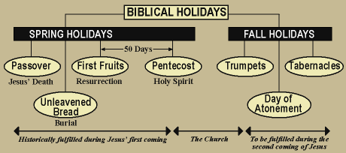
Tenth Day Of This Month
This month shall be unto you the beginning of months: it shall be the first month of the year to you
Feast of Unleavened Bread
Passover
Tenth day of this month
The Passover occurred in the spring, the beginning of the Hebrew calendar
Exodus 12:2-3

Slide 3
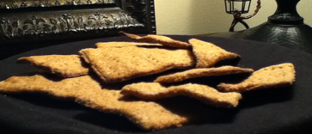
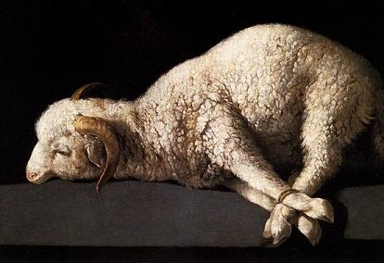
Sacrificial Lamb
“At the time appointed for their deliverance from Egyptian bondage, the Lord commanded each family in Israel to sacrifice a lamb, to sprinkle its blood on their doorposts, and then to eat unleavened bread for seven more days…
Exodus 12:4-11
(1)

Slide 4
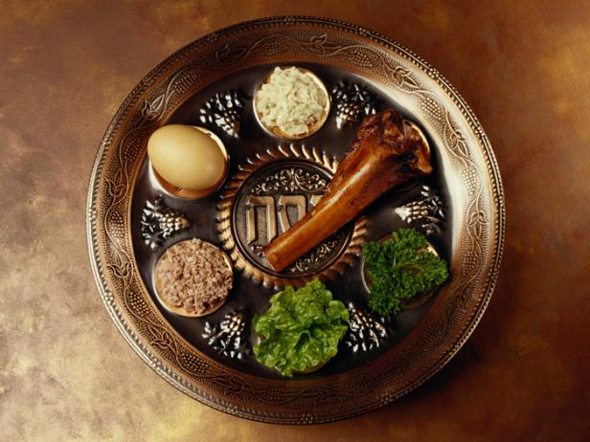
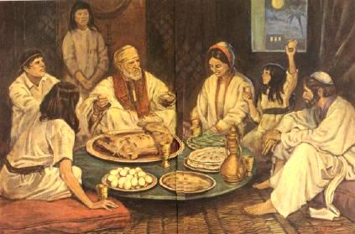
Passover Feast
Unleavened bread, bitter herbs, and lamb meat.
The Seder is a ritual performed by a community or by multiple generations of a family, involving a retelling of the story of the liberation of the Israelites from slavery in ancient Egypt.
Exodus 12:8

Slide 5
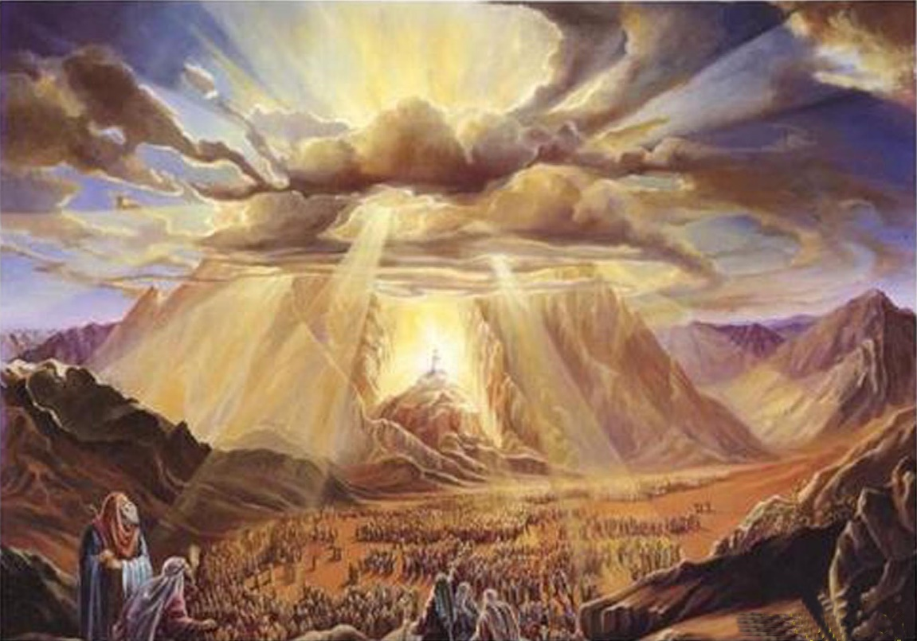
Pass Over and Destroy
—all to symbolize the fact that the destroying angel would pass over the Israelites as he went forth slaying the firstborn in the families of all the Egyptians; and also to show that, in haste, Israel should go forth from slavery to freedom.
As a pattern for all the Mosaic instructions yet to come, the details of the performances here involved were so arranged as to bear testimony both of Israel’s deliverance and of her Deliverer.”
Exodus 12:7, 12-13, 29
(1)

Slide 6
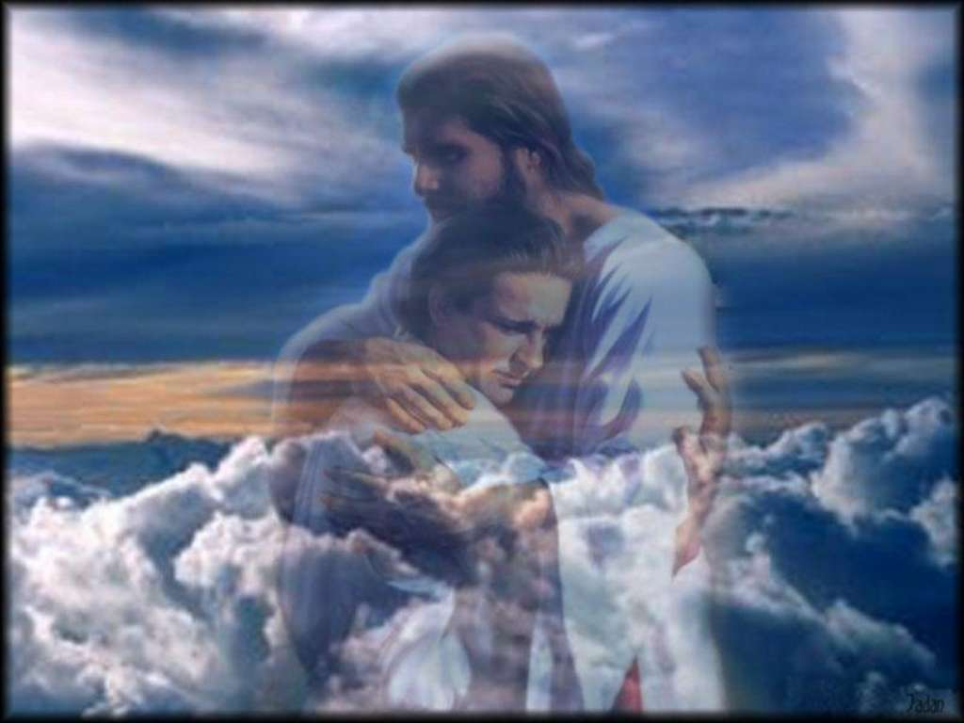
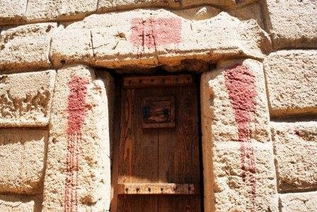
The Protection
The sacrifice of the lamb alone did not bring protection from the destroying angel. The lamb’s blood needed to be placed around the doors to protect the people inside from the destroying angel. Safety was promised only to those who properly marked the doors.
The Atonement of Jesus Christ can protect us from the power of Satan as we apply the conditions of repentance in our lives.
Exodus 12:7, 12-13, 29

Slide 7
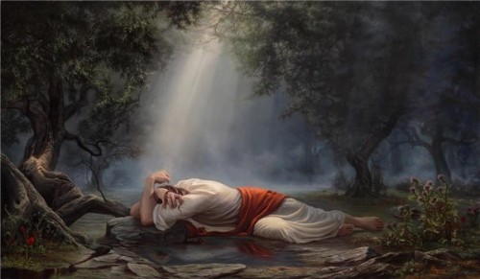
The Lamb
“Jesus Christ, the Lamb without blemish, willingly laid Himself on the altar of sacrifice and paid the price for our sins,” (2)
“Your lamb shall be without blemish, a male of the first year,’ signifying that the Lamb of God, pure and perfect, without spot or blemish, in the prime of his life, as the Paschal Lamb, would be slain for the sins of the world.” (1)
Exodus 12:5

Slide 8
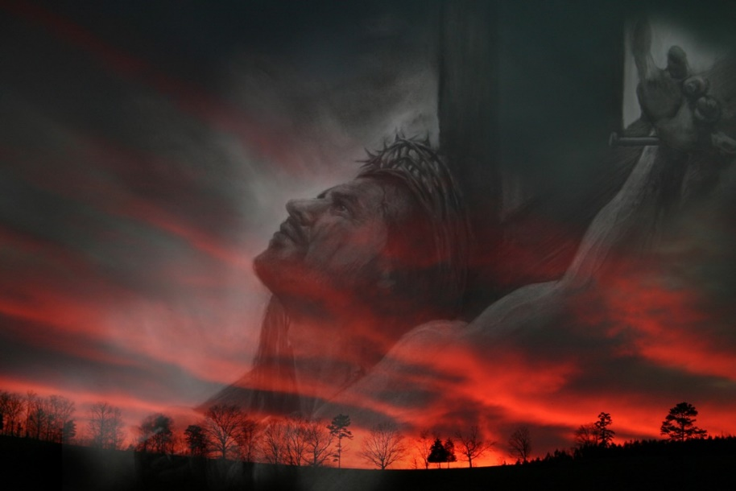
The Blood
The blood of Christ, which should fall as drops in Gethsemane and flow in a stream from a pierced side as he hung on the cross.
They were to take of the blood of the lamb and sprinkle it upon the doorposts of their houses, having this promise as a result: ‘And the blood shall be to you for a token upon the houses where ye are: and when I see the blood, I will pass over you, and the plague shall not be upon you to destroy you,’
Exodus 12:7
(1)

Slide 9
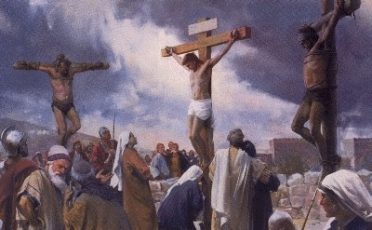
The Bones
Then came the soldiers, and brake the legs of the first, and of the other which was crucified with him.
But when they came to Jesus, and saw that he was dead already, they brake not his legs:
John 19:32-33
As to the sacrifice of the lamb, the decree was, ‘Neither shall ye break a bone thereof,’ signifying that when the Lamb of God was sacrificed on the cross, though they broke the legs of the two thieves to induce death, yet they brake not the bones of the Crucified One ‘that the scripture should be fulfilled, A bone of him shall not be broken.’
Exodus 12:46
(1)

Slide 10
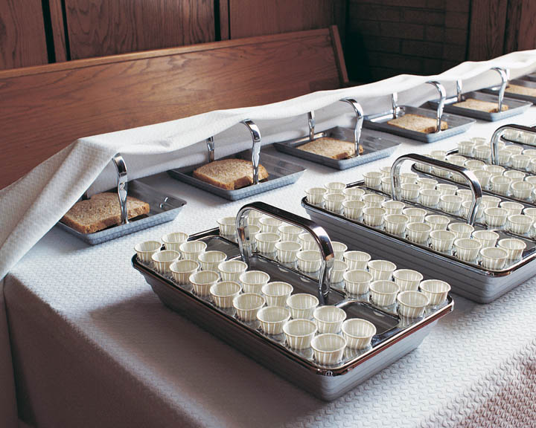
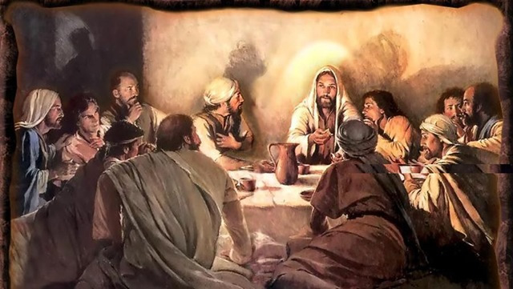
The Flesh and Blood
As to the eating the flesh of the sacrificial lamb, the divine word was, ‘No uncircumcised person shall eat thereof,’ signifying that the blessings of the gospel are reserved for those who come into the fold of Israel, who join the Church, who carry their part of the burden in bearing off the kingdom; signifying also that those who eat his flesh and drink his blood, as he said, shall have eternal life and he will raise them up at the last day.
Whoso eateth my flesh, and drinketh my blood, hath eternal life; and I will raise him up at the last day. John 6:54
Exodus 12:8
(1)

Slide 11
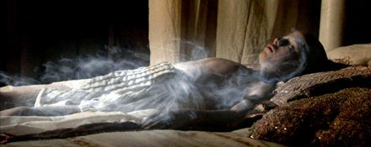
The Firstborn
The Lord smote all the firstborn in the land of Egypt’ because they believed not the word of the Lord delivered to them by Moses and Aaron, even so should the Firstborn of the Father, who brings life to all who believe in his holy name, destroy worldly people at the last day, destroy all those who are in the Egypt of darkness, whose hearts are hardened as were those of Pharaoh and his minions.
Jesus Christ is the Firstborn of the Father in the spirit. He is the Only Begotten of the Father in the flesh. (3)
For God so loved the world, that he gave his only begotten Son, that whosoever believeth in him should not perish, but have everlasting life. John 3:16
Exodus 12:29-31
(1)

Slide 12
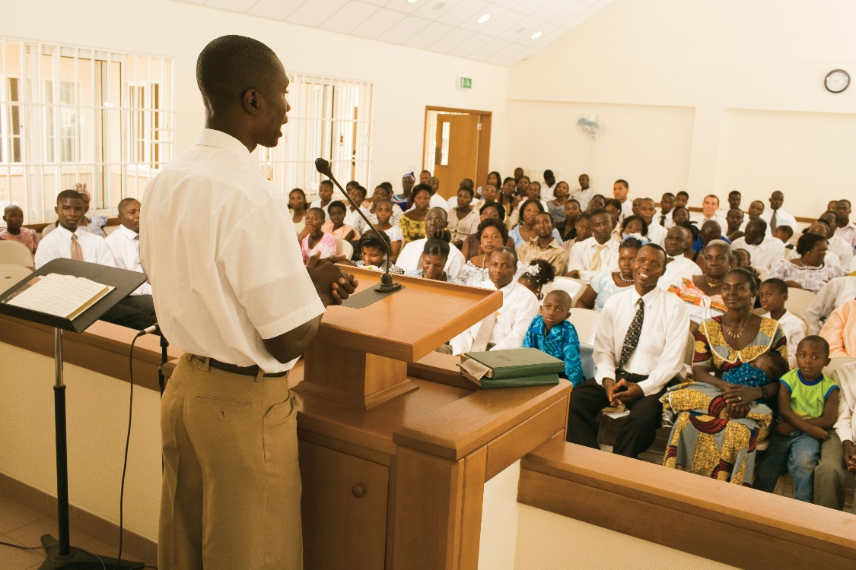
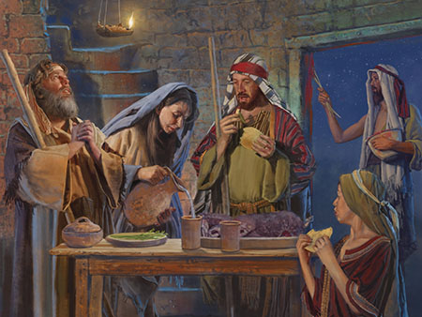
The Meetings
On the first and seventh days of the Feast of Unleavened Bread, the Israelites were commanded to hold holy convocations in which no work might be done except the preparation of their food. These were occasions for preaching and explaining and exhorting and testifying.
We go to sacrament meetings to be built up in faith and in testimony
Ancient Israel attended holy convocations for the same purposes
Exodus 12:47
(1)

Slide 13
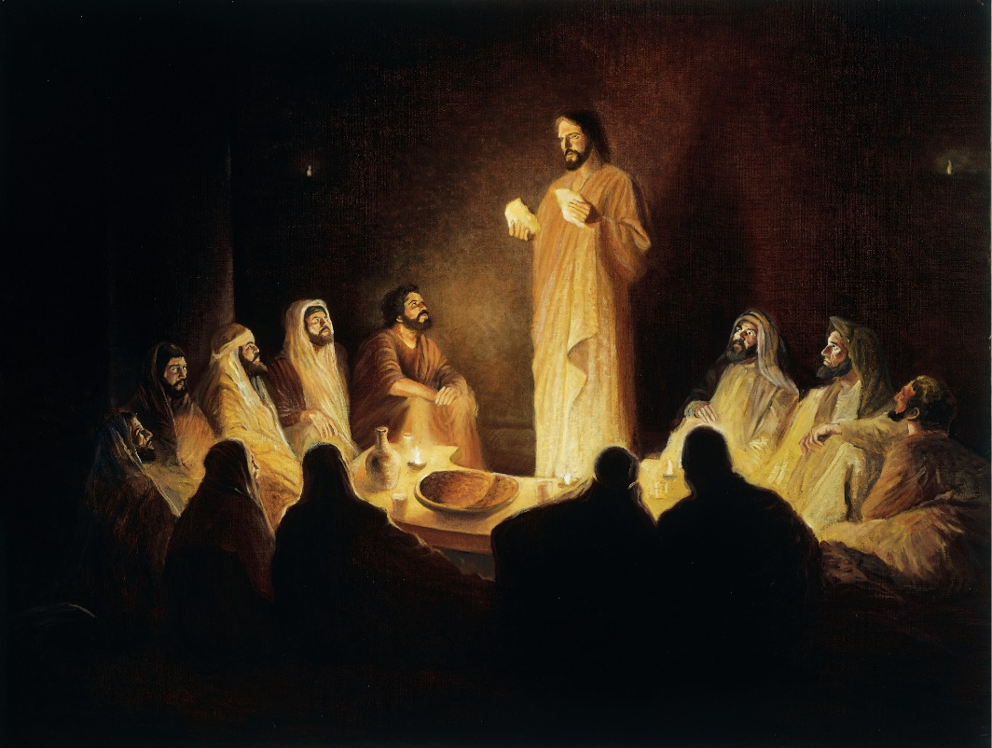
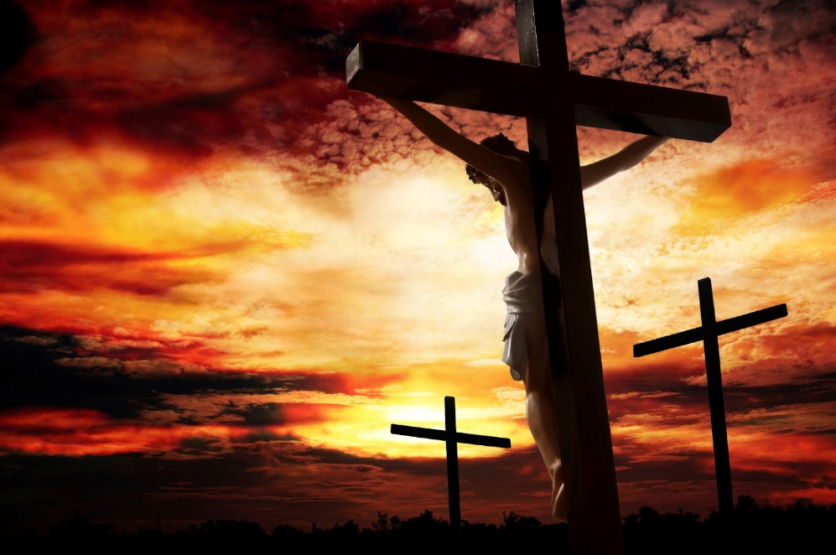
The Ordinance
“…while Jesus and the Twelve were keeping the Feast of the Passover that our Lord instituted the ordinance of the sacrament, to serve essentially the same purposes served by the sacrifices of the preceding four millenniums.”
“After that final Passover day and its attendant lifting up upon the cross of the true Paschal Lamb, the day for the proper celebration of the ancient feast ceased.”
Exodus 12:43
(1)

Slide 14
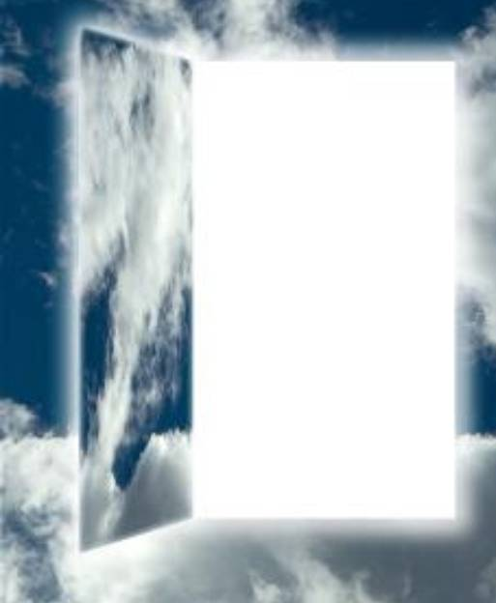
The Worthy
No uncircumcised men shall eat of the Passover
Only those who have worthily made covenants with the Lord can receive all the blessings the Atonement makes possible.
Exodus 12:47-48

Slide 15
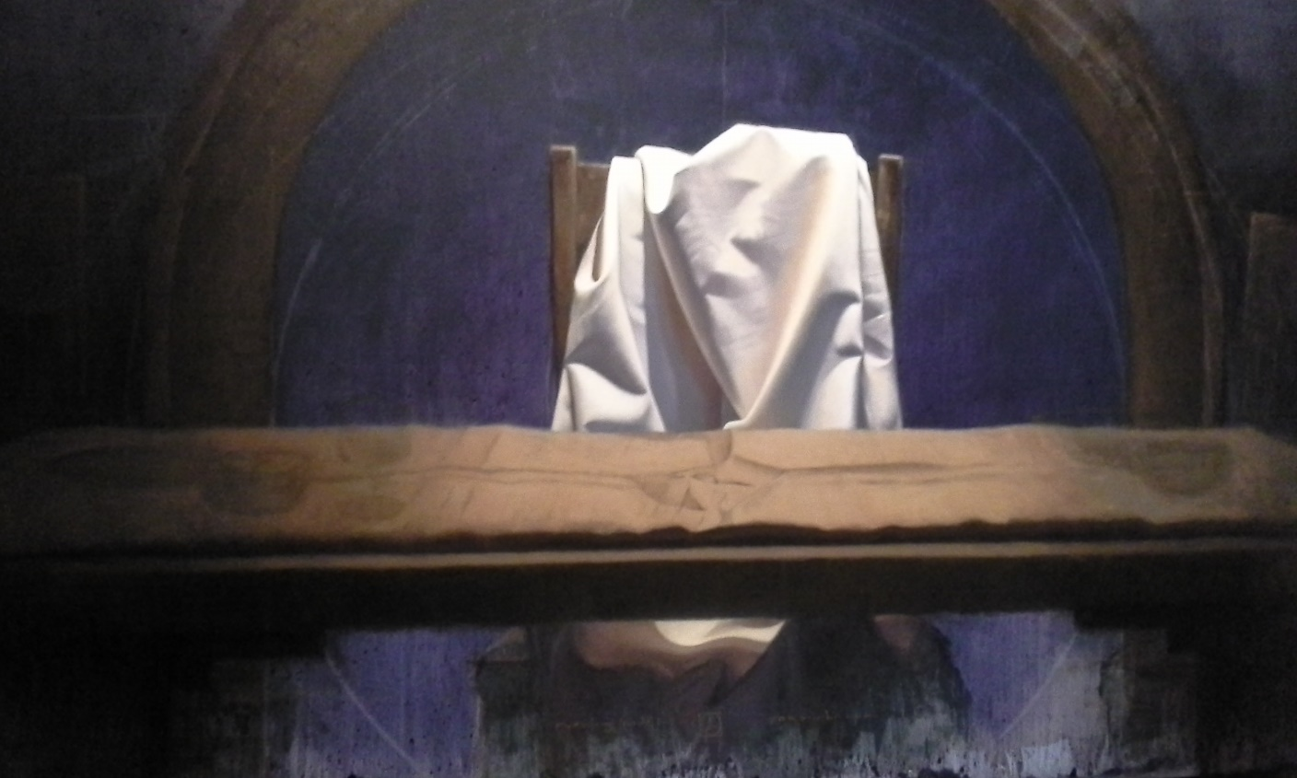
Our Passover
‘Christ our passover is sacrificed for us,’ and to give the natural exhortation that flowed therefrom: ‘Therefore let us keep the feast, not with old leaven, neither with the leaven of malice and wickedness; but with the unleavened bread of sincerity and truth.’ (1 Cor. 5:7–8.)”
We can be delivered from spiritual death through the atoning blood of Jesus Christ
We can apply the atoning blood of Jesus Christ through repentance and obedience

Slide 16
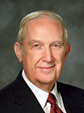
“Repentance and obedience are absolutely essential for the Atonement to work its complete miracle in your life. …
“The Atonement was a selfless act of infinite, eternal consequence. … Through it the Savior broke the bonds of death.
… It opens the gates to exaltation for all who qualify for forgiveness through repentance and obedience” (4)

Slide 17
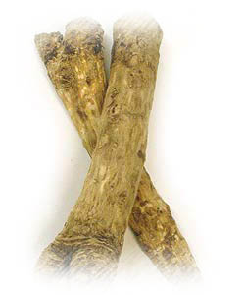
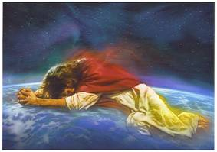
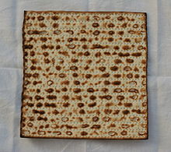
To Remember
Lamb (Jesus Christ)
Bitter herbs (bondage, sin)
As the Israelites ate the bitter herbs, they were to remember their bondage to the Egyptians
Blood (Atonement of Jesus Christ)
Unleavened bread (repentance, removal of sin)
Unleavened bread is not prepared with raising agents
Exodus 13:3

Slide 18
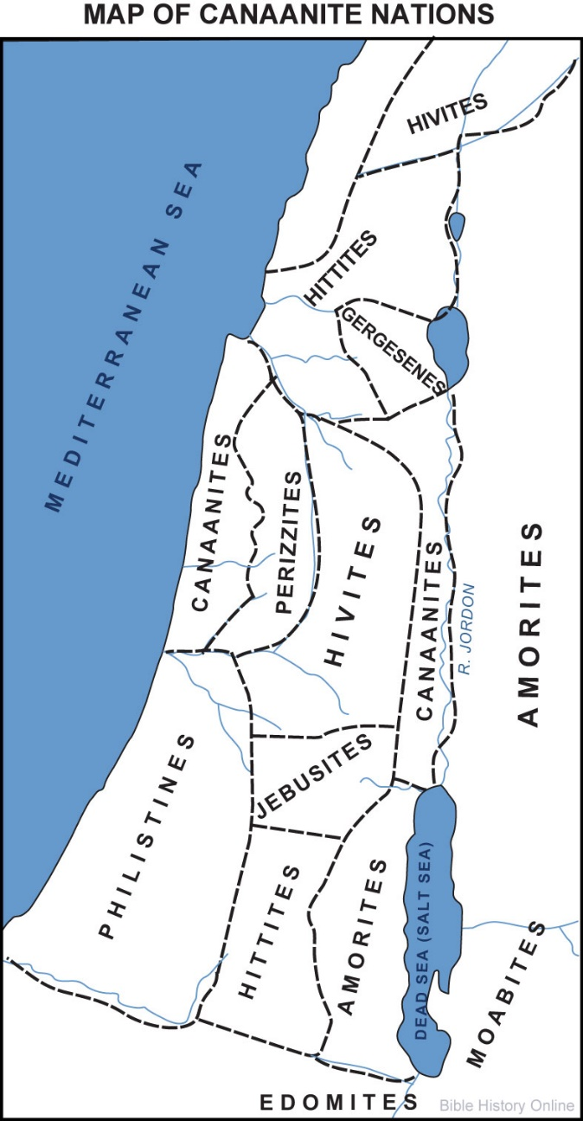
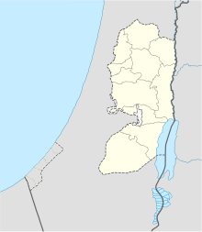
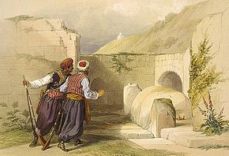
To the Land of Milk and Honey
The land of the Canaanites, and the Hittites, and the Amorites, and the Hivites, and the Jebusites,
They took the bones of Joseph with them
The Torah provides four details regarding the traditions surrounding Joseph’s remains. The account in Genesis relates that, before his death, he had his brothers swear they would carry his bones out of Egypt to Canaan. He is then said to have been embalmed then placed in a coffin in Egypt. In Exodus, we are told that Moses fulfilled the pledge by taking Joseph's bones with him when he
left Egypt. In Joshua, Joseph’s bones are said to
have been brought from Egypt by the Children of Israel and interred in Shechem. (5)
Exodus 13:5, 19
David Roberts

Slide 19
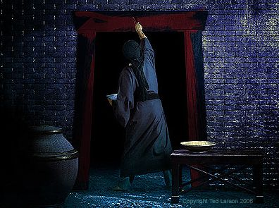
Sources:
Suggested Hymn: #107 Lord, Accept Our True Devotion
Video: The Passover
Elder Bruce R. McConkie The Promised Messiah, pp. 429–31. (excerpts from)
Visiting Teaching Message February 2015 The Attributes of Jesus Christ: Without Sin President Dieter F. Uchtdorf
Guide to the Scriptures “Firstborn”
Elder Richard G. Scott(“The Atonement Can Secure Your Peace and Happiness,” Ensign or Liahona, Nov. 2006, 42).
Wikipedia
Presentation by ©http://fashionsbylynda.com/blog/

Slide 20
Exodus 12 The Passover
Scripture Reference | The Lord’s Instructions | Possible Symbolism
Exodus 12:3–6 | Each Israelite family was to kill a male lamb that was without blemish. | Jesus Christ, “the Lamb of God” (John 1:36), was perfect and gave His life for us.
Exodus 12:46 | No bone of the lamb was to be broken. | None of Jesus Christ’s bones were broken at the time of His death (see John 19:36).
Exodus 12:8, 15 | The Israelites were to eat bitter herbs and unleavened bread. They were to rid their homes of all leaven for seven days. | The bitter herbs reminded the Israelites of their years of bitter bondage in Egypt. The bitter bondage is like the bitterness of our sins. Leaven, or yeast, causes bread to become moldy. As part of our repentance, we are to rid our lives of anything that can corrupt our spirits.
Exodus 12:9–10 | The Israelites were to eat all of the lamb and burn the remains. | We are to receive Jesus Christ’s Atonement completely. No part of His Atonement was wasted. He did not sacrifice Himself needlessly.
Exodus 12:11 | The Israelites were to eat the Passover meal “in haste,” dressed prepared to leave. | We should be ready to leave behind any sinful ways.
Exodus 12:7, 12–13, 29 | The sacrifice of the lamb alone did not bring protection from the destroying angel. The lamb’s blood needed to be placed around the doors to protect the people inside from the destroying angel. Safety was promised only to those who properly marked the doors. | The Atonement of Jesus Christ can protect us from the power of Satan as we apply the conditions of repentance in our lives.
Exodus 12:30–31 | The deaths of the firstborns in Egypt led to the Israelites’ freedom from bondage. | The Atonement of Jesus Christ, the Firstborn spirit child of Heavenly Father, makes possible our freedom from the bondage of sin.
Exodus 12:47–48 | No uncircumcised men shall eat of the Passover. | Only those who have worthily made covenants with the Lord can receive all the blessings the Atonement of Jesus Christ makes possible.

Slide 21
Gospeldoctrine.com

Slide 22
As preparation for reading the scriptural account of this remarkable event, consider Elder Bruce R. McConkie’s summary of the significance of these events:
“At the time appointed for their deliverance from Egyptian bondage, the Lord commanded each family in Israel to sacrifice a lamb, to sprinkle its blood on their doorposts, and then to eat unleavened bread for seven more days—all to symbolize the fact that the destroying angel would pass over the Israelites as he went forth slaying the firstborn in the families of all the Egyptians; and also to show that, in haste, Israel should go forth from slavery to freedom. As a pattern for all the Mosaic instructions yet to come, the details of the performances here involved were so arranged as to bear testimony both of Israel’s deliverance and of her Deliverer. Among other procedures, the Lord commanded, as found in Exodus 12:
“1. ‘Your lamb shall be without blemish, a male of the first year,’ signifying that the Lamb of God, pure and perfect, without spot or blemish, in the prime of his life, as the Paschal Lamb, would be slain for the sins of the world.
“2. They were to take of the blood of the lamb and sprinkle it upon the doorposts of their houses, having this promise as a result: ‘And the blood shall be to you for a token upon the houses where ye are: and when I see the blood, I will pass over you, and the plague shall not be upon you to destroy you,’ signifying that the blood of Christ, which should fall as drops in Gethsemane and flow in a stream from a pierced side as he hung on the cross, would cleanse and save the faithful; and that, as those in Israel were saved temporally because the blood of a sacrificial lamb was sprinkled on the doorposts of their houses, so the faithful of all ages would wash their garments in the blood of the Eternal Lamb and from him receive an eternal salvation. And may we say that as the angel of death passed by the families of Israel because of their faith—as Paul said of Moses, ‘through faith he kept the passover, and the sprinkling of blood, lest he that destroyed the firstborn should touch them’ (Heb. 11:28)—even so shall the Angel of Life give eternal life to all those who rely on the blood of the Lamb.
“3. As to the sacrifice of the lamb, the decree was, ‘Neither shall ye break a bone thereof,’ signifying that when the Lamb of God was sacrificed on the cross, though they broke the legs of the two thieves to induce death, yet they brake not the bones of the Crucified One ‘that the scripture should be fulfilled, A bone of him shall not be broken.’ (John 19:31–36.)
“4. As to the eating the flesh of the sacrificial lamb, the divine word was, ‘No uncircumcised person shall eat thereof,’ signifying that the blessings of the gospel are reserved for those who come into the fold of Israel, who join the Church, who carry their part of the burden in bearing off the kingdom; signifying also that those who eat his flesh and drink his blood, as he said, shall have eternal life and he will raise them up at the last day. (John 6:54.)
“5. As ‘the Lord smote all the firstborn in the land of Egypt’ because they believed not the word of the Lord delivered to them by Moses and Aaron, even so should the Firstborn of the Father, who brings life to all who believe in his holy name, destroy worldly people at the last day, destroy all those who are in the Egypt of darkness, whose hearts are hardened as were those of Pharaoh and his minions.
“6. On the first and seventh days of the Feast of Unleavened Bread, the Israelites were commanded to hold holy convocations in which no work might be done except the preparation of their food. These were occasions for preaching and explaining and exhorting and testifying. We go to sacrament meetings to be built up in faith and in testimony. Ancient Israel attended holy convocations for the same purposes. Knowing that all things operate by faith, would it be amiss to draw the conclusion that it is as easy for us to look to Christ and his spilt blood for eternal salvation as it was for them of old to look to the blood of the sacrificed lamb, sprinkled on doorposts, to give temporal salvation, when the angel of death swept through the land of Egypt?
“It was, of course, while Jesus and the Twelve were keeping the Feast of the Passover that our Lord instituted the ordinance of the sacrament, to serve essentially the same purposes served by the sacrifices of the preceding four millenniums. After that final Passover day and its attendant lifting up upon the cross of the true Paschal Lamb, the day for the proper celebration of the ancient feast ceased. After that Paul was able to say: ‘Christ our passover is sacrificed for us,’ and to give the natural exhortation that flowed therefrom: ‘Therefore let us keep the feast, not with old leaven, neither with the leaven of malice and wickedness; but with the unleavened bread of sincerity and truth.’ (1 Cor. 5:7–8.)” (The Promised Messiah, pp. 429–31.)
The Whole Article by Bruce R. McConkie
Found in Institute Manual
Old Testament

Slide 23
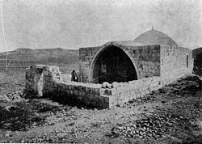
Connection Between Passover and the Sacrament:
“At Gethsemane and Golgotha the Savior’s blood was shed. Centuries earlier the Passover had been introduced as a symbol and a type of things to come. It was an ordinance to be kept forever (see Exodus 12). …
“After the crucifixion of the Lord, the law of sacrifice required no more shedding of blood. … The sacrifice thenceforth was to be a broken heart and a contrite spirit—repentance.
“And the Passover would be commemorated forever as the sacrament, in which we renew our covenant of baptism and partake in remembrance of the body of the Lamb of God and of His blood, which was shed for us” President Boyd K. Packer (“Atonement, Agency, Accountability,” Ensign, May 1988, 72).
Lamb’s Blood on the Door:
Consider the courage the ancient Israelites showed when they obeyed the command to place blood on their doorposts. Four hundred years of Egyptian rule likely included persecution for those who openly worshipped Jehovah. Thus, the placement of the lamb’s blood on the doorposts was a bold public statement, a marker that identified those who worshipped Jehovah. How does the courageous example of the ancient Israelites influence the way we live our beliefs and standards as Latter-day Saints? Although we don’t sprinkle blood on our doorposts today, what outward characteristics might distinguish the homes and lives of faithful Latter-day Saints from the homes and lives of others? Are we afraid of persecution or concerned about public opinion and being accepted by the world? Or do we say, as Paul did, “I am not ashamed of the gospel of Christ” (Romans 1:16)?
The bones of Joseph, which the Children of Israel brought up out of Egypt, were buried in Shechem in a parcel of land Jacob bought from the sons of Hamor, father of Shechem, for a hundred pieces of silver (qeśîṭâ).Joshua 24:32
The Bible does not identify a specific site in Shechem where his bones were laid to rest

