Slide 1
Lesson 5
The Bible
Holy Bible
We believe the Bible to be the word of God as far as it is translated correctly; we also believe the Book of Mormon to be the word of God.
Article of Faith 1:8
Presentation by ©http://fashionsbylynda.com/blog/

Slide 2
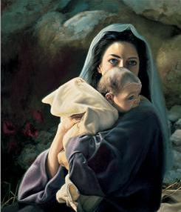
Miracles
Miracles are seals of a divine mission. The sacred writers appealed to them as proofs that they were messengers of God. Our Lord also appealed to miracles as a conclusive proof of his divine mission.
Thus, being out of the common course of nature and beyond the power of man, they are fitted to convey the impression of the presence and power of God.
Where miracles are there certainly God is. The man, therefore, who works a miracle affords thereby clear proof that he comes with the authority of God; they are his credentials that he is God’s messenger.
For the Father loveth the Son, and sheweth him all things that himself doeth: and he will shew him greater works than these, that ye may marvel.
John 5:20
Bible Encyclopedia

Slide 3
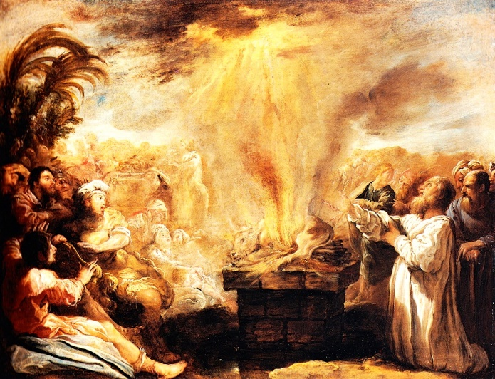
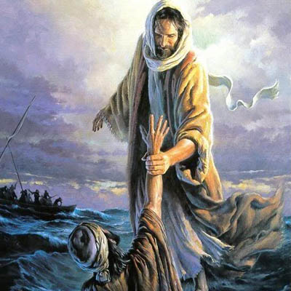
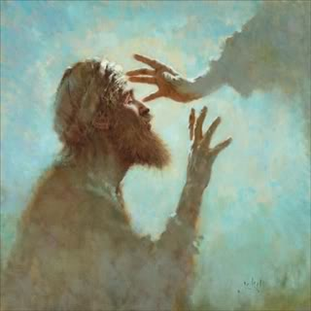
4 Greek Words
In the New Testament to designate miracles
Wonder-causing events; portents; producing astonishment in the beholder.
An evidence of a divine commission; an attestation of a divine message a
token of the presence
and working of God;
the seal of a higher
power.
Semeion “Sign”
Terata “Wonders”
Works of superhuman power of a new and higher power.
Dunameis ”mighty works”
The works of Him who is “wonderful in working”.
Erga (Works”
Bible Encyclopedia

Slide 4
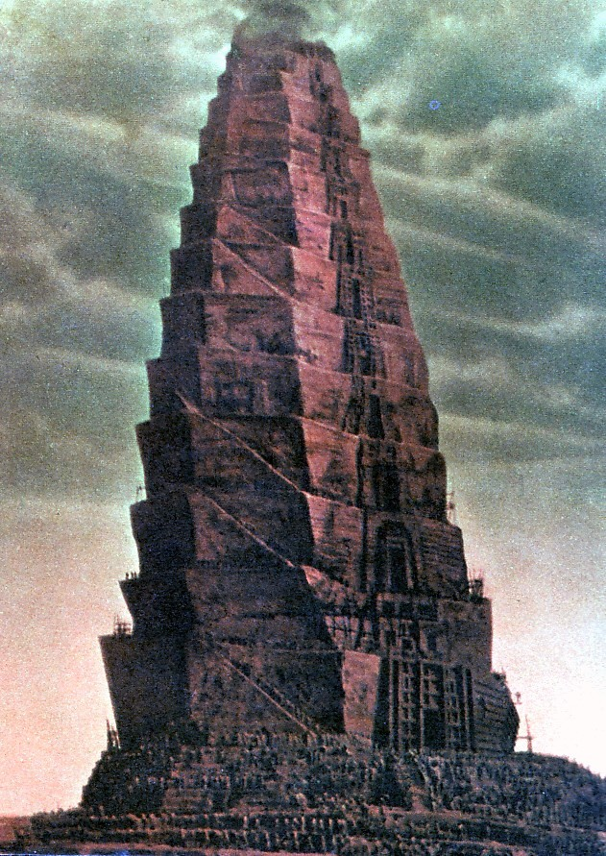
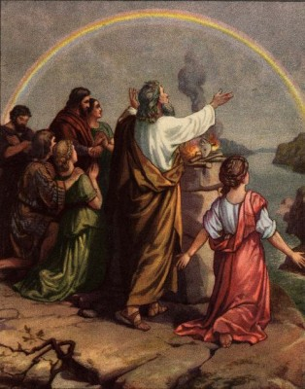
Some Miracles
The Creation
Red Sea Divided
Tower of Babel
The Flood

Slide 5
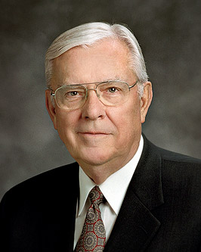
“My brothers and sisters, the Holy Bible is a miracle!
It is a miracle that the Bible’s 4,000 years of sacred and secular history were recorded and preserved by the prophets, apostles, and inspired churchmen. …
“It is not by chance or coincidence that we have the Bible today”
Elder M. Russell Ballard

Slide 6
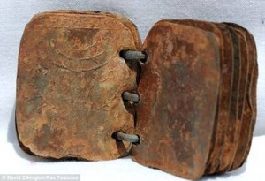
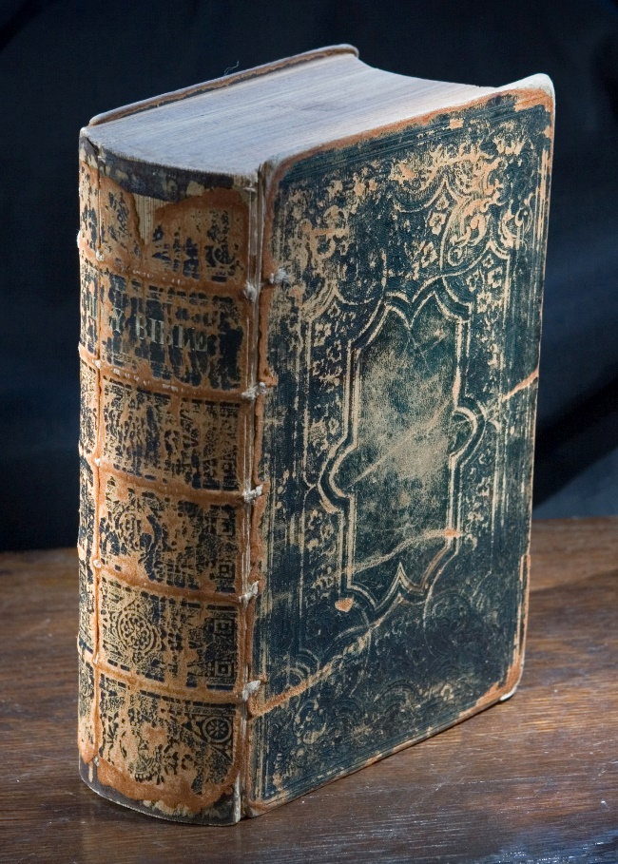
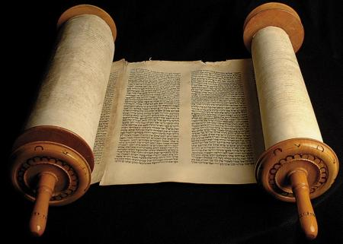
What is the Bible?
The collection of writings that contain the records of divine revelation.
The word itself is of Greek origin, being derived from ta biblia, “the books.”
In course of time biblia, a neuter plural, was regarded as a feminine singular, and in that way “the books” came to be spoken of as “the book.”
By the word Bible therefore we must understand not a single book but a divine library.
Discovered in Jordan Judeo-Christian books of the 1st century
1859 American Bible
Bible Dictionary LDS

Slide 7
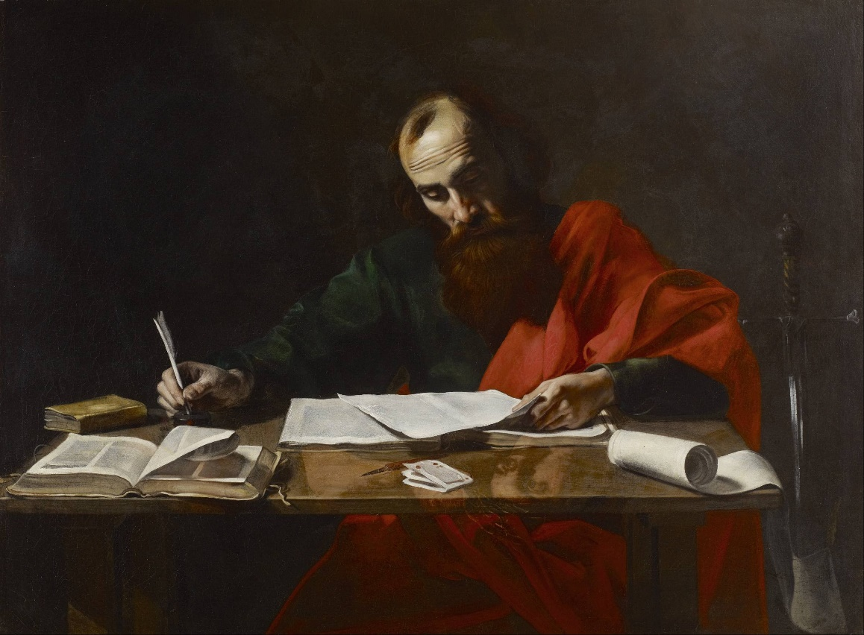
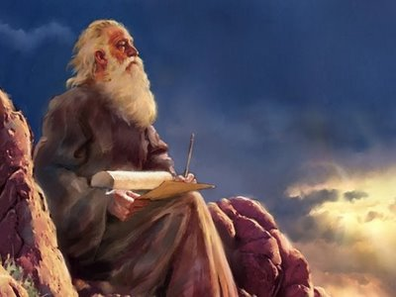
The Authors
The Bible is the work of many prophets and inspired writers acting under the influence of the same Holy Spirit; but at the same time it came into being “in many parts and in many modes” by a gradual growth extending over many centuries, and we can see in the books themselves evidence of the varied conditions of time and place and thought under which they were composed.
Paul Writing His Epistles, painting attributed to Valentin de Boulogne, 17th century
Bible Dictionary LDS

Slide 8
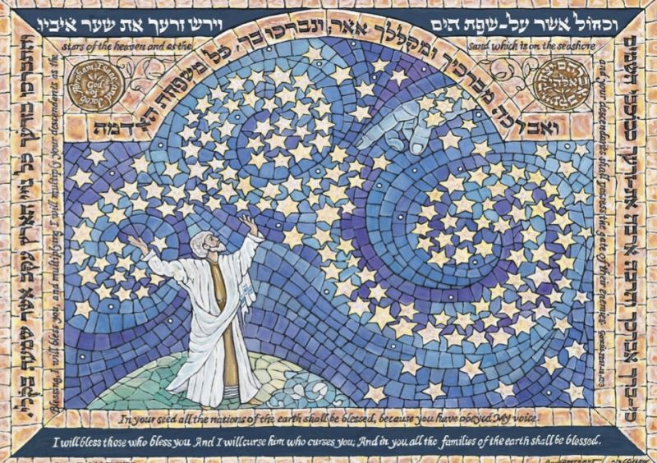
The Structure
Consists of the canon of scriptures current among the Jews of Palestine in our Lord’s time and received on that account in its entirety by the Christian Church.
Contains writings belonging to the apostolic age, selected by the Church and regarded as having the same sanctity and authority as the Jewish scriptures.
The Bible
Old Testament
New Testament
The books of the Old Testament are drawn from a national literature extending over many centuries and were written almost entirely in Hebrew.
The books of the New Testament are the work of a single generation and were written in Greek (with the possible exception of the Gospels of Matthew and John, which may have been written originally in Aramaic.
Bible Dictionary LDS

Slide 9
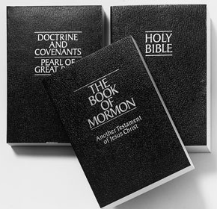
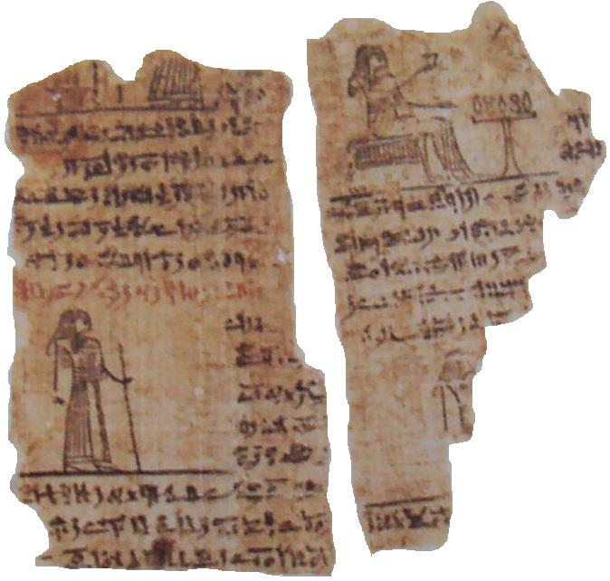
Canon
A word of Greek origin, originally meaning “a rod for testing straightness,” now used to denote the authoritative collection of the sacred books used by the true believers in Christ.
In The Church of Jesus Christ of Latter-day Saints, the canonical books are called standard works.
The history of the process by which the books of the Bible were collected and recognized as a sacred authority is almost hidden in obscurity.
There are several legends extant and these may have some truth in them but certainly are not complete or totally accurate.
Though many of the details have not been preserved, we know that the servants of the Lord have been commanded to keep records even from the earliest times, and that those records have been revered by the faithful and handed down from generation to generation.
Bible Dictionary LDS

Slide 10
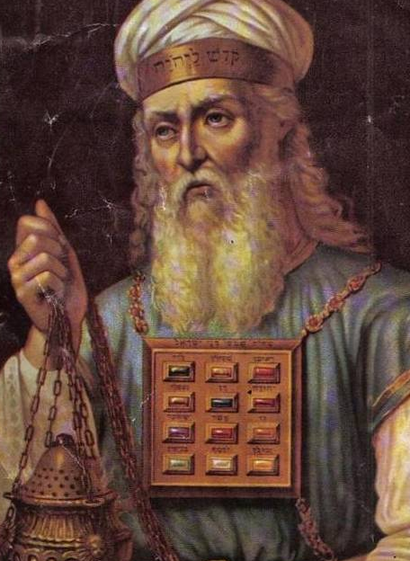
Divided into 3 Groups
The Law
And he said unto them, These are the words which I spake unto you, while I was yet with you, that all things must be fulfilled, which were written in the law of Moses, and in the prophets, and in the psalms, concerning me.
Luke 24:44
Old Testament-
The Hebrew Bible
The Prophets
The Writings (or Hagiographa).
This arrangement was according to the Jews’ evaluation of the importance of the books based on the identity of the author.
The Bible used by the Christian world is based on a different arrangement of the Old Testament books and was set up by a Greek translation called Septuagint.
In this case the books are classified according to subject matter, such as historical, poetical, and prophetical.
Bible Dictionary LDS

Slide 11
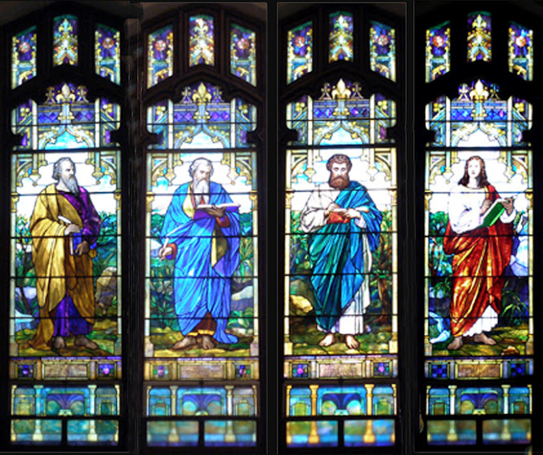
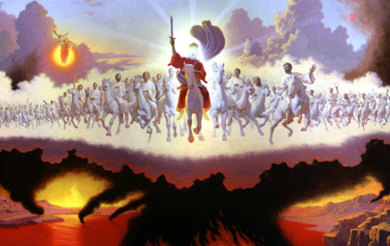
The New Testament
The 4 Gospels and Acts (Matthew, Mark, Luke and John)
The Epistles of Paul, James, Peter, John, and Jude (arranged according to length, except Hebrews)
New Testament
The Apocalypse or Revelation of John
Bible Dictionary LDS

Slide 12
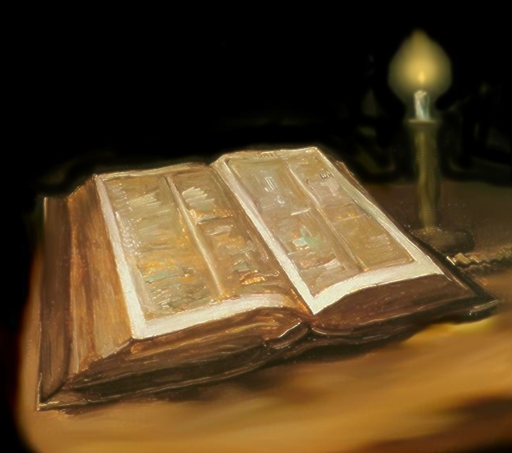
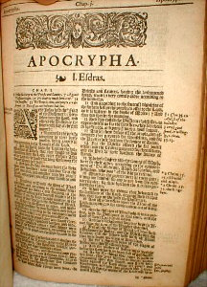
The Bible Used Today
The Bible used by most non-Catholic churches today has 66 books—39 in the Old Testament and 27 in the New Testament.
The books called Apocrypha have generally not been printed in the non-Catholic Bibles in the past century, although in recent years these books have been gaining in popularity.
Bible Dictionary LDS

Slide 13
Position of the church
We believe the Bible to be the word of God as far as it is translated correctly; we also believe the Book of Mormon to be the word of God.
Article of Faith 1:8
Joseph Smith taught that “many important points touching the salvation of men, had been taken from the Bible, or lost before it was compiled.”
He also said that the Bible was correct as “it came from the pen of the original writers,” but that “ignorant translators, careless transcribers, or designing and corrupt priests have committed many errors.” (HC 1:245; 6:57.)
The Church reveres and respects the Bible but recognizes that it is not a complete nor entirely accurate record. It affirms also that the Lord has given additional revelation through His prophets in the last days that sustains, supports, and verifies the biblical account of God’s dealings with mankind.
Bible Dictionary LDS

Slide 14
The Word of God
Testament--Covenant
Old Testament-
Between A.D. 300–400, Christian leaders chose a number of books that had been written during Old Testament and New Testament times and combined them to form the Bible that we know today.
New Testament
The Old Testament contains God’s covenant with His children as they looked forward to the coming of Jesus Christ.
The New Testament contains a record of Jesus Christ’s ministry and Atonement and again records God’s covenant with His people.

Slide 15
Five Books of Moses
Genesis
Exodus
Leviticus
Numbers
Deuteronomy
The first book of the Hebrew Bible (the Tanakh)
It includes a history from the beginning of the Creation to Moses, and laws
Moses leading the children of Israel to the promise land, including revelation, the Book of Commandments, and laws
How Moses builds the tabernacles, Priest instructions, and temple practices.
A continuation of Exodus from Mt. Sinai to where the Israelites crossed the Jordan River
Consists of 3 speeches delivered to the Israelites by Moses before they entered into the promised land

Slide 16
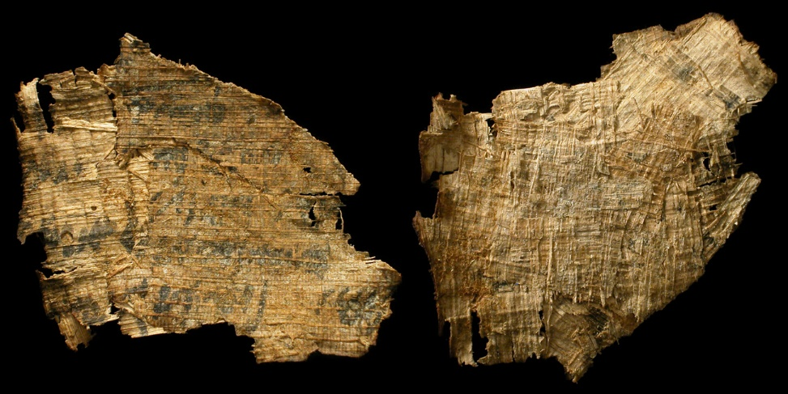
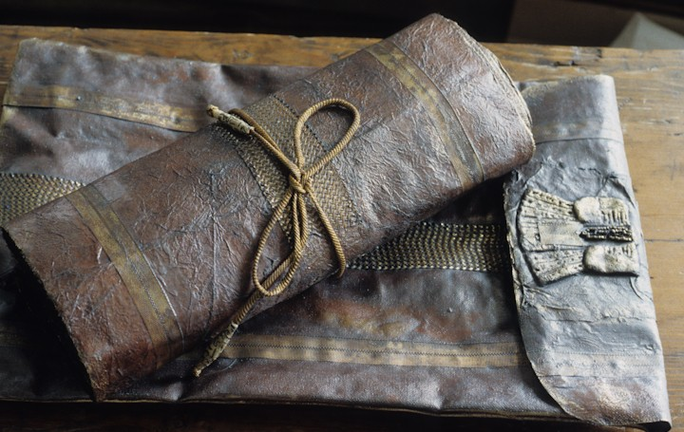
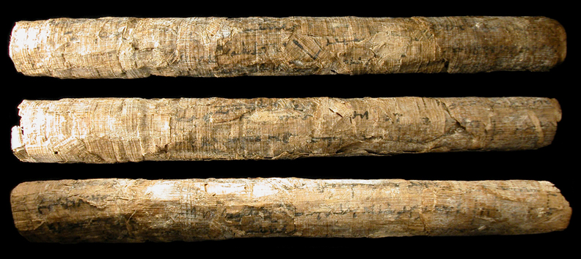
Scrolls
The books of the Old Testament were originally written on material such as leather or papyrus.
These were eventually transcribed and preserved as scrolls, which were written mostly in Hebrew
Over the years several efforts were made to collect and organize the authentic inspired words of the prophets
Papyrus scroll fragment
ancient mayan scrolls buried at Iximche
Israelite or Canaanite. Holy Land, c. 1st millennium BC

Slide 17
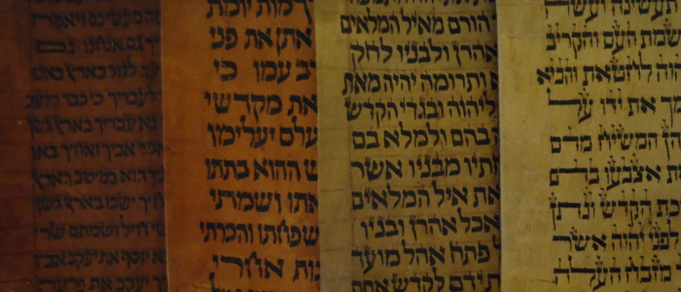
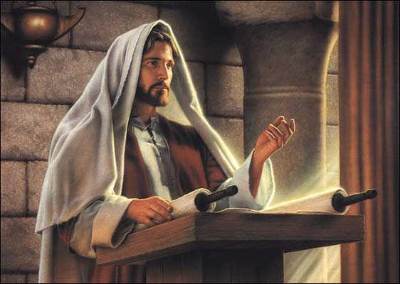
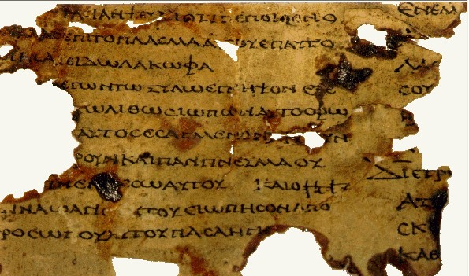
The Language
During the third to second century B.C. the original language of most of the Old Testament was Hebrew, but at this time Jewish scholars translated the Old Testament writings into Greek and decided to organize them categorically.
This Greek version of the Old Testament, referred to as the Septuagint, was the version commonly used by the Jews in the Savior’s day.

Slide 18
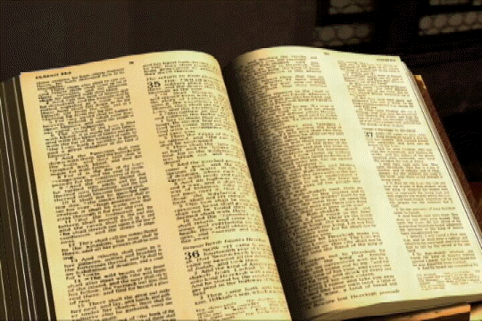
Order of the bible
The Law
Genesis - Deuteronomy
The History
Joshua - Esther
The Prophets
Isaiah - Malachi
The Poetry
Job – Song of Solomon

Slide 19
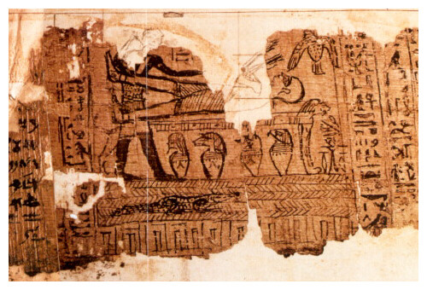
Apocrypha
Some books and writings that for various reasons were not included in the Hebrew Bible.
When Joseph Smith was engaged in his inspired translation of the Bible, he inquired of the Lord concerning the Apocrypha. He was instructed that while there were many good things contained in the Apocrypha, it was not needful that it should be translated by the Prophet (see D&C 91; see also Bible Dictionary, “Apocrypha”).
Verily, thus saith the Lord unto you concerning the Apocrypha—There are many things contained therein that are true, and it is mostly translated correctly;
There are many things contained therein that are not true, which are interpolations by the hands of men.
Verily, I say unto you, that it is not needful that the Apocrypha should be translated.
D&C 91:1-3
Bible Dictionary LDS

Slide 20
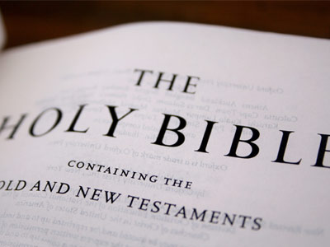
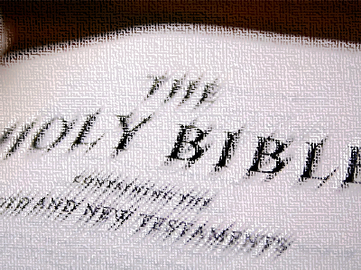
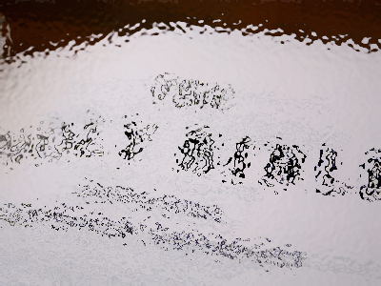
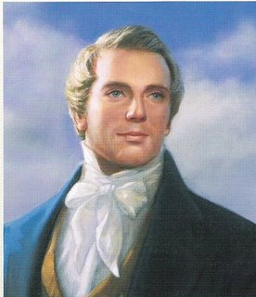
Copies of Copies
The oldest known sources of Bible text are copies of copies.
As copies of the Bible texts were made, translated, and transmitted, scribal errors—both unintentional and intentional—were perpetuated with each succeeding copy
…for behold, they have taken away from the gospel of the Lamb many parts which are plain and most precious; and also many covenants of the Lord have they taken away.
1 Nephi 13:26
“Joseph Smith taught that ‘many important points touching the salvation of men, had been taken from the Bible, or lost before it was compiled.’ He also said that the Bible was correct as ‘it came from the pen of the original writers,’ but that ‘ignorant translators, careless transcribers, or designing and corrupt priests have committed many errors.”
(History of the Church, 1:245; 6:57.)”
Bible Dictionary LDS

Slide 21
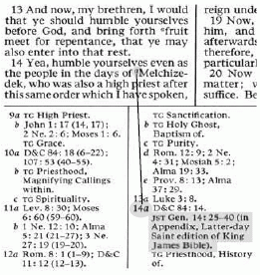
Joseph Smith’s Translation
A revision or translation of the King James Version of the Bible begun by the Prophet Joseph Smith in June 1830. He was divinely commissioned to make the translation and regarded it as “a branch of his calling” as a prophet.
Although the major portion of the work was completed by July 1833, he continued to make modifications while preparing a manuscript for the press until his death in 1844, and it is possible that some additional modifications would have been made had he lived to publish the entire work. Some parts of the translation were published during his lifetime.
Many excerpts from the JST are also given in the appendix and footnotes in the edition of the KJV that accompanies this dictionary. The JST to some extent assists in restoring the plain and precious things that have been lost from the Bible.
Bible Dictionary LDS

Slide 22
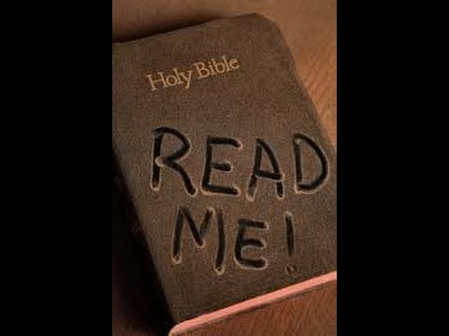
“Without the Bible, we would not know of His Church then, nor would we have the fulness of His gospel now. …
“… Do not discount or devalue the Holy Bible. It is the sacred, holy record of the Lord’s life … [and] the bedrock of all Christianity.”
“It is a miracle that the Bible literally contains within its pages the converting, healing Spirit of Christ, which has turned men’s hearts for centuries, leading them to pray, to choose right paths, and to search to find their Savior”
Elder M. Russell Ballard

Slide 23
Sources:
Suggested Song: The Books in the Old Testament pg. 114-115 in Children’s Songbook
Old Testament Seminary Manual for Teachers
Bible Encyclopedia--http://christiananswers.net/dictionary/miracle.html
Elder M. Russell Ballard (“The Miracle of the Holy Bible,” Ensign or Liahona, May 2007, 80).
Video: The Miracle of the Holy Bible
Presentation by ©http://fashionsbylynda.com/blog/

Slide 25
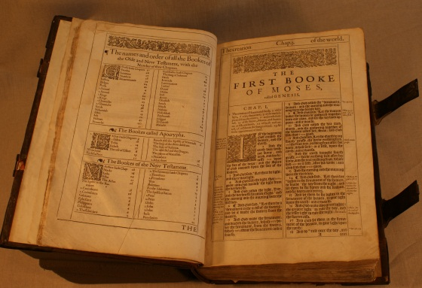
King James Bible:
The first link in the chain was forged by William Tyndale (c.1494-1536), 80 years before James I commissioned his Authorized Version. The Oxford-educated religious reformer, who was inspired by Erasmus and Luther, was forced to flee England in 1525. He was a gifted linguist and translated the New Testament from the original Greek into accessible English. By 1534, Tyndale had settled in Antwerp and was working on a translation of the Old Testament from the original Hebrew. However, in 1535, his friend Henry Phillips betrayed him to the Antwerp authorities. Tyndale was arrested, incarcerated for sixteen months, and in October 1536, he was publicly executed in Vilvoorde Castle, near Brussels, before he could complete his translation.
In 1535, just as Tyndale was printing his final revision of the New Testament in Antwerp, Miles Coverdale (c.1488-1569) was in the same city printing his complete English Bible. Coverdale was an Augustinian friar and a Cambridge man. Like Tyndale, his reformist views forced him into exile. He did not know enough Greek and Hebrew to translate the original texts, so he worked from German and Latin versions instead, consulting Tyndale’s version at the same time. Back in England, big changes were taking place: as Thomas Cranmer and Thomas Cromwell’s influence grew, Henry VIII became more inclined to fulfil the promise he had made five years earlier to provide ‘learned men’ with a translation of the New Testament. In this new climate, Coverdale dedicated his Bible to the King and was able to return safely to London.
Tyndale’s unpublished translations of the Old Testament were eventually printed in ‘Matthew’s’ Bible of 1537. John Rogers, chaplain of the English House in Antwerp, had rescued the manuscripts after Tyndale’s arrest and he printed them together with Tyndale’s Pentateuch and New Testament. For the remaining books of the Old Testament, he used Coverdale’s translation. Because Tyndale’s translations were still banned, the book was published under the fictitious name of Thomas Mathew. It is the closest thing we have to a complete Tyndale Bible. Ironically, this was the first English Bible to receive a royal license and copies were quickly distributed to every parish.
However, it soon became apparent that not enough copies had been printed to supply all 8,500 churches, and since the king still had some reservations as to some of the marginal notes, a new version was needed. The London Library’s copy of ‘Matthew’s’ Bible was printed by Thomas Raynalde in London in 1549, two years after Henry’s death. Henry VIII’s Great Bible was prepared by Coverdale, who revised ‘Matthew’s’ Bible rather than his own version. The first edition was printed in Paris in 1539.
No new versions were produced during the short reigns of Edward VI and Mary Tudor. John Roger’s execution, ordered by Mary in 1555, must have served as a powerful deterrent for anyone contemplating Biblical translations on English soil. However, a group of English Protestants, which included the dean of Durham, William Whittingham (c.1524-1579), had fled Mary’s regime to settle in Calvinist Geneva where they prepared a new Bible translation. Coverdale had returned to England after Henry’s death, but when Mary Tudor came to the throne he was forced into exile once again, and in October 1558, he joined the Geneva translators. The Geneva Bible, first printed in 1560, became the most popular version of the Scripture and was still in regular use even after the publication of the King James Bible.
- See more at: http://www.historytoday.com/dunia-garcia-ontiveros/treasures-london-library-strongest-link#sthash.VW7FBCRC.dpuf
THE KING JAMES BIBLE HAS SUPERIOR ORIGINAL LANGUAGE TEXTS. The first reason for defending the KJV is because it has superior texts, both Hebrew and Greek. This correctly implies that the various versions and perversions of the Bible have inferior texts, both Hebrew and Greek.
THE KING JAMES BIBLE HAS SUPERIOR TRANSLATORS. The second reason for defending the KJV is because it has superior translators. This correctly implies that the various versions and perversions of the Bible have inferior translators.
THE KING JAMES BIBLE HAS SUPERIOR TECHNIQUE. The third reason for defending the KING JAMES BIBLE is because it has superior technique of translation. This correctly implies that the various versions and perversions of the Bible have inferior technique of translation.
THE KING JAMES BIBLE HAS SUPERIOR THEOLOGY. The fourth reason for defending the KING JAMES BIBLE is because it has superior theology. This correctly implies that the various versions and perversions of the Bible have inferior theology. That is why we use the King James Version for our audio bible.
By Dr. D.A. Waite—Theology of the King James Bible
http://scourby.com/king-james-bible.php

Slide 26
Creation (Genesis 1-2)
Flood (Genesis 7-8)
Confusion of Languages at Babel (Genesis 11:1-9)
Sodom and Gomorrah destroyed (Genesis 19:24)
Lot’s wife turned into a “pillar of salt” (Genesis 19:29)
Isaac conceived by elderly Sarah and Abraham (Genesis 21:1)
The Ten plagues of Egypt (Exodus 7:20-12:30)
Exodus Miracles Exodus 3-Josuha 10
Burning bush
Aaron’s Rd
Red Sea parts
Bitter waters of Marah
Manna sent
Water from rock
Fiery serpents
River Jordan divided
Walls of Jericho fall
Sun and moon stay motionless
Hailstorms destroys Amorite army
9. Balaam’s donkey protects (Numbers 22:21-35)
10. Samson’s strength (Judges 14-16)
11. Idol (Dagon) falls 1 Sam. 5:1-12)
12. Disease of Emerods on Philistines (1 Samuel 5:1-12)
13. Men of Bethsheme smitten for looking into the ark of the covenant (1 Samuel 6:19)
14. Thunderstorm causes panic among the Philistines at Ebenezer (1 Samuel 7:10-12)
15. Death of Uzzah for touching the ark at Perez-Uzzah (2 Samuel 6:6, 7)
16. Jeroboam’s hand instantly withered and then restored (1 Kings 13:4-6
17. Jeroboam’s new altar destroyed at Bethel (1 Kings 13:4-6)
Bible Encyclopedia
A few other miracles in the Old Testament

Slide 27
Canon:
Much of the information we now have on this subject has come to us through latter-day revelation. For example, we learn that Adam was an intelligent being who could read and write and had a pure and perfect language. Sacred records were kept by him and handed down to succeeding patriarchs, even to Enoch and Abraham, who also added their own writings to the collection (Moses 6:3–6, 46; Abr. 1:31). Likewise Moses kept a record in his day (Moses 1:40–41). A collection of Old Testament documents and other writings was available in Jerusalem in 600 B.C., written upon plates of brass, and was obtained by Nephi from Laban (1 Ne. 4; 5:10–19).
The various Old Testament prophets wrote or dictated to scribes who recorded (such as Jeremiah to Baruch, Jer. 36), and thus the sacred books were produced and collected.
In New Testament times the apostles and prophets kept records, giving an official testimony of the earthly ministry of the Savior and the progress and teachings of the Church. Many of the details, such as time and place involved in the production and the preservation of the records, are not available, but the general concept is clear that the servants of the Lord wrote what they knew to be true of Jesus. Thus came the Gospels. The epistles were primarily written to regulate affairs among the members of the Church.
With the multiplicity of true books, of both Old and New Testament origin, there was also a proliferation of false writings from apostates and from authors who for one reason or another wished to propagate some particular thesis. From time to time decisions needed to be made as to which books were authoritative and which were false. A council of Jewish scholars met for this purpose in Jamnia, or Javneh (near Joppa), in about A.D. 90, and some determinations were made as to what were the official and accepted books of the Jews’ religion. This probably was a defensive reaction to the rise of Christian writings, and perhaps also from the fact that the Christians freely used the Jewish scriptures (Old Testament) as well as the writings of the Apostles and the early Christian leaders. It appears that the rabbis wanted to make clear the distinction between the two.
Councils were held in early Christianity to determine which of the writings were authoritative and which were heretical. Some good judgment was used, and many spurious books were rejected, while our present New Testament was preserved. Times of persecution also precipitated decisions as to which books were true and which false. If a Christian is forced by the Roman government to burn his books, he most likely will surrender those that are nonauthoritative and conceal the more valuable documents. In order to do this, he must know which are which.
No doubt many writings, of both Old and New Testament times, have been lost, and perhaps even willfully destroyed (see Lost books). When the Church was in apostasy, whether before or after the time of Christ, some valuable writings were misjudged to be in error (because the judges lacked the truth) and so were discarded. Likewise some books of lesser value may have been judged to be good. In the main, however, sound guidelines were established that helped to preserve the authoritative books. Among these rules were the following: (1) Is it claimed that the document was written by a prophet or an apostle? (2) Is the content of the writing consistent with known and accepted doctrines of the faith? (3) Is the document already used and accepted in the Church? By application of these tests the books now contained in the Bible have been preserved.
Although the decisions were made in the past as to which writings are authoritative, that does not mean that the canon of scripture is complete and that no more can be added. True prophets and apostles will continue to receive new revelation, and from time to time the legal authorities of the Church will see fit to formally add to the collection of scripture.
Bible Dictionary LDS
Preservation of the Text of the Old Testament. The original language of most of the Old Testament is Hebrew, but a few portions (Ezra 4:8–6:18; 7:12–26; Jer. 10:11; Dan. 2:4–7:28) were written in what is popularly called Chaldee, but more correctly Aramaic. The direct evidence for the text of the Old Testament is of three kinds: Hebrew manuscripts, ancient versions, and quotations in the Talmud and other ancient Jewish writings. The manuscripts are of two kinds: (1) synagogue rolls, about which the Talmud gives elaborate rules as to the nature of the skins and fastenings, the number of columns in each, and the size of each column and title; these were written without vowel points or accents; (2) manuscripts for private use, in book form of various sizes, the vowel points being inserted, and a commentary generally provided in the margin.
The Dead Sea Scrolls, some of which are believed to be as early as the 2nd century B.C., give evidence that the Old Testament text was corrupted at least by that time.
Bible Dictionary

Slide 28
Apocrypha
Secret or hidden. By this word is generally meant those sacred books of the Jewish people that were not included in the Hebrew Bible (see Canon). They are valuable as forming a link connecting the Old and New Testaments and are regarded in the Church as useful reading, although not all the books are of equal value. They are the subject of a revelation recorded in D&C 91, in which it is stated that the contents are mostly correct but with many interpolations by man. Among these books the following are of special value:
The First Book of Esdras. Contains an account of Josiah’s religious reforms and the subsequent history down to the destruction of the Temple 588 B.C. It then describes the return under Zerubbabel and the events that followed, of which we have another account in the books of Ezra and Nehemiah. Esdras is another form of the name Ezra.
In Esdras 3:1–5:6 is a story that tells how Zerubbabel by his wisdom as page of Darius won the king’s favor and obtained permission to restore the captive Jews to their own country. This section is entirely independent of the canonical scriptures.
Of the date of the compilation of the book we know nothing save that its contents were known to Josephus (born A.D. 38).
The Second Book of Esdras. Contains seven visions or revelations made to Ezra, who is represented as grieving over the afflictions of his people and perplexed at the triumph of gentile sinners. The book is marked by a tone of deep melancholy. The only note of consolation is presented in the thought of the retribution that is to fall upon the heads of the Gentiles who have crushed the Jews. The references to the Messiah (7:28–29; 12:32; 13:32, 37, 52) deserve special notice. Many scholars feel the book was composed in the 1st century A.D.
The Book of Tobit. The story is briefly as follows: Tobit is a Jew of the tribe of Naphtali, living in Nineveh, a pious God-fearing man and very strict in the observance of the Jewish law. Trouble comes upon him, and he loses his eyesight. He sends his son Tobias to fetch ten talents of silver, which he had left in the hands of his kinsman Gabael who dwelt at Rages in Media. Tobias takes a traveling companion with him, who is in reality the angel Raphael. On the way they stop at Ecbatana and lodge at the house of one Raguel, whose daughter Sara has through the evil spirit Asmodeus been seven times deprived of husbands on the night of wedlock. Tobias on the ground of kinship claims her in marriage, and her parents grant consent. By supernatural means, with which Raphael had supplied him, he is able to expel the demon Asmodeus. During the marriage festivities the angel journeys to Rages and obtains the money from Gabael. Tobias and his wife then return to Nineveh; and by further application of supernatural means Tobias is able to restore his father’s sight. Raphael, having revealed his true nature, disappears. Tobit breaks forth into a song of thanksgiving. He and his family end their days in prosperity. The work’s general character seems to show that it was written in praise of a life spent in devout consistency with the Jewish law, even in a strange land.
The Book of Judith. Purports to describe a romantic event in the history of the Jews, that is, the murder of the Assyrian general Holofernes by Judith, a rich and beautiful widow of Betulia. The historical contradictions in the story, as well as its general character, leave us no reason to doubt that it is a work of fiction, in which perhaps some traditional deed of heroism in early days has been worked up.
The rest of the chapters of the Book of Esther. These chapters expand in greater detail the narrative of the canonical book. Their object is to illustrate the hearing of prayer and the deliverances from the Gentiles that God wrought for His people the Jews.
The Book of the Wisdom of Solomon. Written in praise of “Wisdom” and in condemnation of those who willfully rejected her. It purports to be addressed by the Israelite king Solomon to the kings and rulers of the earth. Many scholars feel it is of 1st century A.D. origin, in the Greek language. It shows traces of the influence of Greek philosophy. The most famous passages are those containing the description of “the righteous man” (4:7–18) and the picture of “Wisdom” (Wisdom 7–9).
The object of the book is to warn Alexandrian Jews against abandoning the religion of their fathers. The “Wisdom” of the book of Proverbs, “the fear of the Lord,” is asserted to be the basis of all true happiness.
The Wisdom of Jesus the son of Sirach, or Ecclesiasticus. This is the only book in the Apocrypha to which the name of the author can be assigned. In Ecclesiasticus 50:27 he speaks of himself as “Jesus the son of Sirach of Jerusalem.” We know nothing of him beyond what is told in the prologue to the book.
In style and character the book resembles the canonical book of Proverbs. The greater part is occupied with questions of practical morality. Some of the subjects discussed are friendship, old age, women, avarice, health, wisdom, anger, servants. The Song of Praise of the works of Creation (42:15–43:33) is a very powerful and beautiful composition, and the eulogy of the nation’s great men covers all of the Old Testament heroes, the omission of Ezra, Daniel, and Mordecai being remarkable.
The book was originally written in Hebrew and has come down to us in a Greek translation made by the author’s grandson, who prefixed to it a preface. This preface deserves special notice for its reference to the Jewish scriptures under the threefold title of “the Law, the Prophets, and the rest of the writings.” Some leaves containing about 23 chapters in Hebrew were discovered at Cairo in 1896.
The name Ecclesiasticus dates from the time of Cyprian (Bishop of Carthage, A.D. 248–58). It has no connection with Ecclesiastes.
Bible Dictionary

Slide 29
Apocrypha continued:
The Book of Baruch. So called because it purports to contain a work written by Baruch, the prophet, in Babylon, in the fifth year after the destruction of Jerusalem by the Chaldeans. Most scholars feel that it was probably composed at a later date.
Attached to the Book of Baruch is the so-called Epistle of Jeremy, purporting to be a letter written by the prophet Jeremiah to the Jews who were being carried away captive to Babylon.
The Song of the Three Children. Purports to be the song sung by Shadrach, Meshach, and Abed-nego (they are called Ananias, Azarias, and Misael in verse 66) in the midst of the burning, fiery furnace.
The History of Susanna. This story describes how Daniel as a young man procured the vindication of Susanna from a shameful charge, and the condemnation of the two elders who had borne false witness against her.
Bel and the Dragon. In this fragment we have two more anecdotes related of Daniel. In the first, Daniel discovers for King Cyrus the frauds practiced by the priests of Bel in connection with the pretended banquets of that idol. In the second we have the story of his destruction of the sacred dragon that was worshipped at Babylon. Both stories serve the purpose of bringing idolatry into ridicule.
The Prayer of Manasses, king of Judah. This is a penitential prayer built up, for the most part, of sentences and phrases taken from the canonical scriptures. There is little reason for giving it the title that it bears.
The First Book of the Maccabees. (See Maccabees.) The importance of this work for our knowledge of Jewish history in the 2nd century B.C. can hardly be surpassed. It recounts with great minuteness the whole narrative of the Maccabean movement from the accession of Antiochus Epiphanes (175) to the death of Simon (135). The persecution of Antiochus Epiphanes and the national rising led by the aged priest Mattathias, the heroic war of independence under the lead of Judas the Maccabee, and the recovery of religious freedom and political independence under Jonathan (160–143) and Simon (143–135) mark the chief divisions of the stirring period that the book chronicles.
The Second Book of the Maccabees. Deals with the history of the Jews during 15 years (175–160) and therefore goes over part of the period described in 1 Maccabees. It is inferior to that book both in simplicity and in accuracy because legends are introduced with great freedom. However, the doctrine of the Resurrection is strongly affirmed.
The books mentioned above taken together make up what is generally known as the Apocrypha. They are frequently printed along with the canonical scriptures. The Roman Church regards as part of the canon the books of Tobit, Judith, Wisdom of Solomon, Ecclesiasticus, Baruch, 1 and 2 Maccabees, and the additions to Daniel and Esther. Besides these books, there are other Jewish apocryphal writings. The chief are the Psalms of Solomon, the Book of Enoch, the Apocalypse of Baruch, the Testaments of the Twelve Patriarchs, the Assumption of Moses, the Book of Jubilees, and the Sibylline Oracles.
Bible Dictionary LDS

