Slide 1
Lesson 51
Murmur For Manna
Exodus 16-17
And Jesus said unto them, I am the bread of life: he that cometh to me shall never hunger; and he that believeth on me shall never thirst.
John 6:35

Slide 2
When did you last eat?
If you recently ate, why are you hungry now?
Why do we have to eat regularly?

Slide 3
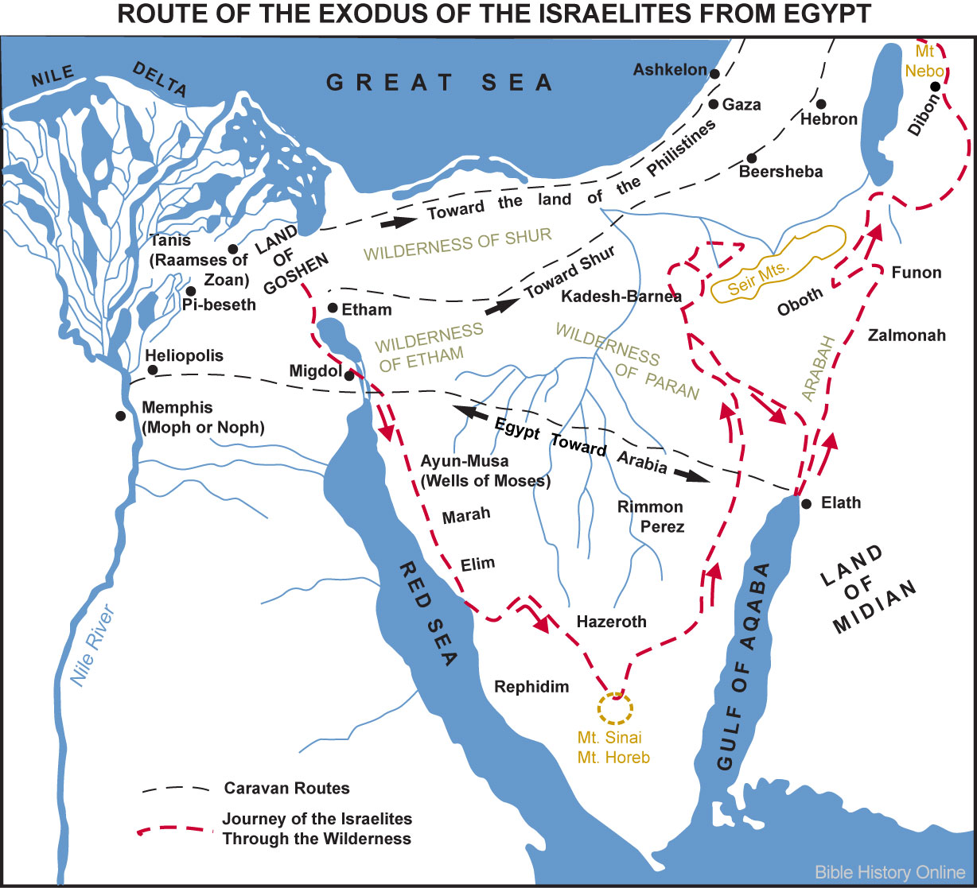
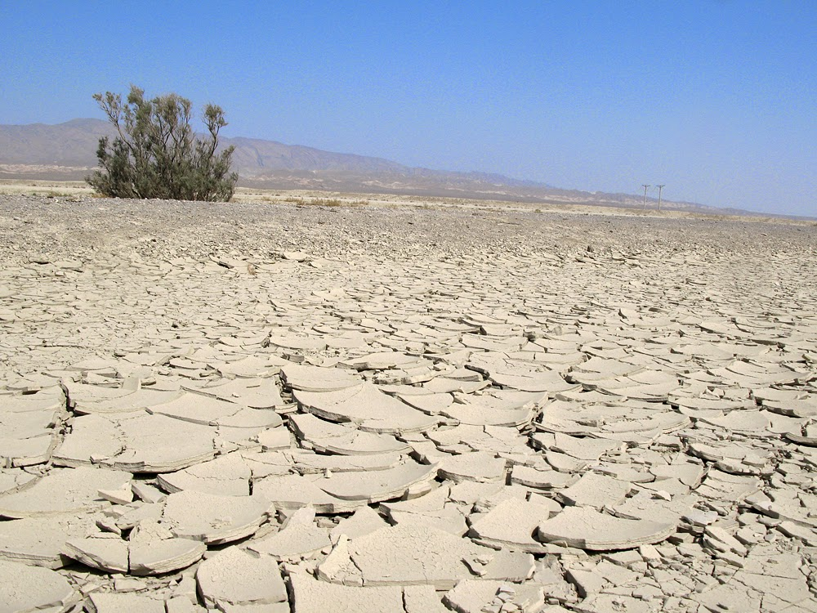
Wilderness of Sin
The wilderness of Sin is adjacent (due east) to the wilderness of Shur
Arriving on the 15th day of the second month. (Iyar 15)
Exodus 16:1-3

Slide 4
Murmuring
What problem did Israel face in the wilderness?
Whom did the children of Israel murmur against?
Even though the children of Israel had just been delivered from bondage, why did they wish they had died back in Egypt?
I’m Hungry
I’m tired
I wanna go home
Exodus 16:1-3

Slide 5
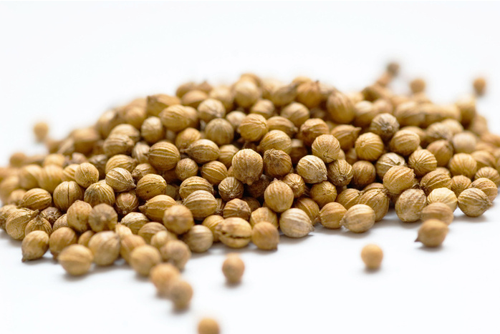
Bread From Heaven
Exodus
Manna is described as being "a fine, flake-like thing" like the frost on the ground.
It had to be collected before it was melted by the heat of the sun, and was white like coriander seed
Raw manna tasted like wafers that had been made with honey
Numbers
It arrives with the dew during the night and would melt like mush if not collected on time and breed larvae
The Israelites ground it and pounded it into cakes, which were then baked, resulting in something that tasted like cakes baked with oil
Exodus 16:4
(1)

Slide 6
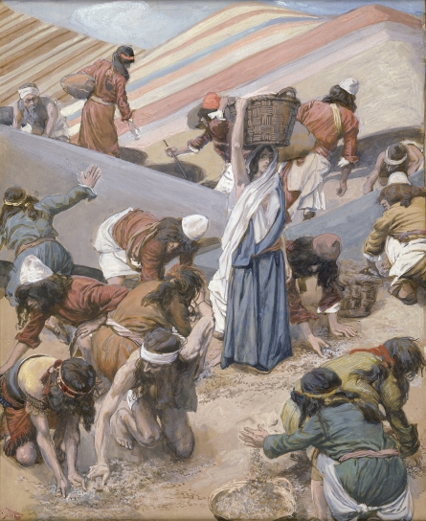
Gather For 6 Days
“By providing a daily sustenance, one day at a time, Jehovah was trying to teach faith to a nation that over a period of some 400 years had lost much of the faith of their fathers.
He was teaching them to trust Him, to ‘look unto [Him] in every thought; doubt not, fear not’ (D&C 6:36).
He was providing enough for one day at a time. Except for the sixth day, they could not store manna for use in any succeeding day or days.
In essence, the children of Israel had to walk with Him today and trust that He would grant a sufficient amount of food for the next day on the next day, and so on. In that way He could never be too far from their minds and hearts.”
Exodus 16:5
(2)

Slide 7
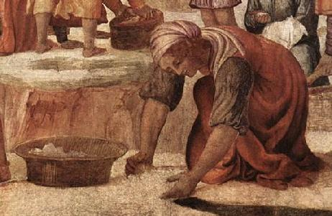
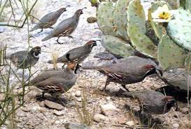
What the Lord Will Provide?
Flesh to eat at night
Bread to eat in the morning
At evening the quails came up, and the people caught with ease as many as they needed.
Bernardino Luini
One reason the Lord gives us commandments is to test our obedience to Him
The manna fell only six days in the week, and in double quantity on the sixth day
Exodus 16:6-10, 13-16
(2)

Slide 8
Murmuring Against the Lord
Do we also complain?
Against the Lord?
Against some of the Policies and Guidelines of the Church?
Against Church Leaders?
Murmuring seems to come so naturally to the natural man. It crosses the scriptural spectrum of recorded complaints.
A basic cause of murmuring is that too many of us seem to expect that life will flow ever smoothly, featuring an unbroken chain of green lights with empty parking places just in front of our destinations!
When we murmur against Church leaders, we are also murmuring against the Lord
Exodus 16:6-8

Slide 9
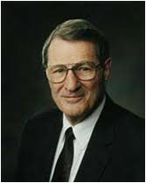
Murmuring can also be noisy enough that it drowns out the various spiritual signals to us, signals which tell us in some cases to quit soaking ourselves indulgently in the hot tubs of self-pity!
Murmuring over the weight of our crosses not only takes energy otherwise needed to carry them but might cause another to put down his cross altogether.
Besides, brothers and sisters, if we were not carrying so much else, our crosses would be much lighter.
The heaviest load we feel is often from the weight of our unkept promises and our unresolved sins, which press down relentlessly upon us.
Exodus 16:9-13
(3)

Slide 10
Rely on the Lord Daily
How much manna were the Israelites told to gather?
What happened if they tried to save it until the next day?
How often did the children of Israel need to gather the manna?
According to verse 21, what happened to the manna that wasn’t gathered?
an omer (ancient unit of measure)for every man, according to the number of your persons
Bred worms and stank
Every morning
If we rely on the Lord daily, He will bless us with the spiritual nourishment needed for that day. As we remember the Lord daily, our trust in Him will grow.
It melted
Exodus 16:16-21, 31

Slide 11
How can we remember the Lord daily?
What difference does it make in your life when you remember the Lord and seek Him daily?
Exodus 16:16-21, 31

Slide 12
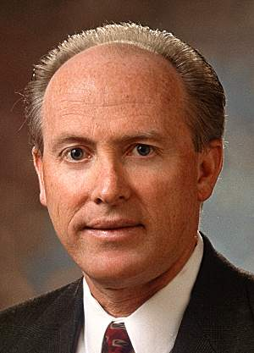
Cramming VS Daily
“Suppose you have a midterm test coming up in geometry in two weeks. One of your goals is to get an A in geometry. How do you go about reaching that goal? Do you wait until the last minute and cram the night before the test? This technique is filled with risk. Instead of truly understanding the material, the attempt is to learn enough that somehow you can make it through the test successfully.”
“Another student who, with the same goal of attaining an A in geometry, realizes that he doesn’t want to count on the intangibles of luck and hope. So, instead of cramming, he or she sets aside a little time every day to calmly and in depth study the subject. This gives the necessary time to digest and properly understand the material. If confusion arises on any given topic, there’s plenty of time to ask the teacher for help.”
“If you stay close to Him on a daily basis, He will stay close to you, and you will reap untold blessings in every aspect of your life, especially the most important, the spiritual.”
For 40 years, the Israelites are daily fed from heaven
(Joshua 5:12)
(4)

Slide 13
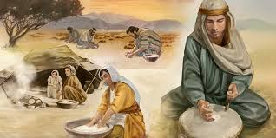
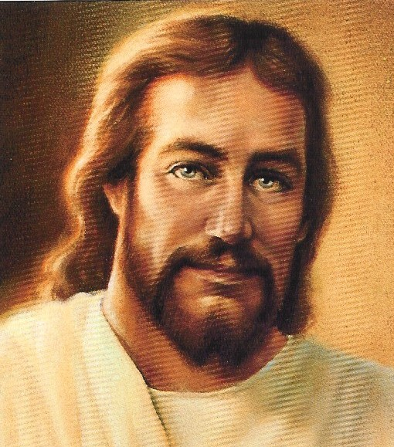
The Sabbath
God used the provision of manna on six days and not the seventh to teach Israel obedience, and convicted them of disobedience
Jesus Christ uses the manna, God-given ‘bread from heaven’, as a type of Himself, the true bread of life, and contrasts the shadow with the substance: ‘your fathers did eat manna in the wilderness, and are dead’ John 6:49
Exodus 16:19, 20, 25-30

Slide 14
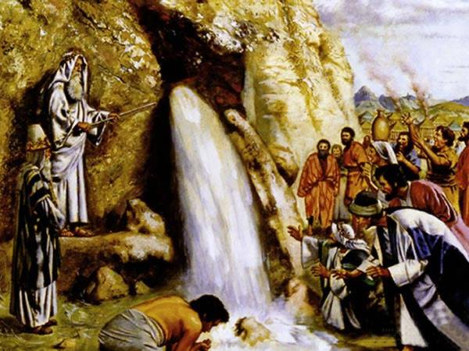
Water From a Rock
Rephidim
…take with thee of the elders of Israel; and thy rod, wherewith thou smotest the river, take in thine hand, and go.
I’m thirsty
I wanna go home
Exodus 17:1-17
Rock in Horeb

Slide 15
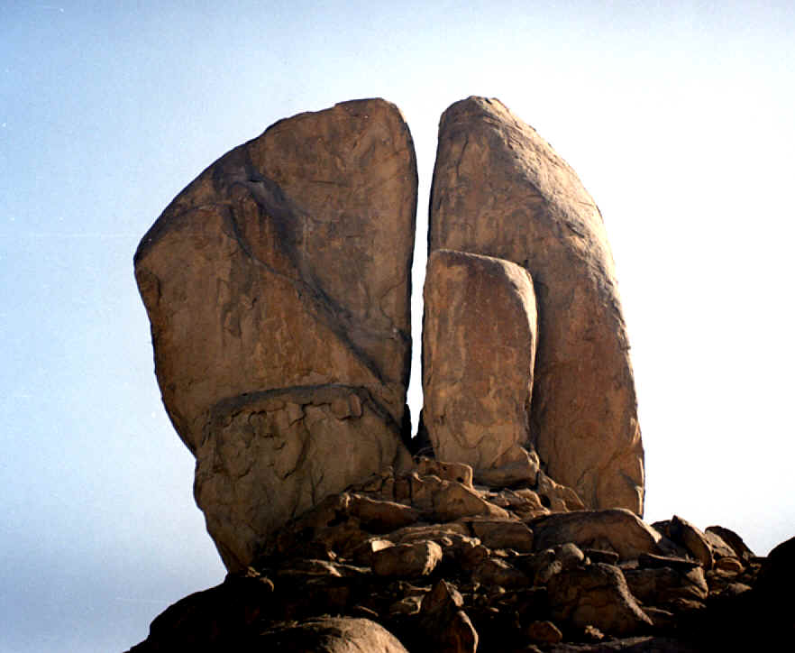
Massah, and Meribah
And he called the name of the place Massah, and Meribah, because of the chiding of the children of Israel, and because they tempted the Lord, saying, Is the Lord among us, or not?
Traditional site of rock in Horeb
Exodus 17:1-17

Slide 16
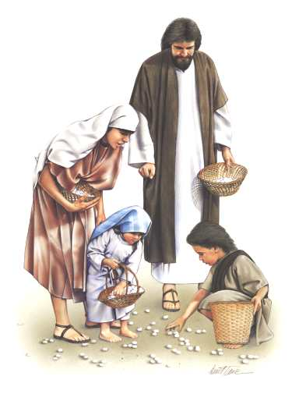
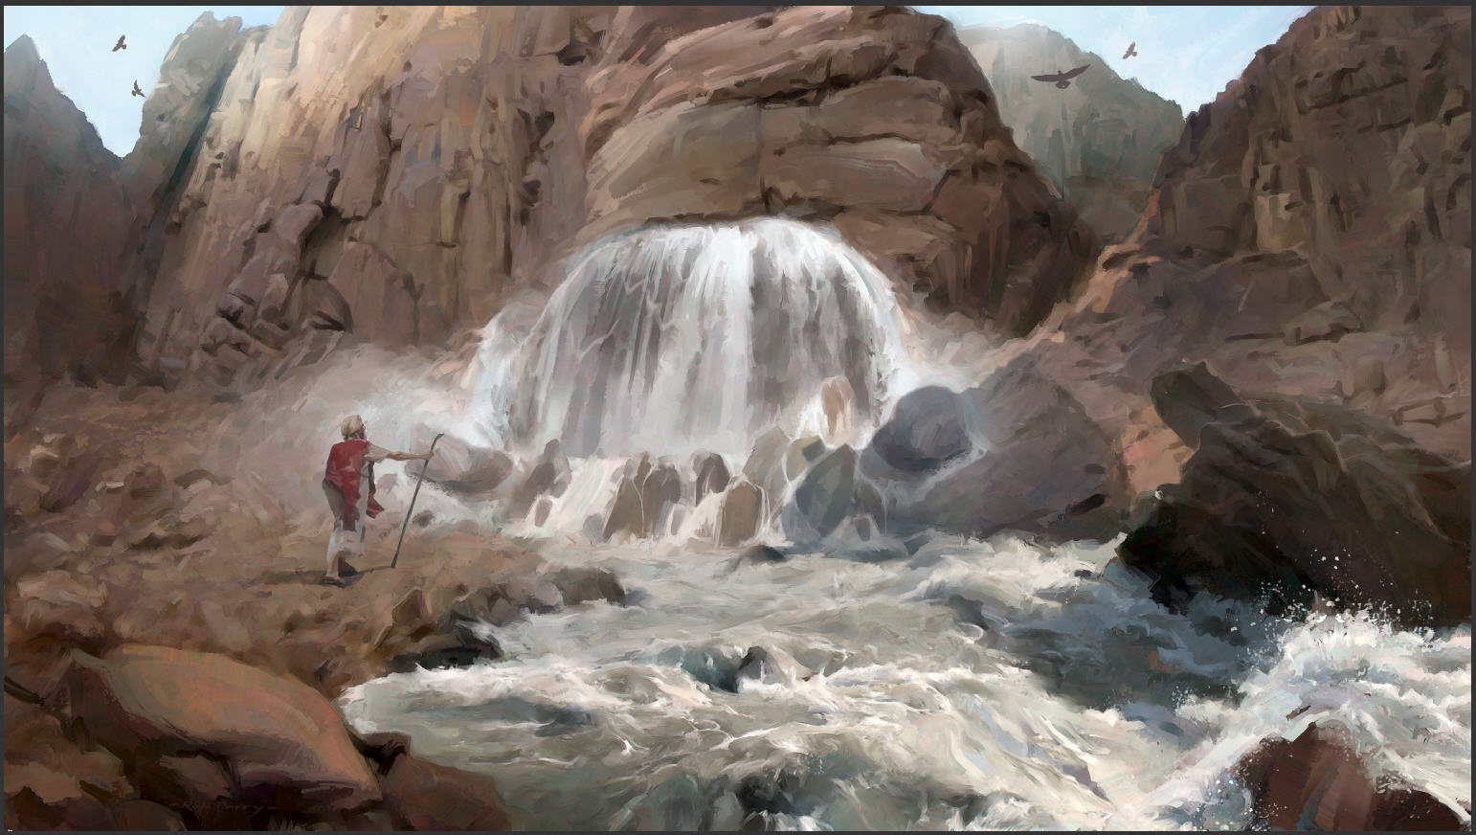
The Bread, The Rock, and The Living Water
But whosoever drinketh of the water that I shall give him shall never thirst; but the water that I shall give him shall be in him a well of water springing up into everlasting life. John 4:14
And Jesus said unto them, I am the bread of life: he that cometh to me shall never hunger; and he that believeth on me shall never thirst.
John 6:35
And did all drink the same spiritual drink: for they drank of that spiritual Rock that followed them: and that Rock was Christ.
1 Corinthians 10:4
The Lord is the source of all spiritual nourishment.

Slide 17
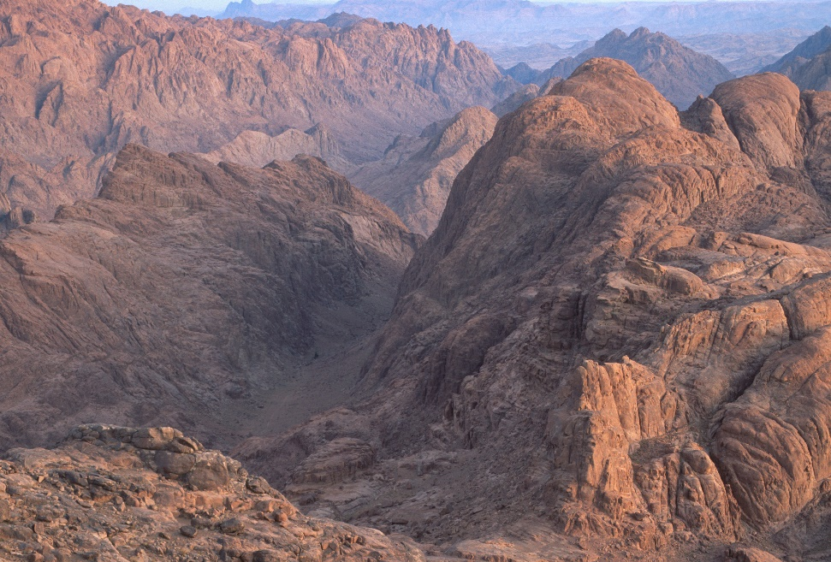
Sources:
Suggested Hymn: # 130 Be Thou Humble
Video: Daily Bread: Pattern (2:52)
Wikipedia
Elder D. Todd Christofferson “Give Us This Day Our Daily Bread” [Church Educational System fireside, Jan 9, 2011]; broadcast.lds.org).
3. Elder Neal A. Maxwell “Murmur Not” October 1989 Gen. Conf.
4. Excerpts from Elder Richard J. Maynes A Celestial Connection to Your Teenage Years Oct. 1997
Presentation by ©http://fashionsbylynda.com/blog/
The wilderness

Slide 18
Jesus Christ was the “bread of life” (John 6:35) that came down from heaven to give life to His people (see John 6:31–35). The manna given by Jehovah to nourish and save the children of Israel was a symbolic foreshadowing of Jesus Christ. Shortly after the Savior physically fed the 5,000 (see John 6), He referred to the account of God providing manna to teach that all people need to receive spiritual nourishment from the “living bread” (John 6:51) to obtain eternal life. The Savior taught, “Whoso eateth my flesh, and drinketh my blood, hath eternal life” (John 6:54).
Elder Bruce R. McConkie of the Quorum of the Twelve Apostles explained, “To eat the flesh and drink the blood of the Son of God is, first, to accept him in the most literal and full sense, with no reservation whatever, as the personal offspring in the flesh of the Eternal Father; and, secondly, it is to keep the commandments of the Son by accepting his gospel, joining his Church, and enduring in obedience and righteousness unto the end. Those who by this course eat his flesh and drink his blood shall have eternal life, meaning exaltation in the highest heaven of the celestial world” (Doctrinal New Testament Commentary,3 vols. [1965–73], 1:358).
Examples of Murmuring:
.
First, the murmurer often lacks the courage to express openly his concerns. If the complaint concerns a peer, the murmurer seldom follows Jesus’ counsel, “Moreover if thy brother shall trespass against thee, go and tell him his fault between thee and him alone: if he shall hear thee, thou hast gained thy brother.” (Matt. 18:15.)
Second, murmurers make good conversational cloak holders. Though picking up no stones themselves, they provoke others to do so.
Third, while a murmurer insists on venting his own feelings, he regards any response thereto as hostile. (See 2 Ne. 1:26.) Furthermore, murmurers seldom take into account the bearing capacity of their audiences.
Fourth, murmurers have short memories. Israel arrived in Sinai, then journeyed on to the Holy Land though they were sometimes hungry and thirsty. But the Lord rescued them, whether by the miraculous appearance by quail or by water struck from a rock. (See Num. 11:31; Ex. 17:6.) Strange, isn’t it, brothers and sisters, how those with the shortest memories have the longest lists of demands! However, with no remembrance of past blessings, there is no perspective about what is really going on.
Perhaps when we murmur we are unconsciously complaining over not being able to cut a special deal with the Lord. We want full blessings but without full obedience to the laws upon which those blessings are predicated. For instance, some murmurers seem to hope to reshape the Church to their liking by virtue of their murmuring. But why would one want to belong to a church that he could remake in his own image, when it is the Lord’s image that we should come to have in our countenances? (See Alma 5:19.)
Laborers in the Lord’s vineyard who murmur over life’s inequities, declared Jesus, murmur “against the good man of the house.” (Matt. 20:11.) The goodness of the Lord is attested to in so many ways—mansions await!—yet we ungrateful guests still complain about the present accommodations.
Of course there are ways provided—formal and informal—for expressing legitimate concerns and complaints, and for doing so productively. These avenues often go unused, especially if one’s real desire is to parade his discontent.
Yes, such individuals may acknowledge God, but they criticize His ways. (See Jacob 4:8; D&C 1:16; D&C 56:14.) We want things to be done in our ways, even though our ways are much lower ways. (See Isa. 55:8–9.)
“Murmur Not”
Neal A. Maxwell
October 1989 Gen. Conf.
Elder Dallin H. Oaks of the Quorum of the Twelve Apostles taught:
“We know that our physical bodies require certain nutrients to sustain life and to maintain physical and mental health. If we are deprived of those nutrients, our physical and mental vitality are impaired and we have a condition called malnutrition. Malnutrition produces such symptoms as reduced mental functions, digestive disorders, loss of physical strength, and impairment of vision. Good nutrition is especially important for children, whose growing bodies are easily impaired if they lack the nutrients necessary for normal growth.
“Our spirits also require nourishment. Just as there is food for the body, there is food for the spirit. The consequences of spiritual malnutrition are just as hurtful to our spiritual lives as physical malnutrition is to our physical bodies. Symptoms of spiritual malnutrition include reduced ability to digest spiritual food, reduced spiritual strength, and impairment of spiritual vision” (“Nourishing the Spirit,” Ensign, Dec. 1998, 7).

Slide 19
Possible Calendar of the Israelites in the Wilderness
Sun | Mon | Tues | Wed | Thurs | Fri | Sat
 |  |  |  | 29 Elim | 30 Camped at Red Sea | 31 Wilderness of Sin Arrive lyar 15 (Exodus 16:1) Sabbath revealed in evening
32 Camp at Wilderness of Sin First Manna | 33 Camp at Wilderness of Sin | 34 Camp at Wilderness of Sin | 35 Camp at Wilderness of Sin | 36 Camp at Wilderness of Sin | 37 Camp at Wilderness of Sin | 38 Camp at Wilderness of Sin First Sabbath
39 Leave in morning to Dophkah | 40 Alush | 41 Evening at Rephidim (Meribah) Water from the Rock of Herob | 42 Rephidim (Meribah) | 43 Rephidim Amalek attacks | 44 Wilderness of Sin lyar 28 (Exodus 19:1) | 45
http://www.bible.ca/archeology/bible-archeology-exodus-route-travel-times-distances-days.htm

