Slide 1
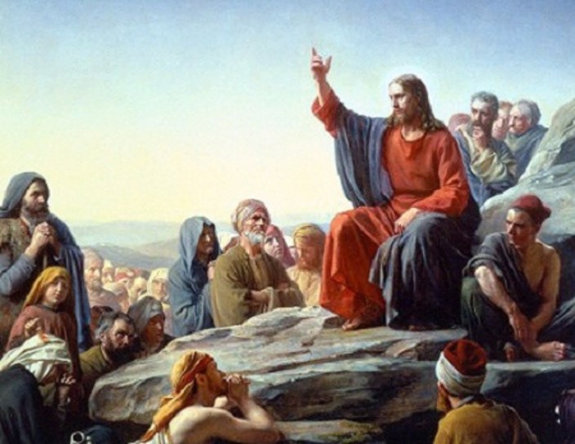
Lesson 53
The Restoration Part 1

Slide 2
The Church
Modern-day prophets
Continuing revelation
Latter-day scripture
Restored doctrine and ordinances
Divine priesthood authority
What are some elements of The Church of Jesus Christ of Latter-day Saints that make it unique?
Have the Church and these elements of it always existed on the earth?

Slide 3
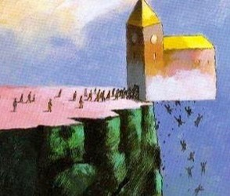
Apostasy
The need for the latter-day Restoration of God’s truths, priesthood authority, and Church arose because of apostasy.
Apostasy occurs when one or more individuals turn away from the truths of the gospel.

Slide 4
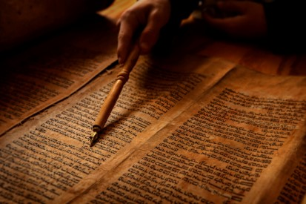
Turning Away From Truth
Following the Savior’s crucifixion and the deaths of His Apostles, many people turned away from the truths the Savior had established.
Let no man deceive you by any means: for that day shall not come, except there come a falling away first, and that man of sin be revealed, the son of perdition;
2 Thessalonian 2:3
Principles of the gospel and parts of the holy scriptures were corrupted or lost.
Unauthorized changes were made in Church organization and priesthood ordinances.

Slide 5
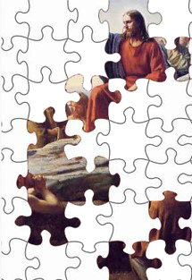
The Great Apostasy
Because of this widespread wickedness, the Lord withdrew the authority and keys of the priesthood from the earth.
Although there were many good and honest people who worshipped God according to the light they possessed and received answers to their prayers, the world was left without divine revelation through living prophets.
This period is known as the Great Apostasy.
Other periods of general apostasy have occurred throughout the history of the world.

Slide 6
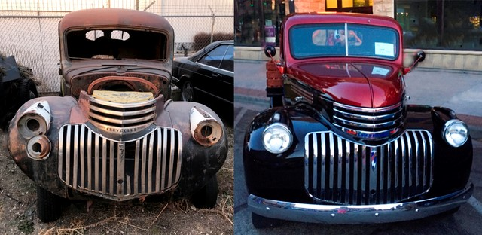
Restoration
To bring it back to its original state.

Slide 7
Foretold
Ancient prophets foretold the latter-day Restoration of the gospel.
Therefore, behold, I will proceed to do a marvellous work among this people, even a marvellous work and a wonder: for the wisdom of their wise men shall perish, and the understanding of their prudent men shall be hid.
Isaiah 29:14
God has restored His gospel in these latter days by reestablishing His truths, priesthood authority, and Church upon the earth.
And he shall send Jesus Christ, which before was preached unto you:
Whom the heaven must receive until the times of restitution of all things, which God hath spoken by the mouth of all his holy prophets since the world began.
Acts 3:20-21

Slide 8
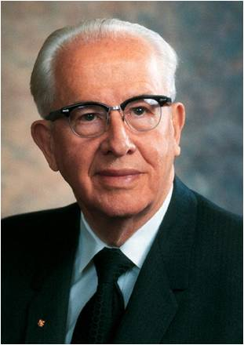
Precept of Men
The world worships the learning of man. They trust in the arm of the flesh. To them, men's reasoning is greater than God's revelations.
The precepts of man have gone so far in subverting our educational system that in many cases a higher degree today, in the so called social sciences, can be tantamount to a major investment in error.
Very few men build firmly enough on the rock of revelation to go through this kind of an indoctrination and come out untainted.
Unfortunately, of those who succumb, some use their higher degree to get teaching positions even in our Church educational system, where they spread the falsehoods they have been taught.
President Joseph F. Smith was right when he said that false educational ideas would be one of the three threats to the Church within. (1)
Isaiah 29:13-14

Slide 9
Marvellous Work and Wonder
The Restoration of the gospel, including the coming forth of the Book of Mormon
Restoration of the gospel was accomplished by the power of God and not by men
Isaiah 29:13-14

Slide 10
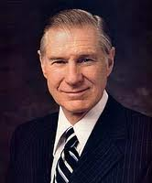
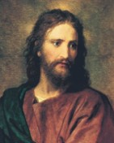
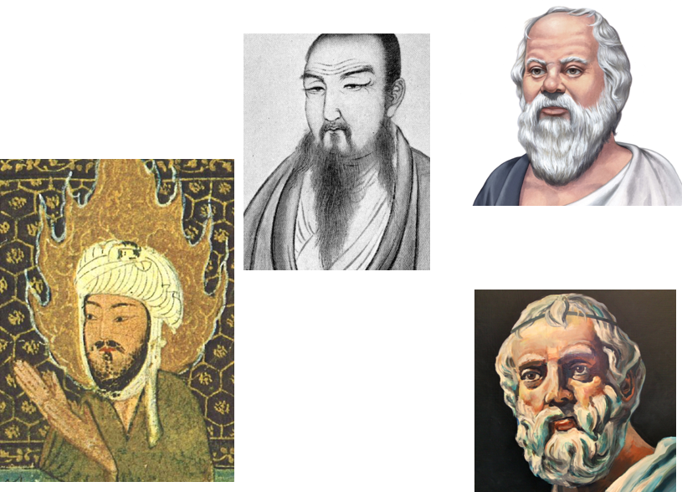
Restoration From Original Church Established by Jesus Christ
“We believe The Church of Jesus Christ of Latter-day Saints is a restoration of the original Church established by Jesus Christ, which was built “upon the foundation of the apostles and prophets, Jesus Christ himself being the chief corner stone.”
It is not a breakoff from any other church.”
…as the First Presidency stated in 1978, we believe that “the great religious leaders of the world such as Mohammed, Confucius, and the Reformers, as well as philosophers including Socrates, Plato, and others, received a portion of God’s light.
Moral truths were given to them by God to enlighten whole nations and to bring a higher level of understanding to individuals.”
Thus, we have respect for the sincere religious beliefs of others and appreciate others extending the same courtesy and respect for the tenets we hold dear.” (2)

Slide 11
Sources:
President Benson, CR, April 1969, p. 12
President James E. Faust “The Restoration of All Things” April 2, 2006 Morning Session of Gen. Conf.

