Slide 1
Lesson 57 Part 1
Building a Tabernacle
Exodus 25-27and 30
Presentation by ©http://fashionsbylynda.com/blog/

Slide 2
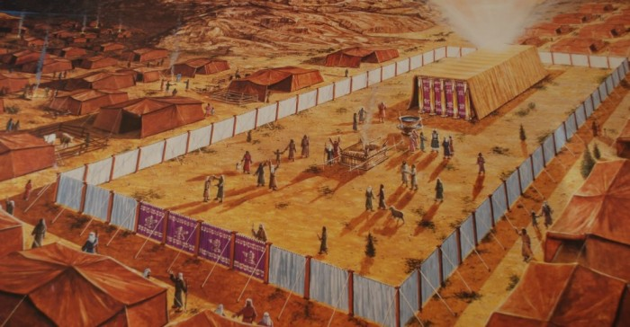
Tabernacle
The center place of Israel’s worship activities during the wanderings and until the building of the temple in Solomon’s day.
The tabernacle was in fact a portable temple. It was an inner tent, the area available for sacred purposes

Slide 3
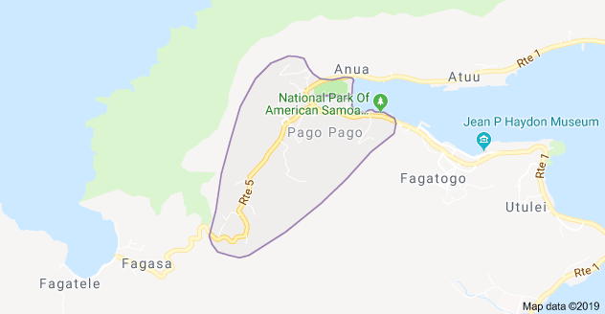
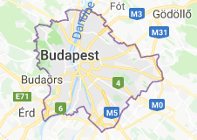
Temples Announced
April Conference 2019
Temples are planned for:
Pago Pago, American Samoa, (the first in American Samoa)
Okinawa City, Okinawa
Neiafu, Tonga
Tooele Valley, Utah
Moses Lake, Washington
San Pedro Sula, Honduras ( the country’s first house of the Lord)
Antofagasta, Chile
Budapest, Hungary
President Nelson also provided an updated on the renovation of pioneer-era temples. He said plans for the renovation of the Salt Lake Temple, Temple Square, and the adjoining plaza near the Church Office Building will be announced on Friday, April 19, 2019. He also said the Manti and Logan Temples will be renovated in coming years.
As of April 2019 there are 209 LDS temples throughout the world either in operation, under construction or announced. (2)
(1)

Slide 4
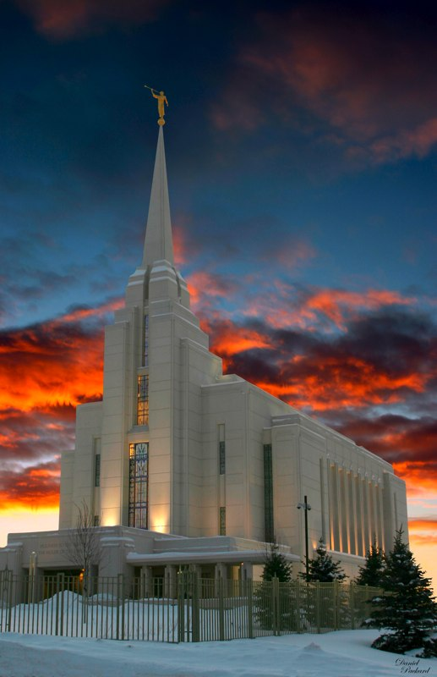
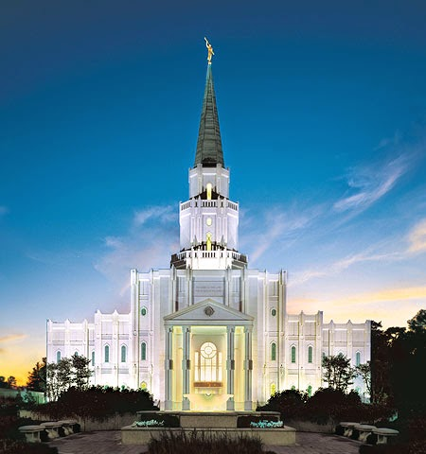
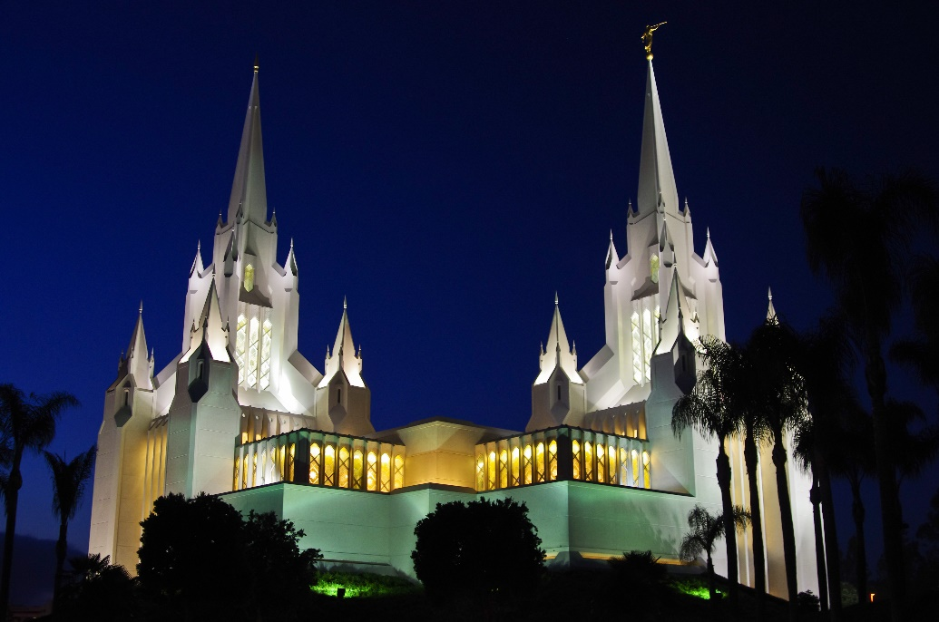
Temples Today
Houston, Texas
Dedication
August 26-27 by Gordon B. Hinckley
97th Temple
San Diego, California
Dedication
April 25-30, 1933 by Gordon B. Hinckley
45th Temple
Rexburg, Idaho
Dedication delayed one week due to the death of President Gordon B. Hinckley
10 February 2008 by Thomas S. Monson
125th Temple

Slide 5
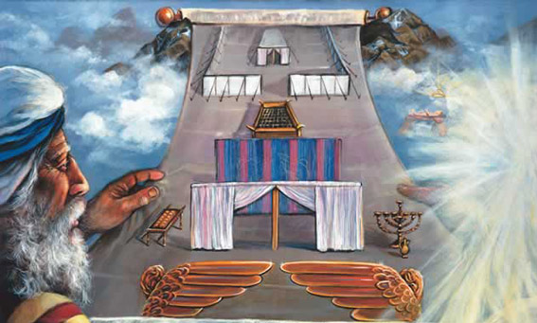
Sanctuary
Moses and 73 others ascended the mountain, Moses asked them to remain while he ascended farther up the mountain to speak with the Lord.
A holy place or a place of safety.
The Lord wanted the children of Israel to build a tabernacle (or sanctuary)
The Lord commands us to build temples so He can dwell among us
During his forty-day fast upon the mount, Moses received every detail needed for the construction of a tabernacle, a house of the Lord, where Israel could come and receive the keys of salvation and exaltation.
Exodus 25:1-8

Slide 6
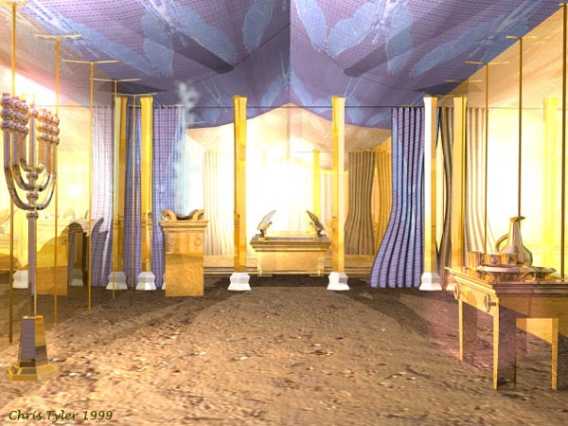
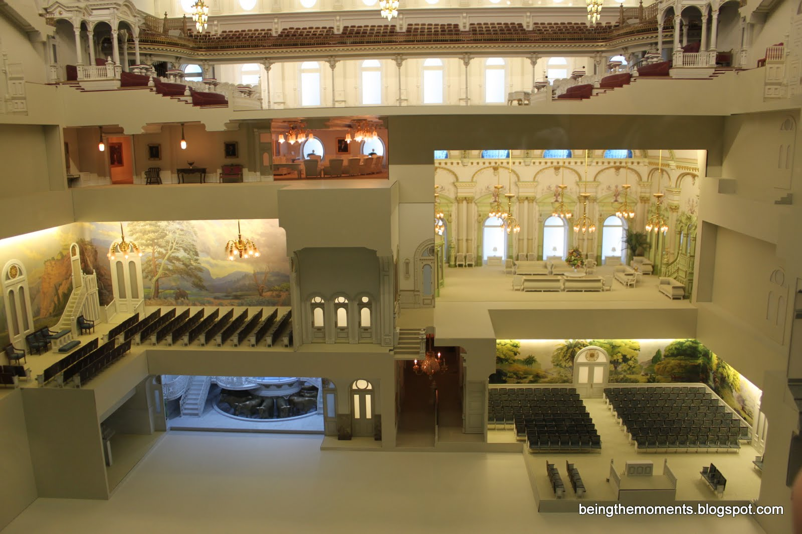
Tabernacles VS Temples
Although the tabernacle Moses was commanded to build shared similarities with modern temples (such as priesthood ordinances being performed in both), the tabernacle functioned under the law of Moses and thus differed substantially from modern temples.
However, both the ancient tabernacle and modern temples are the house of the Lord, where the Lord’s people can feel close to Heavenly Father and Jesus Christ.
Exodus 25:1-8
Salt Lake Temple replica

Slide 7
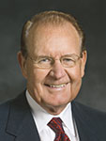
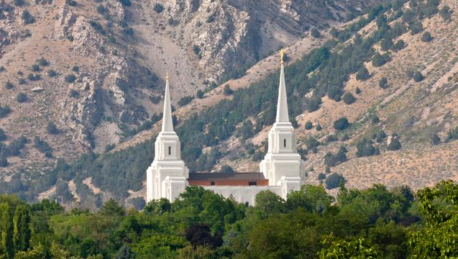
“Temples have always symbolized being in the presence of the Lord. … There is a closeness to God that comes through consistent worship in the house of the Lord. We can come to know Him and feel welcome, ‘at home,’ in His house.
“… The simple presence of a temple should serve as a reminder of covenants we have made, the need for integrity, and the fact that God is never far away.” (4)
Brigham City Temple

Slide 8
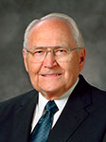
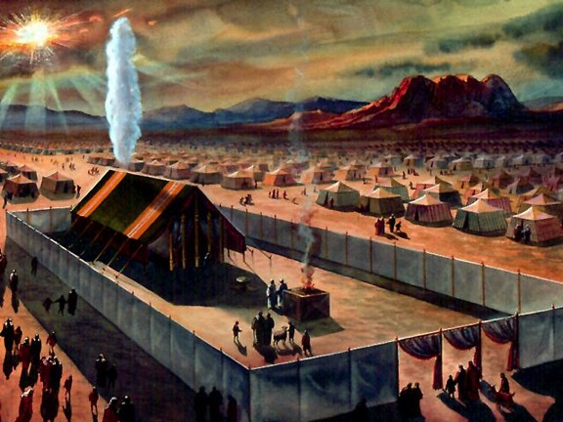
The Portable Temple
“In order that they would have a centerpiece for their worship and activity, the Lord instructed Moses to build a tabernacle. The tabernacle was a forerunner of the temple, made portable so they could easily carry it with them.” (5)
It included the ark of the covenant (sometimes called the ark of the testimony), which held the stone tablets with the Ten Commandments written on them. The ark of the covenant was kept in the most holy part of the temple. (See Ex. 25–26; 1 Kgs. 8:9.)
Exodus 25:9

Slide 9
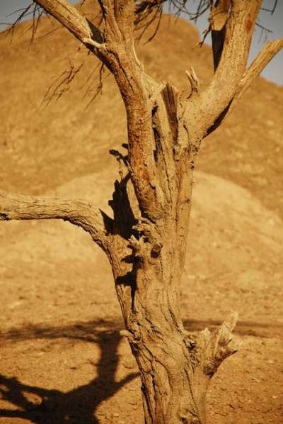
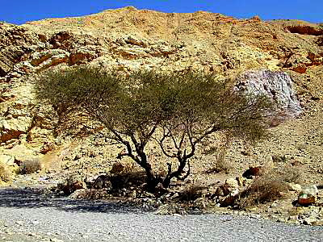
The Ark of the Covenant
ark of shittim wood
The ark of the covenant was a chest, or box, of shittim wood overlaid with gold. It was approximately three feet nine inches long, two feet three inches wide, and two feet three inches high. Staves, or poles, on both sides allowed the priests to carry it without actually touching the ark itself.
Inside, the tablets of the law given to Moses on Mount Sinai were placed
Latter the Pot of Manna gathered by Aaron and his rod. (Hebrews 9:4) (6)
Shittim tree in Sinai Desert
It is abundant everywhere in Egypt and in the desert, and furnishes the natives with the toughest material
Exodus 25:10-22

Slide 10
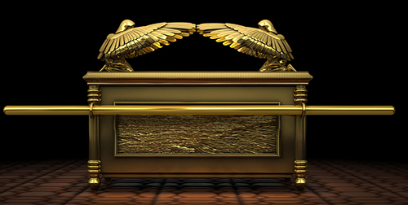
The Mercy Seat
The lid, or covering, for the ark is described in Exodus 25:17–22.
The King James Version translates the Hebrew word kapporeth (which means “seat of atonement”) as “mercy seat.”
The covering was made of solid gold and on it were formed two cherubim with wings which came up and overshadowed the lid or mercy seat.
The ark was placed inside the inner room of the tabernacle known as the most holy place, or Holy of Holies.
The ark was viewed with the greatest reverence by the Israelites, and prayers were recited before it was moved or placed in position. (Numbers 10:35-36)
We don’t know what the ark looked like
The word cherubim usually refers to guardians of sacred things. While the exact meaning of the word is not known, most scholars agree that these cherubim represented “redeemed and glorified manhood” or “glorified saints and angels” (7)
The word cherubim is the plural form meaning more than one heavenly creature. Bible Dictionary
Exodus 25:10-22

Slide 11
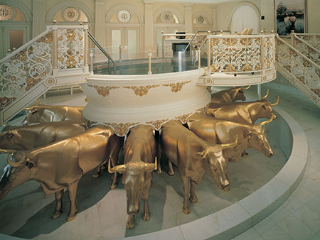
Pattern for Building the Temple
What do you think the 12 oxen around the baptismal font represent?
What do you think is the purpose of the symbols used in the temple?
Exodus 25:23-27

Slide 12
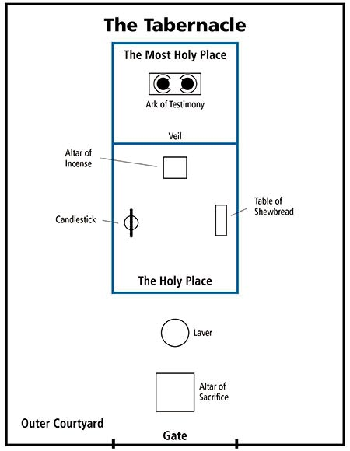
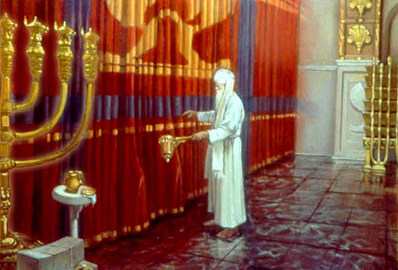
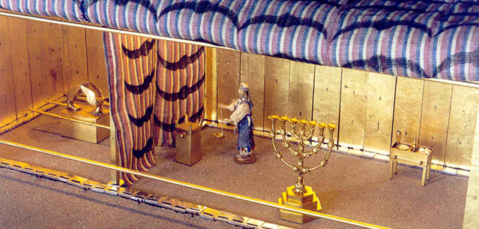
Blueprint
Ark of the testimony was the central feature of the tabernacle representing the presence of the Lord
Into this courtyard anyone of Israel could bring sacrifices, but only the priests could enter the tabernacle itself.
Most Holy Place is often called the Holy of Holies.
The Veil of the Tabernacle dividing two rooms
Basons underneath the Alter would catch the blood from the sacrifice
For the priests to clean and prepare to enter into Tabernacle
Exodus 26

Slide 13
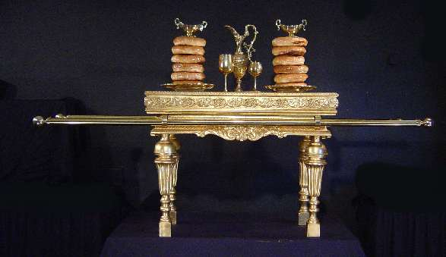
Table of Shewbread
Twelve loaves of bread
The second article of furniture described by the Lord was the table of shewbread. Like the ark of the covenant, it too was to be made of shittim wood with a gold overlay.
It had a crown and border (probably a rim) of gold on the top, or surface, of the table and had rings and staves to provide for easy transport.
It was about three feet long, eighteen inches wide, and twenty-seven inches high. Various vessels of gold, called the spoons, dishes, covers, or bowls in the King James Version of the Bible, were made for use with the table.
The Lord called it “shewbread” which translates literally the Hebrew word meaning “the bread of faces,” or “the bread of the presence,” signifying that this bread was placed before the face of the Lord or in His presence (8)
The bread was made of fine flour (that is, the wheat had been very finely ground and not left with the kernels partially intact) into twelve loaves of considerable size
Exodus 25:23-30

Slide 14
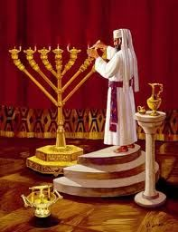
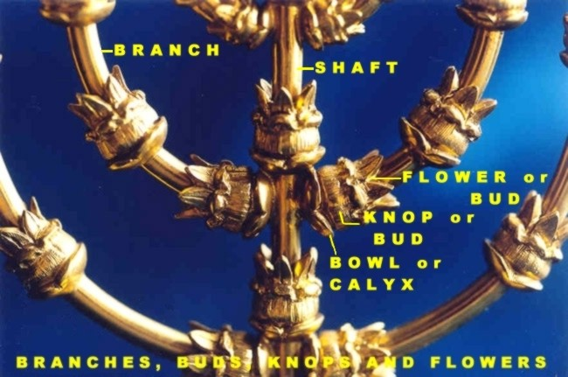
Candlesticks—A Source of Light
Menorah—place of lights
It held not candles but rather seven cup-shaped containers filled with pure olive oil into which a wick was inserted and lit.
Made of solid gold, the menorah was supported by a base which rested upon three feet.
Each of the branches of the menorah was crowned with a light which illuminated the holy place, or first room of the tabernacle. (6)
Exodus 25:31-39

Slide 15
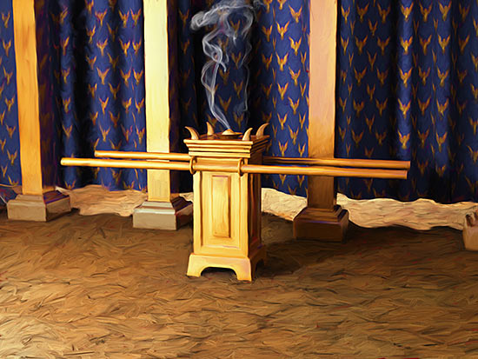
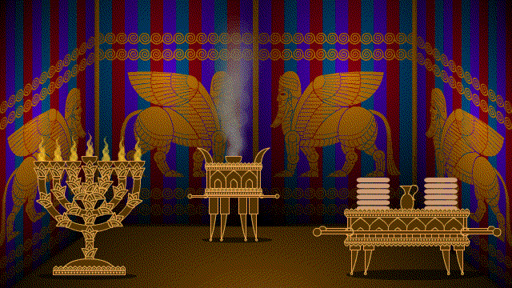
Alter of Incense
The third piece of furniture found in the holy place along with the sacred candlestick and the table of shewbread was the altar of incense.
It stood directly in front of the veil. Like the ark of the covenant and the table of shewbread, it was made of shittim wood covered with gold and had rings and staves for carrying.
Hot coals were placed on the altar, and each morning and evening the high priest would burn incense.
This ritual seems to signify that one can approach the presence of God only through prayer, for scriptures elsewhere indicate that incense is a symbol of prayer. (see Revelation 5:8; 8:3–4 Psalm 141:2). (6)
Exodus 30:1-8

Slide 16
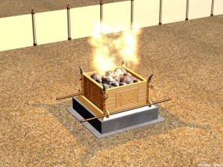
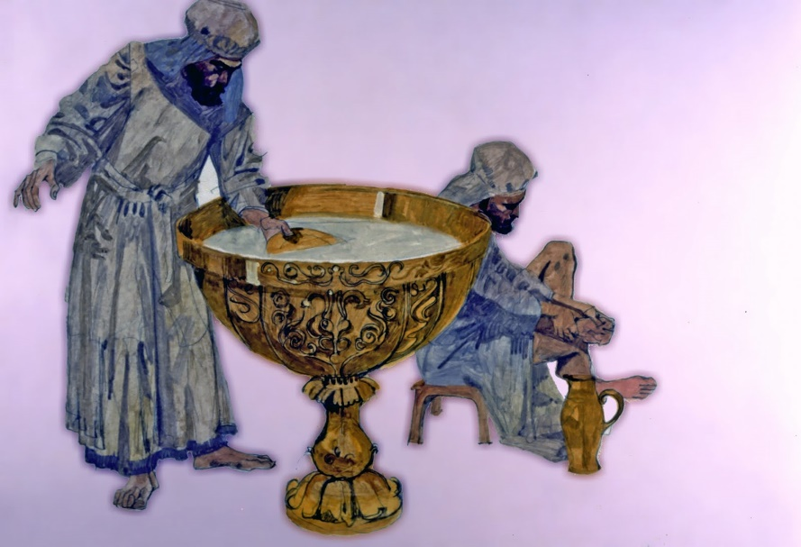
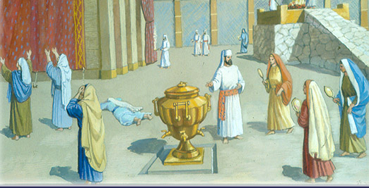
Alter of Sacrifice/Laver of Water
Surrounding the tabernacle itself was a large enclosed area protected by woven hangings attached to a movable wall.
In this courtyard was located the altar of burnt offerings (altar of sacrifice) and the laver of water for the symbolic cleansing of hands and feet.
Into this courtyard anyone of Israel could bring sacrifices, but only the priests could enter the tabernacle itself.
Exodus 27:1-8, 30:1-8, 18

Slide 17
Symbolism—To Teach
The sacred items of the tabernacle lead from the gate to the most holy place, where the ark is.
These items and the ordinances performed with them were symbolic and were meant to teach Israel how to journey through life back to God
The ordinances and symbols of the temple teach us how to proceed faithfully through this life and eventually enter God’s presence
Candlestick with 7 lamps | Table of showbread | Altar of Sacrifice | Altar of Incense | Laver
The Light of Christ and the Holy Ghost | The Savior’s body (similar to the meaning of the sacrament) | Giving ourselves completely to God, giving up sin, and relying on the great and last sacrifice of the Atonement of Jesus Christ | Prayer (we can approach God through prayer) | Cleansing, such as through repentance and baptism
Exodus 25:23-27

Slide 18
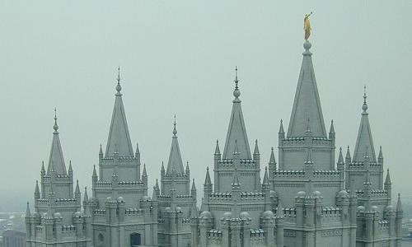
“The temple is a house of learning. Much of the instruction imparted in the temple is symbolic and learned by the Spirit. This means we are taught from on high.
Temple covenants and ordinances are a powerful symbol of Christ and His Atonement. We all receive the same instruction, but our understanding of the meaning of the ordinances and covenants will increase as we return to the temple often with the attitude of learning and contemplating the eternal truths taught.”
(8)

Slide 19
Sources:
Suggested Hymn: #54 Behold, The Mountain of the Lord
Video: The Tabernacle (7:19)
Church News April 7, 2019 Contributed By Newsroom.ChurchofJesusChrist.org
Desert News April 7, 2019 by Aaron Shill
3.
4. Elder David E. Sorensen (“Small Temples—Large Blessings,” Ensign, Nov. 1998, 65).
5. Elder L. Tom Perry (“We Believe All That God Has Revealed,” Ensign or Liahona, Nov. 2003, 87).
6. Old Testament Institute Manual
7. Wilson, Old Testament Word Studies, s.v. “cherubim,” p. 75.
“shew, shew-bread,” p. 388; Hastings, Dictionary of the Bible, s.v. “shewbread,” p. 847.
8. Sister Silvia H. Allred “Holy Temples, Sacred Covenants,” Ensign or Liahona, Nov. 2008, 113
http://www.ldschurchtemples.com/chronological/
Presentation by ©http://fashionsbylynda.com/blog/

Slide 20
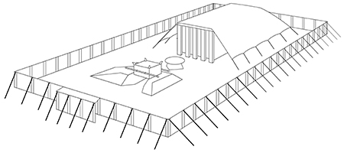
The Tabernacle:
It was oblong, 30 cubits in length and 10 in breadth and height. Its north, west, and south sides were made of 46 boards (10 cubits by 1½) and two narrower corner ones of acacia wood (Ex. 26:15), overlaid with gold (26:29). These boards were fitted with golden rings, through which were passed bars of acacia wood overlaid with gold to fasten all firmly together. Suspended over them, and serving as an inner lining to the tent covering, was the rich covering—10 curtains (each 28 cubits by 4) made of fine twined linen, and blue and purple and scarlet, embroidered with figures of cherubim (Ex. 26:1)
Over the tabernacle the tent was spread. Its length was 40 cubits, or 10 cubits longer than the tabernacle. The entrance toward the east was closed by a screen of blue, purple, and scarlet and fine twined linen. Over the tent came the covering of the tent, which consisted of two parts: (1) an inner covering of ramskins dyed red; (2) a covering of badger skins over all (Ex. 26:14).
The tent stood in a court 100 cubits by 50, surrounded by a fence (Ex. 27:18) five cubits high, composed of pillars and hangings of fine white linen. The entrance toward the east was 20 cubits wide (Ex. 27:16) and was closed by a screen of linen of four different colors on four pillars.
Inside The Tabernacle:
The tabernacle was divided into two parts by a veil of the same materials as the screen of the court, the inner roof covering of the tabernacle, and the screen of the tent (Ex. 36:35, 37). In the outer compartment (20 cubits by 10), called the Holy Place, were three things: (1) In the middle, before the veil and before the mercy seat (Ex. 30:6), stood the altar of incense, similar in construction to the altar of burnt offering but smaller and overlaid with gold. On it incense was burned morning and evening (no animal sacrifices); and on its horns was put once a year, on the Day of Atonement, the blood of the sin offering (Ex. 30:10). (2) On the south side of the altar of incense stood the candlestick (Ex. 26:35), of pure gold of beaten work, with six branches and seven lamps. Pure olive oil beaten was burned in the lamps (Ex. 27:20–21; Lev. 24:2). Aaron lit the lamps at evening and dressed them in the morning (Ex. 30:8; Lev. 24:3). (3) On the north side of the altar stood the table of shewbread (Ex. 25:23–30) made of acacia wood. On it was placed the shewbread, consisting of 12 unleavened cakes made of fine flour. They were placed in two rows (or piles), and frankincense was put on each row (Lev. 24:7). The shewbread was changed every Sabbath day, and the old loaves were eaten by the priests in a holy place (Lev. 24:9)..
The Holy of Holies contained only one piece of furniture: the Ark of the Covenant, or the Ark of the Testimony (Ex. 25:22). It was an oblong box of acacia wood, 2½ cubits long and 1½ cubits wide and high, overlaid within and without with gold, and with a rim or edging of gold round its top. It had rings and staves by which to carry it, and the staves were never to be removed from the rings (Ex. 25:15). The ark had within it “The Testimony” (the two tables of stone) (Ex. 25:21; 31:18). From these the ark got both its names. According to Heb. 9:4 the ark also contained a pot of manna and Aaron’s rod that budded. In the Old Testament it is said of these that they were put or laid up “before the testimony” (Ex. 16:34; Num. 17:10). They were not in the ark in the time of Solomon (1 Kgs. 8:9). The book of the law was placed by the side of the ark of the covenant, not inside it (Deut. 31:26). Upon the ark and forming the lid was the mercy seat. It served, with the ark beneath, as an altar on which the highest atonement known to the Jewish law was effected. On it was sprinkled the blood of the sin offering of the Day of Atonement (Lev. 16:14–15). The mercy seat was the place of the manifestation of God’s glory (Ex. 25:22). It was God’s throne in Israel. Compare the phrase “The Lord God of Israel, which sitteth upon (or dwelleth between) the cherubim” (1 Sam. 4:4). At the ends were placed two cherubim of gold of beaten work, spreading out their wings so as to cover the mercy seat and looking toward it.
Outside The Tabernacle:
In the court outside the tent and in front of its door stood the altar of burnt offering, a square of five cubits, three cubits high. Its outer frame was acacia wood overlaid with brass (Ex. 27:1–2, 8), whence its name (Ex. 39:39). The hollow was probably filled with earth or unhewn stones (Ex. 20:24–25). Around and halfway up the altar was a ledge (Ex. 27:5), supported by a grating or network of brass. Besides various brazen utensils for use in the sacrifices, it had rings and staves by means of which it was carried.
Between the altar of burnt offering and the door of the tent stood a laver of brass on a base of brass (Ex. 30:18). In it the priests washed their hands and feet when they went into the tent for any priestly purpose (Ex. 30:19–21)..
Bible Dictionary

Slide 21
Fun Facts About the Latter-day Temples:
The Salt Lake Temple took 40 years to build. It was dedicated 46 years after its announcement, the same length of time taken to erect the ancient Jerusalem Temple (John 2:20).
Eight temples do not have an angel Moroni: St. George Utah; Manti Utah; Logan Utah; Laie Hawaii; Cardston Alberta Canada; Mesa Arizona; Hamilton New Zealand; Oakland California.
Brigham Young disliked the original "squatty" tower of the St. George Utah Temple. Shortly after his death, it was struck by lightning and burned to its base. The tower was rebuilt taller and with a more elegant shape.
There are four temples in Texas: Dallas (1984), Houston (2000), Lubbock (2002) and San Antonio (2005)
The first smaller temple (a concept introduced by then-president of the Church Gordon B. Hinckley) to be completed was the Monticello Utah (1998) and it originally had the first and only white angel Moroni. This was too hard to see, so it was replaced with a gold Moroni. The white angel Moroni was glazed with gold and now sits atop the Columbus Ohio temple.
The largest LDS temple in the world is the Salt Lake City temple. The Los Angeles California temple was briefly the largest until the SLC temple underwent an expansion and reclaimed the title.
The Washington D.C. temple has the largest grounds, coming in at 52 acres
The Jordan River Utah temple has the most sealing rooms, with 17. Portland Oregon and Seattle Washington tie for second with 13 sealing rooms apiece.
The Draper Utah temple has the largest sealing room and can accommodate over 100 people.
There were 34 temple dedications in 2000, the most in a single year.
The Mexico City Mexico temple is the largest temple outside the U.S
The original Nauvoo temple was the first to have an angel Moroni on top and it was also a weather vane. The angel has been redesigned for other temples several times since and, whenever possible, is placed facing east.
There have been four times when two temples were dedicated on the same day (Once in 1999 and three times in 2000). (President Gordon B. Hinckley was Prophet during this time)
The Bountiful Utah temple had 28 dedicatory sessions and had over 201,000 members in attendance. Over 870,000 visitors toured the temple during its 6-week open house.
he Kyiv Ukraine Temple was awarded first place for the best religious building constructed in Ukraine in 2010.
After touring the Lima Peru temple, the wife of the mayor of La Molina said she “felt the love of God” there and added ““If heaven really exists, today I have visited a little piece of that heaven.”
Portland, Oregon is known as the “City of Roses.” The Portland Temple was awarded first place by the Royal Rosarians of Portland in the category of commercial rose plantings.
Heavy rain fell during a big thunderstorm on the day of the Santiago Chile temple groundbreaking ceremony in May 1981. The thunderclaps made “the windows vibrate” an attendee reported in the Church News. As soon as President Spencer W. Kimball arose to start the ceremony, "from among the dark clouds came a ray of sunshine, followed by others. Soon the clouds parted and bright sunshine warmed all those present.“
The Seoul Korea temple was dedicated in 1985 and Kim Jung Shik, who diligently kept genealogy records, submitted 50 generations of ancestors starting with his direct line immediately following the dedication.
The Ogden Utah temple recently underwent a massive exterior renovation and was rededicated in September. The Phoenix Arizona temple open house is scheduled through Nov. 1 and will be dedicated on Sunday, Nov. 16.
President Gordon B. Hinckley dedicated 85 temples (more than any other Presidents)
Blog: Oct. 2014 Aggieland Mormons

Slide 22
Blue:
Tekheleth, as far as we can tell, is a shade of (sky)blue made from the glands of the mollusk Murex trunculus.
The Hebrew word ‘tekeleth’ is translated blue. It signifies a spectrum of blue from sky blue (Josephus) to a deep dark blue, but can also indicate violet.
Blue is connected with that which is holy in God's service. Exodus 26:36; Numbers 4:6-7
This color is also connected with chastening and teaching. This is a different word 'chabbuwrah' which means bruise or blueness. It is translated as 'blueness’ only in the King James Version
"The blueness of a wound cleanseth away evil: so do stripes the inward parts of the belly." Proverbs 20:30
The ark of the covenant in the Tabernacle was covered with blue cloth representing its close association with the Word of God (Numbers 4:5-7; 11-13).
The robe of the High Priest was also blue, again symbolizing the close association with God and His Word (Exodus 28:31-33).
Purple:
Argaman (Hebrew) is a deep red-purple similarly made from a type of mollusk, similar to what was known as "royal purple" or "Tyrian purple".. The color purple was found for example in the materials used for constructing of the Tabernacle and Temple.
The color purple is associated with royalty and status.
The color purple is associated with royalty and status for example:
"So Mordecai went out from the presence of the king in royal apparel of blue and white, with a great crown of gold and a garment of fine linen and purple; and the city of Shushan rejoiced and was glad." Esther 8:15
The curtain itself symbolizes the separation of man from the most Holy things associated with God.
Purple is also associated with riches and finery, "There was a certain rich man who was clothed in purple and fine linen and fared sumptuously every day." Luke 16:19
Purple speaks of the corruption and corrupting influence of riches.
"The woman was arrayed in purple and scarlet, and adorned with gold and precious stones and pearls, having in her hand a golden cup full of abominations and the filthiness of her fornication." Rev 17:4
Jesus was clothed in purple as a sign of royalty, but in mockery of His claim to be the promised Messiah and heir to the throne of David.
"And they clothed Him with purple; and they twisted a crown of thorns, put it on His head, .... And when they had mocked Him, they took the purple off Him, put His own clothes on Him, and led Him out to crucify Him." Mark 15:17&20
Interesting ideas on color
http://www.biblebasics.co.uk/colours/col8.htm

Slide 23
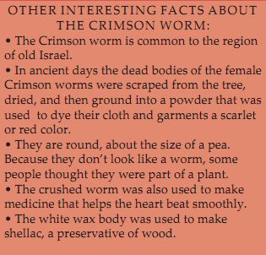
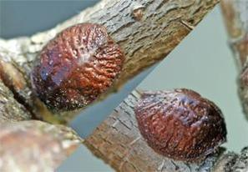
Scarlett/Crimson:
The Hebrew word 'towla' (Masculine) and 'towle' (feminine) means scarlet or crimson. Shani is a crimson red made from crushed scale insexts (tola’at shani” literally “worm crimson” in the Bible.
Each colour in the Tabernacle construction had a meaning of its own and both crimson and scarlet are associated with sin.
"Come now, and let us reason together," Says the LORD, "Though your sins are like scarlet, They shall be as white as snow ; Though they are red like crimson, They shall be as wool." Isa 1:18
Scarlet was the colour of the cord that Rahab was told to display from her window if she and her family were to be saved when Jericho was destroyed (Joshua 2:17-21)
When Pilate had condemned Jesus to be crucified the soldiers of the governor took Jesus into the Praetorium and clothed him in a scarlet robe, twisted a crown of thorns and placed it upon His head. Thus they mocked Jesus claim to be a King saying "Hail, King of the Jews" (Matthew 27:27-30)
Scarlet is the colour of the beast and the clothing of the woman riding it as described in Revelation. This vision symbolises the corruption of true religion and represents a political and religious system that persecutes the true followers of Christ and represents all that is corrupt in God's sight (Revelation 17:3-6)
The insect ‘coccus ilicis’ is related to the cochineal insect and found on the twigs and branches of evergreen oaks in Southern Europe and North Africa. They belong to the family of insects known as Coccidae or Scale-insects. When the female of the species is ready to lay eggs, she attaches her body firmly to the tree. The eggs are laid beneath her body and following the egg laying the insect dies. Thus the eggs are protected by the insects body until the larvae are hatched. It was from the dead bodies of these insects that the scarlet dyes used in ancient times were extracted.
Symbolism = protection of Christ’s Atonement
In terms of their significance, in general these colors are often brought together as symbols of royalty, luxury, and Divinity — the Tabernacle hangings, garments of nobles and kings, etc.
http://www.biblebasics.co.uk/colours/col8.htm

Slide 24
Cherubim:
Since Latter-day Saints do not believe that angels have wings, as they are often shown in religious art, the commandment to form wings on the cherubim may raise some questions.
Another revelation indicates, however, that wings symbolically represent the power to move and to act (see D&C 77:4). Between these cherubim on the mercy seat, God told Moses, He would meet with him and commune with him. Latter-day revelations state that angels stand as sentinels guarding the presence of God (see D&C 132:19).
Old Testament Institute Manual
Shewbread:
The cakes would likely have weighed over ten pounds each. The loaves were put into two stacks, and upon each pile was placed pure frankincense that was later burned on the altar of incense “an offering made by fire unto the Lord” (Leviticus 24:7; see also v. 6). The bread was changed each Sabbath and the bread that was removed was eaten by the priests (see Leviticus 24:8–9). This was the bread given to David when he fled from King Saul (see 1 Samuel 21:1–6;Matthew 12:4).
Most scholars and old Jewish traditions agree that wine was also placed on the table along with the bread, although it is not mentioned specifically in the biblical account. The spoons were actually vessels or cups, rather than spoons as they are known today, and were probably the containers for the liquid. (See Fallows, Bible Encyclopedia, s.v. “shewbread,” 3:1576; Hastings, Dictionary of the Bible, s.v. “shewbread,” p. 847.) Thus, the items placed on the table of shewbread have distinct parallels in the emblems of the sacrament.
Old Testament Institute Manual
Gold, Silver, and Brass:
Gold has been highly treasured by men from the earliest times and thus has symbolic as well as monetary significance. “Gold is often employed in Scripture as an emblem of what is divine, pure, precious, solid, useful, incorruptible, or lasting and glorious” (Fallows, Bible Encyclopedia, s.v. “gold,” 2:723). This symbolism clearly explains the use of gold in the ark of the covenant.
Silver and brass also were used in other parts of the tabernacle and its furnishings. These two metals have symbolic as well as functional significance. The Encyclopaedia Judaica notes:
“The relativity of holiness was further pointed up by the materials. Fine or pure gold was used for the Ark, the propitiatory, the table of the Presence and its vessels; for the lampstand and its accessories; for the altar of incense; and for the high priest’s garments. Ordinary gold was employed for the moldings, the rings, and the staves of the Ark, of the table, and of the incense altar; for the hooks of the curtains; for the frames and bars; for the pillars of the veil and screen; and for other parts of the high priest’s vestments. Silver was reserved for the bases of the frames, for the pillars of the veil, and for moldings in the court. Finally there was bronze, of which metal the altar of burnt offering and its utensils, the bases of the court, and the laves were made. The same principle applied to the embroidered stuff and linen.
“The theme of gradation was continued in respect of the three divisions of the people. The Israelites could enter the court only; the priests could serve in the Holy Place; the high priest alone could enter the Holy of Holies but once a year—on the Day of Atonement.” (S.v. “tabernacle,” 15:687.)
Old Testament Institute Manual
Candlesticks:
The number seven has sacred significance in the Old Testament, connoting wholeness or perfection (see Smith, Dictionary of the Bible, s.v. “seven,” pp. 607–8; Douglas, New Bible Dictionary, s.v. “numbers,” p. 898). Thus, the light provided in the house of the Lord symbolized the perfect light.
The oil for the seven lamps had to be pure olive oil (see Exodus 27:20) that had been consecrated for that purpose. The Jewish festival of Hannukah, or the festival of lights, celebrates the time when Judas Maccabeus finally drove the Greeks from the temple in Jerusalem around 165 B.C. According to Jewish tradition, the Maccabees found only enough consecrated oil for the sacred lamps to last one day. The consecration of new oil took eight days; yet miraculously, the meager supply burned until a new supply could be properly prepared. (See Josephus, Antiquities of the Jews, bk. 12, chap. 7, par. 6.)
Other scriptures indicate that olive oil represents the Holy Spirit, probably because it provided fire, heat, and light when burned in the lamps (see D&C 45:56–57). Thus, the sacred menorah was a type or symbol of the true source of spiritual light, namely the Holy Ghost as He bears witness of the Father and the Son.
Old Testament Institute Manual

Slide 25
Altar of burnt offerings:
All burnt offerings performed within the tabernacle took place on this altar. It was hollow, five cubits square and three cubits high, or about 7½ x 7½ x 5 feet in dimension. It was made of shittim wood overlaid with brass plates.
It had four horns on its corners. Upon these horns the blood of the sacrifice was to be smeared. By laying hold of these horns, a person could find asylum and safety (see 1 Kings 1:50; 2:28), although not if he was guilty of premeditated murder (see Exodus 21:14). Sometimes the horns were used to bind the animal or intended sacrifice.
Holy instruments of sacrifice. The pan was a large, brazen dish placed under the altar to receive the ashes as they fell through.
Brazen fire shovels were used for emptying the pans.
The basons were receptacles used to catch the blood from the sacrifice.
The fleshhook was a three-pronged hook that the priest used to dip into the sacrificial container. That which he brought up was to be kept for himself.
The firepan was the container in which was kept the continuously burning fire for sacrifice.
.
Laver.
This, like the altar of sacrifice, was made of brass. It stood between the altar of sacrifice and the tabernacle. It was used by the priests for cleansing, preparatory to entering the tabernacle.
In Solomon’s day, when a permanent temple was constructed, the laver was set on the backs of twelve oxen (see 1 Kings 7:23–26).
.

Slide 26
Possible Calendar of the Israelites in the Wilderness
Sun | Mon | Tues | Wed | Thurs | Fri | Sat
60 6th ascension Ex 24:18 Moses spends 40 days at summit | 61-100 God reveals for the first time, the 10 Commandments and the plan for the tabernacle. The people party and build the Golden calf. from day 56 to day 96 when Moses returns.
http://www.bible.ca/archeology/bible-archeology-exodus-route-travel-times-distances-days.htm

