Slide 1
Lesson 60 Part 1
Two New Tablets
Exodus 33-34
Hew thee two tables of stone like unto the first: and I will write upon these tables the words that were in the first tables, which thou brakest.
Exodus 34:1

Slide 2
Two False Beliefs
1. A young man transgresses a commandment. He experiences guilt and shame. He believes that Heavenly Father will never forgive him of his sin.
2. A different young man transgresses the same commandment. He thinks the sin he has committed is not a big deal. He believes that because he is generally a good person, God will not punish him for his sin.
God is forgiving.
God will hold us accountable for our sins.

Slide 3
Punishment For the Israelites
Evil Tidings=Bad News
Take off your ornaments
Stop wearing idols as jewelry
Grow up and take charge of your life
Put your priorities in check
Stop whining
Listen to the prophet
Repent and renew your covenants
BELIEVE
Exodus 33:1-4

Slide 4
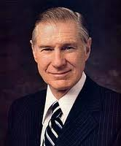
Believing Requires Action
If you prepare to walk down the path of life, you can be rewarded beyond your dreams and expectations.
But to achieve this, you must work very hard, save, be wise, and be alert.
You must learn to deny yourselves of worldly gratification.
You must be faithful in paying tithes; you must keep the Word of Wisdom; you must be free from other addictions.
You must be chaste and morally clean in every respect. You should accept and be faithful in all of the calls that come to you. Steadiness and toil will serve you better than brilliance. (1)
Work
Hard
E
R
U
U
I
A
S
D
J
K
L
C
V
B
N
M
NO
Exodus 33:1-4

Slide 5
Mourning
Sin separates us from the Lord
The Israelites lost the blessings of the Lord
If you want to stay close to someone who has been dear to you, but from whom you are separated, you know how to do it. You would find a way to speak to them, you would listen to them, and you would discover ways to do things for each other. The more often that happened, the longer it went on, the deeper would be the bond of affection. If much time passed without the speaking, the listening, and the doing, the bond would weaken.
God is perfect and omnipotent, and you and I are mortal. But he is our Father, he loves us, and he offers the same opportunity to draw closer to him as would a loving friend. And you will do it in much the same way: speaking, listening, and doing. (2)
Exodus 33:4

Slide 6
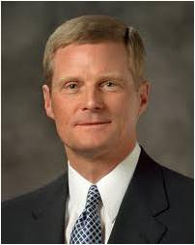
“The promised blessing for honoring [the] covenant [of baptism] is that we may always have His Spirit to be with us (seeD&C 20:77). …
“… Precisely because the promised blessing is that we may always have His Spirit to be with us, we should attend to and learn from the choices and influences that separate us from the Holy Spirit.
“The standard is clear. If something we think, see, hear, or do distances us from the Holy Ghost, then we should stop thinking, seeing, hearing, or doing that thing. If that which is intended to entertain, for example, alienates us from the Holy Spirit, then certainly that type of entertainment is not for us.
Because the Spirit cannot abide that which is vulgar, crude, or immodest, then clearly such things are not for us. Because we estrange the Spirit of the Lord when we engage in activities we know we should shun, then such things definitely are not for us.” (2)

Slide 7
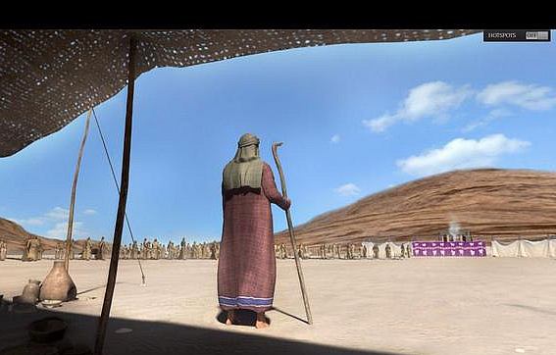
Tent of Meeting
The ‘tent’ is neither the sanctuary of the tabernacle which was not made till after the perfect restoration of the covenant, nor another sanctuary that had come down from their forefathers and was used before the tabernacle was built, …
but a tent belonging to Moses, which was made into a temporary sanctuary by the fact that the pillar of cloud came down upon it, and Jehovah talked with Moses there, and which was called by the same name as the tabernacle, …
because Jehovah revealed Himself there, and every one who sought Him had to go to this tent outside the camp.” (3)
Exodus 33:9-11

Slide 8
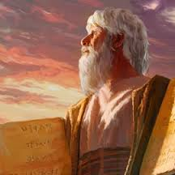
New Stone Tablets
Lord commanded Moses to create another set of stone tables.
The Lord said He would not write all of the same things on the second set of tables
And the Lord said unto Moses, Hew thee two other tables of stone, like unto the first, and I will write upon them also, the words of the law, according as they were written at the first on the tables which thou brakest; but it shall not be according to the first, for I will take away the priesthood out of their midst; therefore my holy order, and the ordinances thereof, shall not go before them; for my presence shall not go up in their midst, lest I destroy them.
JST Exodus 34:1
Exodus 34:1-2

Slide 9
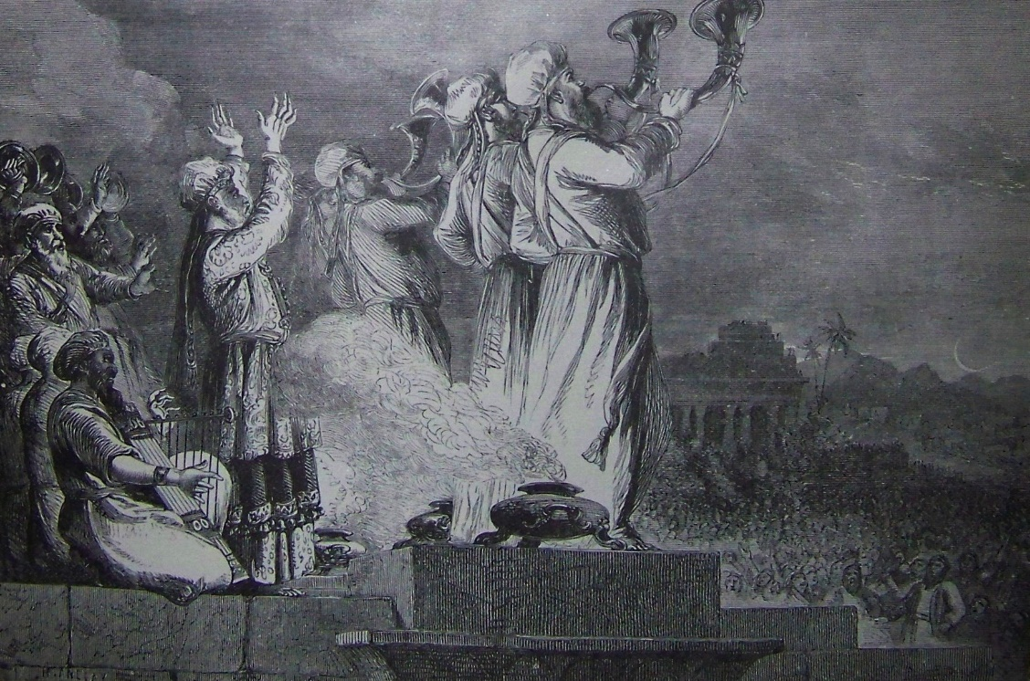
Withholding the Priesthood
But I will give unto them the law as at the first, but it shall be after the law of a carnal commandment; for I have sworn in my wrath, that they shall not enter into my presence, into my rest, in the days of their pilgrimage. Therefore do as I have commanded thee, and be ready in the morning, and come up in the morning unto mount Sinai, and present thyself there to me, in the top of the mount.
Therefore, he took Moses out of their midst, and the Holy Priesthood also;
And the lesser priesthood continued, which priesthood holdeth the key of the ministering of angels and the preparatory gospel;
D&C 84:25-26
The children of Israel at this time were not given the ordinances and covenants of the Melchizedek Priesthood (which are necessary for us to become like God and dwell in His presence), the Lord allowed the Aaronic Priesthood to continue with them
JST Exodus 34:2

Slide 10
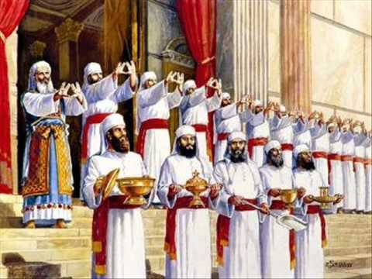
The Lesser Priesthood
“And I will write on the tables the words that were on the first tables, which thou brakest, save the words of the everlasting covenant of the holy priesthood, and thou shalt put them in the ark” (JST, Deuteronomy 10:2)
We must be faithful to the ordinances and covenants of the Aaronic Priesthood to be prepared to receive the ordinances and covenants of the Melchizedek Priesthood

Slide 11
Israel enters into a Covenant (Ex. 23)
God invites Israel to be His covenant People (Exodus 19:3-6)
God writes His law on Stone Tablets
(Ex. 31:18))
Moses reports Israel’s desire to enter God’s Covnant (Ex. 19:7-8)
Israel breaks the covenant
(Ex. 32:9-14)
God warns that the people are not yet prepared to enter His presence (Ex. 19:20-21, 25)
Moses pleads for the people
(ex. 32:34-35)
God Speaks the Ten Commandments to the Israelites (Ex. 19-20)
God writes His law on new stone tables but withholds the higher priesthood and its ordinances (Ex. 34:3-4)
God give Israel additional laws (Ex. 21-23)

Slide 12
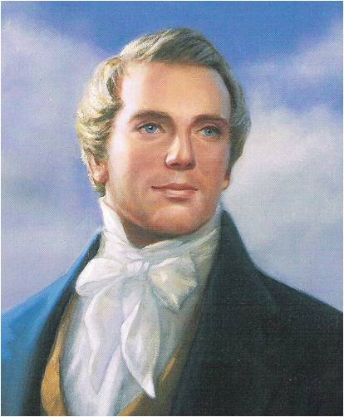
“I want you all to know [God], and to be familiar with Him. …
“… It is the first principle of the gospel to know for a certainty the character of God”
“Three things are necessary in order that any rational and intelligent being may exercise faith unto life and salvation.
“First, the idea that [God] actually exists.
“Secondly, a correct idea of [God’s] character, perfections, and attributes.
“Thirdly, an actual knowledge that the course of life which [the person] is pursuing is according to [God’s] will” (4)

Slide 13
Sources:
Suggested Hymn: #106 God Speed the Right
James E. Faust Pioneers of the Future: “Be Not Afraid, Only Believe” Oct. 1997 Gen. Conf.
Elder David A. Bednar (“That We May Always Have His Spirit to Be with Us,” Ensign or Liahona, May 2006, 29–30).
Keil and Delitzsch, Commentary, 1:2:233–34. Old Testament Institute Manual
Prophet Joseph Smith (Lectures on Faith[1985], 38).
(in History of the Church, 6:305).
Presentation by ©http://fashionsbylynda.com/blog/

Slide 14
The Joseph Smith Translation adds an important clarification to Exodus 34:1–2 that helps us understand that the Lord said He would not write all of the same things on the second set of tables:
“And the Lord said unto Moses, Hew thee two other tables of stone, like unto the first, and I will write upon them also, the words of the law, according as they were written at the first on the tables which thou brakest; but it shall not be according to the first, for I will take away the priesthood out of their midst; therefore my holy order, and the ordinances thereof, shall not go before them; for my presence shall not go up in their midst, lest I destroy them.
“But I will give unto them the law as at the first, but it shall be after the law of a carnal commandment; for I have sworn in my wrath, that they shall not enter into my presence, into my rest, in the days of their pilgrimage. Therefore do as I have commanded thee, and be ready in the morning, and come up in the morning unto mount Sinai, and present thyself there to me, in the top of the mount” (Joseph Smith Translation, Exodus 34:1–2 [in the Bible appendix]).
The Lesser Priesthood: (Not Quite Full)
As a result of the failure of the Israelites to observe the gospel law administered by Moses under the authority of the Melchizedek Priesthood, the Lord gave an additional law of performances and ordinances and “confirmed a priesthood also upon Aaron and his seed, throughout all their generations” (D&C 84:18) to administer it. This priesthood was of lesser power and authority than the priesthood of Melchizedek and was used to administer the outward ordinances, particularly as characterized by the ceremonies of the law of Moses.
The Aaronic Priesthood continued “with the house of Aaron among the children of Israel” from Aaron until John the Baptist, who was a priest in the Aaronic order (D&C 84:26–27), and by this authority he prepared the way for and baptized Jesus. Nineteen centuries later this same John was sent from heaven as a resurrected being to confer the Aaronic Priesthood upon Joseph Smith and Oliver Cowdery. Bible Dictionary

