Slide 1
Lesson 62
The Restoration Part 3
And the Lord called his people Zion, because they were of one heart and one mind, and dwelt in righteousness; and there was no poor among them.
Moses 7:18

Slide 2
Dispensation
Adam
Enoch
Noah
Abraham
Moses
Jesus Christ
Joseph Smith
4000 B.C.
3300 B.C.
2300 B.C.
1900 B.C.
1480 B.C.
30 A.D.
1820-44
What do these individuals have in common?
Adam, Enoch, Noah, Abraham, Moses, Jesus Christ, Joseph Smith, and others have each started a new gospel dispensation. When the Lord organizes a dispensation, the gospel is revealed anew so that the people of that dispensation do not have to depend on past dispensations for knowledge of the plan of salvation. The dispensation begun by Joseph Smith is known as the “dispensation of the fulness of times.”
(1)

Slide 3
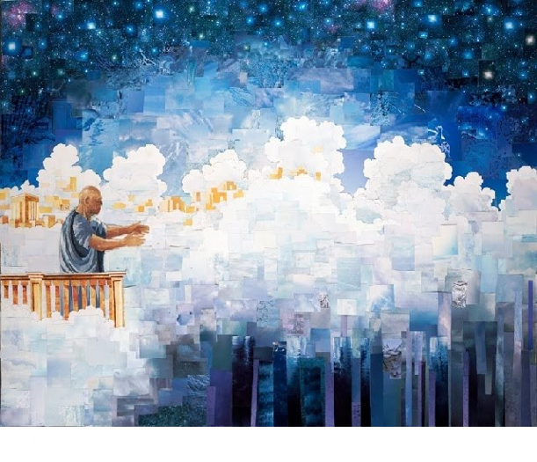
Zion
Enoch
During Enoch’s dispensation he and his people built a righteous and unified society called Zion.
3300 B.C.
In every dispensation, the Lord and His prophets have sought to establish Zion.
Zion refers to the Lord’s covenant people who are pure in heart, united in righteousness, and care for one another.
Moses 7:18

Slide 4
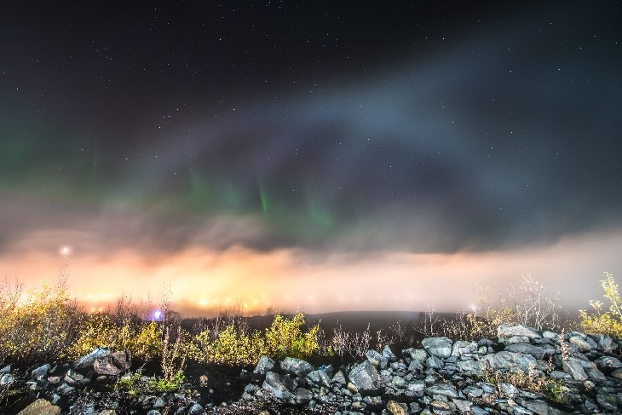
In Every Dispensation
The Lord and His prophets sought to establish Zion in every dispensation
Zion refers to the Lord’s covenant people who are pure in heart, united in righteousness, and care for one another.
Zion also refers to a place where the pure in heart live.
Moses 7:18

Slide 5
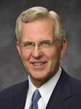
It will be necessary:
“Zion is Zion because of the character, attributes, and faithfulness of her citizens.
Remember, ‘the Lord called his people Zion, because they were of one heart and one mind, and dwelt in righteousness; and there was no poor among them’.
If we would establish Zion in our homes, branches, wards, and stakes, we must rise to this standard.
We cannot wait until Zion comes for these things to happen﻿—Zion will come only as they happen.”
(1) to become unified in one heart and one mind
(2) to become, individually and collectively, a holy people
(3) to care for the poor and needy with such effectiveness that we eliminate poverty among us.
Moses 7:18
(2)

Slide 6
Living the Enoch Way
What are some things you could do to live more like Enoch’s people in your
home
branch
ward
stake

Slide 7
The Final Dispensation
Joseph Smith is the head of what is called
“the dispensation of the fulness of times.”
Today we are living in the final dispensation﻿—the dispensation of the fulness of times. It is the only dispensation that will not end in apostasy. The Church of Jesus Christ of Latter-day Saints will eventually fill the whole earth and stand forever.
Joseph Smith
Daniel 2:44
1820-44

Slide 8
Today
When is the dispensation of the fulness of times?
What is unique about the dispensation of the fulness of times?
What will eventually happen to The Church of Jesus Christ of Latter-day Saints?

Slide 9
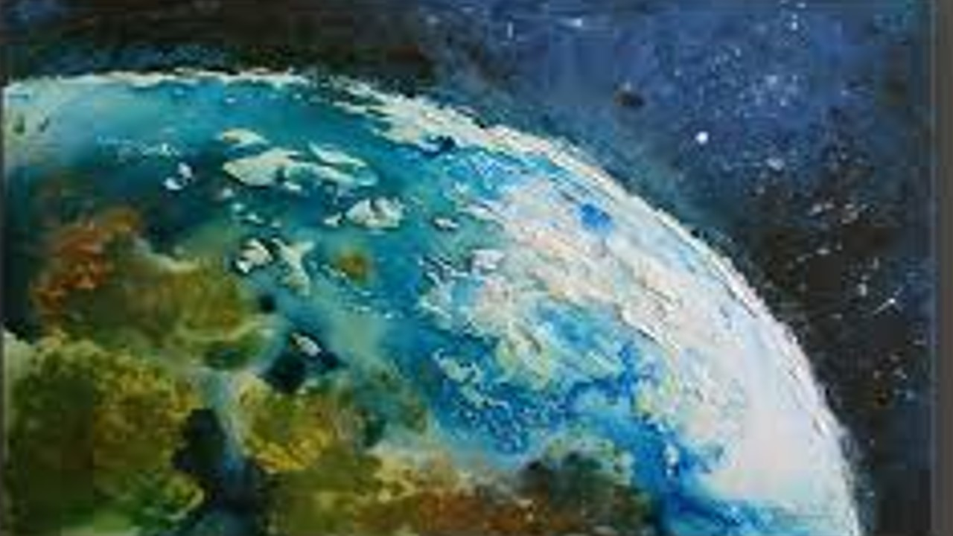
The Church of Jesus Christ of Latter-day Saints will eventually fill the earth and stand forever
And in the days of these kings shall the God of heaven set up a kingdom, which shall never be destroyed: and the kingdom shall not be left to other people, but it shall break in pieces and consume all these kingdoms, and it shall stand for ever. Daniel 2:44

Slide 10
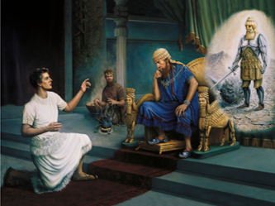
Filling the Whole Earth
The prophet Daniel interpreted a dream of Babylonian King Nebuchadnezzar, in which the king saw a “stone [that] was cut out of the mountain without hands”.
This stone broke down a large statue, “became a great mountain, and filled the whole earth”
How is this prophecy being fulfilled?
What can we do to be a part of this prophecy’s fulfillment?
Daniel 2:45

Slide 11
Sources:
Suggested Hymn:
Video: “Dispensations: The Pattern of Apostasy and Restoration” (6:52)
1. Gospel Study “Dispensation” https://www.churchofjesuschrist.org/study/scriptures/gs/dispensation?lang=eng&clang=eng#p1
2. D. Todd Christofferson, “Come to Zion,” Ensign or Liahona, Nov. 2008, 38
Published by The Church of Jesus Christ of Latter-day Saints Salt Lake City, Utah

Slide 12
“My brethren and sisters, do you realize what we have? Do you recognize our place in the great drama of human history? This is the focal point of all that has gone before. This is the season of restitution. These are the days of restoration. …
“The centuries have passed. The latter-day work of the Almighty, that of which the ancients spoke, that of which the prophets and apostles prophesied, is come. It is here. …
“Given what we have and what we know, we ought to be a better people than we are. We ought to be more Christlike, more forgiving, more helpful and considerate to all around us. …
“May God bless us with a sense of our place in history and, having been given that sense, with our need to stand tall and walk with resolution in a manner becoming the Saints of the Most High” (Gordon B. Hinckley, “At the Summit of the Ages,” Ensign, Nov. 1999, 74).
“When Daniel interpreted the dream of Babylonian King Nebuchadnezzar, making known to the king ‘what shall be in the latter days’ [Daniel 2:28], he declared that ‘the God of heaven [shall] set up a kingdom, which shall never be destroyed: and the kingdom shall not be left to other people, but it shall break in pieces and consume all [other] kingdoms, and it shall stand for ever’ [Daniel 2:44]. The Church is that prophesied latter-day kingdom, not created by man but set up by the God of heaven and rolling forth as a stone ‘cut out of the mountain without hands’ to fill the earth [Daniel 2:45; see also verse 35].
“Its destiny is to establish Zion in preparation for the return and millennial rule of Jesus Christ” (D. Todd Christofferson, “Why the Church,” Ensign or Liahona ,Nov. 2015, 111).

