Slide 1
Lesson 63 Part 1
The Priests Are Consecrated
Leviticus 8-11

Slide 2
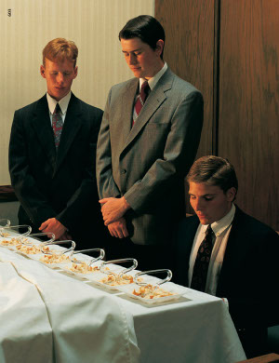
The Magnificent Priesthood
“You will seek to be completely clean and administer the sacrament worthily.
You will treat every young woman with kindness and respect.
You will honor your parents.
You will avoid offending the Spirit in what you think, say, or do.
You will come to know the Lord, whom you serve, and you will ever strive to be like Him.” (1)
How might the way Aaronic Priesthood holders prepare, administer, and pass the sacrament affect your experience with this ordinance?

Slide 3
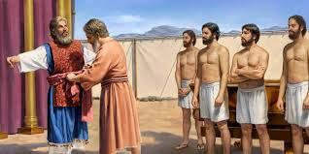
Aaron Is Consecrated
Gathering at the door of the tabernacle:
The garments
The anointing oil
A bullock for the sin offering
Two rams
A basket of unleavened bread
Moses:
Washed them
Put on a coat, a girdle and a robe, the ephod, another girdle and bound them (sash) and anointed
Put on a breastplate and also the breastplate of the Urim and the Thummim
Put on a miter on his head and a golden plate (holy crown)
Leviticus 8:1-9

Slide 4
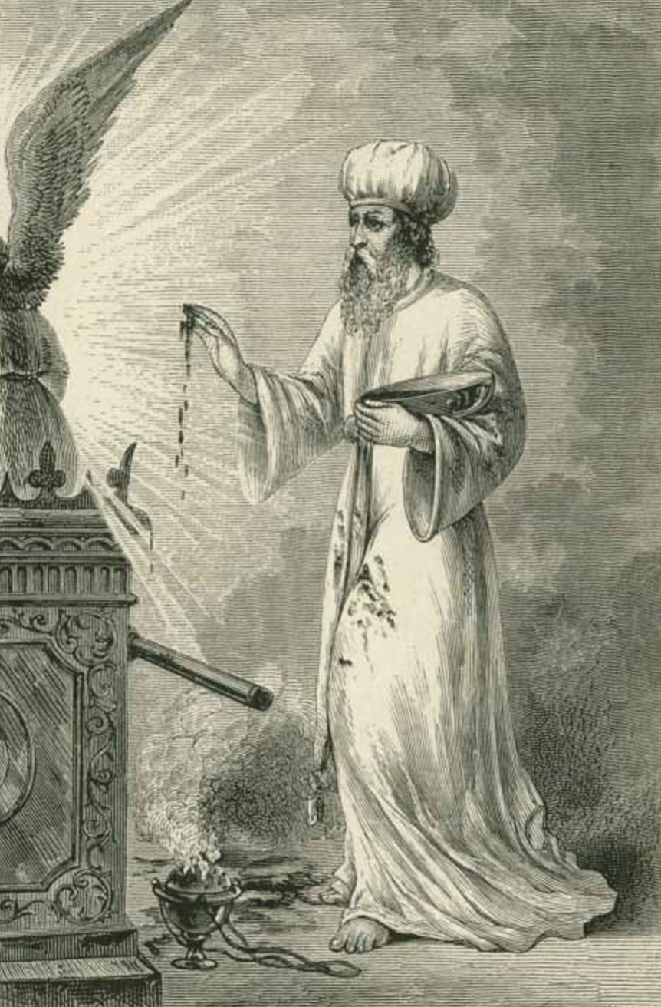
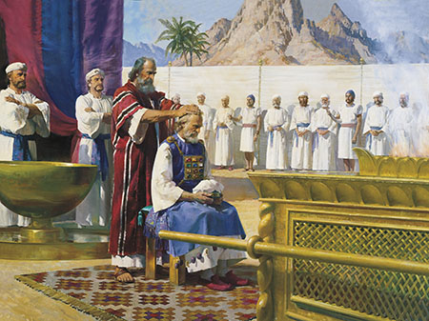
The Tabernacle is Consecrated
Moses:
Anointed the tabernacle and all that was in it
Sprinkled upon the altar seven times and anointed the vessels, laver and his foot
Anointed Aaron’s head to sanctify him
Leviticus 8:10-12

Slide 5
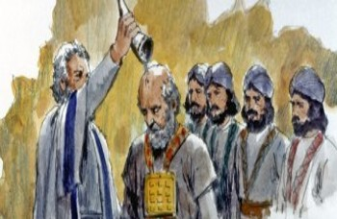
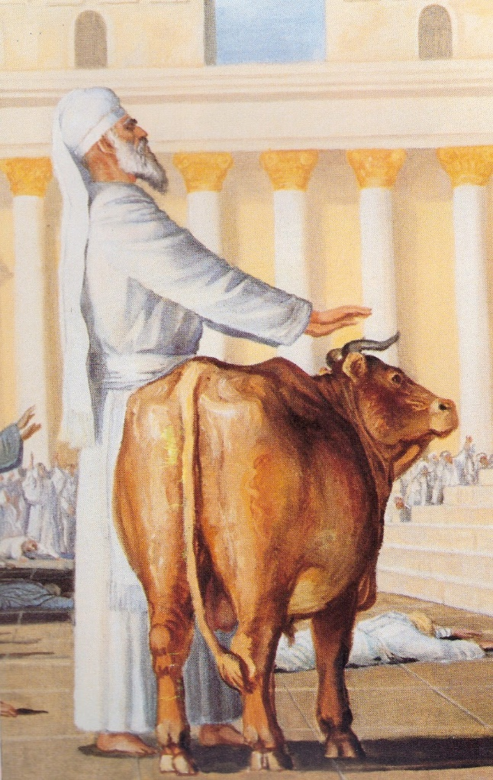
Aaron’s Son are Consecrated
Moses Anoints Aaron’s Sons:
Put coats on them
Girded them
Put a bonnet on them
Offered a bullock for a sin offering, the sons placed there hands on the head of the bullock
Leviticus 8:13-14

Slide 6
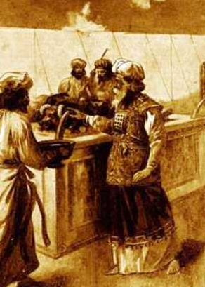
The Bullock
Moses:
Took the blood and put it on the horns of alter and poured the blood at the bottom of alter to sanctify it and make reconciliation upon it.
Took all the fat, the caul (a piece of membrane) above the liver and 2 kidneys and burned it upon the altar
The hide of the bullock and dung he burnt outside of the camp.
The Sin Offering
Leviticus 8:15-17

Slide 7
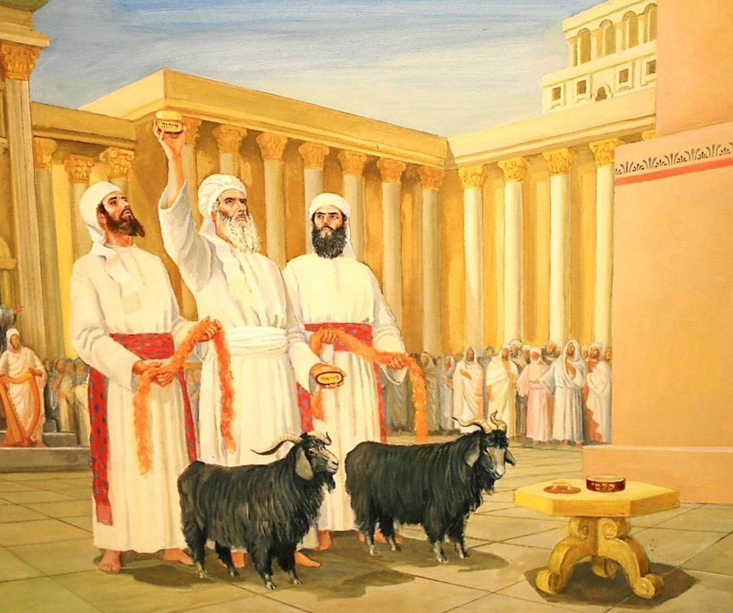
2 Rams—Burnt/Wave Offerings
Aaron and Sons:
Ram is Burnt Offering
They laid their hands on head of ram and then and kill it
Moses:
Sprinkled blood upon the altar and around it
He cut the ram into pieces and burned head and the fat
He washed the innards and legs in water
He burned the whole ram on the altar for a sweet savour and an offering by fire unto the Lord.
Aaron and Sons:
Ram of Consecration
They laid their hands on head of ram and then kill it
Moses:
Takes blood from it and puts it on the tip of Aaron right ear, the thumb of his right hand and the great toes of his right foot
The same is done for Aaron’s sons
He sprinkled the blood upon the altar and around it
He took the fat, the rump and all the fat inwards, caul above the liver, 2 kidneys, and the right shoulder
He took the unleavened bread, puts fat on it and placed it on Aaron and His son’s right shoulder and used it as a wave offering unto the Lord
Leviticus 8:18-21, 22-27

Slide 8
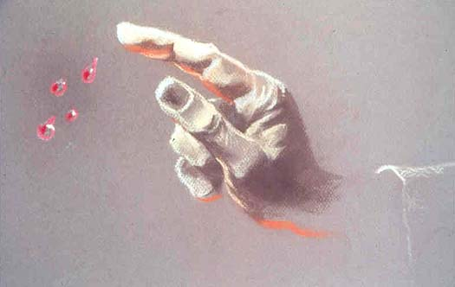
Offerings Unto the Lord
Moses:
Took the ram pieces off Aaron and Son’s hands and burnt them on the altar and were consecrated for a sweet savour unto the Lord
He took the breast of the ram and waved it before the Lord
He took the anointing oil and the blood which was upon the alar and sprinkled it upon Aaron and his clothes and upon his son’s and their clothes and sanctified Aaron and his sons
Aaron and Sons:
They boiled the flesh at the door of the tabernacle of the congregation and are with the bread
The leftovers were burned
Leviticus 8:28-32

Slide 9
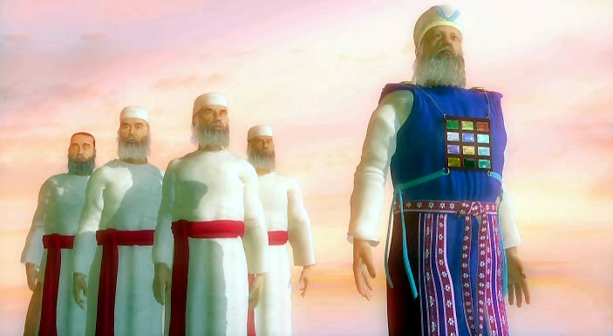
7 Days of Consecration
And ye shall not go out of the door of the tabernacle of the congregation in seven days, until the days of your consecration be at an end: for seven days shall he consecrate you.
As he hath done this day, so the Lord hath commanded to do, to make an atonement for you.
Therefore shall ye abide at the door of the tabernacle of the congregation day and night seven days, and keep the charge of the Lord, that ye die not: for so I am commanded.
So Aaron and his sons did all things which the Lord commanded by the hand of Moses.
Leviticus 8:33-37

Slide 10
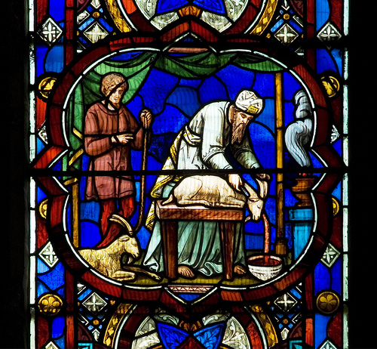
On The 8th Day
Make an atonement for them—Moses and Aaron Bless the People
Moses instructed Aaron to gather the people and offer sacrifices for himself and all of Israel
For Aaron
The Calf—Sin Offering
For the People
A Goat—Sin Offering
For the People
A Bullock and a Ram—Peace Offering
Aaron’s sons presented it at the altar and sprinkled about the altar
Moses’ Promise:
This is the thing which the Lord commanded that ye should do: and the glory of the Lord shall appear unto you.
Leviticus 9

Slide 11
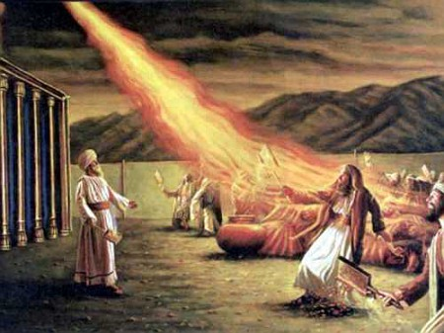
The Strange Fire
Unauthorized Fire
And Nadab and Abihu, the sons of Aaron, took either of them his censer, and put fire therein, and put incense thereon, and offered strange fire before the Lord, which he commanded them not.
And there went out fire from the Lord, and devoured them, and they died before the Lord.
The Lord had previously explained the sacredness of priesthood ordinances and the serious consequences that would follow if priesthood holders did not prepare for and perform them worthily and with exactness.
Although this passage does not fully explain what Nadab and Abihu did that was so serious, it is clear that they transgressed the Lord’s commandments regarding how sacred ordinances were to be performed.
Leviticus 10:1-2

Slide 12
Not Following the Law
Sons of Aaron--The 2nd Time
Part of the sin offering was specified for the use of the priest who administered the offering, thus “bearing the iniquity of the congregation”
However, Eleazar and Ithamar had burned all of it rather than eating their portion. This was the second time the sons of Aaron had not followed the law. Moses rebuked them, but Aaron withstood the rebuke.
Leviticus 10:16-19

Slide 13
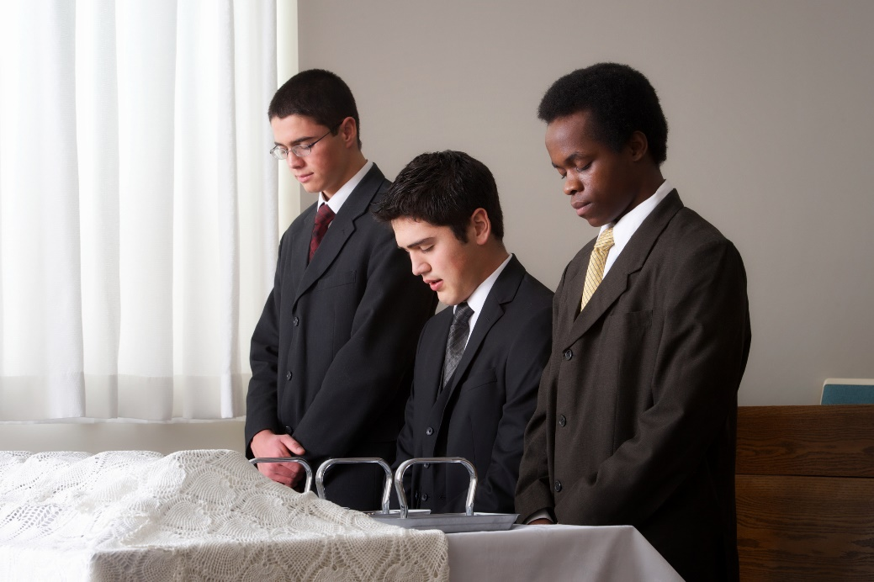
To Be Properly
Why do you think the Lord desires that priesthood ordinances be done properly?
How can priesthood holders make sure they prepare for and appropriately administer their priesthood duties?
Leviticus 10:1-2

Slide 14
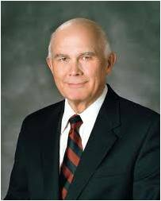
Personal Worthiness
“put difference between holy and unholy”—
“to distinguish between the holy and the profane, and between the impure and the pure.”
If someone officiating in this sacred ordinance is unworthy to participate, and this is known to anyone present, their participation is a serious distraction to that person.
Young men, if any of you is unworthy, talk to your bishop without delay. Obtain his direction on what you should do to qualify yourself to participate in your priesthood duties worthily and appropriately. (2)
“The ordinance does not become invalid if someone involved is unworthy at the time he participates. The sanctity of the ordinance is violated, but not the validity. If the partaker is worthy and sincere, all the possible blessings and benefits will be his.” (3)
“Deny not the gifts of God, for they are many. … And there are different ways that these gifts are administered; but it is the same God who worketh [them] all.” Moroni 10:8
Leviticus 10:9-10

Slide 15
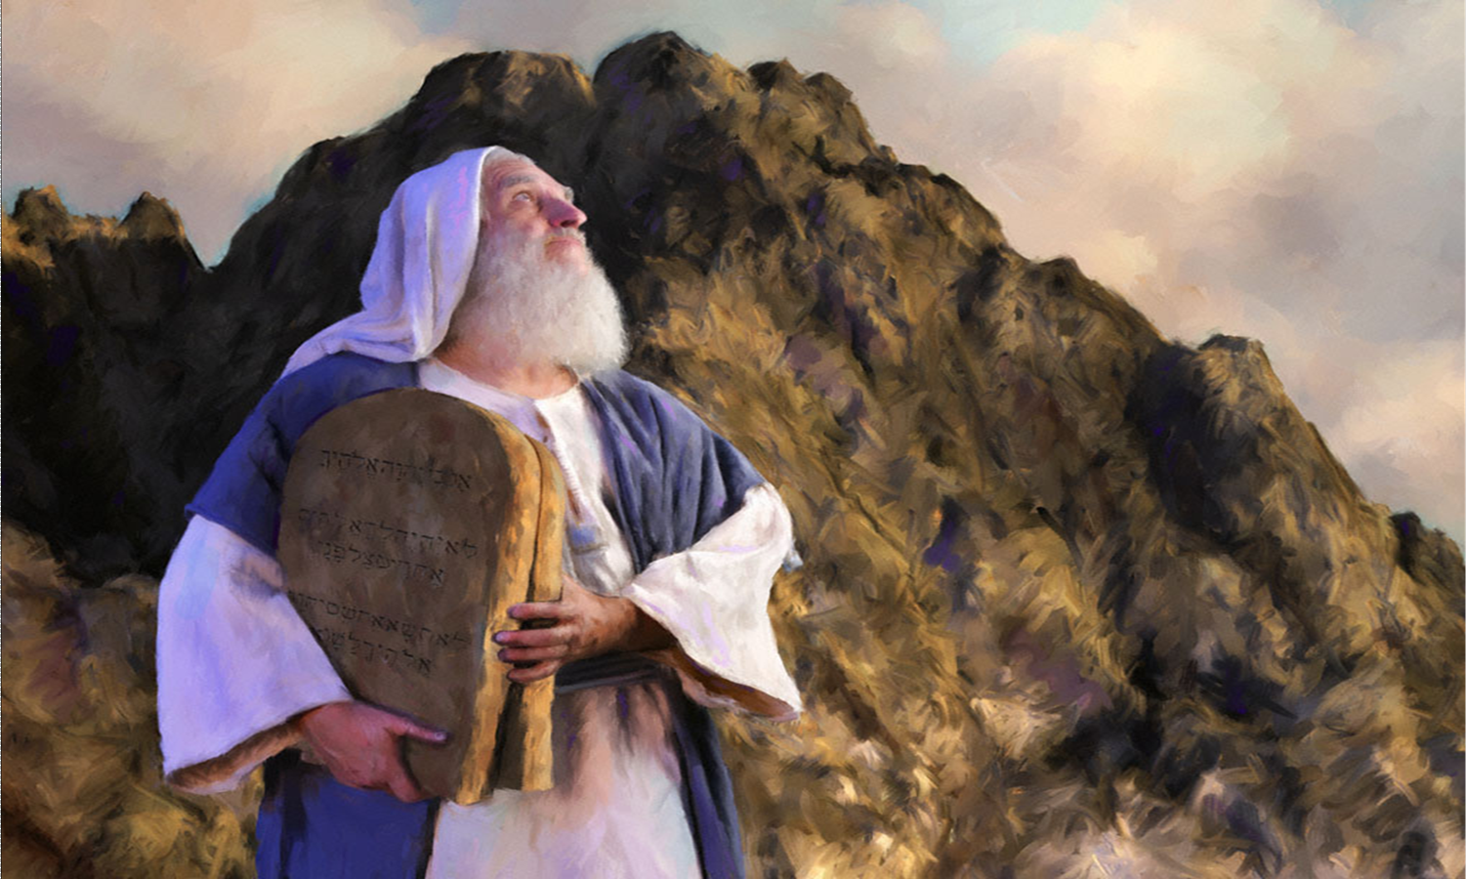
The Laws—Two Primary Functions
To teach the people obedience so that they could progress spiritually
To point their minds toward the ultimate source of salvation in Jesus Christ.
Leviticus 11

Slide 16
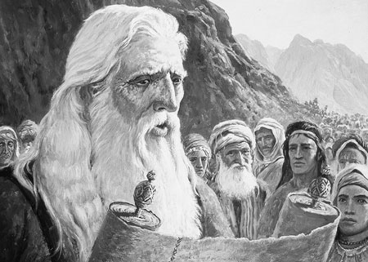
Dietary Laws
The law of Moses included commandments concerning which animals were considered clean and fit for the children of Israel to eat and which were unclean and not proper to eat. In our day, people refer to these laws as kosher laws (from a Hebrew word that means “fit” or “proper.”
But the Hebrew word for clean used in the dietary law means more than just physically clean. It carries the connotation of being “clean from all pollution or defilement … and implying that purity which religion requires, and is necessary for communion with God” (4)
Kosher
From Hebrew Kasher, meaning “fit, proper, and ritually clean” according to Jewish law. Especially applied to the preparation and serving of food according to the specifications given in the law of Moses (Bible Dictionary).
Leviticus 11

Slide 17
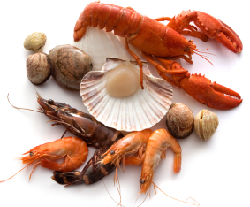
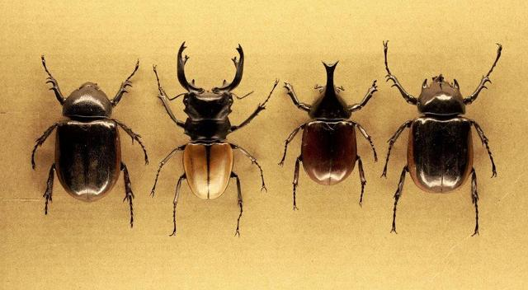
Clean and Unclean Animals
There were practical reasons for these laws related to health and sanitation.
Clean
Unclean
Cloven-footed (that is, the hooves had to be separated into two parts), and they had to chew their cud
Seafood was limited to those that had scales and fins
Insects that fly but also go on all fours: Locust, grasshoppers, beetles
Shellfish, such as lobster and shrimp, and fish such as sharks and dolphins, as well as other sea creatures such as the eel
Birds forbidden were generally birds of prey that lived on carrion, stork, eagle osprey, heron, kite, vulture, owl night hawk, cormorant, bat, pelican, swan
Most flying insects were also forbidden.
Weasel, mouse, tortoise, ferret, chameleon, lizard, snail, mole
If we associate with unclean influences, they can cause us to become unclean
Leviticus 11

Slide 18
Dietary Laws Today
Word of Wisdom
Following the Lord’s health commandments helps us become holy
Meat sparingly
MILK
Leviticus 11

Slide 19
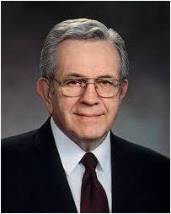
“Our physical body is the instrument of our spirit. In that marvelous revelation, the Word of Wisdom, we are told how to keep our bodies free from impurities which might dull, even destroy, those delicate physical senses which have to do with spiritual communication. …
“… [The Word of Wisdom] is [our] armor and will protect [us] from habits which obstruct the channels of personal revelation” (5)
Leviticus 11

Slide 20
Sources:
Suggested Song: God of Power, God of Right #20
Videos:https://www.lds.org/youth/video/the-magnificent-priesthood?lang=eng. OR https://www.youtube.com/watch?feature=player_embedded&v=1j3MxNZdCeE (2:58)
Priesthood Duty (4:59)
Elder David L. Beck The Magnificent Priesthood April 2010 Gen. Conf.
Elder Dallin H. Oaks The Aaronic Priesthood and the Sacrament Oct. 1998 Gen. Conf.
3. Questions and Answers March 1989 Ensign (What should I do if I know that someone who is administering the sacrament is unworthy? Does this affect the validity of the sacrament?)
Rex W. Allred, Former Executive Secretary, Melchizedek Priesthood General Committee
(Wilson, Old Testament Word Studies, s.v. “clean, cleanse, clear,” p. 78).
Elder Boyd K. Packer (“Revelation in a Changing World,” Ensign, Nov. 1989, 14).
Presentation by ©http://fashionsbylynda.com/blog/

Slide 21
The Book of Leviticus
Bible Dictionary
Chapters 1-7 | Chapters 8-10 | Chapter 11 | Chapters 12 | Chapters 13-15 | Chapter 16 | Chapter 17-26 | Chapter 27
Explains the sacrificial ordinances—the offerings | Describes the ritual observed in the consecration of priests | Explains what may or may not be eaten and what is clean or unclean | Discusses women after childbirth | Are laws relating to ceremonial uncleanness | Contains the ritual to be observed on the Day of Atonement | Contains a code of laws dealing with religious and social observances | Explains that the Lord commanded Israel to consecrate their crops, flocks, and herds to the Lord
Leviticus 8 | Leviticus 9 | Leviticus 10 | Leviticus 11
The Consecration of the Priesthood | Ministry of the Priesthood | Failure of the Priesthood | Laws of Clean and Unclean
Commanded by Lord Cleansing with Water Special Garments Anointing with Oil Consecrating with Blood Remaining in Tabernacle | Offerings for the Priest Offerings for the People The Lord Accepting the Offerings | The Sin of Nadab and Abihu The Sin of Elazar and Ithamar | Animals of the Earth Living things in the water Birds, insects, creeping things, Carcusses of unclean animals Purpose of dietary Law

Slide 22
Put in Order of Occurrence Leviticus 8
Moses anointed Aaron with oil.
Moses washed Aaron and his sons with water.
Moses offered various sacrifices as an atonement for Aaron and his sons.
Moses gathered the children of Israel to the tabernacle
Aaron and his sons remained at the tabernacle for seven days.
Moses clothed Aaron in the clothes of the priesthood.
Moses anointed the tabernacle and altar with oil and consecrated it to the Lord.
Moses anointed Aaron with oil.
Moses washed Aaron and his sons with water.
Moses offered various sacrifices as an atonement for Aaron and his sons.
Moses gathered the children of Israel to the tabernacle
Aaron and his sons remained at the tabernacle for seven days.
Moses clothed Aaron in the clothes of the priesthood.
Moses anointed the tabernacle and altar with oil and consecrated it to the Lord.

Slide 23
Ear, Thumb, and Toes:
“The priest put some of [the] blood [from the offering] upon the tip of the right ear, the right thumb, and the great toe of the right foot of the person to be consecrated, in order that the organ of hearing, with which he hearkened to the word of the Lord, and those used in acting and walking according to His commandments, might thereby be sanctified through the power of the atoning blood of the sacrifice” (Keil and Delitzsch, Commentary, 1:2:387–88, emphasis added).
Old Testament Institute Manual
What should I do if I know that someone who is administering the sacrament is unworthy? Does this affect the validity of the sacrament?
The ordinance of the sacrament is one of the most sacred ordinances of the Church. We are privileged to be able to partake of the sacrament almost every week and, through doing so, renew our baptismal covenants with the Lord.
If a person were aware that an Aaronic Priesthood bearer or possibly an elder was administering the sacrament unworthily, he should quietly inform the bishop of this knowledge and leave the matter in the bishop’s hands. Only the bishop has the responsibility to judge worthiness and to authorize priesthood bearers to administer the sacrament.
Other courses such as refusing to take the sacrament, complaining to others about the unworthiness of a priesthood bearer, or reproaching the accused directly, all have negative results which are not helpful to anyone involved. Matters of this kind are quite sensitive and must be handled with judgement and discretion. The bishop carries the responsibility to do this.
The sacrament is one of the most sacred and holy ordinances in the Church and should be administered with reverence and dignity. No priesthood bearer who has a serious, unresolved moral problem should participate in preparing, blessing, or passing the sacrament.
But while basic worthiness to administer the sacrament or participate in other ordinances must be carefully guarded, we must also remember that perfection is not a requirement for priesthood bearers to be permitted to function in various ordinances and callings. Even though priesthood bearers are imperfect in many ways, the Lord allows them to carry out his work. The Church is a school for those who desire to become like the Lord, not a resting place for those who have already made it.
Ordinances of the priesthood are valid if they are performed by authorized priesthood bearers in the prescribed manner. While local leaders will want to do everything within their power to see that only worthy brethren administer the sacrament, the ordinance does not become invalid if someone involved is unworthy at the time he participates. The sanctity of the ordinance is violated, but not the validity. If the partaker is worthy and sincere, all the possible blessings and benefits will be his.
Worthily administering or partaking of the sacrament brings blessings to our lives each week. What a great privilege it is for members of all ages to participate in this ordinance as part of the restored gospel of Jesus Christ. Questions and Answers: March 1989Ensign
Rex W. Allred, Former Executive Secretary, Melchizedek Priesthood General Committee
The Word Strange:
The Hebrew word translated “strange” means “to be alien … as opposed to that which is holy and legitimate” (Wilson, Old Testament Word Studies, s.v. “strange,” p. 422). Thus, the idea is not that the fire was strange or unusual, but that these two sons of Aaron engaged in an unauthorized form of worship. Whether they took fire (actually hot coals) from another source than the great altar which God Himself had kindled (see Leviticus 9:24), or whether they used an incense not prepared as specified (see Exodus 30:34–37) is not clear from the account. But after revealing the proper preparation of the incense, the Lord warned, “Whosoever shall make like unto that, to smell thereto, shall even be cut off from his people” (Exodus 30:38). Aaron’s other sons were forbidden to officially mourn the death of their brothers, for this action would imply that the Lord had been unjust in the punishment (see Leviticus 10:6).
Deacons, teachers, and priests should always be clean in appearance and reverent in the manner in which they perform their solemn and sacred responsibilities. Teachers’ special assignments in preparing the sacrament are the least visible but should still be done with dignity, quietly and reverently. Teachers should always remember that the emblems they are preparing represent the body and blood of our Lord.
To avoid distracting from the sacred occasion, priests should speak the sacrament prayers clearly and distinctly. Prayers that are rattled off swiftly or mumbled inaudibly will not do. All present should be helped to understand an ordinance and covenants so important that the Lord prescribed the exact words to be uttered. All should be helped to focus on those sacred words as they renew their covenants by partaking.
With the single exception of those priests occupied breaking the bread, all who hold the Aaronic Priesthood should join in singing the sacrament hymn by which we worship and prepare to partake. No one needs that spiritual preparation more than the priesthood holders who will officiate in it. My young brethren, it is important that you sing the sacrament hymn. Please do so. (The Aaronic Priesthood and the Sacrament) by Dallin H. Oaks Oct. 1998 Gen. Conf.
Aaron’s Sons: Nadab and Abihu
“…Nadab and Abihu did not bring those sacrifices which Moses bade them bring, but which they used to offer formerly, and were burnt to death. Now when the fire rushed upon them, and began to burn them, nobody could quench it. Accordingly they died in this manner. And Moses bid their father and their brethren to take up their bodies a=to carry them out of the camp, and to bury them magnificently. Now, the multitude lamented them, and were deeply affected at this their death, which so unexpectedly befell them.” Flavius Josephus (Translated by William Whiston) 3.8.7 Pg. 109

Slide 24
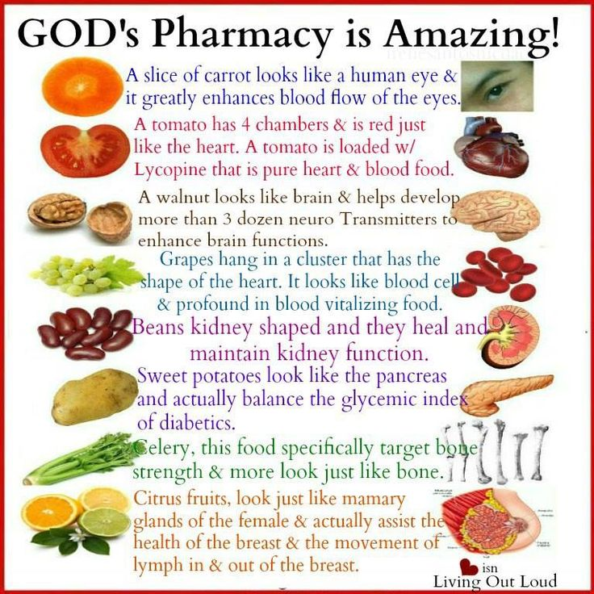
Clean and Unclean:
“A hog could be raised in an incubator on antibiotics, bathed daily, slaughtered in a hospital operating room, and its carcass sterilized by ultra-violet rays, without rendering kosher the pork chops that it yields. ‘Unclean’ in Leviticus is a ceremonial word. That is why the Torah says of camels and rabbits, ‘They are unclean for you, ’limiting the definition and the discipline to Israel. Chickens and goats, which we can eat, are scarcely cleaner by nature than eagles and lions, but the latter are in the class of the unclean.” (Wouk, This Is My God, pp. 100–101.)
Just For Fun
Dietary Function:
God was using the diet as a teaching tool. People may forget or neglect prayer, play, work, or worship, but they seldom forget a meal. By voluntarily abstaining from certain foods or by cooking them in a special way, one made a daily, personal commitment to act in one’s faith.
At every meal a formal choice was made, generating quiet self-discipline. Strength comes from living such a law, vision from understanding it. Further, the law served to separate the Hebrews from their Canaanite neighbors. Each time they got hungry they were forcibly reminded of personal identity and community bond. Indeed, they belonged to a people set apart. The law therefore acted as a social instrument for keeping the Hebrew nation intact, a psychological instrument for preserving the identity of the individual, and a religious instrument for keeping the people in remembrance of Jehovah.
President Ezra Taft Benson taught:
“The Word of Wisdom is one of the recognized and distinctive practices of members of the Church. Generally, others not of our faith acknowledge that members in good standing abstain from tobacco, coffee, tea, and all alcoholic beverages. …
“One principle of the gospel that all young people of the Church should understand is this: God, our Heavenly Father, governs His children by law. He has instituted laws for our perfection. If we obey His laws, we receive the blessings pertaining to those laws. If we do not obey, we receive the consequences.
“The Word of Wisdom is a law—a principle with promise. If we obey the provisions of the law, we receive the promises. If we do not, there will be both temporal and spiritual consequences” (“A Principle with a Promise,” Ensign, May 1983, 53).
Elder Dallin H. Oaks of the Quorum of the Twelve Apostles taught:
“The Lord gave one dietary direction to ancient Israel. Much later, because of the ‘evils and designs’ that exist in these ‘last days’ (D&C 89:4), He has given us a Word of Wisdom suited to the circumstances of our time, accompanied by the promised blessings we need in our time” (“Timing” [Brigham Young University devotional, Jan. 29, 2002], 3; speeches.byu.edu)

