Slide 1
Lesson 64
How to Live Righteously
The Mosaic Law
Leviticus 19-27
“The purpose of the Mosaic Law was to balance the scales of justice with the victim, not the state.”
W. Cleon Skousen
Presentation by ©http://fashionsbylynda.com/blog/

Slide 2
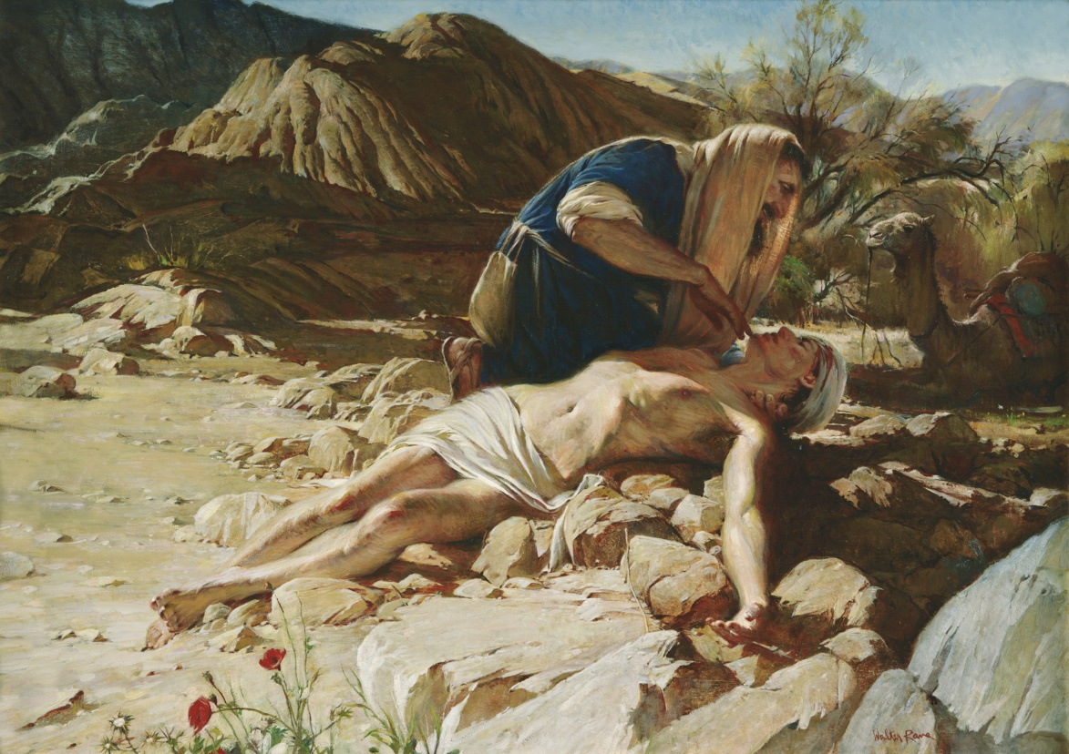
Opportunity
When have you had the chance to make a difference in another person’s life?
Being the Lord’s covenant people includes the opportunity and responsibility to serve others and bring them closer to the Savior.

Slide 3
To Be Holy
Recorded here for the first time is the revelation of the one principle that governed all the laws dealing with proper social relationships
Honor thy Parents
Keep Sabbath Day Holy
Fear—Honor--Respect
Leviticus 19:1-2

Slide 4
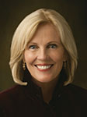
“If you desire to make a difference in the world, you must be different from the world.”
(1)

Slide 5
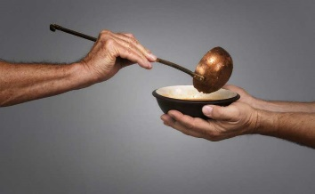
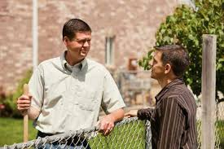
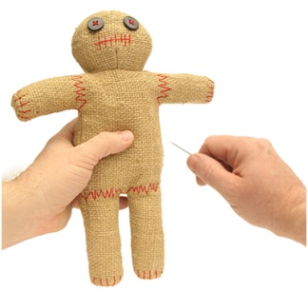
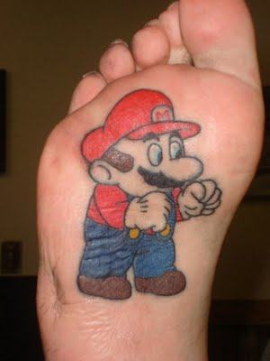
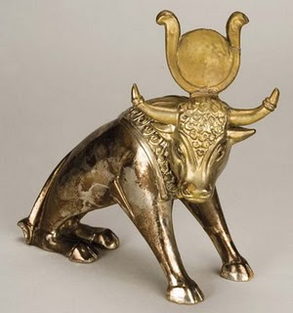
19:3-4
Honor your parents
Keep Sabbath Day Holy
Do not worship idols
19:9-12
Serve the poor and needy
Do not steal
Do not lie or gossip
19:13-16
Love thy neighbor
Be honest
19:17-18
Control your words and thoughts
Do not hold a grudge against anyone or try to get revenge
19:28: 21:5
Do not mark up your bodies in any way
19:33-34, 37
Be kind to others and love one another
Keep all the commandments
Since the Israelites would soon be surrounded by the wicked practices of the world (the Canaanites), which of these commandments do you think would have set Israel apart the most from other nations?
(1)

Slide 6
Appearance of an Israelite
The Lord wanted the Israelites to be distinguished from the Canaanites, Egyptians, and other groups not only through their religion but also their appearance.
The Hair
Markings on the Skin
Herodotus observes that the Arabs shave or cut their hair round, in honour of Bacchus [the god of wine] who, they say, had his hair cut in this way. …(2)
The ancient Egyptians tattooed the courtiers and concubines to the Pharaohs. (4)
Ancient Egyptian (see The Ancient Egyptians) men commonly shaved their faces and their heads, not usually allowing it to grow except in times of mourning, after which it was again shaved. Joseph was clean shaven prior to being allowed in before Pharaoh (Genesis 41:14). The women of Egypt wore their hair long and plaited. (3)
Naturally baldness was considered clean (Leviticus 13:40)
(1)
Leviticus 19
Canaanite (Baal god)

Slide 7
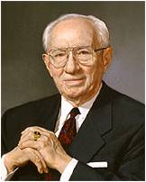
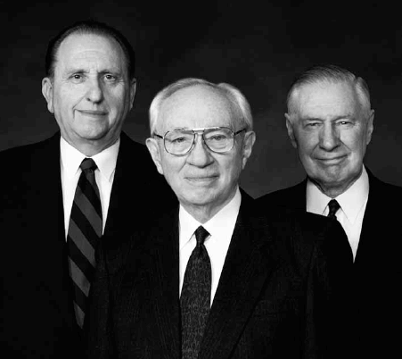
Respect your bodies. The Lord has described them as temples. So many these days disfigure their bodies with tattoos. How shortsighted. These markings last for life. Once in place, they cannot be removed except through a difficult and costly process. I cannot understand why any girl or boy would subject herself or himself to such a thing. I plead with you to avoid disfigurement of this kind.
We—the First Presidency and the Council of the Twelve—have taken the position, and I quote, that “the Church discourages tattoos. It also discourages the piercing of the body for other than medical purposes, although it takes no position on the minimal piercing of the ears by women for one pair of earrings.”
(5)
2000

Slide 8
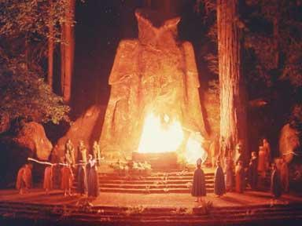
Warning to Parents
Molech
A fire god worshipped by the Ammonites, who made their children pass through or be consumed by a ceremonial fire
From time to time the Israelites lapsed into this form of idolatry, always with devastating consequences. (6)

Slide 9
Fire Gods of Today
Alcohol
Drugs
Addiction to Porn
offensive music
Stress or depression
Family division
Immorality

Slide 10
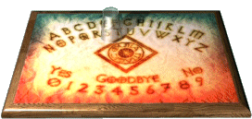
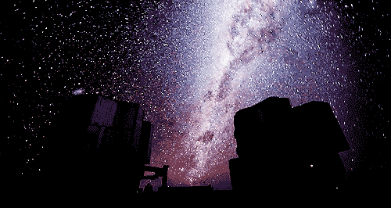
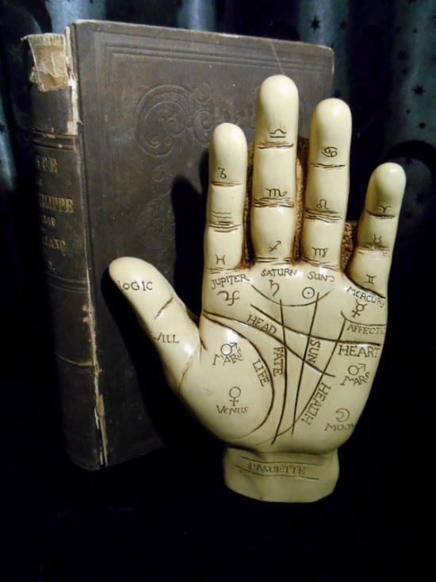
Enchantment--nachash
To practice divination
“observe times” the Hebrew word meaning “to observe clouds” (7)
In the ancient world, sorcerers and necromancers often claimed to read the future through various omens or objects.
Their methods included watching the stars (astrology), observing the movements of clouds and certain animals, tying knots, casting lots, tossing arrows into the air and then reading the pattern of how they fell, and so on. (8)
They were forbidden any use of the occult to read the future.
“Familiar spirits”--ventriloquists
Leviticus 19:26, 31

Slide 11
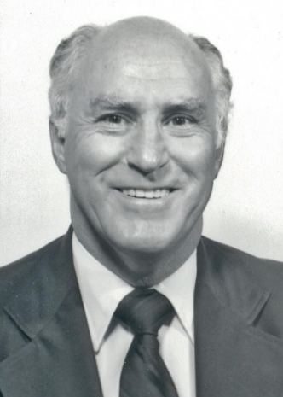
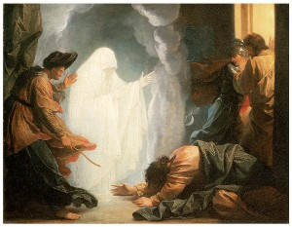
“When thou art come into the land which the Lord thy God giveth thee, thou shalt not learn to do after the abominations of those nations.
“There shall not be found among you any one that maketh his son or his daughter to pass through the fire, or that useth divination, or an observer of times, or an enchanter, or a witch,
“Or a charmer, or a consulter with familiar spirits, or a wizard, or a necromancer.
“For all that do these things are
an abomination unto the Lord:
and because of these abominations
the Lord thy God doth drive them
out from before thee.
Deuteronomy 18:9-12
“The scriptures show that the enchantments and the spells of the wizard, the medium, and the necromancer are characteristic of the false religions and superstitions of the world, and that those who practice such are actually in competition with the true prophets and apostles.
“All who are acquainted with the spirit and faith of Jesus Christ will want nothing to do with any form of divination and spiritual wizardry.” (9)
Leviticus 19:31

Slide 12
Serious Sins
Those Worthy of Death
The Lord clearly stated again and again that the purpose of these laws was to separate Israel from other people so that they could be sanctified and become holy unto God.
Leviticus 20

Slide 13
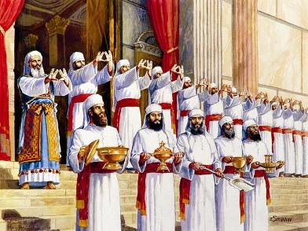
Special Laws For Priesthood
Law of Cleanliness for Priesthood
All members of the priesthood had to marry virgins of their own people.
Prostitutes, adulterous women, or even divorced women, were excluded, thus avoiding the least doubt about personal purity.
The priests could not marry “profane” women (non-Israelites; be defiled by contact with a dead person other than close relatives, or allow a daughter to be a prostitute.
Leviticus 21:1-9

Slide 14
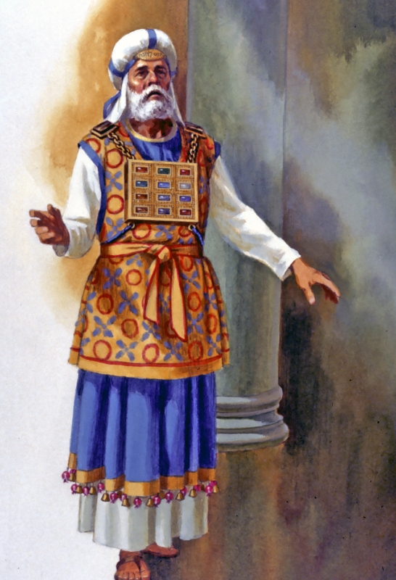
“High Priest”
First time used in Bible
The Hebrew literally means “the Priest, the great one.” As the chief priest, he was the representative of Jehovah among the people.
The Old Testament high priest was an office in the Aaronic Priesthood, not an office in the Melchizedek Priesthood as it is today.
The high priest was the presiding priest, or head, of the Aaronic Priesthood. Today the presiding bishop holds that position.
Leviticus 21:10

Slide 15
God’s Authorized Representatives
The Priests had to maintain an even higher level of separation and sanctification
The high priest, who was a symbol or type of Jesus, “the great high priest,” had to meet a still stricter code
Seeing then that we have a great high priest, that is passed into the heavens, Jesus the Son of God, let us hold fast our profession…
Hebrews 4:14
In addition to meeting the requirements of the regular priesthood for marriage and defilement, he had to be without any physical defects.
Such strictness was to remind the people that Christ, the true Mediator between God and His children, was perfect in every respect. (14)
Leviticus 21:16-21

Slide 16
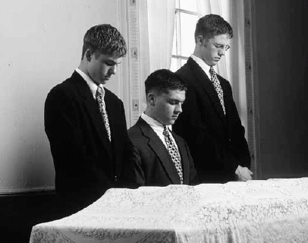
Aaronic Priesthood Today
The Aaronic Priesthood should maintain an high level of separation and sanctification
1. Become converted to the gospel of Jesus Christ and live by its teachings.
2. Serve faithfully in priesthood callings and fulfill the responsibilities of priesthood offices.
3. Give meaningful service.
4. Prepare and live worthily to receive the Melchizedek
Priesthood and temple ordinances.
5. Prepare to serve an honorable full-time mission.
6. Obtain as much education as possible.
7. Prepare to become a worthy husband and father.
8. Give proper respect to women, girls, and children.
(10)

Slide 17
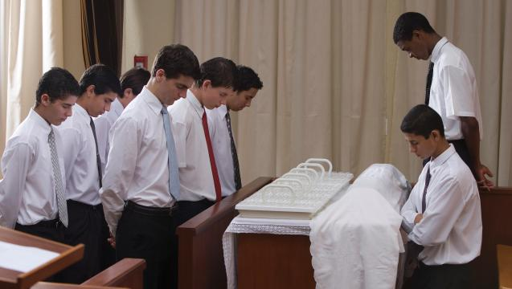
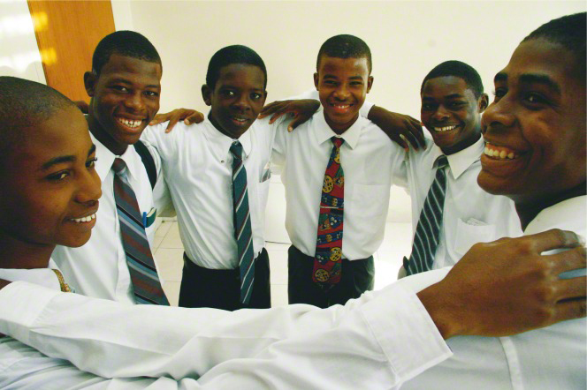
The Proper Dress
Those who bless and pass the sacrament should dress modestly and be well groomed and clean.
Clothing or jewelry should not call attention to itself or distract members during the sacrament.
Ties and white shirts are recommended because they add to the dignity of the ordinance.
However, they should not be required as a mandatory prerequisite for a priesthood holder to participate. Nor should it be required that all be alike in dress and appearance. Bishops should use discretion when giving such guidance to young men, taking into account their financial circumstances and maturity in the Church.
(11)

Slide 18
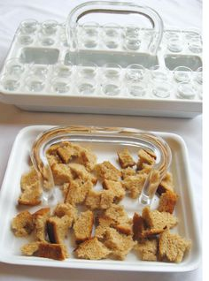
The Sacrament Ordinance
The passing of the sacrament should be natural and unobtrusive, not rigid or overly formal. Those who pass the sacrament should not be required to assume any special posture or action, such as holding the left hand behind the back. The process of passing the sacrament should not call attention to itself or detract from the purpose of the ordinance.
Priesthood holders should wash their hands thoroughly with soap, a disposable towelette, or another cleanser before preparing, blessing, or passing the sacrament.
A priesthood holder who has committed a serious transgression should not prepare, bless, or pass the sacrament until he has repented and resolved the matter with his bishop.
(11)

Slide 19
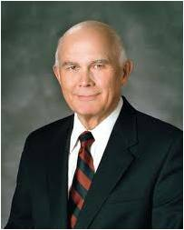
Priesthood holders must be worthy to officiate in priesthood ordinances.
“If someone officiating in this sacred ordinance [the sacrament] is unworthy to participate, and this is known to anyone present, their participation is a serious distraction to that person. Young men, if any of you is unworthy, talk to your bishop without delay. Obtain his direction on what you should do to qualify yourself to participate in your priesthood duties worthily and appropriately.”
(12)

Slide 20
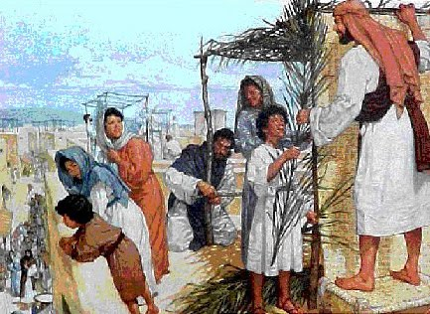
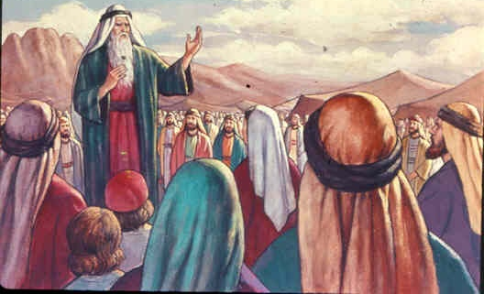
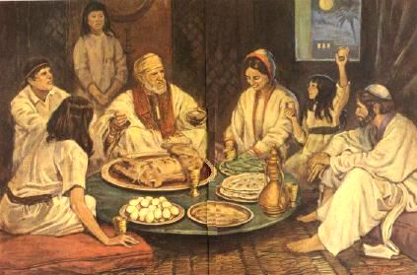
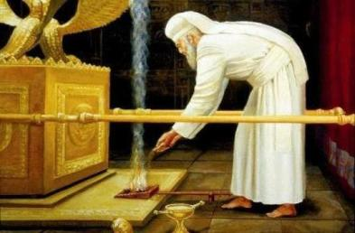
Feasts And Rituals
The feasts and festivals were given by revelation to lift the spirit as well as rest the body. Like all other parts of the Mosaic law, the feasts and festivals also pointed to Christ.
The Sabbath | The Passover and Feast of Unleavened Bread (Pesach) | Feast of Weeks (Pentecost, NT) Shavuot | Day of Atonement | Feast of Tabernacles—or Feast of Booth- or Ingathering
Leviticus 23

Slide 21
An Eye For An Eye
This misunderstanding is unfortunate because it makes the law appear cold, unbending, and revengeful. This misconception has resulted from a failure to distinguish between the social law and the criminal law.
The social law was based on love and concern for one’s neighbor.
The criminal law was not outside that love, but was made to stress absolute justice.
Even then, however, three things must be noted about this eye-for-an-eye application:
“An Eye for an Eye leaves everyone blind.” Mahatma Gandhi
“First, it was intended to be a law of exact justice, not of revenge.
Secondly, it was not private vengeance, but public justice.
Thirdly, by excluding murder from the crimes for which ransom is permissible (Nu. 35:31f.) it makes it probable that compensation for injuries was often or usually allowed to take the form of a fine.”
Leviticus 24:20
(15)

Slide 22
The Sabbatical and Jubilee Year
The Israelite was told that once in every seven years he was to trust wholly in God rather than in the fruits of his own labor for sustenance.
The land, too, was to have its sabbath rest, and no plowing, sowing, reaping, or harvesting was to take place.
Once each fifty years the land would have a double rest.
The seventh sabbatical year (the forty-ninth year) was to be followed by a jubilee year.
God had delivered Israel from the bondage of Egypt, forgiven their numerous debts to Him, and given them an inheritance in the land of promise.
Slaves or servants were to be freed, the land returned to its original owner, and debts forgiven.
Leviticus 25
(14)

Slide 23
Blessings and Cursings
If we obey the Lord, we will be blessed both temporally and spiritually
Obedient
Disobedient
It would rain and they would have an increase in crops
There would be peace in the land—no wars
They would be able to bear children and increase in their posterity
They would have the ordinances of the Tabernacle available to them
They would have the Lord to ’walk’ with them
They would have hunger, sorrow, war, disease, exile, tragedy and abandonment
Their enemies would fight with them—loss of life
Their sins would be punished 7 time more
They would have 7 times more plagues
They would have the loss of the Lord in their life’s
Leviticus 26

Slide 24
Singular Vow and the Tithe
The Lord gave instructions about properties that are consecrated to Him. You may want to suggest that students mark. Also contains the Lord’s instructions to Israel about tithing.
Special vows were a part of the Mosaic law. In that day it was possible for a man or woman to dedicate a person to the Lord,
The Lord was saying that when a man made such a vow, the persons involved had to be reckoned as the Lord’s and could not be taken by another.
A person could also vow (that is, dedicate to the Lord) his personal property. These laws governed the making of such vows.
Leviticus 27

Slide 25
“The purpose of the Mosaic Law was to balance the scales of justice with the victim, not the state.”
(16)

Slide 26
Sources:
Suggested Hymn: #131 More Holiness Give Me
Video: Opportunities to do Good (4:01)
Sister Elaine S. Dalton “Now Is the Time to Arise and Shine!” Ensign or Liahona, May 2012, 124)
(Clarke, Bible Commentary, 1:575.) Found in Old Testament Institute Manual
Keyway.ca Daily Bible Study by Wayne Blank
Paul Roe Britishink Tattoos
President Gordon B. Hinckley The Body is Sacred November 2006 Ensign
Your Greatest Challenge, Mother October 2000 Gen. Conf.
6. Who’s Who in the Old Testament by Ed J. Pinegar and Richard J. Allen pg. 130-131
7. Wilson, Old Testament Word Studies, s.v. “enchantment,” p. 144 Found in Old Testament Institute Manual
8. Hastings, Dictionary of the Bible, s.v. “magic, divination, and sorcery,” pp. 566–70.
9. Robert J. Matthews Searching the Scriptures: What the Scriptures Say about Astrology, Divination, Spirit Mediums, Magic, Wizardry, and Necromancy March 1974 Ensign
10. Handbook 2 (Priesthood) 8.1.3
11. Handbook 2 20.4.1
12. Elder Dallin H. Oaks (“The Aaronic Priesthood and the Sacrament,” Ensign, Nov. 1998, 40).
13. Elder Bruce R. McConkie, The Promised Messiah, pp. 394–96; see also Reading 11-8 for extensive commentary on the Sabbath.
14. Old Testament Institute Manual
15. (Guthrie and Motyer, Bible Commentary: Revised, p. 164.) Found in Old Testament Institute Manual
16. The Third Thousand Years by W. Cleon Skousen pg. 354
You tube https://www.youtube.com/watch?v=75tq1Qwku_A We are Brothers
Presentation by ©http://fashionsbylynda.com/blog/

Slide 27
The Book of Leviticus
Bible Dictionary
Chapters 1-7 | Chapters 8-10 | Chapter 11 | Chapters 12 | Chapters 13-15 | Chapter 16 | Chapter 17-26 | Chapter 27
Explains the sacrificial ordinances—the offerings | Describes the ritual observed in the consecration of priests | Explains what may or may not be eaten and what is clean or unclean | Discusses women after childbirth | Are laws relating to ceremonial uncleanness | Contains the ritual to be observed on the Day of Atonement | Contains a code of laws dealing with religious and social observances | Explains that the Lord commanded Israel to consecrate their crops, flocks, and herds to the Lord
Leviticus 19 | Leviticus 20 | Leviticus 21-22 | Leviticus 23-24 | Leviticus 25-26 | Leviticus 27
Laws of Social Order | Penalty Laws | Laws for Priesthood | Laws for Worship | Laws in the Land | Vows and Consecration
Live righteously and obey commandments Sundry laws Evil practices are forbidden | For worshipping: Molech Consulting spirit Cursing, sexual sins Sanctification of People | Laws for the Priesthood | Feasts Weekly Sabbath Yearly Feasts Elements of Worship | The Land of Canaan Sabbath Year Year of Jubilee Conditions and Results of Obedience and Disobedience Promise of the Restoration | Consecration of persons, animals, houses, fields

Slide 28
The Hair: Leviticus 19:27; 21:5
Herodotus observes that the Arabs shave or cut their hair round, in honour of Bacchus [the god of wine] who, they say, had his hair cut in this way. … He says also that the Macians, a people of Libya, cut their hair round, so as to leave a tuft on the top of the head. … In this manner the Chinese cut their hair to the present day. This might have been in honour of some idol, and therefore forbidden to the Israelites.
“The hair was much used in divination among the ancients, and for purposes of religious superstition among the Greeks; and particularly about the time of the giving of this law, as this is supposed to have been the era of the Trojan war. We learn from Homer that it was customary for parents to dedicate the hair of their children to some god; which, when they came to manhood, they cut off and consecrated to the deity. Achilles, at the funeral of Patroclus, cut off his golden locks which his father had dedicated to the river god Sperchius, and threw them into the flood. …
“If the hair was rounded, and dedicated for purposes of this kind, it will at once account for the prohibition in this verse.” (Clarke, Bible Commentary, 1:575.)
Your body is sacred. Respect it and do not defile it in any way. Through your dress and appearance, you can show that you know how precious your body is. You can show that you are a disciple of Jesus Christ and that you love Him.
Prophets of God have continually counseled His children to dress modestly. When you are well groomed and modestly dressed, you invite the companionship of the Spirit and you can be a good influence on others. Your dress and grooming influence the way you and others act.
Never lower your standards of dress. Do not use a special occasion as an excuse to be immodest. When you dress immodestly, you send a message that is contrary to your identity as a son or daughter of God. You also send the message that you are using your body to get attention and approval.
Immodest clothing is any clothing that is tight, sheer, or revealing in any other manner. Young women should avoid short shorts and short skirts, shirts that do not cover the stomach, and clothing that does not cover the shoulders or is low-cut in the front or the back. Young men should also maintain modesty in their appearance. Young men and young women should be neat and clean and avoid being extreme or inappropriately casual in clothing, hairstyle, and behavior. They should choose appropriately modest apparel when participating in sports. The fashions of the world will change, but the Lord’s standards will not change.
Do not disfigure yourself with tattoos or body piercings. Young women, if you desire to have your ears pierced, wear only one pair of earrings.
Show respect for the Lord and yourself by dressing appropriately for Church meetings and activities. This is especially important when attending sacrament services. Young men should dress with dignity when officiating in the ordinance of the sacrament.
If you are not sure what is appropriate to wear, study the words of the prophets, pray for guidance, and ask your parents or leaders for help. Your dress and appearance now will help you prepare for the time when you will go to the temple to make sacred covenants with God. Ask yourself, “Would I feel comfortable with my appearance if I were in the Lord’s presence?” For the Strength of the Youth Pamphlet pp. 6-7
As the Canaanites and the Israelites began to live in closer contact with each other, the faith of Israel tended to absorb some of the concepts and practices of the Canaanite religion. Some Israelites began to name their children after the Baalim; even one of the judges, Gideon, was also known by the name Jerubbaal ("Let Baal Contend").
Adam Clarke---His quotes are used in the Old Testament Institute Manual—
Born: 1760-1762 (Ireland) and died Aug. 28, 1832. He was a British Methodist theologian of the Bible scholar.
Cutting or marking of skin:
“Most of the barbarous nations lately discovered have their faces, arms, breasts, &c., curiously carved or tatooed, probably for superstitious purposes. Ancient writers abound with accounts of marks made on the face, arms, &c., in honour of different idols; and to this the inspired penman alludes [Revelation 13:16–17; 14:9, 11; 15:2; 16:2; 19:20; 20:4], where false worshippers are represented as receiving in their hands and in their forehead the marks of the beast.”
(Clarke, Bible Commentary, 1:575.)

Slide 29
Jubilee:
“On the close of the great Day of Atonement, when the Hebrews realised that they had peace of mind, that their heavenly Father had annulled their sins, and that they had become re-united to Him through His forgiving mercy, every Israelite was called upon to proclaim throughout the land, by nine blasts of the cornet, that he too had given the soil rest, that he had freed every encumbered family estate, and that he had given liberty to every slave, who was now to rejoin his kindred. Inasmuch as God has forgiven his debts, he also is to forgive his debtors.” C. D. Ginsburg (In Rushdoony, Institutes of Biblical Law, p. 141.)
Something of Interest
Forms of Divination:
Divination is the act of receiving information from higher sources (meaning the supernatural)
ASTROLOGY is divination using celestial bodies: the sun, moon, planets, and stars. Despite the fact that there seems to be some validity to the things our horoscope and zodiac signs reveal, that doesn't change the fact that Astrology is of the occult. The Bible speaks disparagingly of astrologers as "star gazers.“
BIBLIOMANCY (also known as Bible Roulette) is the act of allowing a Bible to fall open to a random page in hopes of getting a message from God, Jesus, or the Holy Spirit. Many Christians find it difficult to believe that this is a form of divination, and therefore invites demonic spirits.
CARTOMANCY is fortune telling using cards such as the Tarot. Tarot cards are one of the most popular forms of divination. Telling fortunes with playing cards, like reading the Tarot, invites demonic spirits into the lives of the person telling the fortune and the person whose fortune is told.
PRECOGNITION is an inner knowledge or sense of future events. Clairaudience (clear hearing) and Clairvoyance (clear seeing) are two forms of E.S.P.
CRYSTALLOMANCY is divination through crystal gazing, such as gazing into a crystal ball. This is among the oldest and widespread forms of divination.
DOWSING or DIVINING RODS are methods of divination where a forked stick is used to locate water or precious minerals. MAP DOUSING is done through the use of a pendulum held above a map.
NUMEROLOGY is the numerical interpretation of numbers, dates, and the number value of letters. Although this may seem innocent enough, it is still a form of divination.
OCULOMANCY is divination from a person's eye.
PALMISTRY involves the interpretation of the lines and structure of the hand. There are those that say palmistry can accurately predict events in a person's life such as lifespan, marriage, and the number of children the person will have. But accurate or not, this is divination.
PSYCHOMETRY is a form of E.S.P. in which a psychic obtains information about another person through paranormal means by holding an object belonging to that person.
SCIOMANCY is divination using a spirit guide. This is a method generally reserved for channelers. no matter how they choose to represent themselves, have the ability to see a certain distance into the future -- in part, based on Probabilities.
SCRYING is a term for divination using a crystal, mirrors, bowls of water, ink, or flames to induce visions. This method of divination is similar to crystalomancy.
TASSEOGRAPHY is the reading of tea leaves in the bottom of the tea cup once the tea has been drunk. Stacie Spielman Divination and Demonic Spirits
Reviewing Our Own Lives: Leviticus 26:
The Statutes and Judgements of the Lord
“Would this be a good time to deeply concern ourselves with these matters? Is this a time when we should return to our homes, our families, our children? Is this the time we should remember our tithes and our offerings, a time when we should desist from our abortions, our divorces, our Sabbath breaking, our eagerness to make the holy day a holiday?
“Is this a time to repent of our sins, our immoralities, our doctrines of devils?
“Is this a time for all of us to make holy our marriages, live in joy and happiness, rear our families in righteousness?
“Certainly many of us know better than we do. Is this a time to terminate adultery and homosexual and lesbian activities, and return to faith and worthiness? Is this a time to end our heedless pornographies?
“Is this the time to set our face firmly against unholy and profane things, and whoredoms, irregularities, and related matters?
“Is this the time to enter new life?” (Spencer W. Kimball, “The Lord Expects His People to Follow the Commandments,” Ensign, May 1977, pp. 4–6.)

Slide 30
“What should our attitude be regarding zodiac signs, astrology, and horoscopes?”
By A. Burt Horsley
Basically our attitude should be the same as it is about fortune-telling, reading tea leaves, crystal ball gazing, or palm reading. To put it bluntly, any trust in such things is sheer superstition.
Historically there has developed a problem of discrimination that centers around the failure of otherwise straight-thinking people to distinguish between astronomy as a bona fide science and astrology, which is a counterfeit or pseudoscience. This is more complicated by the fact that the science may have grown out of the superstition. That is to say, belief in the theory that stars influence human affairs could have been the motivation for serious study of the heavenly bodies by those who eventually developed a basis for the ancient knowledge of astronomy.
By the time of the Middle Ages, astrology and astronomy were often regarded as one and the same and were closely associated with alchemy, magic, and other occult practices. Since the time of Copernicus in the sixteenth century, however, the two have diverged, and up until a decade ago it appeared that modern science had all but destroyed the influence of astrology. In recent years, much to the dismay of scientists and rational theologians alike, there has been a great revival of the fraud, consistent with the general irrationality of our times.
The astrologer, by using a chart of the zodiac and referring to the sign in the ascendant at the time of one’s birth, plots a map of the heavens. This is a horoscope and is supposed to determine one’s temperament, liability to accident, fortune, success, calamity, even susceptibility to disease.
Our reason tells us that God, who recognized the free will of man as basic to his nature and gave him freedom of agency to manifest it, would not have left man’s destiny bound up and governed by the relationships and movements of astronomical bodies. There is no reasonable way of establishing any direct cause and effect relationship between the character and personality of human beings and astronomical phenomena except as we may react to climate or our physical environment in general.
The people of several great nations of antiquity believed in and perpetuated this myth for centuries, giving it more dignity than it deserved. Even the Magian priests of the Zoroastrian religion who came to Palestine from Persia at the time of the birth of Jesus to observe from that ideal vantage point the precalculated appearance of an unusual star believed in astrology. Nevertheless, scripture does not affirm the truth of such a notion; it merely reports that this was their belief. In fact, the Judeo-Christian tradition has, from ancient times to the present, repudiated such things.
Moses was inspired to instruct his people with reference to the will of the Lord in such matters as follows:
“There shall not be found among you any one that maketh his son or his daughter to pass through the fire, or that useth divination, or an observer of times, or an enchanter, or witch,
“Or a charmer, or a consulter with familiar spirits, or a wizard, or a necromancer.
“For all that do these things are an abomination unto the Lord. …” (Deut. 18:10–12.)
In similar manner the prophet Isaiah scorned these practices in his own day when he announced that astrologers, stargazers, and monthly prognosticators should not be able to “deliver themselves from the power of the flame.” (Isa. 47:13–14.)
The batting average of so-called astrologers, fortune-tellers, soothsayers, and others of their ilk is no better than the law of averages would allow anyway. Daniel and his companions had a much better record to show by relying on the influence of the Spirit of the Lord in their lives.
“And in all matters of wisdom and understanding, that the king inquired of them, he found them ten times better than all the magicians and astrologers that were in all his realm.” (Dan. 1:20.)
It is also interesting to note that astrologers are referred to as unreliable in other places in scripture, including at least three places in the Book of Daniel alone.
We need to have our attitudes rationally as well as spiritually grounded and not be influenced and sustained by superstition and myth.
Teacher Development Director, Provo Stake Fifth Ward; Professor of Philosophy and Religion Brigham Young University.
Question and Answers April 1972 Ensign

Slide 31
Feasts and Rituals
Leviticus 23:1-3 | Leviticus 23:4-14 | Leviticus 23:15-23 | Leviticus 23:26-32 | Leviticus 23:33-44
The Sabbath | The Passover and Feast of Unleavened Bread (Pesach) | Feast of Weeks (Pentecost, NT) Shavuot | Day of Atonement | Feast of Tabernacles—or Feast of Booth- or Ingathering
Weekly-- to Remember and Renew | Late march or early April—corresponding to Easter To Remember their days in bondage and their deliverance | Followed Passover 7 weeks later in May— Reconciliation with God | September or early October—Atonement for sins the People | Followed Day of Atonement 5 day later--fifteenth day of Tishri A full harvest
Mankind was permitted one day in seven to rest, renew, and remember. On the Sabbath he was to remember three important events: That the Creation was an act of the Lord Jesus Christ for the advancement of mankind; That the release of Israel from Egyptian bondage was accomplished through the power of Jehovah That the resurrection of Christ would bring the promise of immortality for all mankind. (13) | The festival began on the fifteenth day of Nisan (the latter part of March) and continued for seven days. The main part of the celebration was the eating of the paschal, or Passover, meal of bitter herbs, unleavened bread, and roasted lamb. The lamb was slain the evening before the celebration began, and the father of each household sprinkled its blood on the door posts and lintel of the home. Strict rules governed the preparation and eating of the paschal meal. The lamb was to be roasted whole, care being taken not to break any of its bones. The members of the family stood and ate hastily. Any portions of the lamb remaining from the meal were to be burned. | Pentecost—Greek--meaning “the fiftieth day.” The festival, one day in length, came seven weeks, or forty-nine days, after Passover. It marked the beginning of the harvest of the new wheat. The offerings placed upon the great altar on that day included sheaves of wheat and signified to all present that while man plows the ground, sows the seed, and reaps the harvest. Two lambs, a young bull, and two rams were offered as sin and peace offerings, and burned on the altar of sacrifice. These sacrifices indicated that the purpose of the feast was for Israel to gain a remission of sins and obtain a reconciliation with God | All manual labor stopped, and there was no feasting or frolicking. On one day each year—the tenth day of the seventh month—Israel’s high priest of the Levitical order, the one who sat in Aaron’s seat, was privileged to enter the Holy of Holies in the house of the Lord, to enter as it were the presence of Jehovah, Priest cleansed himself, and for the people. Sacrificial animals were slain and blood sprinkled on the mercy seat and before the altar, incense was burned and ordinances carried out. Two goats were selected, lots were cast, and the name of Jehovah was placed upon one goat; the other was called Azazel, the scapegoat and let into the wilderness. | Began and ended on a Sabbath and so was eight days in length. The people erected temporary huts or booths (Succoth) made from the boughs of trees. They stayed in these huts for the duration of the feast. This requirement reminded the people of the goodness of the Lord during their forty-year sojourn in the wilderness of Sinai and the blessing that was theirs to live permanently, if they were obedient, in the promised land. Sacrifices of bullocks, rams, lambs, and goats were offered by the priests for the nation as a whole than at all the other Israelite feasts combined. Their was a holy convocation, waving palm branches and shouting thanks to God.
(13, 14)

