Slide 1
Lesson 66
Lack of Faith VS Dare to Stand Alone
Numbers 13-14
Dare to be a Mormon;
Dare to stand alone.
Dare to have a purpose firm;
Dare to make it known.
--President Thomas S. Monson
Presentation by ©http://fashionsbylynda.com/blog/

Slide 2
Previously…
For the migration to Canaan, Israel was organized into four companies:
Company 1:
Judah
Issachar
Zebulun
The Levites—sons of Gerson and Merari
Company 3
Ephraim
Manasseh
Benjamin
v
Company 2:
Reuben
Simeon
Gad
Levites—sons of Kohath
Company 4
Dan
Asher
Naphtali
Numbers 10:14-16, 21-24

Slide 3
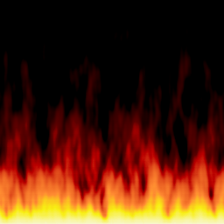
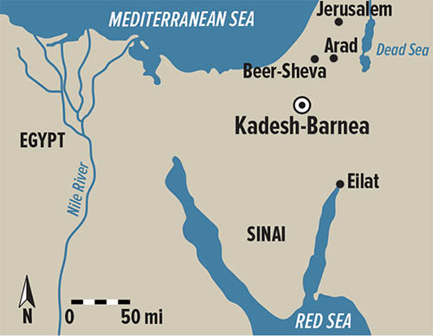
Fire, Quail Plague, and Leprosy
Three days’ travel from Sinai was the first encampment at Taberah, where fiery judgment consumed those who were complainers.
Next, they came to Kibroth-hattaavah, where quail was again provided; but many were smitten with a plague because of their lustfulness. Seventy of the “elders” of the people were endowed to assist Moses in directing the people.
v
The nation removed to Hazeroth, and Aaron and Miriam slandered their brother Moses and were judged accordingly.
Finally, they arrived in the wilderness of Paran, in the area of Kadesh-barnea, near the borders of the land of Canaan.
Wilderness of Paran
(1)

Slide 4
12 Spies
Reuben
Simeon
Judah
Issachar
Ephraim
Benjamin
Zebulun
Zaccur
Hori
Jephunneh
Joseph
Nun
Raphu
Sodi
Shammua
Shaphat
Caleb
Igal
Oshea
(Jehoshua)
Palti
Gaddiel
Manasseh
Dan
Asher
Naphtali
Gad
Susi
Gemalli
Michael
Vophsi
Machi
Moses selected one member from each of the 12 tribes to carry out an important task
Gaddi
Ammiel
Sethur
Nahbi
Geuel
Numbers 11:1-16

Slide 5
The Survey
SURVEY—The Land
SURVEY—The City
Yes
No
Yes
No
Is it green with rich dirt?
Is there a city?
Is there water?
If there is a city, is it large?
Is there food?
Is there a wall around the city?
Is there fruit growing?
Do the people live in tents?
Is there fruit?
Do they live in strongholds?
Are there trees?
Who is in the city?
Is it good wood?
Could we overtake the inhabitants?
Numbers 11:17-20
(1)

Slide 6
The Report
After 40 days
SURVEY—The Land
SURVEY—The City
Yes
No
Yes
No
Is it green with rich dirt?
Is there a city?
Is there water?
If there is a city, is it large?
Is there food?
Is there a wall around the city?
Is there fruit growing?
Do the people live in tents?
Are there trees?
Do they live in strongholds?
Who is in the city?
Is it good wood?
Children of Anak--Giants
Could we overtake the inhabitants?
And…..The Amalekites dwell in the land of the south: and the Hittites, and the Jebusites, and the Amorites, dwell in the mountains: and the Canaanites dwell by the sea, and by the coast of Jordan.
Numbers 11:21-33
(1)

Slide 7
10 VS 2
“The people are stronger and huge…”giants”
The city is fortified.”
“The land is good.
We can overcome them.
The Lord is with us.”
Israel tragically listened to the bad report and acted on it by murmuring against Moses and Aaron
They openly rejected the numerous evidences of God’s power that had been almost daily fare and began to cry out that it would have been better for them never to have left Egypt.
Numbers 11:21-33
(2)

Slide 8
Movement to Return to Egypt
A movement was started to reject Moses and choose a leader that would take them back to Egypt
And refused to obey, neither were mindful of thy wonders that thou didst among them; but hardened their necks, and in their rebellion appointed a captain to return to their bondage: but thou art a God ready to pardon, gracious and merciful, slow to anger, and of great kindness, and forsookest them not. Nehemiah 9:17
Numbers 14:4
(2)

Slide 9
The Lord is With Us
Only Caleb, the representative of the tribe of Judah, and Joshua, the representative of the tribe of Ephraim, expressed faith that, with God’s assistance, Israel could conquer the land.
But when Joshua and Caleb tried to counteract the effect of the negative report, the congregation sought to have them stoned
If we know the Lord is with us, we can overcome fear and more courageously stand for righteousness
Numbers 14:9
(1)

Slide 10
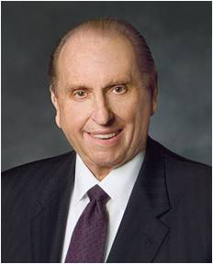
“We may at times find ourselves surrounded by others and yet standing in the minority or even standing alone concerning what is acceptable and what is not.
Do we have the moral courage to stand firm for our beliefs, even if by so doing we must stand alone? …
“… May we ever be courageous and prepared to stand for what we believe, and if we must stand alone in the process, may we do so courageously, strengthened by the knowledge that in reality we are never alone when we stand with our Father in Heaven.”
(3)

Slide 11
Consequences for Rebellion
Because of their rebellion the Lord would have destroyed the Israelites, but through the pleadings of Moses the Lord granted their request to die in the wilderness:
They were cursed to live in the desert of Kadesh one year for each day the spies were in the land of Canaan, or 40 years.
Only their small children would be alive to obtain the Promised Land
However: Because of the faithfulness of Caleb and Joshua, them and their tribes would reach the Promised Land.
Numbers 14:28
(3)

Slide 12
Attempt An Attack
Like immature children who missed the whole point of parental punishment Israel suddenly decided they would go up against the Canaanites in the southern regions of the land, with the hope they might yet occupy the covenant place of their inheritance. Moses refused to lead them and they were defeated. (2,3)
“Then the Amalekites came down, and the Canaanites which dwelt in that hill, and smote them, and discomfited them.”
Israel had lost three things because they did not would not follow the Lord:
The right to go and obtain their inheritance (the land) having to live in the desert another 38 years
The loss of many—those who went to fight
And the Lord was not with them
Numbers 14:40-45

Slide 13
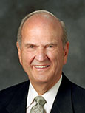
“[You] will encounter people who pick which commandments they will keep and ignore others that they choose to break. I call this the cafeteria approach to obedience. This practice of picking and choosing will not work. It will lead to misery. To prepare to meet God, one keeps all of His commandments. It takes faith to obey them, and keeping His commandments will strengthen that faith.” (4)
To receive all of the Lord’s blessings, we must choose to follow Him fully

Slide 14
Sources:
Suggested Song: Dare to Do Right #158 Children’s Songbook
Video: Dare to Stand Alone
Edward J. Brandt Journeys and Events in the Life of Moses Oct. 1973 Ensign
Old Testament Institute Manual
President Thomas S. Monson (“Dare to Stand Alone,” Ensign or Liahona, Nov. 2011, 60, 67).
Elder Russell M. Nelson (“Face the Future with Faith,” Ensign or Liahona, May 2011, 34).
Presentation by ©http://fashionsbylynda.com/blog/

Slide 15
The Book of Numbers
Bible Dictionary
Chapters 1-12 | Chapters 13-20 | Chapter 21-36
Old Generation Organization and Preparation to leave Mt. Sinai | Transition to Kadesh-barnea—drawing back in unbelief—brings God’s discipline Wilderness | New Generation Move to Plains of Moab—east of Promised Land Reorganization of Israel Regulations (offerings and Vows) Conquest and Division of Israel
Numbers 13 | Numbers 14
Investigation of Promised Land | Israel’s Judgment
12 spies 10 “evil reports” The strength of the inhabitants | Joshua (Oshea) and Caleb gives good report of Canaan Israel murmurs Israel’s judgment is to remain in wilderness and only the little children will see the Promised Land Some of Israel try to defeat the Amalekites, to no avail.

Slide 16
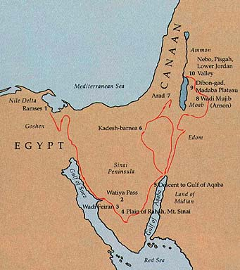
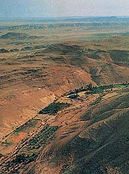
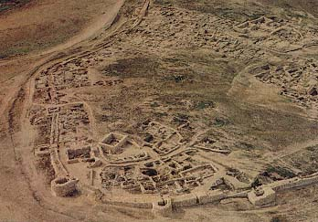
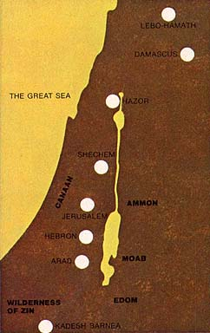
Ancient Arad (restored)
March 1990 Ensign Exodus: Israel’s Wanderings in the Wilderness
Arad offered the most direct route to Canaan.
Passing through the wilderness of Zin, they fought the Amalekites and Canaanites at Hormah and Arad and were soundly beaten.
Nearly forty years later, they defeated the king of Arad but still had to return to the Red Sea and approach Canaan east of the Salt Sea
Called Kadesh or Kadesh-barnea, it became Israel’s base camp.
Near Kadesh, Moses also smote the rock so that water would spring forth.
Miriam died at Kadesh (Num. 20:1)
Lack of Faith and Rebellion:
For the next thirty-eight years they were to wander in the harsh wilderness of Sinai. During that time they could have conquered the inhabitants of the land of promise, built cities, eaten the fruit of the land flowing “with milk and honey” (Numbers 13:27), and raised their children in comfort and peace. But they would not, and so all above the age of twenty who had repudiated the power of the Lord, except Joshua and Caleb, were to die in the wilderness.
Caleb’s faithfulness:
“From Caleb’s example we learn very important lessons. Just as Caleb had to struggle and remain true and faithful to gain his inheritance, so we must remember that, while the Lord has promised us a place in his kingdom, we must ever strive constantly and faithfully so as to be worthy to receive the reward” President Spencer W. Kimball(“Give Me This Mountain,” Ensign, Nov. 1979, 79).

Slide 17
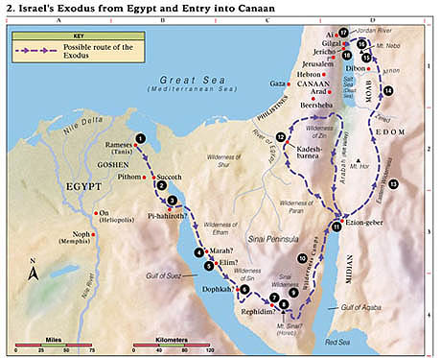
1. Rameses Israel was thrust out of Egypt (Ex. 12; Num. 33:5).
2. Succoth After the Hebrews left this first campsite, the Lord attended them in a cloud by day and in a pillar of fire by night (Ex. 13:20–22).
3. Pi-hahiroth Israel passed through the Red Sea (Ex. 14; Num. 33:8).
4. Marah The Lord healed the waters of Marah (Ex. 15:23–26)
Elim Israel camped by 12 springs (Ex. 15:27).
5. Wilderness of Sin The Lord sent manna and quail to feed Israel (Ex. 16).
6. Rephidim Israel fought with Amalek (Ex. 17:8–16).
7. Mount Sinai (Mount Horeb or Jebel Musa) The Lord revealed the Ten Commandments (Ex. 19–20).
8. Sinai Wilderness Israel constructed the tabernacle (Ex. 25–30).
9. Wilderness Camps Seventy elders were called to help Moses govern the people (Num. 11:16–17).
10. Ezion-geber Israel passed through the lands of Esau and Ammon in peace (Deut. 2).
11. Kadesh-barnea Moses sent spies into the promised land; Israel rebelled and failed to enter the land; Kadesh served as the main camp of Israel for many years (Num. 13:1–3, 17–33; 14;32:8; Deut. 2:14).
12. Eastern Wilderness Israel avoided conflict with Edom and Moab (Num. 20:14–21; 22–24).
13. Arnon River Israel destroyed the Amorites who fought against them (Deut. 2:24–37).
14. Mount Nebo Moses viewed the promised land (Deut. 34:1–4). Moses delivered his last three sermons (Deut. 1–32).
15. Plains of Moab The Lord told Israel to divide the land and dispossess the inhabitants (Num. 33:50–56).
16. Jordan River Israel crossed the Jordan River on dry ground. Near Gilgal, stones from the bottom of the Jordan River were placed as a monument of Jordan’s waters being divided (Josh. 3:1–5:1).
17. Jericho The children of Israel captured and destroyed the city (Josh. 6).

