Slide 1
Lesson 70
The Restoration Part 4
Moreover, thou son of man, take thee one stick, and write upon it, For Judah, and for the children of Israel his companions: then take another stick, and write upon it, For Joseph, the stick of Ephraim, and for all the house of Israel his companions:
And join them one to another into one stick; and they shall become one in thine hand.
Ezekiel 37:16-17
Presentation by ©http://fashionsbylynda.com/blog/

Slide 2
Acquiring Spiritual Knowledge
Act in faith
Examine concepts and questions with an eternal perspective
Seek further understanding through divinely appointed sources.

Slide 3
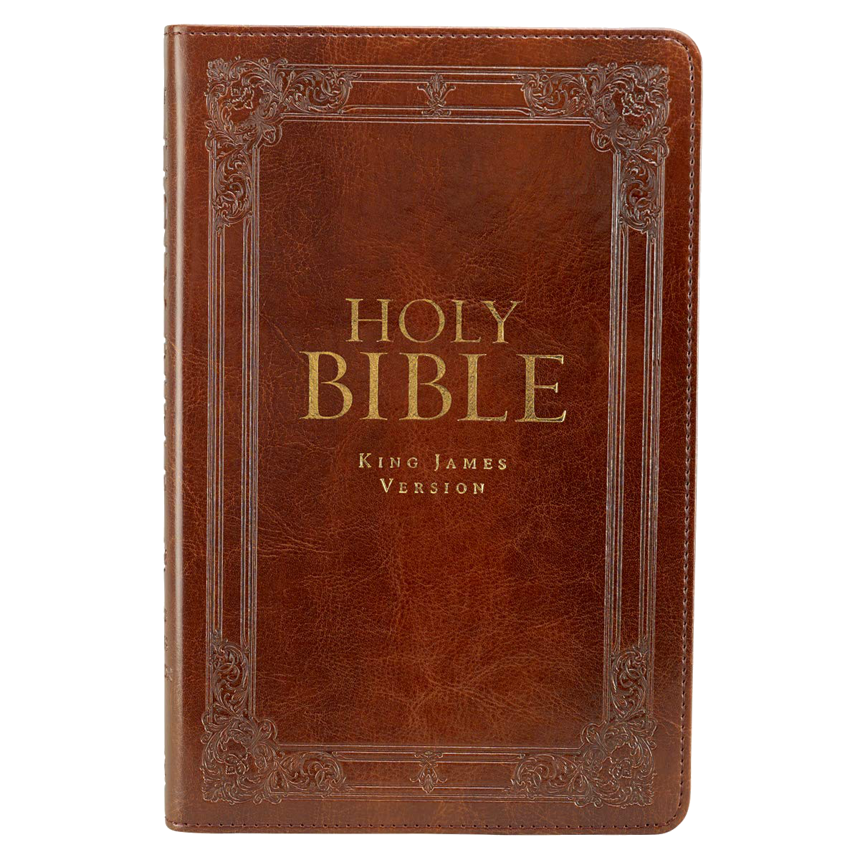
Scenario
Megan is a member of The Church of Jesus Christ of Latter-day Saints.
Rachel, a Christian of another faith, and Megan have been friends for a long time.
They talk about a variety of topics, including religion.
One day while they are riding on the bus, Rachel says to Megan, “Help me understand something.
Like you, I believe the Bible to be the word of God.
Why would we need the Book of Mormon if we already have the Bible?”

Slide 4
How could having a testimony of the Book of Mormon help Megan to act in faith as she responds to Rachel’s concern?
What views or assumptions might have led Rachel to ask this question?
What gospel teachings might Megan use that could relate to Rachel’s question?
What gospel teachings might Megan use that could relate to Rachel’s question?
What doctrinal mastery passage in the Bible could Megan use to help answer Rachel’s question?
What are some other divinely appointed sources Megan could use to help answer Rachel’s question?

Slide 5
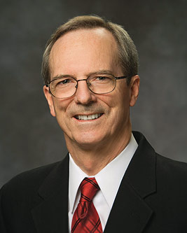
“Why is the Book of Mormon so essential if we already have the Bible to teach us about Jesus Christ?
Have you ever wondered why there are so many Christian churches in the world today when they obtain their doctrines from essentially the same Bible?
It is because they interpret the Bible differently. If they interpreted it the same, they would be the same church. This is not a condition the Lord desires, for the Apostle Paul declared that there is ‘one Lord, one faith, one baptism’ (Ephesians 4:5).
To help bring this oneness about, the Lord established a divine law of witnesses. Paul taught, ‘In the mouth of two or three witnesses shall every word be established’ (2 Corinthians 13:1).
(1)

Slide 6
“The Bible is one witness of Jesus Christ; the Book of Mormon is another.
Why is this second witness so crucial?
The following illustration may help: How many straight lines can you draw through a single point on a piece of paper?”
(1)

Slide 7
The answer is infinite.
BIBLE
For a moment, suppose that single point represents the Bible and that hundreds of those straight lines drawn through that point represent different interpretations of the Bible and that each of those interpretations represents a different church.
(1)

Slide 8
“What happens, however, if on that piece of paper there is a second point representing the Book of Mormon? How many straight lines could you draw between these two reference points: the Bible and the Book of Mormon?”
The
Book
of
Mormon
ANOTHER TESTAMENT
OF JESUS CHRIST
Only one.
Only one interpretation of Christ’s doctrines survives the testimony of these two witnesses.
(1)

Slide 9
“Again and again the Book of Mormon acts as a confirming, clarifying, unifying witness of the doctrines taught in the Bible so that there is only ‘one Lord, one faith, one baptism’
Holy Bible
The
Book
of
Mormon
ANOTHER TESTAMENT
OF JESUS CHRIST
One Lord, one faith, one baptism
Ezekiel 4:5
(1)

Slide 10
If Rachel is to learn for herself why we need the Book of Mormon, what would she need to do to act in faith?

Slide 11
Sources:
Suggested Hymn: Go Forth With Faith #263
Video: What is the Book of Mormon (Mormon Channel) (6:26)
1. Tad R. Callister “The Book of Mormon—A Book from God,” Ensign or Liahona, Nov. 2011, 75
Presentation by ©http://fashionsbylynda.com/blog/

