Slide 1
Lesson 71
Preparing Israel to Enter Into the Promised Land
Deuteronomy 1-13
Jesus said unto him, Thou shalt love the Lord thy God with all thy heart, and with all thy soul, and with all thy mind.
Matthew 22:37
Presentation by ©http://fashionsbylynda.com/blog/

Slide 2
Deuteronomy
Moses is the author of Deuteronomy.
He is known as “the great law-giver”.
5th book in Pentateuch
The book’s title means “second law” or “repetition of the law”
The book of Deuteronomy contains Moses’s final words to the children of Israel before they entered the land of Canaan with Joshua as their leader.
Genesis
Exodus
Leviticus
Deuteronomy
Numbers
One of the most notable features of the book of Deuteronomy is the frequency with which it is quoted in other scripture. Of the five books of Moses, Deuteronomy is the one most often quoted by the Old Testament prophets
Moses repeated to the Israelites many of the laws and commandments, exhorted them to remember and keep covenants and the consequences of either obeying or disobeying the Lord’s laws and commandments.
Moses was also a prototype of the Messiah, Jesus Christ
(1)

Slide 3
Moses’ Final Words
While Moses was camped on the east side of Jordan, in Moab, he summarized the Mosaic code in three final discourses he gave to Israel before leaving them
He did not give them new laws, but repeated what had already been given.
3
2
1
Deuteronomy 27-30
Renewal of Covenants and Warnings
Reviewed the Lord’s mercy and all that He had done for them
Deuteronomy 5-26
A review of the law including the Ten Commandments
Also explanation and enforcement of the laws
Deuteronomy 1:6-4: 40
The wanderings in the wilderness and the laws given at Sinai
(1)

Slide 4
Recollection
The Lord miraculously delivers the Israelites from Egypt
Israel rebels against the Lord by making and worshipping a golden calf
Israel hears the Lord declare the Ten Commandments from Mount Horeb (Sinai)
Israel is fed manna in the wilderness
Deuteronomy 4:34;
6:21–23;
7:17–19
Deuteronomy 8:3, 16
Deuteronomy 4:10-13, 33
5;4-22
Deuteronomy 9:11-12, 16, 21
Events are recorded also in Exodus and Numbers
Deuteronomy means “Repetition of the law”

Slide 5
Do Not Forget
Only take heed to thyself, and keep thy soul diligently, lest thou forget the things which thine eyes have seen, and lest they depart from thy heart all the days of thy life: but teach them thy sons, and thy sons’ sons;
If we are not diligent, then we may forget times when we have seen the Lord’s influence in our lives
Deuteronomy 4:9
(2)

Slide 6
Remembering
When have you seen the Lord’s influence in your life or in the life of someone you know?
How can always remembering this experience help you remain faithful to the Lord?

Slide 7
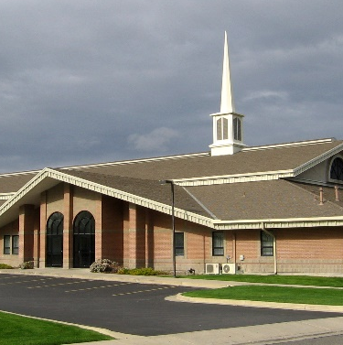
Limited Freedom?
Have you ever known someone who felt that the Lord’s commandments and standards limited their freedom or their ability to have fun?
Freedom for some may mean largely doing what they want to do without restraint and interference.
Misunderstanding the principle of freedom, we lead lives of limited capacity and, thus, diminished choice.
Freedom is not just freedom from—freedom from interference, restraint, responsibility—although there certainly are things we want to be free from. But the greatest freedom, the freedom of God, is the freedom to do.
“Ye shall know the truth, and the truth shall make you free.” (John 8:32.)
(4)

Slide 8
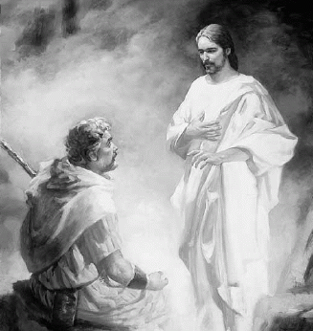
Christ in Deuteronomy
(First Great Commandment—Matthew 22:38)
Both Christ and Moses were in danger of death during childhood; both are saviors (Moses—deliverance of Israelites), both are rejected by their brethren.
I will raise them up a Prophet from among their brethren, like unto thee, and will put my words in his mouth; and he shall speak unto them all that I shall command him. Deut. 18:18
This is that Moses, which said unto the children of Israel, A prophet shall the Lord your God raise up unto you of your brethren, like unto me; him shall ye hear. Acts 7:37
Moses is the only biblical figure other than Christ to fill the three offices of Prophet, priest, and king (although Moses was not king, he functioned as ruler of Israel)
Deut. 34:10-12
Exodus 32:31-35/ D&C 84:6
Deut. 33:4-5
Deuteronomy 5:6-7
(3)

Slide 9
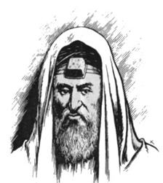
Teach Your Children
And thou shalt teach them diligently unto thy children, and shalt talk of them when thou sittest in thine house, and when thou walkest by the way, and when thou liest down, and when thou risest up.
A man wearing the traditional tefillin (or a phylactery).
Hebrew scriptures from the Shema are written on parchment that is rolled up and placed inside a mezuzah.
Deuteronomy 6:6-9

Slide 10
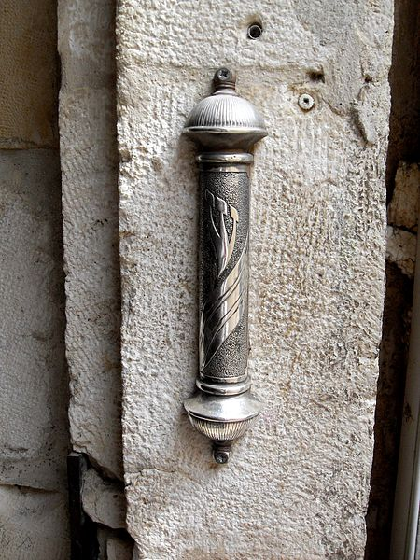
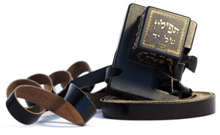
Shema, Mezuzah, and Tefillin
The Shema refers to several scripture passages, including Deuteronomy 6:4–9, that are recited daily by devout Jews.
Many Jews write these same passages on a small piece of parchment and place the parchment in a small container called a mezuzah (the Hebrew word for doorpost), which is then placed on the right side of the doorframe of their homes.
Tefillin are small, square leather boxes worn over the forehead and on the inside of the biceps of the non-dominant arm. These boxes contain pieces of parchment with scriptures from the Shema.
While we do not wear tefillin or place mezuzahs on the doorframes of our homes, what can we do to remind ourselves of the Lord’s commandments and to have them in our hearts?
Deuteronomy 6:4-9

Slide 11
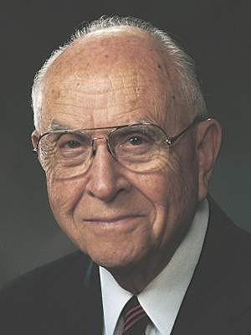
Commandments For Our Good
The commandments God gives us are always for our good
And the Lord commanded us to do all these statutes, to fear the Lord our God, for our good always, that he might preserve us alive, as it is at this day.
“Take advantage of this great opportunity in your life to live it well, to be good, to have good works, and to influence other people for good.” (5)
Deuteronomy 6:24

Slide 12
Those In Canaan
The Hittites, Hivites, and Jebusites were direct descendants of Canaan, son of Ham, and were therefore Canaanites.
The Girgashites, Amorites, and Perizites were inhabitants of Canaan. (Canaanite also refers to one who lived in the land of Canaan, irrespective of descent.)
Undoubtedly these groups had intermarried.
By the time Israel approached the promised land, these Canaanites had become an extremely wicked and idolatrous people.
When Abraham was told that his seed would inherit the land of Canaan, the Lord also told him that Israel would first be taken into captivity in Egypt because “the iniquity of the Amorites is not yet full” (Genesis 15:16).
Now, several hundred years later, that fulness of iniquity had come.
Deuteronomy 7:1-5

Slide 13
To Utterly Destroy
Certain acts are so evil and so destructive to the order of the society that the only just reparation is the death of the guilty parties (see Exodus 21:12–17).
Likewise, the kinds of evil of which the Canaanites were guilty were so infectious, so contaminating, that to have shown mercy and let them survive would have proven to be the spiritual downfall of Israel.
Nephi said of this people:
Behold, the Lord esteemeth all flesh in one; he that isrighteous is favored of God. But behold, this people had rejected every word of God, and they were ripe in iniquity; and the fulness of the wrath of God was upon them; and the Lord did curse the land against them, and bless it unto our fathers; yea, he did curse it against them unto their destruction, and he did bless it unto our fathers unto their obtaining power over it. (1 Nephi 17:35)
Deuteronomy 7:1-5; 9:5
(1)

Slide 14
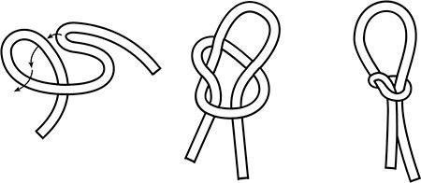
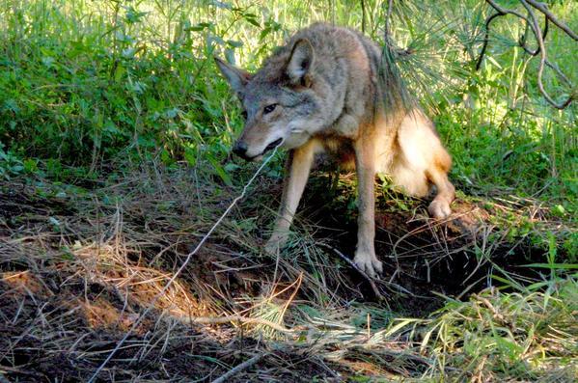
The Snare
A snare is created by making a noose out of rope or other line and positioning it so animals will be caught as they step into it.
Moses taught the Israelites what they must do to overcome snares, or sources of temptation that could lead to being trapped in sin, that existed in the promised land.
Deuteronomy 7

Slide 15
Trapped by the Adversary
Beckoned by something that entices us or ignoring consequences
“To prevail over the devil’s strategies and temptations, we are counseled to pray sincerely, to remember what we have been taught, and to “lay hold upon the word of God”.
Doing this, we can “divide asunder all the cunning and the snares and the wiles of the devil” and stay above “that everlasting gulf of misery which is prepared to engulf the wicked” (Hel. 3:29).
“Through the grace of God, the devil’s strategies to defeat us will fail as we commit to the Savior and follow His gospel.”
(6)

Slide 16
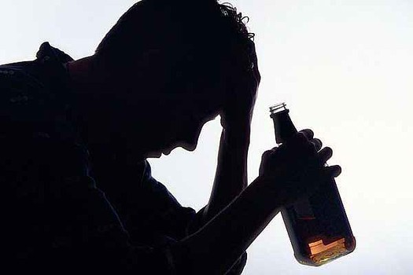
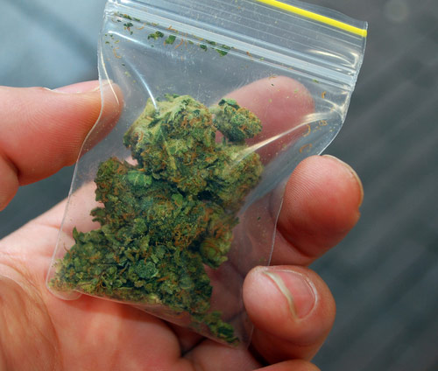
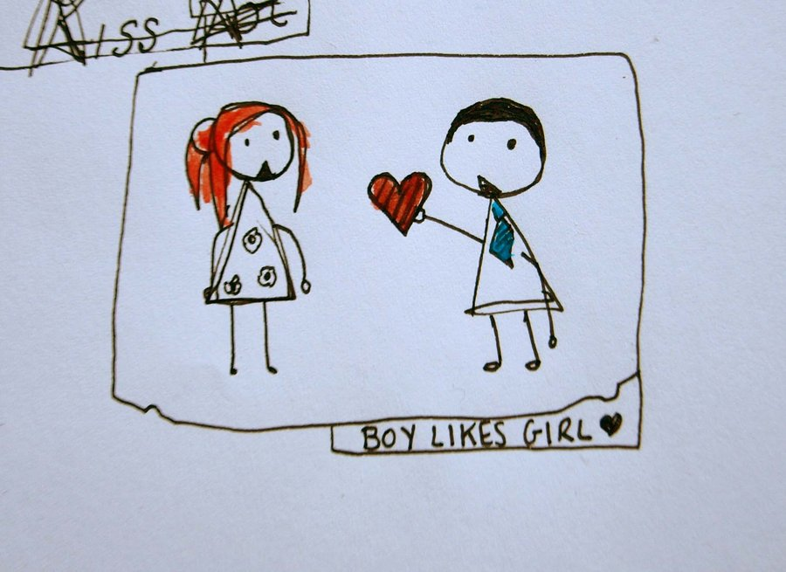
Snares of Today
We may turn away from our covenants.
What happens when we get caught in these snares?

Slide 17
A Holy People
Holy is to be set aside for sacred purposes.
The term holy people refers to those who are set aside or chosen to serve God in accomplishing His purposes for the salvation of His children.
To be the Lord’s people, we must remove and avoid influences that can lead us to sin
Although we may not be able to remove every source of temptation from our lives, the Lord will bless us as we seek to remove whatever evil we can from our immediate surroundings and develop self-discipline to avoid other influences that can lead us to sin.
Deuteronomy 7:6

Slide 18
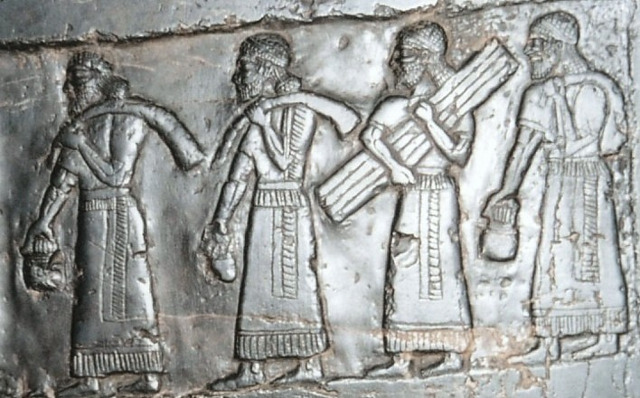
Thy Raiment Waxed Not Old
Raiment--Clothes
The words used by Moses affirm the idea that the clothes of the Israelites did not wear out because God gave them a miraculous durability.
Some early rabbis and Christian theologians interpreted this passage to mean that the clothes of the younger generation grew upon their backs like the shells of snails.
Israel did, however, have limited means for producing some items of clothing.
The clothing of the people in Biblical times was made from wool, linen, animal skins, and perhaps silk. Wikiwand
Deuteronomy 8:4
(1)

Slide 19
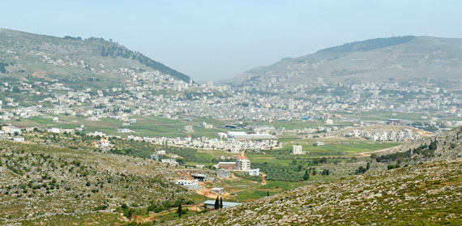
Mount Ebal and Mount Gerizim
Symbolism of Blessing and A Cursing
Moses selected two of the most prominent hills in central Canaan to use as object lessons. Mount Gerizim was appointed to be the mount of blessing, and Mount Ebal the mount of cursing.
Today
Looking west into the pass at Shechem
Mount Gerizim (left) and Mount Ebal (right)
Deuteronomy 11:26-32

Slide 20
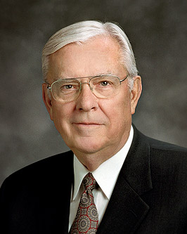
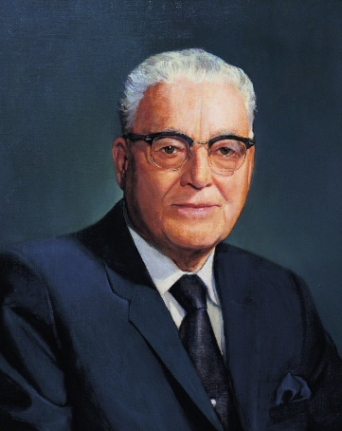
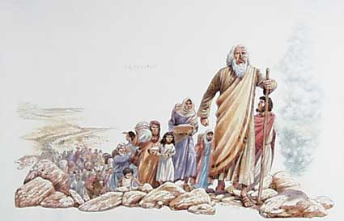
Warnings in Chapters 8-13
Moses taught the Israelites that Canaan was a land where they would “not lack any thing” (Deuteronomy 8:9) and where they would prosper.
However, he warned that if the Israelites forgot the Lord in their prosperity, they would perish. He also warned against the temptation to attribute their success to themselves rather than to God.
“The love of work is an attitude that members of the Church must develop. In some ways, we have gone through a period of great prosperity which may, when history is written, prove to be as devastating as the Great Depression in its effect upon the attitudes of the people.
President Harold B. Lee said, ‘Today we are being tested and tried by another kind of test that I might call the “test of gold”—the test of plenty, affluence, ease—more than perhaps the youth of any generation have passed through, at least in this Church.’” (7)

Slide 21
Sources:
Suggested Hymn: 161 The Lord Be With Us
Old Testament Institute Manual
Bible Dictionary
Excerpts from Talk Through the Bible by Bruce Eilkinson and Kenneth Boa p. 39
4. Robert M. Wilkes Some Thoughts about Personal Freedom July 1985 Ensign
Elder David B. Haight Live the Commandments April 1998 Ensign
Elder Joseph T. Hicken Book of Mormon Principles: Shunning Satan’s Snares Sept. 2004 Ensign
Elder M. Russell Ballard (Sweet are the Uses of Adversity … ,Brigham Young University Speeches of the Year, Provo, 7 Feb. 1962, p. 3.)” (“Providing for Our Needs,” Ensign, May 1981, 86).
Presentation by ©http://fashionsbylynda.com/blog/

Slide 22
Deuteronomy
Deuteronomy 1-13 | Deuteronomy 14-19 | Deuteronomy 20-26 | Deuteronomy 27-34
Preparing Israel to enter the Promised Land | The Lord’s Laws and Feasts | War and Punishments | Obedience and Disobedience Moses’ Final Sermon
Deuteronomy 1-2 | Deuteronomy 3 | Deuteronomy 4 | Deuteronomy 5 | Deuteronomy 6
Recitation of 40 years Commanded to posses Canaan Judges and rulers chosen Report of spies Defeat of Amorites | Destruction of Bashan Two and a half tribes given land east of Jordon Moses denied entrance to Canaan Transition of leadership to Joshua | Keep commandments and summary of the covenants Mercy and Goodness of the Lord | The Lord’s Covenant with Israel Sabbath Day observance Obedience | Teach your children the commandments
Deuteronomy 7 | Deuteronomy 8-9 | Deuteronomy 10-11 | Deuteronomy 12-13
Conquer Canaan (7 Nations) Marriage Laws Removal of sickness if obedient | Remembrance of 40 years Rebellion of Israel | Ten Commandments placed in Ark of the Covenant The Lord’s mercy, blessings and cursings Victory of the Obedient | Israel is to destroy Canaan and idols Additional Laws Law of Idolatry

Slide 23
Moses’ Three Great Sermons:
The book of Deuteronomy contains Moses’s three great final sermons to the children of Israel. “The first discourse is found in Deut. 1–4 and is introductory. The second discourse (Deut. 5–26) consists of two parts: (1) 5–11, the Ten Commandments and a practical exposition of them, (2) 12–26, a code of laws, which forms the nucleus of the whole book. … The third discourse (Deut. 27–30) contains a solemn renewal of the covenant [between God and Israel] and an announcement of the blessings of obedience and the curses upon disobedience”
These sermons contain Moses’s heartfelt pleas for the Israelites to remember the Lord and live His laws in the promised land. The instructions recorded in Deuteronomy were specifically directed to a new generation whose parents had died in the wilderness following their rebellion (see Numbers 14:26–33; 26:63–65).
Utterly Destroying Canaanites:
Israel was not commanded to treat all her enemies in this manner. One commentator explained why the Canaanites were different: “The second commandment prohibits graven images in worship; it requires the destruction of all such forms of worship: ‘Thou shalt not bow down to their gods, nor serve them, nor do after their works; but thou shalt utterly overthrow them, and quite break down their images’ (Ex. 23:24). In Deuteronomy 12:1–14, the contrast is drawn clearly: obedience means on the one hand destroying all places of idolatrous worship, and, on the other hand, bringing offerings to God in the prescribed manner and to the prescribed place. The commandment to destroy idolatrous places and images is restated in Deuteronomy 7:5; 16:21, 22; Numbers 33:52; and Exodus 34:13, 14. But, in certain instances, the destruction of graven images required also the destruction of the people of the images (Deut. 7:1–5); not only are covenants with the Canaanites forbidden, but inter-marriage also. The Canaanites were ‘devoted’ or set apart, ‘sanctified’ unto death by God’s order. This is an important point and needs careful attention. The law specifically forbad reprisals against Egyptians or any other foreigner; instead of vengeance, they should remember their oppression in Egypt as a means of greater dedication to justice for all under God’s law (Lev. 19:33–37).
Having suffered injustice at foreign hands, they should themselves be careful to avoid being like the Egyptians, themselves the instruments of injustice. Egypt sought to exterminate all Hebrews (Ex. 1:15–22), but Israel was required to render justice to all Egyptians in terms of their individual obedience or disobedience to the law. But all Canaanites were devoted to death. The criterion was not enmity to Israel but the law of God. Egypt was an enemy of God as was Canaan, but the iniquity of the Canaanites was ‘full’ or total in God’s sight (Gen. 15:16; Lev. 18:24–28, etc.). Prostitution and homosexuality had become religious practices to the point where the people were entrenched in depravity and proud of it. Their iniquity was ‘full’ or total. Accordingly, God sentenced them to death and made Israel the executioner. … The Canaanites as a whole were deserving of death; God’s patience allowed them a few centuries from Abraham’s day to Joshua’s and then His judgment was ordered executed. The failure of Israel to execute it fully became finally their own judgment.” (Rushdoony, Institutes of Biblical Law, pp. 92–93.)
Repetitive:
Jesus’ “thorough knowledge of the scriptures is evidenced by the fact that He repeatedly cited them. When the devil tempted Him to turn the stones into bread, He countered by quoting from Deuteronomy: ‘… It is written, Man shall not live by bread alone, but by every word that proceedeth out of the mouth of God.’ (Matthew 4:4; see Deuteronomy 8:3.) When the tempter challenged Him to cast Himself down from the pinnacle of the temple, He responded by quoting from the same book: ‘It is written again, Thou shalt not tempt the Lord thy God.’ (Matthew 4:7; see Deuteronomy 6:16.) For the third time He quoted from Deuteronomy (6:13) when Satan offered Him the kingdoms of the world, saying: ‘Get thee hence, Satan: for it is written, Thou shalt worship the Lord thy God, and him only shalt thou serve.’ (Matthew 4:10.)” Elder Marion G. Romney (Jesus Christ, Man’s Great Exemplar, Brigham Young University Speeches of the Year, Provo, Utah, 9 May 1967, p. 9.)
Mount Ebal and Mount Gerizim:
“The two mountains mentioned were selected for this act, no doubt because they were opposite to one another, and stood, each about 2500 feet high, in the very centre of the land not only from west to east, but also from north to south. Ebal stands upon the north side, Gerizim upon the south; between the two is Sichem, the present Nabulus, in a tolerably elevated valley, fertile, attractive, and watered by many springs, which runs from the south-east to the north-west from the foot of Gerizim to that of Ebal, and is about 1600 feet in breadth. The blessing was to be uttered upon Gerizim, and the curse upon Ebal.” (Keil and Delitzsch, Commentary, 1:3:349–50.)

