Slide 1
Lesson 75
Crossing the Jordan River
Joshua 3-5
Every place that the sole of your foot shall tread upon, that have I given unto you...
Joshua 1:2
Presentation by ©http://fashionsbylynda.com/blog/

Slide 2
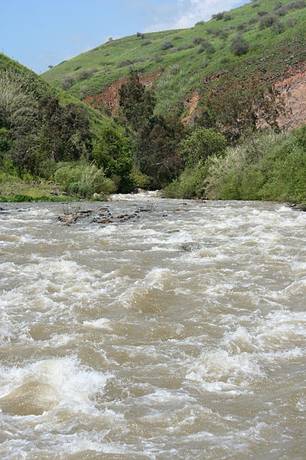
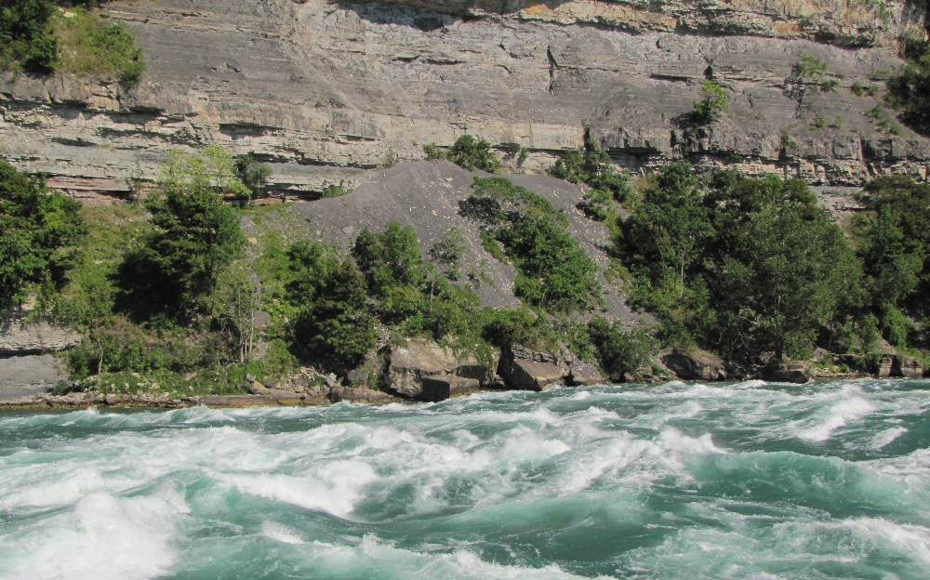
The Current is Strong
Joshua moved the camp by the Jordon River
“Now while Joshua, the commander, was in fear about their passing over Jordan, for the river ran with a strong current…God promised so to dispose of the river, that they might pass over it…” (1)
Jordon River in the Spring
Joshua 3:1

Slide 3
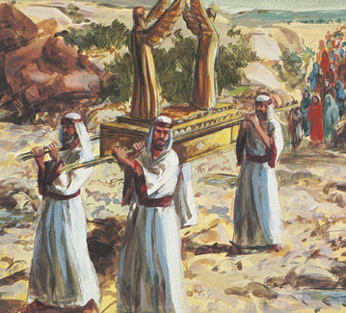
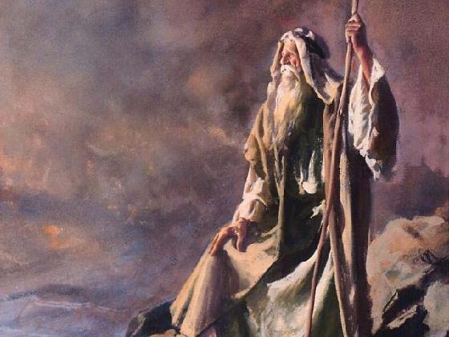
Required Distance
The ark of the covenant represented the presence of the Lord.
On one occasion, when Moses spoke with the Lord on Mount Sinai, the people were to watch from a distance but were not to approach the mountain (Ex. 19:10-13).
The required distance from the mount suggested they were not holy enough to endure the presence of Jehovah. The distance between the ark and the children in this instance represents the same thing—the children of Israel were to follow the Lord but they were not yet sanctified enough to enter his presence. None of them, save the high priest only, could enter into that part of the tabernacle of Moses which represented the Celestial Kingdom and the presence of God. (2)
Joshua 3:3-4

Slide 4
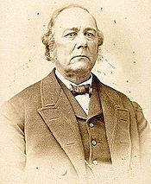
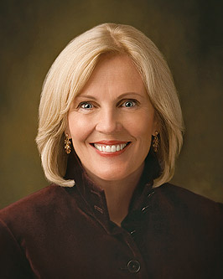
Sanctify Yourselves
Prepare yourselves spiritually
“… in every dispensation those who have been willing to receive the everlasting Gospel have been required to sanctify themselves by living according to its precepts.”
(3)
“This was Joshua’s call for a return to virtue, and it is the same call to us today. We simply cannot do the work we have been reserved and prepared to do unless we can access the strength and confidence that comes by living a virtuous life.” (4)
Joshua 3:5

Slide 5
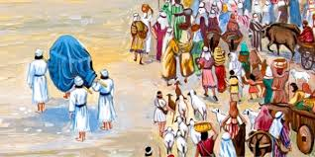
Stand Upon a Heap
The water would stop flowing downstream
The command to cross Jordan was given when all was in readiness. The priests carrying the ark went first, as planned. As their feet entered the river the waters were shut off from above—not just at the site of the crossing but from above—and they stood as in a heap. (6)
The elements find control through faith. The wind, the clouds, the heavens obey the voice of faith. . . . (7)
About 40,000 soldiers crossed and women and children (Josh. 4:13)
Joshua 3:8-17

Slide 6
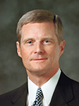
“Recall how the Israelites came to the river Jordan and were promised the waters would part, and they would be able to cross over on dry ground.
Interestingly, the waters did not part as the children of Israel stood on the banks of the river waiting for something to happen; rather, the soles of their feet were wet before the water parted.
The faith of the Israelites was manifested in the fact that they walked into the water before it parted. They walked into the river Jordan with a future-facing assurance of things hoped for” (9)
Moving forward in faith invites God to perform miracles on our behalf

Slide 7
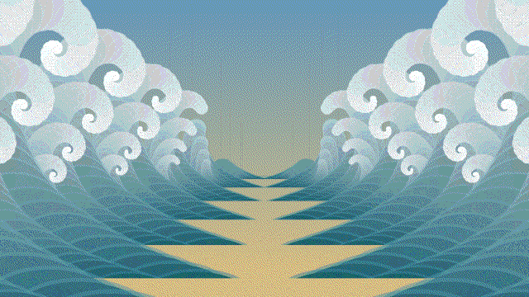
Getting Our Feet Wet
We sometimes must do the hard things we have been asked to do before we will be blessed.
Joshua and his priests, in a little-read replication of the parting and crossing of the Red Sea, crossed the flooded Jordan River in another miracle.
But the miracle did not begin for ancient Israel until after Joshua and his priests got the soles of their feet wet. (5)
Although we may not have flooded rivers to cross in our lives, we will have obstacles and challenges that we may not know how to overcome.
Joshua 3:15-17

Slide 8
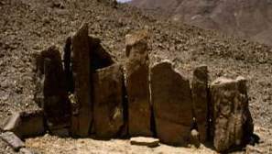
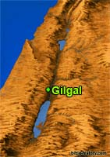
A Memorial of God’s Power
Biblical peoples were very fond of symbolic acts to commemorate great events. In order to memorialize God’s blessing in parting the waters of the Jordan River, Joshua commanded that twelve stones be taken from the riverbed and placed where all the people could see them:
“These stones shall be for a memorial unto the children of Israel for ever” (v. 7).
In later years, when their children would ask the meaning of the stones, Israel could rehearse the story of God’s miracle; thus, the stones would serve as a visible reminder of God’s power.
Joshua 4
(8)

Slide 9
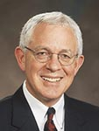
As we remember what the Lord has done for us, our reverence for Him increases and our testimonies are strengthened
“Remembering enables us to see God’s hand in our past, just as prophecy and faith assure us of God’s hand in our future.”
Joshua 4
(10)

Slide 10
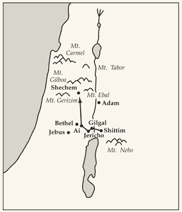
Circumcised
Israelites were in the promised land, the Lord instructed Joshua to have all the men circumcised.
Circumcision was a token of the covenant that the Lord had made with Abraham and his seed.
For some reason this practice had ceased during their 40 years in the wilderness, and the Lord wanted it reinstituted
Flint knives from ancient Israel
Joshua 5:1-9

Slide 11
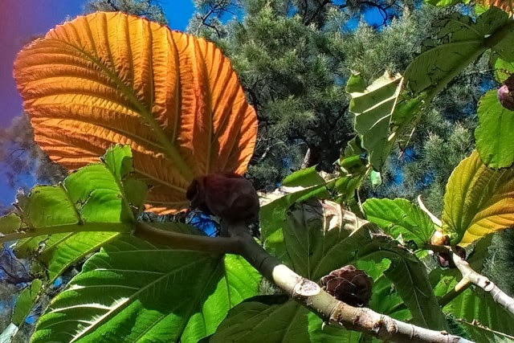
Manna Ceased
The Passover on the fourteenth day of the month at twilight on the plains of Jericho.
But they ate of the fruit of Canaan
Once the Israelites were in the promised land—a fertile land where they could grow and raise their own food—the Lord expected them to provide for themselves.
Joshua 5:12

Slide 12
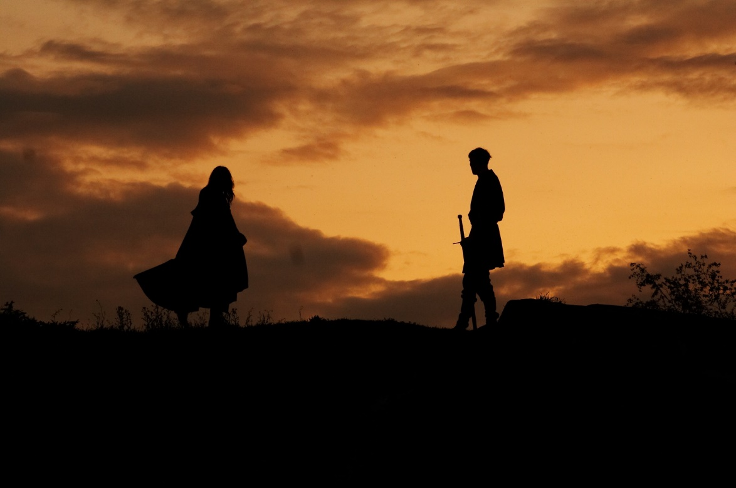
Captain of the Lord
“Christ himself is the chief soldier in his own army; as Commander, he carries the title Captain of the Lord’s Host.
By this name he appeared to Joshua, who seeing ‘him with his sword drawn in his hand,’ and hearing him say, ‘As captain of the host of the Lord am I now come, …
Joshua fell on his face to the earth, and did worship, and said unto him, What saith my lord unto his servant? And the captain of the Lord’s host said unto Joshua, Loose thy shoe from off thy foot; for the place whereon thou standest is holy.’
What further direction was then given has not been preserved for us.”
Joshua 5:13-15
(11)

Slide 13
Sources:
Suggested Hymn: #85 How Firm A Foundation
Flavius Josephus translated by William Whiston A.M.
Edward J. Brandt, “Q&A: Questions and Answers,” New Era, May 1973, 50)
Elder Charles C. Rich (remarks by) The Gathering—Knowledge of Salvation Enjoyed By the Latter-Day Saints—Build Up the Kingdom of God. April 6, 1875 Gen. Conf. (found in LDS Scripture Citation Index)
Elaine S. Dalton Remember Who You Are! August 2010 Ensign
Elder Neal A. Maxwell (All These Things Shall Give Thee Experience, pp. 44-45)
Mark E. Peterson (Joshua: Man of Faith [Salt Lake City: Deseret Book Co., 1978], 41)
7. President Spencer W. Kimball (LDS Church News, 1994, 03/26/94)
8. Old Testament Institute Manual
9. Elder David A. Bednar (“Seek Learning by Faith,” Ensign, Sept. 2007, 63).
10. Elder Marlin K. Jensen (“Remember and Perish Not,” Ensign or Liahona, May 2007, 38).
11. Elder Bruce R. McConkie (Mormon Doctrine, 2nd ed. [1966], 111–12).
Presentation by ©http://fashionsbylynda.com/blog/

Slide 14
The Ark of the Covenant
“The ark was transported from Sinai to the land of promise. The miraculous crossing of the Jordan River (Josh. 3:3–17) and the fall of the city of Jericho (Josh. 6:1–21) evidence the importance of the ark of the Lord to the Israelites.
Once in the land of promise the ark was cared for in various places until its place of permanent rest, the temple, was constructed. During the reign of the Judges, the ark was found at the town of Bethel. (Judg. 20:27.)
While Samuel was the prophet and until the war with the Philistines, the ark was located at Shiloh (1 Sam. 1:9, 3:3); during the war it was taken to the battlefield called Ebenezer, where it was captured.
For seven months the Philistines were plagued and severely smitten because of their unauthorized possession of the ark. This caused them to return the ark to the Israelites, which they did at the village of Kirjath-jearim. (1 Sam. 4–6.)
Here it remained some twenty years, ignored by King Saul except for one battle when its presence had been requested.
Finally King David brought the ark to Jerusalem, and after some years his son Solomon constructed the long-awaited temple.” (Edward J. Brandt, “Q&A: Questions and Answers,” New Era, May 1973, 50)
Although there is a noticeable lack of detail in this account, what is recorded suggests a miraculous vision shown to Joshua. Most commentators assume either a mortal servant of God or an angel came to strengthen Joshua and Israel as they prepared for their first battle.
Two things, however, suggest that Joshua may actually have seen Jehovah, the premortal Jesus Christ. First, when Joshua fell down to worship him, no attempt was made to stop him. Yet the mortal servants of God are quick to prevent others from worshiping them, even when they have demonstrated great power (see Acts 10:25–26; 14:8–18; Alma 18:15–17). The same thing is true of angels, for twice, when he was awed at the presence of angels and fell at their feet to worship them, John the Revelator was told the same thing, “See thou do it not: for I am thy fellow servant, and of thy brethren the prophets” (Revelation 22:9; see also 19:10). The angel who appeared to Samson’s parents clearly taught them that any offerings were to be to the Lord (see Judges 13:16). But no attempt was made to prevent Joshua from falling down to worship this being.
Second, the personage commanded Joshua to remove his shoes because he was standing on holy ground—the same instructions Jehovah gave to Moses on Mount Sinai (see Exodus 3:5). But, since this account in Deuteronomy is very scant on details, it can only be surmised that the being may have been the Lord. Old Testament Institute Manual
President Henry B. Eyring O Remember, Remember
2007 November Ensign https://www.lds.org/ensign/2007/11/o-remember-remember.p1?lang=eng

