Slide 1
Lesson 77
The Great Campaign
Joshua 11-24
And all these kings and their land did Joshua take at one time, because the Lord God of Israel fought for Israel.
Joshua 10:42

Slide 2
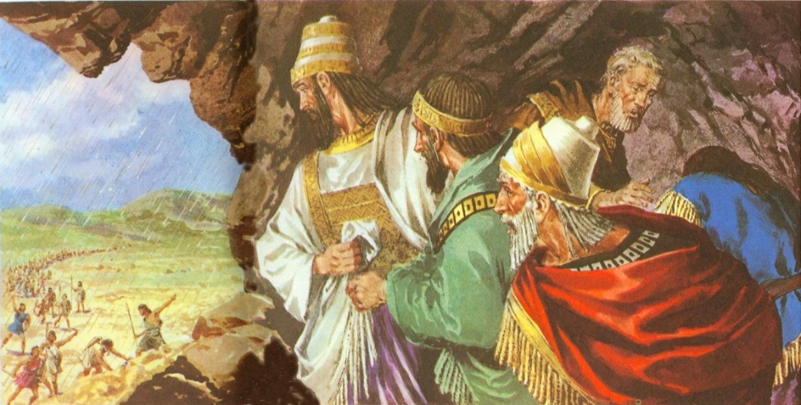
Previously…
The Gibeonites deceived Israel by telling them that they were not Canaanites and wanted to make peace with the Israelites…Upon a promise of Eleazar, the high priest, they were spared…however, when Israel found out that they were really Canaanites they were put into servitude unto the Israelites.
The five kings of the surrounding area found out about the Gibeonites making peace with the Israelites sought out to “make an example” of them and went to battle against them.
The Israelites, duty bound to spare them, went to Gibeon to defend them. They battled and killed many but those who fled were caught in a hailstorm and died. The five kings fled and hid in a cave near Makkedah. Joshua captured them, killed them, hung them on a tree, then entombed them in the cave by placing large boulders over the entrance to seal it up.
Joshua declared that the sun should stand still… the extra hours permitted Joshua to completely consumed the Amorites at Gibeon

Slide 3
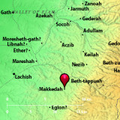
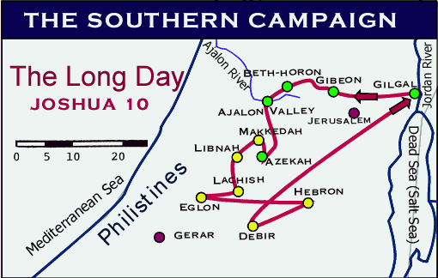
With The Lord’s Help
All these places were destroyed
Makkedah– was the first
Libnah
Bachis
Gezer
Eglon
Hebron
Debir
Kadesh-barnea
Gaze
Goshen
Joshua 10:28-41
Gilgal was the Israelite home base

Slide 4
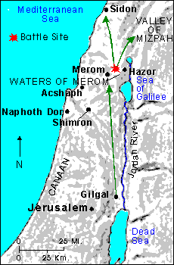
Gathering of the Kings
Gathering of the Kings:
Jaban King of Hazor
Jobab king of Madan
King of Shimron
King of Achshaph
All the Kings North, east and west
Amorites, Hittites, Perizzrite, Jebusites, and Hivites…joined the kings by the waters of Merom to battle against the Israelites
To hough a horse is to cut the leg tendons above and behind the tarsal joint or ankle, thus rendering the horse useless.
The Israelites were foot soldiers rather than charioteers. The fear seems to have been that should the horses and chariots be used as vehicles of war, Israel would turn from faith in God and trust in the arm of flesh. (1)
And the Lord delivered them into the hand of Israel,
Joshua 11

Slide 5
Kings That Were Destroyed
2 kings on the east side of Jordan River and 31 kings on the west of the river were destroyed= 33 kings
King of Jericho
King of Ai
King of Jerusalem
King of Hebron
King of Jarmuth
King of Lachish
King of Eglon
King of Gezer
King of Debir
King of Geder
King of Hormah
King of Arad
King of Libnah
King of Adullam
King of Makkeda
King of Beth-el
King of Tappuah
King of Hepher
King of Aphek
King of Aphek
King of Lasharon
King of Madon
King of Hazor
King of Shimron-meron
King of Achshaph
King of Taanach
King of Megiddo
King of Kedesh
King of Jokneam
King of Dor
King of Tirzah-- all the kings thirty and one.
Sihon king of the Amorites, who dwelt in Heshbon, and ruled from Aroer
Og king of Bashan, which was of the remnant of the giants, that dwelt at Ashtaroth and at Edrei,
Joshua 12

Slide 6
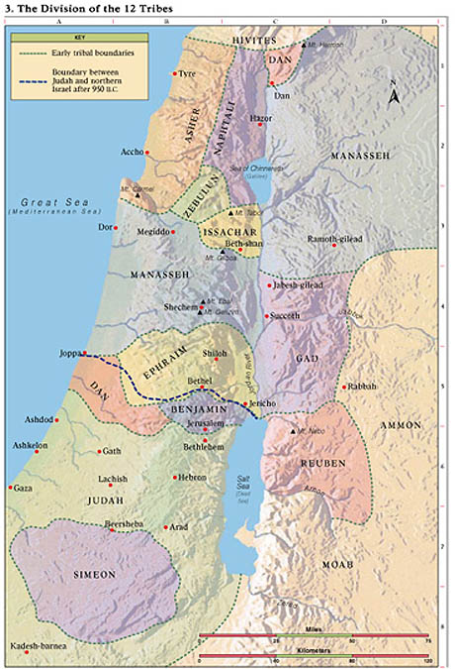
Division of the Land
Joshua gave each tribe an inheritance in the promised land and that the tabernacle was set up at a place called Shiloh
Caleb inherits Hebron as a special reward for his faithfulness
The Levites were not given a specific piece of land but were given 48 cities among each of the other tribes’ inheritances. This would allow the Levites to continue their priesthood service among the Israelites.
The Jebusites were not driven out but dwelt with the tribe of Judah (Josh. 15:36)
Joshua 13-21

Slide 7
6 Cities of Refuge
Golan in Bashan out of the tribe of Manasseh.
And they appointed Kedesh in Galilee in mount Naphtali
and Shechem in mount Ephraim
and Kirjath-arba, which is Hebron, in the mountain of Judah.
Ramoth in Gilead out of the tribe of Gad
Bezer in the wilderness upon the plain out of the tribe of Reuben
Joshua 13-20

Slide 8
Cleave
To cling, adhere, or be loyal to something or someone.
If we cleave unto the Lord and obey Him, then He will be with us and strengthen us
If we cleave to other gods, we will bring negative consequences upon ourselves and lose the blessings of the Lord

Slide 9
Parting Advice
What God has done for them:
He fought and will continue to fight for Israel (verses 3, 5, 10)
He gave Israel land for an inheritance (verse 4)
He will expel the other nations from the land (verse 5)
He has kept and will continue to keep His promises to Israel (verses 5, 10)
What Israel is to do:
Be very courageous (verse 6)
Keep the law of Moses (verse 6)
Don’t serve or worship other gods (verse 7)
Cleave (be loyal) unto the Lord (verse 8)
Love the Lord (verse 11)
Remembering what God has done for us strengthens our resolve to love and serve Him
Joshua 23

Slide 10
Doctrinal Mastery
And if it seem evil unto you to serve the Lord, choose you this day whom ye will serve; whether the gods which your fathers served that were on the other side of the flood, or the gods of the Amorites, in whose land ye dwell: but as for me and my house, we will serve the Lord.
Joshua 24:15

Slide 11
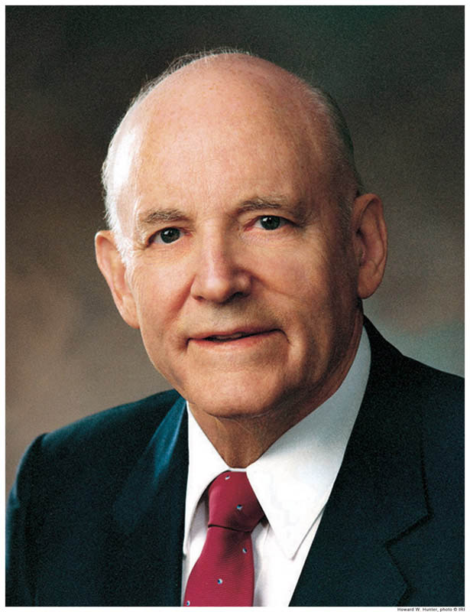
“After Israel had rested from the wars with their enemies, Joshua, who was now very old, called all Israel together.
In his farewell address he reminded them they had been victorious because God had fought for them, but if they now ceased to serve the Lord and keep his law they would be destroyed. …
“This great military and spiritual leader then urged a commitment, and made one himself and for his family: ‘Choose you this day whom ye will serve; … but as for me and my house, we will serve the Lord.’ (Josh. 24:15)

Slide 12
“Here was a great statement of full commitment of a man to God. …
He was telling the Israelites that regardless of how they decided, he would do what he knew was right.
He was saying that his decision to serve the Lord was independent of whatever they decided; that their actions would not affect his; that his commitment to do the Lord’s will would not be altered by anything they or anyone else would do.
Joshua was firmly in control of his actions and had his eyes fixed on the commandments of the Lord. He was committed to obedience.
“Surely the Lord loves, more than anything else, an unwavering determination to obey his counsel.
Surely the experiences of the great prophets of the Old Testament have been recorded to help us understand the importance of choosing the path of strict obedience.” (2)

Slide 13
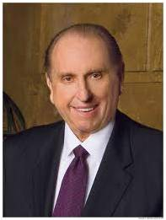
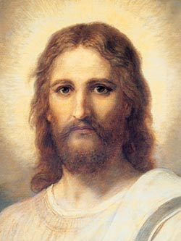
“Joshua of old declared, ‘Choose you this day whom ye will serve; … but as for me and my house, we will serve the Lord’ [Joshua 24:15]. …
“… Positioned on the wall of my office, directly opposite my desk, is a lovely print of the Savior, painted by Heinrich Hofmann.
I love the painting, which I have had since I was a 22-year-old bishop and which I have taken with me wherever I have been assigned to labor. I have tried to pattern my life after the Master.
Whenever I have a difficult decision to make, I have looked at that picture and asked myself, ‘What would He do?’ Then I try to do it.
We can never go wrong when we choose to follow the Savior.” (3, 4)

Slide 14
Sources:
Suggested Hymn: #7 Israel, Israel, God is Calling
Old Testament Institute Manual
President Howard W. Hunter (“Commitment to God,” Ensign, Nov. 1982, 58; see also Spencer W. Kimball, “The False Gods We Worship,” Ensign, June 1976, 2–6).
President Thomas S. Monson (“Choose You This Day,” Ensign or Liahona, Nov. 2004, 67).
[see Jesus Christ, Gospel Art Book [2009], no. 1]. Picture of Jesus
Presentation by ©http://fashionsbylynda.com/blog/

Slide 15
9 ½ Remaining Tribal Inheritances
Tribe | Location | Number of Cities
Simeon | Extreme south (Negeb) | 17
Judah | Between Dead Sea and Mediterranean Sea | Not given
Benjamin | Jordan River, half-way to the Mediterranean Sea | 26
Dan | From Benjamin to Mediterranean Sea | 17
Ephraim | Samaria-from Jordan River to Mediterranean Sea | Not given
Manasseh | Above Ephraim from Jordan River to Mediterranean Sea | Not given
Issachar | From Jordan River half-way to Mediterranean Sea | 16
Zebulon | Landlocked area half-way between Galilee and Mediterranean Sea | 12
Asher | Mt. Carmel north to Mt. Lebanon | 22
Naphtali | Galilee to Mount Hermon | 19
W. Cleon Skousen Third Thousand Years p.517

Slide 16
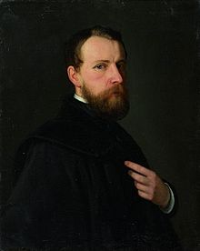
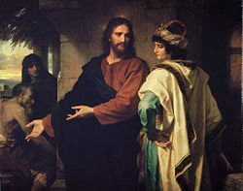
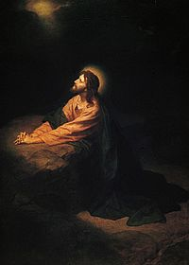
Johann Michael Ferdinand Heinrich Hofmann (March 19, 1824 - June 23, 1911) was a German painter of the late 19th to early 20th century. He was the uncle of the German painter Ludwig von Hofmann. He was born in Darmstadt and died in Dresden. He is best known for his many paintings depicting the life of Jesus Christ.
Heinrich Hofmann grew up in a family that harbored a deep interest in art. His father, advocate Heinrich Karl Hofmann (1795–1845) painted in watercolors, his mother Sophie Hofmann, née Volhard (1798–1854) gave lessons in art before she married, and his four brothers all showed artistic talent. Heinrich, however, was the only one for whom art was not only a profession but the center of his life.
Hofmann received his first lessons in art from the copper engraver Ernst Rauch in Darmstadt. Then, in 1842, he entered the Academy of Art in Düsseldorf and attended the classes given in painting by Theodor Hildebrandt. Later, he was accepted into the studio of Wilhelm von Schadow and there he created his first large painting: A scene from the life of Alboin, King of the Langobards.
Thereafter, he traveled to the Netherlands and France to intensify his studies of art. In 1846, Hofmann visited the Academy of Art in Antwerp. After passing a longer period of time in Munich he returned to Darmstadt in 1848, and at that time, he began an intensive phase of painting portraits. The young artist found that the political activities of his family opened many doors to influential persons of the time. This afforded him the opportunity to create two portraits of Heinrich von Gagern and one of Justus von Liebig (this portrait is now in the possession of Queen of the United Kingdom). In 1851, Hofmann went to Dresden to visit the art gallery there. In 1853, he traveled to Prague to paint the portrait of Dr. Beer, Great Grand Master of the Brotherhood of the Knights of the Cross.
In 1853, Hofmann returned to Darmstadt, and in the beginning of 1854, his beloved mother died. He was deeply moved by her death and it inspired him to paint his first large religious work: Burial of Christ.
In fall of 1854, he started on a journey to Italy. His first longer stop was in Venice and he used the time there to study Giorgione, Bellini and Giotto (in nearby Padua). After having proceeded to Florence – where Hofmann stayed for two months – he then went to Rome in January 1855. The comprehensive correspondence with his family and his detailed diary reports convey an impression of his way of painting at that time. He was deeply impressed by artwork of Antiquity, Christianity and the Renaissance.
Not long after his arrival in Rome, he was introduced to Peter von Cornelius (1783–1867) and frequently paid him a visit. When he began his masterpiece The Arrest of Jesus in 1854, this work awakened the interest of Cornelius and for 4 years he accompanied Hofmann with his counsel and his constructive criticism. In 1858 the painting was finished and acquired by the Grand Duchy Art Gallery in Darmstadt. (It is still there – not on exhibition but in the archives of the Hessisches Landesmuseum.)
In 1858, Hofmann returned to Darmstadt and in the following year he married Elisabeth Werner. The couple had no children.
Now another period of painting portraits began. In addition Hofmann created a large altarpiece for the church in Obermörlen (Hesse): “Madonna with Christ Child and apostles Paul and Peter”. Some time later an altarpiece for Væggerløse Church (Denmark) was painted: “The Resurrected Christ”.
In 1862, Hofmann and his wife moved to Dresden. More and more he devoted himself to the genre of religious paintings. In 1870, Heinrich Hofmann was appointed successor of Professor Johann Carl Baehr of the Academy of Art in Dresden whose honorable member he already was. In 1872, King Johann bestowed on him the Great Golden Medal and later he received the Albrecht-Medal from King Albert. In 1891, Hofmann’s wife died and soon after that he withdrew from the Academy of Art in Dresden. Even though he stopped working for the Academy it is obvious from his letters that in private life he continued to create many works of art until his death on June 23, 1911.
Wikipedia

