Slide 1
Lesson 79
Prophets and Revelation
Part 1

Slide 2
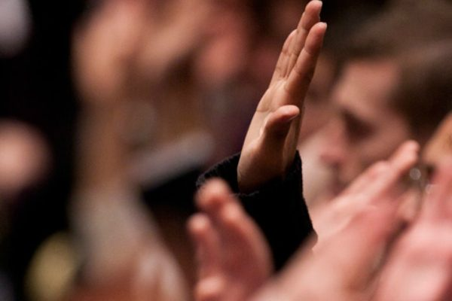
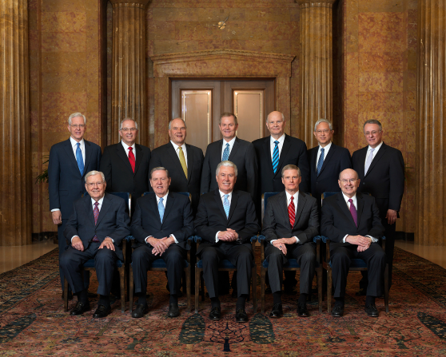
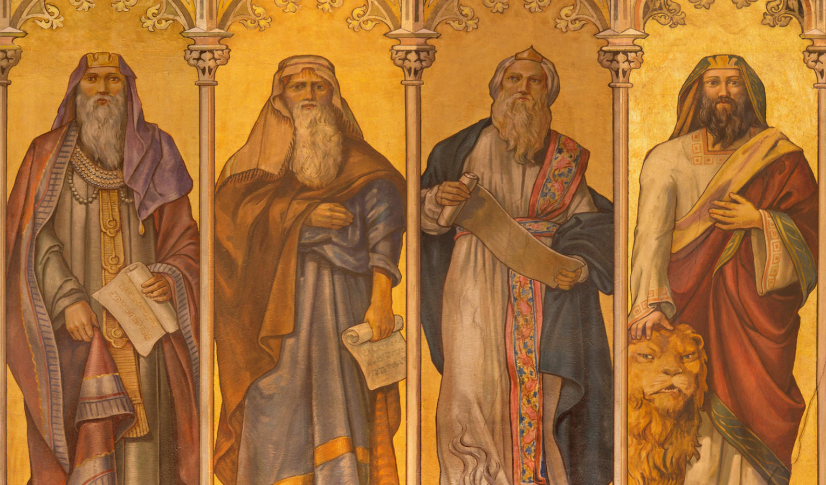
God’s Authorized Servants
We sustain the President of the Church as prophet, seer, and revelator—the only person on the earth who receives revelation to guide the entire Church.
We also sustain the counselors in the First Presidency and the members of the Quorum of the Twelve Apostles as prophets, seers, and revelators.
Like the prophets of old, prophets today testify of Jesus Christ and teach His gospel
(1)

Slide 3
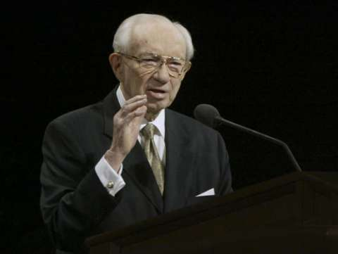
What Do Prophets Do?
Prophets testify of Jesus Christ
They make known God’s will and true character.
They speak boldly and clearly, denouncing sin and warning of its consequences.
At times, they may be inspired to prophesy of future events for our benefit.
“What I the Lord have spoken, I have spoken, and I excuse not myself; and though the heavens and the earth pass away, my word shall not pass away, but shall all be fulfilled, whether by mine own voice or by the voice of my servants, it is the same” D&C 1:38
(1)

Slide 4
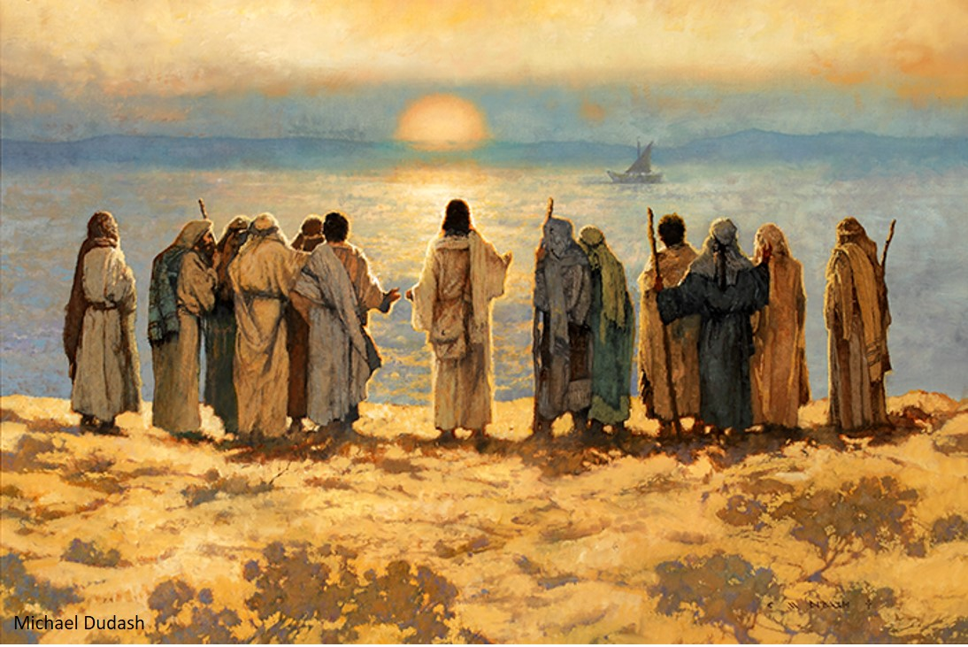
Jesus
During His mortal ministry and again in our day, the Lord organized His Church on the foundation of prophets and apostles
(1)

Slide 5
Today
The President of The Church of Jesus Christ of Latter-day Saints is God’s prophet to all the people of the earth today.
We sustain the President of the Church as a prophet, seer, and revelator and as the only person on the earth who receives revelation to guide the entire Church.
If we faithfully receive and obey the teachings of the President of the Church, God will bless us to overcome deception and evil.
Read D&C 21:4-6

Slide 6
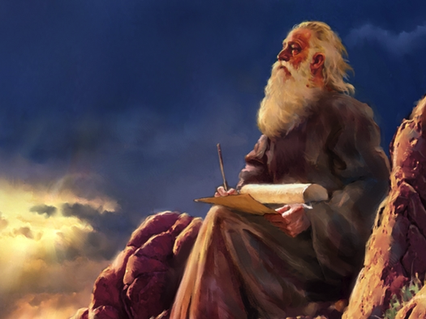
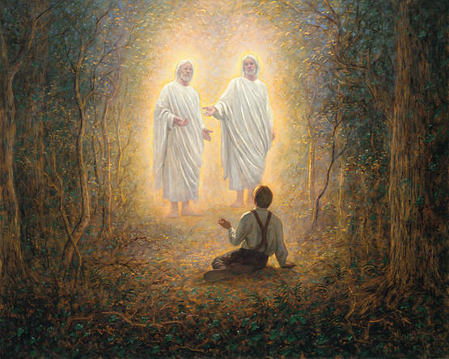
By Revelation
Revelation is communication from God to His children.
Revelation can also come through visions, dreams, and visitations by angels.
Most revelation comes through impressions, thoughts, and feelings from the Holy Ghost.

Slide 7
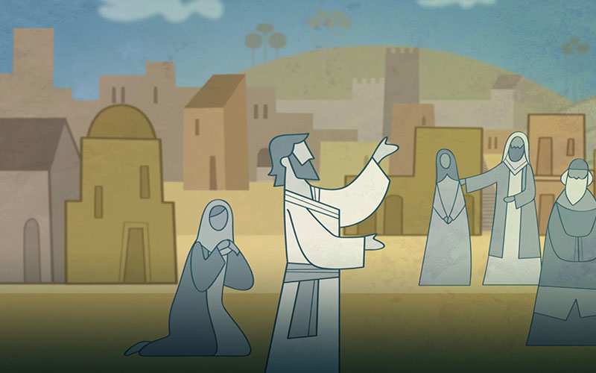
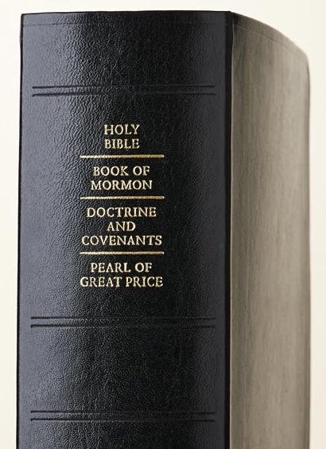
Revelation Through Scriptures
The Bible, Book of Mormon, Doctrine and Covenants, and Pearl of Great Price﻿—contain revelations given through ancient and latter-day prophets.
As we study the words of prophets, we can learn truth and receive guidance.

Slide 8
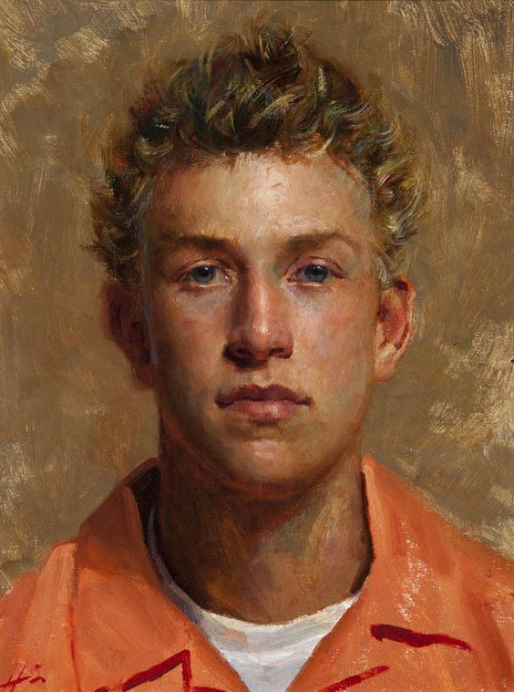
Individual Revelation
While God gives revelation through prophets to guide all of His children, individuals can receive revelation to help them with their specific needs, responsibilities, and questions and to help strengthen their testimonies.
Jeff Hein
However, personal inspiration from the Lord will never contradict the revelation God gives through His prophets.
Elspeth C. Young

Slide 9
Prophets and Revelation
Why is it important that there are prophets and apostles on the earth today who fulfill these roles?
How have you personally been blessed as prophets have fulfilled one or more of these roles?
Why is it important for us to be guided by personal revelation from the Holy Ghost in addition to the revelations received by prophets?

Slide 10
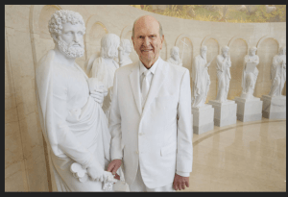
Called of God
A prophet is a person who has been called by God to speak for Him
“All leaders in the Lord’s Church are called by proper authority.
No prophet or any other leader in this Church, for that matter, has ever called himself or herself.
No prophet has ever been elected.
The Lord made that clear when He said, ‘Ye have not chosen me, but I have chosen you, and ordained you’ [John 15:16]
You and I do not ‘vote’ on Church leaders at any level. We do, though, have the privilege of sustaining them.”
President Nelson stood next to the statue portraying the apostle Peter, first in line to the marble statues of Jesus’s other apostles.
(2)

Slide 11
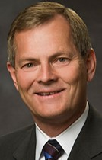
“President Monson described that acting on the will of the Lord, he was extending a call to the Quorum of the Twelve to me. He asked me if I would accept this call, to which, following what I am sure was a very undignified audible gasp, in complete shock, I responded affirmatively.
And then, before I could even verbalize a tsunami of indescribable emotion, most of which were feelings of inadequacy, President Monson kindly reached out to me, describing how he was called many years ago as an Apostle by President David O. McKay, at which time he too felt inadequate.
He calmly instructed me, ‘Bishop Stevenson, the Lord will qualify those whom He calls.’ These soothing words of a prophet have been a source of peace, a calm in a storm of painful self-examination and tender feelings in the ensuing agonizing hours which have passed day and night since then.”
(3)

Slide 12
Doctrinal Mastery
Jeremiah 1:4-5
Then the word of the Lord came unto me, saying,
Before I formed thee in the belly I knew thee; and before thou camest forth out of the womb I sanctified thee, and I ordained thee a prophet unto the nations.

Slide 13
Jeremiah
He was born of a priestly family in Anathoth, son of Hilkiah
He was a prophet and ordained of the Lord during the days of Lehi and Daniel
He prophesied during a 40 year periods, from around 626 to 585 BC, including the 70 year captivity of Judah
He declared with power and authority the central governing principles of the gospel—that peace and happiness depend on obedience and honoring the covenants of the Lord
He witnessed the fall of Jerusalem
His writings are included in the brass plates of Laban (1 Nephi 5:10-13) and also mentioned two other times in the Book of Mormon (1 Ne. 7:14; Hel. 8:20)
He prophesied of a ‘new and everlasting covenant’ that would be fulfilled in the return of the kingdom of God to earth prior to the Second Coming (Jeremiah 31:31-34)
After the fall of Jerusalem the Jews who escaped into Egypt took Jeremiah with them as a kind of fetish (Jeremiah 43:6), and at last, according to tradition, stoned him to death
(3)

Slide 14
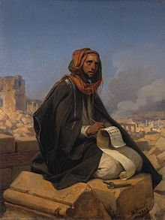
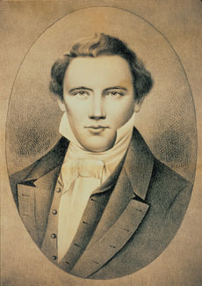
Foreordained=Ordained
“God’s premortal ordination of His valiant spirit children to fulfill certain missions during their mortal lives” (5)
“Every [one] who has a calling to minister to the inhabitants of the world was ordained to that very purpose in the Grand Council of heaven before this world was. I suppose that I was ordained to this very office in that Grand Council” (6).

Slide 15
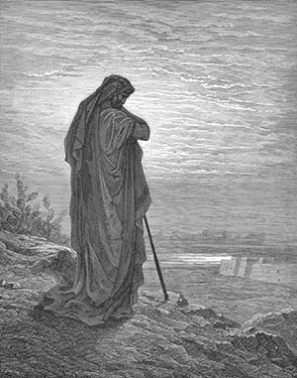
Speak for Him
Surely the Lord God will do nothing, but he revealeth his secret unto his servants the prophets
Amos 3:7
The people of Israel and the nations nearby were very wicked and had rejected many prophets during the prophet Amos’s lifetime.
God called Amos as a prophet and commanded him to warn the Israelites to repent or else they would be destroyed.
“revealeth his secret unto his servants the prophets”
Through revelation, prophets are able to speak on behalf of God and reveal truths that would otherwise be unknown.
Amos 7:14–15

Slide 16
Sources:
Suggested Hymn: #19 We Thank Thee, O God, for a Prophet
Video: “Why Do We Have Prophets” (1:36)
Gospel Topics “Prophets”
Russell M. Nelson, “Sustaining the Prophets,” Ensign or Liahona, Nov. 2014, 74–75).
Gary E. Stevenson, “Plain and Precious Truths,” Ensign or Liahona, Nov. 2015, 91
Who’s Who in the Old Testament by Ed J. Pinegar and Richard J. Allen pp. 57-58 and Bible Dictionary
“Foreordination” Guide to the Scriptures
Teachings of Presidents of the Church: Joseph Smith [2007], 511

