Slide 1
Lesson 8
Acquiring Spiritual Knowledge Part 1

Slide 2
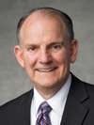
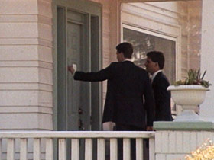
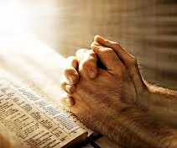
“When I was a young man, my parents joined The Church of Jesus Christ of Latter-day Saints. We knew that the missionaries had been teaching them, but my parents had taken the missionary lessons alone.
“After this surprising announcement, my brothers and I began to listen to the missionaries as well, and they each received the message of the Restoration with gladness. Although I was curious, my heart was not into changing my life. I did, however, accept the challenge to pray about whether the Book of Mormon was the word of God, but I did not receive an answer.”
Sometimes those who ask Heavenly Father for spiritual knowledge feel that their prayers are not being answered

Slide 3
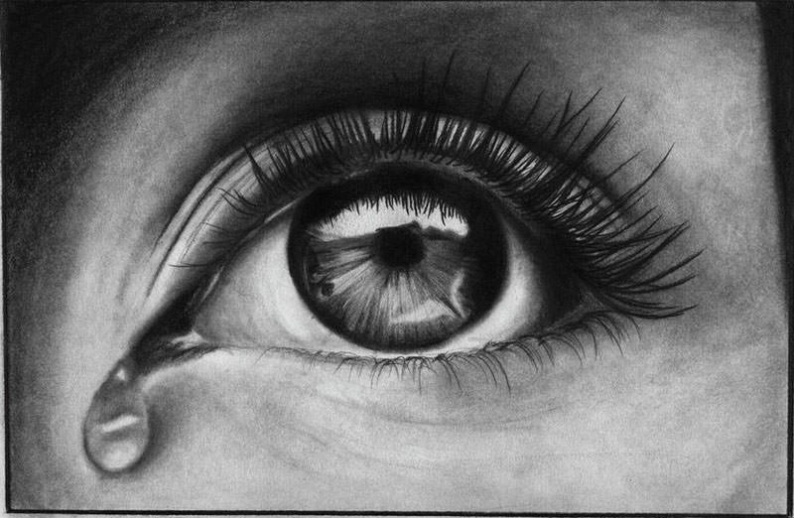
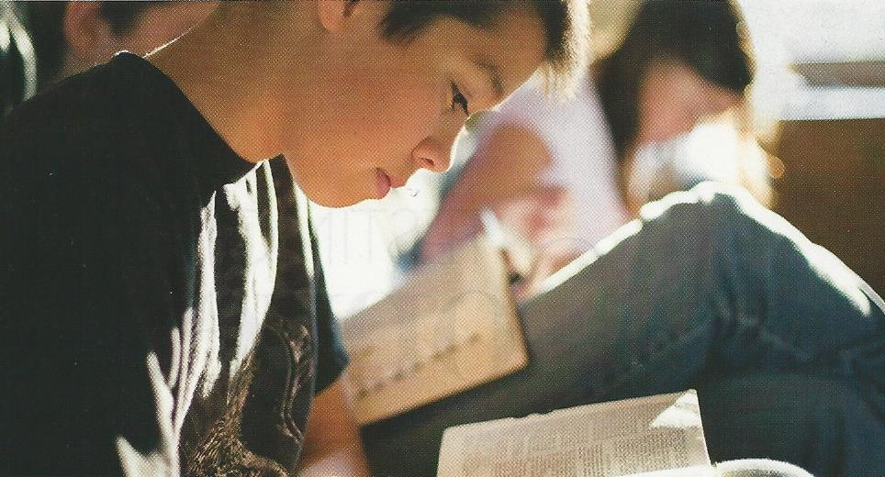
Acquiring Spiritual Knowledge
Because our Heavenly Father loves us and wants us to progress toward becoming like Him, He has encouraged us to “seek learning, even by study and also by faith”.
In our search for truth, we can trust Him completely, relying on His wisdom, His love, and His power to teach and bless us. God knows all things and is the source of all truth.
He has promised to reveal truth to our minds and hearts through the Holy Ghost if we will diligently seek Him.
Believe in God; believe that he is, and that he created all things, both in heaven and in earth; believe that he has all wisdom, and all power, both in heaven and in earth; believe that man doth not comprehend all the things which the Lord can comprehend.
D&C 88:118; Mosiah 4:9; D&C 8:2-3

Slide 4
What characteristic of God allows us to trust Him when seeking answers?
Why would it be important for a person who is seeking to acquire spiritual knowledge to first understand that God is the source of all truth?
How we should seek to acquire spiritual knowledge?

Slide 5
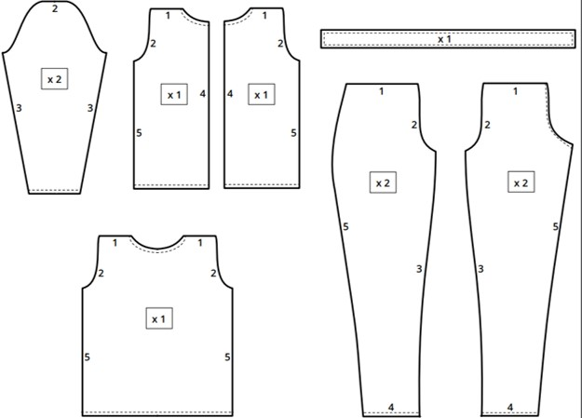
Pattern
A model or design that a person can follow or copy in order to create something.
If someone knew how to follow this pattern and had the necessary skills and materials, what would he or she likely be able to do?
What problems could result if a person chose not to follow the pattern while trying to make this item?
If we understand God’s pattern for acquiring spiritual knowledge and how to use that pattern, we can obtain and apply spiritual truths.

Slide 6
God’s Pattern
And when ye shall receive these things, I would exhort you that ye would ask God, the Eternal Father, in the name of Christ, if these things are not true; and if ye shall ask with a sincere heart, with real intent, having faith in Christ, he will manifest the truth of it unto you, by the power of the Holy Ghost.
And by the power of the Holy Ghost ye may know the truth of all things. Moroni 10:4-5
Have an honest desire to know the truth
Be willing to live according to that which God has revealed
If any man will do his will, he shall know of the doctrine, whether it be of God, or whether I speak of myself. John 7:17
If any of you lack wisdom, let him ask of God, that giveth to all men liberally, and upbraideth not; and it shall be given him.
6 But let him ask in faith, nothing wavering. For he that wavereth is like a wave of the sea driven with the wind and tossed. James 1:5-6
Seek truth through prayer
Angels speak by the power of the Holy Ghost; wherefore, they speak the words of Christ. Wherefore, I said unto you, feast upon the words of Christ; for behold, the words of Christ will tell you all things what ye should do.
2 Nephi 32:3
Seriously study of the word of God

Slide 7
To Be Prepared
Why do you think it is important for us to have an honest desire to know the truth and to be willing to live according to the truth God gives us?
How should we pray in order to receive answers and acquire spiritual knowledge?
How can a serious study of the scriptures and the words of the prophets help us acquire spiritual knowledge?
If we consistently strive to follow God’s pattern for acquiring spiritual knowledge, we will be much more prepared to receive Heavenly Father’s guidance and direction when difficult situations or questions arise.

Slide 8
Asking Questions and Seeking Answers
A vital part of our effort to learn truth
Some of the questions that come to our minds may be inspired by the Holy Ghost.
Inspired questions should be considered gifts from God that provide opportunities for us to increase our understanding and to strengthen our assurance that the Lord is willing to teach us.
We have been blessed with the ability to think and reason and to have the Lord’s influence expand our minds and deepen our understanding.
The attitude and intent with which we ask questions and seek answers will greatly affect our ability to learn through the Holy Ghost.

Slide 9
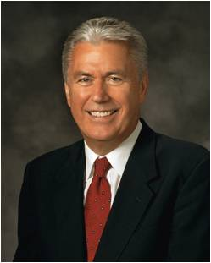
“My dear young friends, we are a question-asking people. We have always been, because we know that inquiry leads to truth. …
“… Inquiry is the birthplace of testimony. Some might feel embarrassed or unworthy because they have searching questions regarding the gospel.
“But they needn’t feel that way. Asking questions isn’t a sign of weakness. It’s a precursor of growth.
God commands us to seek answers to our questions and asks only that we seek ‘with a sincere heart, with real intent, having faith in Christ’.
When we do so, the truth of all things can be manifested to us ‘by the power of the Holy Ghost’.
Fear not. Ask questions. Be curious, but doubt not. … Always hold fast to faith and to the light you have already received.”
Dieter F. Uchtdorf

Slide 10
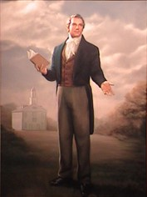
Eventually I began to be sincere. I remember when the missionary who was teaching me asked if I was ready to be baptized. I replied that I still had some questions. This wise missionary told me that he could answer them but that I would have to answer his question first.
He asked me if the Book of Mormon was true and if Joseph Smith was a prophet. I told him that I did not know, but I wanted to know.
“My questions led to increased faith. For me, the answer came not as an event but as a process. I noticed that as I did ‘experiment upon [the] words’ and began to ‘exercise a particle of faith,’ the Book of Mormon became ‘delicious to me’ and it did ‘enlighten my understanding’ and truly did ‘enlarge my soul.’ Eventually I had that experience the scriptures describe as a swelling within your breast.
It was at this point that I desired to be baptized and to commit my life to Jesus Christ.
Read Alma 32:27-28

Slide 11
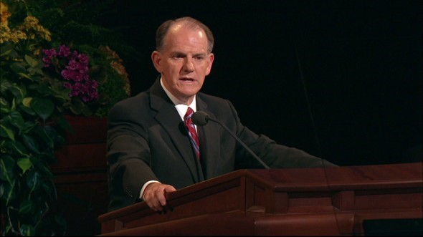
Testify
“I truly know that the Book of Mormon is the word of God. I know that Joseph Smith was a prophet. Oh, I still have things I do not comprehend, but my testimony of truth draws me closer to the Savior and builds my faith.”
James B. Martino

Slide 12
Sources:
Suggested Song: “Search, Ponder, and Pray” #109 Children’s Songbook
Video:
“Turn to Him and Answers Will Come” (8:16–9:30)
James B. Martino, “Turn to Him and Answers Will Come,” Ensign or Liahona, Nov. 2015, 58).
Elder Jeffrey R. Holland “Lord, I Believe,” Ensign or Liahona, May 2013, 94).
Dieter F. Uchtdorf, “The Reflection in the Water” [Church Educational System fireside for young adults, Nov. 1, 2009], lds.org/media-library
Presentation by ©http://fashionsbylynda.com/blog/

Slide 13
General Authority Seventy Elder James B. Martino was sustained as a General Authority Seventy of The Church of Jesus Christ of Latter-day Saints on April 4, 2009. At the time of his call, he had been serving as a member of the Sixth Quorum of the Seventy in the North America Southwest Area. Elder Martino has served as a member and President of the Central America Area Presidency and as a member of the Europe East Area Presidency. He is currently serving as President of the Europe East Area.
Elder Martino received a bachelor of science degree in business from Brigham Young University in 1974. After graduation, he began working for Russell-Newman, Inc., an apparel company. He was president and CEO of the company from 1989 to 2000. He served as chairman of the company from 2003 until his retirement in 2009.
Since joining the Church in 1968, Elder Martino has served in numerous Church callings, including full-time missionary in the Guatemala-El Salvador Mission, stake executive secretary, stake Young Men president, seminary teacher, bishop, stake president, and mission president.
James Boyd Martino was born in Denton, Texas, on March 28, 1951. He married Jennie Marie Barron in August 1973. They are the parents of five children.

