Slide 1
Lesson 82
A Chosen Prophet
1 Samuel 1-2
"Children are an heritage of the Lord: and . . . happy is the man [and woman] that hath [their] quiver full of them."
Psalms 127:3-5.

Slide 2
“It is uncertain who the author was or when he wrote [the book of 1 Samuel]. (1)
The book of 1 Samuel recounts the ministry of the prophet Samuel, who “restored law and order and regular religious worship in the land”
2 Chronicles
Judges
1 Chronicles
Joshua
Ruth
1 Kings
2 Kings
2 Samuel
1 Samuel
Nehemiah
Ezra
Esther
It is unclear when and where the books of Samuel were written. “Originally, 1 and 2 Samuel were one book in the Hebrew Bible.
The division into two separate books probably occurred when this book of Samuel was translated into Greek, which necessitated putting the book on two scrolls instead of one” (3)
Samuel is divided into 3 main sections:
1. Samuel, the righteous priest, prophet and judge
2. Saul, the first king of Israel
3. The Rise of David

Slide 3
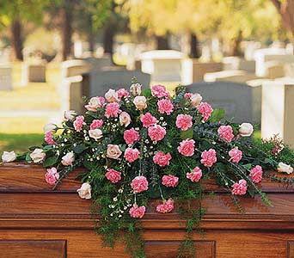
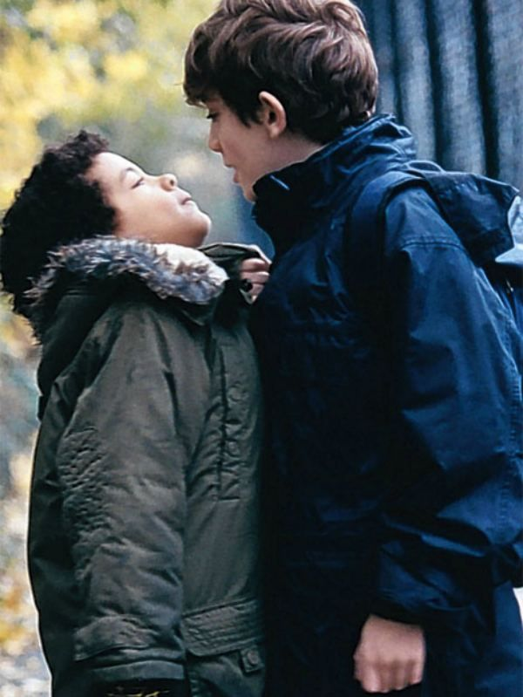
Adversity
An accident or illness
A premature death of a close one
A physical or learning disability
Experiencing the cruelty of others
Why is this happening to me?

Slide 4
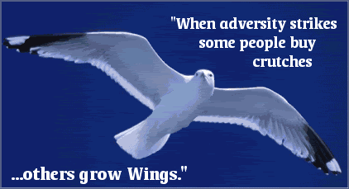
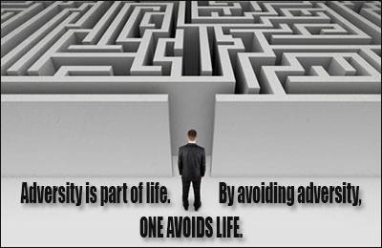
Natural Conditions
Many adversities and challenges are natural conditions of mortality and do not occur because the person experiencing them is at fault.

Slide 5
Hannah
Her name means grace
She was the wife of Elkanah, a devout Ephraimite (from the tribe of Levi) who lived in the central mountainous district of Israel (Ramah) * see note on Elkanah
She was barren for some years, while Elkanah’s other wife, Peninnah, had children. This was a sorrow for Hannah to not be able to have children
She prayed one day near the Tabernacle and Eli, the high priest, saw her sorrow, and later blessed her that her desires would be granted
She made a vow to have her son, Samuel, serve the Lord all his days. When Samuel was young she took him to the temple and he was cared for by the high priest, Eli
She would make him a little coat and brought it each year during the yearly sacrifice to Shiloh, where the Tabernacle was
Hannah was blessed with 5 more children: 3 sons, and 2 daughters

Slide 6
Hannah’s Adversity
She was unable to bear children and she suffered unkindness from others
Childlessness is never presented as a positive or acceptable condition
The position of the childless woman in the Hebrew Bible is ranked among the despised, the poor, the helpless, the widow (Job 24:21) and contrasted with the mother who is blessed, joyful and rich in children.
Isaiah 54:1 the image of the barren women is used to illustrate the contrasting promise of a joyful reversal that will be enacted by God.
Sing, O barren, thou that didst not bear; break forth into singing, and cry aloud, thou that didst not travail with child: for more are the children of the desolate than the children of the married wife, saith the Lord. Isaiah 54:1
1 Samuel 1:3-8
(4)

Slide 7
Eli and Sons
Eli was a high priest and judge in Israel during the days of Samuel the prophet and served for 40 years
Eli was of the lineage of Ithamar, the youngest surviving son of Aaron
Eli’s history was recorded in 1 Samuel 1-4
Eli pronounced a blessing upon Hannah, wife of Elkanah
Eli took the son of Hannah, Samuel, into the Lord’s service at a very young age and taught him
Eli had 2 sons, Hophni and Phinehas, who were Levite Priests. They were selfishly misusing the offerings brought to the Tabernacle in Shiloh, and they were guilty of immorality with the women who came before the Tabernacle
Eli did not take proper discipline towards his sons, and Samuel prophesied the calamity of his house and sons, therefore the his sons fell into the hands of the Philistines, and Eli died at age 98 by falling off a chair and breaking his neck.
His daughter-in-law (Phinehas’ wife) lost her life during childbirth, but remained alive long enough to name her son I-chabod
(2)

Slide 8
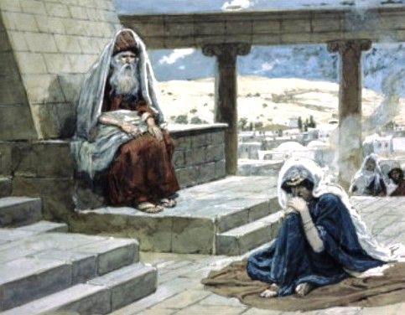
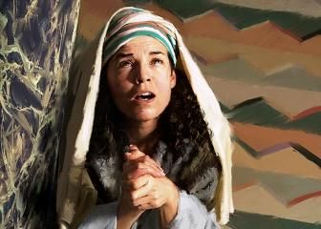
Hannah’s Plea
Elkanah takes is wives to Shiloh on their yearly passage
As we turn to the Lord in our adversity, He can provide help, hope, comfort, and peace
Hannah pleads with the Lord and made a vow unto the Lord
Eli witnesses this woman and presumes she is drunk-- Hearing her say nothing, but only seeing her lips move a long time, with such gestures.
1 Samuel 1:9-14
Tissot

Slide 9
The Vow--Nazarite
Hannah’s covenant with the Lord that, if she were given a child, “no razor” would come upon his head seems to be a promise to raise Samuel as a Nazarite, one under a special vow to God never to cut his hair.
In Samuel is a great contrast to Samson, the former keeping his Nazarite vows throughout life, becoming a powerful man of God, and the latter violating all his vows, becoming a wretched example of failure to serve God. (5)
A consecrated man: A man under a vow to abstain from wine, from any cutting of the hair, and any contact with the dead. The vow might be lifelong, or for a short, definite period. (1)
Samuel’s was lifelong.
1 Samuel 1:11

Slide 10
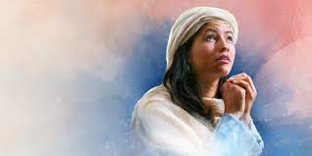
“Daughter of Belial”
When Hannah protested to Eli that she was not a “daughter of Belial” she meant a “worthless or profane person.”
Belial means “worthless, someone of evil affiliation.”
It is capitalized by the English translators as if it were a title for Satan and is sometimes so used in later books of the Old Testament (6)
1 Samuel 1:16

Slide 11
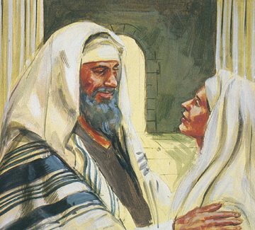
Eli’s Blessing
Go in peace: and the God of Israel grant thee thy petition that thou hast asked of him.
1 Samuel 1:17

Slide 12
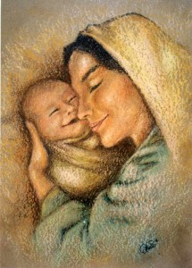
Hannah’s Faith
Hannah’s tests involved progressive degrees of sacrifice. Her blessings, like ours, did not come until after her trial of faith.
Her blessing of motherhood came only when she had sufficiently proven both her righteousness in adverse circumstances and her willingness to submit to a divine decree of barrenness.
She received her powerful testimony of the Savior only after she had fulfilled her vow to consecrate Samuel.
And finally, the promise of additional children came only as she continued faithful without receiving further posterity.
When we ask the Lord to bless us, we must be willing to use those blessings to serve Him
1 Samuel 1:17
(7)

Slide 13
Samuel
His name means “Heard of God” in Hebrew
He was the son of Elkanah and Hannah
True to his mother’s vow he was brought before the High Priest, Eli in his care
Samuel spoke with the Lord in a serious of 4 visits which told him of the sad prophecy to Eli and his family
Samuel continued in righteousness and became the prophet of the Lord
1 and 2 Samuel covers the time period of his birth to the period prior to the death of David—a span of about 130 years…he passed away prior to the end of 1 Samuel
(2)

Slide 14
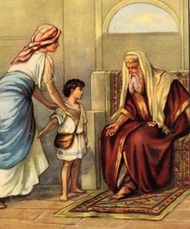
Samuel Presented At The Temple
I have lent him to the Lord; as long as he liveth he shall be lent to the Lord
“Once Samuel was weaned, Hannah did not delay their separation but took him directly to Shiloh.
The words ‘and the child was young’ (1 Sam. 1:24) portray the significance of Hannah’s offering to the Lord.
Dirk Dzimirsky
“Sometimes we are like Hannah; the Lord has to prepare us before he can grant our righteous desires.”
1 Sam. 1:28
(7, 8)

Slide 15
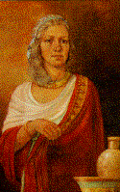
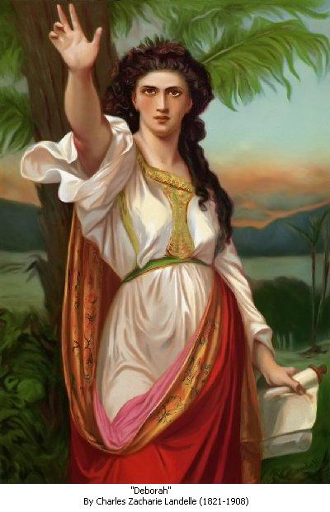
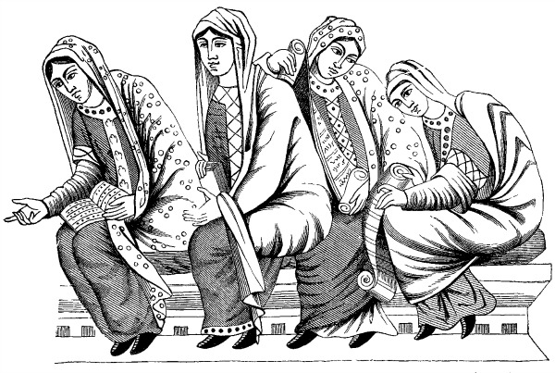
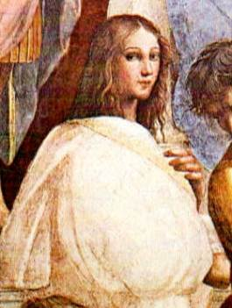
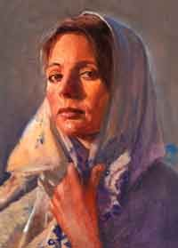
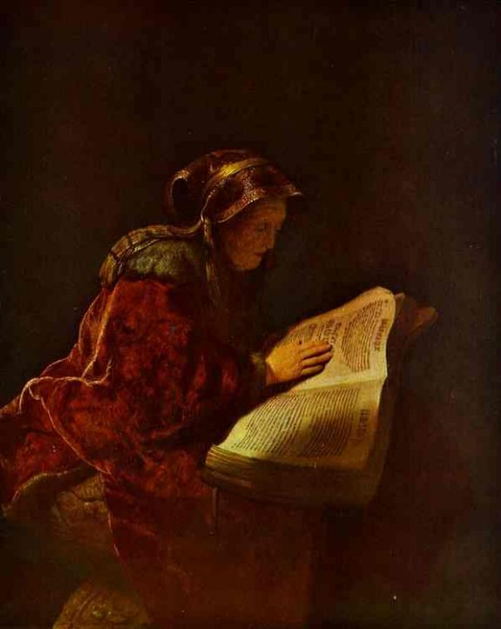
Prophetess
Women, filled with the spirit of prophecy testifying of the goodness of God, are more common in the Bible than any other scripture.
Miriam (Exodus 15:20)
Philip’s 4 daughters (Acts 21:9)
Charles Zacharie Landelle
Deborah (Judges 4:4)
A woman who had an abundance of the special gift of testimony may have been referred to as a prophetess.
Huldah (2 Kings 22:14)
Isaiah’s wife (Isaiah 8:3)
Anna (Luke 2:36-38)

Slide 16
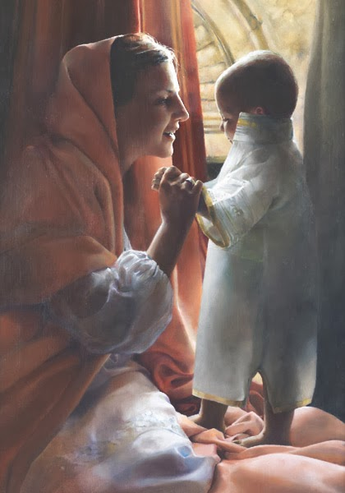
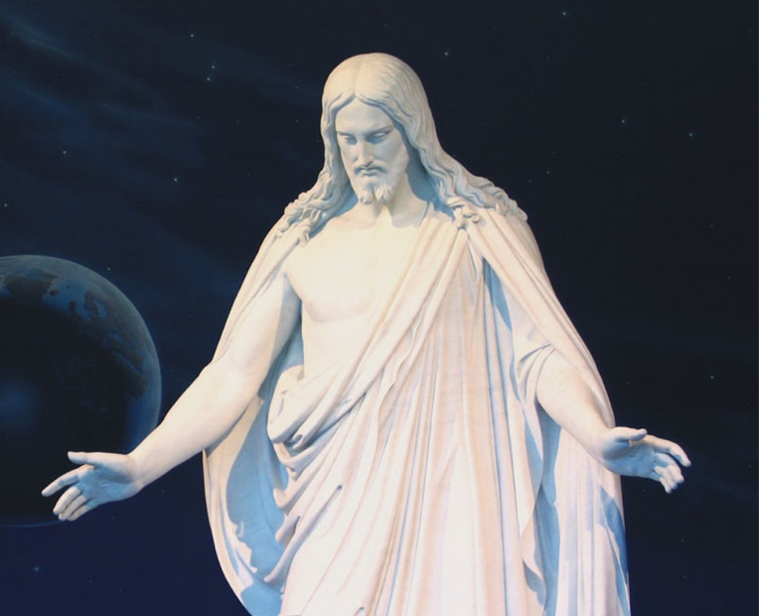
Hannah’s Psalm
This passage is a choice Old Testament reference to the future Messiah and shows that Hannah was blessed with the gift of prophecy.
The rock was a representation of protection. Jesus Christ is the rock or stone of Israel, the protector from evil
The horn symbolized power and strength. God had given her the power to bear a child.
The Messiah is “the anointed one” who will break all adversaries of the Lord in pieces (the Greek word for Messiah, Christos, also means “the anointed one”).
He would be given strength in that his horn (power) would be exalted before men.
1 Samuel 2:1-11
(5)

Slide 17
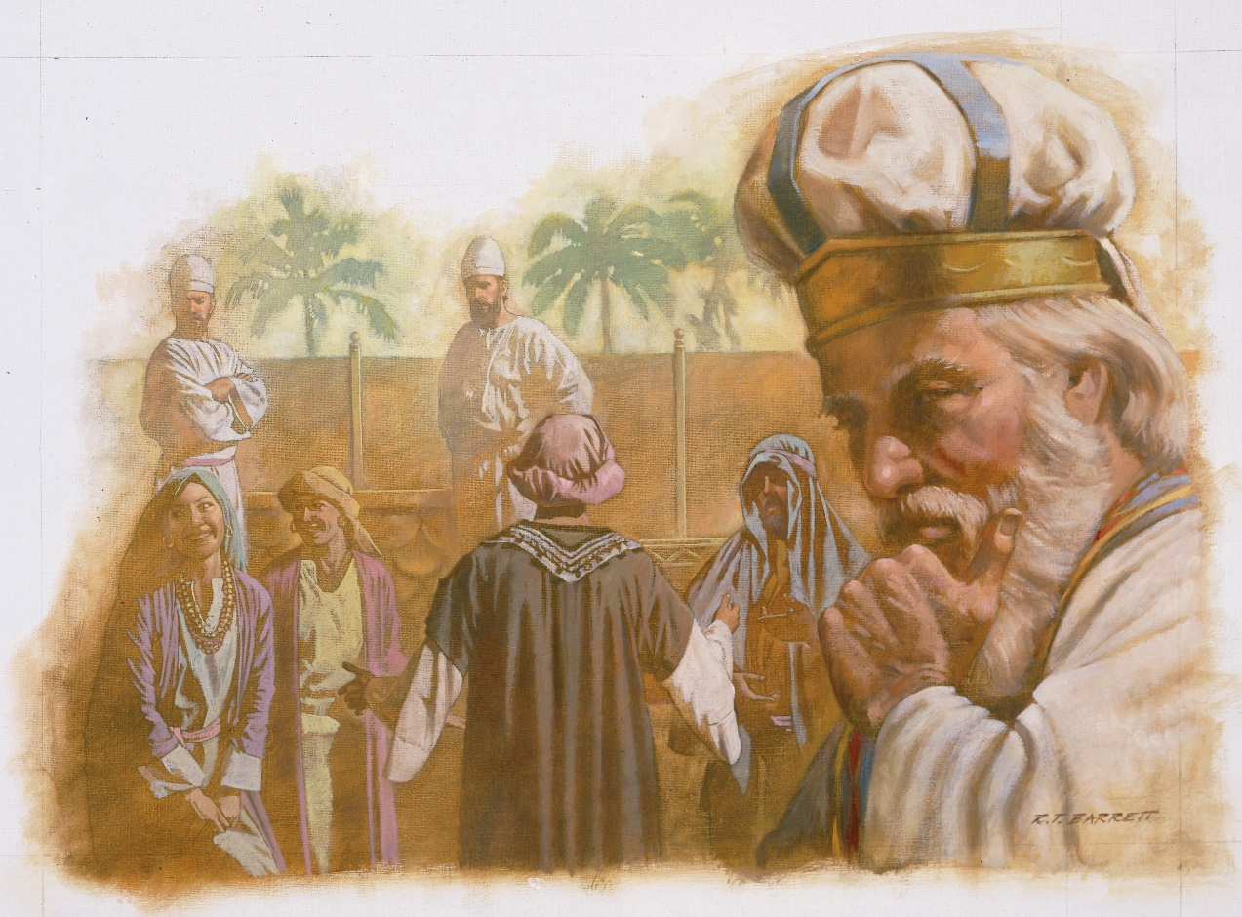
Eli Failed To Do His Duty
Under the law of Moses, willful disobedience to parents was punishable by death, and the parents were obliged to see that the punishment was carried out (Deuteronomy 21:18–21).
Hophni and Phineas bring disrespect to the house of God by taking meat offerings that did not belong to them.
Also they were engaged in immoral acts with the women who visited the Temple
Because Eli did not carry out the punishment that the law of Moses required for his sons’ actions, he was failing to do his duty.
1 Samuel 2:11-36

Slide 18
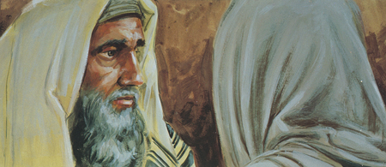
Honor
If we honor the Lord by keeping His commandments, He will honor us
Despise means to view with contempt or as worthless.
Esteemed means respected or honored. If we view God with contempt, He will not respect or honor us.
“Behold the days come, that I will cut off thine arm, and the arm of thy father’s house, and there shall not be an old man in thine house…And this shall be a sign unto thee, that shall come upon thy two sons…in one day they shall die both of them.”
Cut of thine arm=Eli lost his right to preside and his blessings of posterity because he did not respect God enough to punish his unrepentant sons for their sins.
And I will raise me up a faithful priest,
However, Hannah received blessings for serving God.
1 Samuel 2:30-36

Slide 19
Sources:
Suggested Hymn: #74 Praise Ye the Lord
Video: Hannah’s Faith (3:09)
1. Bible Dictionary, “Samuel, books of”, Nazarite
2. Who’s Who in the Old Testament by Ed J. Pinegar and Richard J. Allen ps. 45-47, 67-68
3. (Richard Neitzel Holzapfel, Dana M. Pike, and David Rolph Seely, Jehovah and the World of the Old Testament [2009], 190).
4. The Biblical World Posted Wednesday, January 26, 2011
Old Testament Institute Manual
Rasmussen, Introduction to the Old Testament, 1:161). Found in Old Testament Institute Manual
Linda M. Campbell Hannah: Devoted Handmaid of the Lord March 1998 Ensign
Arta M. Hale, “Lessons in Womanhood,” Ensign, Oct. 1973, 73
Keil and Delitzsch, Commentary, 2:2:35–36. Found in Old Testament Institute Manual
Presentation by ©http://fashionsbylynda.com/blog/

Slide 20
Jacob (Israel)
*Elkanah
Levi
Kohath
Amram (father of Moses Aaron and Miriam)
Izhar Brother of Amram
Josephus says that Eleanah, the husband of Hannah, was a Levite who dwelt in Ephraim near Jerusalem.
Dictionary.com
citizen of Ephratah, the old name of Bethlehem (Ruth 1:2; 1 Sam.17:12), or Bethlehem-Judah.
The Ephrathite Descendants Of Ephraim? The Ephrathite was an ancient biblical ethnic group in the Old Testament. Some of the famous biblical characters were Ephrathite, such as Naomi and her husband Elimelech, and their two sons Mahlon, and Chilion. When Naomi husband and her two sons die, her daughter-in-law Ruth remarried one of her husband relatives name Boaz, who also was an Ephrathite (Ruth chapter 2, verse 1). King David father Jesse was an Ephrathite (I Samuel chapter 17, verse 12). The Ephrathite are probably descendants of Ephratah Hezron first wife. When Hezron died his son Caleb took Ephratah as his wife, I Chronicles chapter 2, verse 24. Hezron is the grandchild of Judah, and Tamar; Hezron grandmother Tamar was a Canaanite, Genesis chapter 38, verse 2. Yahshua bloodline is from Ephratah.
The Ephrathite clan was assimilated into the tribe of Judah through marriage, throughout the biblical centuries, losing their Ephraim, and Ephrathite tribal identity.
(Etymological: The study of historical linguistic change, as applied to individual words). From the book entitled, “The North African Atlantic Hidden Birthright.” Pp. 41-46.
Korah
Ebiasaph
Elkanah is descended from Kohath and Levi, making him a Levite.
1 Chronicles 6:33-3 And the residue of the families of the sons of Kohath had cities of their coasts out of the tribe of Ephraim
Elkanah was the son of Jeroham, who was the son of Elihu, who was the son of Tohu, who was the son of Zuph.
Elkanah is described as having originated from Zuph, specifically Ramathaim-Zophim, which was part of the tribal lands of Ephraim; however, the Books of Chronicles state that he was a Levite. He is the great great great grandson of another Elkanah. Wikipedia
Assir
Tahath
Zephaniah
Azariah
Joel
Elkanah
Amasai
Mahath
Elkanah
Zuph
Tohu/Toah
Elihu/Eliel
Jeroham
Elkanah
Hannah
Samuel
The Talmud lists him as a prophet, along with his wife and son.

Slide 21
Infertility:
“The most difficult aspect of infertility to overcome was the effect that it had on my feelings of self-worth. During those pain-filled years, I mistakenly felt that because I could not have children, I must be of no worth. The resulting depression and despair only made my feelings of worthlessness worse.
“Through prayer and scripture study, I learned that the source of my depression was Satan and that his influence can be overcome by going to the Lord for help and then acting upon the impressions received. One of the scripture study topics I felt to focus on was that of charity, the pure love of Christ. Learning about charity brought new insight, for I recognized a source of true and lasting self-worth—the love of our Heavenly Father and our Savior for us all. The more I studied about charity, the greater my desire to feel the pure love of Christ in my life, to know that he loves me even with all my imperfections and problems.
“What a glorious day it was when I knelt and asked if I was loved by my Heavenly Father and his Son. The joy that filled my soul as a result was indescribable. I understand now, to a greater degree, why Mormon tells us: ‘Pray unto the Father with all the energy of heart, that ye may be filled with this love, which he hath bestowed upon all who are the true followers of his Son, Jesus Christ’ (Moro. 7:48).
“What great motivation that divine love has been in my life to bring about change and improvement!” (Janet Nelson Christensen, “I Yearned for a Baby,” Ensign, Aug. 1996, 53, emphasis added)
Eli sits near a post:
In the ancient Middle East, it was customary for certain officials to place a stool or seat in a courtyard or near the gate of the city where they could sit in judgment, hearing cases or complaints. These seats usually had no backs and were placed near a wall or post to provide a backrest. This circumstance would explain why Eli was sitting near a post. It was probably on such a backless seat that Eli was sitting when he heard the news of the death of his sons and fell over backwards, killing himself (see 1 Samuel 4:18).
“Weaning took place very late among the Israelites.
According to [2 Maccabees 7:27], the Hebrew mothers were in the habit of suckling their children for three years. When the weaning had taken place, Hannah would bring her son up to the sanctuary, to appear before the face of the Lord, and remain there forever, i.e. his whole life long. The Levites generally were only required to perform service at the sanctuary from their twenty-fifth to their fiftieth year [see Numbers 8:24–25]; but Samuel was to be presented to the Lord immediately after his weaning had taken place, and to remain at the sanctuary forever, i.e. to belong entirely to the Lord. To this end he was to receive his training at the sanctuary, that at the very earliest waking up of his spiritual susceptibilities he might receive the impressions of the sacred presence of God.” (Keil and Delitzsch, Commentary, 2:2:26.)
Every year, Elkanah, Peninnah and her children, and barren Hannah go up to Shiloh, some 20 miles or so north of Jerusalem where the tabernacle is stationed. They go there to observe one of three annual feasts (Exodus 23:14-17; Deuteronomy 16:16). This very special time is to be a time of rejoicing.
Most Difficult For Hannah: and probably for Elkanah as well, rejoicing before the Lord is most difficult. But the primary source of Hannah’s pain on this annual trek to Shiloh is that Peninnah takes advantage of this good opportunity to harass Hannah year after year without letting up (see 1 Samuel 1:4-7). This results in many tears for Hannah and an inability to join in with the festive meal (1 Samuel 1:7).
Extra Portion: It is not that Elkanah, her husband, does not try to comfort her or to come to her aid. Elkanah assures her of his love by giving her a double portion of the meat which has been sacrificed (1 Samuel 1:5). He makes sincere efforts to compensate for her barreness.
But after eating and drinking, she hurries off from the family to find her way to the tabernacle, where she pours out her soul to God. Inside, she prays silently as Eli, sitting by the doorway, looks on with interest. He sees her shoulders heaving as she sobs in great distress and weeps bitterly (1:10). Not hearing her words, Eli jumps to the wrong conclusion, assuming that she has been celebrating too much, and that her happiness is inappropriate drunkenness. He rebukes her for drunkenness and instructs her to give up this kind of drinking (1:13-14).

Slide 22
Samuel, The Prophets:
“Samuel was a great prophet of the Old Testament. He was a bridge, a connecting link, between the patriarchs, judges and the kings. He was both the last of the judges and ‘the first of the later prophets.’ He lived at a pivotal point in the Lord's dealings with His chosen people as they demanded a king to replace the patriarch and judge governments which had been in place since the beginning. He was a witness of the first separation of church and state and of the change from a confederation of twelve tribes to a single united kingdom. He served the Lord at a time of an ever-weakening House of Israel as it started its downward spiral to eventual captivity and dispersal.
“Perhaps in our minds he is always ‘the boy Samuel’ and hardly ranks in the same category of importance as the patriarchs who preceded him. But like the others, Samuel was called by the Lord to serve an entire lifetime as His prophet. (Evelyn T. Marshall, “Samuel Became 'first of Later Prophets',” LDS Church News, 1994, 09/24/94)
Eli’s Sons:
“Of these offerings, the portion which legally fell to the priest as his share was the heave-leg and wave-breast. And this he was to receive after the fat portions of the sacrifice had been burned upon the altar [see Leviticus 7:30–34]. To take the flesh of the sacrificial animal and roast it before this offering had been made, was a crime which was equivalent to a robbery of God. … Moreover, the priests could not claim any of the flesh which the offerer of the sacrifice boiled for the sacrificial meal, after burning the fat portions upon the altar and giving up the portions which belonged to them, to say nothing of their taking it forcibly out of the pots while it was being boiled [see 1 Samuel 2:12–17]. Such conduct as this on the part of the young men (the priests’ servants), was a great sin in the sight of the Lord, as they thereby brought the sacrifice of the Lord into contempt.” (Keil and Delitzsch, Commentary, 2:2:35–36.)
The poor example of the priests caused others in Israel to abhor “the offering of the Lord” (v. 17). But these actions were not all, for the sons of Eli seduced women and engaged in adulterous acts at the very door of the tabernacle, evidently by misusing their office of priest to entice the women Under the law of Moses, willful disobedience to parents was punishable by death, and the parents were obliged to see that the punishment was carried out. Hophni and Phinehas compounded their already serous sins by disobeying their father, and Eli failed in his parental responsibility as well as in his office as the presiding priest. Although he rebuked his sons, he took no action to see that the abomination in his family and at the tabernacle was corrected. Therefore, “a man of God” (some unnamed prophet) came to Eli and pronounced the Lord’s curse upon Eli’s house because “[thou] honourest thy sons above me” (vv. 27, 29). That is, Eli’s relationship with his sons was of more value to him than his relationship with God.

Slide 23
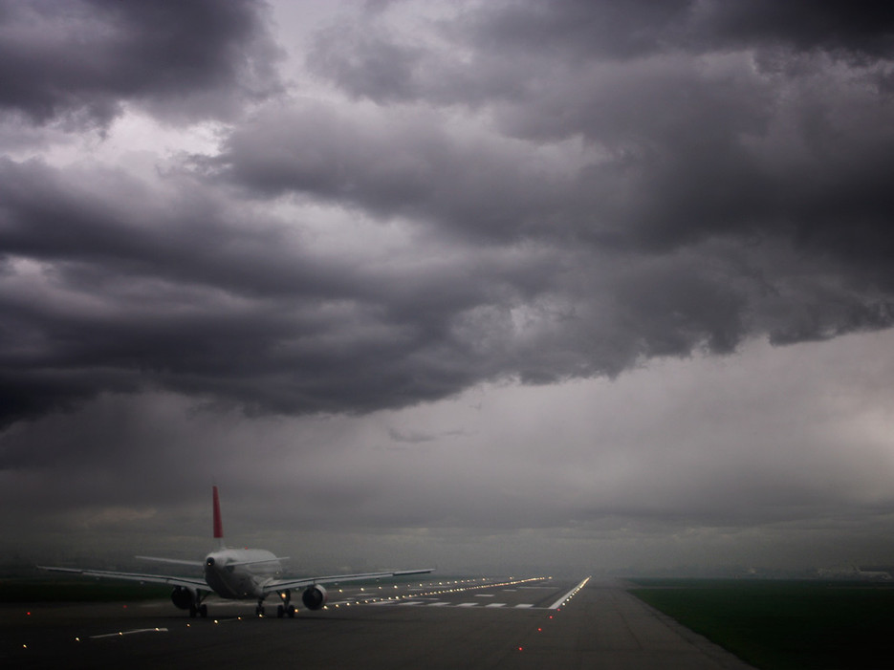
Now we’re no famous pilots, but it seems so counterintuitive: Wouldn't a pilot have an easier time if, instead of rushing into the gale, the wind were coming from behind the aircraft—giving it a push, so to speak? We remember what happened a few months ago in Spain when fierce winds at Bilbao’s Internatinal Loiu Aiport made planes wobble dramatically during takeoffs and landings. We asked scientists to break it down for us.
Much to the TSA’s disapproval, we’re sure, the most apt metaphor for the physics involved in a plane's takeoff is the recoil of a gun after it fires a shot. "The gun springs back on reaction to the force of the bullet accelerating in the other direction," says Snorri Gudmundsson, assistant professor of aerospace engineering at Embry-Riddle Aeronautical University, Florida. The recoil—as you’ll no doubt remember from high school classes—is an example of Newton's Third Law about how every action generates an equal and opposite reaction. In this case of takeoff, the fast air bearing down on the plane generates an upward force on the wings (analogous to a gun's recoil), which helps lift the aircraft.
Pilots like to take off into a headwind because it helps them achieve "wheels up" faster. "A jetliner like a Boeing 747, needs at least 150 mph of airspeed to become airborne," says Gudmundsson. "Without wind, the plane has to accelerate to a groundspeed of 180 mph to lift off, but when you have a 30 mph headwind, the plane only has to accelerate to 150 mph, thanks to the extra boost it gets from the headwind.“
Another factor in takeoff is air pressure, and how it changes. Wind traveling across the top of a plane’s wing moves differently than wind rushing beneath it due to the wing's aerodynamic shape. "The faster velocity of air passing over the wing creates a region of suction on the upper surface of the wing, especially toward the front," says Steve Smith, aerospace engineer at NASA's Ames Research Center. "The suction pulls the wing up.“
You can see how this works by taking a strip of paper that's, say, two-inches-by-11-inches-long, and blowing lengthwise along the top of it, creating a headwind. The paper will lift up because of the pressure changes resulting from the flow of your breath, similar to what happens to a wing. But blow on it sideways, and the paper ripples wildly—a small reminder to never to fly in high crosswinds in Bilbao.
Traveler
Something of Interest: Adversity

Slide 24
1. Who ensured Moses’s safety after he’d been put in the river? a. Moses’s sister, Miriam b. The daughter of Pharaoh c. One of the Pharaoh’s handmaids d. Moses’s mother, Jochebed
2. What was Esther’s Hebrew name? a. Vashti b. Hadassah c. Mikhal d. Hagar
3. What gift did Hannah give her son, Samuel, every year when she saw him at the temple? a. A blanket b. A bullock c. A dove d. A coat
4. Which woman slew the wicked general Sisera, thereby delivering Israel from Canaanite bondage? a. Jael b. Dinah c. Rahab d. She is not named
5. Who was the only known female judge in Israel? a. Miriam b. Jezebel c. Deborah d. She is not named
Trivia Quiz: Heroines of the Old Testament
By Kelsey Berteaux | Aug. 15, 2013
Answers
1. A: Before the Pharaoh’s daughter drew Moses from the river, Miriam looked after the ark of bulrushes, “to wit what would be done to him” (Exodus 2:4). Miriam also ensured that Moses’s mother, Jochebed, would be his wet nurse.
2. B: To better assimilate into Persian culture, the Jewish orphan Hadassah changed her name to Esther when she left her caretaker and uncle, Mordecai, to be presented to the king. Later, at some risk, she reveals her true identity as a Jew to save her people from the wicked Haman.
3. D: Samuel was Hannah’s only child; after giving him up to the temple in exchange for the blessing of motherhood, Hannah could visit him only once a year, and each time brought him “a little coat” (1 Samuel 2:19).
4. A: Because Jael slayed the Canaanite general Sisera with a tent spike while he slept in her home, the Israelite army was able to prevail against the evil king Jabin. As the Israelites celebrated their victory, Jael is praised as being “blessed above women” (Judges 5:24).
5. C: Apart from her position as a judge in Israel, Deborah is also named a righteous prophetess in the scriptures (Judges 4:4). Under her guidance, and with the help of Jael (see question 4), Israel is victorious against the Canaanite armies of Sisera.

Slide 25
6. How did Rahab save her family from destruction at Jericho? a. She heeded the words of the scriptures and knew to flee the city beforehand b. She prayed to the Lord to be spared and was granted her petition c. She hid Joshua’s spies from the king of Jericho and secured from them a promise of safety d. She took her family to the Israelite temple which was spared from destruction
7. How old was Sarai, Abraham’s wife, when she bore Isaac? a. 74 b. 86 c. 91 d. 103
8. What did Rebekah do that showed Abraham’s servant she was to be Isaac’s wife? a. She was the only woman at the desert well when Abraham’s servant came b. She offered to draw water for the camels of Abraham’s servant c. She took off her sandals before approaching the well d. She spoke a heartfelt prayer before drawing water
9. Whom does Solomon’s “song of songs” praise? a. One of Solomon’s wives b. All covenant women c. Daughters of Jerusalem d. A Shulamite woman
10. Who said: “whither thou goest, I will go; and where thou lodgest, I will lodge: thy people shall be my people, and thy God my God”? a. Ruth b. Esther c. Leah d. Rachel
Answers
6. C: When the two spies from Joshua came to Rahab, she recognized that they were sent of the Lord. After hiding them from searchers, she was told to hang a scarlet thread in her window so that she and all her house would be spared.
7. C: Isaac’s miraculous conception, when Sarai was 91 and Abraham 100, fulfilled the Lord’s promise to her: “she shall be a mother of nations; kings of people shall be of her” (Genesis 17:16).
8. B: As Abraham’s servant approached the desert well, he prayed for a specific sign: whoever was to marry Isaac should offer to draw water for his camels. This the faithful Rebekah did, and after meeting with her family, the servant took Rebekah to be Isaac’s wife (Genesis 24).
9. D: While the woman praised in Solomon’s song is never named, in one verse we learn of her origin: she is a Shulamite, or one hailing from Shulem (Song of Solomon 6:13). Another famous Shulamite (or Shunammite) in the Old Testament in the faithful woman who housed Elisha and was promised a son for her righteousness (2 Kings 4).
10. A: Despite being a Moabitess and stranger in Bethlehem, Ruth remained loyal to her marriage vows and mother-in-law, Naomi. She spoke this phrase, evidencing her virtue and devotion, when she was offered the opportunity to leave Naomi and return to her mother and native people (Ruth 1:16).

