Slide 2
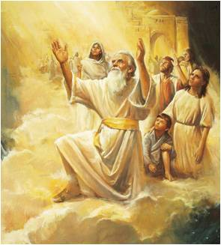
Enoch
The Old Testament prophet Enoch was blessed to speak with the Lord and see everything that would happen on the earth.
As part of this vision, Enoch saw the great wickedness and destruction that would take place on the earth.
Moses 7:20–67

Slide 3
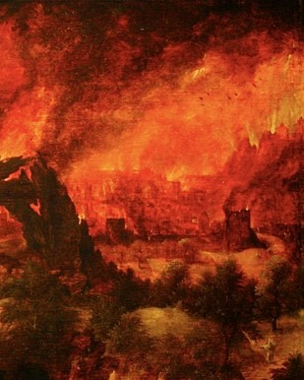
What was Enoch’s response to the wickedness and destruction he saw?
And as Enoch saw this, he had bitterness of soul, and wept over his brethren, and said unto the heavens: I will refuse to be comforted;
According to the end of this verse, what did the Lord tell Enoch to do?
Lift up your heart, and be glad; and look.
Moses 7:44

Slide 4
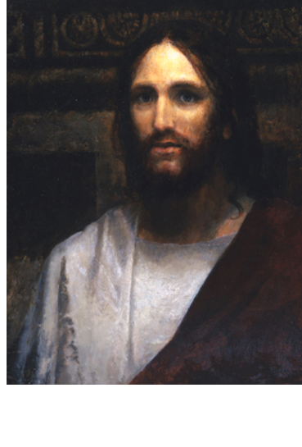
Cause To Rejoice
Titles for Jesus Christ:
Son of Man= A title that Jesus Christ used when speaking of Himself
The Righteous
The Lamb
And behold, Enoch saw the day of the coming of the Son of Man, even in the flesh; and his soul rejoiced, saying: The Righteous is lifted up, and the Lamb is slain from the foundation of the world; and through faith I am in the bosom of the Father, and behold, Zion is with me. Moses 7:47

Slide 5
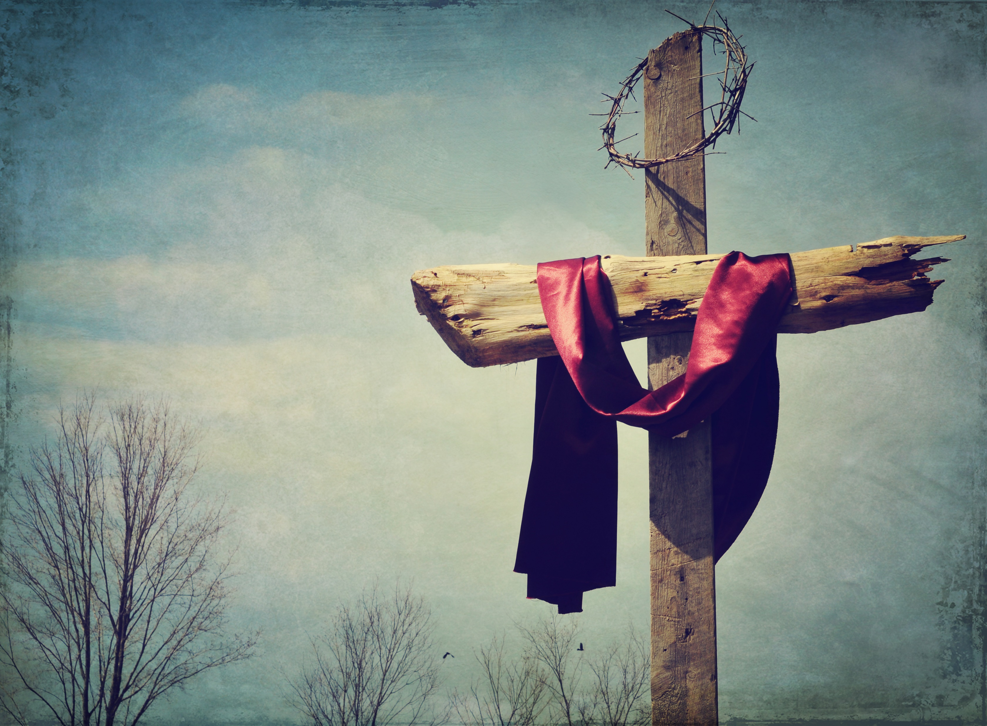
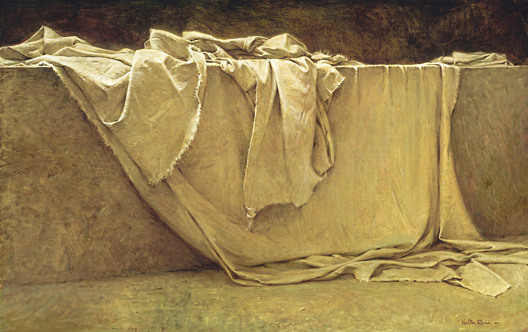
Crucifixion and Resurrection
Enoch saw the Savior, and learned about His Crucifixion and Resurrection, the redemption of mankind from sin and death,

Slide 6
Restoration and Destruction
Enoch saw the Restoration of the gospel in the latter days, the destruction of the wicked

Slide 7
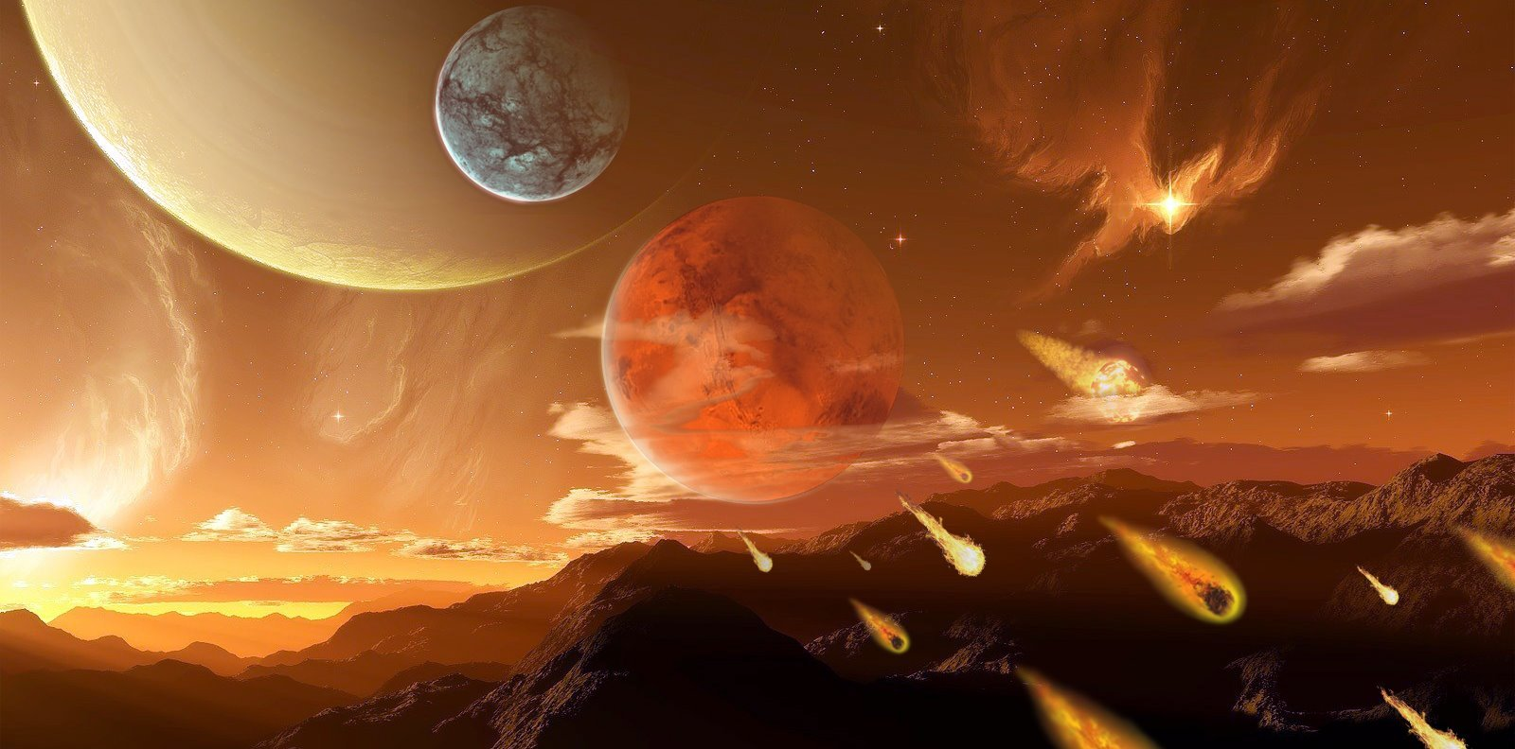
Ultimate Triumph
Enoch saw the ultimate triumph of the righteous.
All of these events are elements of the plan of salvation.

Slide 8
Experiencing Joy
When we view difficult circumstances with an eternal perspective, we can experience joy rather than bitterness of soul
Enoch was blessed with a vision that helped him gain an eternal perspective.

Slide 9
What have we been blessed with that can help us gain an eternal perspective?
The Commandments
The Scriptures
Personal Revelation
The Testimonies of Prophets and Apostles

Slide 10
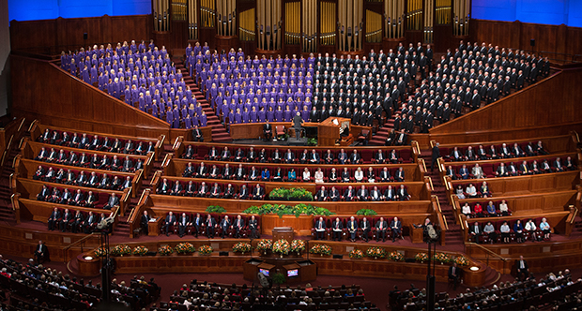
Alex Scenario
As you are watching general conference with your family, the time comes to sustain the leaders of the Church.
After the sustaining is finished, your brother Alex begins to look a little concerned.
You notice that he continues to seem bothered throughout the remainder of the session, so when it is over you ask him what is wrong.

Slide 11
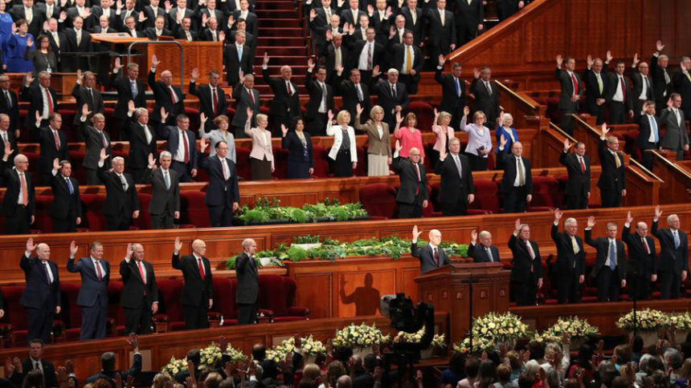
Alex Scenario
Alex responds by saying that while the Church leaders were being sustained, he noticed that most of the members of the First Presidency and the Quorum of the Twelve Apostles seem to have come from similar cultural backgrounds.
He asks, “Why aren’t there more Apostles from other cultures or countries? Isn’t this a global church?”

Slide 12
Eternal Perspective
What truths do you know about prophets and apostles and the way in which they are called that could help Alex see his question with an eternal perspective?
What scripture passages can you think of that might be helpful to Alex?

Slide 13
Chosen
Before I formed thee in the belly I knew thee; and before thou cames forth out of the womb I sanctified thee, and I ordained thee a prophet unto the nations.
Jeremiah 1:5
You know that there are other divinely appointed sources that could help answer Alex’s question. However, you can’t think of any at the moment, so you suggest that Alex take some time before the next day’s sessions of general conference to gain additional understanding of this subject by studying and praying about the scriptures and the words of prophets and apostles. You tell him that you will do the same.

Slide 14
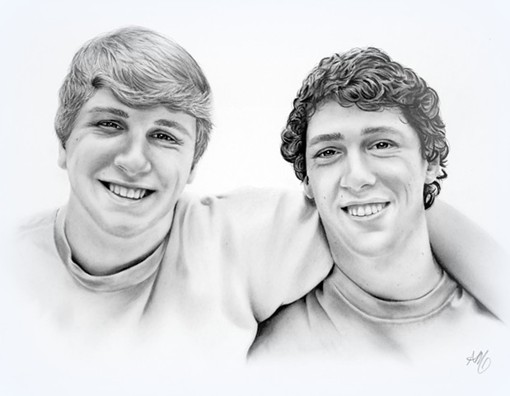
Next Day
The next day, you and Alex discuss a source each of you has found that testifies of the inspired calling of prophets and apostles.
Alex says he is beginning to feel better about his concerns, but you know there is one more principle of acquiring spiritual knowledge that can help him: acting in faith.
What are some ways you could invite Alex to act in faith that would help him continue to find peace about his question?

Slide 15
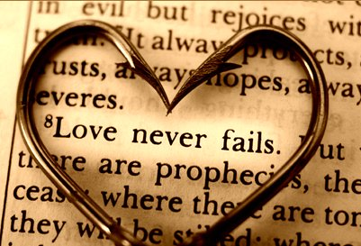
Open Heart and Scripture Search
After discussing with Alex what he thinks he could do to act in faith, he decides that during the upcoming sessions of general conference, he will listen with an open heart, seeking a stronger testimony that the leaders of the Church are called of God.
He says he will also continue to search and pray about the scriptures and the words of prophets and apostles to learn more about this subject.

Slide 16
A Week Later
A week later, you follow up with Alex and ask him how he is doing with his question. Alex shares with you that while he’s still not exactly sure why God calls who He calls to be prophets and apostles, the Spirit has testified to him that the Savior is the head of the Church, and that he trusts that we are led by prophets and apostles who are called of God.
You realize that although someone might not fully understand every detail about a certain question or issue, the principles of acquiring spiritual knowledge can still help people understand enough through the Spirit and therefore find peace.

Slide 17
Sources:
Suggested Hymn: Come, Listen to a Prophets Voice #21
Old Testament Seminary Teacher’s Manual Lesson 84
Article:
Church News article “New First Presidency Answers Questions about Church Challenges and Opportunities” [Jan. 16, 2018, LDS.org].)

