Slide 1
Lesson 87
A New King
1 Samuel 16
I will send thee to Jesse the Beth-lehemite: for I have provided me a king among his sons.
1 Samuel 16:1

Slide 2
Outward Vs Inward
How can we know?
We may see one thing but the image may be totally misrepresented
(2)

Slide 3
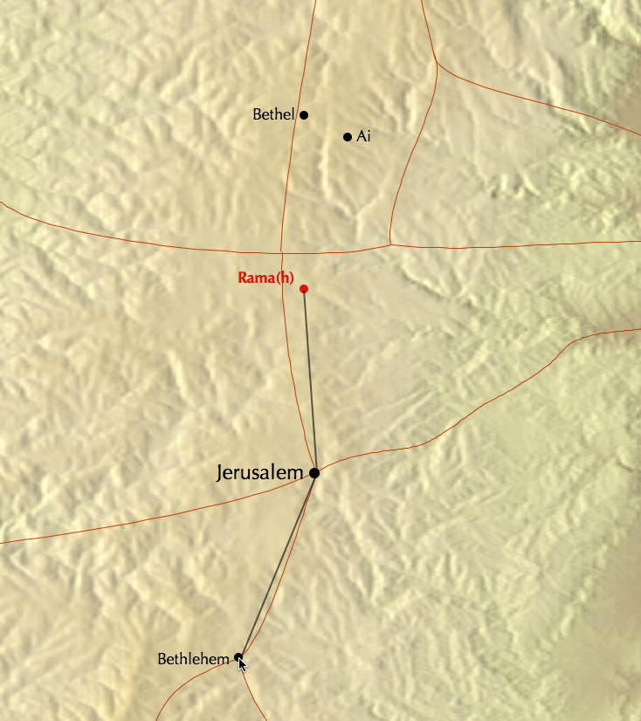
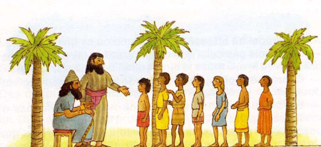
Finding a King
The Lord commanded Samuel to find a king.
He was to leave Ramah—his home– find a man named Jesse in Bethlehem
Ramah was three miles north of Jerusalem and Bethlehem was only seven miles south of Jerusalem
Jesse had Eliab, his first son, presented to Samuel and Samuel had thought he was looking at the next king of Israel
1 Samuel 16:1-6
(2)

Slide 4
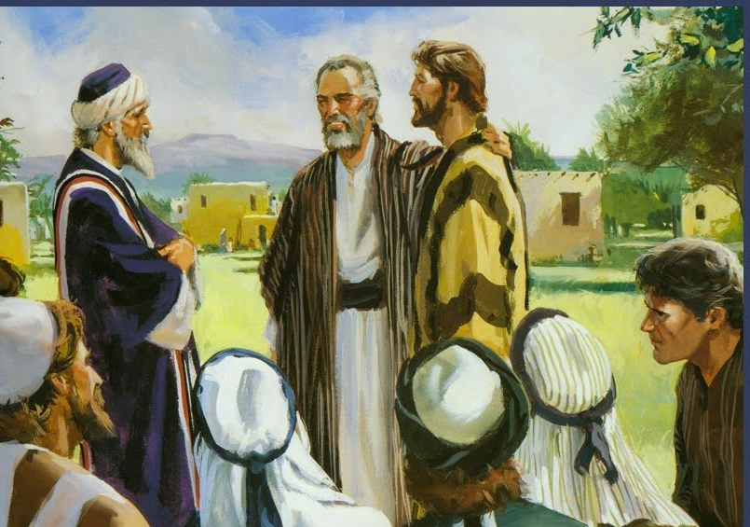
The Countenance
Eliab, Abinadab, Shimmah, and others
But the Lord said unto Samuel, Look not on his countenance, or on the height of his stature; because I have refused him: for the Lord seeth not as man seeth; for man looketh on the outward appearance, but the Lord looketh on the heart.
Mortals tend to see the outward appearance, but the Lord has the power to look to the very depths of men and things.
1 Samuel 16:7
(3)

Slide 5
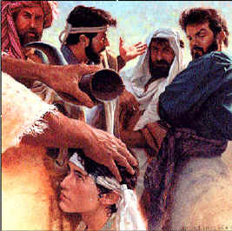
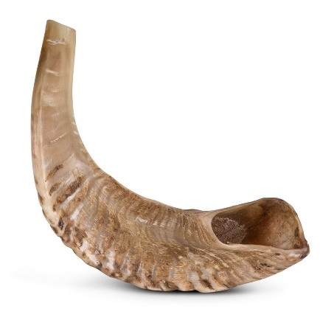
The Youngest Son
Jesse presents his youngest son to Samuel
God judges us by our hearts rather than our outward appearance
Samuel notices David’s beautiful countenance and anoints him King
The “horn of oil” was probably a ram’s horn filled with olive oil and used to anoint those chosen of the Lord
1 Samuel 16:12-13
(2)

Slide 6
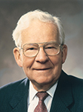
“When the Lord measures an individual, … He measures the heart as an indicator of the person’s capacity and potential to bless others.
“Why the heart? Because the heart is a synonym for one’s entire make-up. …
“The measure of our hearts is the measure of our total performance. As used by the Lord, the ‘heart’ of a person describes his effort to better self, or others, or the conditions he confronts.”
(4)

Slide 7
Recordings of David
Now the acts of David the king, first and last, behold, they are written in the book of Samuel the seer, and in the book of Nathan the prophet, and in the book of Gad the seer,
1 Chronicles 29:29
All 3 of these books have been lost
Book of Samuel
Book of Nathan
Book of Gad
Before they disappeared certain unknown compilers extracted material from them to create the 6 books known to us as
1 and 2 Samuel
1 and 2 Kings
1 and 2 Chronicles
(2)

Slide 8
David
David was born around 1032 BC, the youngest son of Jesse from the tribe of Judah
His name means beloved
He was a shepherd before he was anointed by Samuel as King
He fought with Goliath proving his faithfulness in the Lord
He was put in charge of Saul’s army, however, Saul tries to murder him
He united the tribes as one great nation and ensured that the government was based on the law of God.
Through his transgression with Bathsheba his union with her brought forth Solomon, who was an ancestor of Jesus Christ.
Some of Psalms was written during David’s reign and many—though not all—of Psalms in the Old Testament collection are ascribed to David personally
(1,2)

Slide 9
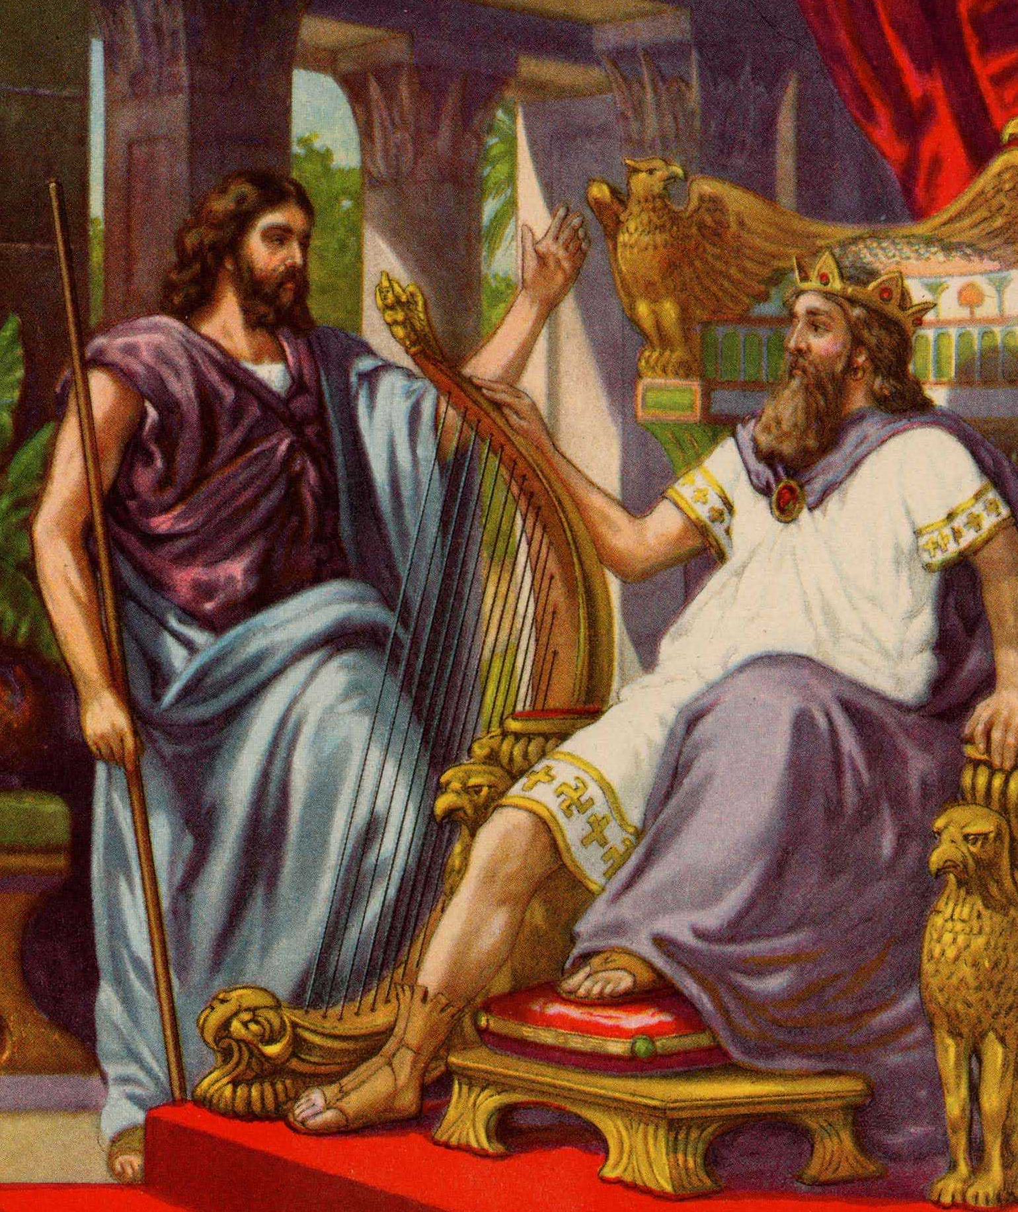
Saul’s Loses Spirit of the Lord
But the Spirit of the Lord departed from Saul, and an evil spirit from the Lord troubled him.
JST : 14
“David from then until he was brought to the aid of the mentally disturbed Saul. As a consequence of his transgressions, Saul had lost the Spirit of the Lord and often fell into states of deep melancholic depression. The servants in his court suggested that music might be an excellent antidote; and one of them volunteered:”
“With that recommendation David was brought to Saul and assigned to his personal court as armor-bearer for the king.”
Armor-bearer--a person selected by the king to carry his armor and to stand by the king in times of danger.
1 Samuel 16:18
(5)

Slide 10
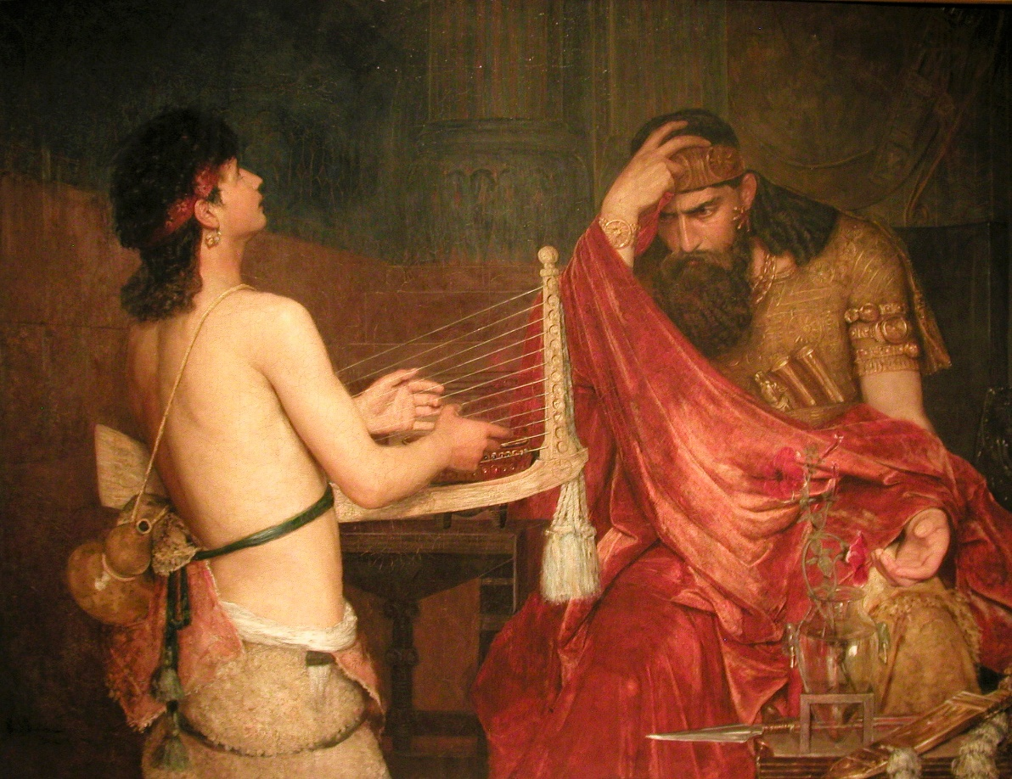
Music To His Ears
The evil spirit departed
Rembrandt van Rijn, c. 1658.
Although Saul may have temporarily felt better by listening to spiritually uplifting music, the only way Saul could have found lasting peace was by repenting.
1 Samuel 16:23
(5)

Slide 11
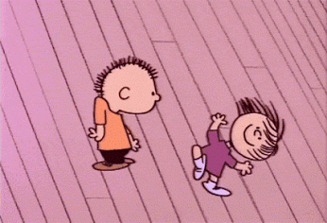
Choose Carefully the Music You Listen To
“Music can enrich your life. It can edify and inspire you and help you draw closer to Heavenly Father.
Some music can carry evil and destructive messages.
Music has a profound effect on your mind, spirit, and behavior.
Do not listen to music that encourages immorality or glorifies violence through its lyrics, beat, or intensity.
“Learn and sing the hymns. Hymns can lift your spirit, move you to righteous action, and help you withstand the temptations of the adversary”
Do not listen to music that uses vulgar or offensive language or promotes evil practices. Such music can dull your spiritual sensitivity.
Pay attention to how you feel when you are listening
(6)

Slide 12
Sources:
Suggested Hymn: Who’s on the Lord’s Side
Video: Measure of Our Hearts (1:08)
The Song of the Heart (2:52)
Who’s Who in the Old Testament by Ed J. Pinegar and Richard J. Allen pp. 38-39
W. Cleon Skousen The Fourth Thousand Years pp. 1-2
Old Testament Student Manual
Elder Marvin J. Ashton (“The Measure of Our Hearts,” Ensign, Nov. 1988, 15).
Arthur R. Bassett The King Called David October 1973 Ensign
For the Strength of Youth [booklet, 2011], 22.
Presentation by ©http://fashionsbylynda.com/blog/

Slide 13
6 or 7 sons?:
“1 Samuel 16:10 says seven sons, but 1 Chronicles 2;13 identifies each son by name and lists David as the seventh. This would lead us to conclude that only 6 were presented before David arrived.” W. Cleon Skousen
Tribe of Judah
Salma
Rahab
Boaz
Ruth
Obed
Jesse
Eliab
Abinadab
Shammah
Shimeah
Shimma
Nethaneel
Raddai
Ozem
David
Zeruiah
Abigail
1 Sam. 16:8
2 Sam. 13:3
1 Chron. 2:13

Slide 14
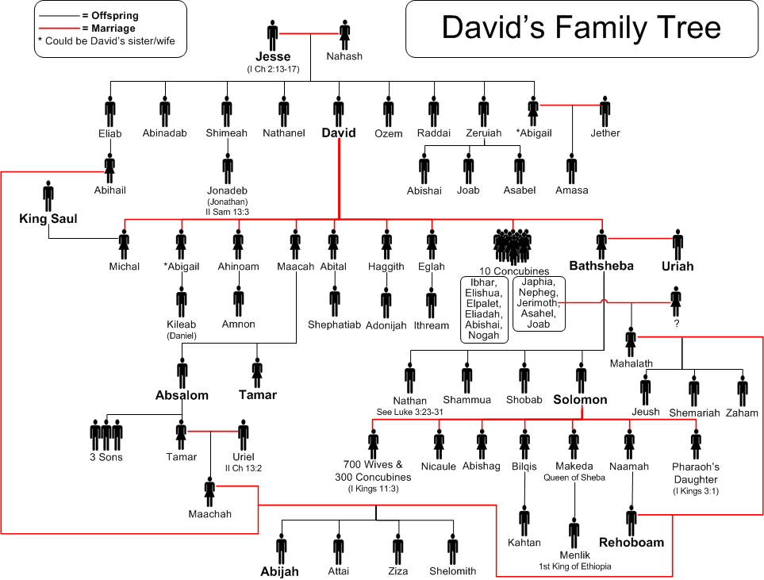

Slide 15
Music:
“If you can control your thoughts, you can overcome habits, even degrading personal habits. If you can learn to master them you will have a happy life.
“This is what I would teach you. Choose from among the sacred music of the Church a favorite hymn, one with words that are uplifting and music that is reverent, one that makes you feel something akin to inspiration. … Go over it in your mind carefully. Memorize it. Even though you have had no musical training, you can think through a hymn.
“Now, use this hymn as the place for your thoughts to go. Make it your emergency channel. Whenever you find these shady actors have slipped from the sidelines of your thinking onto the stage of your mind, put on this record, as it were.
“As the music begins and as the words form in your thoughts, the unworthy ones will slip shamefully away. It will change the whole mood on the stage of your mind. Because it is uplifting and clean, the baser thoughts will disappear. For while virtue, by choice, will not associate with filth, evil cannot tolerate the presence of light.
“In due time you will find yourself, on occasion, humming the music inwardly. As you retrace your thoughts, you discover some influence from the world about you encouraged an unworthy thought to move on stage in your mind, and the music almost automatically began” Elder Boyd K. Packer (“Inspiring Music—Worthy Thoughts,” Ensign, Jan. 1974, 28).
Evil Spirits:
Evil spirits are not sent by God, nor does God give revelations through the evil spirits which sometimes trouble men. He cast these evil spirits out of heaven long ago for their rebellion against Him. The Joseph Smith Translation corrects this passage to say, “An evil spirit which was not of the Lord troubled him” (JST, 1 Samuel 16:14; emphasis added). Recorded here are the first effects of Saul’s rejection of the Lord. More and more Saul failed to find peace with himself until at last he became a miserable, guilt-ridden man. Old Testament Institute Manual
1 Samuel 16:7 . “But the Lord looketh on the heart”:
“Heavenly Father’s interest in you does not depend on how rich or beautiful or healthy or smart you are. He sees you not as the world sees you; He sees who you really are. He looks on your heart [see 1 Samuel 16:7]. And He loves you [see 1 Peter 5:6–7] because you are His child” (Dieter F. Uchtdorf, “Your Wonderful Journey Home,” Ensign or Liahona, May 2013, 128).

