Slide 1
Lesson 89
Prophets and Revelation Part 3

Slide 2
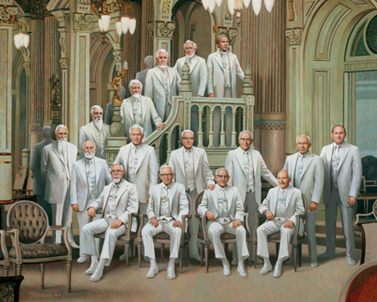
Review
A prophet is a person who has been called by God to speak for Him.
Prophets testify of Jesus Christ and teach His gospel.
They make known God’s will and true character.
Prophets denounce sin, warn of its consequences, and help us avoid deception.

Slide 3
Ezekiel
He was of the lineage of Zadok; the son of Buzi, in the land of the Chaldeans by the river Chebar (Tel Abib)
His name means God will strengthen
He was carried away into Babylon by Nebuchadnezzar along with Jehoiachin (King of Judah) and prophesied during the period of 592-570 B.C.
Ezekiel’s family must have been considered prominent and influential, for, according to the account in 2 Kings 24:14–16, mostly the ‘chief men of the land’ were taken captive
He was granted extraordinary vision and provided consequences of apostasy, idolatry, repentance covenants and the blessing of being heirs with the Good Shepherd
He saw beyond the tragedies of his era to a future time of renewal when the Lord would gather His people, give them “a new heart” and “a new spirit,” and help them live His laws
He prophesied of the miraculous events of the coming of the Book of Mormon
(2, 3)

Slide 4
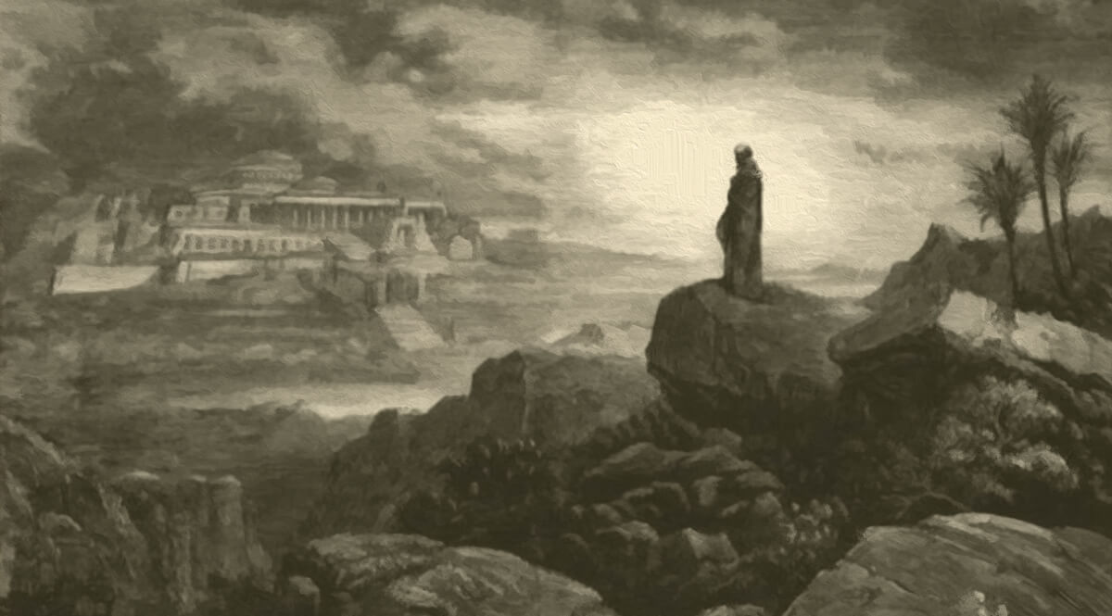
A Watchman
Son of man, I have made thee a watchman unto the house of Israel: therefore hear the word at my mouth, and give them warning from me. Ezekiel 3:17
The Lord had just called Ezekiel to be a prophet and had told him to warn the wicked Israelites to repent.
Watchman = a man who was assigned to stand “on a wall or in a tower in order to look out for and warn of dangers approaching from afar.”
Watchtowers were common structures in ancient Israel, and watchmen were used “to protect cities as well as vineyards, fields, or pastures” from animals or thieves.
(1)

Slide 5
In what ways can a prophet be compared to a watchman on a tower?
How might viewing prophets as watchmen increase our willingness to follow them?

Slide 6
Warnings and Statements
From Latter-day Prophets
This booklet was written at the direction of prophets and apostles to help warn the youth of the Church of some of the dangers of our day.
According to For the Strength of Youth, what are some promised blessings for heeding this warning or counsel?
How could ignoring this warning or counsel put us in spiritual danger?
If it is not too personal or sacred, consider sharing ways that you or someone you know have been blessed by following this warning or counsel from our prophets and apostles?
Turn with a partner to any section of the For the Strength of Youth booklet, and find a warning or counsel that has been given by our prophets and apostles.
(2)

Slide 7
Acquiring Knowledge Scenario
Your friend Leilani has become interested in the Church and has been meeting with the missionaries.
During one of the lessons, the missionaries show Leilani a picture of the current First Presidency and Quorum of the Twelve Apostles.
After the discussion is over, Leilani tells you that she noticed that most of the leaders of the Church look like they are elderly.
She says, “I understand what the missionaries were saying about God calling prophets in our time, and I think it is amazing that your Church teaches that there are living prophets, but can elderly Church leaders really understand or relate to the issues and challenges that young people face today?”
Adly Mirza
(2)

Slide 8
What are some ways that you could invite Leilani to act in faith in order to obtain a testimony that those who are in the First Presidency and Quorum of the Twelve Apostles are truly prophets of God?
What are some ways that you have been able to see that Church leaders understand the issues and challenges that young people face today? How could you use these experiences to help answer Leilani’s question?
(2)

Slide 9
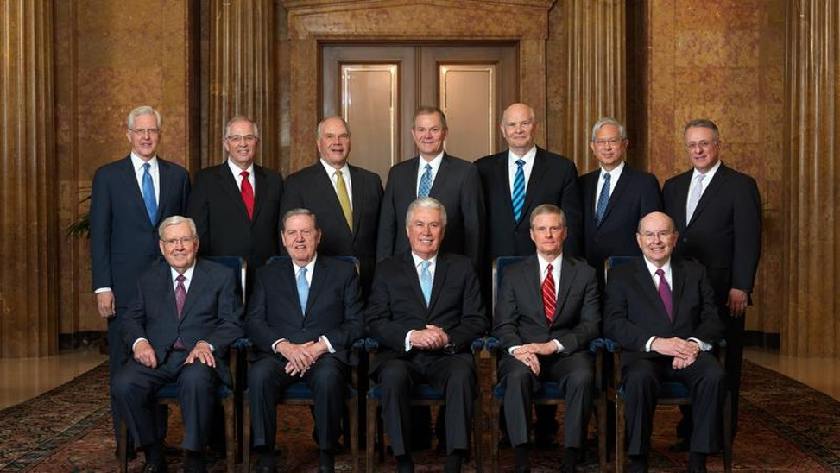
“I have heard that some people think the Church leaders live in a ‘bubble.’
What they forget is that we are men and women of experience, and we have lived our lives in so many places and worked with many people from different backgrounds.
Our current assignments literally take us around the globe, where we meet the political, religious, business, and humanitarian leaders of the world.
Although we have visited the White House in Washington, D.C., and leaders of nations throughout the world, we have also visited the most humble homes on earth, where we have met and ministered to the poor.
(3)

Slide 10
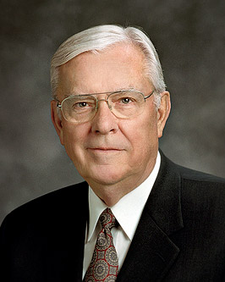
“When you thoughtfully consider our lives and ministry, you will most likely agree that we see and experience the world in ways few others do. You will realize that we live less in a ‘bubble’ than most people.
“Others say we are too old. …
“However, there is something about the individual and combined wisdom of the Brethren that should provide some comfort. We have experienced it all, including the consequences of different public laws and policies, disappointments, tragedies, and deaths in our own families. We are not out of touch with your lives”
(3)

Slide 11
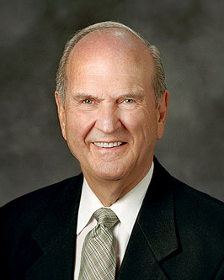
“The Apostle with the longest seniority in the office of Apostle presides. That system of seniority will usually bring older men to the office of President of the Church. It provides continuity, seasoned maturity, experience, and extensive preparation, as guided by the Lord. …
“… Senior leaders are constantly being tutored such that one day they are ready to sit in the highest councils. They learn how to hear the voice of the Lord through the whisperings of the Spirit.”
(4)

Slide 12
Sources:
Suggested Hymn: We Listen to Our Prophet’s Voice #22
“Watchmen on the Tower,” Ensign, April 2016, 28.)
For the Strength of Youth (booklet, 2011)
M. Russell Ballard, “Be Still, and Know That I Am God” [Church Educational System devotional for young adults, May 4, 2014], broadcasts.lds.org).
President Russell M. Nelson “Sustaining the Prophets,” Ensign or Liahona, Nov. 2014, 75).
Presentation by ©http://fashionsbylynda.com/blog/

Slide 13
“Some people have suggested younger, more vigorous leaders are needed in the Church to address effectively the serious challenges of our modern world. But the Lord does not use contemporary philosophies and practices of leadership to accomplish His purposes (see Isaiah 55:8–9). We can expect the President and other senior leaders of the Church will be older and spiritually seasoned men. …
“I have observed in my Brethren at least a part of the Lord’s purpose for having older men of maturity and judgment serve in senior leadership positions of the Church. These men have had a sustained season of tutoring by the Lord, whom they represent, serve, and love. They have learned to understand the divine language of the Holy Spirit and the Lord’s patterns for receiving revelation. These ordinary men have undergone a most extraordinary developmental process that has sharpened their vision, informed their insight, engendered love for people from all nations and circumstances, and affirmed the reality of the Restoration” (David A. Bednar, “Chosen to Bear Testimony of My Name,” Ensign or Liahona, Nov. 2015, 129).

