Slide 1
Lesson 9
Acquiring Spiritual Knowledge Part 2
Presentation by ©http://fashionsbylynda.com/blog/

Slide 2
Act in Faith
“When those moments come and issues surface, the resolution of which is not immediately forthcoming, hold fast to what you already know and stand strong until additional knowledge comes.” Elder Jeffrey R. Holland
Look unto me in every thought; doubt not, fear not.
D&C 6:36
When we may not immediately find answers to our questions, it is helpful to remember that although Heavenly Father has revealed all that is necessary for our salvation…
He has not yet revealed all truth

Slide 3
Trust
Learning how to trust in the Lord is vital to being able to act in faith
What does it mean to trust someone?
Who in your life do you trust to help you make it safely through mortality?
We act in faith when we choose to trust God and turn to Him first through sincere prayer, a study of His teachings, and obedience to His commandments.

Slide 4
Prayer, Study, and Keeping Commandments
How would turning to God first in prayer show that you trust Him?
How does a willingness to pray, study the Lord’s teachings, and obey His commandments show that we trust Him and want to act in faith?
How does an unwillingness to do these things show a lack of trust in Him?

Slide 5
Hold Fast To What You Know
It is important that we rely on the testimony that we already have of Jesus Christ, the Restoration of His gospel, and the teachings of His ordained prophets.”
Elder Jeffrey R. Holland
…hold fast to what you already know and stand strong until additional knowledge comes.”

Slide 6
Trust in the Lord
Trust in the Lord with all thine heart; and lean not unto thine own understanding.
In all thy ways acknowledge him, and he shall direct thy paths.
Proverbs 3:5-6
For behold, thus saith the Lord God: I will give unto the children of men line upon line, precept upon precept, here a little and there a little; and blessed are those who hearken unto my precepts, and lend an ear unto my counsel, for they shall learn wisdom; for unto him that receiveth I will give more; and from them that shall say, We have enough, from them shall be taken away even that which they have.
2 Nephi 28-30

Slide 7
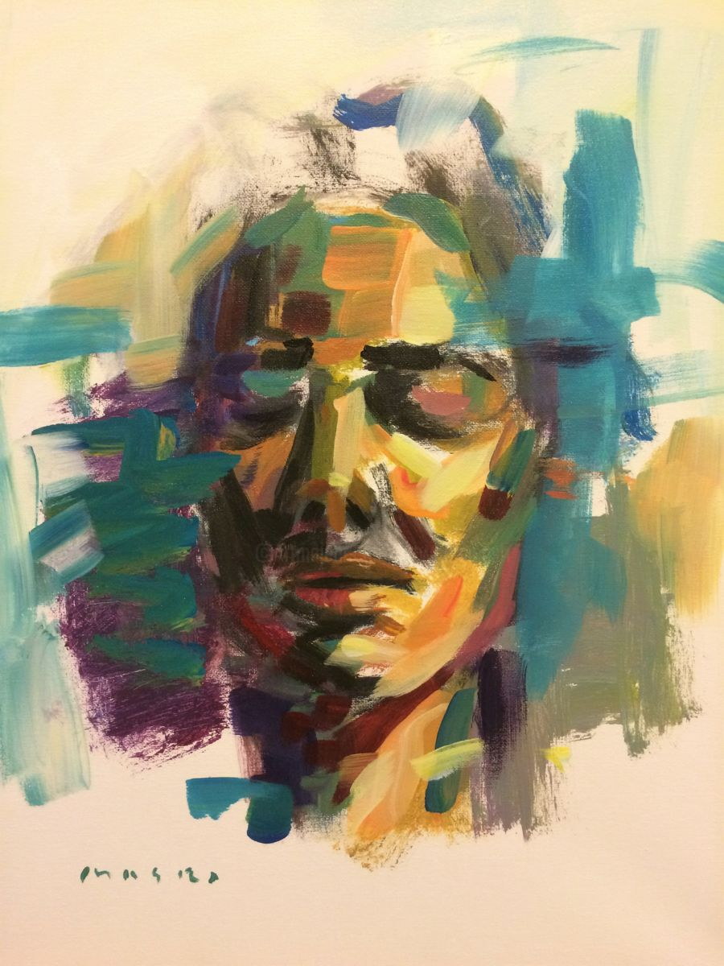
Examine Concepts and Questions with an Eternal Perspective
To examine doctrinal concepts, questions, and social issues with an eternal perspective, we consider them in the context of the plan of salvation and the teachings of the Savior.
We seek the help of the Holy Ghost in order to see things as the Lord sees them
That your faith should not stand in the wisdom of men, but in the power of God.
But God hath revealed them unto us by his Spirit: for the Spirit searcheth all things, yea, the deep things of God.
For what man knoweth the things of a man, save the spirit of man which is in him? even so the things of God knoweth no man, but the Spirit of God.
1 Corinthians 5, 10-11
MASRI

Slide 8
The Gift Itself
To be distracted by less significant details at the expense of missing the unfolding miracle of the Restoration is like spending time analyzing a gift box and ignoring the wonder of the gift itself.
To examine doctrinal concepts, questions, and social issues with an eternal perspective, we consider them in the context of the plan of salvation and the teachings of the Savior.

Slide 9
Seek Further Understanding through Divinely Appointed Sources
Truth Through:
The light of Christ, the Holy Ghost, the scriptures, parents, and Church leaders.
The First Presidency and the Quorum of the Twelve Apostles—the Lord’s prophets upon the earth today—are a vital source of truth. The Lord has chosen and ordained these individuals to speak for Him.

Slide 10
Trustworthy Sources
Sincere seekers of truth should be wary of unreliable sources of information
Woe unto them that call evil good, and good evil; that put darkness for light, and light for darkness; that put bitter for sweet, and sweet for bitter! Isaiah 5:20
Learning to recognize and avoid unreliable sources can protect us from misinformation and from those who seek to destroy faith.

Slide 11
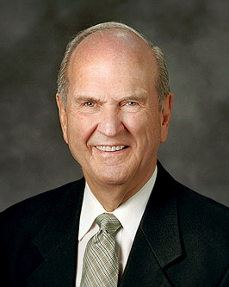
“The temptation to be popular may prioritize public opinion above the word of God. Political campaigns and marketing strategies widely employ public opinion polls to shape their plans.
Results of those polls are informative. But they could hardly be used as grounds to justify disobedience to God’s commandments!
Even if ‘everyone is doing it,’ wrong is never right. Evil, error, and darkness will never be truth, even if popular.”
Russell M. Nelson
How can popularity or public opinion make it difficult to recognize good and evil?

Slide 12
“The Church of Jesus Christ has always been led by living prophets and apostles. Though mortal and subject to human imperfection, the Lord’s servants are inspired to help us avoid obstacles that are spiritually life threatening and to help us pass safely through mortality to our final, ultimate, heavenly destination. …
“Too many people think Church leaders and members should be perfect or nearly perfect. They forget that the Lord’s grace is sufficient to accomplish His work through mortals. Our leaders have the best intentions, but sometimes we make mistakes. This is not unique to Church relationships, as the same thing occurs in our relationships among friends, neighbors, and workplace associates and even between spouses and in families.

Slide 13
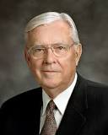
“Looking for human weakness in others is rather easy. However, we make a serious mistake by noticing only the human nature of one another and then failing to see God’s hand working through those He has called.
“Focusing on how the Lord inspires His chosen leaders and how He moves the Saints to do remarkable and extraordinary things despite their humanity is one way that we hold on to the gospel of Jesus Christ and stay safely aboard the Old Ship Zion” M. Russell Ballard

Slide 14
Sources:
Videos:
“Act in Faith: The Stonemason” (4:57)
“Examining Questions with an Eternal Perspective” (2:56)
Elder Jeffrey R. Holland “Lord, I Believe,” Ensign or Liahona, May 2013, 94).
Russell M. Nelson, “Let Your Faith Show,” Ensign or Liahona, May 2014, 30–31.
M. Russell Ballard, “God Is at the Helm,” Ensign or Liahona, Nov. 2015, 24–25
Presentation by ©http://fashionsbylynda.com/blog/

Slide 15
“All things are to be revealed in the millennial day. The sealed part of the Book of Mormon will come forth; the brass plates will be translated; the writings of Adam and Enoch and Noah and Abraham and prophets without number will be revealed. We shall learn a thousand times more about the earthly ministry of the Lord Jesus than we now know. We shall learn great mysteries of the kingdom that were not even known to those of old who walked and talked with the Eternal One. We shall learn the details of the creation and the origin of man. … Nothing in or on or over the earth will be withheld” (Bruce R. McConkie, The Millennial Messiah: The Second Coming of the Son of Man [1982], 676).
Seeking Further Understanding:
Much of what the Lord reveals to His prophets is intended to prevent sorrow for us as individuals and as societies. When God speaks, He does so to teach, inspire, refine, and warn His children. When individuals and societies ignore their Heavenly Father’s instructions, they do so at the risk of trial, torment, and toil.
“God loves all His children. That is why He pleads so earnestly with us through His prophets. Just as we want what is best for our loved ones, Heavenly Father wants what is best for us. That is why His instructions are so crucial and sometimes so urgent. That is why He has not abandoned us today but continues to reveal His will to us through His prophets. Our fate and the fate of our world hinge on our hearing and heeding the revealed word of God to His children” (Dieter F. Uchtdorf, “Why Do We Need Prophets?” Ensign, Mar. 2012, 4).
Vital Source of Truth:
“There seems to be no end to the Savior’s desire to lead us to safety. And there is constancy in the way He shows us the path. He calls by more than one means so that it will reach those willing to accept it. And those means always include sending the message by the mouths of His prophets, whenever people have qualified to have the prophets of God among them. Those authorized servants are always charged with warning the people, telling them the way to safety” (Henry B. Eyring, “Finding Safety in Counsel,” Ensign, May 1997, 24).
God Uses Ordinary Men to Lead:
“On one occasion, Karl G. Maeser was leading a party of young missionaries across the Alps. As they reached the summit, he looked back and saw a row of sticks thrust into the snow to mark the one safe path across the otherwise treacherous glacier.
“Halting the company of missionaries, he gestured toward the sticks and said, ‘Brethren, there stands the priesthood [meaning the priesthood leaders God has put in place to guide His people]. They are just common sticks like the rest of us, … but the position they hold makes them what they are to us. If we step aside from the path they mark, we are lost.’ (In Alma P. Burton, Karl G. Maeser, Mormon Educator, Salt Lake City: Deseret Book Co., 1953, p. 22.)
“Although no one of us is perfect, the Church moves forward, led by ordinary people.
“The Lord promised:
“‘If my people will hearken unto my voice, and unto the voice of my servants whom I have appointed to lead my people, behold, verily I say unto you, they shall not be moved out of their place.
“‘But if they will not hearken to my voice, nor unto the voice of these men whom I have appointed, they shall not be blest.’ (D&C 124:45–46.)
“I bear witness, brethren and sisters, that the leaders of the Church were called of God by proper authority, and it is known to the Church that they have that authority and have been properly ordained by the regularly ordained heads of the Church. If we follow them we will be saved” (Boyd K. Packer, “From Such Turn Away,” Ensign, May 1985, 35).
Vital Source of Truth:
The Church is making great efforts to be transparent with the records we have, but after all we can publish, our members are sometimes left with basic questions that cannot be resolved by study. … Some things can be learned only by faith (see D&C 88:118). Our ultimate reliance must be on faith in the witness we have received from the Holy Ghost” (Dallin H. Oaks, “Opposition in All Things,” Ensign or Liahona, May 2016, 117).

