Slide 1
Lesson 90
Saul VS David
1 Samuel 18-24
For jealousy is the rage of a man: therefore he will not spare in the day of vengeance.
Proverbs 6:34

Slide 2
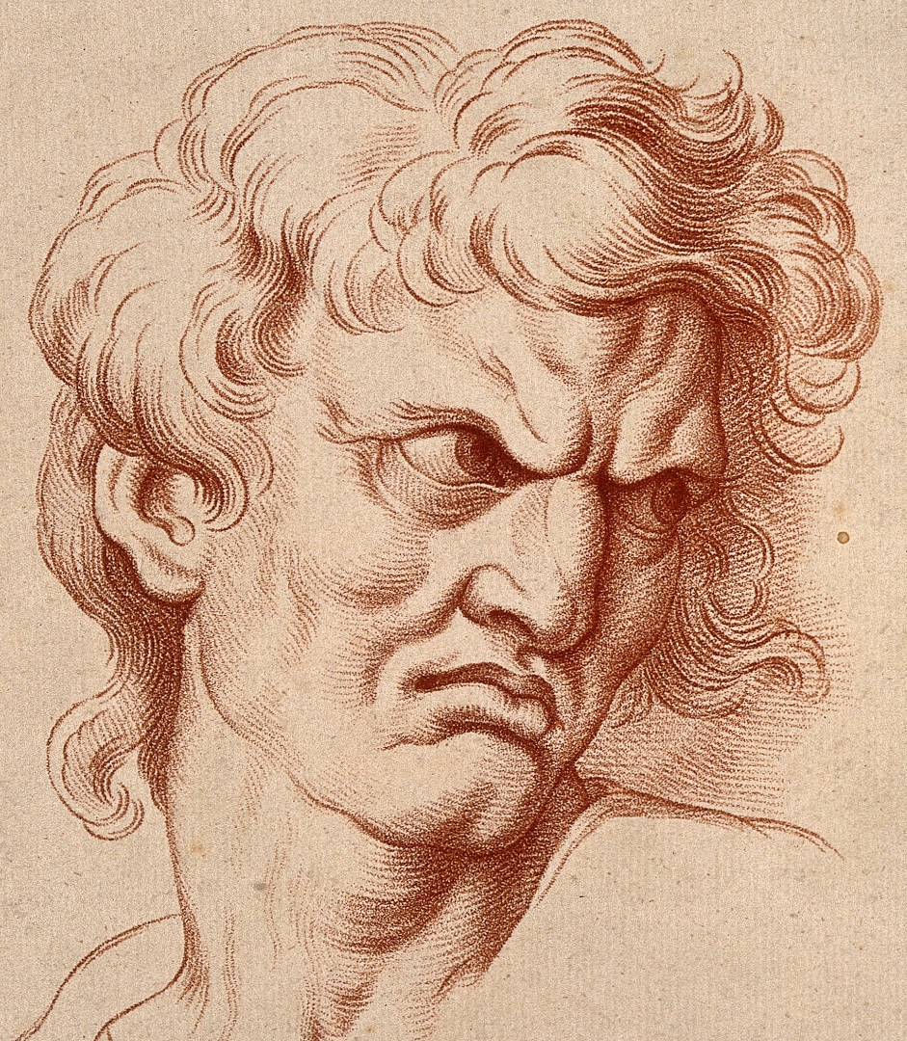
Acts of Jealousy
Jealousy is an emotion that most of us feel at some time in our lives.
It is complex because it contains elements of anger, fear, and resentment.
Jealousy always involves people, and is centered in the fear of losing someone’s affection or recognition.
Jealousy also gnaws at the roots of self-esteem. (1)
William Hebert

Slide 3
BFF
David became close friends with Saul’s son Jonathan. Saul set David over the army.
Jonathan could have been jealous of David’s success, but he instead rejoiced.
When Jonathan gave his clothing and weapons to David, he was showing his friendship and his support of David becoming the next king
Fear not: for the hand of Saul my father shall not find thee; and thou shalt be king over Israel, and I shall be next unto thee; and that also Saul my father knoweth.
1 Samuel 23:17
1 Samuel 18:1-5

Slide 4
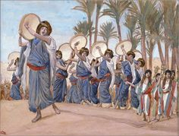
Success of the Battle
“The unbelievable good news of David’s magnificent heroism in challenging and killing Goliath swept through the cities and villages of Israel like a wild wind.
‘As a result, great throngs of women went streaming down the roadways to meet the returning victors…
…cheering women drew close enough to sing their song of welcome and praise.” (2)
Tissot
“Saul hath slain his thousands, and David his ten thousands!”
“Saul eyed David from that day and forward” = Saul’s growing jealousy and anger toward David.
1 Samuel 18:6-9

Slide 5
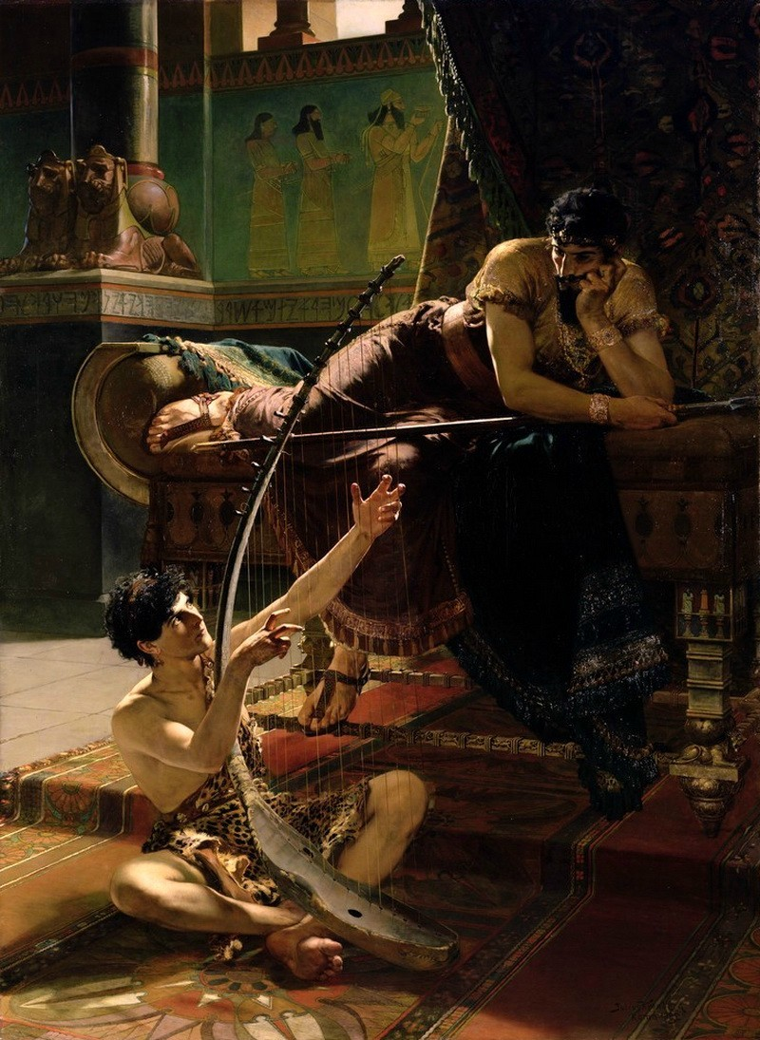
A Jealous Act
“the evil spirit which was not of God” JST
The Sin of Jealousy-- warns that jealousy provokes anger to the point of rage
When we are jealous and angry, we allow the influence of the adversary into our lives
2 times David avoided Saul’s javelin
Julius Kronberg
1 Samuel 18:10-11
(3)

Slide 6
“There are going to be times in our lives when someone else gets an unexpected blessing or receives some special recognition.
May I plead with us not to be hurt—and certainly not to feel envious—when good fortune comes to another person?
We are not diminished when someone else is added upon.
We are not in a race against each other. …
The race we are really in is the race against sin, and surely envy is one of the most universal of those”
1 Samuel 18:10-11
(3)

Slide 7
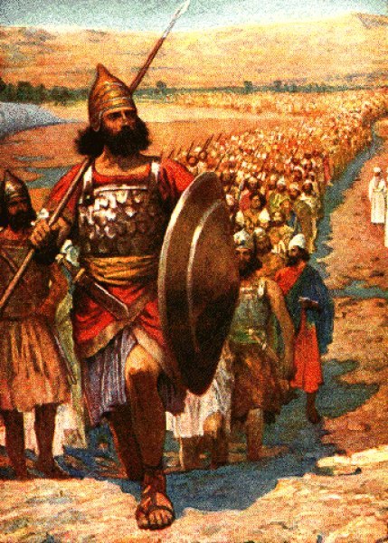
Behave Wisely
Soon after Saul announced the removal of David as his armor-bearer and is now captain over ‘a thousand’
To please the people Saul sends David to the battle field
PS—a greater risk of being killed
As we behave wisely, we invite the Lord to be with us
1 Samuel 18:12-16

Slide 8
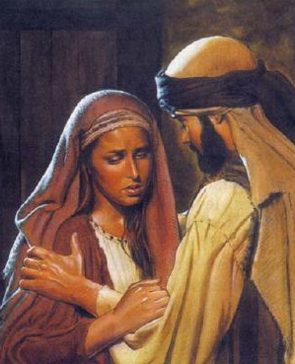
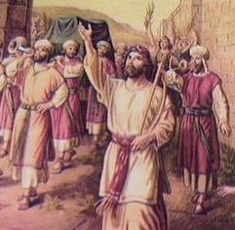
A Deception
Saul devised a plan to have David killed.
He offered one of his daughters for David to marry if David would kill one hundred Philistines.
Saul hoped that David would be killed in battle, but David was victorious and married Saul’s daughter Michal.
Saul tried two ways to do away with David.
But although Saul was jealous of David’s growing popularity with the people, there was no indication yet that he knew that David had been anointed to be his successor. (4)
1 Samuel 18:17-27

Slide 9
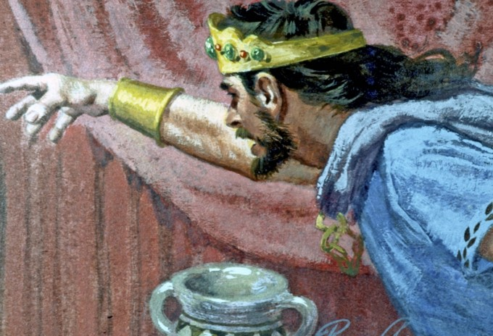
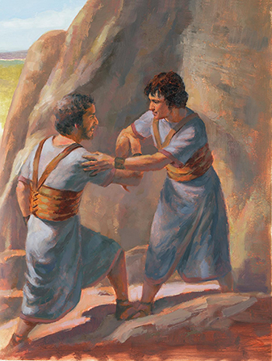
David Escapes
Jonathan informed David of his father’s plans and persuaded Saul to promise not to kill David.
Saul commanded his son Jonathan and all his servants to kill David.
However, after David returned victorious from another battle with the Philistines, Saul’s jealousy returned and he tried repeatedly to kill David.
1 Samuel 19:1-17

Slide 10
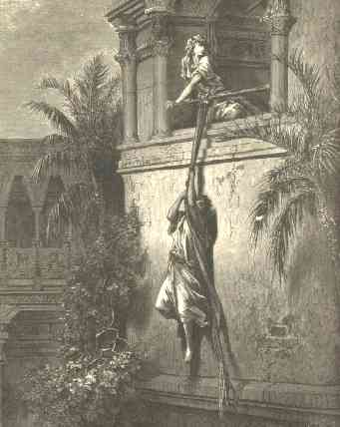
Psalms 59– Michal Helps David Escape
Deliver me from mine enemies, O my God: defend me from them that rise up against me.
Deliver me from the workers of iniquity, and save me from bloody men.
For, lo, they lie in wait for my soul: the mighty are gathered against me; not for my transgression, nor for my sin, O Lord.
They run and prepare themselves without my fault: awake to help me, and behold.
Thou therefore, O Lord God of hosts, the God of Israel, awake to visit all the heathen: be not merciful to any wicked transgressors. Selah.
They return at evening: they make a noise like a dog, and go round about the city.
Behold, they belch out with their mouth: swords are in their lips: for who, say they, doth hear?
But thou, O Lord, shalt laugh at them; thou shalt have all the heathen in derision.
1 Samuel 19:12-17

Slide 11
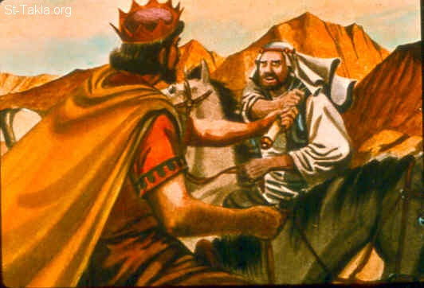
David Goes to Samuel
Saul found out David was with the prophet Samuel, he attempted to capture David. However, because of the Lord’s influence, Saul was unable to take him.
Mt. Carmel
Mt. Tabor
Mt. Gilboa
Ramah
Jerusalem
Bethlehem
Mt. Nebo
1 Samuel 19:18-23

Slide 12
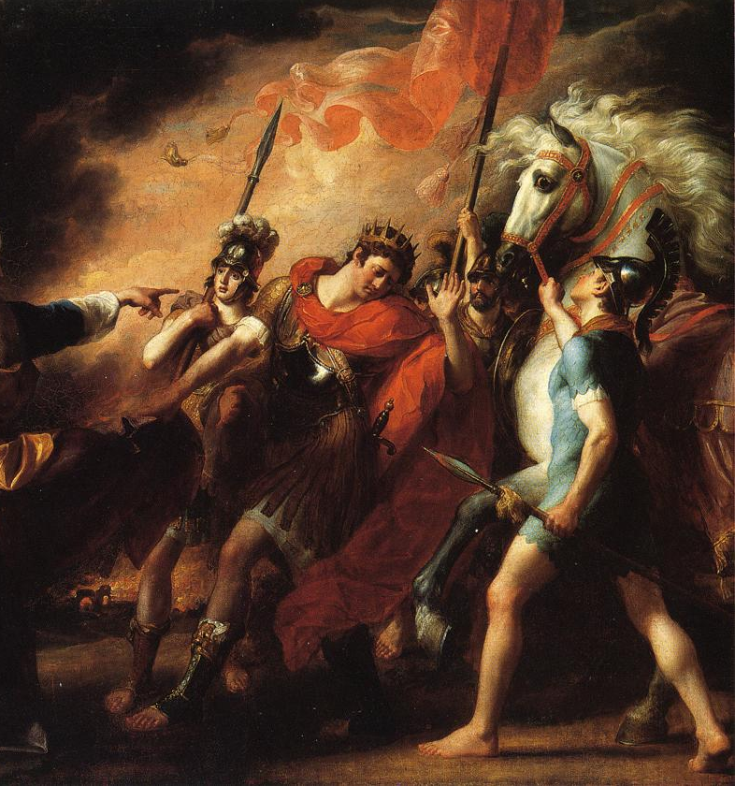
Overcome by the Spirit
Saul had difficulty with his servants following orders. He had commanded them previously to kill David, but none of them seemed excited to carry out the order.
Angry that a group of priests had fed and protected David, Saul commanded that they be killed.
This time, Saul’s servants are sent to kill, but are instead overcome by the Spirit. (7)
But the servants of the king would not put forth their hand to fall upon the priests of the Lord”
1 Samuel 19-22

Slide 13
Stripped off His Clothes”
Took off his armor
And he stripped off his clothes also, and prophesied before Samuel in like manner, and lay down naked all that day and all that night. Wherefore they say, Is Saul also among the prophets?
Naked = a defenseless position of guilt
Wherefore, we shall have a perfect knowledge of all our guilt, and our uncleanness, and our nakedness; and the righteous shall have a perfect knowledge of their enjoyment, and their righteousness, being clothed with purity, yea, even with the robe of righteousness.
2 Nephi 9:14
Saul, like the prophets who were with him, “stripped off his clothes… and prophesied before Samuel… and lay down naked all that day and all that night.” which clarifies that “lay down naked” in this instance means only that he was “divested of his armor and outer robes.” (5)
1 Samuel 19:24

Slide 14
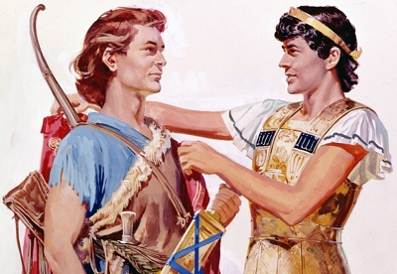
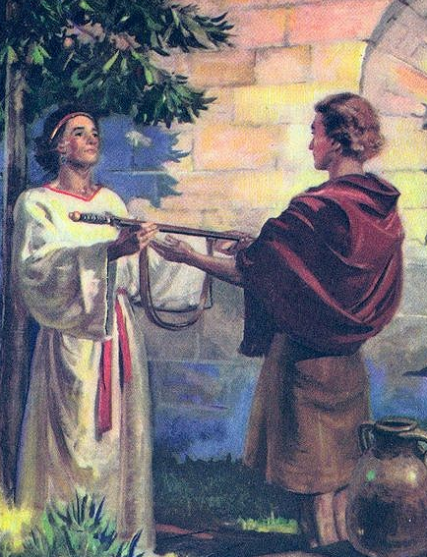
David and Johnathan’s Covenant
David left the prophet Samuel, David met with Jonathan and they made a covenant of friendship.
Jonathan covenanted to warn David of danger from his father and David covenanted to watch over Jonathan’s family, including his posterity.
David decided to hide from the king the next day instead of eating with him, and he requested Jonathan’s help in discovering Saul’s plot against him.
When Saul did not see David at his table the next day, he became angry and told Jonathan that if David was allowed to live then Jonathan would never be king. Jonathan sent a message to David to flee for safety.
1 Samuel 20

Slide 15
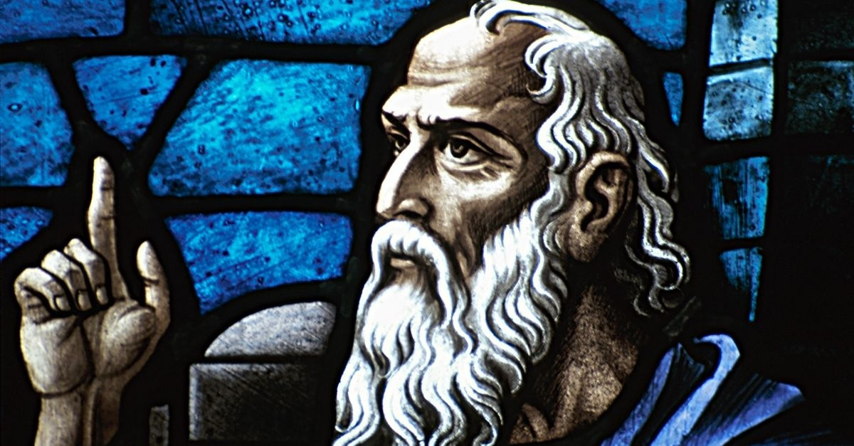
School of the Prophets
These scholars showed that such prophets as Samuel, Elijah, and Elisha conducted special schools that were called here “the company of the prophets.”
Elsewhere, the men who attended these schools were called “sons of the prophets” (1 Kings 20:35).
Samuel, who was established in the eyes of all Israel as a prophet of the Lord, organized the prophets into a society for common instruction and edification.
He established schools for the prophets, where men were trained in things pertaining to holy offices; the students were generally called "sons of the prophets.”
Such schools were established at Ramah, Bethel, Jericho, and Gilgal.
The members seem to have lived together as a society.
1 Samuel 19:20

Slide 16
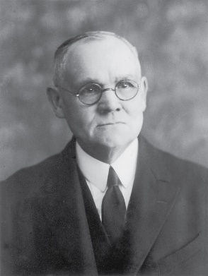
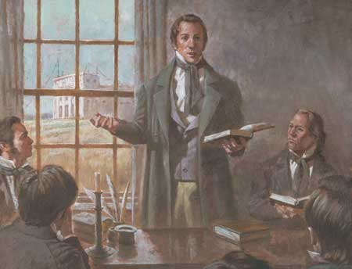
School of the Prophets
Joseph Smith set up a similar school in Kirtland, Ohio, to help teach priesthood holders their special duties.
In the present dispensation, a similar organization was effected under the direction of the prophet Joseph Smith; this also received the name of the School of the Prophets. (6)

Slide 17
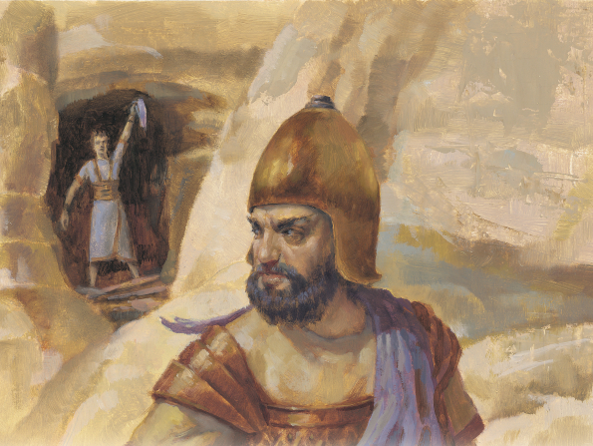
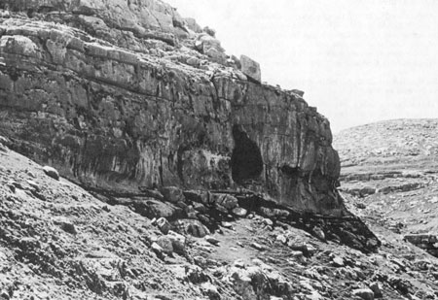
David Preserves Saul’s Life
En-gedi---a hiding place for David and his men—
Today the cliffs are called “Dead Sea Scrolls”—(2)
Possible site of the cave of Adullam where David hid from Saul
1 Samuel 23

Slide 18
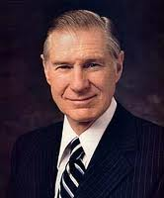
Seeking Revenge
Because the Lord is a perfect judge, we do not need to seek revenge against those who have hurt us
Seeking revenge is different from seeking justice. Letting the Lord be the judge does not mean you should not seek help when it is needed.
“Only as we rid ourselves of hatred and bitterness can the Lord put comfort into our hearts. …
“… When tragedy strikes, we should not respond by seeking personal revenge but rather let justice take its course and then let go. It is not easy to let go and empty our hearts of festering resentment.
The Savior has offered to all of us a precious peace through His Atonement, but this can come only as we are willing to cast out negative feelings of anger, spite, or revenge.”(8)
1 Samuel 23-24

Slide 19
Presentation by ©http://fashionsbylynda.com/blog/
Sources:
Suggested Hymn: #237 Do What Is Right
Video: Avoid Envy (1:13)
Darnell Zollinger When Sibling Rivalry Strikes 1975 February Ensign
W. Cleon Skousen The Fourth Thousand Years p. 26
Elder Jeffrey R. Holland “The Laborers in the Vineyard,” Ensign or Liahona, May 2012, 31).
Old Testament Institute Manual
By Jeffrey M. Bradshaw· January 24, 2013
James E. Talmage (Articles of Faith [Salt Lake City: Deseret Book Co., 1981], 444)
School of the Prophets (1 Kings 20:35; 2 Kings 2:3, 5, 7; 4:1, 38; 9:1)
Schools established in Ramah (1 Sam. 19:19, 20),
Bethel (2 Kings 2:3),
Jericho (2 Kings 2:5),
Gilgal (2 Kings 4:38)
7. Gospel Doctrine
8. President James E. Faust (“The Healing Power of Forgiveness,” Ensign or Liahona, May 2007, 69).

Slide 20
“David’s flight takes him throughout the land, from Nob, the city of the priests; to Gath, the hometown of Goliath; to the Cave of Adullam, in the far western regions of Judah; to the land of Moab, on Judah’s eastern border; and back to Keilah, again on the western border with Philistia. Additional retreats take him to Ziph, southeast of Keilah; to En-gedi, an oasis on the Dead Sea; and to Maon and Hachilah, towns in Judah. Throughout this time spent in the wilderness, David gathers about him a militia, all the while becoming more threatening to Saul (1 Samuel 22:1-2)…
“David’s stay at Keilah is particularly telling of the tragedy that continues to plague Israel because of Saul’s refusal to relinquish the office of kingship (1 Samuel 23:1-14). The city of Keilah, located at the foothills of Judah’s territory, is continually besieged by its enemy, who is infamous for raiding their harvests… The struggle between Saul and David has tragic implications for the people of this beleaguered city. Threatened now, not by the Philistines, but by their very own king, they so fear Saul’s retaliation for harboring the fugitive David that they plot to betray the latter. David discovers this by another inquiry to God and flees before it is too late. The greater damage to the loyalties of the unified regions of Judah, however, cannot be undone, and the hunt for the popular hero David will continue to divide the people.” (Barry J. Beitzel, ed., Biblica: The Bible Atlas, [Australia: Global Book Publishing, 2006], 231-232)
“Saul had lost all control. As he struggled against the decision of God, personified in David, he became more and more aware that his efforts were futile. But this dawning recognition was at war with his stubborn will. There was no fault in David—David respected Saul as the anointed of the Lord. Twice he spared Saul’s life—first in the dark cave at En-Gedi, and second in Saul’s camp in the wilderness of Ziff. Realizing this, Saul wept and cried aloud, admitting his evil to David and calling out plaintively to him that he, too, knew that David would surely be king over Israel.
“The final days of Saul’s tragic life are heightened by his growing paranoia and his terrible need for help outside himself. Formerly, he had been able to appeal to God, to the prophet Samuel, and to the priests. Now, however, “when Saul enquired of the Lord, the Lord answered him not, neither by dreams, nor by Urim, nor by prophets.” (1 Sam. 28:6.) He was completely alone. Samuel was dead, and Saul himself had murdered the priests. Saul’s own family no longer respected him. The people whom he had sought to serve refused to support him.
“’All of you have conspired against me,’ Saul cried at Gibeah. ‘There is none of you that is sorry for me.’ (1 Sam. 22:8.) Yet Saul did not repent; neither did he change.” (Richard G. Ellsworth, “The Tragic Dimensions of Saul,” Ensign, June 1990, 40)
“David’s adversary was delivered into his hands. With one thrust of his spear, David could have been rid of Saul and the discomforts of life that Saul had caused him. His men urged him to do it. But he wouldn’t…
“Nearly the same scenario repeated itself two chapters later: Saul came down against David with 3,000 of his troops. At night, when they were sleeping, David and one of his men snuck into Saul’s camp and came to Saul’s side. David’s companion urged him to take up Saul’s spear and thrust it through him, to put an end to the misery Saul had been causing him. But David wouldn’t. ‘The Lord forbid that I should stretch forth mine hand against the Lord’s anointed,’ he answered… (1 Sam. 26:16-20)
“David’s response in each of these situations fills me with wonder. How is such a response possible? How can we not only resist vengeance toward those who have harmed us but apparently feel no desire for it? David’s response at the news of Saul’s death in Second Samuel chapter 1 makes this question even more salient, for when he heard that both Saul and Jonathan had been killed in battle, he wept for Jonathan and Saul alike: ‘Then David took hold on his clothes, and rent them… and wept, and fasted until even, for Saul, and for Jonathan his son… And David lamented with this lamentation over Saul and over Jonathan his son… Saul and Jonathan were lovely and pleasant in their lives, and in their death they were not divided: they were swifter than eagles, they were stronger than lions… How are the mighty fallen…!’ (2 Sam. 1:11-27)
“What is striking about David’s response here is that there is almost no difference in his expressed feelings for Saul and for Jonathan. He is devastated by both of their deaths. One would expect him to feel that way about Jonathan, but Saul? How could David’s feelings for one who tried to destroy him be so similar to the feelings he had for one who loved him as his own soul?
“Accordingly, the last half of First Samuel presents us with two intriguing questions: How is it possible that two men, Saul and Jonathan, could respond so differently to their loss of the throne? And how is it possible that one man, David, could respond with the same loving attitude toward two men, Saul and Jonathan, whose treatment of him was so different? What makes such responses possible?
“Few questions are more pertinent to our lives, for who has not felt envious, angry, or embittered toward others? Such feelings seem to haunt our lives, but Jonathan and David suggest that they don’t have to. Their lives testify of a better way.” (James L. Ferrell, The Hidden Christ, [Deseret Book, 2009] 163-165)

Slide 21
Elhanan—also son of Dodo of Bethleham and apparently a brother of Eleazar
Shammoth—the Harorite, sometimes spelled Shmmah, the Harodite
Helez—the Pelonite
Ira—the son of Ikkesh the Tekoite
Abiezer—the Antothite
Sibbecai—the Hushathite, identified as Mebunnai in 2 Samuel 23:27
Ilai—the Ahohite identified as Zalmon in 2 Samuel 23:28
Maharai—the Netphathite
Heled—son of Baanah the Netophathite identified as Heleb in 2 Sam. 23:29
Ithai—son of Ribai of Gibeah in Benjamin
Benaiah—the Pirathonite
Hurai—of the brooks of Gaash, identified as Hiddai in 2 Samuel 23:30
Abiel—the Arbathite, identified as Abialbon in 2 Sam. 23:31
Azmaveth—the Baharumite
Eliahba—the Shaalbonite
Jonathan—the son of Shage the Hararite
Ahiam—son of Sacar the Hararite
Eliphal—son of Ur, identified as Elephelet in 2 Sam. 23:34
Hepher—the Mecherathite
Ahijah—the Pelonite
Hezro—the Carmelite, identified as Hezrai in 2 Sam. 23:35
Naarai—son of Ezbai
Joel—the brother of Nathan
Mibhar—the son of Haggeri
Zelek—the Ammonite
Naharai—the Berothite, who served as the armor-bearer for Joab, the chief commander.
Ira—the Ithrite
Gareb—the Ithrite
Uriah—the Hittite, husband of Bath-sheba and a loyal soldier to David
Joab—Commander-in-chief under David. He was King David’s nephew who murdered Abner but was rehabilitated in the minds of the people after going up the water way and capturing Jerusalem (Jebus) from the inside
Abishai—elder brother of Joab and therefore another nephew of David. He accompanied David on the dangerous night mission into the camp of Saul. He saved David’s life when he was about to be killed by Goliath’s son. In one battle he slew 300 Philistines. He was loyal to David during Absalom’s rebellion.
Jashobeam—a Hachmonite who was chief of David’s captains and famed for having taken on a large body of Philistines single-handedly
Eleazar—son of Dodo, the Ahohite, who was with David at Pasdammin, and when the other soldiers had fled he was one of the few that stood his ground and drove the Philistines away.
Benaiah—son of Jehoiada. He slew two lion-like men of Moab; also he went down and slew a lion in a pit in a snowy day. And he slew an Egyptian, man of great stature.
Asahel—youngest brother of Joab and Abishai, a nephew of David. He was extremely fleet-footed and was overtaking Abner, commander of the northern Kingdom when Abner thrust his spear into Asahel so that the butt-end pierced him through and killed him.
David’s Mighty Ones
David moved his 600 band and their families from place to place
He called them his “mighty ones”
Found in 1 Chronicles 11
W. Cleon Skousen
The Fourth Thousand Years pp. 98-100

Slide 22
David flees to Samuel at Ramah | 1 Samuel 19:18
Johnathan makes covenant with David | 1 Samuel 20
David Travels to Nob and receives Goliath’s sword from the priest, Ahimelech | 1 Samuel 21:1-9
David goes to Gath, and meets with king Achish and pretends to be mad and thrown out of city | 1 Samuel 21:10-15
David goes to the cave Adullam and gathers followers | 1 Samuel 22:1-2
David goes to Moab and finds refuge for his parents in Mizpeh | 1 Samuel 22:3-4
David is told by the prophet Gad to go into Judah, the forest of Hareth | 1 Samuel 22:5
Saul learns of David’s location and rounds up Ahimelech’s priests who had harbored David to slay them, but not one servant would obey the orders, so Saul ordered Doeg the Edomite to slay 85 priests then the entire village of Nob was slaughtered | 1 Samuel 22:9-19
One son of Ahimelech, Abiathar, escaped and found David. Abiathar had the ephod—connection with revelation (Urim and Thummim) | 1 Samuel 22:20-23, 1 Samuel 23:6
David and his band went to Keilah as the Lord commanded. Saul also went to Keilah to go to war and besiege David and his men. The Lord tells David that the people of Keilah will betray him. | 1 Samuel 23:7-13
David flees to the wilderness of Ziph. Saul hunted every day for David and his some 600 men. He gets discouraged and returns to Gibeah Johnathan finds him and they renew their covenant with each other | 1 Samuel 23:14-18
David moved hi men to Maon and the elders of Ziph reported to Saul were David was. Saul went on one side of the mountain and David was on the other side of the mountain (calling the place Sela-hammahlekoth)and word reached Saul that the Philistines were invading the land, so Saul abandoned his plan to capture David. David went to En-gedi | 1 Samuel 23:19-29
As Saul returns from fighting the Philistines he approaches the place where David was. Exhausted, Saul sleeps and David creeps in to where Saul slept, but instead of slaying him David cuts of piece of Saul’s cloak. The Lord had told him to spare Saul’s life. When Saul went to leave David called after him and showed him his cut skirt. Saul wept and asked David not to slay his posterity, and David promised not to. | 1 Samuel 24

Slide 23
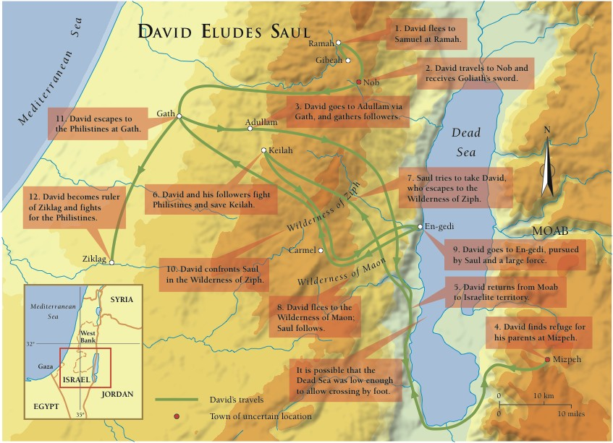

Slide 24
David escaped from Saul and entered a self-imposed exile and became a fugitive, fleeing from place to place, hiding in cities, caves, and forests; eventually, he sought refuge among the Philistines and Moabites.
Aided first by Samuel and then by the Levites in the city of Nob, who fed him with consecrated bread from the tabernacle of the Lord and armed him with Goliath’s sword (which apparently had been sent to the tabernacle at Nob as a type of sacred trophy), David made his way from place to place, avoiding the soldiers of Saul. Soon he was joined by all of the dissidents of Israel, “every one that was in distress, and every one that was in debt, and every one that was discontented” (1 Sam. 22:2), as David began to develop an army of his own.
Guided by Gad, an inspired seer of the Lord, David soon assembled a select guerrilla band of 600 distinguished men of war. His forces were constantly sought out and plagued by the armies of Saul, and twice in these encounters David could have killed Saul; but out of respect for the Lord’s anointed (which Saul still was in the eyes of David), David did not take the king’s life. He did, however, take some of the personal belongings that lay next to where the king slept. Then, after removing himself a safe distance from Saul’s forces, he held up the things he had taken and called out to the king so that he could see that he had no desire to harm his sovereign but desired only peace. Saul, however, desired not David’s help, but his head.
Because of constant harassment, David ultimately decided to leave Israel’s boundaries and to unite his forces with Israel’s enemies, the Philistines. This time spent with Israel’s foes may well have been one of the most important parts of his life, because he was undoubtedly able to become familiar with the Philistine strongholds and with their weaponry. Up to this time the Philistines had had a virtual monopoly on iron, a newly developed metal vitally important in battle.
Achish, one of the Philistine leaders, received David and his 600 warriors and their families and employed them initially as mercenary southern border guards against the non-Israelite enemies of the Philistines. Through this means the Philistines were able to rally their forces for one massive assault on Israel, and this battle proved fatal to the house of Saul. Both the king and his son Jonathan lost their lives, leaving Israel without a monarch. David at the time was 30 years of age, and the southern tribe of Judah claimed him as their king. The other tribes of Israel chose for their king Ishbosheth, the son of Saul.
Immediately the king set about consolidating his gains and establishing his kingdom. His first target was Jebus, the Jebusite city that had been constructed on the ancient site of Salem, the city of Melchizedek near Mount Moriah. Although the fortress surrounding this city was considered nearly impregnable, David’s men devised an ingenious plan for penetrating the city through its waterworks, and the city fell to David’s new army.

