Slide 1
Lesson 94
Prophets and Revelation
Part 4

Slide 2
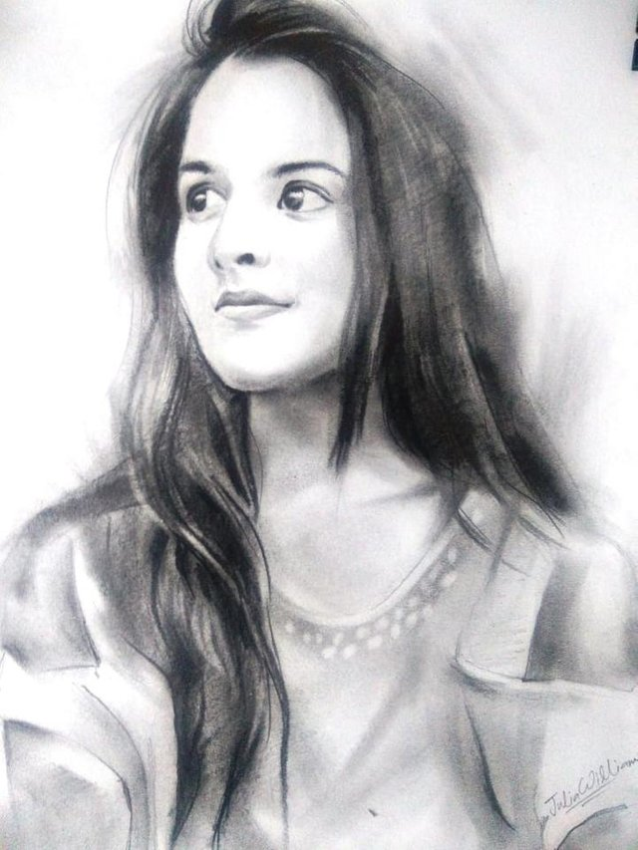
Scenarios
Come now, and let us reason together, saith the Lord: though your sins be as scarlet, they shall be as white as snow; though they be red like crimson, they shall be as wool.
Isaiah 1:8
Elizabeth feels the Savior’s love for her when she learns that she can be completely forgiven of a serious sin that she has committed.
What can Elizabeth do with this knowledge?
What kind of questions can she ask herself and her bishop?
Where can she go to for guidance and comfort?

Slide 3
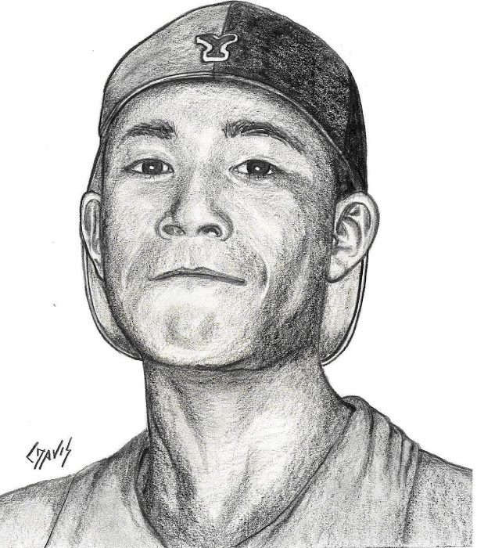
Scenarios
Surely the Lord God will do nothing, but he revealeth his secret unto his servants the prophets. Amos 3:7
Vincent has a strong testimony that the Lord reveals His will through prophets and apostles.
And it came to pass at the end of seven days, that the word of the Lord came unto me, saying,
Son of man, I have made thee a watchman unto the house of Israel: therefore hear the word at my mouth, and give them warning from me. Ezekiel 3:16-17
How can Vincent be an influence to others?
What can he do further to receive his own personal revelations?
How can he help others around him?

Slide 4
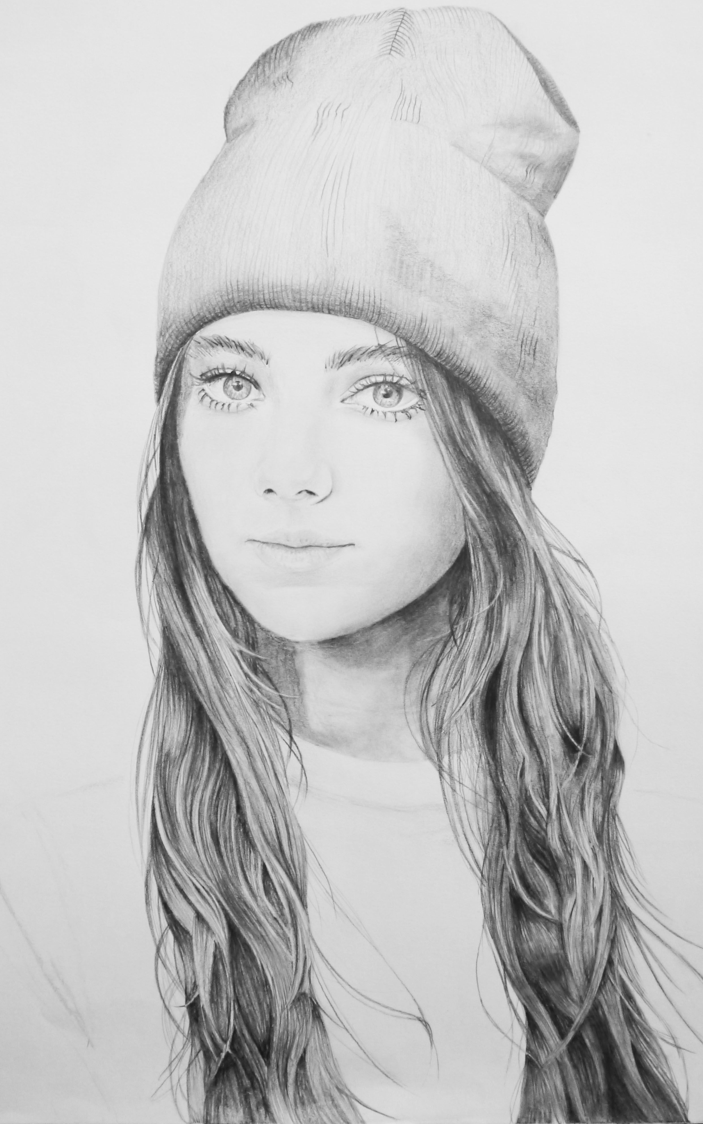
Scenarios
Maya feels a deep sense of gratitude for the Savior after learning that He was despised and rejected by others and that He suffered for our sins.
He is despised and rejected of men; a man of sorrows, and acquainted with grief: and we hid as it were our faces from him; he was despised, and we esteemed him not.
Surely he hath borne our griefs, and carried our sorrows: yet we did esteem him stricken, smitten of God, and afflicted.
But he was wounded for our transgressions, he was bruised for our iniquities: the chastisement of our peace was upon him; and with his stripes we are healed. Isaiah 53:3-5
How can Maya be an influence to others?
What can she do further to receive her own personal revelations?
How can she help others around her?

Slide 5
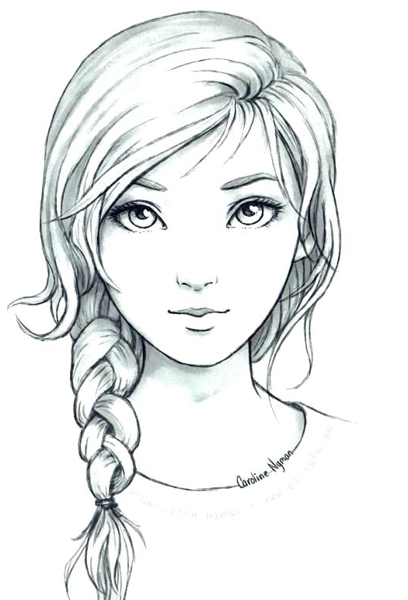
Scenarios
The word of the Lord came again unto me, saying,
Moreover, thou son of man, take thee one stick, and write upon it, For Judah, and for the children of Israel his companions: then take another stick, and write upon it, For Joseph, the stick of Ephraim, and for all the house of Israel his companions:
And join them one to another into one stick; and they shall become one in thine hand. Ezekiel 37:15-17
Olivia, who is investigating the Church, asks you, “Are there any scriptures in the Bible that refer to the Book of Mormon?”
Wherefore the Lord said, Forasmuch as this people draw near me with their mouth, and with their lips do honour me, but have removed their heart far from me, and their fear toward me is taught by the precept of men:
Therefore, behold, I will proceed to do a marvellous work among this people, even a marvellous work and a wonder: for the wisdom of their wise men shall perish, and the understanding of their prudent menshall be hid. Isaiah 29:13-14
How can you help Olivia find the true answers to her questions?

Slide 6
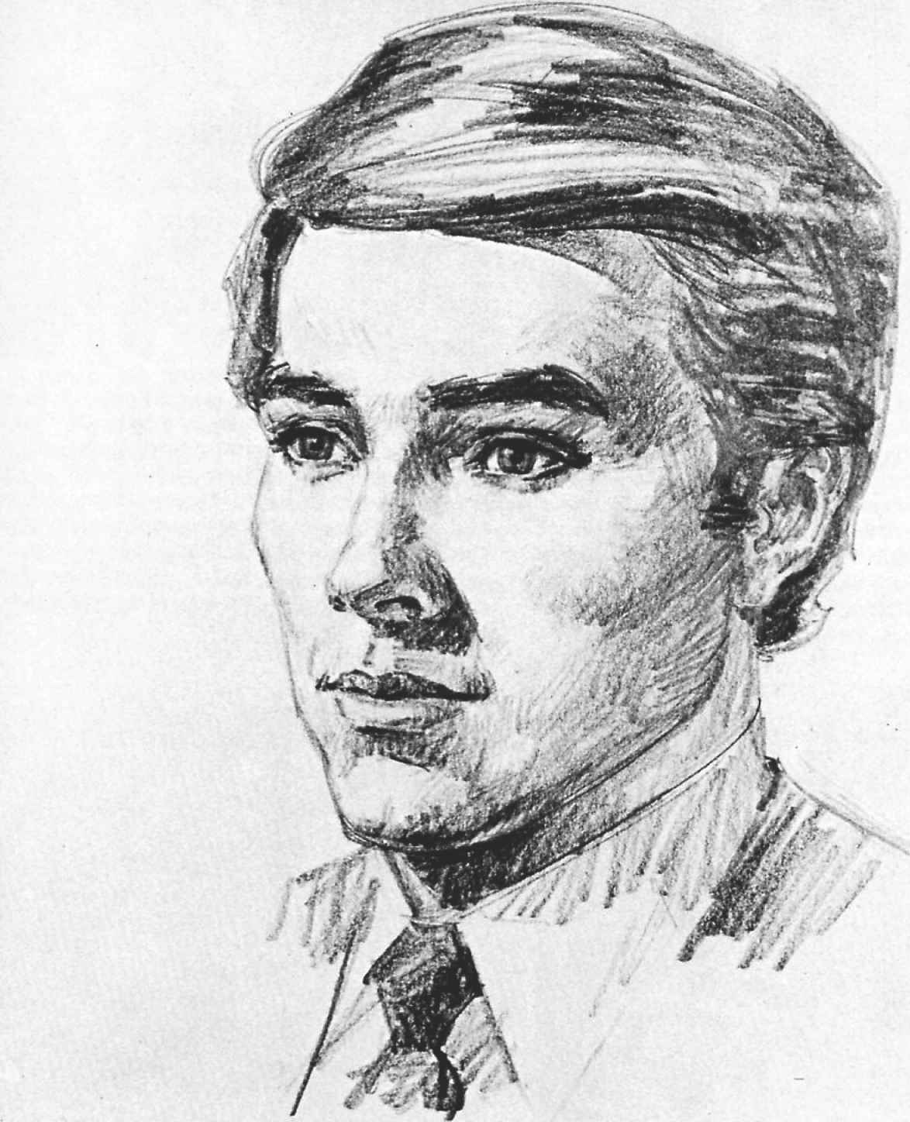
Scenarios
Brandon wants to establish unity in his Aaronic Priesthood quorum, so he teaches his quorum members about Zion.
And the Lord called his people Zion, because they were of one
heart and one mind, and dwelt in righteousness; and there was no poor among them. Moses 7:18
How can Brandon achieve his goals?
What can Brandon do to receive more knowledge of Zion?

Slide 7
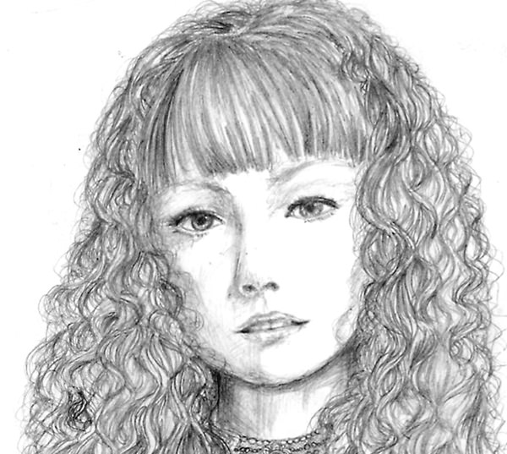
Scenarios
Jean was amazed to learn in Sunday School that the Church will continue to fill the earth and will stand forever.
And in the days of these kings shall the God of heaven set up a kingdom, which shall never be destroyed: and the kingdom shall not be left to other people, but it shall break in pieces and consume all these kingdoms, and it shall stand for ever. Daniel 2:44
What can Jean do to further her knowledge about the Church?
How can she know that the Church is true?

Slide 8
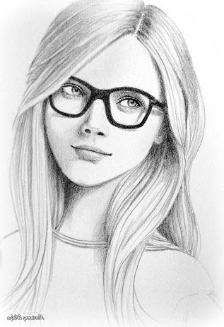
Scenarios
Now the Lord had shown unto me, Abraham, the intelligences that were organized before the world was; and among all these there were many of the noble and great ones;
And God saw these souls that they were good, and he stood in the midst of them, and he said: These I will make my rulers; for he stood among those that were spirits, and he saw that they were good; and he said unto me: Abraham, thou art one of them; thou wast chosen before thou wast born. Abraham 3:22-23
Shaylee is looking for a scripture that teaches that we were foreordained to do certain things before we were born.
Then the word of the Lord came unto me, saying,
Before I formed thee in the belly I knew thee; and before thou camest forth out of the womb I sanctified thee, and I ordained thee a prophet unto the nations. Jeremiah 1:4-5
Where else could Shaylee go to find answers?

Slide 9
Scenarios
Sage understands that God is not a formless mass of spirit because the scriptures teach that God created us in His own image.
And God said, Let us make man in our image, after our likeness: and let them have dominion over the fish of the sea, and over the fowl of the air, and over the cattle, and over all the earth, and over every creeping thing that creepeth upon the earth.
So God created man in his own image, in the image of God created he him; male and female created he them. Genesis 1:26-27
Where else could Sage go to find answers?
What can she do with this knowledge?

Slide 10
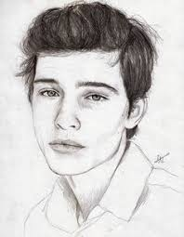
Scenarios
Cy has noticed that many in the world are celebrating evil behaviors and practices and mocking righteous ones.
Woe unto them that call evil good, and good evil; that put darkness for light, and light for darkness; that put bitter for sweet, and sweet for bitter! Isaiah 5:20
What can Cy learn about the truth of the principles he has been taught?
Where can Cy go to learn more about the truths he has been taught?
What else can Cy do to know about the truth?

Slide 11
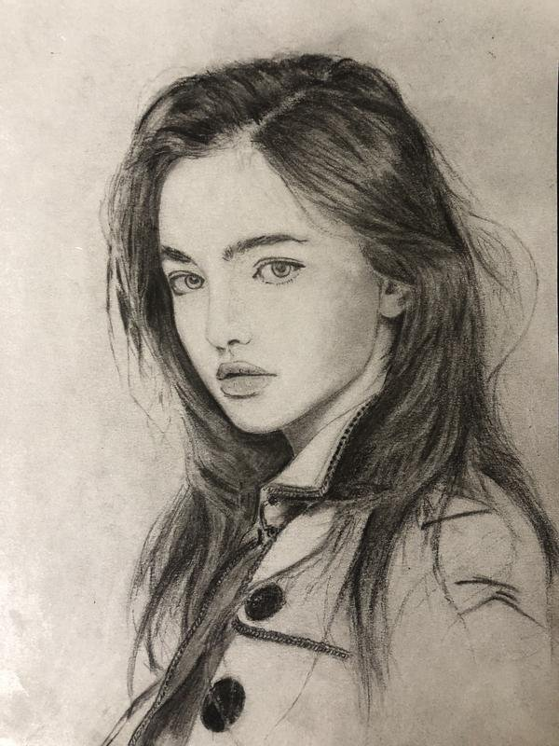
Scenarios
Amelia is looking for a scripture that describes the restored gospel as “a marvellous work and a wonder.”
Wherefore the Lord said, Forasmuch as this people draw near me with their mouth, and with their lips do honour me, but have removed their heart far from me, and their fear toward me is taught by the precept of men:
Therefore, behold, I will proceed to do a marvellous work among this people, even a marvellous work and a wonder: for the wisdom of their wise men shall perish, and the understanding of their prudent men shall be hid. Isaiah 29:13-14
Where else can Amelia go to find an answer?

Slide 12
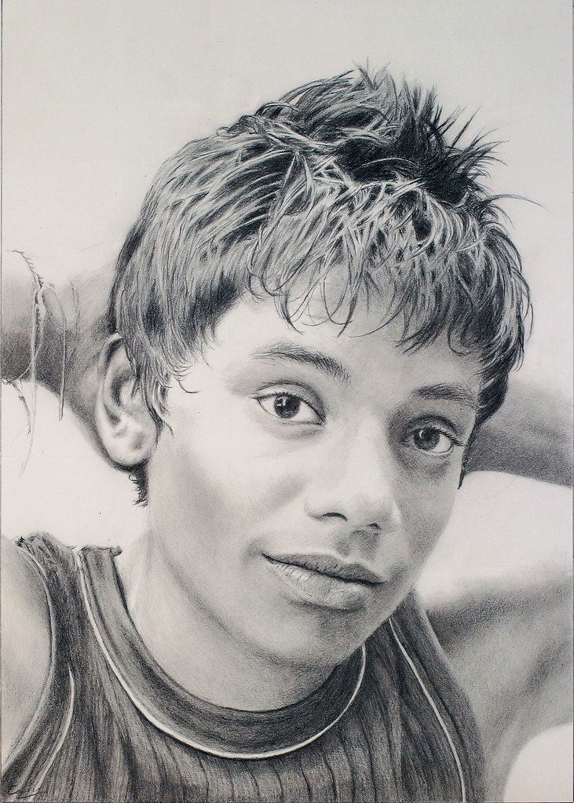
Scenarios
Marcus has struggled with many questions and concerns in the past, but as he has put his trust in the Lord, he has noticed that he is receiving much more clarity and direction in his life.
Trust in the Lord with all thine heart; and lean not unto thine own understanding. In all thy ways acknowledge him, and he shall direct thy paths. Proverbs 3:5-6
What more could Marcus do to have his questions answered?
How could you help Marcus understand his concerns?
Who could help Marcus besides you?

Slide 13
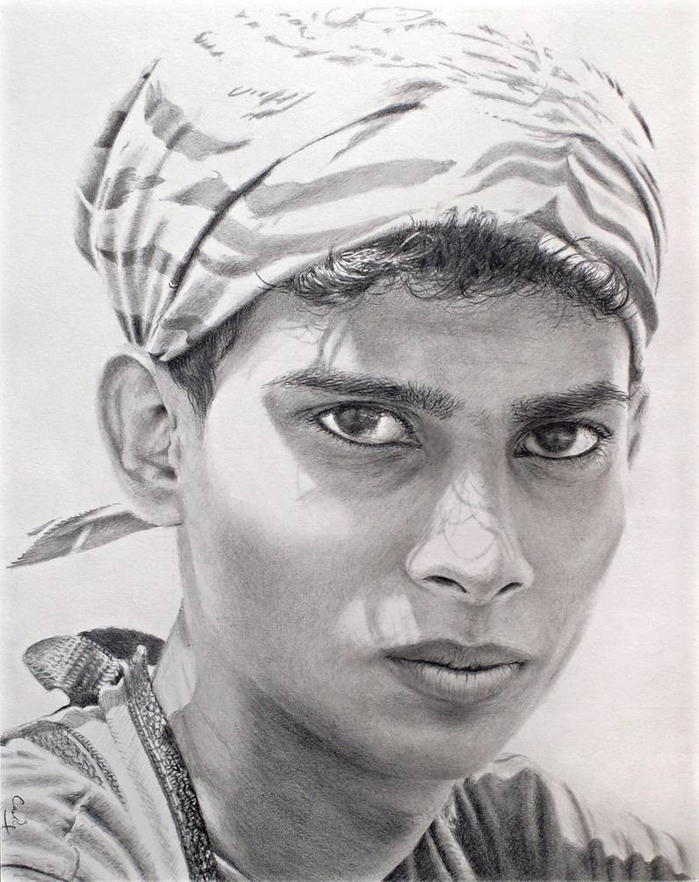
Scenarios
Eduardo has made a commitment to always serve and follow the Lord, even if others around him choose to engage in sinful behaviors.
And if it seem evil unto you to serve the Lord, choose you this day whom ye will serve; whether the gods which your fathers served that were on the other side of the flood, or the gods of the Amorites, in whose land ye dwell: but as for me and my house, we will serve the Lord. Joshua 24:15
How can Eduardo be an influence to others?
What can he do further to receive his own personal revelations?
How can he help others around him?

Slide 14
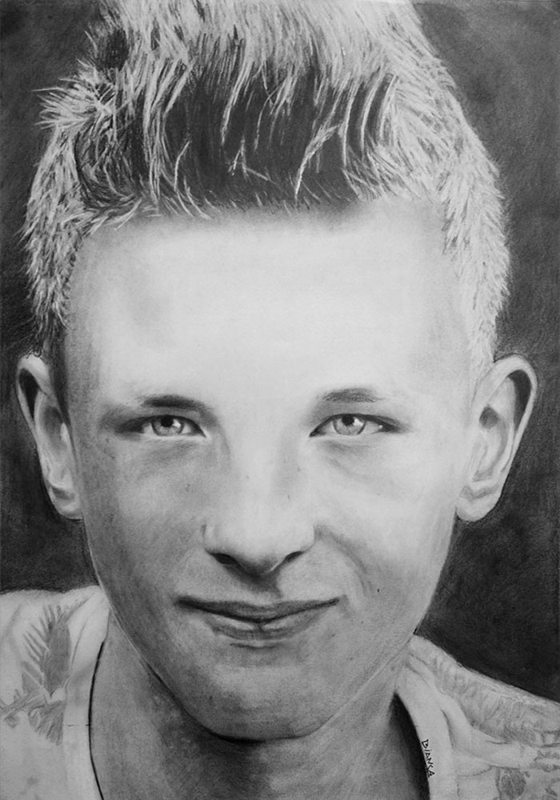
Scenarios
Alan often wonders why God created the earth and the people on it.
For behold, this is my work and my glory—to bring to pass the immortality and eternal life of man. Moses 1:39
What more could Allen do to have his questions answered?
How could you help Allen understand his concerns?
Where else can Allen look up to gain further knowledge about the creation?

Slide 15
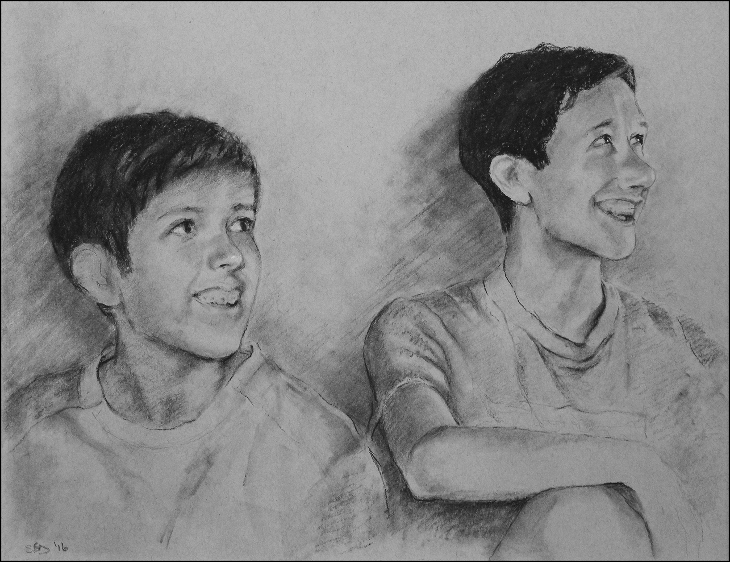
Scenarios
Joel taught his younger brother about the responsibilities of living prophets by comparing them to watchmen on a tower.
And it came to pass at the end of seven days, that the word of the Lord came unto me, saying,
Son of man, I have made thee a watchman unto the house of Israel: therefore hear the word at my mouth, and give them warning from me. Ezekiel 3 :16-17
How can Joel be an influence to others?
What can he do further to receive his own personal revelations?

Slide 16
Sources:
Suggested Hymn: Truth Reflects upon Our Senses #273
Sources for Scenarios:
Old Testament Seminary Teachers Manual Lesson 94 “Prophets and Revelations” Part 4
NOTE * Feel free to change the questions
Presentation by ©http://fashionsbylynda.com/blog/

