Slide 1
Lesson 96
Empire of David and Solomon
1 Kings 1-10
And David assembled all the princes of Israel, the princes of the tribes, and the captains of the companies that ministered to the king by course, and the captains over the thousands, and captains over the hundreds, and the stewards over all the substance and possession of the king, and of his sons, with the officers, and with the mighty men, and with all the valiant men, unto Jerusalem.
1 Chronicles 28:1

Slide 2
Book of Kings 1
Covers around 120 years
2 Chronicles
Judges
1 Chronicles
Joshua
Ruth
1 Kings
2 Kings
2 Samuel
1 Samuel
Nehemiah
Ezra
Esther
It also recounts the ministry of the prophet Elijah among the northern ten tribes of Israel.
The book of 1 Kings provides an account of the death of David, the reign of his son Solomon, and the decline and division of the Kingdom of Israel after Solomon and many of his successors turned to idol worship
“The books [of 1 and 2 Kings] were compiled by some unknown writer from a variety of written documents, including the state chronicles.”
The state chronicles were not the books of 1 and 2 Chronicles but rather a collection of records maintained under the direction of the kings of Israel. (1)

Slide 3
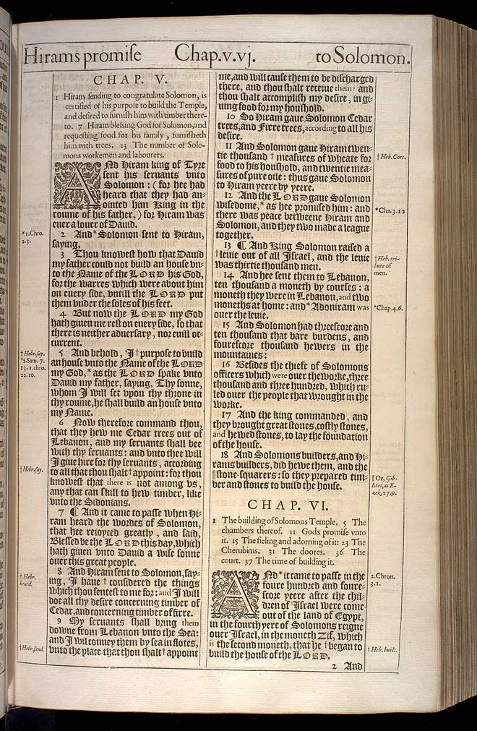
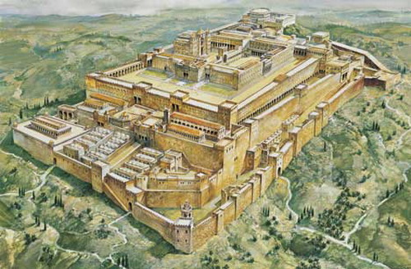
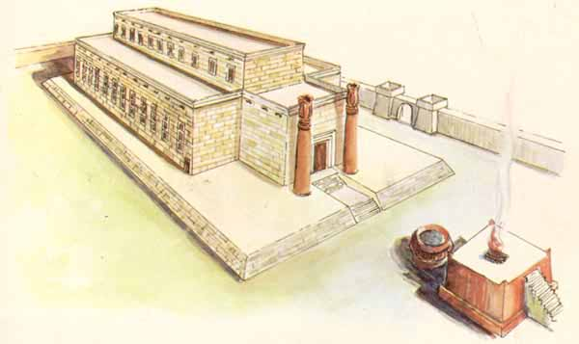
Book of Kings 1
1015 BC
1012 BC
1004 BC
991 BC
975 BC
Death of King David
And Solomon made King
Solomon begins to build the temple
Solomon begins to build his own house
Temple and Palace are finished.
(It took approximately 7 years to build the temple and 13 years to finish Solomon’s Palace)
Death of Solomon The ten tribes revolt from Rehoboam
This is the text and a scan of the actual, original, first printing of the 1611 King James Version

Slide 4
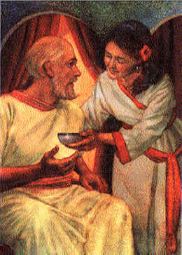
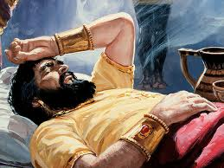
Abishag—the Nurse
David’s Chills—in order for him to be comforted in his aging years they had a maiden, Abishag a Shunammite, warm his body with hers…this was in warmth only— “but the king knew her not”
This was the best remedy which in his state could be prescribed. His nearly exhausted frame would infallibly absorb from her young and healthy body an additional portion of animal heat, and consequently trim and revive the flame of animal life. (3)
1 Kings 1:1-4

Slide 5
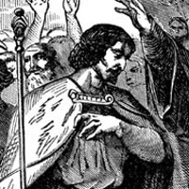
Adonijah Makes a Move
Adonijah is the next in line for the throne and prepared to take over the kingdom.
However, the Lord revealed to David that Solomon was to be his successor and the builder of the temple.
(1 Chronicles 22:9-10)
Bath-sheba
David
Haggath
Solomon
Adonijah
His actions were thus designed to convince the people of his right and to create a base of popular support that would consolidate his position.
He set up a royal processional; sought the support of important people, including Joab, the commander of the military, Abiathar, the high priest, the other princes of the court, and David’s personal staff; and prepared a great feast.
However, those who sought to cause division in the kingdom were either banished or put to death.
1 Kings 1:5-9
(4)

Slide 6
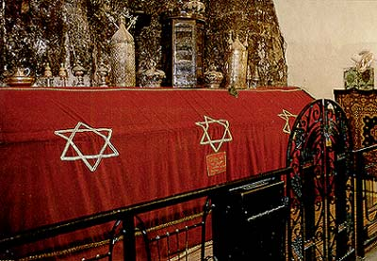
King David’s Final Instructions
David charged his son to keep all the commandments of God, to study the law, and to exercise righteous judgment upon the people. Solomon was also instructed concerning some of David’s enemies as well as some of his friends.
At this conference David performed four great services: (1) He gained the support of the people for the completion of the temple;
(2) He presented a vast treasure for the temple;
(3) He publicly turned over to Solomon the plans for the temple and disclosed that they had been given to him by divine revelation; and
(4) He succeeded in having Solomon crowned and anointed a second time when the people of every tribe were officially represented and could declare their loyalty.
David was buried in the city of David
1 Kings 2:1-10
(4)

Slide 7
Solomon
He was the son of David and Bathsheba and the successor to David on the throne of Israel. He was only 20 years old.
He reigned around 1050 BC until his death around 975 BC
His name means peaceable
He is well known for his wisdom, building the temple in Jerusalem, his great wealth, and his many wives and concubines. He had seven hundred wives, princesses (of royal birth), and three hundred concubines (1 Kings 11:3)
He was the author of the book of Proverbs (3,000 Proverbs and 2,005 songs) (1 Kings 4:32)
He found favor in the sight of the Lord, but shifted unwisely and married outside Israel and his heart turned to idolatry (1 Kings 11)
Solomon is mentioned by Jesus in the Sermon on the Mount and also by Nephi in the Book of Mormon (2 Nephi 5:16) and by Jacob (Jacob 1:15; 2:23; 24)
(9)

Slide 8
Adonijah
He was the 4th son of David and Haggith and was next in line for the kingship
He tried to overtake the throne from his aging father, David
King David learned of this plot and knowing that the Lord wanted Solomon to be king he arrange Solomon to be anointed king
Adonijah fled from David’s men and sought refuge in Mt. Moriah
He tried again to seek the throne after his father’s death by asking Bath-sheba to arrange that he marry Abisha, David’s wife and nurse.
Solomon realizes this is a treasonous act so he has Adonijah killed by the hand of Benaiah the son of Jehoiada
(9)

Slide 9
Adonijah’s Request
“Amongst Eastern nations the wives and concubines of a deceased or dethroned king were taken by his successor; and so Adonijah’s request for Abishag was regarded as tantamount to a claim on the throne” (5)
Solomon knew and understood this law.
…And why dost thou ask Abishag the Shunammite for Adonijah? ask for him the kingdom also…
At first it may seem puzzling that Bath-sheba would take Adonijah’s request to Solomon since she almost certainly knew and understood this law.
Perhaps she, knowing how Solomon would react, recognized an opportunity to rid Solomon of the threat that Adonijah continued to be to the throne of Israel.
Solomon did react quickly, for this was the second time Adonijah had attempted to take the throne by subtlety.
2 Samuel 12:8; 16:21-22 and 1 Kings 2:19-25
(4)

Slide 10
Conspirators
Abiathar—the high priest, son of Ahimelech, 4th descendant of Eli.
Which was the last of Eli's House. The only one of the priests to escape from Saul's massacre
He was removed from office and replaced by Zadok of the family of Eleazar
Joab—a general of the king’s army under King David. He turned his support to Adonijah rather than Solomon. For treason by Solomon he was executed by the hand of Benaiah and replace by Benaiah the son of Jehoiada
And one of the sons of Ahimelech the son of Ahitub, named Abiathar, escaped, and fled after David.
And Abiathar shewed David that Saul had slain the Lord’s priests. 1 Samuel 22:20
Shimei—of the house of Saul who actively and aggressively opposed David during the uprising of Absalom.
David pardoned him but later he had violated an oath causing him to be executed for treason by Benaiah
James Tissot
1 Kings 2:26-46
(4)

Slide 11
An Understanding Heart
Give therefore thy servant an understanding heart to judge thy people, that I may discern between good and bad: for who is able to judge this thy so great a people?
How did the Lord feel about Solomon’s desire?
Why do you think the Lord was pleased?
How might Solomon have been able to better serve his people because of the additional blessings of riches and honor?
When we selflessly seek the Lord’s help to serve others, He will magnify our abilities to serve
1 Kings 3
(4)

Slide 12
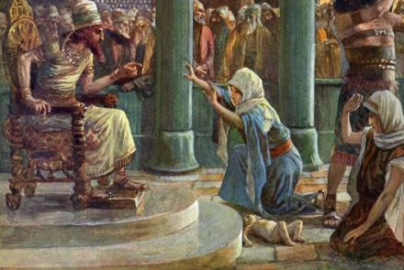
The Judgement
Solomon went to Jerusalem, worshipped the Lord, and provided a feast for all his servants.
During the feast two women petitioned King Solomon to judge a difficult circumstance.
The two women lived with each other and bore children about the same time.
One night one of the women woke up to find that her baby had died. Rather than mourn the loss of her baby, she switched her dead baby with the other woman’s baby.
The next morning, when the second woman awoke to nurse her child, she found a dead baby that was not her son.
The first woman denied the other woman’s accusation fervently.
They sought King Solomon’s judgment to settle the matter.
1 Kings 3:16-24

Slide 13
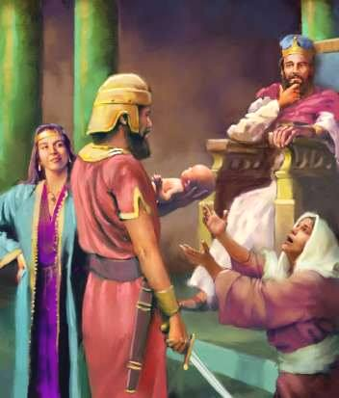
The True Mother
Then spake the woman whose the living child was unto the king, for her bowels yearned upon her son, and she said, O my lord, give her the living child, and in no wise slay it. But the other said, Let it be neither mine nor thine, but divide it.
Then the king answered and said, Give her the living child, and in no wise slay it: she is the mother thereof.
1 Kings 3:26-27

Slide 14
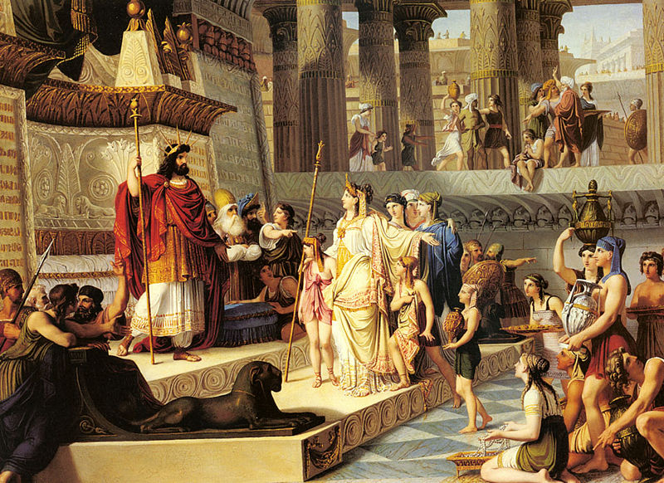
Samuel’s Prophecy Fulfilled
Each district supplied food for one month of every year.
The officers in turn imposed the burden of providing food on the farmers and shepherds
The king shall reign over you
He will take your sons and appoint them for himself
He will appoint captains over thousands to reap his harvest
He will take your daughter to be maid, cook and bakers
He will take your crops and give them to his servants
He will take a 10th of your seed, crops, and give to his officers and to his servants
He will take your menservants, maidservants, young men and asses and put them to work
He will take a 10th of your sheep (flocks)
1 Samuel 8:11-20
Such taxation fulfilled the words of the prophet Samuel, who many years before had warned Israel what would happen if they chose to have a king rule over them.
1 Kings 4
(2)

Slide 15
Hirum/Huram
His mother was from the tribe of Napitali, and his father was a famous brass maker
He was the king of Tyre who befriended David as the new king of Israel
He assisted David in building his palace
He had architectural experience and assisted Solomon in building the temple in Jerusalem
Hiram supplied Solomon with cedar-trees, fir-trees, and Tyrian constructors for the building of the Temple; and Solomon repaid him with wheat and olive-oil
Twenty years later Hiram sent to Solomon gold and another large supply of cedar- and fir-trees; and Solomon gave him in return a present of twenty towns in Galilee.
Although Hiram was dissatisfied with the present, his friendship for Solomon did not diminish; and he sent Solomon 120 talents of gold
Hiram helped build a flat of great ships permitting Solomon's ships to sail with his own to Ophir; and the Israelites were guided by the Tyrians, who were the better mariners
*Another Hirum/Huram is mentioned in the Bible, so they may have been two separate persons or related father to son. One is mentioned as a king and another is a master craftsman.
(8, 9)

Slide 16
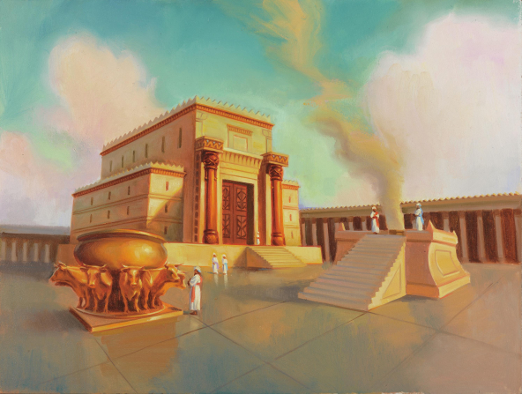
Solomon Builds The Temple
Why does the Church go to such great lengths to build temples all over the world?
Why do some Latter-day Saints sacrifice so much in order to worship in the temple?
Solomon’s temple was different than our temples today because it was patterned after the tabernacle the children of Israel carried with them through the wilderness.
Nevertheless, like the ancient tabernacle and the temples today, the temple Solomon built was a symbol of the Lord’s presence with His people.
By making every effort to be worthy to enter and serve in the temple, we demonstrate our desire to enjoy His presence.
1 Kings 5-7

Slide 17
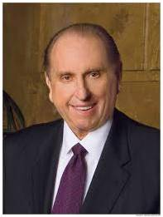
“Those who understand the eternal blessings which come from the temple know that no sacrifice is too great, no price too heavy, no struggle too difficult in order to receive those blessings. …
“Your sacrifice may be bringing your life into compliance with what is required to receive a recommend, perhaps by forsaking long-held habits which disqualify you.”
1 Kings 5-7
(6)

Slide 18
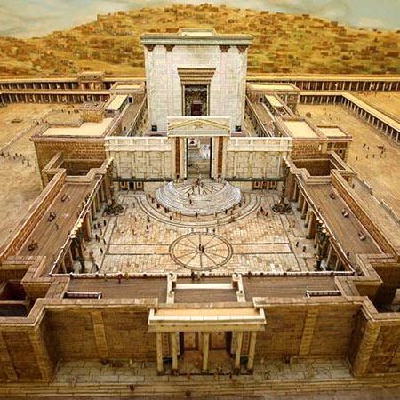
Dedication of the Temple
Solomon gathered many Israelites to participate in the dedication of the temple. After they placed the ark of the covenant in the Holy of Holies, the glory of the Lord appeared as a cloud that filled the temple
Dedicatory prayer Solomon offered on this occasion.
1 Kings 8:22-53
If we worship the Lord in the temple, then the Lord may grant us blessings to help us with challenges we face

Slide 19
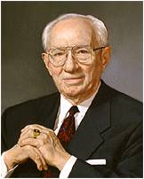
“The temple is … a place of personal inspiration and revelation. Legion are those who in times of stress, when difficult decisions must be made and perplexing problems must be handled, have come to the temple in a spirit of fasting and prayer to seek divine direction.
Many have testified that while voices of revelation were not heard, impressions concerning a course to follow were experienced at that time or later which became answers to their prayers.”
1 Kings 5-7
(7)

Slide 20
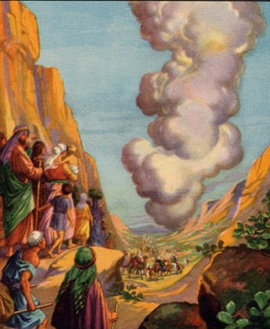
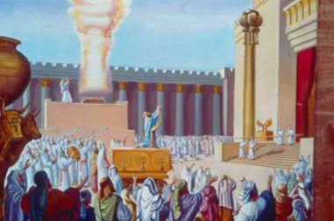
The Cloud of God’s Presence
He took not away the pillar of the cloud by day, nor the pillar of fire by night, from before the people.
Exodus 13:22
After the sacrifice—instantly consumed
So that the priests could not stand to minister because of the cloud: for the glory of the Lord had filled the house of the Lord.
After 500 years when the Israelites were guided the wilderness and protected by the Lord, they were once again in the presence of the Lord
1 Kings 8:11

Slide 21
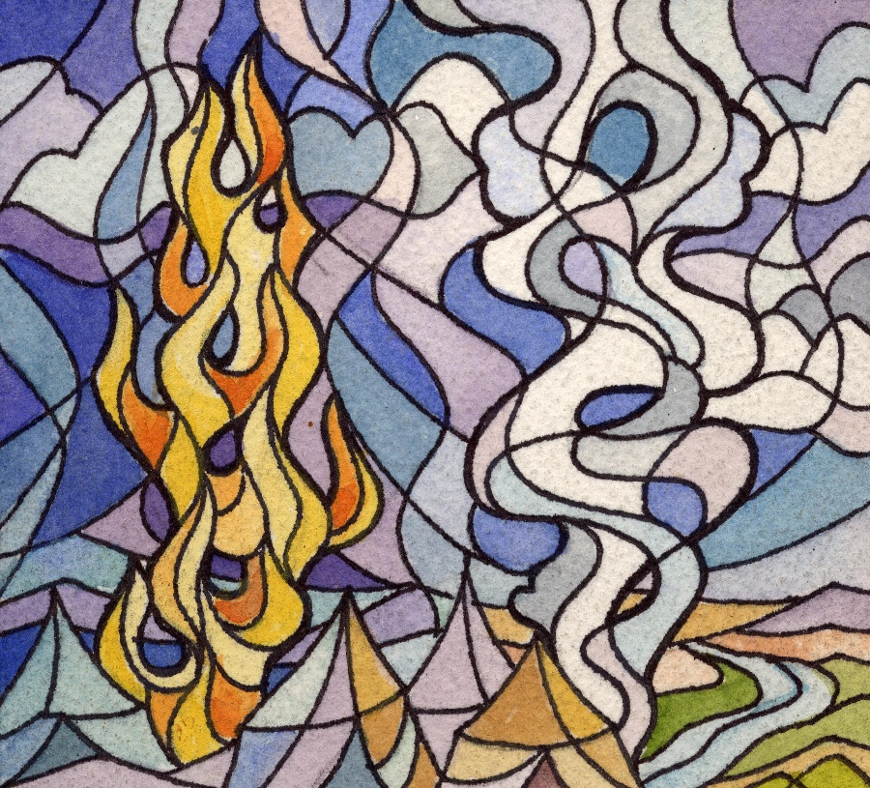
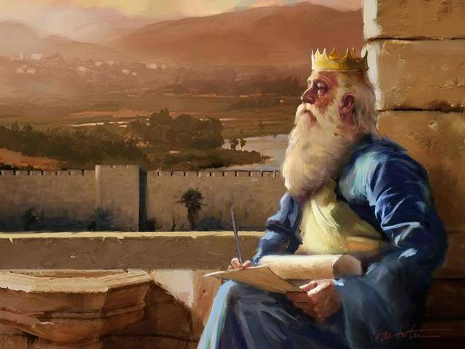
Solomon’s Halleluiah
And the priests waited on their offices: the Levites also with instruments of musick of the Lord, which David the king had made to praise the Lord, because his mercy endureth for ever, when David praised by their ministry; and the priests sounded trumpets before them, and all Israel stood. 2 Chronicles 7:6
On the eighth day he sent the people away: and they blessed the king, and went unto their tents joyful and glad of heart for all the goodness that the Lord had done for David his servant, and for Israel his people. 1 Kings 8:66

Slide 22
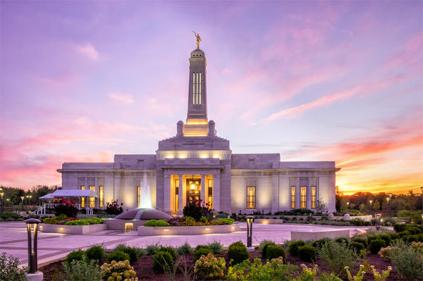
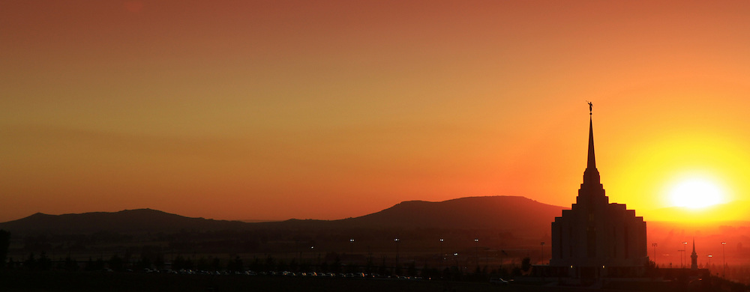
The Lord Fulfills His Promise
If we walk in the Lord’s ways, then the Lord will be with us in His temple
Indianapolis Temple
When we selflessly seek the Lord’s help to serve others, He will magnify our abilities to serve
Rexburg Idaho Temple
1 Kings 9-10

Slide 23
Sources:
Suggested Hymn: #257 Rejoice! A Glorious Sound Is Heard
Videos: Until We Meet Again (2:08)
Temple Blessings—Worth Every Sacrifice (1:52)
Bible Dictionary
Old Testament Who’s Who by Ed J. Pinegar and Richard J. Allen p. 175-176
Adam Clark Bible Commentary 1 Kings 1:2
Old Testament Institute Manual Religion 302
Dummelow, Commentary, p. 212. Found in Old Testament Institute Manual
President Thomas S. Monson (“The Holy Temple—a Beacon to the World,” Ensign or Liahona, May 2011, 92–93).
President Gordon B. Hinckley (“The Salt Lake Temple,” Ensign, Mar. 1993, 6).
Jewish Encyclopedia
Who’s Who in the Old Testament by Ed J. Penigar and Richard J. Allen p. 7
Presentation by ©http://fashionsbylynda.com/blog/

Slide 24
Things David Knew About the Coming Messiah
Pre-existence of Jesus Christ:
Psalm 110:3—”Out of the womb, before the morning star, have I begotten thee.”—translated by Eusebius with the following comment: he (the Christ) came into existence from God himself before the morning star, that is before the organization of the world.” (Eusebius, Church History, 3:16-18). If Eusebius is correct in his version of this passage, not the implication that in the pre-existence the Messiah was born of a heavenly mother before he was born of Mary in this life! That Eusebius was apparently correct in his version of this passage is supported by a number of authorities and several of the most ancient texts. (Clark, Bible commentary Vol. 3, p. 581)
Christ Sired By God:
Psalm 2:7 “The Lord hath said unto me (the Messiah). Thou art my Son; this day have I begotten thee.”
Christ to be a High Priest after the order of Melchizedek:
Psalm 110:4 “Thou art a priest for ever after the order of Melchizedek.”
Christ to be betrayed by a friend:
Psalm 41:9 “Yea, mine own familiar friend, in whom I trusted, which did eat of my bread, hath lifted up his heel against me.”
Christ’s body not to see corruption:
In Acts 2:27 Peter quotes from David’s Psalm 16:9-10 “Therefore my heart is glad, and my glory rejoiceth: my flesh also shall rest in hope. For thou wilt not leave my soul in hell; neither wilt thou suffer thine Holy One to see corruption.”
Christ’s suffering on the cross:
Many details concerning the crucifixion appear in the Messiah’s lamentation which David wrote.
Psalm 22:1, 6 “My God, my God, why hast thou forsaken me.” “But I am…a reproach of men and despised of the people.”
W. Cleon Skousen The Fourth Thousand Years pp. 118-119

Slide 25
United Kingdom
Establishment of Solomon | Rise of Solomon | Decline of Solomon
1 Kings 1-2 | 1 Kings 3-8 | 1 Kings 9-11
Jerusalem: Capital of United Kingdom for 40 years
Divided Kingdom
Division of the Kingdom | Reign of Various Kings | Reign Ahab with Elijah | Reign of Jehoshaphat in Judah | Reign of Ahaziah in Israel
1 Kings 12-14 | 1 Kings 15-16 | 1 Kings16-22 | 1 Kings 22 | 1 Kings 22
Samaria: Capital of Israel
Jerusalem: Capital of Judah
For 90 years

Slide 26
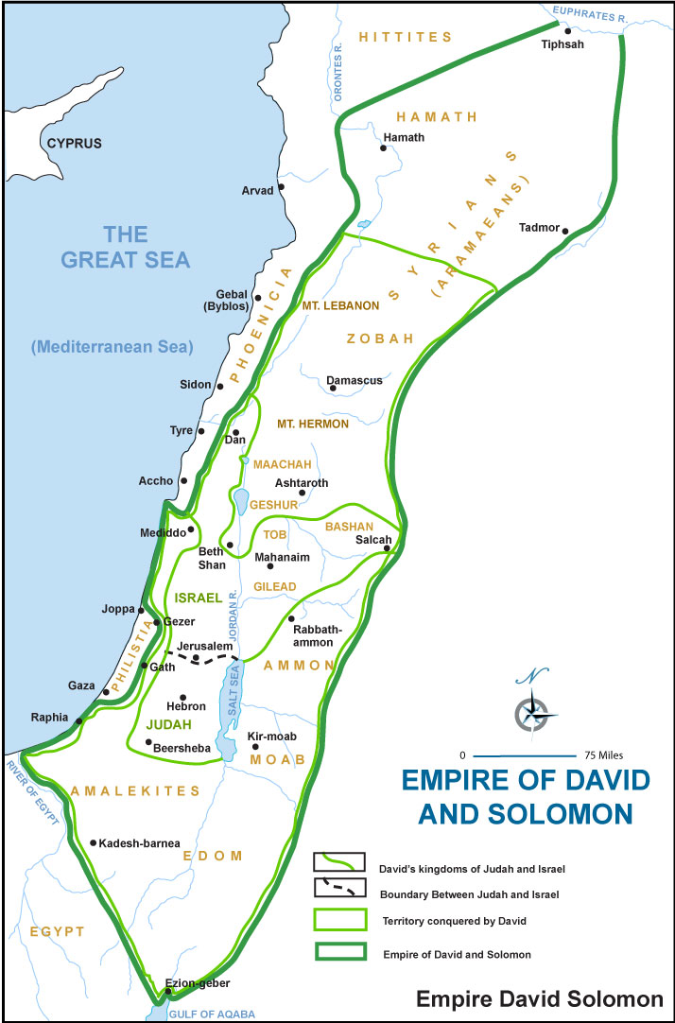
The Book of 1 Kings:
Additionally, the book of 1 Kings introduces the reader to the bold and noble prophet Elijah. The Prophet Joseph Smith taught that Elijah “holds the keys of the authority to administer in all the ordinances of the Priesthood” (Teachings of Presidents of the Church: Joseph Smith [2007], 310). “The power of Elijah is the sealing power of the priesthood by which things that are bound or loosed on earth are bound or loosed in heaven [see D&C 128:8–18]” (Guide to the Scriptures, “Elijah” ;scriptures.lds.org). Through the power of the priesthood, Elijah caused a drought that lasted three and a half years, raised the dead, called down fire from heaven, and prophesied the downfall of King Ahab and his wife, Jezebel, who together ruled in wickedness in the Northern Kingdom of Israel.
Adonijah’s plan—1 Kings 1
His plan was thwarted, however, when Nathan heard what Adonijah was doing and reported it to Bath-sheba, Solomon’s mother. His warning to her that her life as well as Solomon’s life was in danger (see v. 12) illustrates one of the problems with a monarchical system of government. Because of the competition that typically existed in the royal family itself, the new king often assassinated all his brothers and other possible heirs who might pose any threat to his rule.
Moving swiftly, Bath-sheba and Nathan joined together (see v. 11) to bring Adonijah’s manipulations to the attention of King David. When David learned that Adonijah sought to take the throne, he quickly appointed Solomon as co-regent. They ruled together until David died.
Thus, in one quick and decisive move, David cut off Adonijah’s attempts to usurp the throne, and Solomon was established as king. One can easily imagine why those at Adonijah’s feast were struck with fear and hastened to desert Adonijah’s presence. They were caught in the midst of what bordered on treason against the new king, and they were anxious to disassociate themselves from Adonijah.
So, as soon as he learned of the enthroning of Solomon, Adonijah fled not to his home, but immediately to the heights of Mount Moriah just above the city of David.
Horns of an alter—A place of refuge
Old Testament Institute Manual
Solomon is anointed:
Although only twenty years of age, Solomon, like David and Saul before him, was anointed to his kingship by a rightful priest and by the prophet (1 Kings 1:34, 39). To clearly show the people that Solomon was David’s choice and the Lord’s, David commanded that the inauguration of his co-regent take place immediately.
He commanded that Solomon be placed on his (David’s) mule to ride in procession to Gihon in the traditional way that a king made his triumphal entry into a city (see J. R. Dummelow, ed., A Commentary on the Holy Bible,p. 693; compare with Jesus’ triumphal entry into Jerusalem recorded in Matthew 21:1–11). The people responded joyously and accepted Solomon as their new king (see 1 Kings 1:39–40).

Slide 27
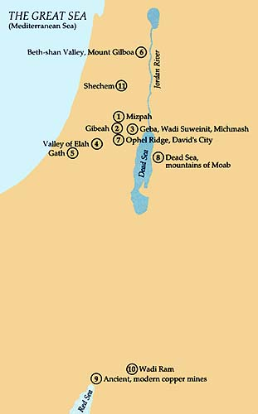
Places of David and Solomon
7. Ophel Ridge and David’s City. The City of David was located on the southern ridge, called Ophel, of Mount Moriah. Its boundaries were the Kidron Valley (the steep valley to the right of center) and the Tyropoeon Valley, which has been largely filled in since David’s time.
After the twelve tribes asked David to become king over all Israel, he captured the stronghold of Jerusalem, which had remained in Jebusite hands until that day, and made it the capital, calling it the city of David.
Shortly before his death, David had Solomon anointed king at Gihon. (See 1 Kgs. 1:38–40.) Solomon built the temple on Mount Moriah, near where the Moslem buildings stand today.
11. Shechem. In the foreground is the excavation site for the ancient city of Shechem. Behind it, on the slope of Mount Gerizim, is part of the modern city of Nablus. The kingdom of Solomon split apart at Shechem. After Solomon’s death, all Israel gathered at Shechem. The people, led by Jeroboam, asked Rehoboam, Solomon’s son, if he would reduce taxes, but he answered that he would increase them. Ten tribes then broke off from Judah and Benjamin, and Rehoboam fled for his life. The ten tribes then made Jeroboam their king. Rehoboam was left to rule over the southern two tribes. (See 1 Kgs. 12:1–24.)
9. Ancient and modern copper mines. In the center of the photograph are copper mines that probably provided Solomon with metal. The mines have been mined continuously since his days. Furthermore, Solomon controlled the area because his port city, Ezion-geber, was nearby. The northern tip of the Gulf of Aqaba (Red Sea), where the port was, is just visible in the upper right corner. The brass Solomon had cast could not be weighed because of its abundance. (See 1 Kgs. 7:13–47.) The term brass in the Old Testament could refer to copper or to either of its alloys—brass or bronze.
10. Wadi Ram. Just south of the Edomite plateau, which is off the bottom of the photograph, is this rock-filled sandy plain—Wadi Ram. The King’s Highway, a principal trade route from the north, split in the desert near the plateau. The route leading to southern Arabia ran through this wadi. The Queen of Sheba would probably have used this wadi on her trip to meet Solomon. (See 1 Kgs. 10:1–10.) It was well traveled and served to connect Solomon’s port with the King’s Highway.
The Lands of Saul, David, and Solomon—June 1990 Ensign

Slide 28
At the time of Solomon’s succession the government of Israel, even under Saul and David, had never been controlled by an ‘administration’ as we know it, but rather by a patriarchal or charismatic leader who ruled largely by personal magnetism and inspiration from the Lord.
Solomon makes administrative changes
He created three new offices in his cabinet adding Ahishar to be in charge of the palace and serve as prime minister.
Adoniram was named the chief of forced labor-for building.
Adoniram would supervise both foreign slave laborers 9the descendants of those who had survived the Israelite Conquest) and a newly organized, conscripted labor force of Israelites, who served one out of every 3 months.
Azariah, the son of Nathan, was over the officers (provincial governors) of the 12 districts of Israel.
Solomon divided Israel into 12 administrative districts, all comparatively equal in population and resources.
To accommodate the new territory, the arbitrary divisions ignored the old tribal boundaries, and for all practical purposes the tribal distinctions were abandoned except for temple duties and genealogies.
“Solomon assigned one officer to head each district; all of them were responsible to Azariah.
The 12 officers were in charge of raising provisions for the king’s household—each district supplied food for one month of every year.
The officers in turn imposed the burden of providing food on the farmers and shepherds, and quite a burden it was.
The provision needed for one day by Solomon’s court ‘was thirty cors [188 bushels] of fine flour, and sixty cors [about 370 bushels] of meal, ten fat oxen, and twenty pasture-fed cattle, a hundred sheep, besides harts, gazelles [fallow deer], roebucks, and fatted fowl … And those offices … let nothing be lacking. Barley also and straw for the horses and swift steeds they brought to the place where it was required, each according to his charge.’ And this was only part of the taxation.” (Great People of the Bible and How They Lived, pp. 186–88.)
Such taxation fulfilled the words of the prophet Samuel, who many years before had warned Israel what would happen if they chose to have a king rule over them (see 1 Samuel 8:11–20).
Old Testament Institute Manual

Slide 29
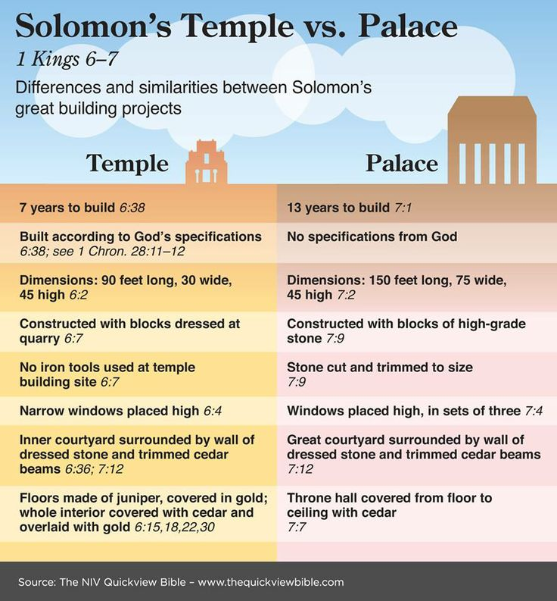
The Cloud of Glory:
“Before Solomon gave the dedicatory prayer, a cloud of glory filled the house of God, indicating the very presence of God. That this glory should accompany the dedication exercises is interesting for Latter-day Saints since a similar glory attended the dedication of the Kirtland Temple on 27 March 1836. Many present reported seeing angels and hearing the ‘sound of a rushing mighty wind, which filled the Temple,’ and many in the community reported ‘seeing a bright light like a pillar of fire resting upon the Temple’ (History of the Church, 2:428). The special events attending the dedication of both temples are signs of the Lord’s divine acceptance of the houses built in His name to His honor” (Old Testament Student Manual: 1 Kings–Malachi, 3rd ed. [Church Educational System manual, 2003], 7).
Hiram’s Assistance:
The prophet Nathan instructed David that one of his children would build a temple unto God (see 2 Samuel 7:12).
So, David spent much time and energy in gathering materials for the temple. When Solomon came to the throne, one of the first things he did was direct his attention to building the temple. In order to make the building as beautiful as possible, Solomon employed the services of King Hiram of Tyre:
“Solomon had depended on the skill of Hiram’s Phoenician architects and laborers, as well as precious Lebanon cedar, to construct the most impressive buildings in Jerusalem—the temple and the royal buildings for government. From almost the beginning of Solomon’s reign,’
… Hiram supplied Solomon with all the timber of cedar and cypress that he desired, while Solomon gave Hiram twenty thousand cors [125,000 bushels] of wheat as food for his household, and twenty thousand cors [over a million gallons] of beaten oil. Solomon gave this to Hiram year by year,’ on an installment plan.” (Great People of the Bible, p. 190.)
How did Solomon know how to build the temple?
President Brigham Young said: “The pattern of this temple, the length and breadth, and height of the inner and outer courts, with all the fixtures thereunto appertaining, were given to Solomon by revelation, through the proper source. And why was this revelation-pattern necessary? Because Solomon had never built a temple, and did not know what was necessary in the arrangement of the different apartments, any better than Moses did what was needed in the tabernacle.” (Discourses of Brigham Young,p. 414.)
The temple of Solomon was later destroyed, and the kingdom of Judah was scattered. Zerubbabel’s temple, which Herod renovated, was later built on the same spot. This later temple was the one standing in the Savior’s day. Ezra 6:13-15
Labor on the temple: “Soon after Solomon’s accession to the throne he set about the labor, which, as heritage and honor, had come to him with his crown. He laid the foundation in the fourth year of his reign, and the building was completed within seven years and a half. With the great wealth accumulated by his kingly father and specifically reserved for the building of the Temple, Solomon was able to put the [surrounding lands] under tribute, and to enlist the co-operation of nations in his great undertaking. The temple workmen numbered scores of thousands, and every department was in charge of master craftsmen. To serve on the great structure in any capacity was an honor; and labor acquired a dignity never before recognized. … The erection of the Temple of Solomon was an epoch-making event, not alone in the history of Israel, but in that of the world.” (James E. Talmage, The House of the Lord, pp. 5–6.)
Found in Old Testament Institute Manual

Slide 30
Warning for the Temple:
Elder James E. Talmage explained how the prophetic warning was ignored and came to fulfillment:
“The glorious pre-eminence of this splendid structure was of brief duration. Thirty-four years after its dedication, and but five years subsequent to the death of Solomon, its decline began; and this decline was soon to develop into general spoliation, and finally to become an actual desecration.
Solomon the king, the man of wisdom, the master-builder, had been led astray by the wiles of idolatrous women, and his wayward ways had fostered iniquity in Israel.
The nation was no longer a unit; there factions and sects, parties and creeds, some worshipping on the hill-tops, others under green trees, each party claiming excellence for its own particular shrine.
The Temple soon lost its sanctity. The gift became depreciated by the perfidy [betrayal] of the giver, and Jehovah withdrew His protecting presence from the place no longer holy.” (House of the Lord, pp. 6–7.)
Economic Stress:
Though Solomon’s remarkable building projects became world famous, they created serious problems in his own kingdom. He taxed the people heavily and used forced labor to complete his massive projects. The people began to complain, and a deep resentment, especially in the northern tribes, began to fester.
“The life of the common man had been disrupted. In the past, a man’s wealth had been calculated mostly by the land he owned, the number of flocks he had and the size of his family. Solomon’s sweeping economic changes altered that system. Land was no longer of supreme importance—in fact, it may have become somewhat of a burden. The more land a man owned, the more crops he could grow, and thus the more he would have to turn over to the king’s officers when collection time came around every 12 months. Likewise, flocks were surrendered to tax collectors and sons were forced to serve one month of every three in the king’s labor force.
“Now wealth was calculated not by property ownership but by the amount of money a man controlled. Certainly more and more money in gold and silver came into Israel every year, but very little of it ever filtered down to the average Israelite, who had to surrender so much of his livelihood to the king’s coffers. Instead, the money was used to pay growing international debts, salaries for the full-time government officials, commissions to merchants and artisans in the king’s employ, temple and palace upkeep and other expenses.
“For the first time in Israel’s history, there began to be a distinct difference between ‘rich’ and ‘poor.’ The king and his household were rich; the common people were poor. In between were the salaried civil servants and the merchants and artisans, many of whom had organized craft guilds by that time. Such class separations had not been known in the Israel where a shepherd boy like David could be anointed king—only 50 years earlier.” (Great People of the Bible, pp. 192–93.)
Hiram and Queen of Sheba:
Hiram’s people, the Phoenicians, were masters of the sea, whereas the Israelites were not. First Kings 9:26–28 indicates that Hiram’s servants taught Solomon’s men the seafaring trade. As a result, Solomon was able to secure gold from Ophir (thought to be a port in southern Arabia) to be used to build the temple. (See also 1 Kings 10:23.)
It is very likely that the woman was a Sabean from Arabia near the southern end of the Red Sea (see Clarke, Commentary, 2:421). Three proofs are offered: (1) the area in which the Sabeans lived is known to have abounded in riches and spices; (2) many ancient writers refer to the gold and silver mines of Saba; and (3) the Sabeans had women rather than men for their rulers.
Part of Solomon’s wealth came through trading and international commerce, but much of it came through the economic oppression of the people.
Found in Old Testament Institute Manual

Slide 31
Something of Interest: Hirum of Tyre
The tale of Hiram Abiff as passed down in Masonic Lodges underpins the third degree. It starts with his arrival in Jerusalem, and his appointment by Solomon as chief architect and master of works at the construction of his temple. As the temple is nearing completion, three fellowcraft masons from the workforce ambush him as he leaves the building, demanding the secrets of a master mason. Hiram is challenged by each in turn, and at each refusal to divulge the information his assailant strikes him with a mason's tool (differing between jurisdictions). He is injured by the first two assailants, and struck dead by the last. His murderers hide his body under a pile of rubble, returning at night to move the body outside the city, where they bury it in a shallow grave marked with a sprig of acacia. As the Master is missed the next day, Solomon sends out a group of fellowcraft masons to search for him. The loose acacia is accidentally discovered, and the body exhumed to be given a decent burial. The hiding place of the "three ruffians" is also discovered, and they are brought to justice. Solomon informs his workforce that the secrets of a master mason are now lost. He replaces them with substitutes (based on gestures given and words spoken upon the discovery of Hiram's body). Such is the general legend as related in the Anglo-American jurisdictions.
In Continental Freemasonry the tale is slightly different: a large number of master masons (not just Hiram) are working on the Temple, and the three ruffians are seeking the passwords and signs that will give them a higher wage. The result is the same, but this time it is master masons who find the body. The secrets are not lost, but Solomon orders them buried under the Temple, inscribed on Hiram's grave, and the same substitution is made as a mark of respect. The secrets "lost" in the other tradition are here given to new master masons as part of their ritual. In this version, Hiram is often renamed Adoniram.
Anderson's revised 1738 Constitutions describe the place of the Deputy Grand Master, to the left of the newly installed Grand Master John Montagu, 2nd Duke of Montagu, as the "Chair of Hiram Abiff“.
In the Tanakh and the Christian Old Testament, there are three separate instances of people named Hiram that were involved in the construction of the temple of Solomon:
Hiram, King of the realm of Tyre (today, in the modern nation of Lebanon), is credited in 2 Samuel 5:11 and 1 Kings 5:1-10 for having sent building materials and men for the original construction of the Temple in Jerusalem. In the Masonic drama, "Hiram, King of Tyre" is clearly distinguished from "Hiram Abiff". The former is clearly a king and the latter clearly a master craftsman. They can be confused in other contexts.
In 1 Kings 7:13–14, Hiram is described as the son of a widow from the tribe of Naphtali who was the son of a Tyrian bronze worker, sent for by Solomon to cast the bronze furnishings and ornate decorations for the new temple. From this reference, Freemasons often refer to Hiram (with the added Abiff) as "the widow's son." Hiram cast these bronzes in clay ground in the plain of the Jordan between Succoth and Zarethan/Zeredathah (1 Kings 7:46-47).
2 Chronicles 2:13-14 relates a formal request from King Solomon of Jerusalem to King Hiram I of Tyre, for workers and for materials to build a new temple. King Hiram (Huram in Chronicles) responds "And now I have sent a skillful man, endowed with understanding, Ḥuram 'abi. (the son of a woman of the daughters of Dan, and his father was a man of Tyre), skilled to work in gold and silver, bronze and iron, stone and wood, purple and blue, fine linen and crimson, and to make any engraving and to accomplish any plan which may be given to him, with your skillful men and with the skillful men of my lord David your father.“ The phrase italicised above is translated in the New King James Version as "Huram my master craftsman". Most translations of this passage take the "'ab-" in "'abi" as the construct state of 'abba, here translated as master. Older translations preferred to translate "'ab-" as father. The common translation of the -i suffix is "my", giving the problematic reading that Hiram was sending his own father, also called Hiram. This is found in the Vulgate, the Douay–Rheims Bible and in Wycliffe's Bible The other reading is as the old Hebrew genitive, and some variant of "of my father" is found in the Septuagint, the Bishop's Bible and the Geneva Bible. In his 1723 "Constitutions", James Anderson announced that many problems with this text would be solved by reading "'abi" as the second part of a proper name, which he rendered as "Hiram Abif",agreeing with the translations of Martin Luther and Miles Coverdale's reading of 2 Chronicles 4:16. Wikipedia

