Slide 1
Lesson 98
Priesthood and Priesthood Keys

Slide 2
1. Through the priesthood, God created the earth and redeems and exalts His children.
True
False

Slide 3
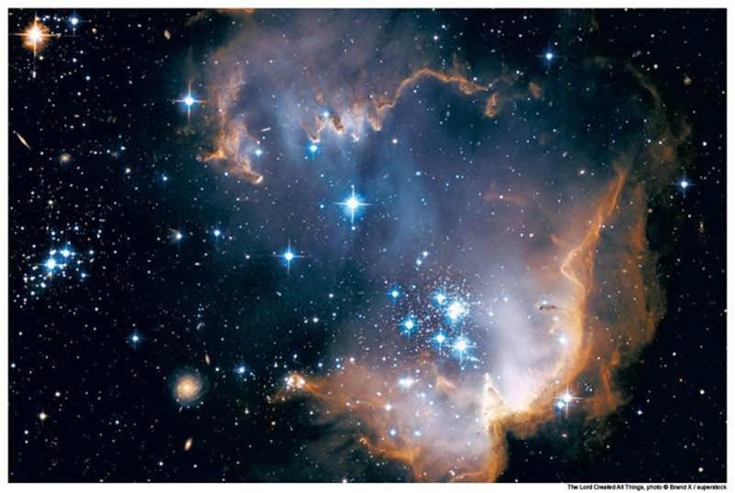
Power and Authority
The priesthood is the eternal power and authority of God.
Through the priesthood, God created and governs the heavens and the earth.
The blessings of the priesthood are available to all of God’s children through the ordinances and covenants of the gospel.
Through this power He redeems and exalts His children.
The priesthood is conferred upon worthy male members of the Church.

Slide 4
The keys of the priesthood are the rights of presidency, or the power God gives to man to govern and direct the kingdom of God on the earth.
2. Priesthood keys allow man to govern and direct the kingdom of God on the earth.
True
False
Priesthood keys are necessary to direct the preaching of the gospel and the administration of the ordinances of salvation.
Matthew 16:15–19

Slide 5
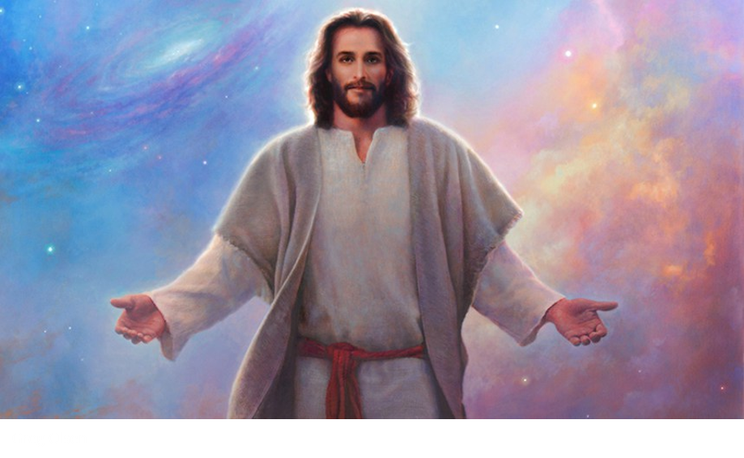
3. The President of the Church and each of the Apostles are authorized to exercise all of the priesthood keys that pertain to the kingdom of God on earth.
True
False
Jesus Christ holds all the keys of the priesthood pertaining to His Church.
He has conferred upon each of His Apostles all the keys that pertain to the kingdom of God on earth.
Apostles hold the keys but they are not authorized unless the President of the Church gives them authority.

Slide 6
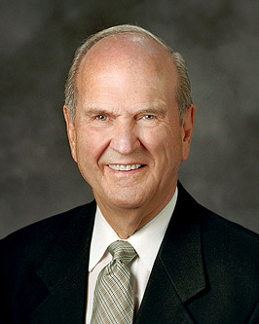
4. All priesthood holders have priesthood keys.
True
False
The President of the Church is the only person authorized to exercise all of those priesthood keys.
Temple presidents, mission presidents, stake presidents, bishops, and quorum presidents also hold priesthood keys that allow them to preside over and direct the work they have been commissioned to do.

Slide 7
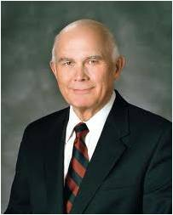
5. All who serve in the Church—men and women—are called under the direction of one who holds priesthood keys.
True
False
“Whoever functions in an office or calling received from one who holds priesthood keys exercises priesthood authority in performing her or his assigned duties.” (1)
Again I say unto you, that it shall not be given to any one to go forth to preach my gospel, or to build up my church, except he be ordained by some one who has authority, and it is known to the church that he has authority and has been regularly ordained by the heads of the church.
D&C 42:11

Slide 8
6. Personal righteousness does not matter in priesthood service.
True
False
Priesthood authority can only be exercised in righteousness.
That the rights of the priesthood are inseparably connected with the powers of heaven, and that the powers of heaven cannot be controlled nor handled only upon the principles of righteousness.
No power or influence can or ought to be maintained by virtue of the priesthood, only by persuasion, by long-suffering, by gentleness and meekness, and by love unfeigned;
By kindness, and pure knowledge, which shall greatly enlarge the soul without hypocrisy, and without guile.
D&C 121:36, 41-42

Slide 9
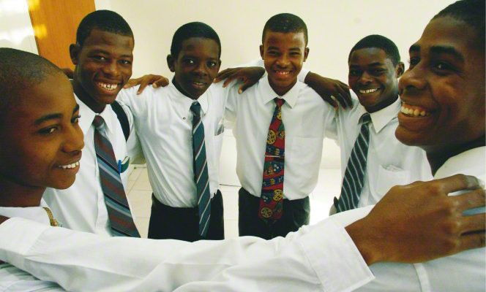
7. The Aaronic Priesthood is often called the preparatory priesthood.
True
False
The Aaronic Priesthood “holds the keys of the ministering of angels, and of the gospel of repentance, and of baptism.”
Through the exercise of this priesthood, the sacrament is prepared, blessed, and administered.
Upon you my fellow servants, in the name of Messiah I confer the Priesthood of Aaron, which holds the keys of the ministering of angels, and of the gospel of repentance, and of baptism by immersion for the remission of sins; and this shall never be taken again from the earth, until the sons of Levi do offer again an offering unto the Lord in righteousness. D&C 13:1

Slide 10
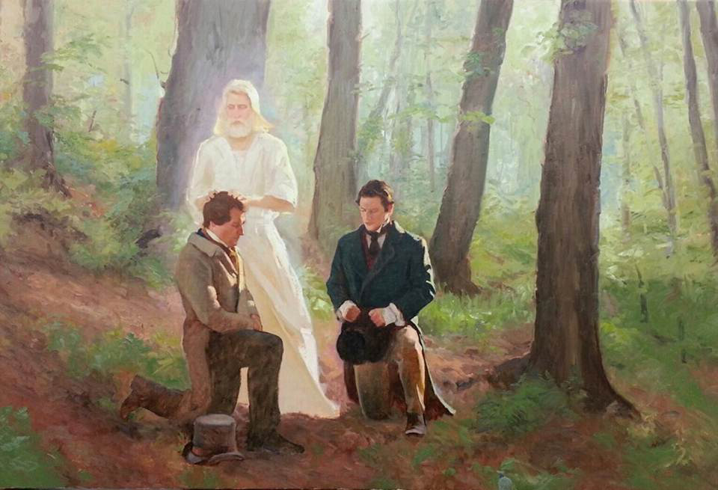
8. The offices of the Aaronic Priesthood include the office of bishop.
True
False
The offices of the Aaronic Priesthood are deacon, teacher, priest, and bishop.

Slide 11
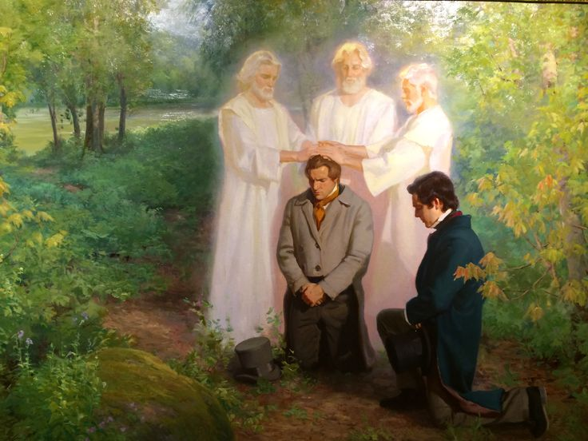
9. The Aaronic Priesthood “holds the right of presidency, and has power and authority over all the offices in the church.”
True
False
The Melchizedek Priesthood is the higher, or greater, priesthood and “holds the right of presidency, and has power and authority over all the offices in the church in all ages of the world, to administer in spiritual things.”
The Melchizedek Priesthood holds the right of presidency, and has power and authority over all the offices in the church in all ages of the world, to administer in spiritual things. D&C 107:8

Slide 12
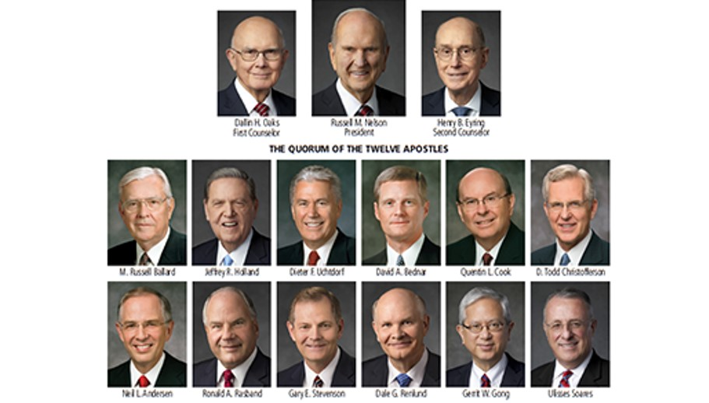
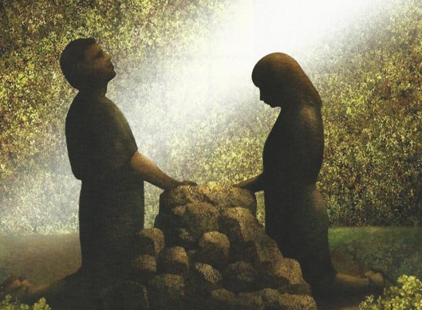
10. The President of the Church is the President of the Melchizedek Priesthood.
True
False
All of the blessings, ordinances, covenants, and organizations of the Church are administered under the authority of the President of the Church, who is the President of the Melchizedek Priesthood.
This priesthood was given to Adam and has been on the earth whenever the Lord has revealed His gospel. Within the Melchizedek Priesthood are the offices of elder, high priest, patriarch, Seventy, and Apostle.

Slide 13
Those who are ordained to the Melchizedek Priesthood enter into the oath and covenant of the priesthood.
If they magnify their calling and faithfully receive the Lord and His servants, they will obtain the blessings of exaltation.
Women are likewise promised the blessings of exaltation as they are faithful to the covenants they have made with the Lord.

Slide 14
Sources:
Suggested Hymn: Praise to the Man #27 Verse 3
President Dallin H. Oaks (“The Keys and Authority of the Priesthood,” Ensign or Liahona, May 2014, 51).
Lesson 98 Church of Jesus Christ of Latter-days Saints Seminary Teacher Manual
Presentation by ©http://fashionsbylynda.com/blog/

Slide 15
Doctrinal Mastery has come by revelation
Elder Kim B. Clark of the Seventy shared the following about Doctrinal Mastery: “I want you to know and feel in your hearts that it has come by revelation from the Lord; it is a miracle. I have reflected often on how it came and when it came and why it came. I have come to see Doctrinal Mastery in the larger context of Church education and the great work of the Lord in the earth” (Kim B. Clark, “Doctrinal Mastery and Deep Learning” [evening with a General Authority, Feb. 17, 2017], broadcasts.lds.org).
Doctrinal Mastery has come by revelation
Elder Kim B. Clark of the Seventy shared the following about Doctrinal Mastery: “I want you to know and feel in your hearts that it has come by revelation from the Lord; it is a miracle. I have reflected often on how it came and when it came and why it came. I have come to see Doctrinal Mastery in the larger context of Church education and the great work of the Lord in the earth” (Kim B. Clark, “Doctrinal Mastery and Deep Learning” [evening with a General Authority, Feb. 17, 2017], broadcasts.lds.org).
Doctrinal Mastery has come by revelation
Elder Kim B. Clark of the Seventy shared the following about Doctrinal Mastery: “I want you to know and feel in your hearts that it has come by revelation from the Lord; it is a miracle. I have reflected often on how it came and when it came and why it came. I have come to see Doctrinal Mastery in the larger context of Church education and the great work of the Lord in the earth” (Kim B. Clark, “Doctrinal Mastery and Deep Learning” [evening with a General Authority, Feb. 17, 2017], broadcasts.lds.org).
Doctrinal Mastery has come by revelation
Elder Kim B. Clark of the Seventy shared the following about Doctrinal Mastery: “I want you to know and feel in your hearts that it has come by revelation from the Lord; it is a miracle. I have reflected often on how it came and when it came and why it came. I have come to see Doctrinal Mastery in the larger context of Church education and the great work of the Lord in the earth” (Kim B. Clark, “Doctrinal Mastery and Deep Learning” [evening with a General Authority, Feb. 17, 2017], broadcasts.lds.org).

