Slide 1
Lesson 110
Ordinances and Covenants Part 2

Slide 2
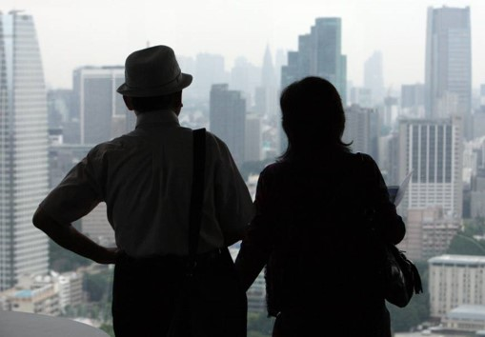
Why Can’t Everyone Enter the Temple
Your brother and his fiancée have made the choice to be sealed in the temple.
Shortly after receiving this exciting news, your parents get a phone call from Mrs. Lee, the mother of your brother’s fiancée.
Mrs. Lee explains that she and her husband have recently learned that because they are not members of the Church, they cannot enter the temple to attend the sealing ceremony.
Mrs. Lee says in frustration, “Your church isn’t very welcoming of outsiders. Why does it prevent people from entering the temple?” As you ponder Mrs. Lee’s question, you begin to wonder the same thing.
What are some assumptions that Mrs. Lee might have about God, the Church, marriage, or the temple that could have led to her frustration?

Slide 3
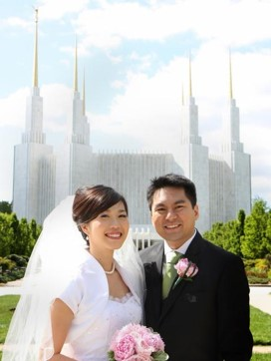
Truths = His Plan of Salvation
One reason the Lord has specific standards for those who enter the temple is because we commit to live according to covenants that we make there.
Making covenants with God in the temple invites great blessings into our lives. However, there are also consequences if we fail to keep those covenants.
Therefore, the Lord’s standards serve as a protection to those who are not committed to living according to the expectations the Lord has for those who make covenants with Him.
These same standards also protect the sanctity and holiness of the house of the Lord.

Slide 4
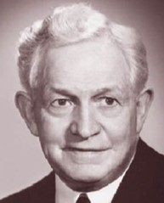
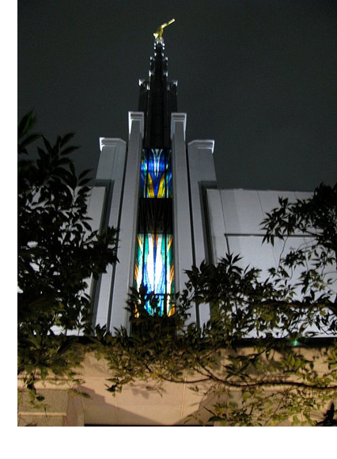
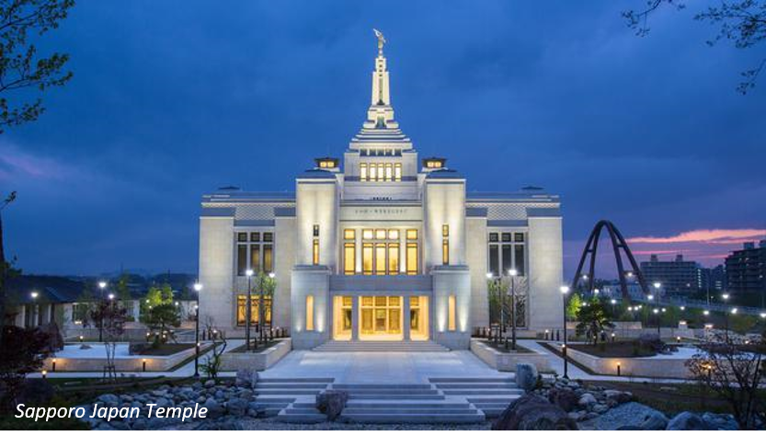
Before Going to the Temple
“We must be prepared before we go to the temple. We must be worthy before we go to the temple. There are restrictions and conditions set. They were established by the Lord and not by man. And, the Lord has every right and authority to direct that matters relating to the temple be kept sacred and confidential.” (1)
“Temples are built for the performance of sacred ordinances﻿—not secret, but sacred.
A Temple is not a public house of worship. It is erected for special purposes.
Indeed after a Temple is dedicated only members of the Church in good standing may enter.” (2)

Slide 5
Why do you think it is important for someone to be both prepared and worthy to enter the temple?
What is the process for determining whether members of the Church are prepared and worthy to enter the temple?
How do the teachings from these statements help explain why the Lord has set specific standards that we must meet in order to enter the temple?

Slide 6
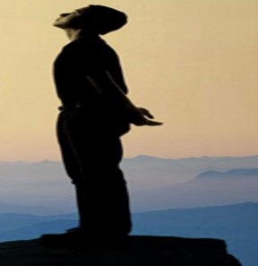
Who shall ascend into the hill of the Lord? or who shall stand in his holy place?
He that hath clean hands, and a pure heart; who hath not lifted up his soul unto vanity, nor sworn deceitfully.
Psalm 24:3-4

Slide 7
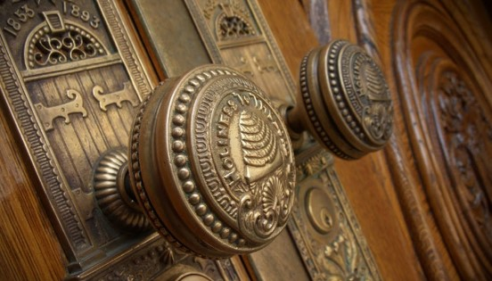
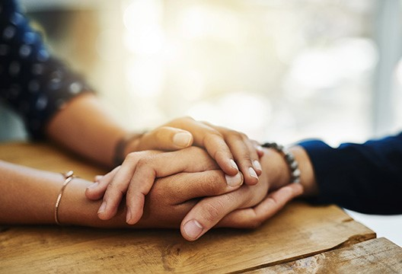
Be Sensitive
Though the Lord requires that those who enter the temple must be prepared and worthy, we should be sensitive and show compassion toward those who are unable to enter the temple to attend their loved ones’ sealings.
What are some ways that family members of different faiths can show respect for each others’ beliefs at weddings and other family events?
How can the principles of acquiring spiritual knowledge help us as we strive to maintain good relationships with those not of our faith?

Slide 8
Sources:
Suggested Song: I Love to See the Temple Children’s Songbook #95
Preparing to Enter the Holy Temple[booklet, 2002], 2.
Teachings of Presidents of the Church: David O. McKay [2003], 126.
Church of Jesus Christ of Latter-day Saints Seminary Manual (Old Testament) Lesson 110
Presentation by ©http://fashionsbylynda.com/blog/

Slide 9
Answers: (1) h; (2) j; (3) e; (4) a; (5) g; (6) k; (7) o; (8) b; (9) m; (10) l; (11) p; (12) d; (13) f; (14) q; (15) c; (16) n; (17) i
Answers: (1) h; (2) j; (3) e; (4) a; (5) g; (6) k; (7) o; (8) b; (9) m; (10) l; (11) p; (12) d; (13) f; (14) q; (15) c; (16) n; (17) i

