Slide 1
Parable of a Friend At Midnight
Luke 11:5-10

Slide 2
Ask, and it shall be given you; seek, and ye shall find; knock, and it shall be opened unto you
Lend me three loaves; for a friend of mine in his journey is come to me, and I have nothing to set before him?
Trouble me not: the door is now shut, and my children are with me in bed; I cannot rise and give thee.
Luke 11:5-10

Slide 3
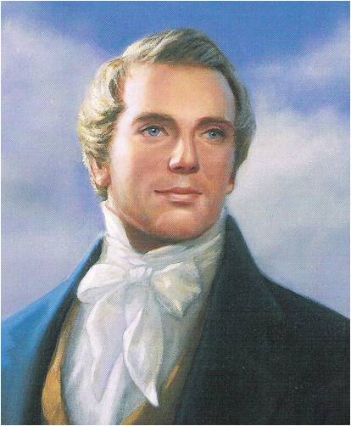
Constant Prayers
The friend to whom the traveler goes for bread represents our Father in Heaven.
The parable teaches that persistent, righteous, and faithful prayers to our Father open the doors of heaven because of His overwhelming goodness and His love and concern for His children. (1)
If we persistently pray and seek Heavenly Father’s blessings in times of need, then He will answer our prayers in ways that bless us most
“Your heavenly Father will not fail to give unto you whatsoever ye ask of him.”
Luke 11:5-10 JST Luke 11:5 footnote a

