Slide 1
His Invitation
Romans 10:21
Luke 14:16-24
Parable of the Great Supper
Notes:
Even when

Slide 2
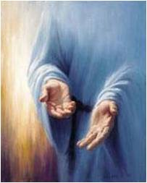
“…All day long I have stretched forth my hands unto a disobedient and gainsaying people”
Romans 10:21
His hand is still stretched out even when we refuse His Invitation
Notes:
Even when

Slide 3
A Certain Man
“…Blessed is he that shall eat bread in the kingdom of God.”
Luke 14:15
Notes:
Even when

Slide 4
Planning
Planning for a feast takes long hours
The Lord’s servants labor long to bring the message of the Word of the Lord
Luke 14:16
Notes:
Even when

Slide 5
Guest List
Special chosen People were on the Guest list
The Lord’s chosen people of Israel, the covenant people
Notes:
Even when

Slide 6
An Invitation
An Invitation to the supper (feast.) was sent out.
An Invitation to come unto Christ
You are invited
“Perhaps there’s only one thing more humiliating than not being invited to a party; inviting people to your party and having them choose not to come…” (2)
Luke 14:17
Notes:
Even when

Slide 7
“Come: for all things are now ready”
There was no reply on the first invitation so He sent out his servant to remind the people of the supper
Luke 14:17
Notes:
Even when

Slide 8
Excuses
“I have bought a piece of ground, and I must needs go and see it”
I have so much to do
“I have bought five yoke of oxen, and I go to prove them”
I have other things to take care of
“I have married a wife, therefore I can not come.”
My wife hasn’t a thing to wear
Luke 14:18-20
Notes:
Even when

Slide 9
Declined
The servant returned and told Him that no one was coming.
The Word of the Lord will be taught to those who will listen. (Gentiles)
The master told his servant to go to the streets and find anyone who would come
Luke 14:21-23
Notes:
Even when

Slide 10
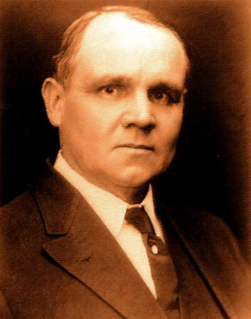
“…The gladsome invitation was to be carried to the Gentiles, who were looked upon as spiritually poor, maimed, halt, and blind. And later, even the pagans beyond the walls, strangers in the gates of the holy city, would be bidden to
the supper.” (6)
Notes:
Even when

Slide 11
What should I do?
?
?
Accept the invitation.
Don’t let unimportant things or material things, keep you from feasting at the Lord’s table
Important:
Those who found excuses were not going off to sin. Their excuses were not evil, just misplaced priorities
Notes:
Even when

Slide 12
…Even when we refuse his invitations “His hand is stretched out still.”
Isaiah 9:12, 17, 21
Notes:
Even when

