Slide 1
“One Proud, One Humble”
Parable of the Pharisee and The Publican
Luke 18:9-14

Slide 2
“Two men went to the temple to pray, one a Pharisee, and the other a publican”
Luke 18:10

Slide 3
Pharisee stood and prayed thus with himself, God, I thank thee, that I am not as other men are, extortioners, unjust, adulterers, or even as this publican.”
“I fast twice in the week, I give tithes of all that I posses”
Luke 18:11-12

Slide 4
“And the publican, standing afar off, would not lift up so much as his eyes unto heaven…
…But smote upon his breast, saying, God be merciful to me a sinner”
Luke 18:13

Slide 5
“I tell you, this man went down to his house justified rather than the other:
Luke 18:14

Slide 6
“For every one that exalteth himself shall be abased;
,,,And he that humbleth himself shall be exalted.”
Luke 18:14

Slide 7
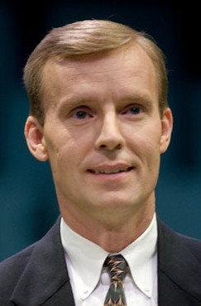
The Pharisee VS the Publican
Expresses gratitude that he is not as other men.
Expresses sorrow for his sins
Enumerates his works (fasting and tithing), as if to put God in his debt
Acknowledges his sins, his debt to God
Prays about himself with humility
Self-justified, self-sufficient, needs nothing
In need of mercy
Prays about himself
Looks down in humility
Looks up with pride
His prayer is 7 words, one which is “God” and one a personal pronoun “me”
His prayer is 34 words, 5 of which are “I”, one of which is “God”
(3)

Slide 8
Alma 31:17
“…Thou hast elected us that we shall be saved, whilst all around us are elected to be cast by thy wrath down to hell; for the which holiness, O God, we thank thee…
Prayer of the Zoramites on top of Rameumptom

Slide 9
Alma 31:17
…and we also thank thee that thou hast elected us, that we may not be led away after the foolish traditions of our brethren, which doth bind them down to a belief of Christ, which doth lead their hearts to wander far from thee, our God.”

