Slide 1
Parable of the Talents
Master of the servants
The Talents
The Servants
The Lord Jesus Christ
The Lord’s disciples
The gifts and abilities the Lord gives His disciples
Matthew 25:14-18

Slide 2
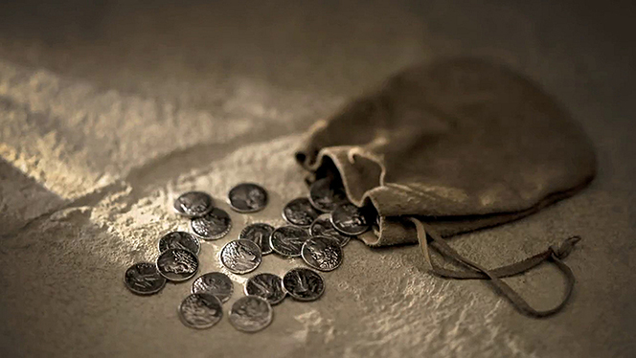
Talent
In the Savior’s time, a “talent” was a unit of weight and also a large sum of money.
In modern usage, the word “talent,” as used in this parable, has come to represent any spiritual gift or any skill or ability given to us by God, and the parable teaches that we are responsible to use these gifts wisely and profitably.
And unto one he gave five talents, to another two, and to another one; to every man according to his several ability; and straightway took his journey.
Matthew 25:15
(1)

Slide 3
Servant 1
Then he that had received the five talents went and traded with the same, and made them other five talents.
Matthew 25:16
(1)

Slide 4
Servant 2
And likewise he that had received two, he also gained other two.
Matthew 25:17
(1)

Slide 5
Servant 3
But he that had received one went and digged in the earth, and hid his lord’s money.
Matthew 25:18
(1)

Slide 6
Well Done
Matthew 25:19-24
(1)

Slide 7
Wicked and Slothful Servant
Take therefore the talent from him, and give it unto him which hath ten talents.
Matthew 25:25-28
(1)

Slide 8
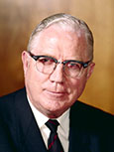
“[The third servant’s] loss was not because he did anything wrong, but rather because his fear had prevented him [from] doing anything at all. Yet this is the process by which most of our blessings are lost. …
Fear can prevent us from using the gifts and abilities the Lord has given us. If we do not develop and use our spiritual gifts for good, then we will lose them
“… When one fails to use the muscles of his arm he loses his strength. … When we don’t develop our abilities, we lose our abilities. When the people in past ages have not honored the Priesthood, it has been taken from them. … Neither spiritual, mental nor physical talents develop while they are buried in the earth.” (3)
(1)

