Slide 1
Lesson 43
The Atonement of Jesus Christ
Part 1
and the Church of Jesus Christ of Latter-day Saints Seminary Manual (Old Testament)

Slide 2
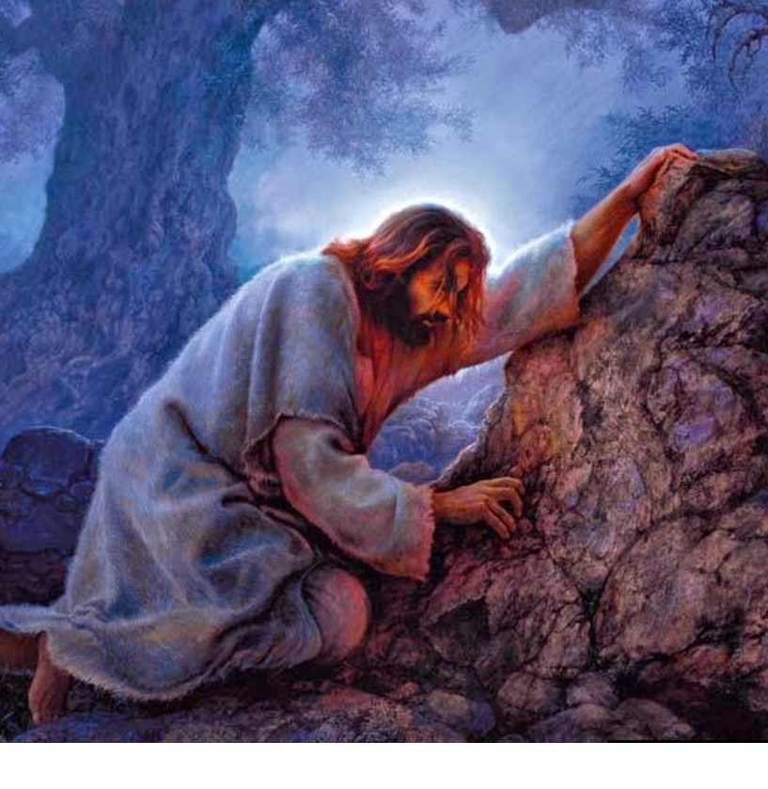
Jesus Christ Chosen to Be Our Savior
Jesus Christ was foreordained in the premortal council to be our Savior and Redeemer.
He came to earth and willingly suffered and died to redeem all mankind from the negative effects of the Fall and to pay the penalty for our sins.
Jesus Christ’s triumph over spiritual and physical death by His suffering, death, and Resurrection is called the Atonement.
His sacrifice benefits each of us and demonstrates the infinite worth of each and every one of Heavenly Father’s children.
D&C 18:10–11

Slide 3
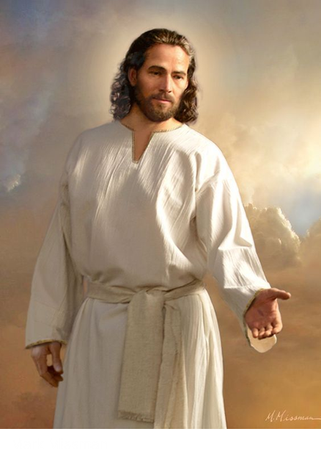
Jesus Christ – The Only One Capable
It is only through Jesus Christ that we can be saved because He was the only one capable of making an infinite and eternal Atonement for all mankind.
Only He had the power to overcome physical death. From His mortal mother, Mary, He inherited the ability to die.
From God, His immortal Father, He inherited the power to live forever or to lay down His life and to take it up again.
He alone could redeem us from our sins. Because He lived a perfect, sinless life, He was free from the demands of justice and could pay the debt for those who repent.
Alma 34:9-10

Slide 4
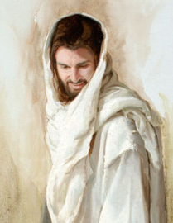
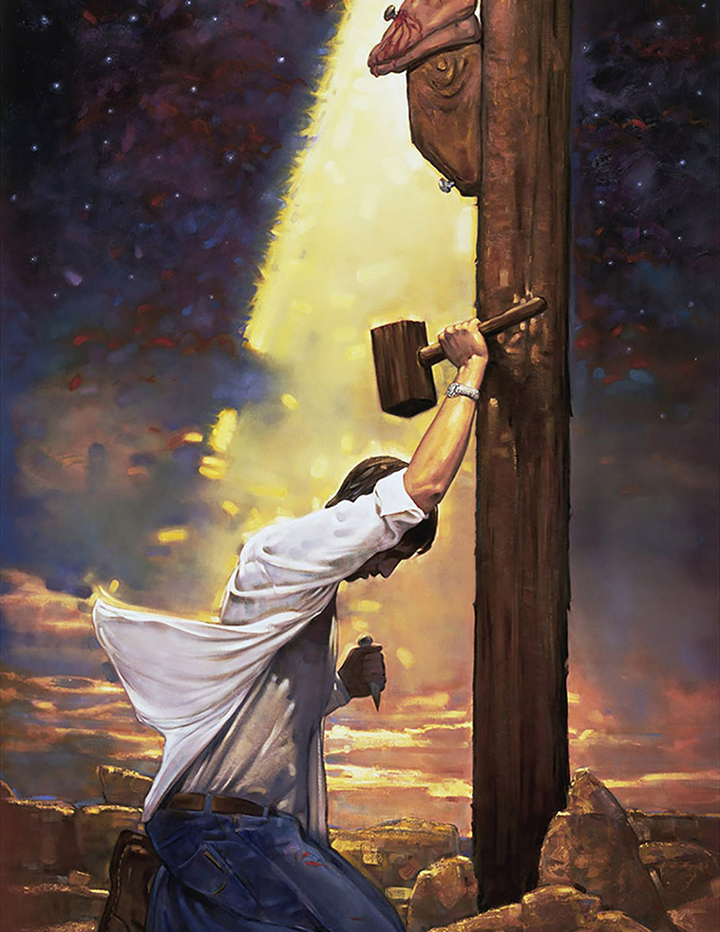
Possible For Us
The Atonement of Jesus Christ included His suffering for the sins of mankind in the Garden of Gethsemane, the shedding of His blood, His suffering and death on the cross, and His literal Resurrection.
He was the first to be resurrected. He rose from the tomb with a glorified, immortal body of flesh and bone.
Jared Barnes
Because of His Atonement all mankind will be resurrected with perfect, immortal bodies and be brought back into God’s presence to be judged.
Jesus Christ’s atoning sacrifice provided the only way for us to be cleansed and forgiven of our sins so that we can dwell in God’s presence eternally.
Ron DiCianni
Luke 24:36-39; Isaiah 1:18; D&C 19:16-19

Slide 5
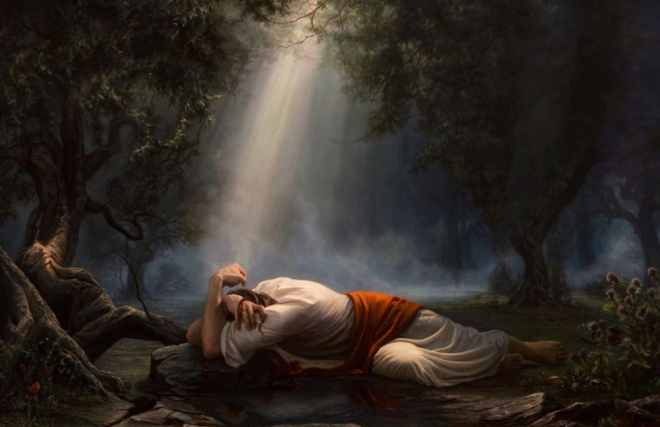
Taking On Himself
As part of His Atonement, Jesus Christ not only suffered for our sins, but He also took upon Himself the pains, temptations, sicknesses, and infirmities of all mankind.
Adam Abram
He understands our suffering because He has experienced it.
As we come to Him in faith, the Savior will strengthen us to bear our burdens and accomplish tasks that we could not do on our own.
Isaiah 53:3-5; Alma 7:11-13; Matthew 11:28-30; Ether 12:27

Slide 6
Effect
In paying the penalty for our sins, Jesus Christ did not eliminate our personal responsibility.
In order to accept His sacrifice, be cleansed from our sins, and inherit eternal life, we must exercise faith in Him, repent, be baptized, receive the Holy Ghost, and endure faithfully to the end of our lives.
Arti Chauhan
Sergey Selivanov
John 3:5; 1 Corinthians 15:20–22; Mosiah 3:19; 3 Nephi 11:10–11; 3 Nephi 27:20; D&C 76:22–24

Slide 7
Expressing True Faith
The first principle of the gospel is faith in the Lord Jesus Christ. Our faith can lead to salvation only when it is centered in Jesus Christ.
Having faith in Jesus Christ includes having a firm belief that He is the Only Begotten Son of God and the Savior of the world.
We recognize that the only way we can return to live with our Heavenly Father is by relying on His Son’s infinite Atonement and by trusting Jesus Christ and following His teachings.
More than passive belief, true faith in Jesus Christ leads to action and is expressed by the way we live.
Our faith can increase as we pray, study the scriptures, and obey God’s commandments.
Dorina Costras
Helaman 5:12; James 2:17-18

Slide 8
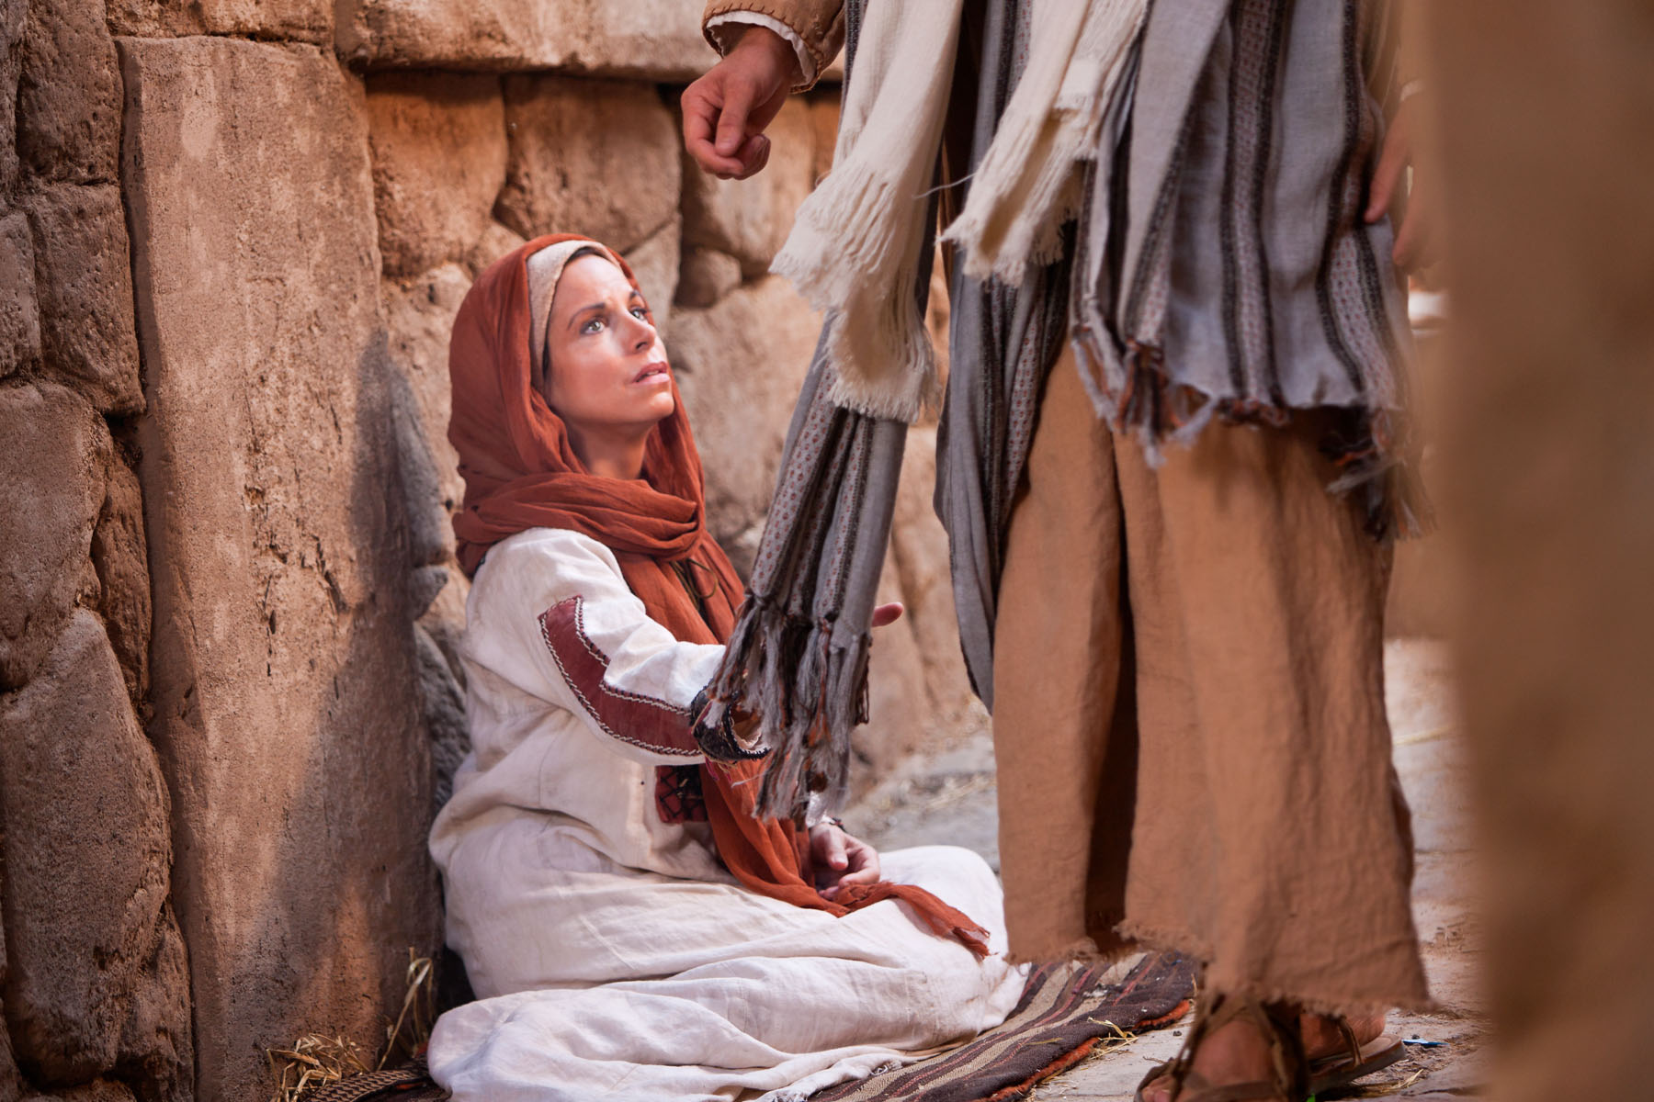
Faith and Repentance
Faith in Jesus Christ and our love for Him and Heavenly Father lead us to repent. Repentance is part of Heavenly Father’s plan for all of His children who are accountable for their choices.
This gift is made possible through the Atonement of Jesus Christ.
Repentance is a change of mind and heart. It includes turning away from sin and turning our thoughts, actions, and desires toward God and aligning our will with His.
Mosiah 3:19

Slide 9
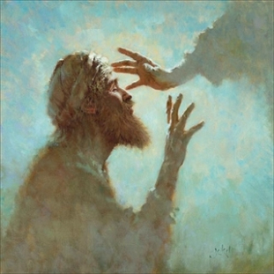
Repentance
Repentance includes recognizing our sins; feeling remorse, or godly sorrow, for committing sin; confessing our sins to Heavenly Father and, if necessary, to others; forsaking sin; seeking to restore, as far as possible, all that has been damaged as a result of our sins; and living a life of obedience to God’s commandments.
The Lord promises to forgive us of our sins at baptism, and we renew that covenant each time we sincerely partake of the sacrament with the intent of remembering the Savior and keeping His commandments.
D&C 58:42-43

Slide 10
Sincere Repentance
Through sincere repentance and the grace offered through Jesus Christ’s Atonement, we can receive God’s forgiveness and feel peace.
We feel the influence of the Spirit in greater abundance, and we are more prepared to live eternally with our Heavenly Father and His Son.

Slide 11
Sources:
Suggested Hymn: #194 There is a Green Hill Far Away (my favorite)
Seminary Teacher Manual…putting pictures with words
Presentation by ©http://fashionsbylynda.com/blog/ and the Church of Jesus Christ of Latter-day Saints Seminary Manual (Old Testament)

