Slide 1
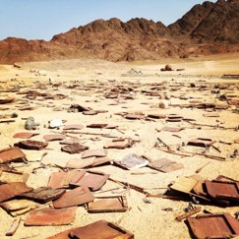
Worries of the Last Days
The Lord spoke of the destruction that would come upon the wicked in the last days, but He also made powerful promises to the Saints.
He directed the Saints, at that time, to purchase land in Missouri for the establishment of Zion, which He had promised would be a place of refuge
D&C 45

Slide 2
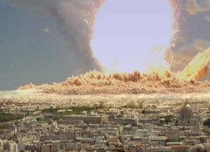
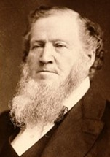
The Last Days
1. During the wars in the last days, wicked people will destroy one another.
Scripture
D&C 63:32–33.
True False
“You will hear of magnificent cities, now idolized by the people, sinking in the earth, entombing the inhabitants. The sea will heave itself beyond its bounds, engulfing mighty cities. Famine will spread over the nations and nation will rise up against nation, kingdom against kingdom and states against states, in our own country and in foreign lands; and they will destroy each other, caring not for the blood and lives of their neighbors, of their families, or for their own lives.”
Brigham Young

Slide 3
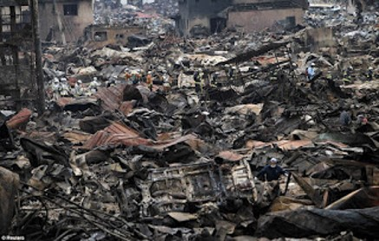
Destruction of the Last Days
2. The righteous Saints will easily escape all the destruction of the last days.
Scripture
D&C 63:34.
True False
“It is a false idea that the Saints will escape all the judgments, whilst the wicked suffer; for all flesh is subject to suffer, and ‘the righteous shall hardly escape;’ … many of the righteous shall fall a prey to disease, to pestilence, etc., by reason of the weakness of the flesh, and yet be saved in the Kingdom of God”
HC

Slide 4
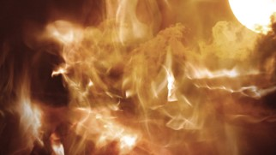
The Last Days
3. When Jesus Christ comes again, He will destroy any wicked people who are still on the earth.
Scripture
D&C 63:34.
True False
“Because of the destruction of the wicked at the Savior’s Second Coming, only righteous people will live on the earth at the beginning of the Millennium. They will be those who have lived virtuous and honest lives. These people will inherit either the terrestrial or celestial kingdom.”
Gospel Principles

Slide 5
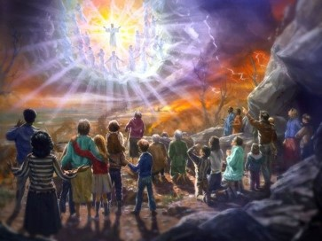
Millennium
4. Those who are faithful will eventually overcome all the challenges of this life.
Scripture
D&C 63:47–48.
True False
During the Millennium, Satan will be bound. This means he will not have power to tempt those who are living at that time The “children shall grow up without sin unto salvation” (D&C 45:58)
During the Millennium, there will be no war. People will live in peace and harmony together. Things that have been used for war will be turned to useful purposes.
Gospel Principles

Slide 6
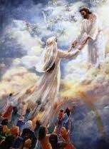
Resurrection
5. Righteous people who die before the Second Coming will be resurrected when the Savior comes to the earth.
Scripture
D&C 63:49.
True False
Those who have obtained the privilege of coming forth in the resurrection of the just will rise from their graves. They will be caught up to meet the Savior as He comes down from heaven.
Those who already have been resurrected and those who will be resurrected at the time of His coming will all inherit the glory of the celestial kingdom. See Mathew 27:52-53
After the resurrection of those who will inherit celestial glory,
another group will be resurrected: those who will receive a
terrestrial glory. When all these people have been resurrected,
the First Resurrection will be completed.
Gospel Principles

Slide 7
During the Millennium
6. Righteous people who are living on the earth at the time of the Second Coming will never die
Scripture
D&C 63:50–51.
True False
During the Millennium, there will be no death as we know it. When people have lived to an old age, they will not die and be buried. Instead, they will be changed from their mortal condition to an immortal condition in “the twinkling of an eye.”
Gospel Principles

